Slide 1
Development and Verification of an Icarus/Mutation++ B' Table Utility
Intern Presentation
Avery Pendley
August 13, 2021

Slide 2
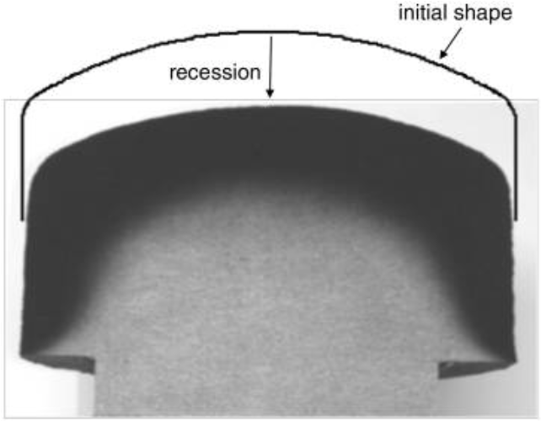
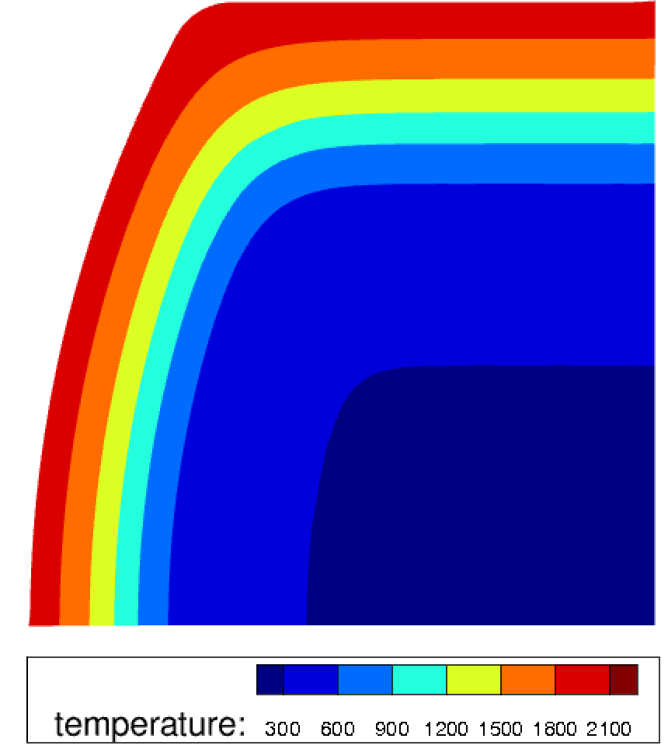
Importance of Accurate Models for Gas Surface Interaction (GSI)
Icarus was directly coupled to external libraries for ablation gas surface interaction phenomena
Development of software for the generation of B’ tables with Mutation++
  Decoupling of Icarus from dependencies
  Improving efficiency and accuracy
  Achieving backward compatibility with FIAT
Figure Cross section of iso-q model (Milos & Chen)
Figure 2D model of iso-q model
Explain importance of GSI- small sentence
Importance of good tools
Add to title instead of Motivation
  Solving the equation in terms of the conservative variables
Notes:
Modelign material response. Most iportant part is gas surface interaction. How the gas trasnfers heat to the material itself. Since GSI plays a important role, must model it as accuratey as possible. Efficiency/accuracy etc.

Slide 3

Boundary Conditions
(Lachaud & Mansour)
Surface mass balance
Surface Mass & Energy Balances:
B’ Assumption
Mass Transfer
Advection
Mass:
$$j_{k,w }−\left(ρV\right)y_{k,w}= {\dot{m}}_{p}y_{k,p}+{\dot{m}}_{c}y_{k,c}$$
∀ k in gases
Energy:
Pyrolysis Gas (p)
Char Ablation (c)
$$q_{conv }−\left(ρV\right)h_{w}+q_{rad,in}−q_{rad,out}−q_{cond}+ {\dot{m}}_{p}h_{p}+{\dot{m}}_{c}h_{c}=0$$
Surface energy balance
Convective
Advective
Radiative Heating
Radiative cooling
Ablating Surface
Pyrolysis gas (p)
Conduction
Char ablation (c)
Mp of B’g is the mass that is entering the our surface and then exits
Same for Mdot c
  Solving the equation in terms of the conservative variables
Notes:
BC for a solver
Fluxes from the gas phase are equal to the solid phase. Mass energy from gas is equal to mass energy entering the material itself
Need both mass and energy balance
Not solving these exactly, our approach is modifying them… How to get from mass to bprime (look at M++ training)
V: advective velocity (velocity of gas leaving surface)
Energy- surface temp
mass- surface composition of surface gases and pyro
Ideal case we would solve this, but it’s very common to use an approx. assumption for Bprime. Let me explain bprime since it is a central part of my work
Start with surface mass balance and perform transformation (found in lit), we get bprime term

Slide 4
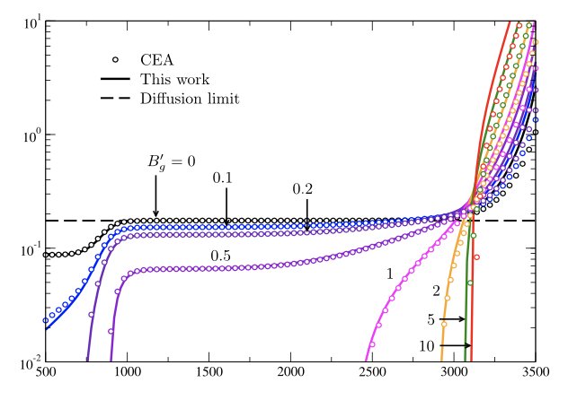
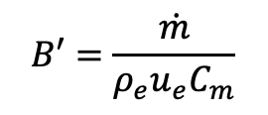
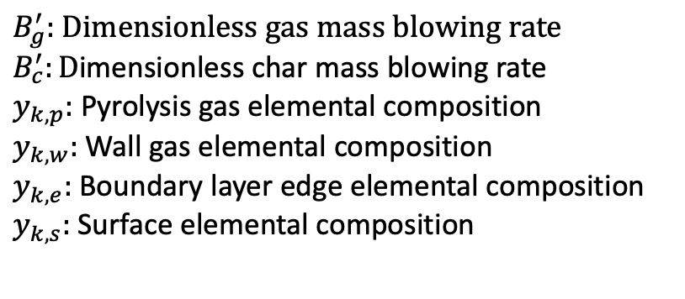
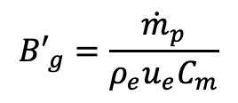
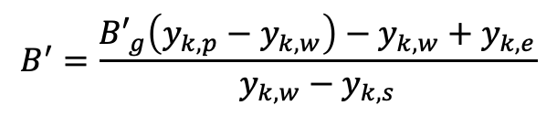
B’ Generation
B’ term derived from mass balance as:
Energy equation:
B’ Tables for TACOT
$$B^{′}=\frac{{B′}_{g}\left(y_{k,p}−y_{k,w}\right)−y_{k,w}+y_{k,e}}{y_{k,w}−y_{k,s}}$$
$$B′=\frac{\dot{m}}{ρ_{e}u_{e}C_{m}}$$
$${B′}_{g}=\frac{{\dot{m}}_{p}}{ρ_{e}u_{e}C_{m}}$$
$B_{g}^{′}:$ $Dimensionless gas mass blowing rate$
$B_{c}^{′}:D$imensionless char mass blowing rate
$y_{k,p}:$ Pyrolysis gas elemental composition
$y_{k,w}:$ Wall gas elemental composition
$y_{k,e}:$ Boundary layer edge elemental composition
$y_{k,s}:$ Surface elemental composition
B’c
(Scoggins et al.)
Temperature, K
(Scoggins et al.)
$$q_{cond}=\left(ρ_{e}u_{e}C_{m}\right)\left(h_{r}−h_{w}\right)+ \dot{m_{c}\left(h_{c}−h_{w}\right)+ \dot{m_{p}\left(h_{p}−h_{w}\right)+q_{rad}}}$$
Mass flux over diffusion flux
Mdot = how much mass is lost on the surface
Make summary and send over on
Only care about carbon
Easy way to break it down: Mass balance gives us recession while energy balance gives us temperature
  Solving the equation in terms of the conservative variables
LHS: replace and write q_cond
RHS: switch C’H with rho,u,Cm
RHS: switch he to hr (recovery given by cfd solver)
RHS: ca -> c pg ->p
Hc = enthalpy of material (Tacot)
Hp = enthalpy of pyro gases (not valid for model 0)
Hwall= enthalpy of gases next to surfaces (given by B’ formulation)
Solver energy equ to get surface temperature
Notes:
Given by this. Explain each term
Temperature, Pressure, BLE, PG, B’g
Y, k,wall is a function of temperature and pressure
B’ is returned to icarus and then we get recession velocity
Formula on the right is the quantity that is tabulated
B’ is exactly the same as mass equation. Now solving nondiemtional Bprime instead of mass
B’c is more or less an indicator of how much the surface will ablate. High b’c- ablates a lot. Low B’c- ablates less
Flat line:diffusion limit which means the surface is chemically active and is consuming all the species coming from the boundary layer
Submilmation: everything is burning
As B’g goes up, the curve moves down

Slide 5
B’ Table Functionality for Icarus
Previous software provide methods to calculate B’ tables (Mutation++, ACE, MAT, etc.)
Icarus B’ table generator using the multi-phase equilibrium solver in Mutation++
Converting FIAT to Icarus format for backwards compatibility
Adding arbitrary composition surfaces
Table format specifically for Icarus
Set values for B’g, T, & P
Be consistant with B’ vs bprime
Started a new code that is part of the icarus framework,
Started a new C++ code
Several softwares that give us tables
Why did we create a new one?
-specific for icarus to achieve the folloeing
-Coupled to M++
-wanted to reproduce results
-better backward compatibility
-M++ was limited to carbon surfaces, expanded it to other elements
(same algorithm, instead of carbon graphite for example we’ve done iron)
-Needed this for specific format for Icarus tables
Mutation++ mixture file
Boundary Layer Edge
Pyrolysis Gas
B’ Generator
B’c h_{w}
B’ Table
Icarus
Screenshot .xml file for tacot
24sp-
Command: ic –m etc.
Header of TACOT table
5
  Solving the equation in terms of the conservative variables
Notes:
-seceral references, need consistency
-with icarus bprime tool, try to get this kind of information from multiple of them so we can have a good comparison
-for example, convert bprme tables from fiat into need format
-generate bprime tables using functions from M++
-table format (last)
-arbitrary: we can now modifiy/adapt the code to treat arbitrary composition surfaces. Not going to talk about it
-focus on carbon surfaces, this is a work in progress
-in the end, getting bprime tables in format specific for icarus

Slide 6
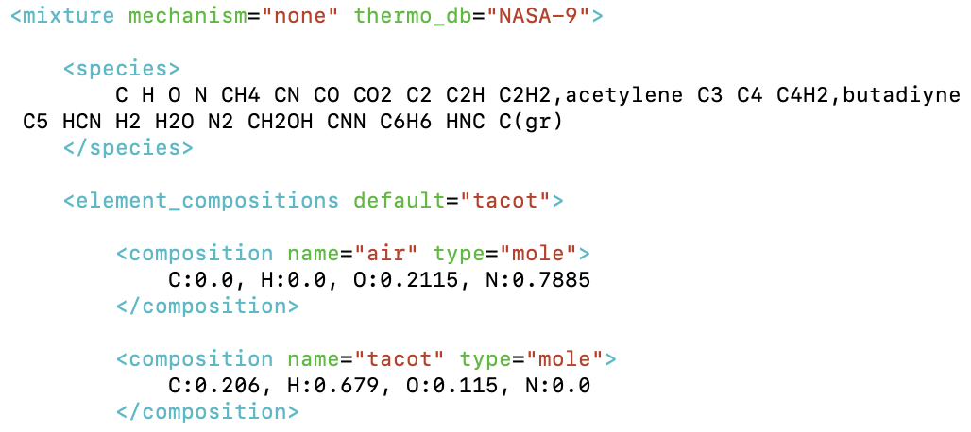
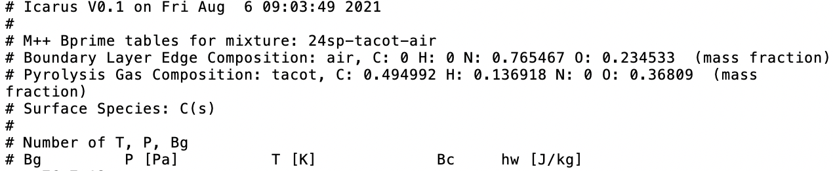
B’ Table Functionality for Icarus
TACOT: Theoretical Ablative Composite for Open Testing
24-Species TACOT-Air mixture Mutation++ file
Boundary layer edge composition
Pyrolysis gas composition
-m 24sp-TACOT-air –ble air –pg tacot
24-Species TACOT-Air generated B’ table
Set value inputs
Outputs

Slide 7
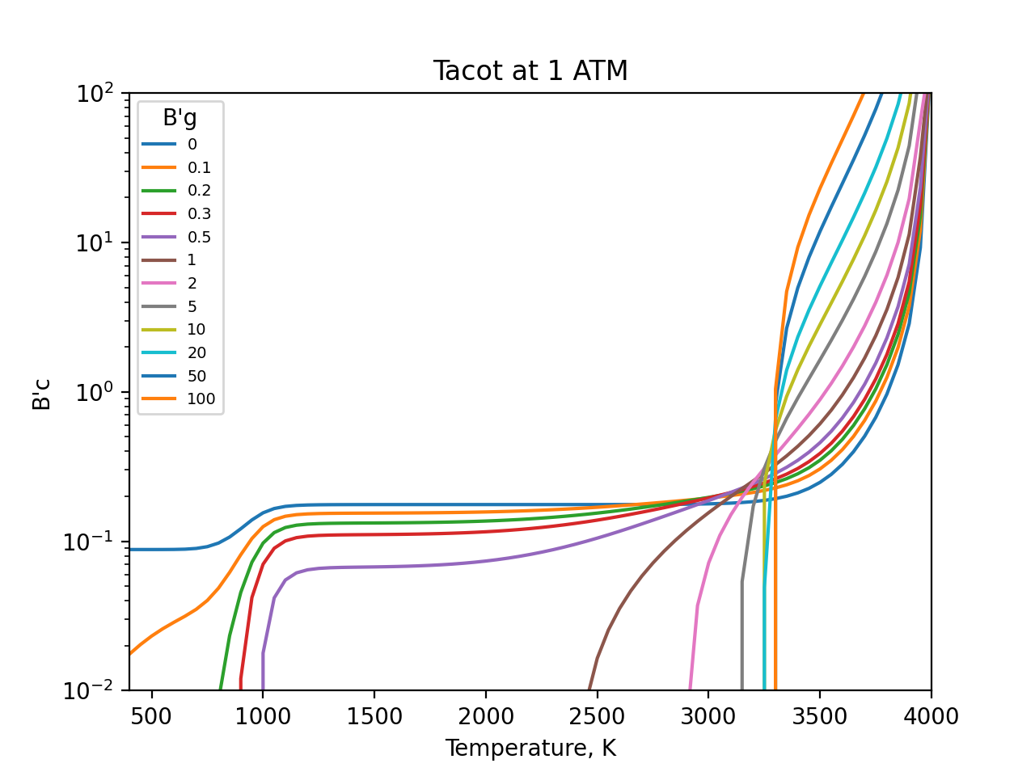
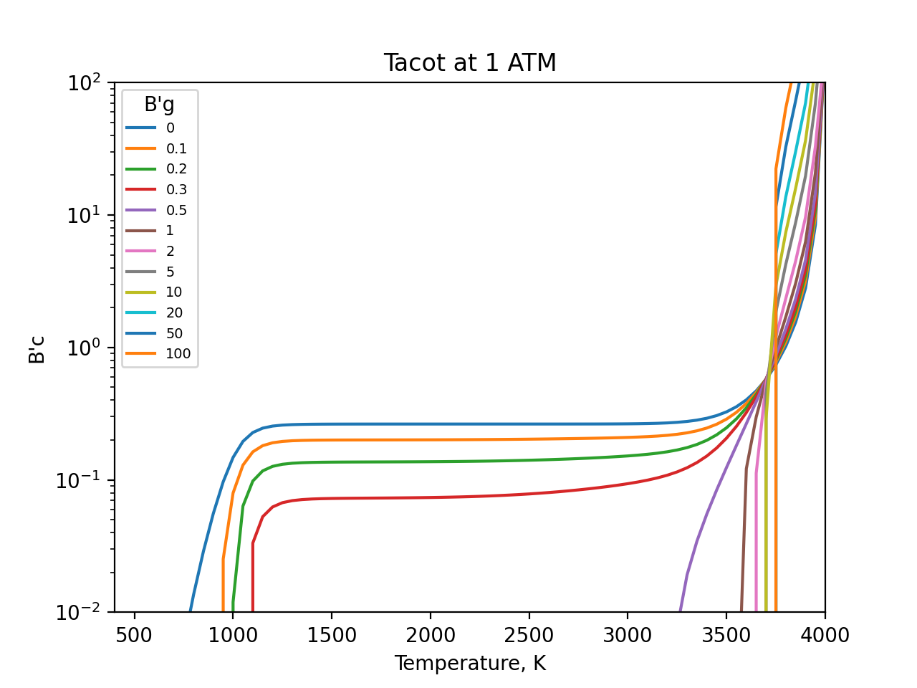
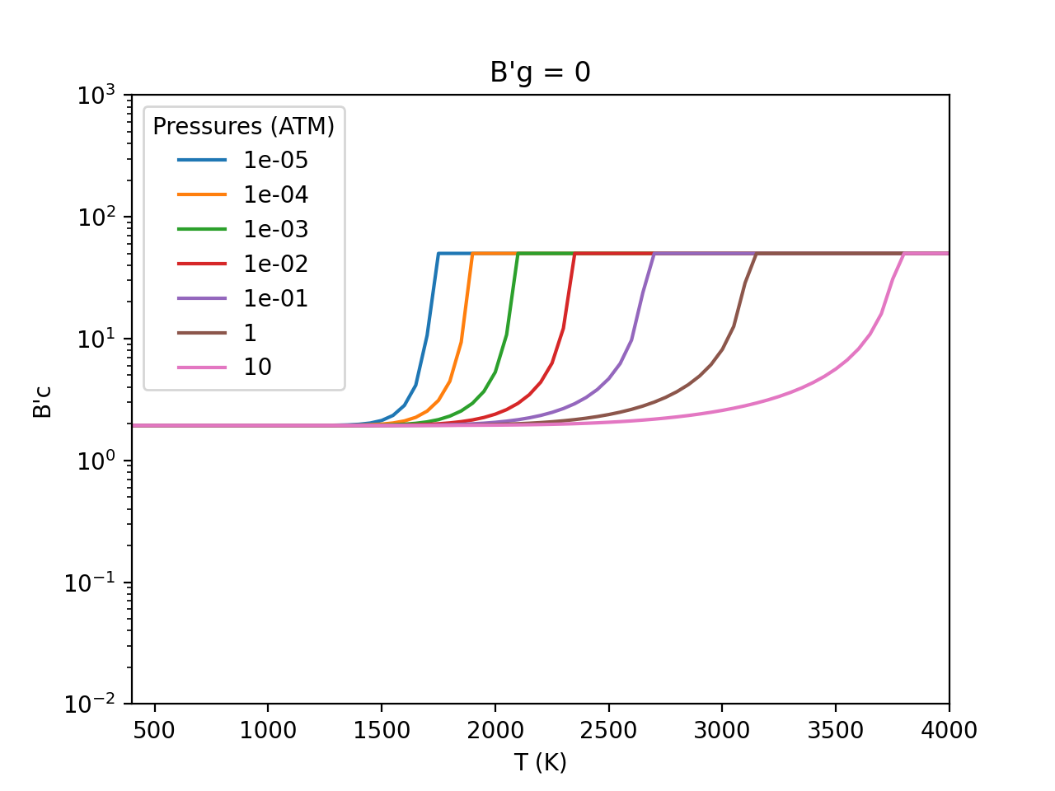
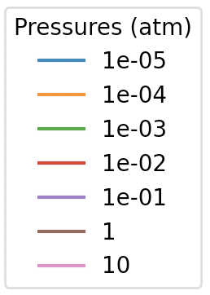
Examples of generated B’ tables
BLE: Boundary Layer Edge Composition
PG: Pyrolysis Gas Composition
1 ATM
24 Species TACOT-air at 1 atm
Carbon Phenolic at 1 atm
Iron B’g =0
B’c
B’c
B’c
Diffusion limit
Sublimation
Temperature, K
Temperature, K
Temperature, K
BLE: Air O:0.2115, N:0.7885
PG: TACOT C:0.206, H:0.679, O:0.115
Species: C H O N CH4 CN CO CO2 etc.
BLE: Venus C:0.322, O:0.644, N:0.034
PG: Resin C:0.461, H:0.461, O:0.077
Species: {gases with C, H, O, N } Ar C(gr)
(Peterson & Nicolet, 1974 Model)
BLE: Air O:0.21, N:0.79
Species: {gases with O, N, Fe} Fe(a),below Fe(a),above Fe(c) Fe(d) Fe(L)
  Solving the equation in terms of the conservative variables
Notes:
Discuss comparison with FIAT, need to have consistency with past
Need sentence to summarize goal of this slide
Explain each region (JB paper)

Slide 8
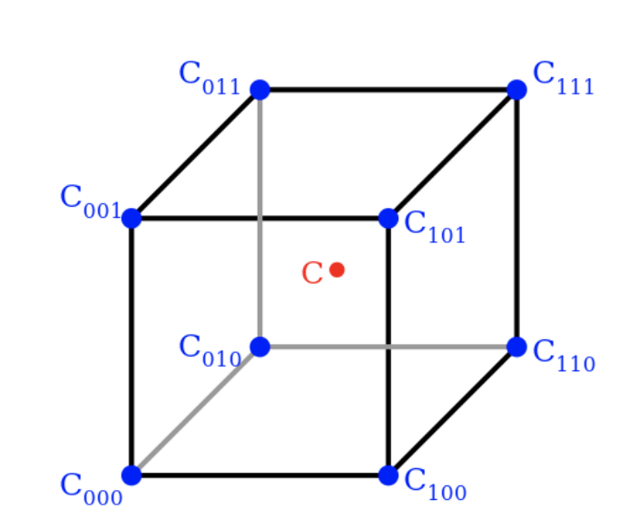
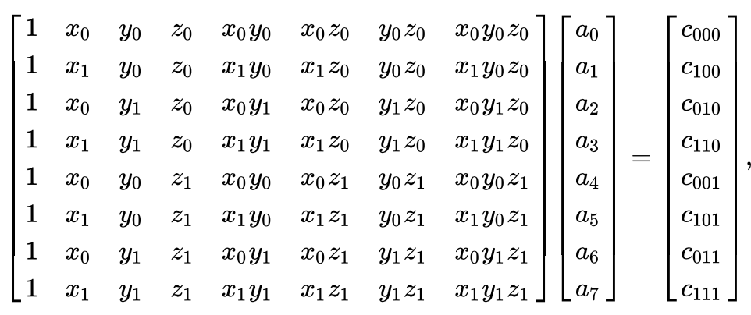
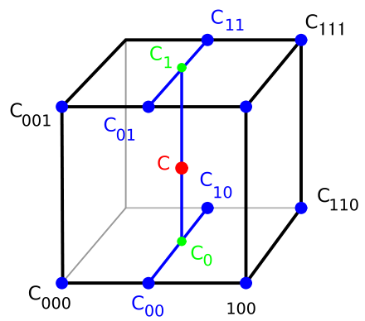
Implementation in Icarus
(“Trilinear Interpolation”)
Trilinear interpolation:
In Icarus:
Implementing our bprime table in icarus:
Used a trilinear interpolation for B’c and Hw in between calculated points
Approximated values as a function at an intermediate point based off the equations here
Function of T,P,B’g
Allows us to fill in missing values to calculate everything in icarus
This system that you see on top is only solved at initialization
At run time, we only perform this multiplication with the coefficents solved for already
$${B′}_{c}\left(T,P,{B′}_{g}\right)≈a_{0}+a_{1}T+a_{2}P+a_{3}{B′}_{g}+a_{4}TP+a_{5}T{B′}_{g}+a_{6}P{B′}_{g}+a_{7}TP{B′}_{g}$$
$$h_{w}\left(T,P,{B′}_{g}\right)≈a_{0}+a_{1}T+a_{2}P+a_{3}{B′}_{g}+a_{4}TP+a_{5}T{B′}_{g}+a_{6}P{B′}_{g}+a_{7}TP{B′}_{g}$$
  Solving the equation in terms of the conservative variables
Notes:
It approximates the value of a function at an intermediate point within the local axial rectangular prism linearly, using function data on the lattice points.

Slide 9
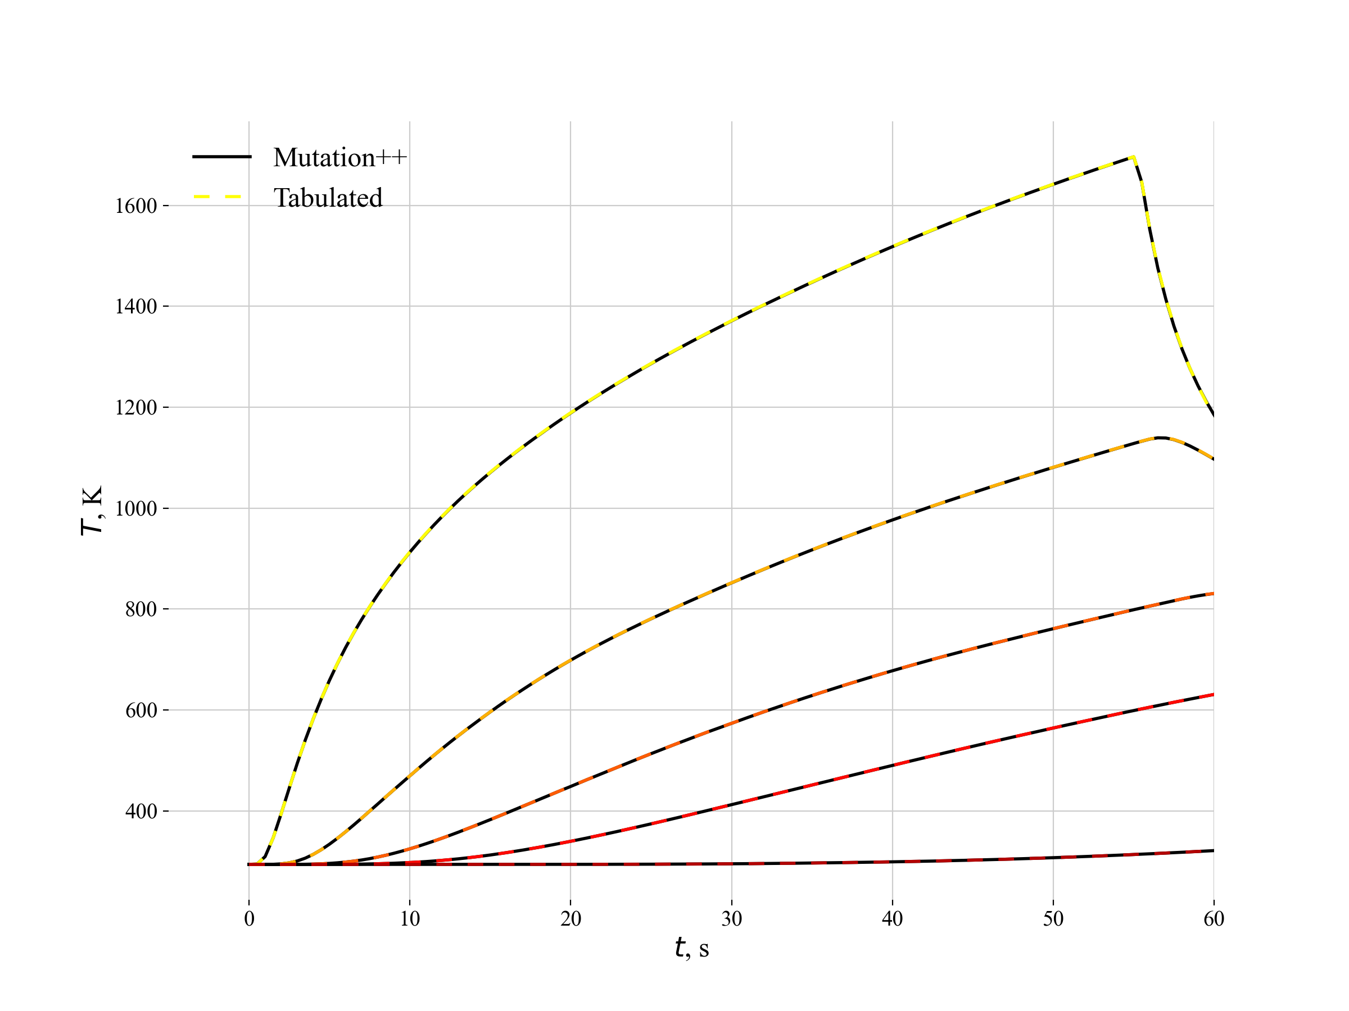
1-D Results
TACOT Arc Jet
Free stream & Boundary conditions:
T∞= 295.0 K
Heat Transfer Coefficient: 0.01
Recovery Enthalpy: 1.24 MJ/kg
Pressure: 2300 Pa
2
Total recession:
30 sec = 1.031 mm (HEATING)
55 sec = 2.098 mm (END OF HEATING)
60 sec = 2.098 mm (COOL DOWN)
1
3
Error Analysis | Total Recession Error (%) | Applied Recession Error (%) | Tmax Error (%)
30 sec | 0.485 | 0.024 | 0.025
55 sec | 0.238 | 0.023 | 0.026
60 sec | 0.191 | ~ 0 | 0.038
TC: 0.381cm
TC: 0.762cm
TC: 1.143cm
6.81% faster with tabulated vs direct calculation
TC: 1.524cm
  First step: excellent agreement, we need to increase complexity
TC: 3.048cm
  Solving the equation in terms of the conservative variables
Notes:
As the first test case to test the new Tabulated boundary conditions a common case from literature was chosen: AW2.2 set-up to verify different material response codes.
Discprepancy between tabulated and m++
Rod around 5cm? Of length ?? Where heat is applied on one side. Explain Tacot. Different timestamps, heat up and cool down.
Conditions for tacot arc jet
Put absolute values of tabulated then explain error WRT M++
7% Efficiency Gain
Now 2D

Slide 10
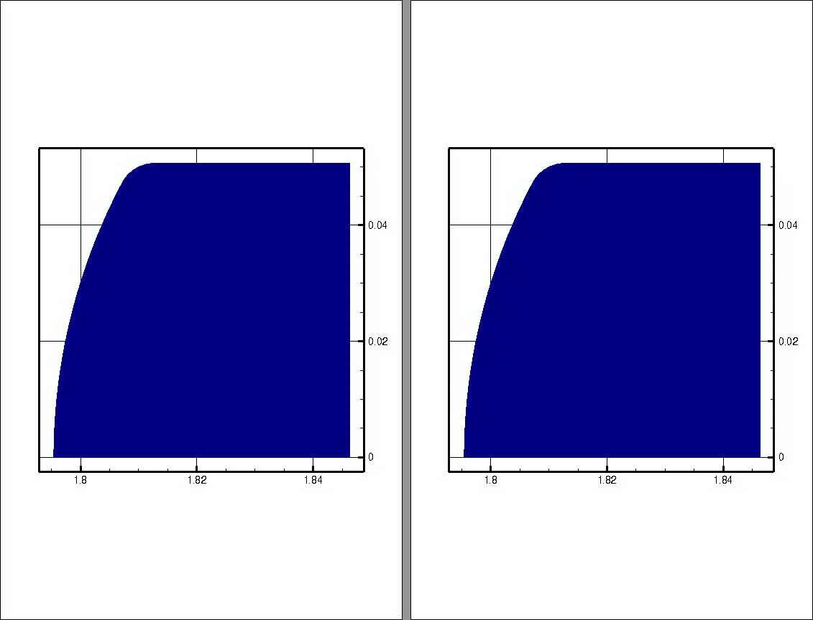
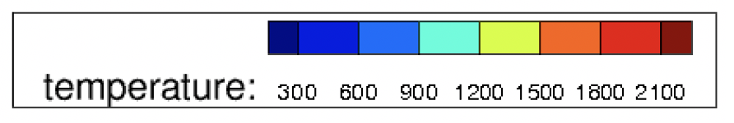
2-D Results with Fiberform
Fiberform Arc Jet
Free stream & Boundary conditions:
BC: Time & Space Varying
T∞= 298.0 K
Heat Transfer Coefficient: 0.01
Recovery Enthalpy: 1.24 MJ/kg
Pressure: 2378.56 Pa
Tabulated
Mutation++
Total recession:
30 sec = 0.662 mm (HEATING)
55 sec = 2.237 mm (END OF HEATING)
60 sec = 2.243 mm (COOL DOWN)
Error Analysis | Total Recession Error (%) | Applied Recession Error (%) | Tmax Error (%)
30 sec | 0.045 | ~ 0 | 0.0002
55 sec | ~ 0 | ~ 0 | 0.0001
60 sec | ~ 0 | 0.086 | 0.179
7.64% faster with tabulated vs direct calculation
  Solving the equation in terms of the conservative variables

Slide 11

2-D results with TACOT
TACOT Arc Jet
Free stream & Boundary conditions:
BC: Time & Space Varying
T∞= 298.0 K
Heat Transfer Coefficient: 0.01
Recovery Enthalpy: 1.24 MJ/kg
Pressure: 2378.56 Pa
Tabulated
Mutation++
Total recession:
30 sec = 0.394 mm (HEATING)
55 sec = 1.339 mm (END OF HEATING)
60 sec = 1.341 mm (COOL DOWN)
Error Analysis | Total Recession Error (%) | Applied Recession Error (%) | Tmax Error (%)
30 sec | 0.101 | ~ 0 | 0.0007
55 sec | .0747 | ~ 0 | 0.0003
60 sec | ~ 0 | ~ 0 | 0.0016
8.1% faster with tabulated vs direct calculation
Recovery enthalpy in aeroheating
Plot at y coordinates: Ch and recovery enthalpy
Rerun tacot model 2
  Solving the equation in terms of the conservative variables

Slide 12
Conclusions
Developed a B’ table generator code for Icarus
  Coupled to Mutation++
  FIAT converter
  Arbitrary surfaces
Icarus BCs adjusted to use the new tables
Verification and efficiency assessment of new approach through 1D & 2D test cases
Future work
  Analyze efficiency gain more rigorously
  Solidify multi-component element surfaces
  GUI
Ability to analyze both carbon/silicon ablators more rigorously
GUI to help with visualization for different B’gs
  Solving the equation in terms of the conservative variables

Slide 13
Acknowledgments
AMA
Icarus Team
Eric Stern & George Bellas
Any questions?
  Solving the equation in terms of the conservative variables

Slide 14
References
[1] Milos, F.S., and Chen, Y.-K. “Ablation and Thermal Response Property Model Validation for Phenolic Impregnated Carbon Ablator.” J. Spacecr Rockets, Vol. 47, No. 5, 2010, DOI: 10.2514/1.42949
[2] Lachaud, J, and Mansour, N. “Porous-Material Analysis Toolbox Based on OpenFOAM and Applications.” J Thermophys Heat Trans, Vol. 28, No. 2, 2014, DOI: 10.2514/1.T4262
[3] James B. Scoggins, Jason Rabinovitch, Benjamin Barros-Fernandez, Alexandre Martin, Jean Lachaud, Richard L. Jaffe, Nagi N. Mansour, Guillaume Blanquart, Thierry E. Magin, Thermodynamic properties of carbon–phenolic gas mixtures, Aerospace Science and Technology, Volume 66, 2017, Pages 177-192, ISSN 1270-9638, https://doi.org/10.1016/j.ast.2017.02.025.
[4] Scoggins et al. Mutation++: MUlticomponent Thermodynamic And Transport properties for IONized gases in C++. SoftwareX 12, 2020.
[5] Peterson, N., and Nicolet, W. “Heat Shielding for Venus Entry Probes.” J. Spacecr Rockets, Vol. 11, 1974, DOI:10.2514/3.62085
[6] Trilinear interpolation. In Wikipedia. https://en.wikipedia.org/wiki/Trilinear_interpolation
  Solving the equation in terms of the conservative variables

Slide 15
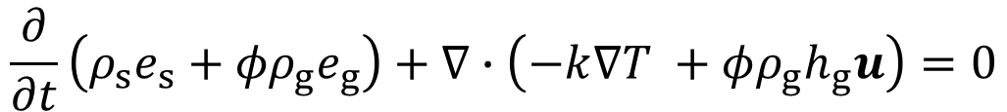
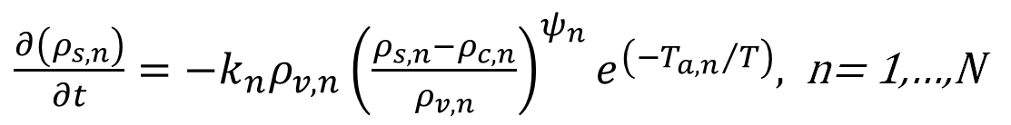
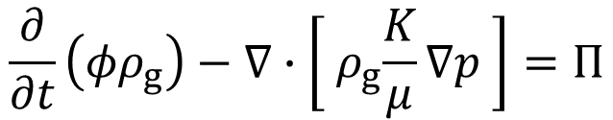
Icarus Governing Equations
Conservation Equations:
Numerical Methods:
$\frac{∂\left(ρ_{s,n}\right)}{∂t}=−k_{n}ρ_{v,n}{\left(\frac{ρ_{s,n}−ρ_{c,n}}{ρ_{v,n}}\right)}^{ψ_{n}}e^{\left({{−T}_{a,n}}/T\right)}$, n= 1,…,N
Solid Decomposition:
$$\frac{∂}{∂t}\left({φρ}_{g}\right)−∇∙\left[{ ρ}_{g}\frac{K}{μ}∇p \right]=Π$$
Continuity Equation:
Energy Equation:
$$\frac{∂}{∂t}\left(ρ_{s}e_{s}+{φρ}_{g}e_{g}\right)+∇∙\left(−k∇T +φρ_{g}h_{g}u\right)=0$$
Finite volume formulation & Explicit time integration
  Solving the equation in terms of the conservative variables

Slide 16
Icarus Version 1.3: Status, Challenges and Future
Georgios Bellas Chatzigeorgis
TSM Branch Meeting | 09.17.20

Slide 17
The Team
Core Development
NSTRF Student Researchers
Eric Stern – Project Manager
Joseph Schulz
  Main Developer
Justin Haskins
  The Icarus Ninja – everything from finding bugs in MPI routines to coding his own conjugate-gradient linear solver.
Grant Palmer
  Surface energy balance and boundary condition code-guru
  Dust erosion models
Partibha Raghunandan
  Verification and Validation / Project Infusion
  Asteroid modeling
Ümran Düzel
  Code Validation
  FiberForm Wedge Simulations
Olivia Schroeder (University of Minnesota)
  Mesh Motion
  PICA ArcJet Simulations
  US3D coupling
David Dang (University of Michigan)
  Thermostructural Material response
  Heeet Simulations
I am missing people (Joe?)
  Who am I missing

Slide 18
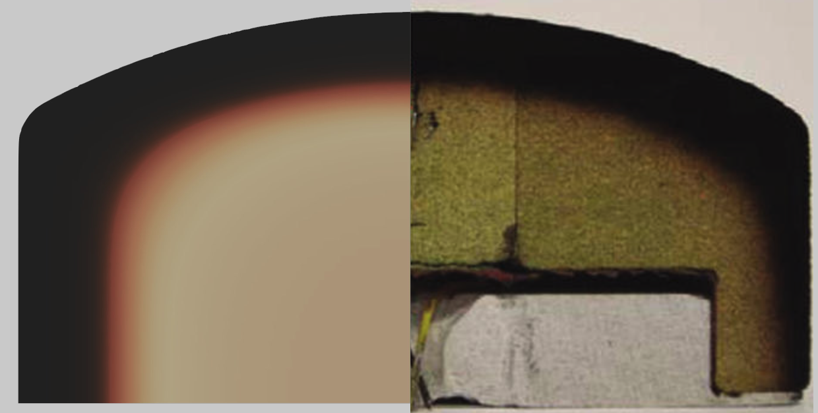
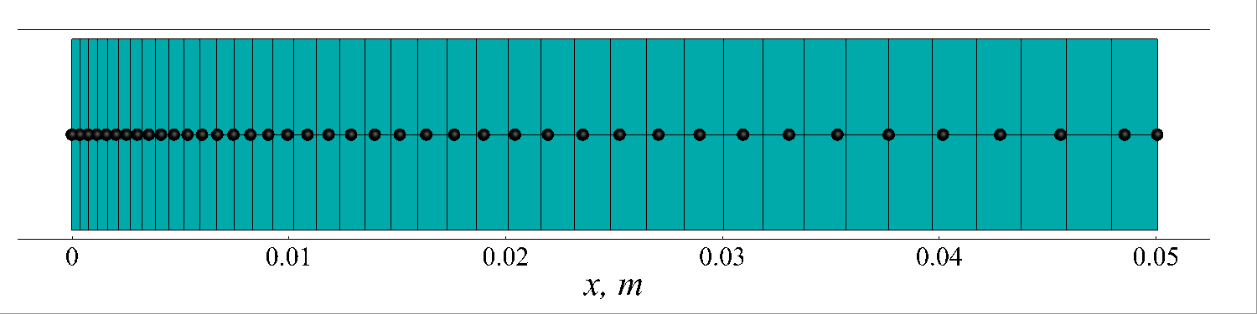
Icarus v1.3: Verification and Validation
Icarus v1.3 (released August, 2020)
  RBF mesh motion approach for recession simulations
  Full aeroheating boundary condition
  Pyrolysis Gas Flow Equation (Implicit Treatment)
Olivia Schroeder
Grant Palmer
David Dang
Figure: Icarus, PATO, and FIAT results for Ablation Workshop Test Case (AWTC)
Figure: Centerline temperature predictions for the HEEET LHMEL experiment using ML-derived conductivity, compared with TC data
Figure: Comparison of in-depth temperature predictions for 107 W/cm2 PICA arc jet experiment

Slide 19
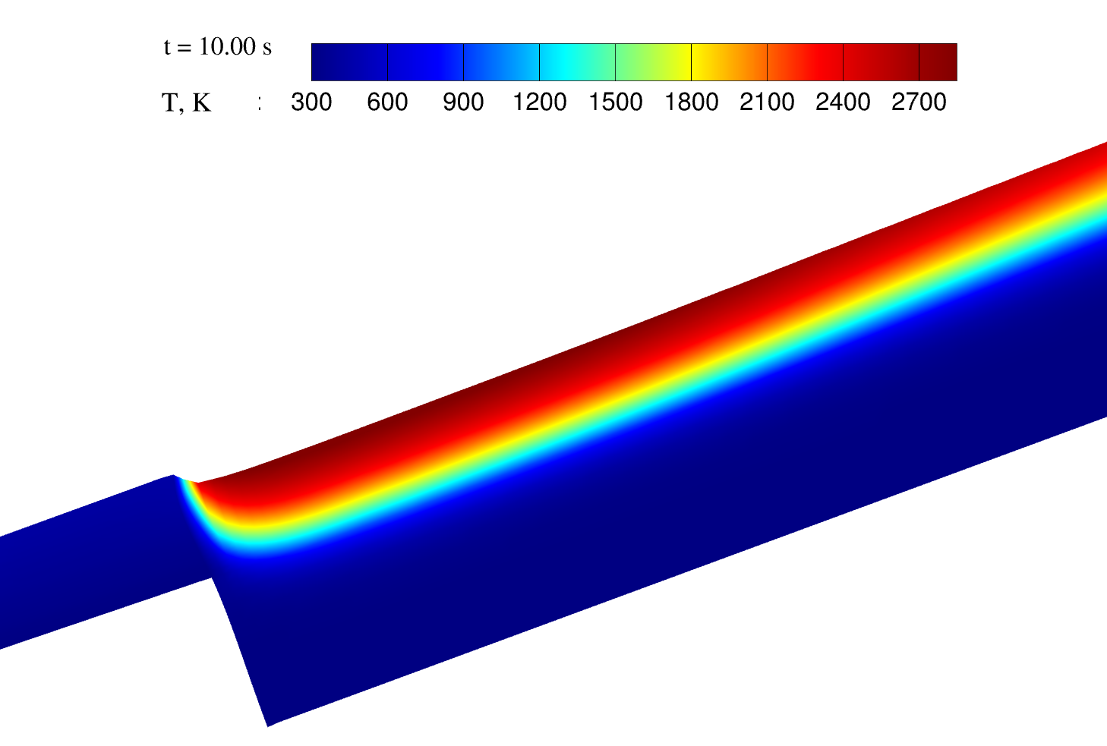
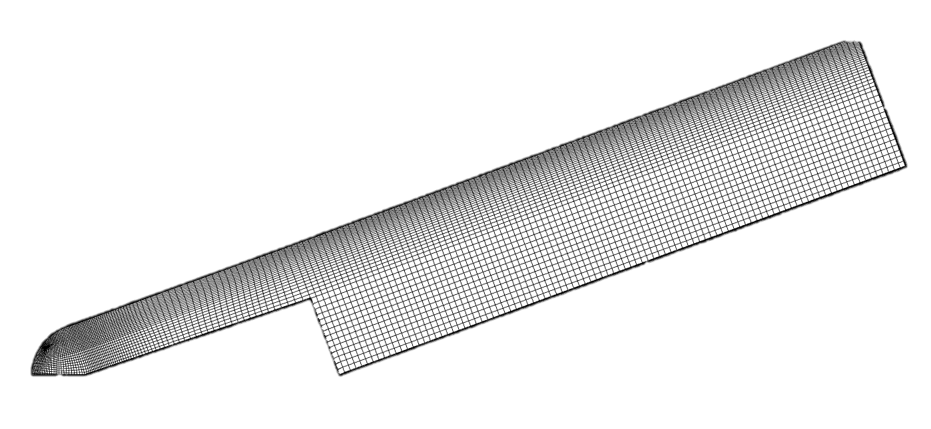
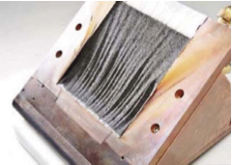
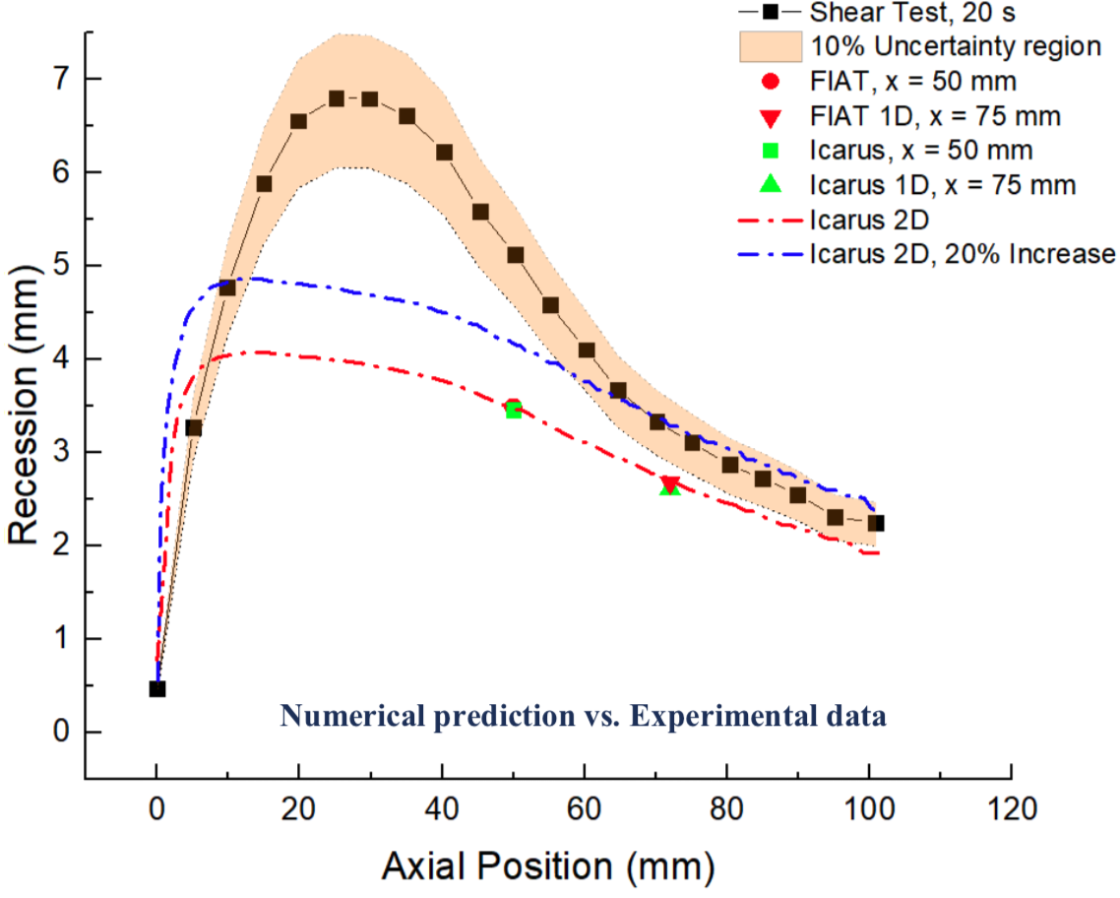
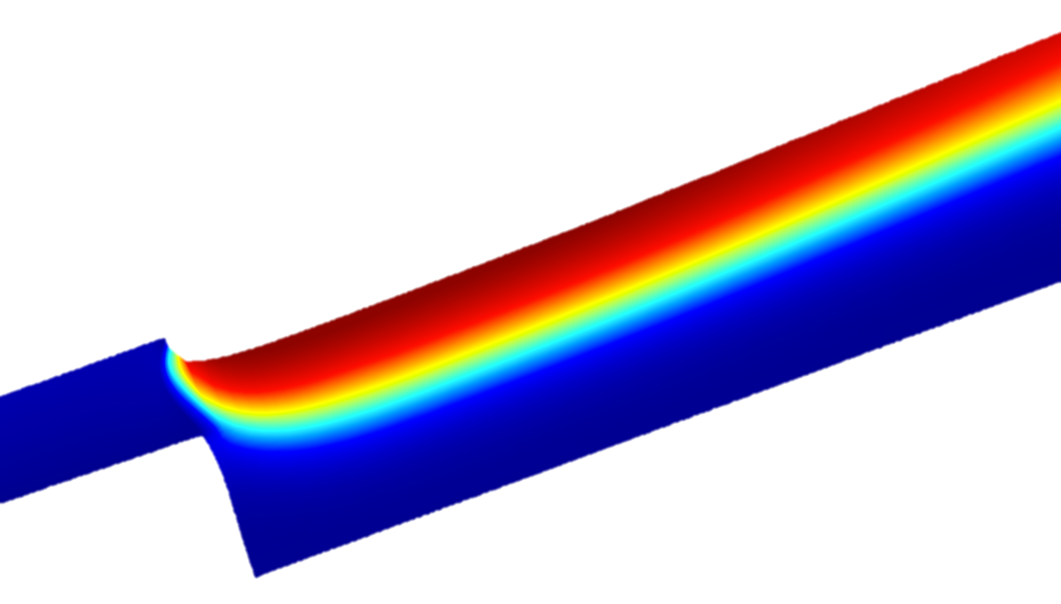
Icarus v1.3: FiberForm Wedge Recession
Icarus v1.3 (released August, 2020)
  RBF mesh motion approach for recession simulations
  Full aeroheating boundary condition
  Pyrolysis Gas Flow Equation (Implicit Treatment)
10s
20s
Ümran Düzel
Figure: Image of post-test FiberForm sample from Driver et al., 2010
Figure: Predicted recession compared with experiment
Figure: Visualization of uncoupled Icarus simulation of the FiberForm wedge case.

Slide 20
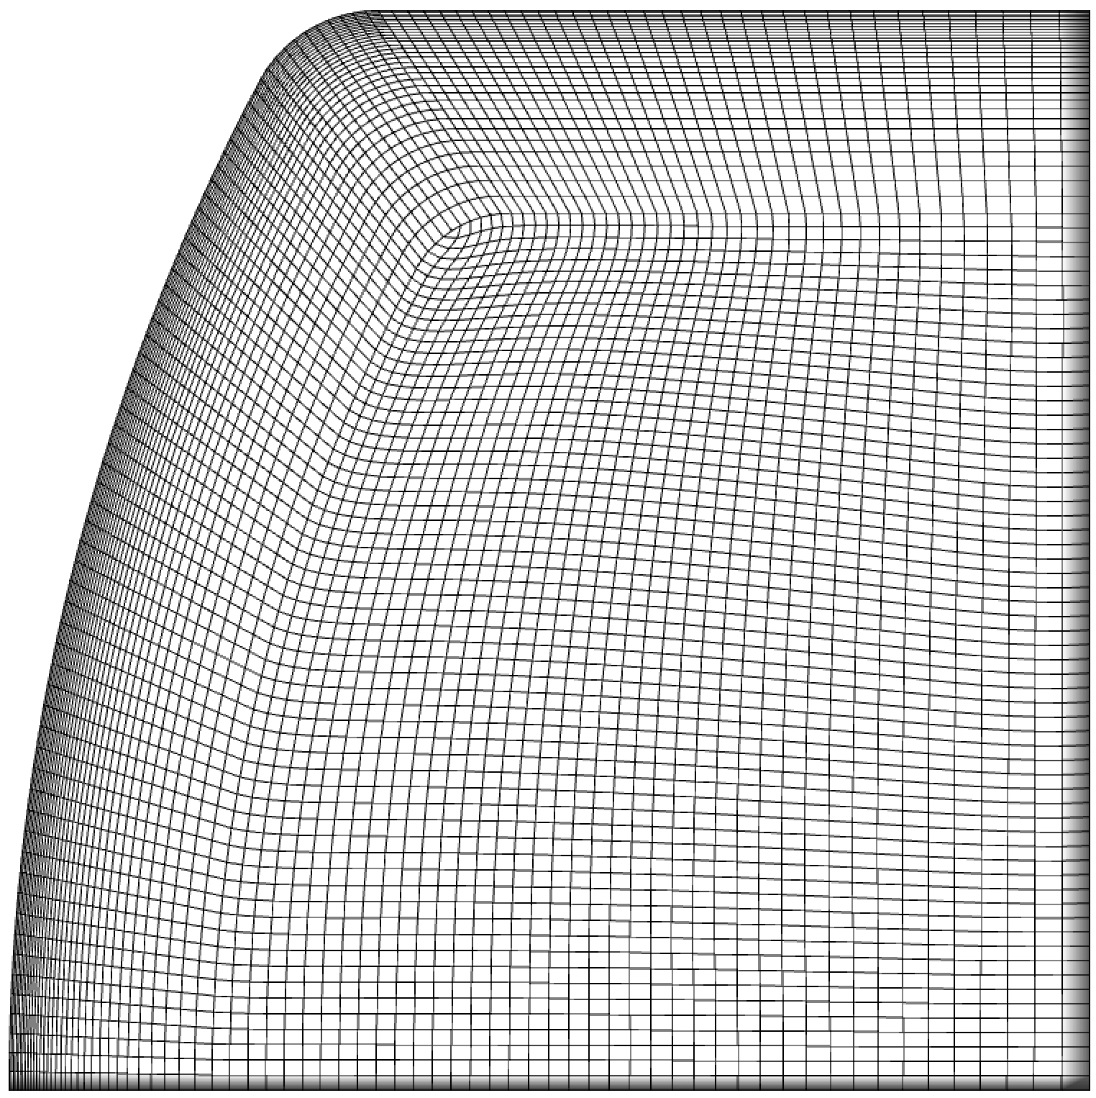
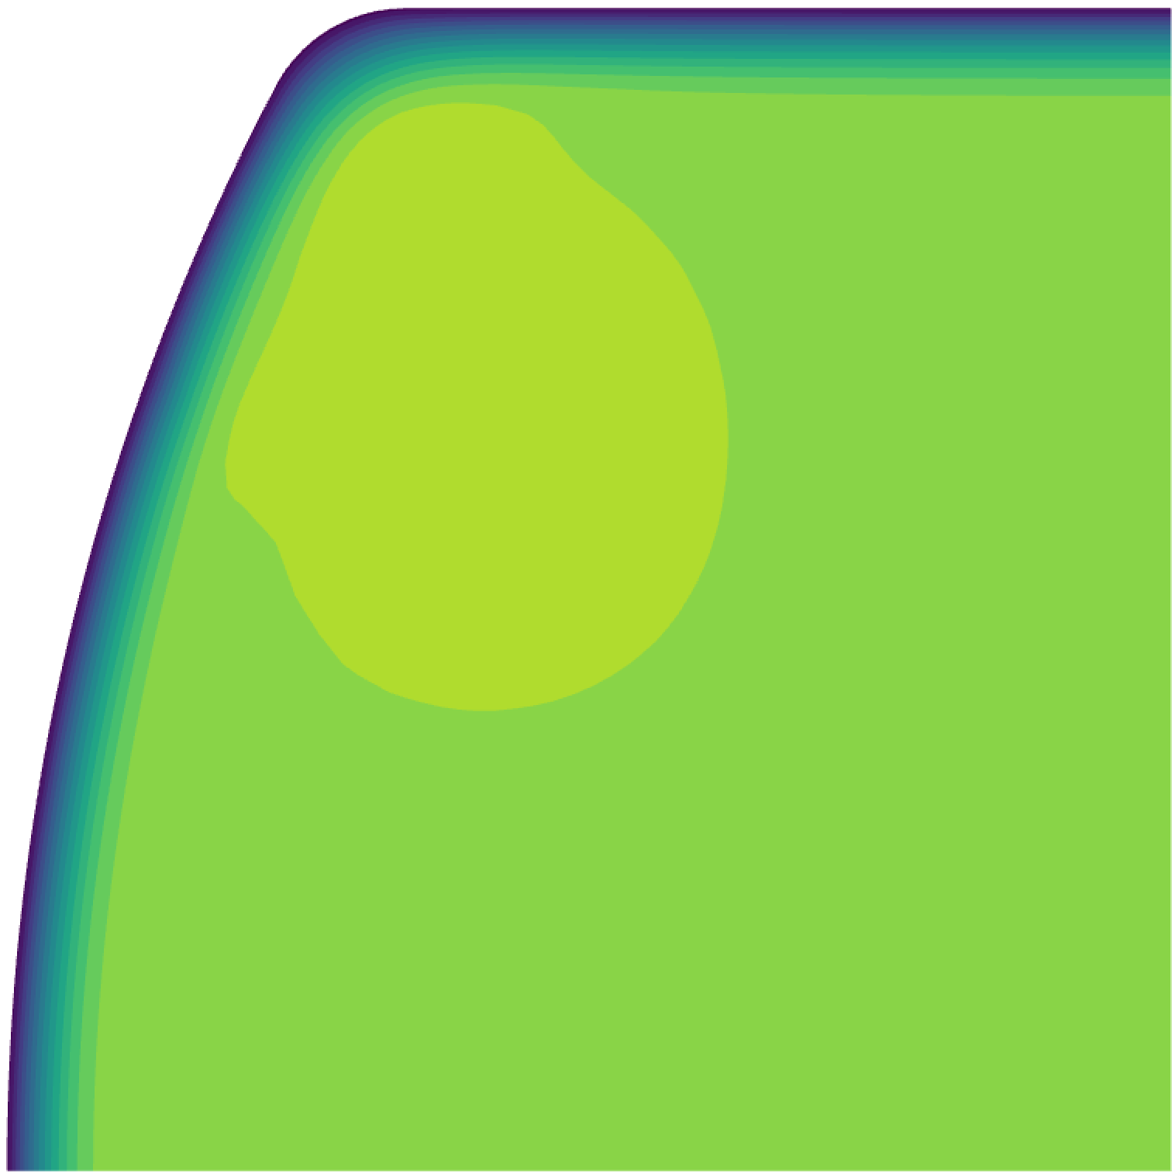
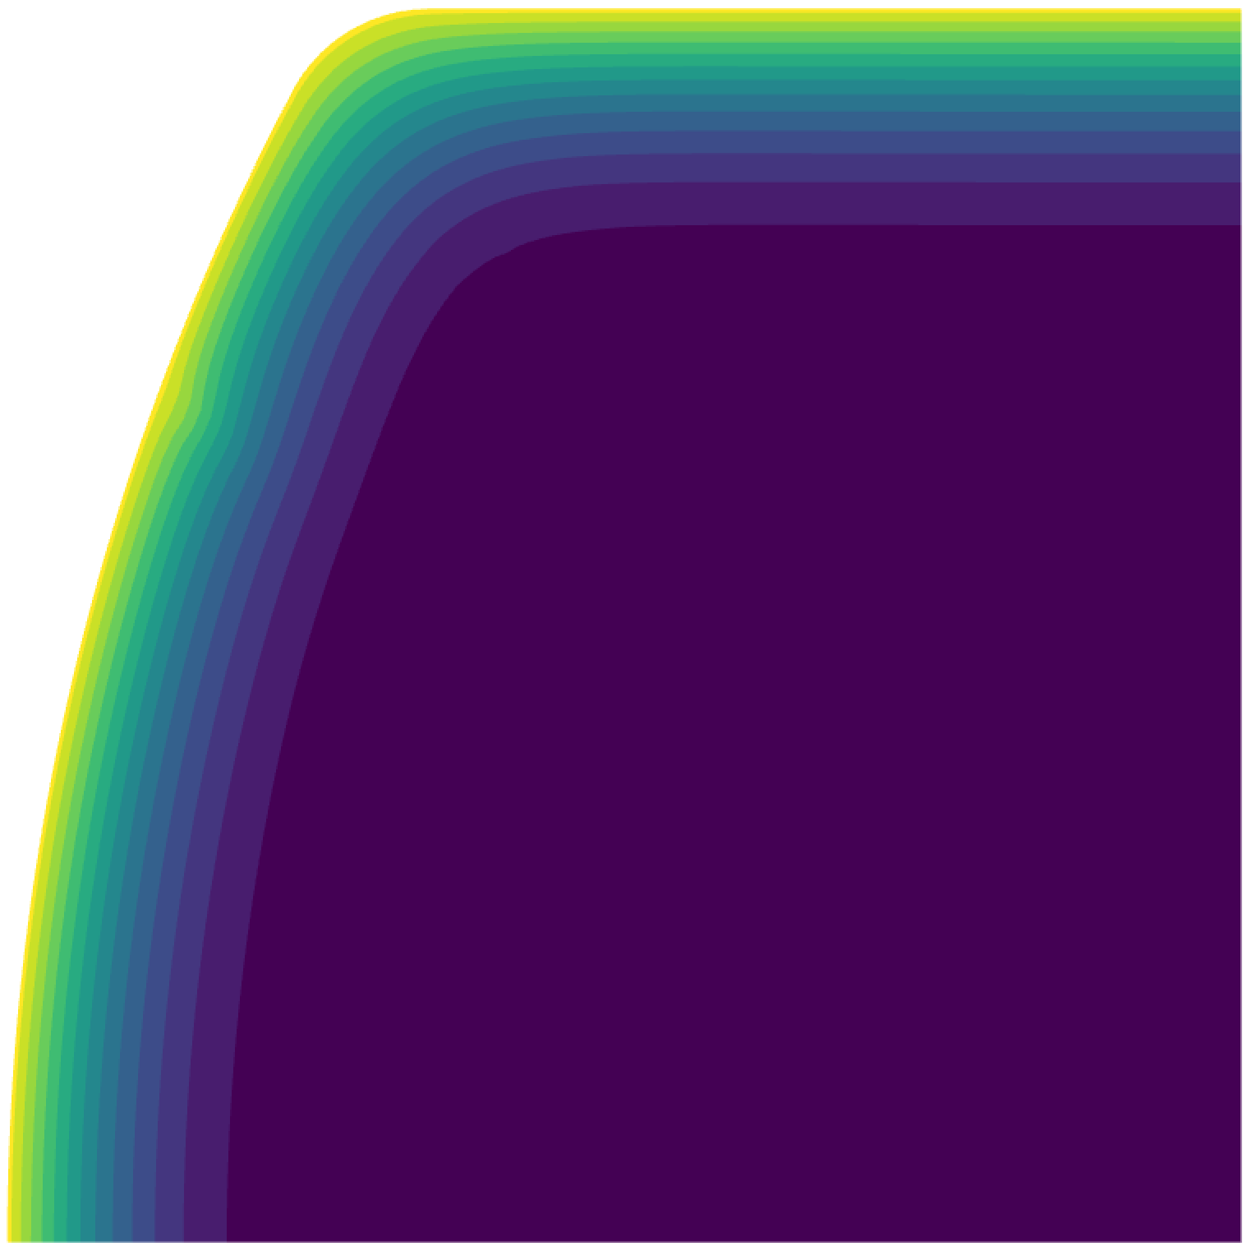
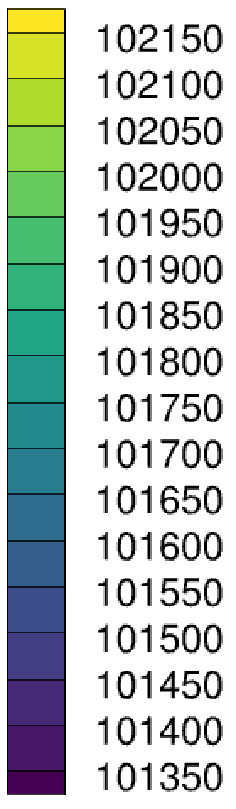
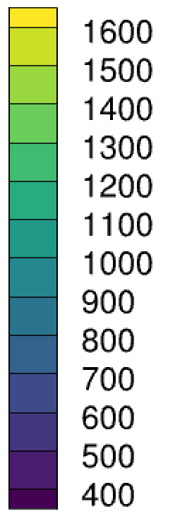
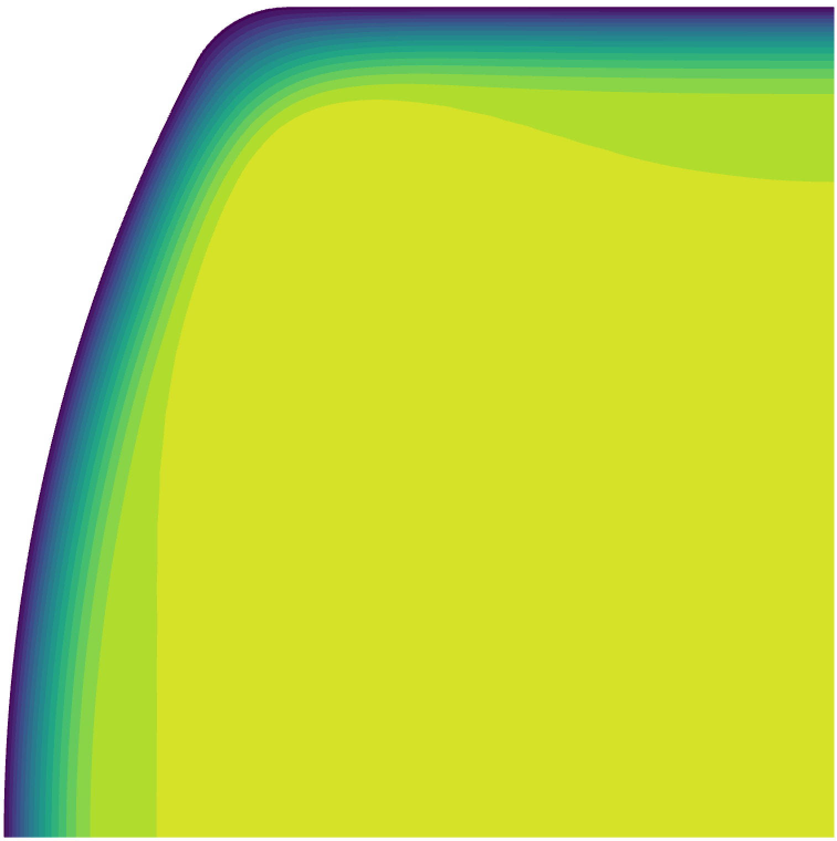
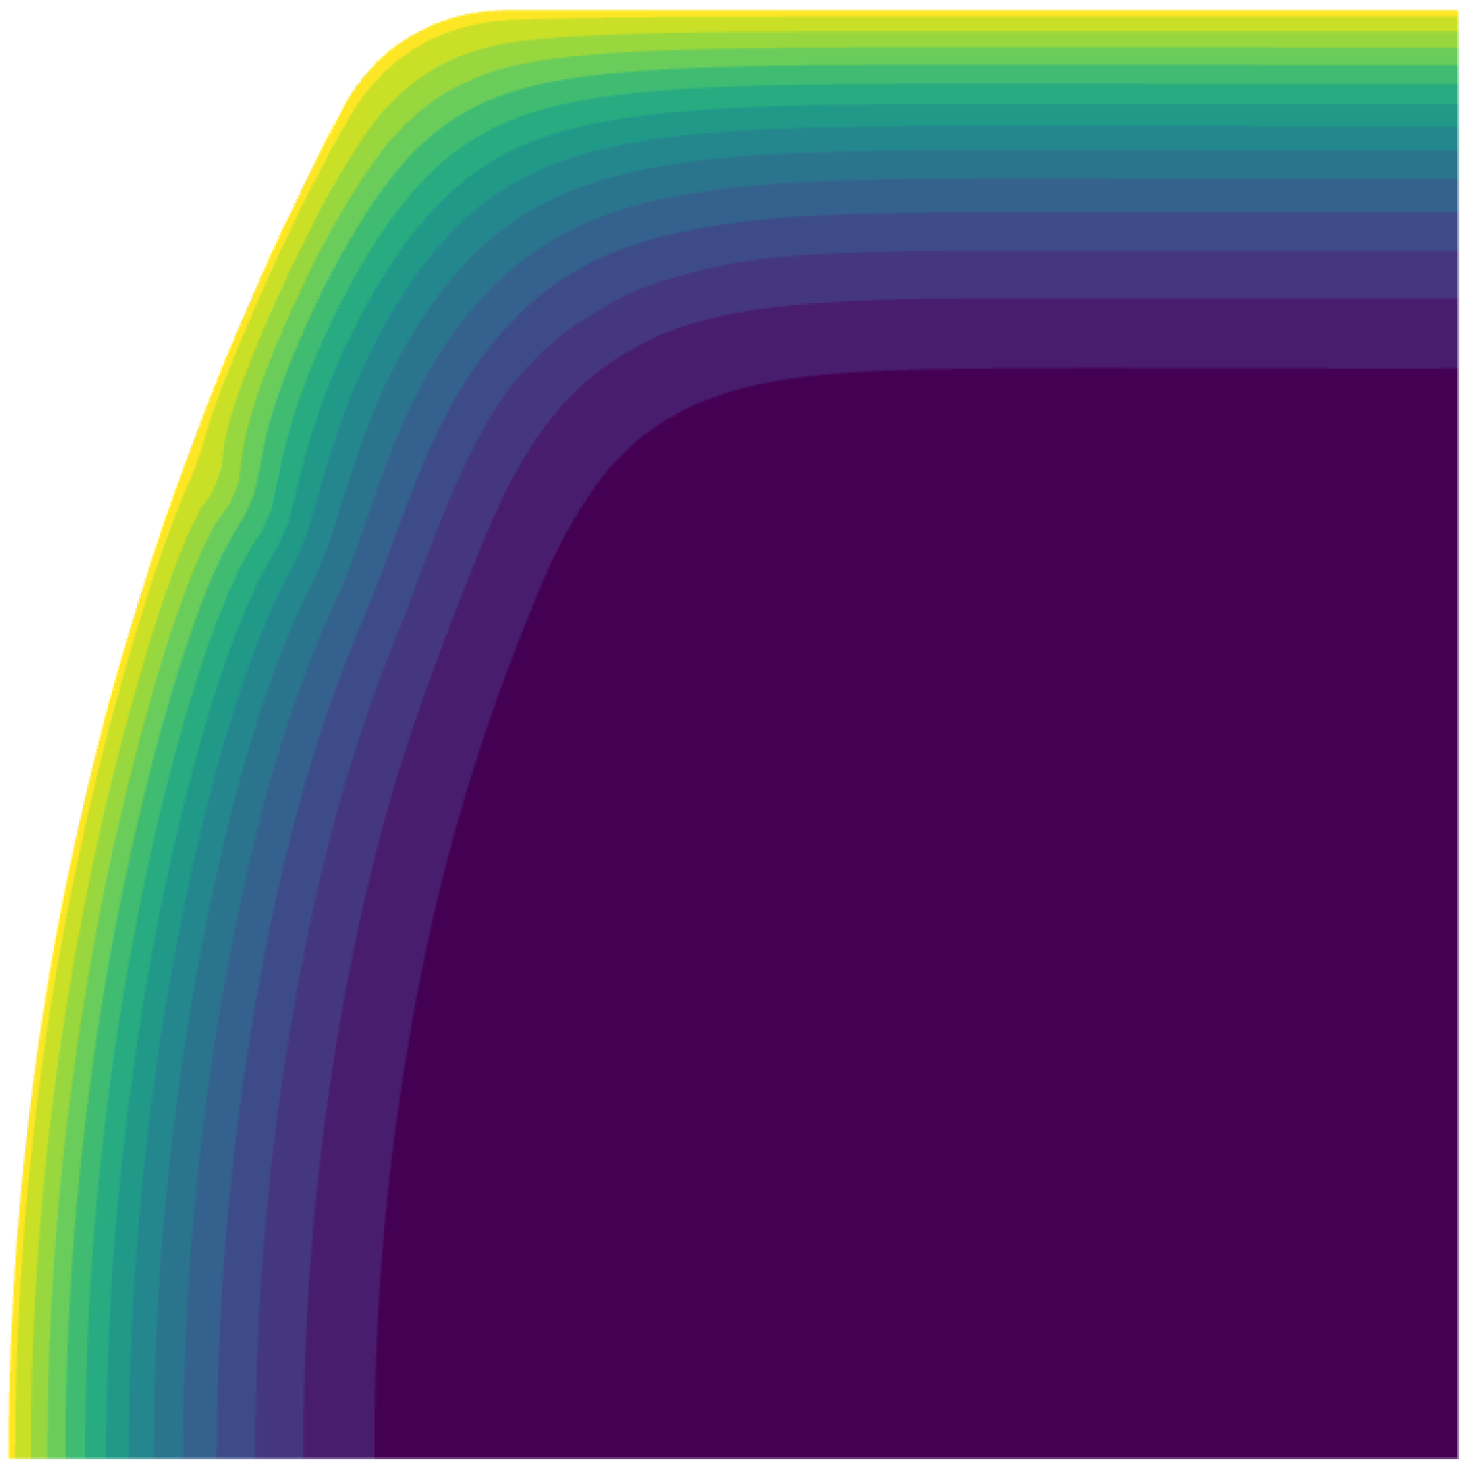
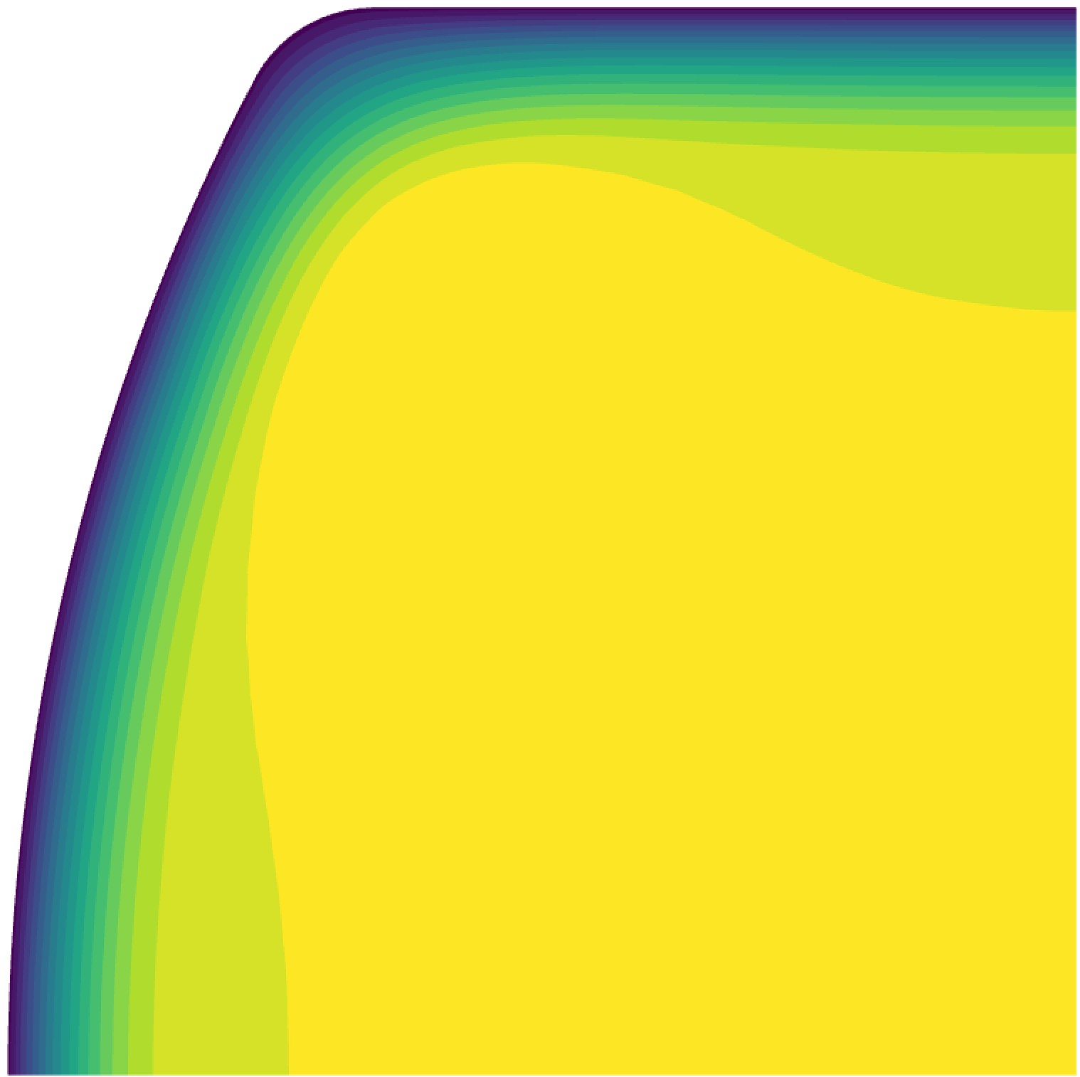

2D Simulation with Pyrolysis Gases
Isothermal:
T = 1644 K
P = 101325 Pa
Pressure [Pa]
t = 10 s
t = 10 s
Temperature [K]
TACOT
Adiabatic
5 cm x 5 cm
t = 20 s
t = 20 s
Adiabatic
Icarus 1.3 multidimensional simulation with pyrolysis gases
in parallel
t = 30 s
t = 30 s

Slide 21
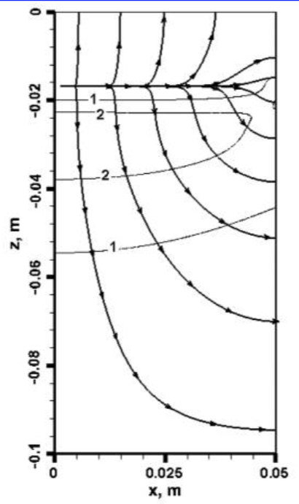
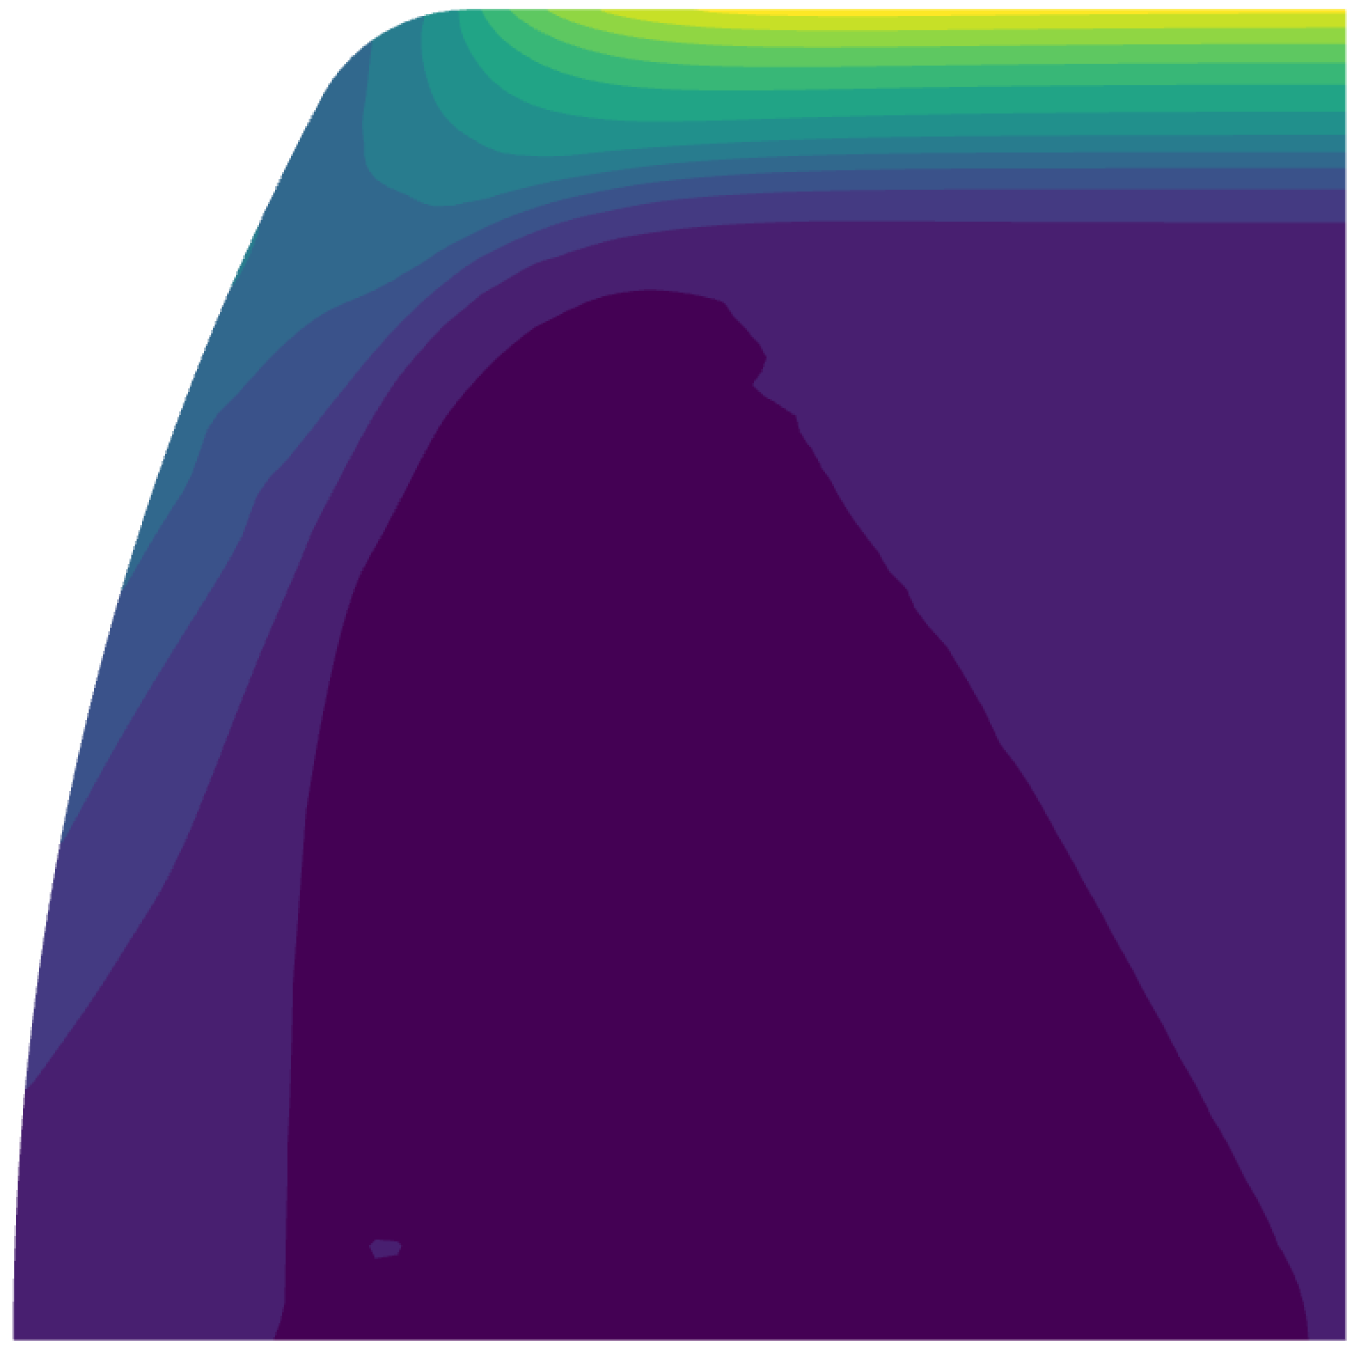
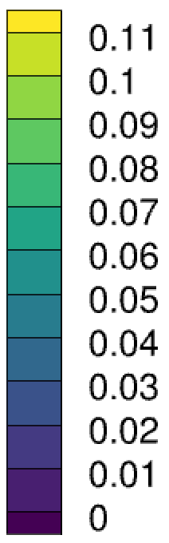

Importance of capturing side flow
Velocity [m/s]
Capability of capturing side flows
Significant in cases such as:
MMOD
Non-isotropic TPS
Of lesser importance here
v
u
Weng 2014, JTHT, Vol. 28, No. 4
  We need to consider pyrolysis gas flow explicitly
FOR MULTI D VELOCITY FLOWS ALSO SIDEWAYS
ARBITRARY PYRO GAS FLOW -> SIDE WAYS
IN ARC JET PRESSURE GRADIENT IN DDR
GAS FLOW AT THE SIDE
THERE IS NOT OTHER WAY
IF YOU DO MULTI D
NOT LACK OF THE FIAT PHYSICS

Slide 22
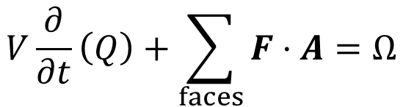



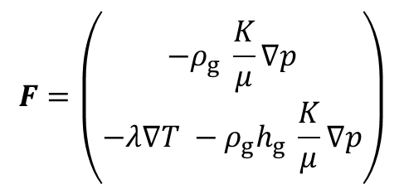
Discretization Method in Space and Time
Cell Centered Finite Volume Method in Space (no mesh motion)
  Solving wrt conservative variables:
  Gradients with Gauss Green or Least Squares
$$F=\left(\begin{matrix}−ρ_{g} \frac{K}{μ}∇p \\ −λ∇T −ρ_{g}h_{g} \frac{K}{μ}∇p\end{matrix}\right)$$
$$V\frac{∂}{∂t}\left(Q\right)+\sum_{faces}{F⋅A}=Ω$$
with fluxes
$$Q=\{ φρ_{g},ρe \}$$
Time Integration Explicit and Implicit
  Analytical Jacobians:
  Numerical Jacobians
$$F^{n+1}={\left(Aq∇q\right)}^{n+1}$$
NOT
$$F^{n+1}={A^{n}q^{n}(∇q)}^{n+1}$$

Slide 23

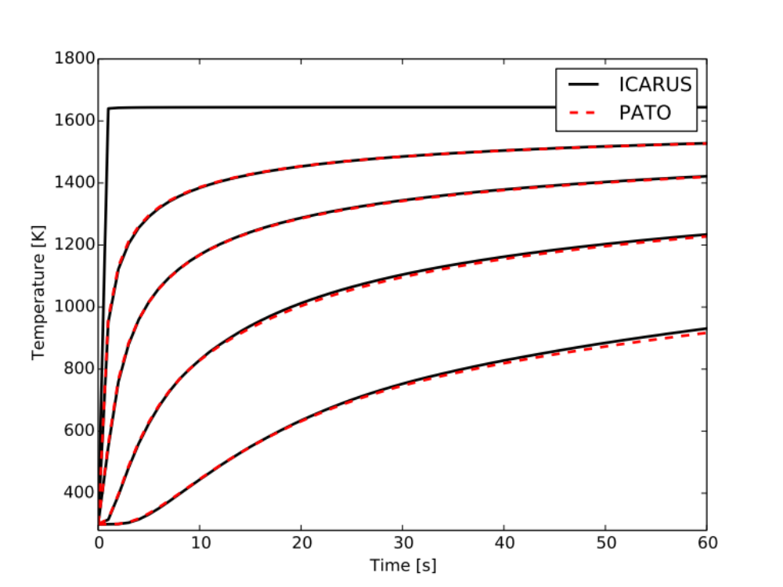
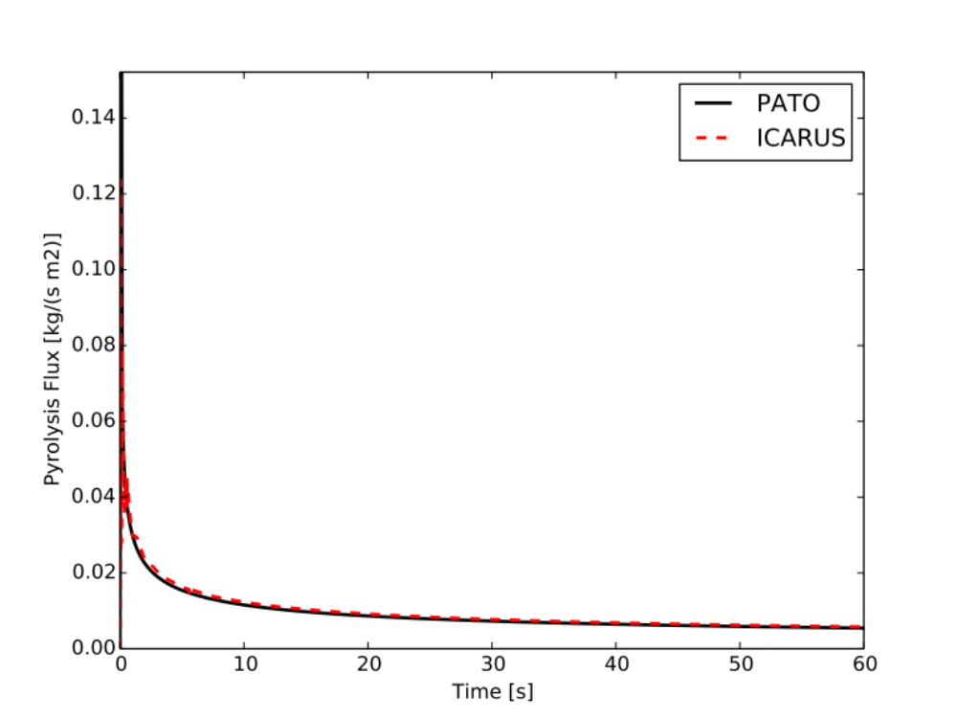
Ablation Workshop Testcase 1
TACOT
40 Cell Grid
Isothermal
T = 1644 K in 0.1 sec
P = 101325 Pa
Initial Conditions
T = 300 K
P = 101325 Pa
Adiabatic
0.05 m
0.001 m
0.002 m
0.004 m
0.008 m
  Excellent matching for temperature and pyrolysis gases. Next step AW 2.1

Slide 24
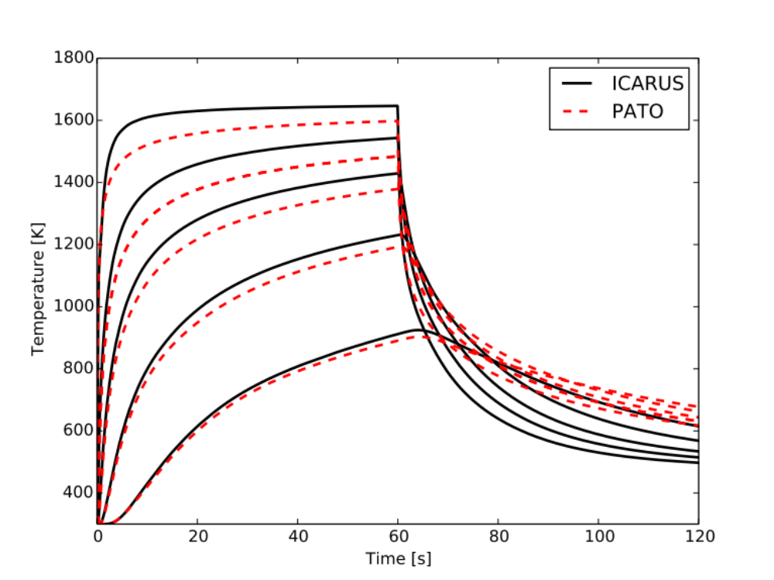

Ablation Workshop Testcase 2.1: No recession
Surface heated for 60 seconds
$${\dot{q}}_{cond}={\dot{q}}_{fluid}+{\dot{q}}_{rad}+{\dot{m}}_{c}\left(h_{s}−h_{g}\right)+ {\dot{m}}_{pg}\left(h_{pg}−h_{g}\right)$$
Surface Energy Balance:
Cooling
$${\dot{m}}_{pg}$$
$${\dot{m}}_{pg}$$
Heating
  Differences in temperature due to mismatch in pyrolysis gas fluxes

Slide 25
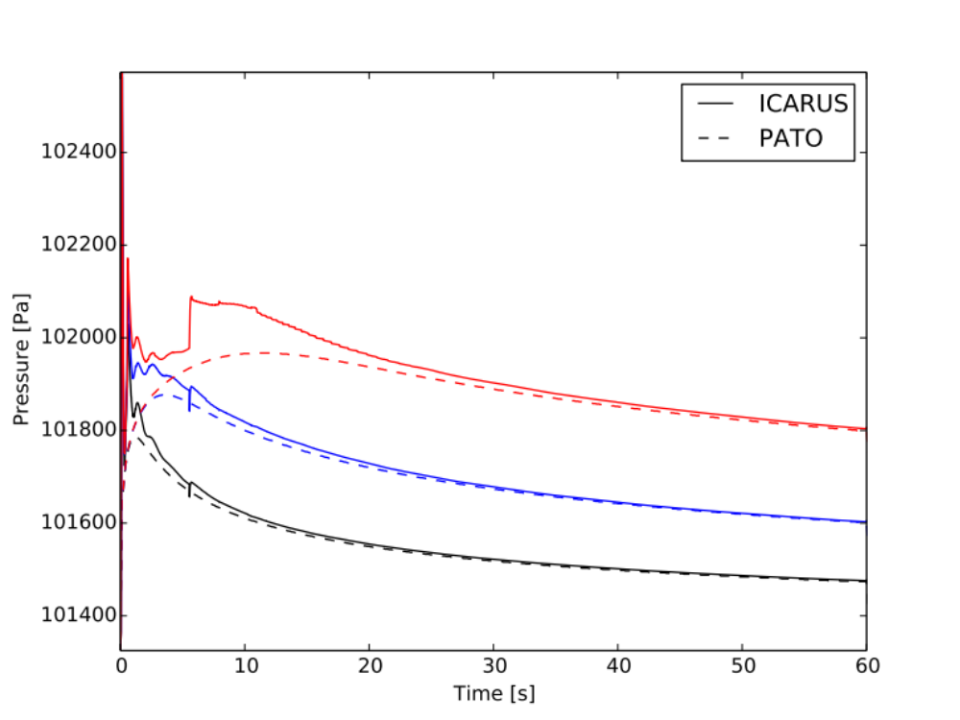
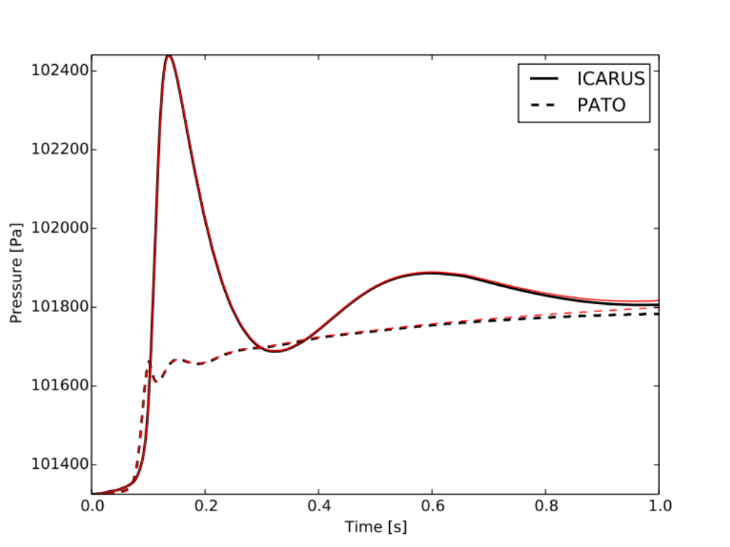
Oscillations in the pressure for AW1
Implicit
Explicit
1st Second
0.005 m
0.002 m
dt = 1.e-7 s
0.001 m
0.001 m
  Oscillations due to:
  Pyrolysis model?
  Inner and boundary fluxes?
Motivation: Improve stability

Slide 26
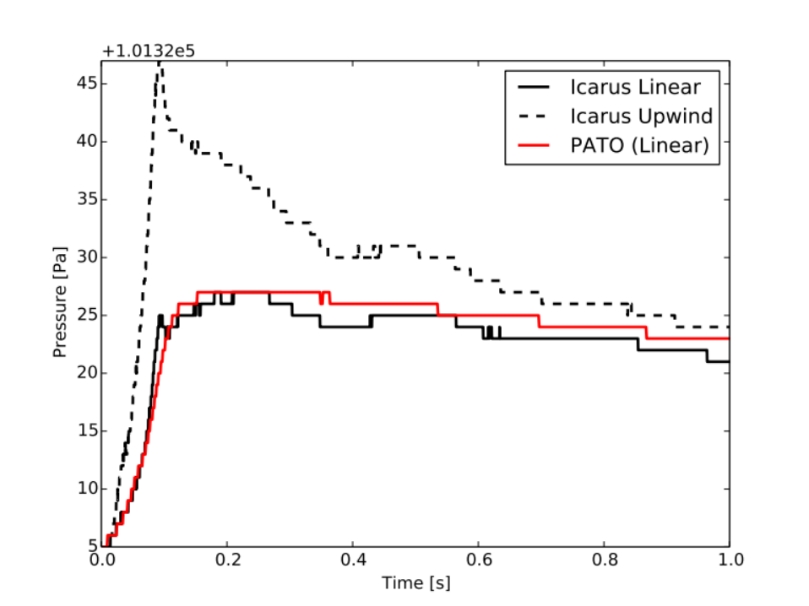


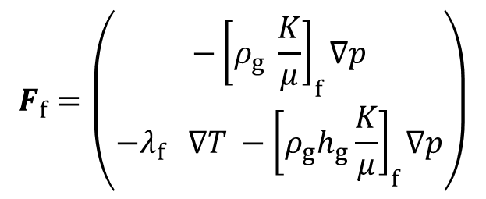




Ablation Workshop Testcase 1: Inert Solid (No Pyrolysis)
Fluxes computed at faces
  Quantities rebuilt at face:
  Particularly important for BCs
$$f$$
$$q_{L}$$
$$q_{R}$$
$$F_{f}=\left(\begin{matrix}−{\left[ρ_{g} \frac{K}{μ}\right]}_{f}∇p \\ −λ_{f} ∇T −{\left[ρ_{g}h_{g}\frac{K}{μ}\right]}_{f}∇p\end{matrix}\right)$$
$$q_{f} =linear (q_{L},q_{R})$$
$$q_{f}=upwind (u,q_{L},q_{R})$$
0.001 m
$$q_{f} =harmonic (q_{L},q_{R})$$
  Still investigating the pros and cons including TVD methods and flux limiters

Slide 27
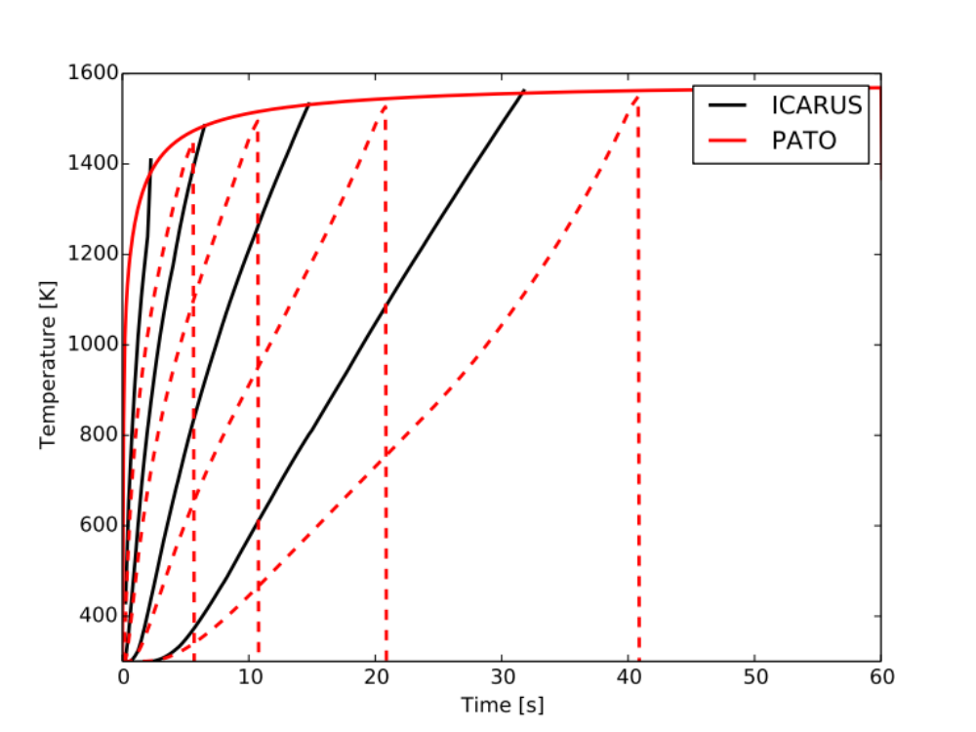
Ablation Workshop Testcase 2.2: Work in Progress
Mesh motion works for cases without pyro gases
  Understanding / Fixing pyrolysis gases fluxes is one of the last pieces in the puzzle

Slide 28

Tools Developed
New grid pre-processor
  Converts Fluent to HDF5 Icarus file
IcarusPyro
  Generates pyrolysis gas
  database files
Material database updates
  YAML format (Joey)
  Property data is tabular
Material properties
example in YAML

Slide 29
Icarus 1.4
Comparison of numerics
and further V & V
Code Refactoring
  Boundary Conditions
  Gas Database
  Post Processing
Coupling with CFD
Boundaries
UML Diagram
for (BC in BCs) BC.setFlux()
for (BC in BCs) BC.setGhostCell()
has nb
CFD Coupling
BCType
Implicit
Implements
Isothermal
Aeroheating
Adiabatic
Implements
etc

