Slide 1
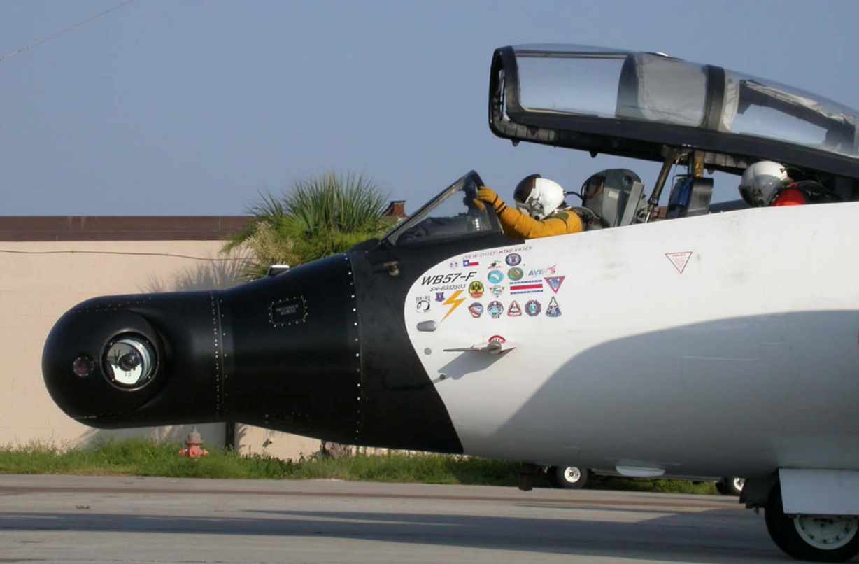
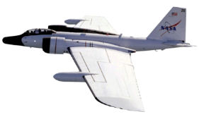
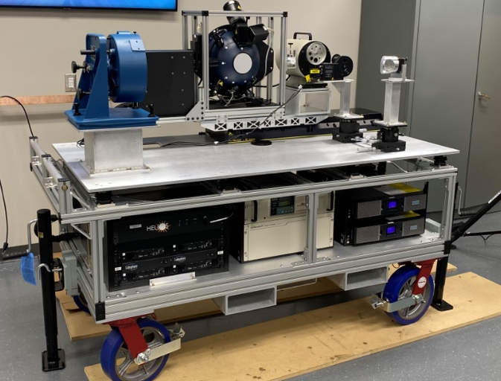
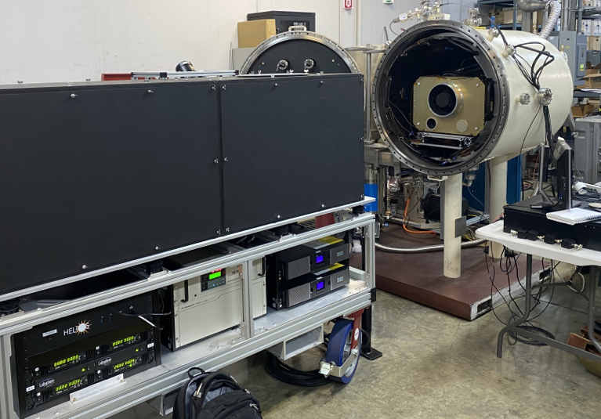
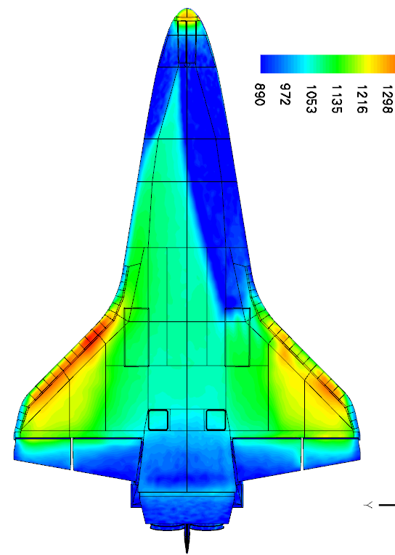
SCIFLI Starship Reentry Observation (SSRO) ACO (SpaceX Starship)
Starship and Starbrick thermal tiles
Project Overview
The NASA Scientifically Calibrated In Flight Imagery (SCIFLI) team seeks to demonstrate enhanced remote observation instrumentation technology for obtaining global surface temperature on a commercial spacecraft returning from low Earth orbit. The product provides non-invasive measurements on an integrated vehicle in an actual hypersonic flight environment that will increase overall mission capability via more accurate modeling/design tools and inform on vehicle in-situ thermocouple performance.
Technical Approach
A high-resolution observation during reentry using calibrated infrared cameras will be used to monitor surface temperature of the entire lower surface of the Starship spacecraft during hypersonic reentry. To perform the thermal observation, the NASA is developing an advanced multispectral imaging system that will be flown on a NASA high- altitude WB-57F research aircraft. The resulting calibrated measurements will inform modeling efforts and anchor surface temperatures inferred from embedded thermocouples.
Results/Summary
Fabrication nearing completion on Artemis-sponsored imaging system. Observation planning process initiated. Material samples to be tested to determine surface emissivity. Targeting Starship reentry observation opportunity near March 2022
NASA WB-57
New calibration cart
Global Temperature (STS-134/2011)
Acceptance testing of Multispectral Airborne Imaging System (SAMI)

Slide 2
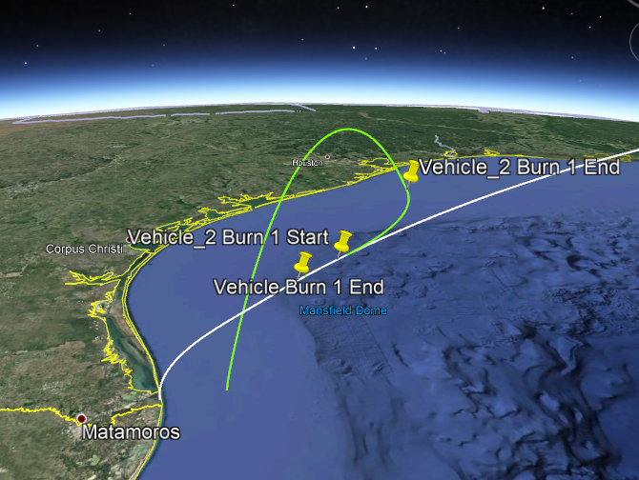
Contributing Partners
HEOMD & SBIR: Funding from Artemis and SBIR Programs for sensor and calibration hardware; CCSC funding for a WB-57 flight test to assess/verify integrated SAMI imaging system performance against an upcoming SpaceX Starship orbital flight test.
DoD: potential partnership to obtain directional and spectral emissivity of thermal protection tiles to catalog in a national database.
Infusion and Transition Plan
Current state-of-the-art thermal protection systems (TPS) (e.g. ablators, ceramic tiles, reinforced carbon carbon) typically require significant maintenance between flights (i.e. inspection, repair, replacement→time, cost).
Starship’s TPS is intended to provide a dramatic leap forward by demonstrating operational reuse, requiring minimal to no maintenance between flights.
A validated design using flight data from NASA’s SAMI imaging system would have a dramatic impact on the commercial space economy by offering a lower marginal launch cost per kg to low Earth orbit. SpaceX’s goal is to further reduce the cost of access to space with Starship by 1 to 2 orders of magnitude relative to its Falcon 9 launch vehicle.
Rapid reusability of the entire Starship launch system—including its heatshield technology—is critical for achieving this reduction. Thus, this partnership with NASA will allow SpaceX to enable the first-ever fully reusable orbital launch and entry vehicle.
a
b
c
d
CCSC Collaborations for Commercial Space Capabilities
DoD Department of Defense
HEOMD Human Exploration and Operations Mission Directorate
SAMI SCIFLI Airborne Multispectral Imager
SBIR Small Business Innovation Research

