Slide 1
SIRIUS
Simulation Infrastructure for Research on Interconnected Unmanned System
María Consiglio (NASA), Andrew Peters (NIA), Brendan Duffy (NIA), Swee Balachandran (NIA), Marco Feliu (NIA),
NASA Langley Research Center
August 2021

Slide 2
Outline
Introduction
SIRIUS Architecture
  Network/Airspace Builder
  Pairwise Encounter Builder
  Simulation Runner
  Analysis and Visualization
Sample Applications
Ongoing and future work

Slide 3
SIRIUS: What is it?
A simulation research environment for fast-time evaluations and analysis of Urban Air Mobility (UAM) operations.
SIRIUS provides a graphical user interface that allows the user to design, build, and configure complex airspace structures containing a large number of aerial vehicles and ground systems participating in a UAM ecosystem.
Comprehensive data collection and interactive data analysis tools enables the evaluation of all required Measures of Performance (MOPs).
SIRIUS is available from https://gitlab.larc.nasa.gov/larc-nia-fm/Sirius

Slide 4
SIRIUS Main Features
Graphical user interface and highly configurable test scenarios
  DAA: Well-clear definition, alerting logic, maneuver guidance, support for intruder-centric DAA logic
  Uncertainty models: Surveillance, communication delays, winds
  Equipped and non-Equipped aircraft
  Aircraft models: point mass, 6-DOF High Fidelity Rotorcraft UAS, 6-PAX Quad EVTOL aircraft models
Support simulations involving 4-D Kinematic Trajectories.
Batch Parallelization:
  Scenarios can be run in parallel on different computers
  Aircraft from the same scenario can be run on different computers
Vehicles simulated in SIRIUS can be configured to have varying levels of autonomy:
  Autonomous behavior is enabled via the ICAROUS system. Vehicles can perform avoidance maneuvers, merging and spacing operations and path planning.
Modular
  Support for alternative DAA logic, e.g., Xu, noise models, metrics, etc.
Deterministic and Monte-Carlo based generation of scenarios

Slide 5
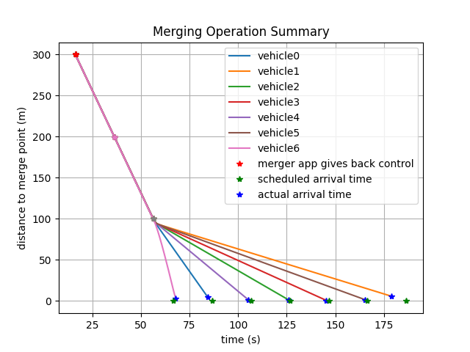
Workflow
Pairwise encounter generator
Use local and remote resources (server) to run multiple simulations in parallel.
Post simulation data analysis to evaluate and visualize metrics
Design sense and avoid encounters of
various geometries, closure rates, etc..
Simulation Runner
Data analyzer
Execution Environment
Data Analysis
Airspace network builder
Data logs
Simulation Manager
Postprocessing interactive plots
Design complex airspace networks and traffic flows in and around vertiports in an urban environment
Aircraft Simulation
Aircraft 1
…
Aircraft Simulation
Aircraft n

Slide 6
Simulation Environment
Simulations can be run locally or on one or more remote host machines.
Simulation Manager
ZMQ socket
ZMQ socket
ZMQ socket
Decision Module
Decision Module
Decision Module
Decision Module
Decision Module
Decision Module
Traffic Module
Traffic Module
Traffic Module
Traffic Module
Traffic Module
Traffic Module
ICAROUS autonomy stack
(uses DAIDALUS, POLYCARP libraries)
Trajectory Module
Trajectory Module
Trajectory Module
Trajectory Module
Trajectory Module
Trajectory Module
….
…..
Guidance Module
Ground Module
Guidance Module
Guidance Module
Guidance Module
Guidance Module
Guidance Module
Aircraft Model X
Ground system
Aircraft Model X
Aircraft Model X
Aircraft Model Y
Aircraft Model Z
Aircraft Model X
Sim Environment
Sim Environment
Sim Environment
Computer 1
Computer 2
Computer N

Slide 7
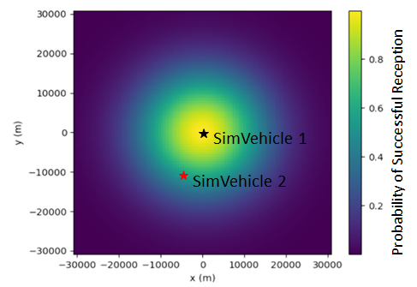
SIRIUS Communication/Surveillance Configuration
Several options for models* to determine probability a radio signal will be received, based on separation range
Or, just set a fixed rate of communication failure (ex: 0%, 1%, 5%)
Configurable update intervals (ex: transmit position every 2 seconds)
Configurable latency/delay
Communication models can be used for position reporting, or for coordination messages between vehicles or with a ground system
Each vehicle can be configured to transmit/receive using different parameters
Example:
SimVehicle1 is equipped with an ADS-B transmitter that transmits position data once per second on 978MHz at 40W
SimVehicle2 is equipped with ADS-B IN, and receives updates
Rayleigh Fading model is used to determine probability of receiving each update
*https://gitlab.larc.nasa.gov/larc-nia-fm/icarous/-/blob/master/Python/pycarous/communicationmodels/modelinformation.md​

Slide 8
Network Builder
  Tool features:
  Enables the construction of a network of air-routes for Urban Air Mobility type operations.
  Create vertiports at desired latitude, longitude and altitude.
  Define interconnections between vertiports.
  Define specific waypoints, merge points and crossing points.
  Simulate vehicles leaving vertiports and predefined output rates.
  Integrates with ATS-TIGAR to obtain preflight schedules for all vehicles operation in the UAM environment.

Slide 9
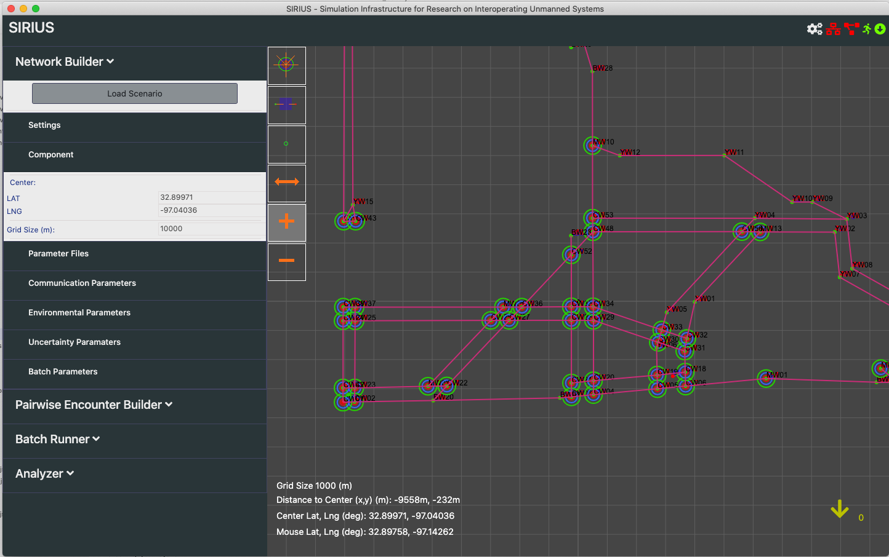
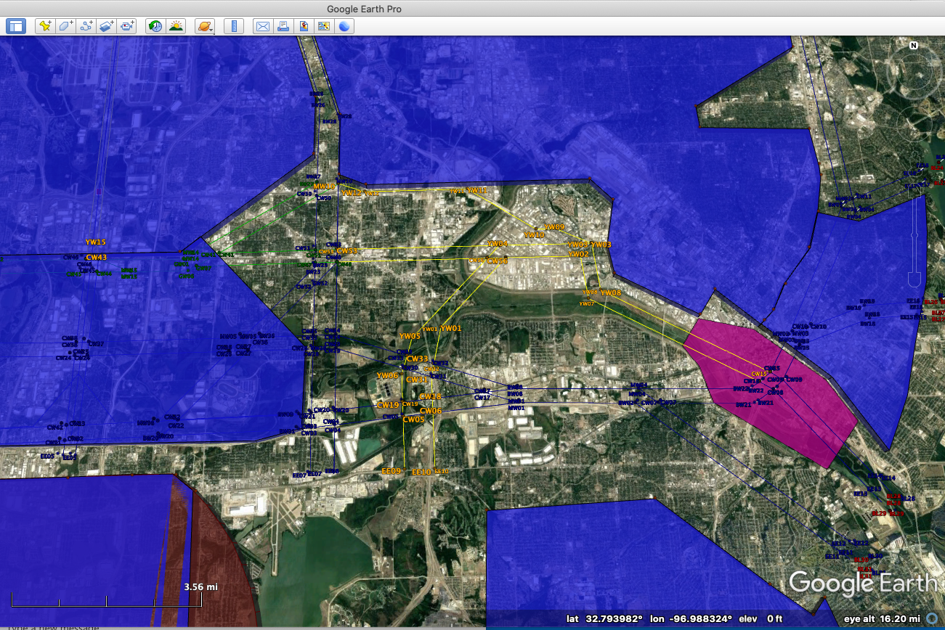
Network Builder
UAM airspace defined for the Dallas Fort Worth airspace.
A subset of the “usable” DFW airspace incorporated into the SIRIUS platform.

Slide 10
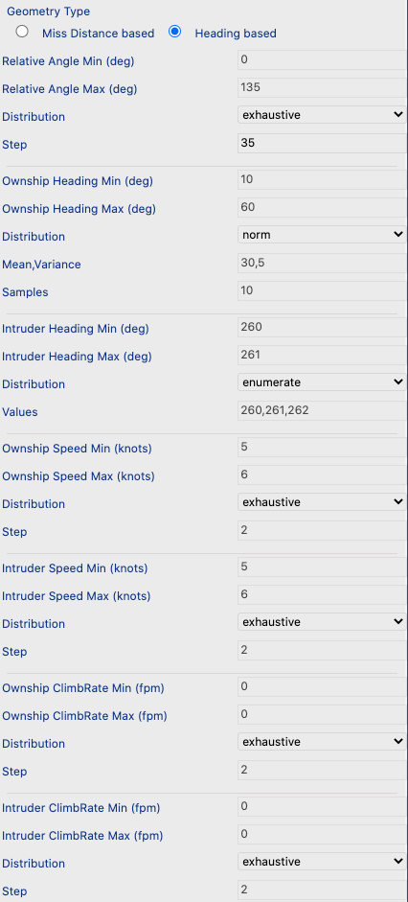
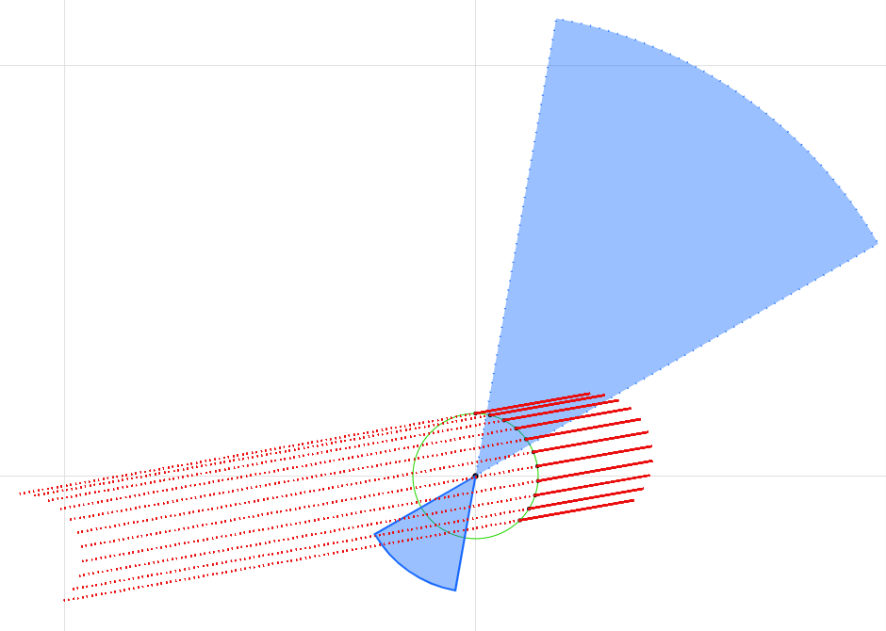
Pairwise Encounter Generation
Purpose of Pairwise tests: In-depth exploration of algorithm performance on a single specific encounter, including flight test data replay. Also, compute aggregate DAA MOPs based on MC variations of a single encounter parameters (e.g., approach angle, horizontal miss distance, etc.)
Range of intruder trajectories
Geometry parameters
Range of ownship trajectories
This example illustrates the definition of a pairwise encounter between 2 DAA-equipped aircraft in which the encounter angle is varied within a range and distribution defined by the user.

Slide 11
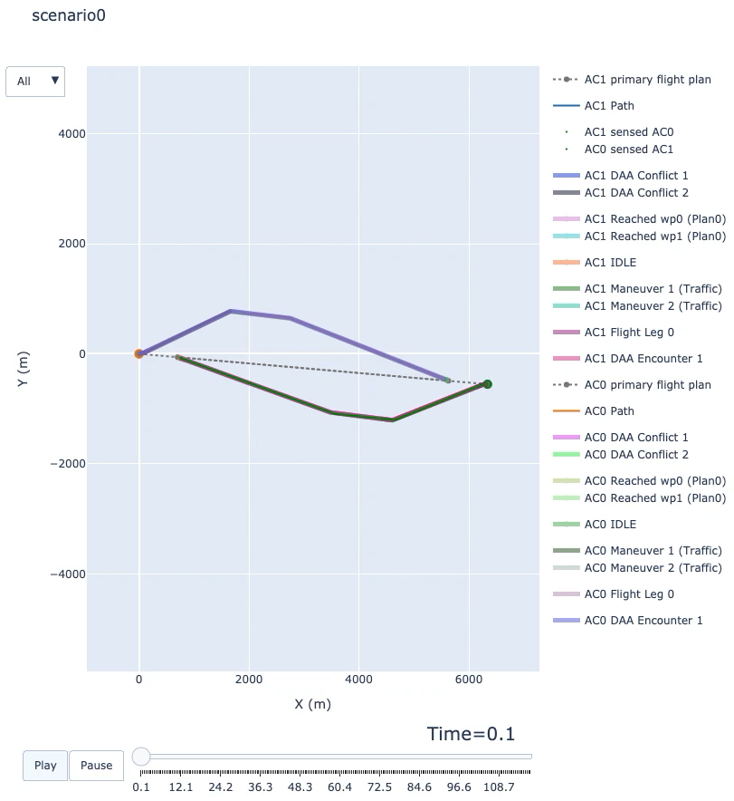
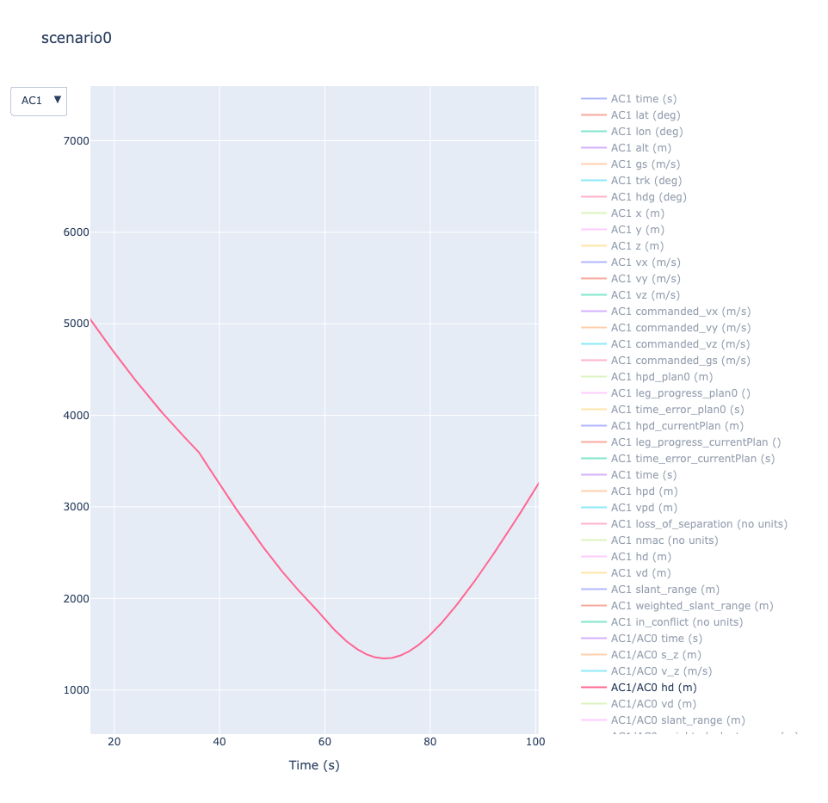
Pairwise Encounter Analysis
Simulation playback
Simulation Analysis

Slide 12
Statistical Analysis Using SIRIUS
SIRIUS provides the capability to run multiple batches of simulations in parallel.
Random sampling can be utilized to generate a wide range of test conditions.
Various distributions can be imposed on how initial conditions and parameters are sampled for each individual simulation run in a given batch.
Statistical analysis on measures of performance can be conducted to evaluate sense and avoid behavior against varying levels of sensor uncertainty.

Slide 13
Demo

Slide 14
Future Work
Optimizations to reduce runtime of large scale simulations.
Continued development of onboard and ground based sensors
Include map background for network builder

