Slide 1


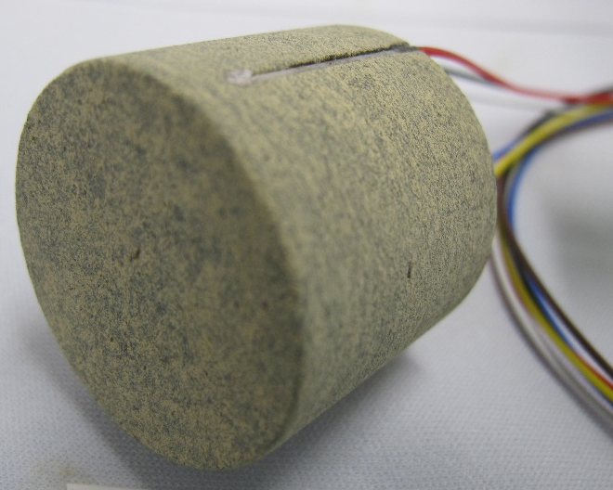
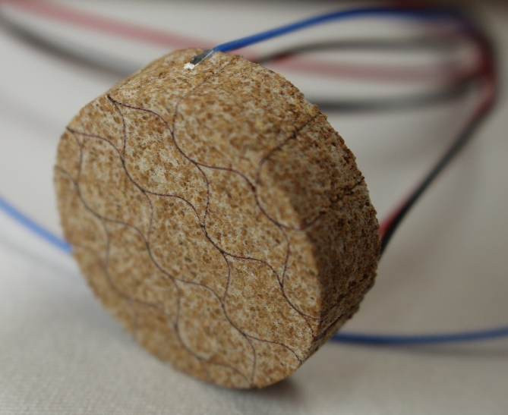
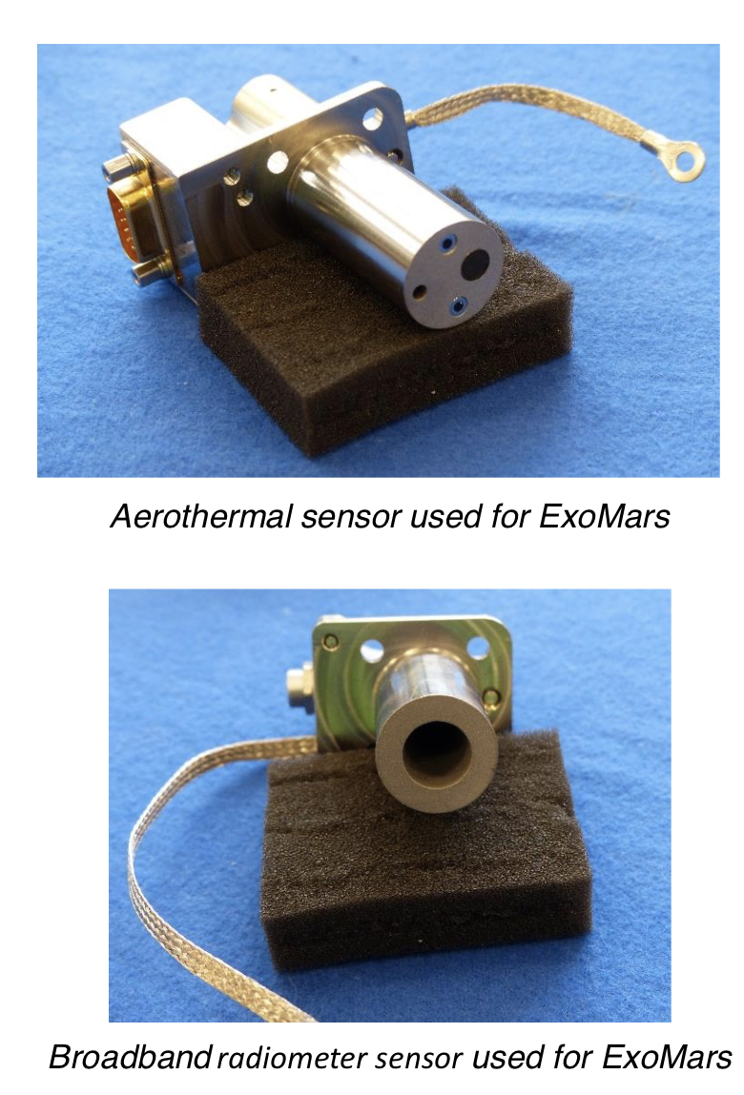
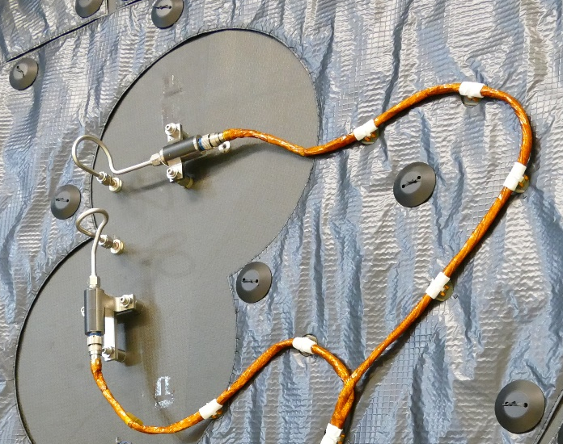
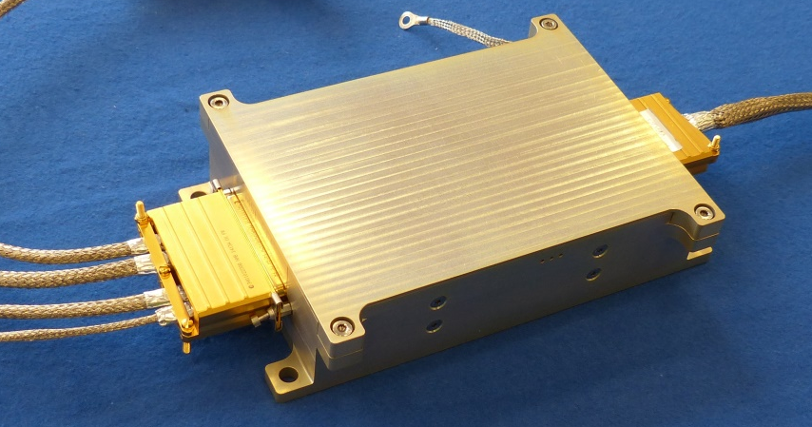
Overview of Dragonfly Entry Aerosciences Measurements (DrEAM)
Jose A. B. Santos¹, Aaron Brandis², Helen Hwang¹, Ali Gülhan³, Thomas Thiele³, Frank Siebe³
¹NASA Ames Research Center, Moffett Field, CA 94035, USA; ²AMA, Inc. at NASA Ames Research Center, Moffett Field, CA 94035, USA;
³German Aerospace Center (DLR e.V.), Supersonic and Hypersonic Technologies Department, Linder Höhe, 51147 Köln, Germany.
What is DrEAM?
Dragonfly Entry Aerosciences Measurements (DrEAM) is an instrumentation suite for the Dragonfly mission’s entry vehicle heat shield and backshell
Satisfies NASA’s Engineering Science Investigation requirement for a New Frontiers mission
Led by NASA’s Ames Research Center, in partnership with NASA’s Langley Research Center and DLR
The Huygens probe was the last mission to Titan, but it carried no TPS instrumentation.
Key in-situ measurements will be made in Titan’s atmosphere for the first time
  The first in a non-oxidizing environment
Sensors with flight heritage from previously flown missions will be leveraged as much as possible:
  Mars Entry, Descent, and Landing Instrumentation 2 (MEDLI2) [1]
  ExoMars Schiaparelli [2]
DrEAM Instruments:
The DrEAM project includes several different sensor types:
Dragonfly Sensors for Thermal Reconstruction (DragSTR)
  Instrumented thermal plugs
Dragonfly Atmospheric Flight Transducer (DrAFT)
  Hypersonic pressure transducers
DLR-provided Combined Sensor System for Titan Atmosphere (COSSTA)
  Total heat flux sensor, pressure sensor, and two narrowband radiometers
  Broadband radiometer
DLR-provided Data Acquisition System to acquire the measurements from the sensors and pass them on to the Dragonfly Lander flight computer.
  Total of 24 channels available on the heat shield and another 24 on the backshell.
DrEAM Science
High level DrEAM project goals:
  Measure heat shield near surface and in-depth temperatures
  Measure backshell near surface and in-depth temperatures
  Measure pressure at the heat shield and backshell surface
  Measure backshell radiative and total heat flux
Value of DrEAM sensor data to the Titan science community:
Infer CH₄ abundance in the upper atmosphere
Reconstruct atmospheric winds
Enhance Dragonfly trajectory reconstruction
Value of DrEAM sensor data to the aerothermal community:
Flight data on the performance of PICA and SLA-561V TPS materials
Data to infer the aerothermal environment around the aeroshell
Validate models used in spacecraft design
Backshell thermal plug used for MEDLI2
DrEAM Project Timeline:
DrEAM flight hardware fabrication and acceptance testing
DrEAM hardware installation;
Dragonfly AI&T activities
Cruise check-outs
Heat shield thermal plug used for MEDLI2
2021-2023
2024-2026
2027 -
2034
Requirements development Do-No-Harm testing
DrEAM flight hardware delivery
Dragonfly Launch
Arrival at Titan
References:
[1] H. Hwang, et. al. “Mars 2020 Entry, Descent and Landing Instrumentation 2 (MEDLI2),” 41st AIAA Thermophysics Conference, 13-17 June 2016, Washington, D.C., AIAA 2016-3536.
[2] A. Gülhan, et. al., “Aerothermal Measurements from the ExoMars Schiaparelli Capsule Entry,” Journal of Spacecraft and Rockets, Vol. 56, No. 1, January 2019
Heat Shield view
Backshell view
Preliminary DrEAM Sensor Layout
(Hardware images shown are from previous missions as noted)
Electronics box used for ExoMars
Pressure transducers used for MEDLI2

