Slide 1
Mexico’s Popocatepetl (El Popo) Volcano Aztec for “Smoking Mountain”
Landsat 8 - OLI
Visualization Date: January 2, 2021
Lessons Learned in Systems Engineering Availability and Recommendations for Mission Technical Leaders
Charles Baker
Dave Everett
72nd International Astronautical Congress
Dubai, United Arab Emirates
25 – 29 October 2021
Notes:
Popocatépetl volcano—the name is Aztec for “smoking mountain”—is one of Mexico’s most active volcanoes. The glacier-clad stratovolcano has been erupting since January 2005, with daily low-intensity emissions of gas, steam, and ash. On January 2, 2021, the Operational Land Imager (OLI) on Landsat 8 captured this image of a plume rising from Popocatépetl (nicknamed El Popo).

Slide 2
What is Systems Engineering Availability?
Availability is more than just time; it is openness to listen to concerns and questions.
It begins by building a level of trust in the team that it is safe to ask questions or share concerns without the fear of blame or additional workload.
It also requires enabling informal conversations (over lunch, coffee, in the clean room, or at the team members desk, etc.) where key information can be exchanged, and team members may even provide an easy-to-implement mitigation idea for another subsystem.
Availability is a highly valuable commodity and completely non-obvious to protect and optimize. The natural tendency of engineers is to keep themselves busy with solving problems that they know about.
This paper is encouraging MSEs to resist this tendency to try and solve all the complex problems themselves and actively devote daily time to learning and solving problems that are found with informal communications with other team members.

Slide 3
Why is Systems Engineering Availability so Difficult to Manage?
NASA Mission Systems Engineers are increasing leading more complex space missions with less support systems engineers and discipline leads.
This is because more and more missions are cost constrained missions or build to cost type missions.
Likewise, management and organizational tools and higher-level meetings increasingly place demands on MSEs to report status and manage tool inputs.
This paper argues that the MSE needs to make a conscious effort to make sure there is dedicated time in their schedule to interact with the discipline engineers working directly with the flight hardware through presenting 7 real mission examples.
Not discovering these mission level hardware issues would have significantly impacted development schedule on the ground or performance in flight.

Slide 4
What is the risk?
The job of the MSE is to be the overall technical lead of the project, therefore a conscious leveling of the risk through the project.
It is important to not neglect the other areas of the project that are not perceived as high risk but will be critical to complete the project.
Often the areas these area are not adequately staffed, nor is attention paid to these areas because of the area’s perceive straight forward nature. Perceptions and reality diverge without conscious attention.
Then it is possible that issues are missed on the ground that impact the mission in flight, or the issues become a major impact to the development schedule.

Slide 5
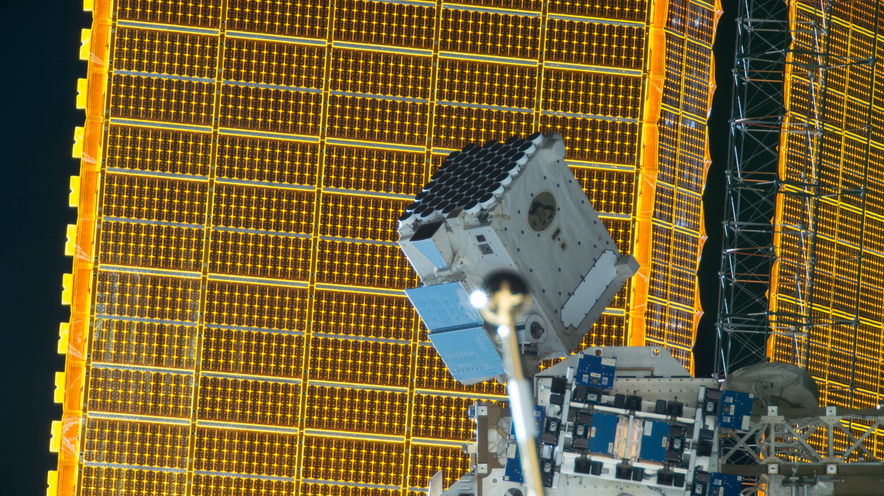
Examples from Neutron Interior Star Composition Explore (NICER)
Mission Overview
  ISS ESPA Payload
  Dragon Transport Vehicle
Issues Discovered and Resolution Path
  Partnering with perfectionist outside expert helps eliminate extra mechanism
    No need to add a mechanism to fix the EXPA when there are magnets
  Simple problem solving, and good will can mitigate months of uncertainty
    Trip to Home Depot with a simple experiment and extra day saves months
  End Item Data Package Review Issues are mitigated with solid partners
Objective | Measurements
Structure — Reveal the nature of matter in the interiors of neutron stars | Neutron star radii to ±5%. Cooling timescales
Dynamics — Uncover the physics iof dynamic phenomena associated with neutron stars | Stability of pulsars as clocks. Properties of outbursts, oscillations, and precession
Energetics — Determine how energy is extracted from neutron stars. | Intrinsic radiation patterns, spectra, and luminosities
MSE Skills that contributed to Resolution
  We realized the importance of partnering with difficult but knowledgeable experts who provided unexpected expertise
  Systems Engineering has open lines of communication to request accommodations that are atypical.
  With trust, unexpected obstacles can be overcome with minimal programmatic impact.

Slide 6
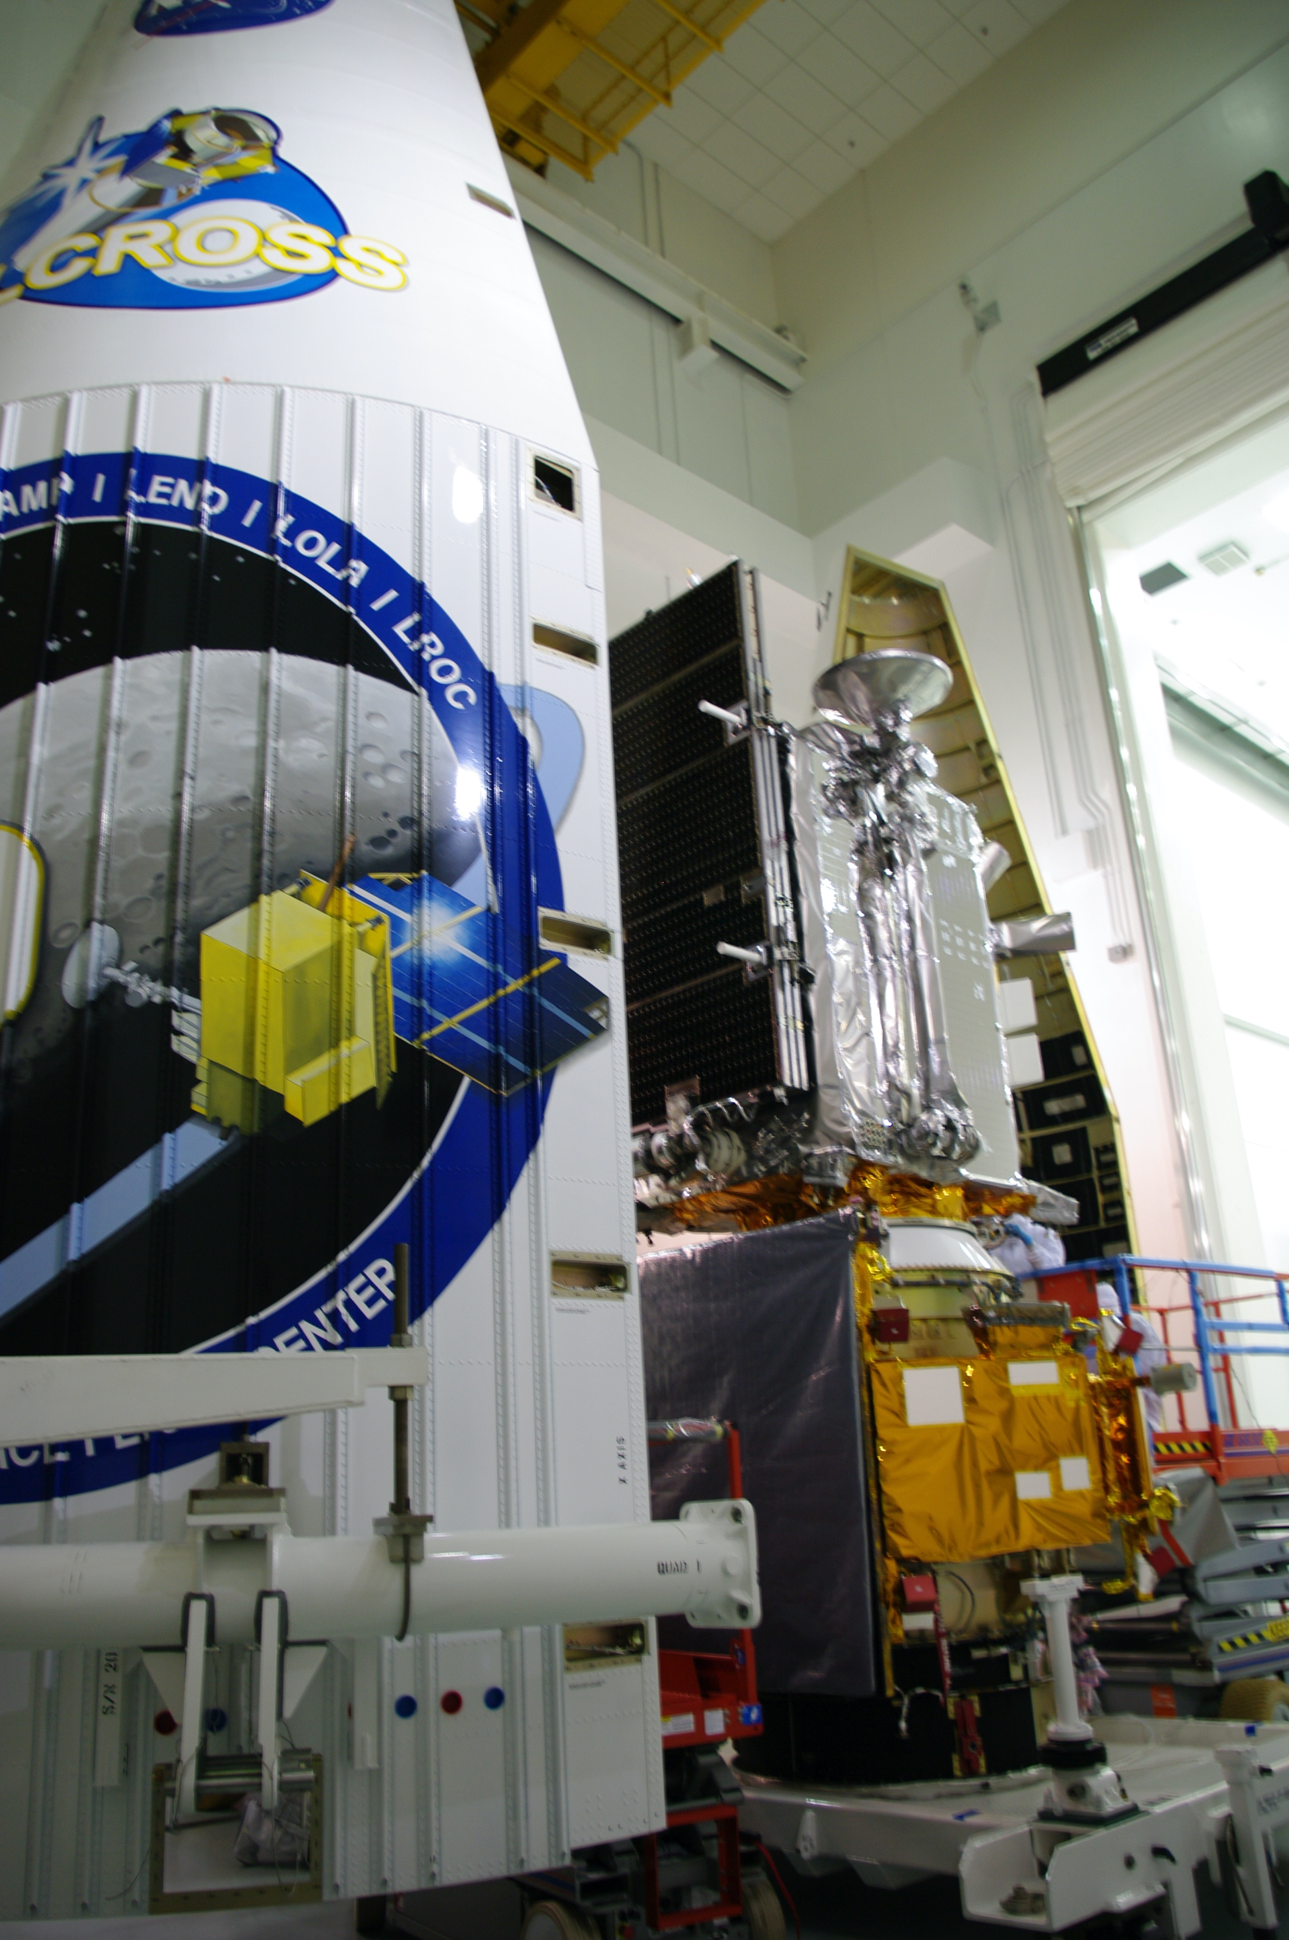
Examples from Lunar Reconnaissance Orbiter (LRO)
Mission Overview
  50 km mean Lunar Polar Orbit
  LRO mission objective is to conduct investigations that will be specifically targeted to prepare for and support future human exploration of the moon
  Locate Potential Resources
  Safe Landing Sites
  Understand the Space Environment
Issues Discovered and Resolution Path
  An undocumented change to a test fixture resulted in a fastener punching through into a lubricated section of a mechanism. Decision was made to replace the mechanism.
  Transponder had a lockup problem in certain addresses. Decision was made to modify the ground system to use other addresses.
  C&DH part was delaying the fabrication of a key board. Integrate a non-flight part to a flight spare board to start Integration and Test earlier.
  CSS was providing a slightly unexpected out of spec current. C&DH hardware reading the CSS had an circuit error that was corrected.
MSE Skills that contributed to Resolution
  Balance Risk amongst the subsystems.
  Pay attention to casual conversations (and foster them).
  Ensure you understand the cause of anomalies however slight as they may be indicating a larger problem.

Slide 7
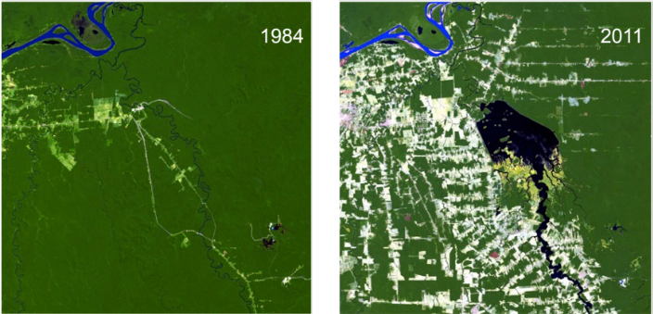
Examples from Landsat 9
Mission Overview
  LEO 705 km, 10:11 am MLT descending node
  Landsat provides multispectral imagery supporting key science and societal benefit areas:
  Mapping Land Use & Change
  Forest Dynamics
  Agriculture & Evapotranspiration
  Ecosystem Science
  Surface Water Quality
  Glacier & Ice Sheet dynamics
  Geology and Natural Resources
  Landsat remains the most widely cited land remote sensing system in the peer-reviewed literature and provided $2.06B of economic benefits to the U.S. in 2017*.
Issues Discovered and Resolution Path
  Heritage Test Environments were too high for the Observatory Radiated Susceptibility Levels.
  Team modeled actual X-band exposure
  Test Limit was lowered
MSE Skills that contributed to Resolution
  This required a good relationship with the seasoned project engineering team and the contractor, both who I had only been working with for a few months.
  Convincing the test engineering team the advantages in not over testing.
Forest Change

Slide 8
How to build Availability and Trust Conclusion (1 of 2)
Building relationships within the team from systems engineering to subsystem leads to partners requires time and care.
The MSE can earn trust by participating in informal reviews, have an open-door policy, request advice and provide direction as appropriate.
  Re-direction is best performed first in person, outside of large forums where re-direction could be seen as lack of confidence.
  We all need to learn, be mentored, and grow in our careers.
  How we manage our own home-to-work-life balance plays into our availability for connection.
At MSE level it is very easy to let process, reporting, endless list of meetings “that you must attend”, and emails that “must have a reply” overwhelm the time that is available to build relationships and casual interactions with partners and subsystem leads.
  Take time for weekly informal get togethers, periodic picnics and parties, daily sharing of hot drinks.
  Personal relationships with partners that are geographically dispersed requires additional techniques such a weekly one on one telecoms, monthly visits, listening carefully to the needs and wants of the partners.
  Be fair with evaluating impacts (cost and schedule) to changes that come from external interfaces to the partners.

Slide 9
How to build Availability and Trust Conclusion (2 of 2)
Being trusted also requires emotional availability for other’s concerns.
  This requires active management in every individual. Emotional availability requires taking time off and doing non-work activities.
  It also means opening up your daily and weekly schedule for impromptu meetings and unexpected discoveries.
  As your availability diminishes, it can then be difficult to determine a clear course of action as the inevitable unexpected surprises occur.
Whenever there was a big decision to make, the MSE, SEs, and or the PI often would take a walk outside to make sure we had looked at all the sides thoroughly enough but using the length of the walk to ensure we made decisions decisively to move the project forward.
  This is objectively achieved by managing your own schedule to prevent back-to-back meetings.
  It also has a subjective portion: don’t forgo relationship building and taking time off to think inside and outside the workplace.

