Slide 1
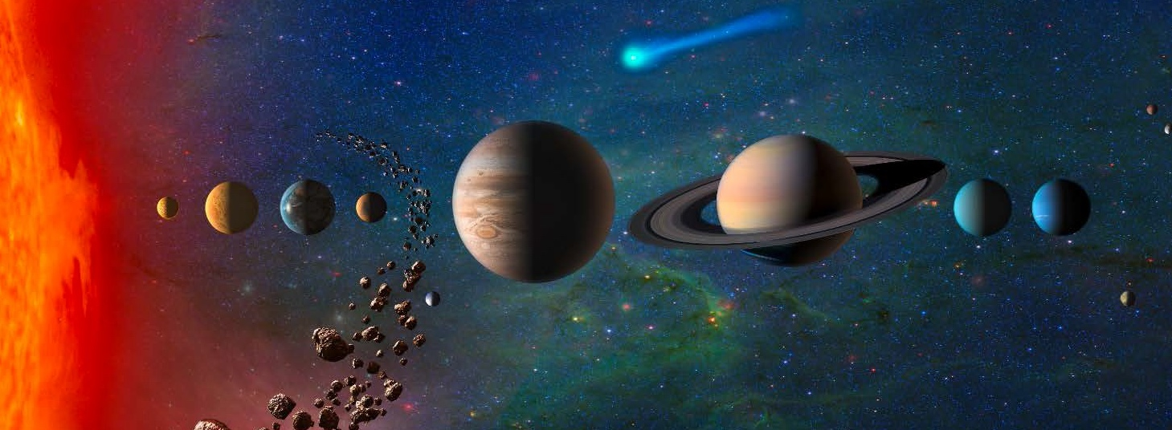
OPAG – Poster Session – Lightning Talk
“ Next Generation Thermal Protection Systems for Outer Planet Missions “
Venkatapathy E., Gasch M., Prabhu D., Allen G., and Hwang H. 9/1/2021

Slide 2
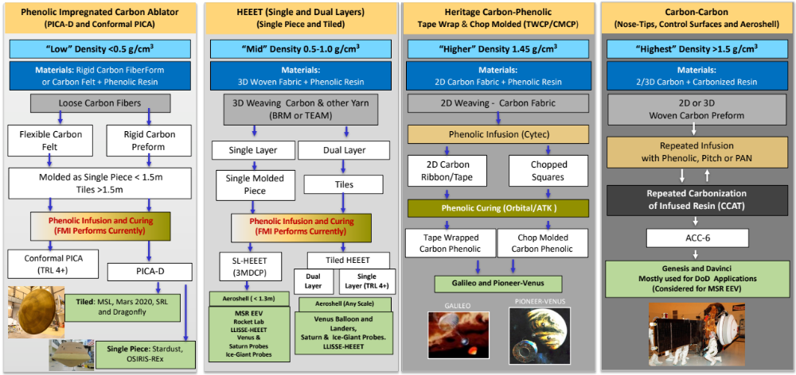
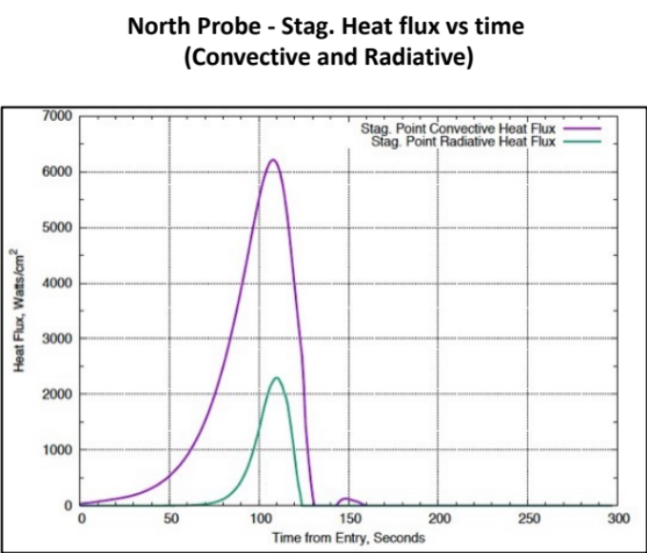
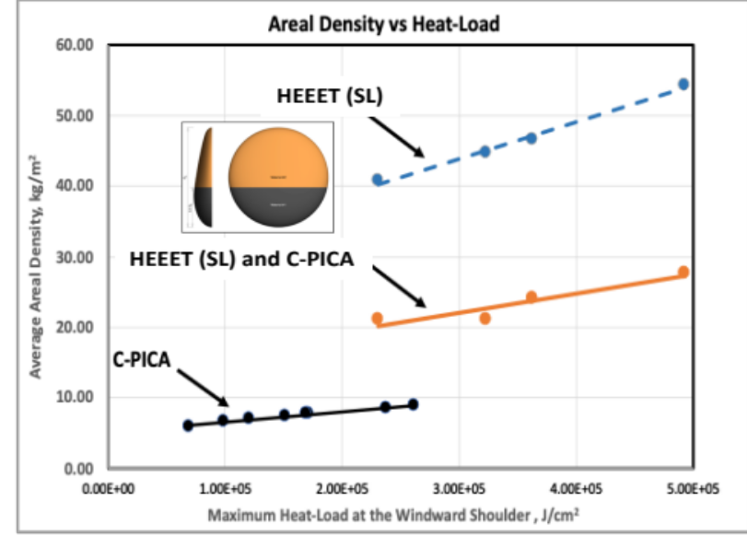
Advocacy Sought from OPAG for the Next Generation of Ablative TPS to Enable Ice-Giant Aerocapture and Enhance Saturn Probe Mission
Aerocapture for Ice-Giant missions – Faster trip Time and substantially bigger payload to enable better science – Coordinated In-situ science along with Orbital investigation – all this enabled by more efficient TPS
Saturn mission – efficient TPS can enable higher latitude missions – multiple probes.
Saturn Probe missions could significantly benefit from the use of single-layer HEEET (SL-HEEET) with a mass savings of 30% - 50% over DL-HEEET.
C-PICA and SL-HEEET can lower the TPS mass fraction by a factor of (3 – 4) compared to DL-HEEET. (5%-20%) TPS mass fraction range makes aerocapture Ice Giant missions very attractive
Use of SL-HEEET (3MDCP) combined with C-PICA can result in significant mass savings and provide additional opportunities for enhanced mission science. We seek OPAG support and advocacy to demonstrate the TPS architectures.
Notes:
Matt: In 2 min here is what I would suggest highlighting:
A more efficient TPS compared to HEEET – Dual Layer – Can enable Ice-Giant Aerocapture mission and Saturn Probe missions, with a much more efficient TPS can consider higher latitude or heading orientation different that pro-grade equatorial for better science.
HEEET single layer as well as Conformal PICA are much more efficient derivatives. So, the completion of their development is much simpler and low cost.
The overall mass fraction benefit makes these developments very attractive and hence we seek OPAG”s support and advocacy

