Slide 1

Analyzing Software Models in Exobiology
Reghan Cornell
National Aeronautics and Space Administration
Matt Knudson, Code TI
Summer 2021
www.nasa.gov

Slide 2
Introduction
Internship Goal
  Analyze multiple software models
  Determine how they may benefit each other
Unfortunately, ran into technical difficulties
  Only able to utilize about half of the summer
However, found a strong model
  So focused on the Atmos/Clima Model

Slide 3
Background of Project / Literature Review
Review
ATMOS/CLIMA Github page
Python About page
Knowledge Base
Background
Most software models in exobiology are independent
Idea was to have a student compile a survey of computational models
Learn about different approaches to the same goal
Determine if overlaps exist and communicate with the scientists

Slide 4
Research Questions
Research currently utilized or late-stage development software models at NASA
Analyze commonalities and uniqueness of the models as they relate to the information that they provide

Slide 5
Methods
Locate and operate models that are used in the detection of possible exobiology
Couple various scripts used in the models
Communicate with the scientific community regarding technology (Code TI) and astrobiology (Code SSX)

Slide 6
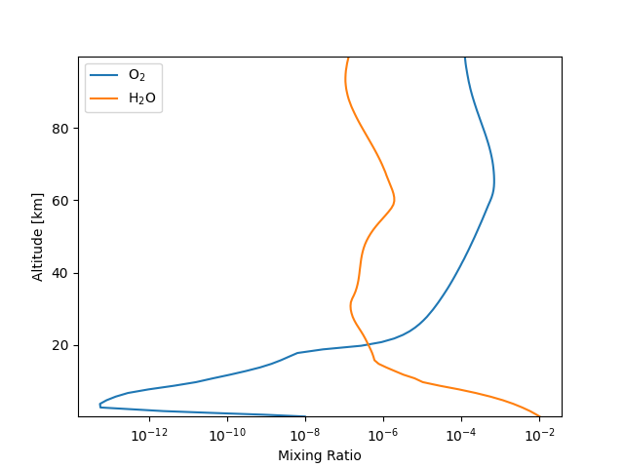
Findings/Data
Atmos/Clima produces many outputs
  I focused on two
One was regarding gases
  Such as oxygen increasing with altitude
The other regarded liquids
  Such as water decreasing with altitude
Predictability was the most interesting
  The model could predict the levels of gases through time

Slide 7
Discussion/Conclusions
The Goldilocks Zone
  Not to hot (close), not too cold (far)
  But it also depends on atmosphere, such as ours
If Atmos/Clima were to be coupled with others
  We could learn more about a planets’ ability to support life
  Other than just the Goldilocks Zone
    Though, that it always a good start
And; it could teach us more about the future of our own planet

Slide 8
Future Research & Implications
The tutorial on reading the outputs of the Atmos/Clima model was interesting
  It caused me to think about the future
  It accurately predicts the past and present for our planet and planets around other stars
Could such modelling techniques be used to predict greenhouse gases into the future?
  And with that, could they be used to help us analyze and maybe prevent future climate change impacts?

Slide 9
Lessons Learned
The biggest lesson I learned is that the only person who will hold me back is myself. I was accepted and encouraged by everyone I spoke to, from fellow interns to people who work within Code TI and SSX that my mentor connected me to. NASA is full of diversity and people who are bursting at the seams to share what they know and what they think will help. It is so much more than rockets. I truly believe NASA is one of the most welcoming organizations I’ll ever work in.

Slide 10
Acknowledgments
I owe everything within this presentation to my mentor, Dr. Matt Knudson, and to Owen Lehmer. They have been there every step of the way, regardless of technical difficulties. I also owe a huge thank you to Brian Gilder at ARFC for encouraging me and keeping me motivated through a unique year.

Slide 11
References
ATMOS/CLIMA Github page
Python About page
Knowledge Base

Slide 12
Questions

Slide 13
SignOffPage
Notes:
NASA Presentation Sign-Off Page

