Slide 1
DSNE and the lunar plasma environment
Wesley A. Chambers, PhD
Natural Environments Branch
NASA Marshall Space Flight Center
14 September 2021

Slide 2
SLS-SPEC-159 DSNE
The Cross-Program Design Specification for Natural Environments defines the natural environment for crewed, deep-space NASA programs
Latest revision (currently Rev H) available through the NASA Technical Reports Server (NTRS)
  https://ntrs.nasa.gov/citations/20205007447
  When searching, latest revision is not always the first result
  Best to filter by Report Number using “SLS-SPEC-159”

Slide 3
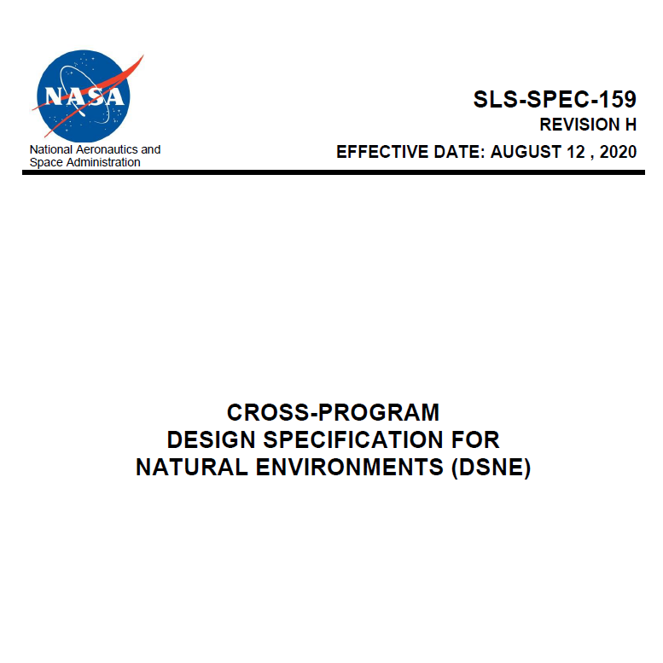
SLS-SPEC-159 DSNE
Relevant sections for the plasma environment
  3.3.3 Plasma Charging (p. 179)
    In-space phase
  3.4.3 Lunar Surface Plasma Environment (p. 255)

Slide 4
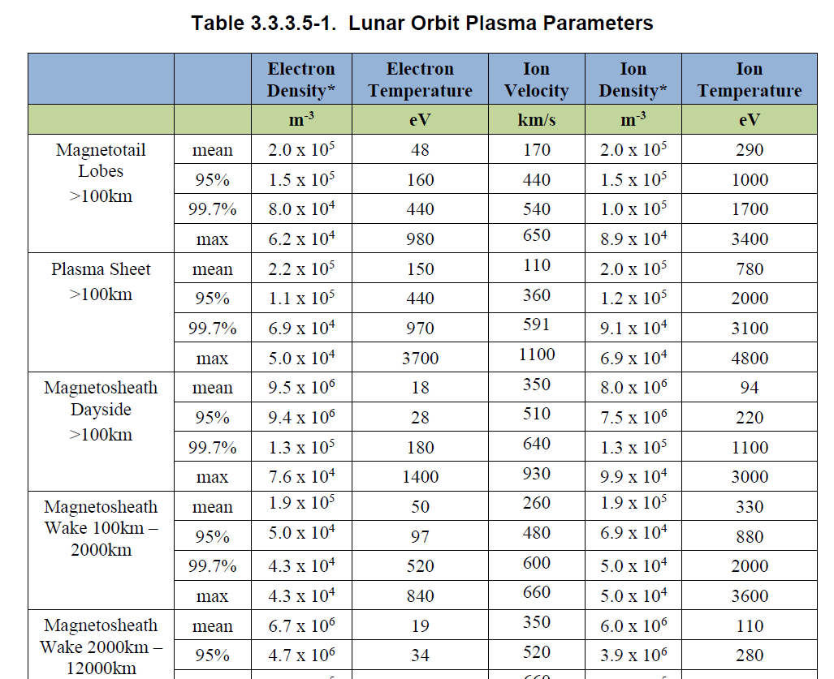
SLS-SPEC-159 DSNE
3.3.3 Plasma Charging (p. 179)
  Lunar on-orbit environment collected by THEMIS-ARTEMIS mission from 2012 to 2018
  Relevant parameters formatted for input into spacecraft charging models

Slide 5
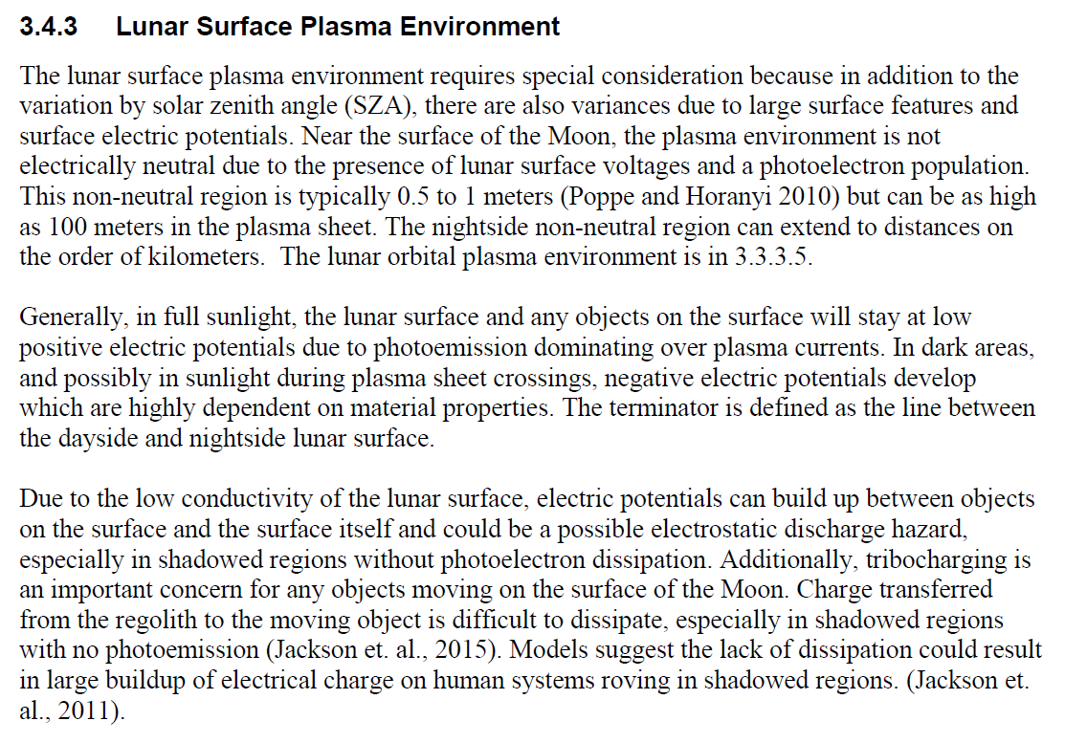
SLS-SPEC-159 DSNE
3.4.3 Lunar Surface Plasma Environment (p. 255)
  Derived from in-space environments using research models
  No known engineering tools to reliably predict spacecraft charging using environment as input

Slide 6
Why do we care about the plasma environment?
Charge collection
  Voltage difference resulting from plasma charge collection may cause electrostatic discharge, impacting avionics/equipment
  Conversely, the plasma environment may dissipate charge generated by movement on the lunar surface (triboelectric charging)
UV lamp for charge control
Solar wind
electrons and ions
Electrons
Rhodes et al 2020

Slide 7
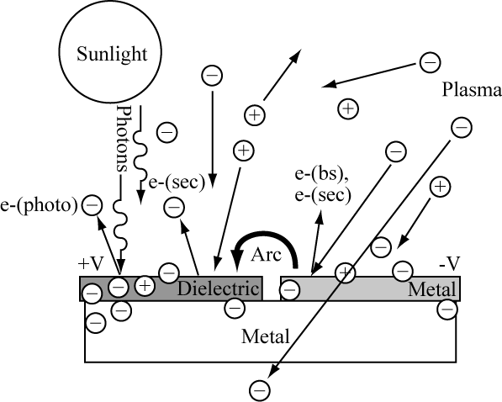

Why do we care about the plasma environment?
Charging governed by current balance
$$I_{E}\left(V\right)−\left[I_{I}\left(V\right)+I_{PH}\left(V\right)+I_{Secondary}\left(V\right)\right]=I_{T}$$
$V=$ spacecraft surface potential relative to plasma
$I_{E}=$ incident electron current
$I_{I}=$ incident ion current
$I_{PH}=$ photoelectric current
$I_{Secondary}=$ electron currents from secondaries, other sources
$I_{T}=$ total current to spacecraft
Figure from NASA-HDBK-4002

Slide 8
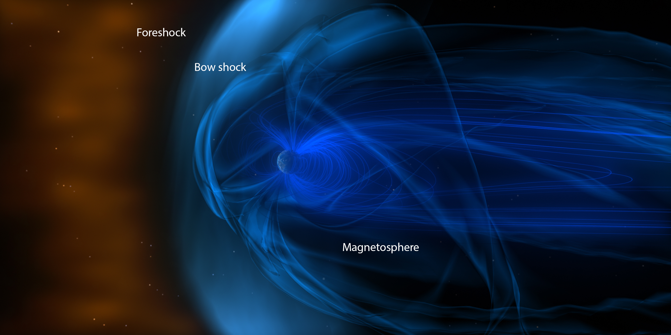
Earth’s magnetosphere
NASA/GSFC
Notes:
https://ccmc.gsfc.nasa.gov/educational/MagnetosphereWebPage.php

Slide 9
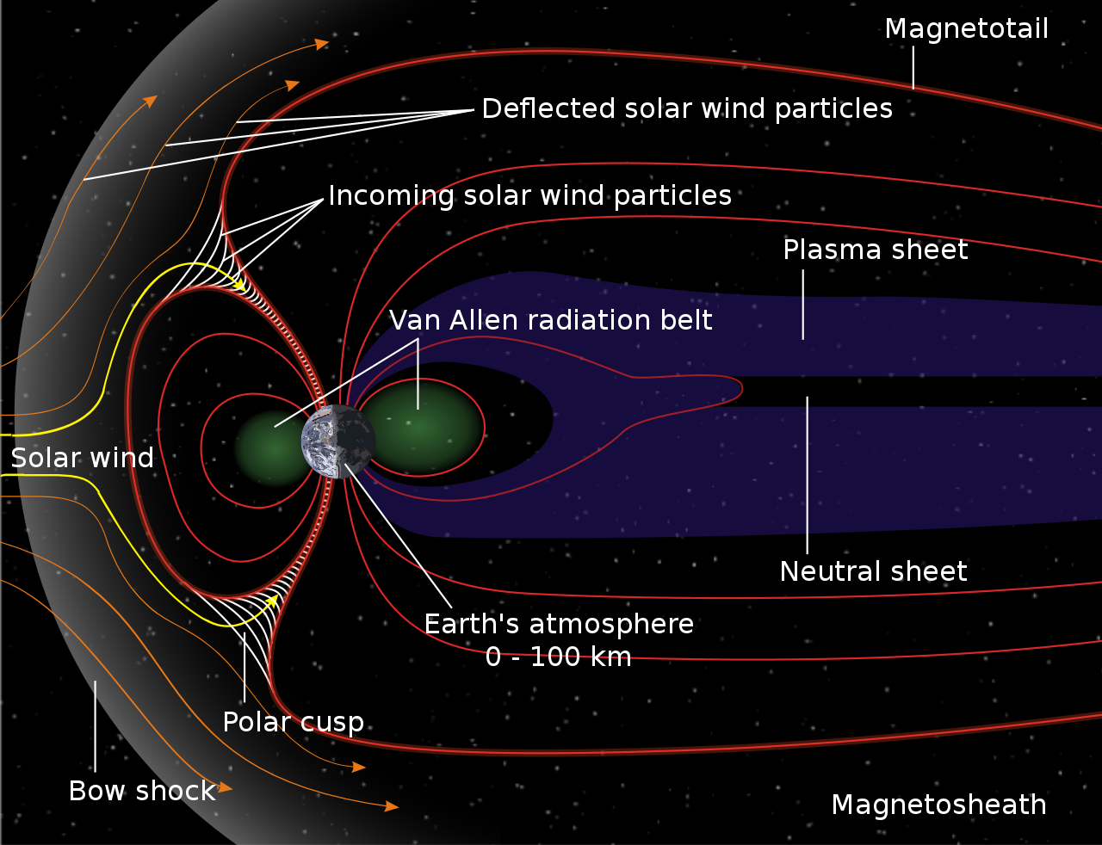
Earth’s magnetosphere
Notes:
https://ccmc.gsfc.nasa.gov/educational/MagnetosphereWebPage.php

Slide 10
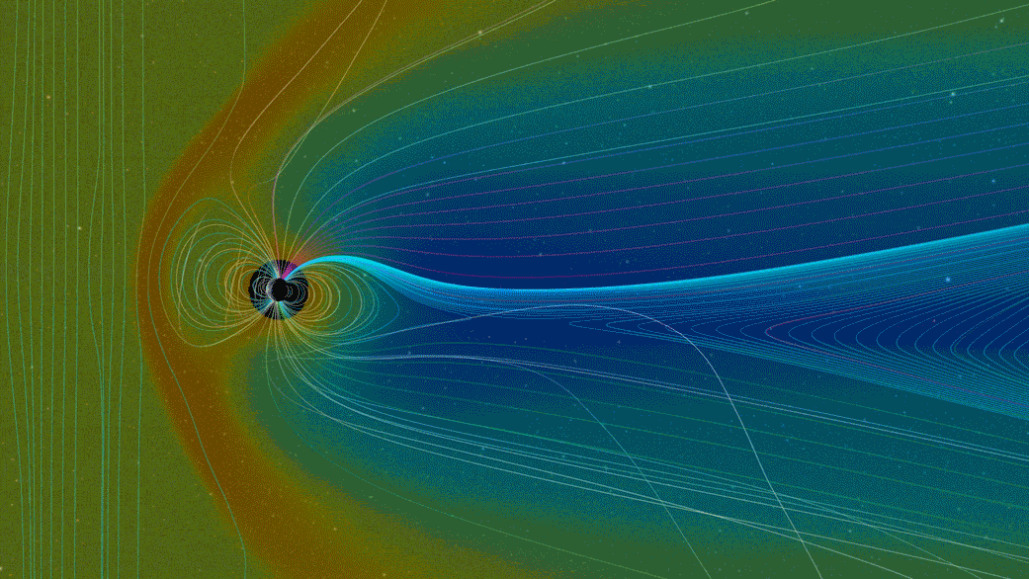
Earth’s magnetosphere
Notes:
https://ccmc.gsfc.nasa.gov/educational/MagnetosphereWebPage.php

Slide 11
Earth’s magnetosphere
ARTEMIS data taken during one Earth orbit
  Light grey region = magnetosheath
  Dark grey region = magnetotail
  No shading = solar wind
Electron temperature increases in magnetosheath
Electron density decreases
THEMIS-ARTEMIS data/Willis et al.

Slide 12
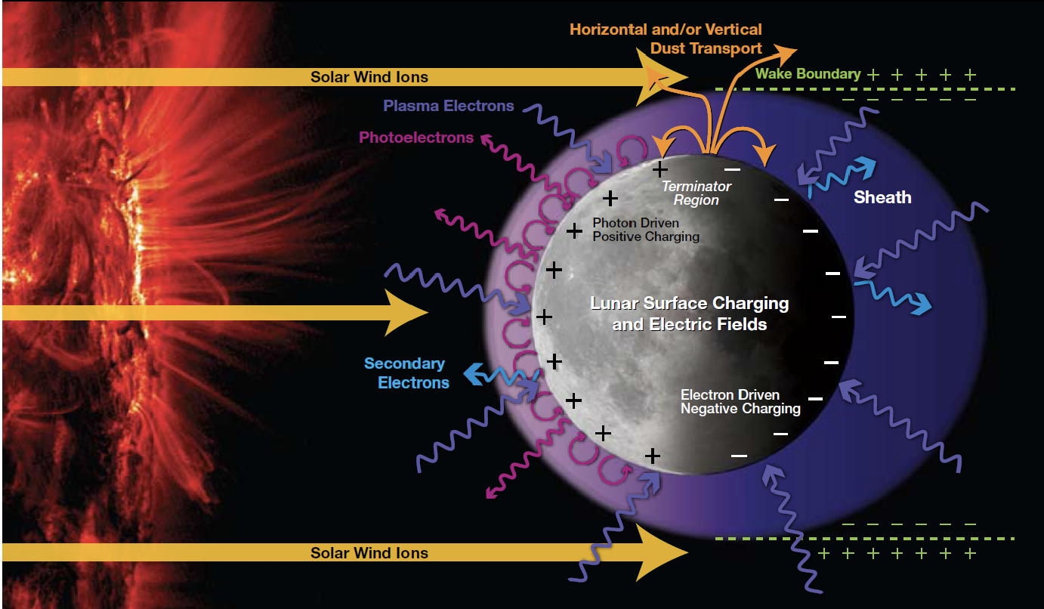
Lunar plasma environment
Notes:
https://science.nasa.gov/files/science-pink/s3fs-public/atoms/files/Final_508Compliant_MoonRpt.pdf

Slide 13
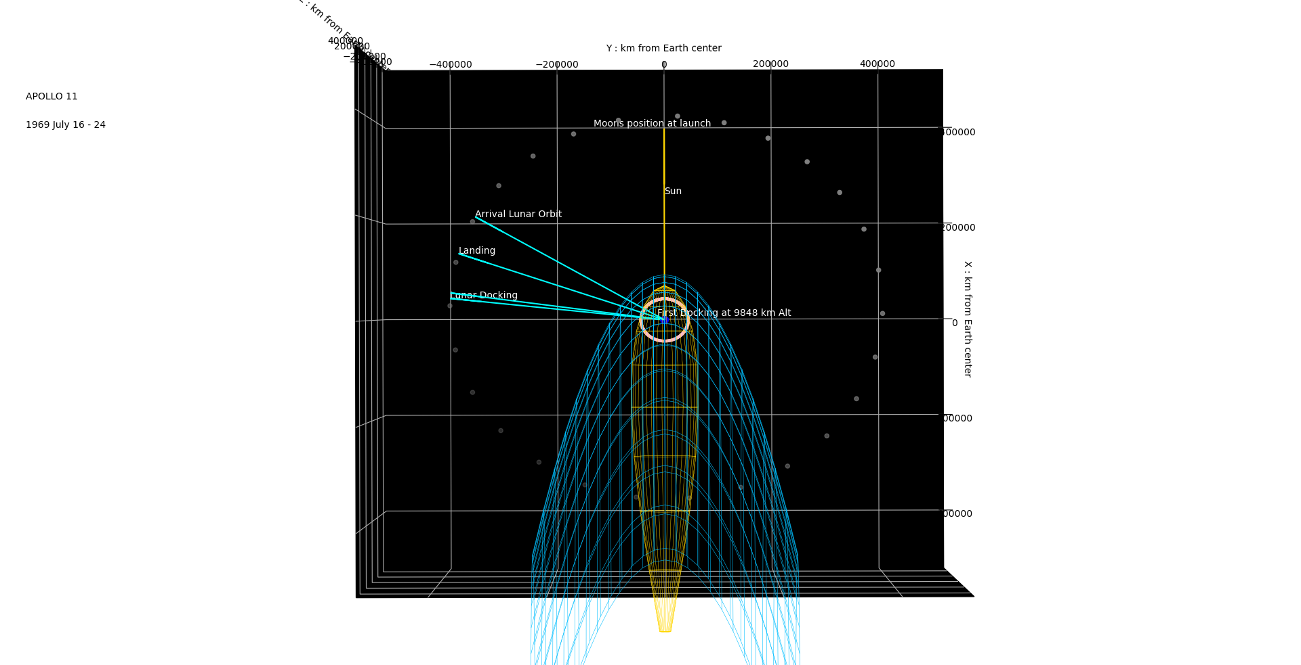
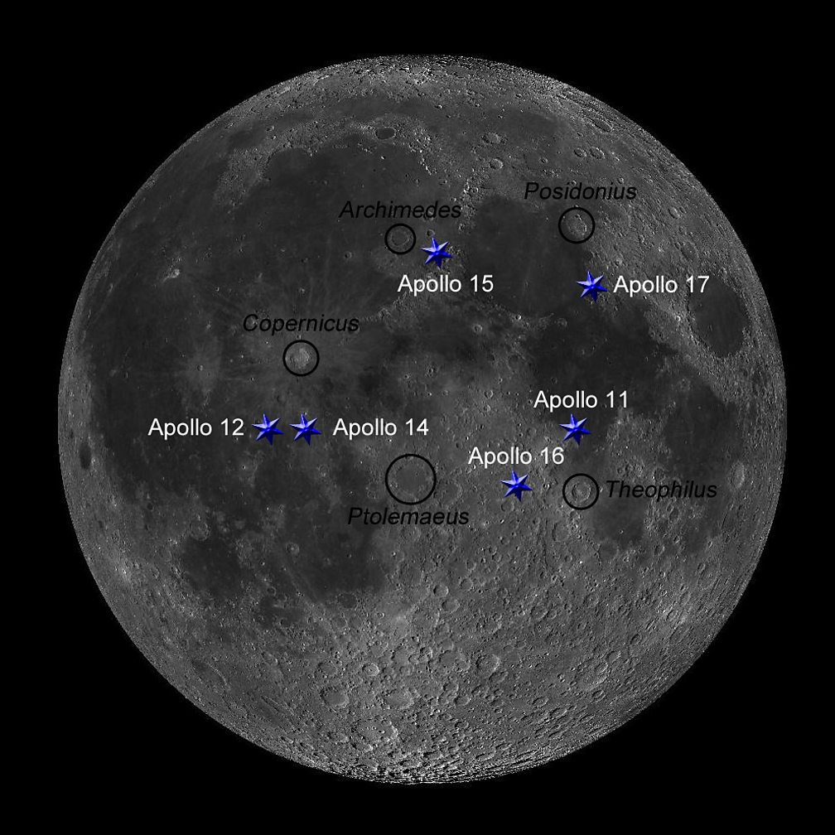
APOLLO 11
1969 JULY 16 – 24
Regions and locations are approximate
Magnetopause is dynamic and changes
NASA/MSFC/Aurelio Paez

Slide 14
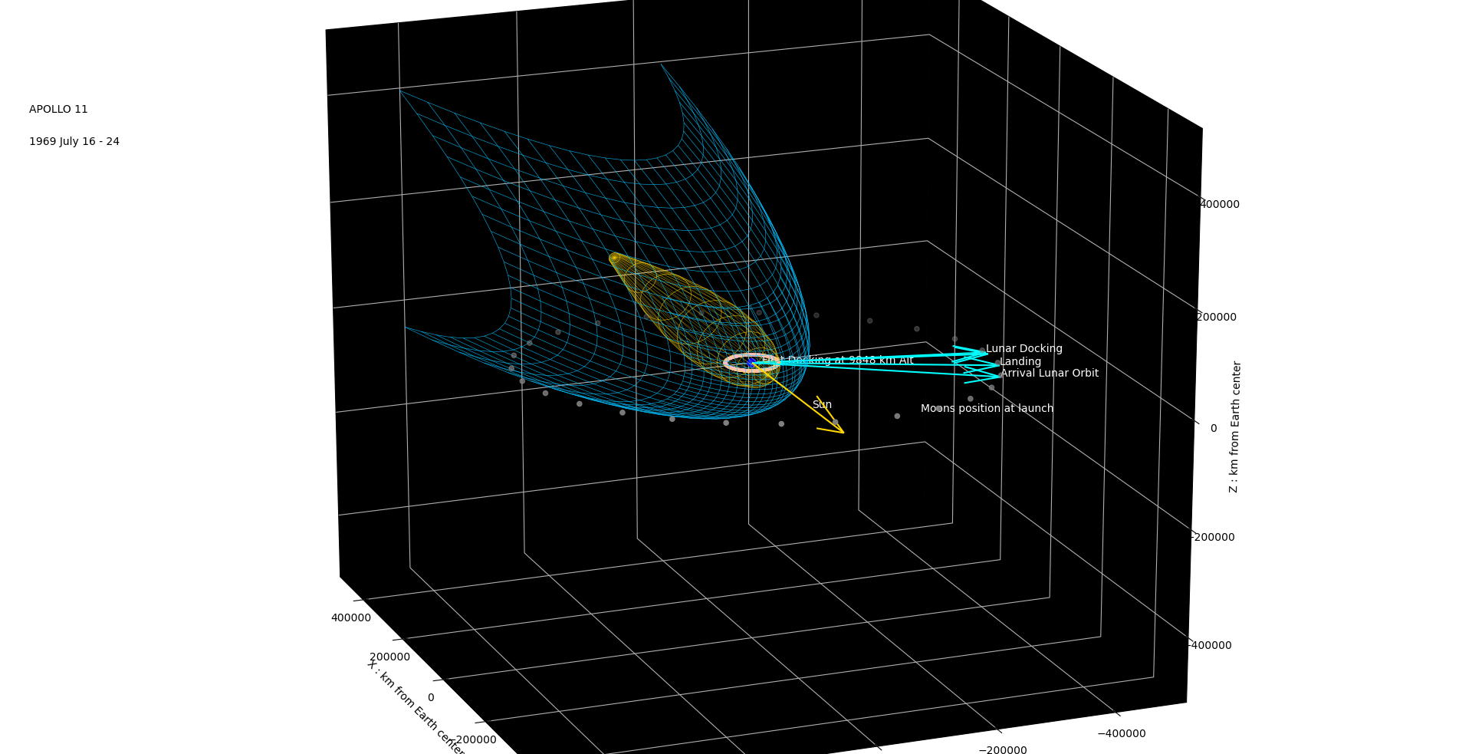
APOLLO 11
1969 JULY 16 – 24
Regions and locations are approximate
Magnetopause is dynamic and changes
NASA/MSFC/Aurelio Paez

Slide 15
Lunar plasma environment
ARTEMIS data taken during one Lunar orbit
  No shading = solar wind
  Grey region = solar wind obstructed by Moon
Electron temperature increases, electron density decreases in lunar wake
THEMIS-ARTEMIS data/Willis et al.

Slide 16
Lunar surface plasma environment
Near-surface plasma environment
  Dayside non-neutral region typically .5 to 1 meters above surface (Poppe and Horanyi 2010)
    Can be up to 100 meters in plasma sheet
  Nightside non-neutral region on order of kilometers
Surface potentials
  Sunlit regions: low positive potentials
  Dark regions: negative potentials dependent on material properties
    Electrostatic buildup without photoelectron dissipation

Slide 17
Lunar surface plasma environment
Environment at lunar poles/terminator more complex
  Low solar zenith angle
  Wake effects behind large surface features
    Reduced plasma density; increased temperature
Farrell et al. 2010

Slide 18
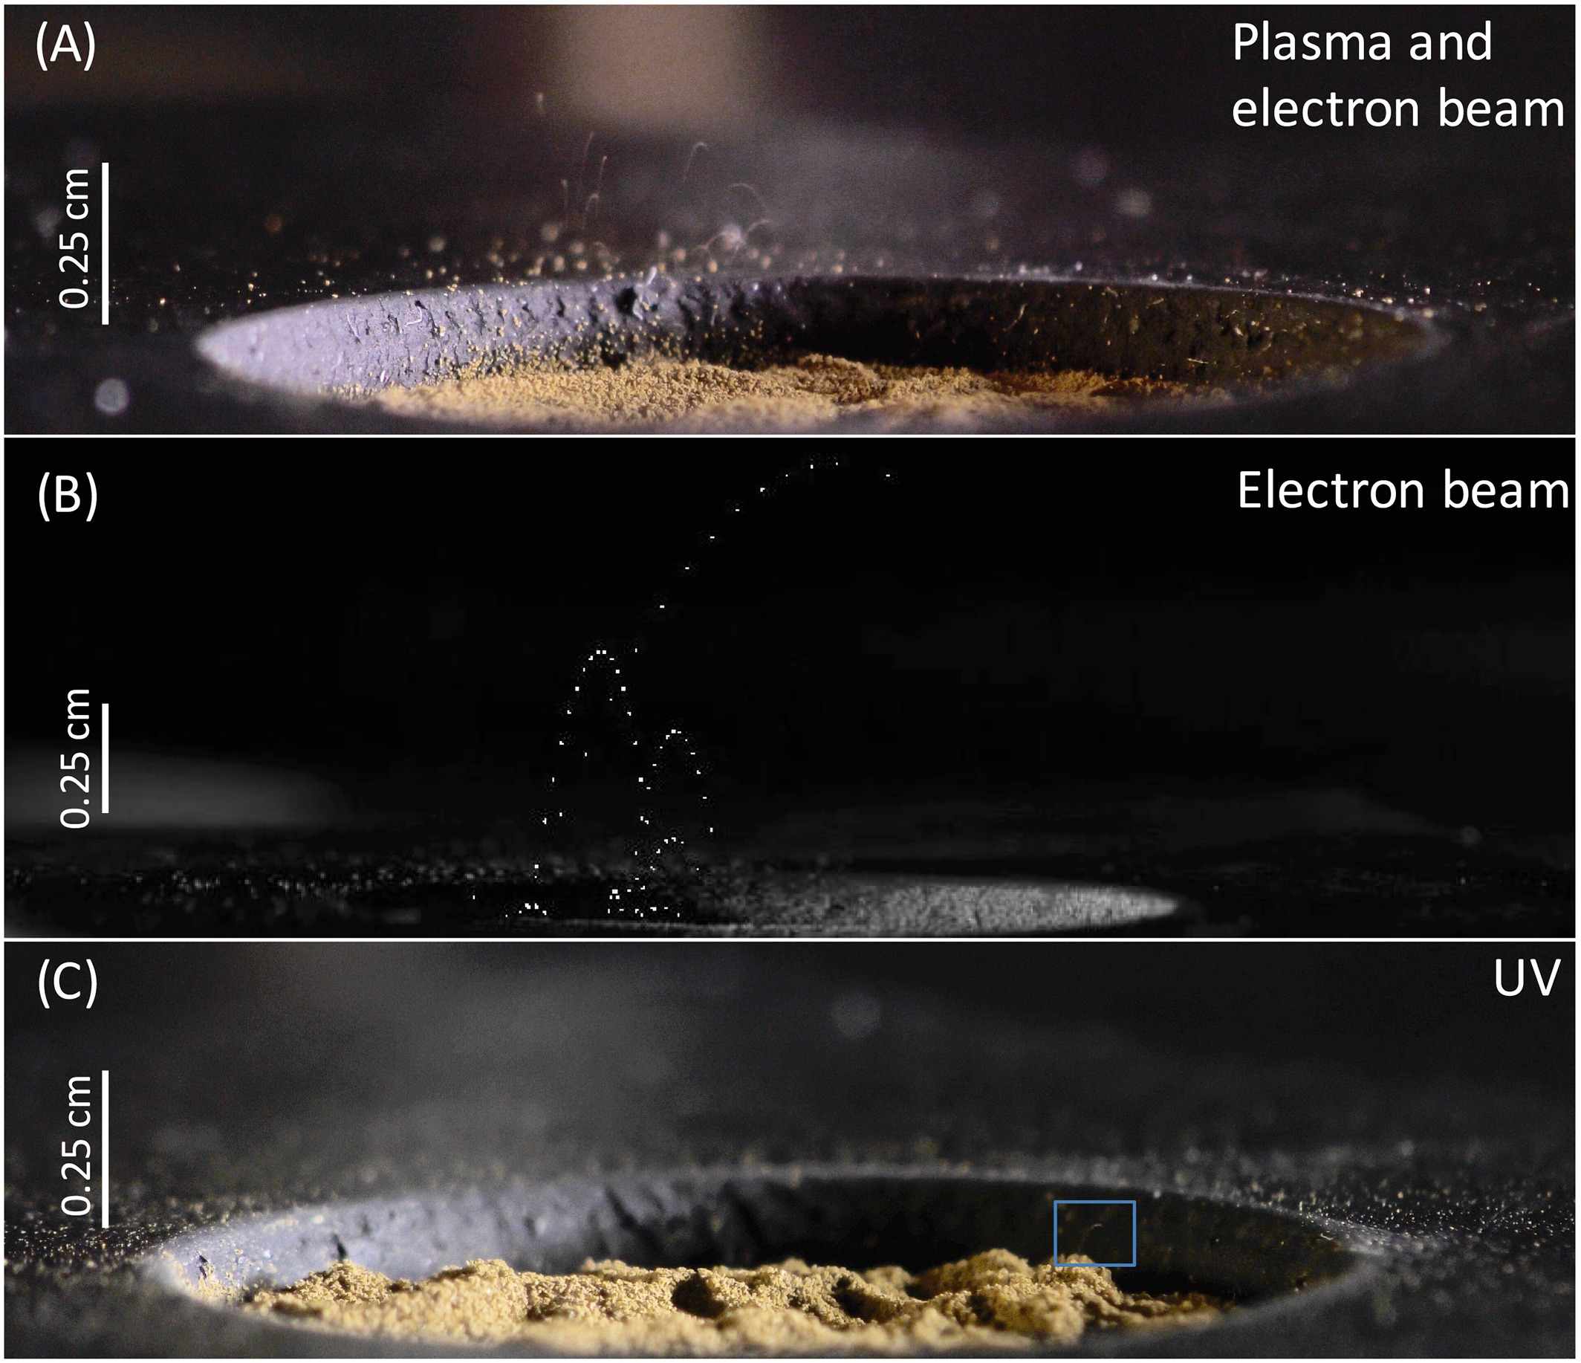
Lunar surface plasma and dust transport
Plasma charging is thought to contribute to dust transport on the surface
Experimental results estimate charged particles could loft to ~10 cm above surface (Wang et al. 2016)
Area of ongoing research
Wang et al. 2010

Slide 19
Uncertainty and limitations
Engineering limitations
  No known engineering tools exist that can take surface plasma environments as input and reliably predict spacecraft charging
Environment uncertainties and knowledge gaps
  Plasma populations and spatiotemporal variation at the lunar surface
  Plasma interactions with the surface and surface features
  Plasma conditions on the night side
  Charging during solar energetic particle events
  Dust behavior and interactions with the plasma environment

