Slide 1
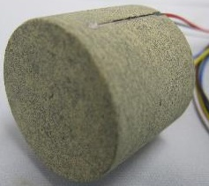
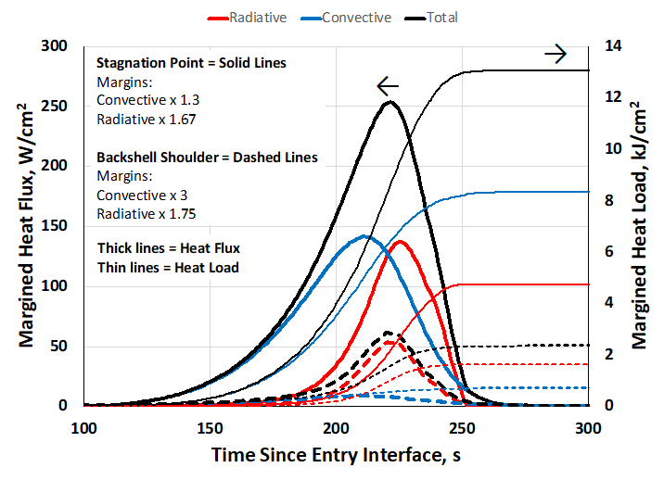
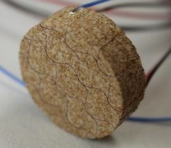
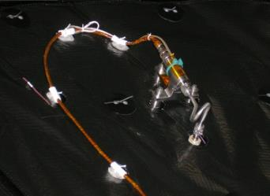
Dragonfly Entry Aerosciences Measurements (DrEAM)
Project Overview
DrEAM is the aeroshell instrumentation suite for the Dragonfly mission which fulfills the Engineering Science Instrumentation (ESI) requirement for New Frontiers 4. DrEAM will make aeroscience measurements at multiple locations on the heatshield and backshell of the Dragonfly entry vehicle during entry and descent into Titan, including temperature, pressure, and heat flux.
Technical Approach
The instrumentation suite includes embedded thermocouple plugs in the Thermal Protection System (TPS), hypersonic-range pressure transducers, and combined sensors that incorporate pressure, temperature, and heat flux instrumentation.
Results/Summary
DrEAM received its Authority to Proceed in March 2021. The DrEAM team has been drafting requirements (Level 1 – 4) in anticipation of the upcoming System Requirements Review in October. The team has also been assessing thermal environments during interplanetary cruise through entry and descent.
a
b
b
c
a
a. Preliminary aerothermal environments for Dragonfly
Thermocouple plugs for b. heatshield and c. backshell (from MEDLI2)
d. Hypersonic pressure transducer for the heatshield (from MEDLI)
d

Slide 2
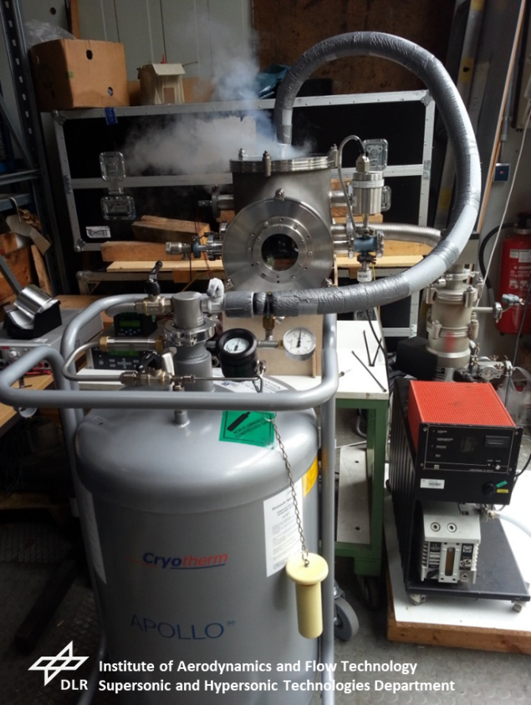
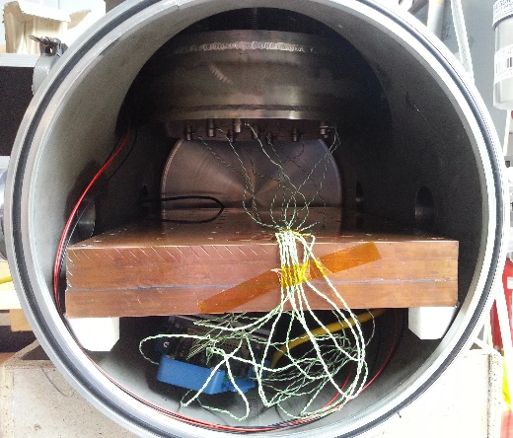
Contributing Partners
The Science Mission Directorate (Planetary Science Division) funds the DrEAM project. The German Space Agency (DLR) provides the combined sensors on the backshell and the Data Acquisition System for the entire sensor suite.
The Johns Hopkins Applied Physics Laboratory (APL) is leading the Dragonfly mission, and Lockheed Martin Space (LMS) is performing the integration of DrEAM into the aeroshell.
h
g
g. Thermal vacuum chamber at DLR Cologne for cold soak testing of sensors shown in (e)
h. Test article mounting surface inside vacuum chamber shown in (g)
e
f
From ESA Schiaparelli mission:
e. Combined sensor from DLR that measures total heat flux, pressure, and radiative heat flux
f. Data acquisition system electronics box from DLR

