Slide 1
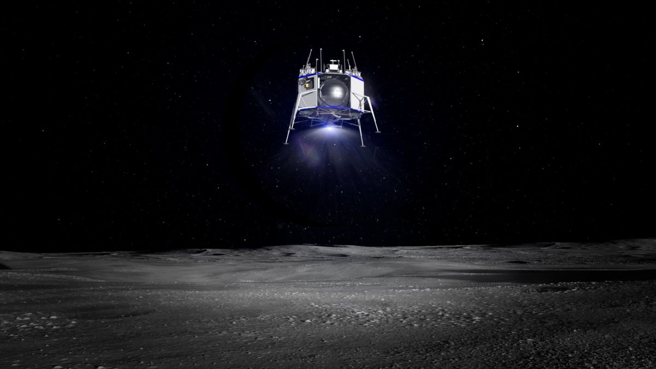


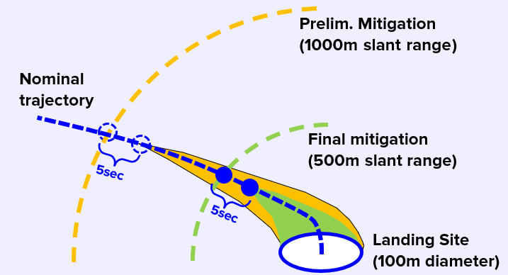
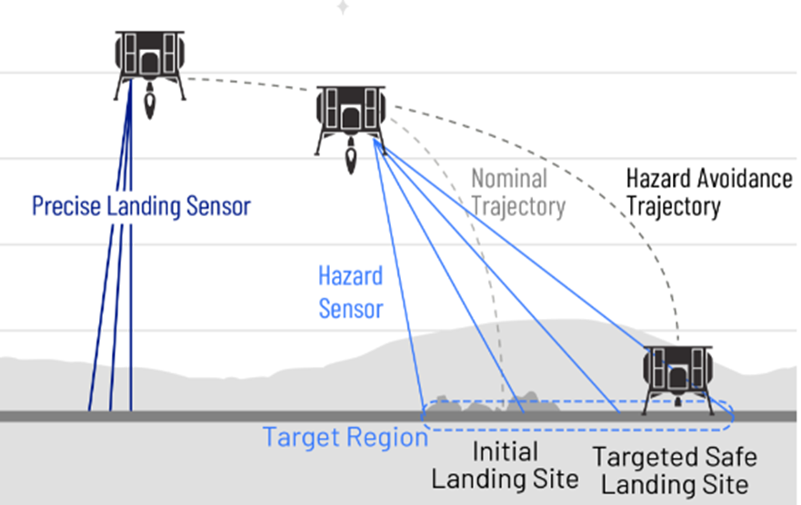
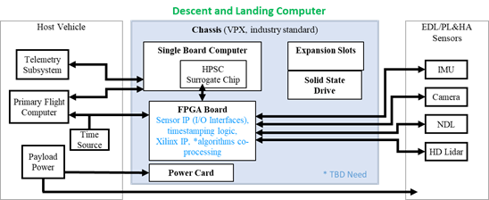
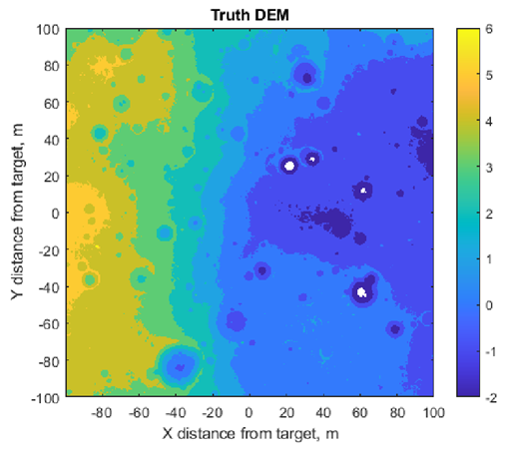
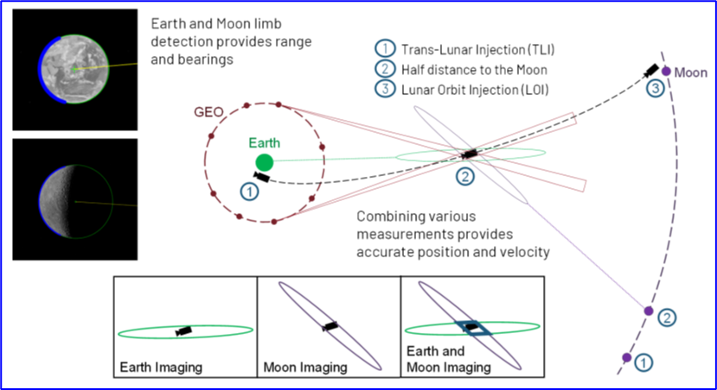
Precision Lunar Landing System ACO (L2S ACO)
Project Overview
Blue Origin is partnering with NASA to evaluate and mature a navigation and
guidance system for lunar missions to enable safe and precise landing.
Technical Approach
Leverage NASA investments in sensors, avionics, algorithms, simulation tools
along with flight test data to develop and test integrated navigation and guidance system technology for the Moon.
Results/Summary
System Studies: Performed integrated safe landing and cis-lunar optical trade studies
Guidance: Simulated flight under NASA’s DQG algorithm and results are currently approaching real-time performance
Compute: HWIL testing & performance metrics for TRN & DQG were obtained. Results driving performance improvements.
Hazard Detection: Created a hazard detection algorithm and baselined safe site selection capability
Optical Navigation: Created the Blue Origin in-house optical navigation algorithm capability for autonomous cis-lunar navigation
Systems Requirements Trade Studies
Advanced Real-Time Guidance
High Performance Computing
Hazard Detection
Optical Navigation
Notes:
Presenter: Stefan Bieniawski / Blue Origin (SBieniawski@blueorigin.com)
Moderators: Danielle Kalitan / Blue Origin (DKalitan@blueorigin.com), Gregg Barton / NASA (gregory.barton@nasa.gov)

Slide 2
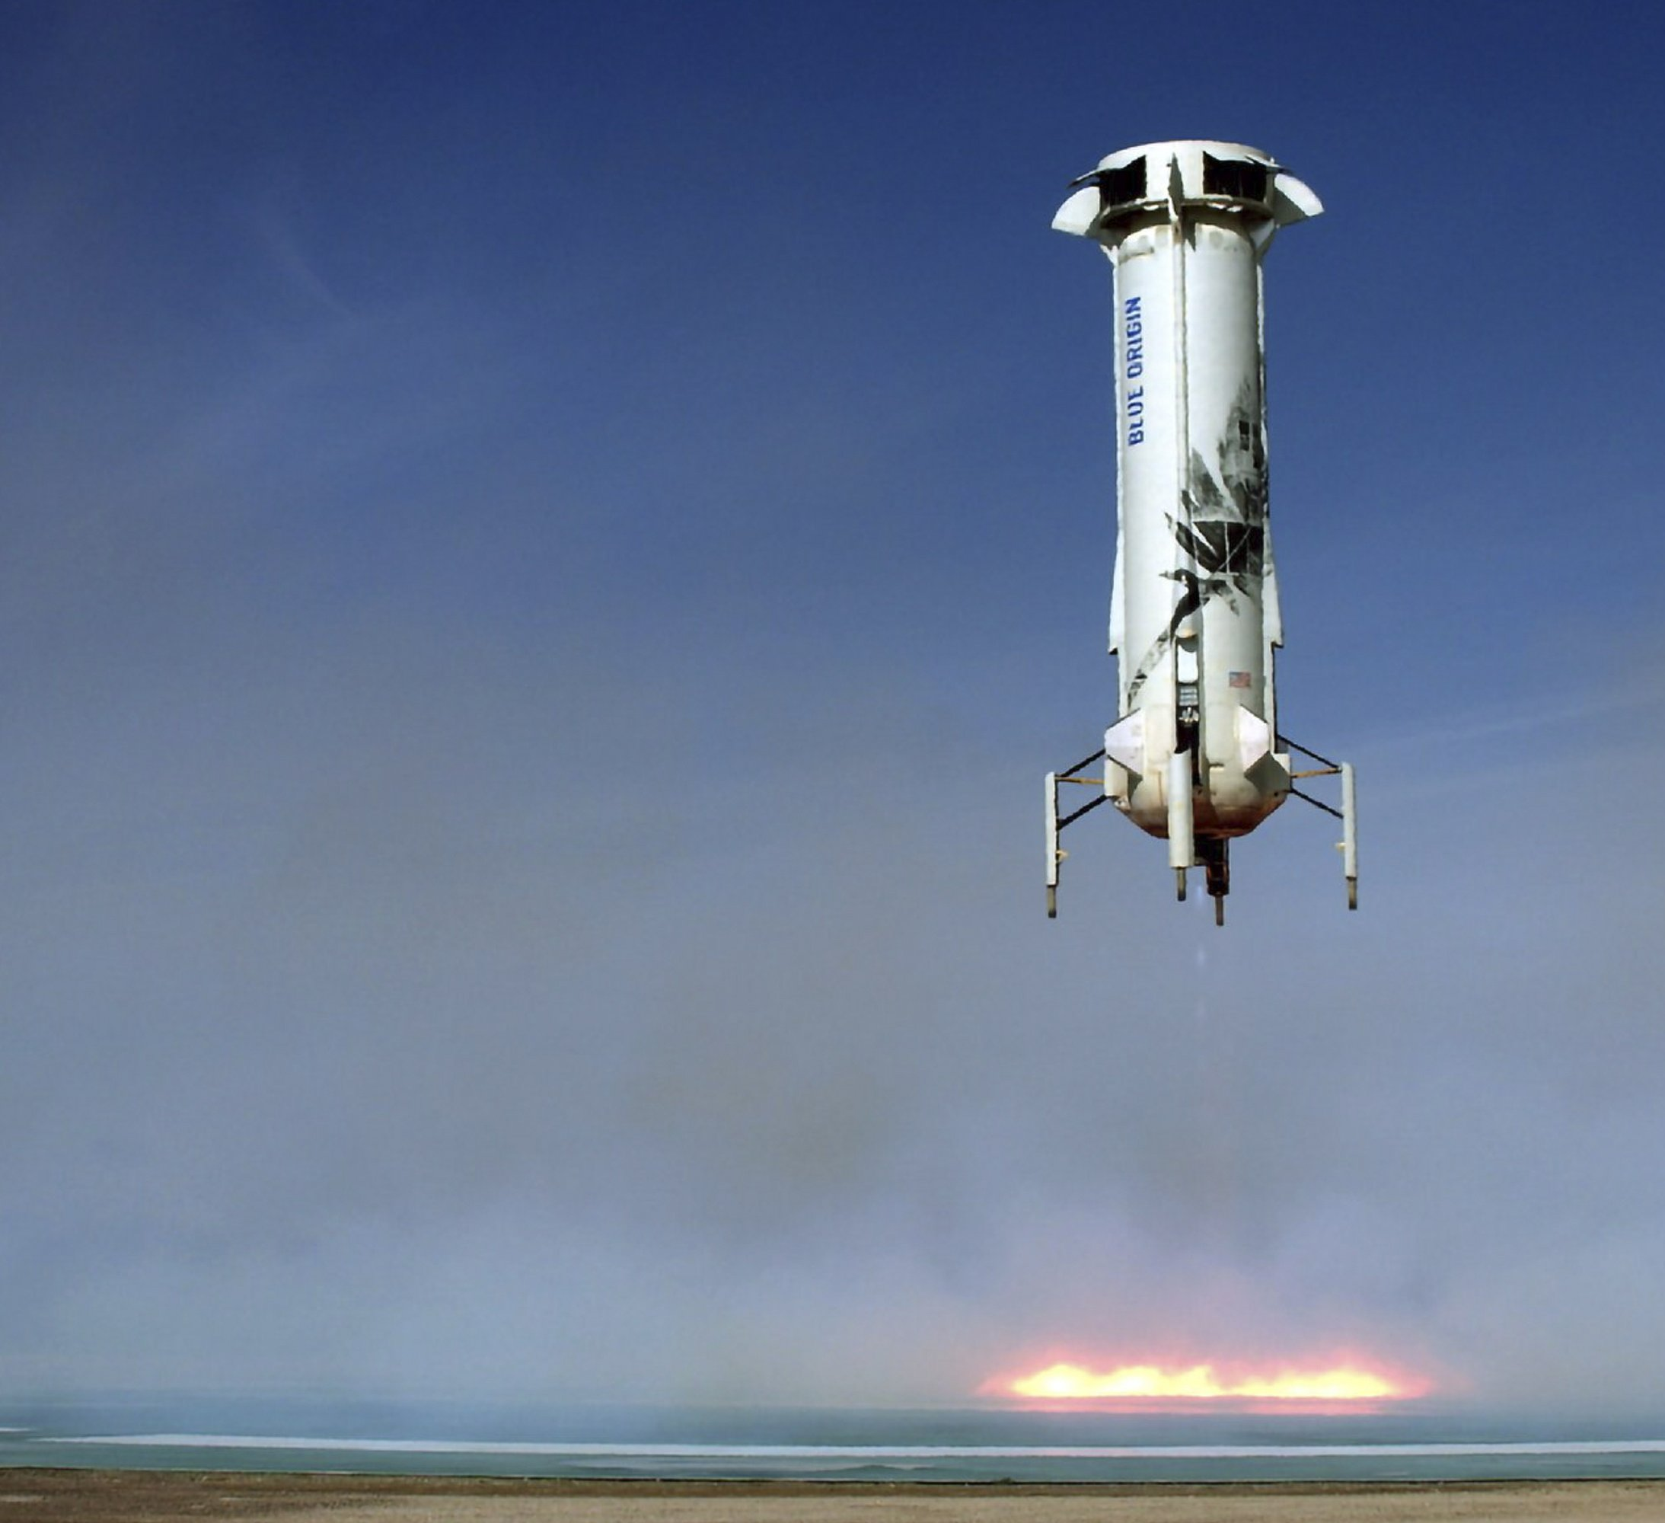
Contributing Partners
NASA JSC, NASA GSFC, University of Washington, Draper Laboratory, NASA Langley Research Center, Utah State University
Infusion and Transition Plan
We plan to transition selected technologies into Blue Origin’s Blue Moon cargo lander service to safely land and precisely deploy payloads to a wide range of landing sites. We are also evaluating the use of advanced guidance technology to support our launch service offerings for our New Shepard sub-orbital vehicle.
Notes:
Presenter: Stefan Bieniawski / Blue Origin (SBieniawski@blueorigin.com)
Moderators: Danielle Kalitan / Blue Origin (DKalitan@blueorigin.com), Gregg Barton / NASA (gregory.barton@nasa.gov)

