Slide 1
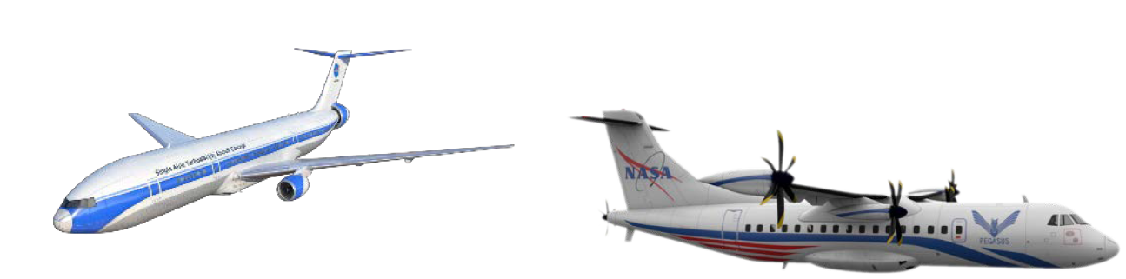
Model Predictive Control Study for an Electrified Turbofan Engine
2021 AISES National Conference
Brittany Nez, University of Colorado Boulder
Joseph Connolly, NASA Glenn Research Center
September 24, 2021
Notes:
Good morning everyone! My name is Brittany Nez and I am an aerospace engineering student at the University of Colorado Boulder. This spring I have been working with Dr. Joseph Connolly on a Model Predictive Control Approach for an electrified turbofan engine.

Slide 2
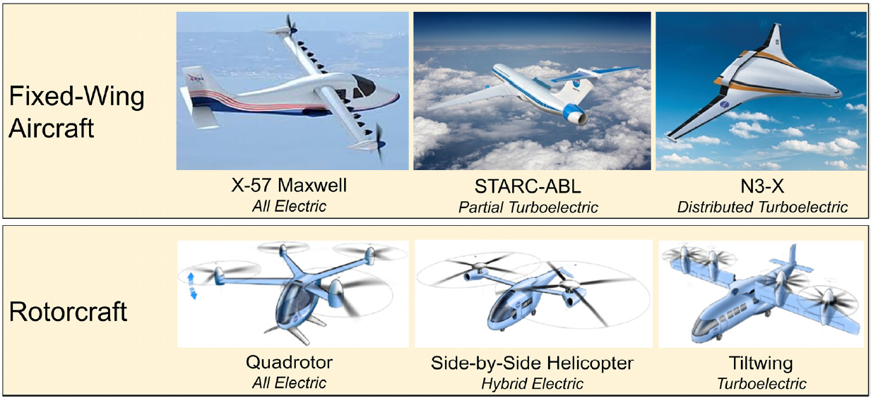
Overview
Introduction
AGTF30 Turbomachinery Model
Controls Study Overview
Baseline Control Study
MPC Sensitivity Study
Summary and Future Work
NASA electrified aircraft concept vehicles¹
Notes:
For this presentation, we will focus on the turboelectric machinery of aircraft similar to the four aircraft that are shown in the red box to the right. We will quickly review some of the fundamental concepts for this project such as the Turbomachinery we are working with, an overview of our controls study and we’ll run through each section of the study. We will then finish off with the summary and future work for this project.

Slide 3
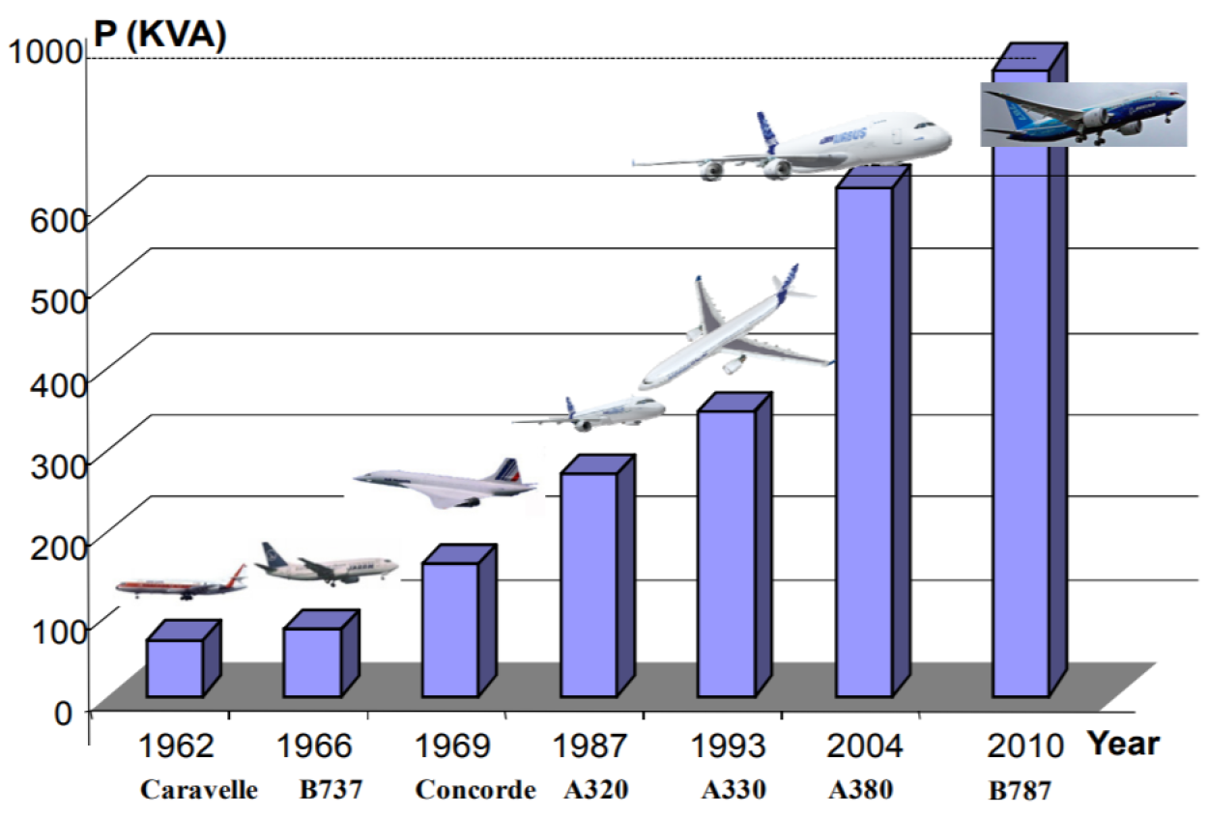
Introduction
Since the 1960’s, the amount of electric power being applied to aircraft has increased by 10x
Electrified Aircraft Propulsion (EAP) utilizes power augmentation to reduce fuel emission, noise, and cost¹
  Near term applications may increase electrification and augment transient operation
Advanced Geared Turbofan 30,000 (AGTF30): open-source simulation that is used to develop control algorithms³
  Modified to include electric machines
Aircraft rising power loads with respect to time²
Notes:
The amount of electric power utilized in aircrafts has grown approximately ten times since the 1960s. NASA GRC has focused on applying electric power to the engines of aircraft to reduce fuel emission, noise and cost. This is known as Electrified Aircraft Propulsion or EAP. For this internship I focused on utilizing EAP technology on an engine concept known as the Advanced Geared Turbofan 30,000. This is an open-source simulation that was created in the MATLAB and Simulink environment for control algorithm development and has been modified to include the electric power components.

Slide 4
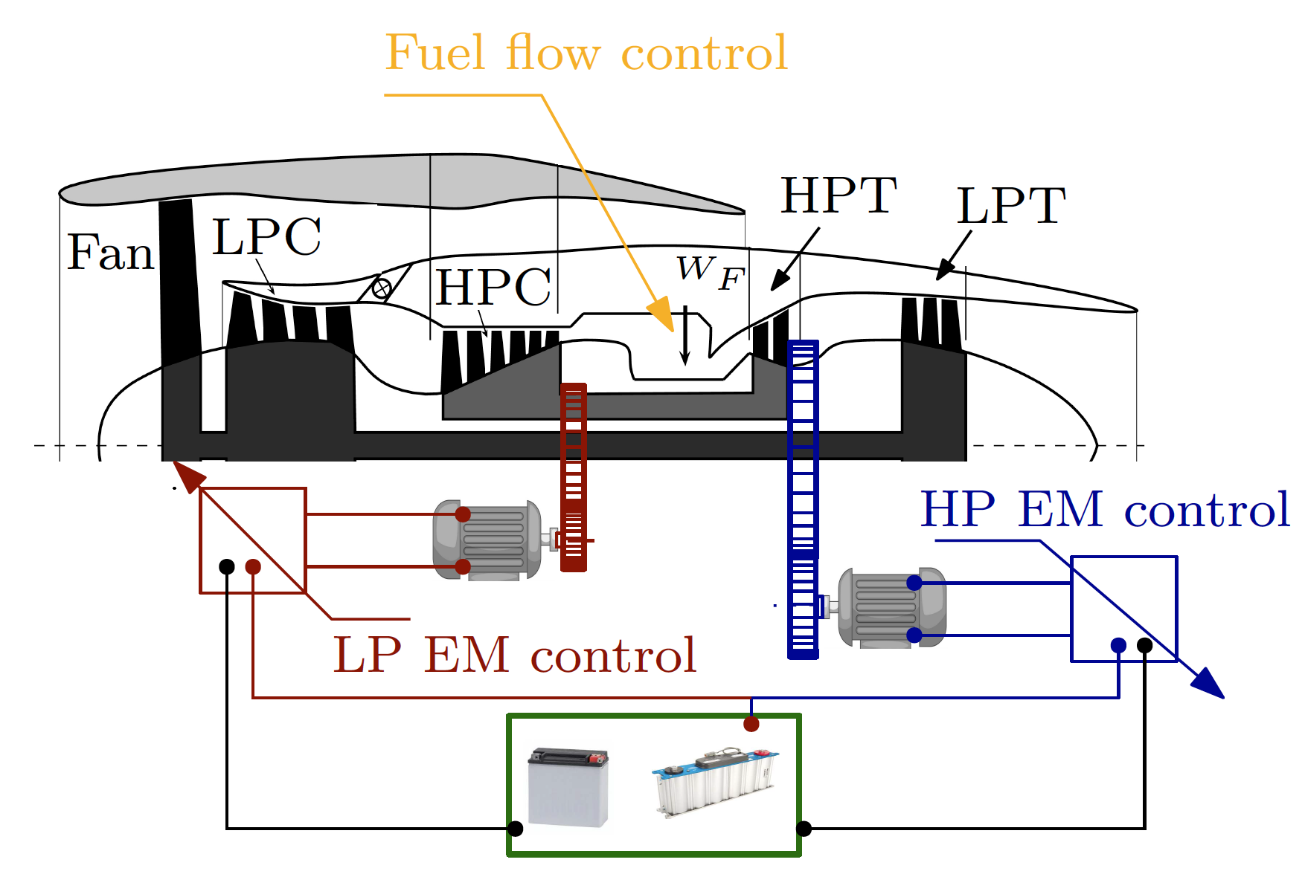
AGTF30 Turbomachinery Model
Fan and Low Pressure Mechanical Components
Low Pressure Electric Components
Turboshaft component model⁴
Notes:
Here is a breakdown of the major AGTF30 Engine components. My current baseline model that we will discuss today can be broken down into two main structures. The low pressure mechanical parts are highlighted in green and include the fan, the low pressure compressor, and the low pressure turbine.

Slide 5
AGTF30 Turbomachinery Model
High Pressure Mechanical Components
High Pressure
Electric Components
Turboshaft component model⁴
Notes:
The high pressure mechanical parts are highlighted in red and include the high pressure compressor and high pressure turbine. These pieces are attached to either a high pressure or low pressure spool and the rotation of these spools is what creates the engine’s power.

Slide 6
AGTF30 Turbomachinery Model
Low Pressure Electric Components
High Pressure
Electric Components
Power Storage
Turboshaft component model⁴
Notes:
Additionally, we also incorporated the low pressure and high pressure electrical components that are attached to the spools of the engine.

Slide 7
Controls Process
Open-Loop Linear Model
Closed-Loop Linear Model
Open-Loop Nonlinear Model
Closed-Loop Nonlinear Model
Closed-Loop Nonlinear Model w/ Sensor Feedback
Open-Loop Comparison
Closed-Loop, Tuned Comparison
Incorporate Sensor Feedback and Uncertainty
Retune Model
Notes:
Here’s a brief overview of a few fundamental controls concepts. In basic control theory you start with a nonlinear dynamic model of the system and work to linearize the model. We want to run what’s called an open loop comparison without any controls to make sure that our nonlinear and linear model agree with each other. We can then begin the closed loop comparison by adding a control to the linear model, tune it, and then try to run it in the closed-loop nonlinear model and again check to make sure that the models are in agreement. We can then add uncertainty with feedback from a sensor or hardware or other things that will be used iteratively to fine tune the design.

Slide 8
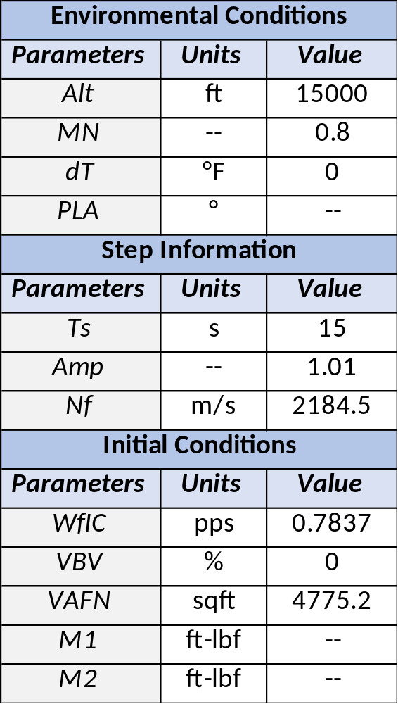
Control Study Parameters
Linear AGTF30 model was tested at steady state cruise point
Controller variations:
  Baseline Proportional-Integral (PI) Control
  Model Predictive Control (MPC)
Actuator sources:
  STARCABL coupled control design⁵
  AGTF30 dynamic model (simplified)
Model was tested and tuned using a commanded fan speed step response
  Note: AGTF30 turbine electrified energy management (TEEM) dynamic model is used for electric motor (EM) components and adjusted to trim conditions
Notes:
For this control study, we utilized the Linear AGTF30 model at steady state cruise point to determine:
State space parameters
Initial conditions
We also looked at two different controller variations in this study:
Baseline Proportional-Integral (PI) Control
Model Predictive Control (MPC)
We used five different actuators through the course of this study:
STARCABL coupled control design: (Don Simon)
Fuel Flow (W_{f})
AGTF30 dynamic model (simplified):
Variable Bleed Valve (VBV)
Variable Area Fan Nozzle (VAFN)
Low Pressure Shaft Motor Torque (M1)
High Pressure Shaft Motor Torque (M2)
Model was tested and tuned using a commanded fan speed step response
Note: Estimation of Power Lever Angle (PLA) when using Electric Motor (EM) control causes slight differences in initial conditions

Slide 9
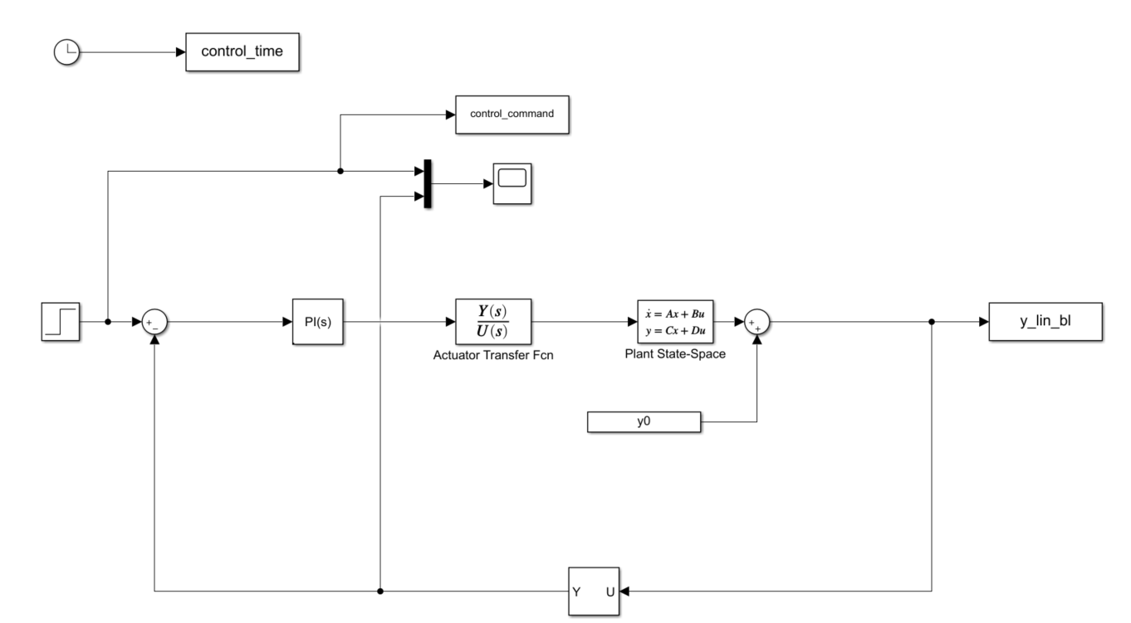
Baseline PI Model
Input
Controller
Actuator
Plant
Output
Notes:
Here is a schematic of our closed loop baseline model.

Slide 10
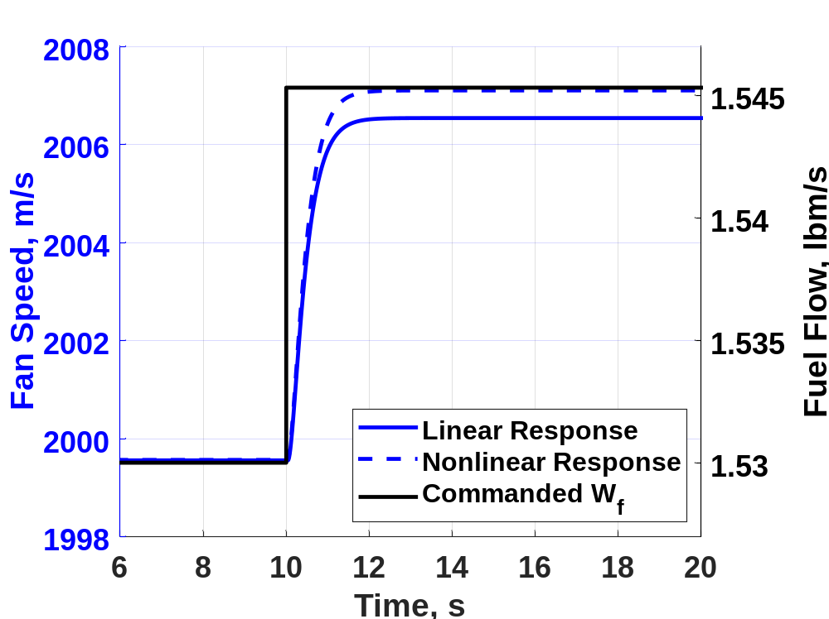
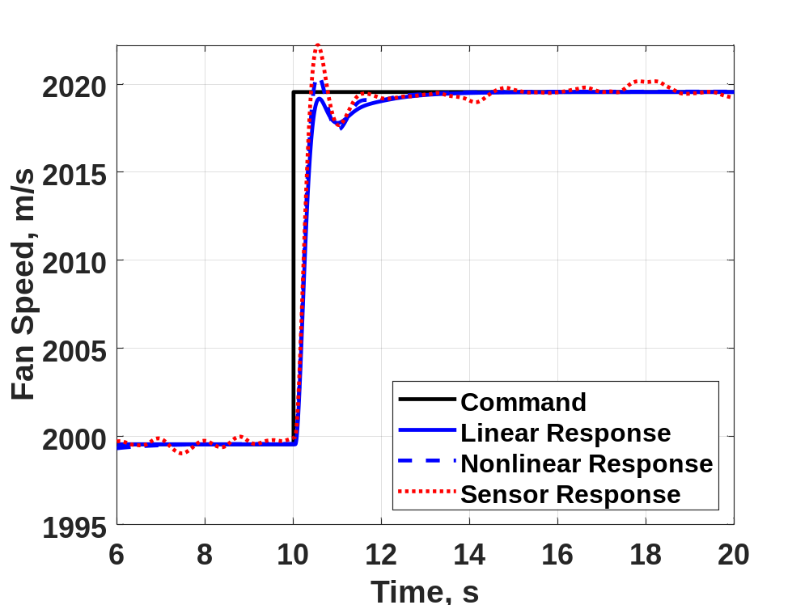
Preliminary Results: Baseline Controller
Open-Loop Comparison
Closed-Loop, Tuned Comparison
Notes:
Here we can see the preliminary results I received from the baseline controller. We can see that the y-axis indicates the fan speed or fuel flow response and the x-axis indicates the time it takes our model to come to steady state after experiencing the perturbation caused by the commanded fuel flow. In the open loop model, you can see that the fuel flow command indicates a disturbance, and that our nonlinear and linear responses notice the perturbation, react accordingly and find steady state relatively close to the command response within a reasonable timeframe. For our case, anything that can come to steady state within 5 seconds will be good enough for this application. Similarly we can see, that after several iterations of tuning our closed loop model, all of the responses will begin to settle after about 4 seconds. We can see that the nonlinear and uncertainty responses produce a bit of overshoot in fuel flow. As I continued working through the control study, I tuned my model to be more robust and increase fuel efficiency by lowering this overshoot.

Slide 11
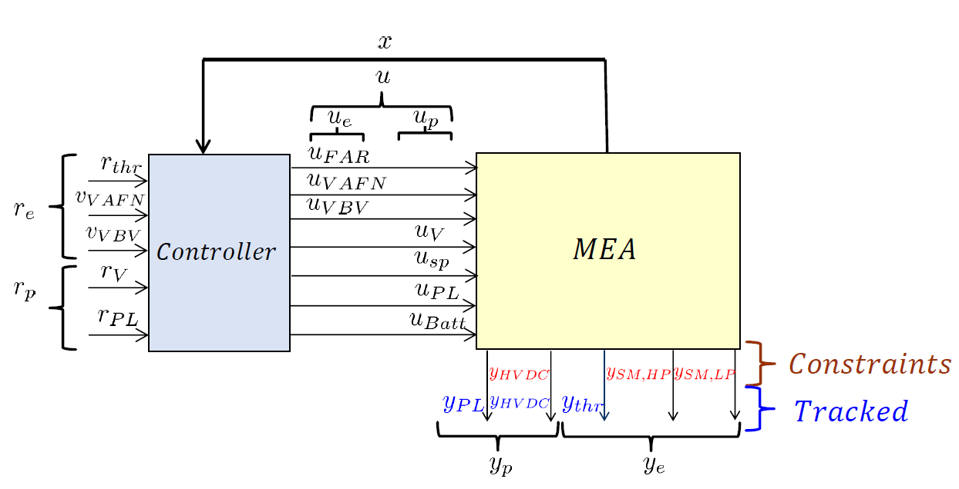
MPC Design
MPC predicts the desired plant input that will guarantee the plant output will track the specified reference
MPC components
  Plant model
  Optimizer
Benefits of MPC
  Multiple-Input-Multiple-Output (MIMO) capability
  Input and output interaction
  Constraint modeling
  Preview capability
v_{Nf}
u_{M1}
u_{M2}
y_{Nf}
Diagram of an example AGTF30 model with EM technology control problem²
Notes:
Let’s get into what MPC design is and how we can utilize it at NASA Glenn. Model predictive control predicts a desired plant input based on how well the plant output tracks a given reference.
MPC is made of two major components:
The first is the plant model which is used to predict future plant outputs
The second is the optimizer which makes sure the calculated output tracks the given reference
Now, there are many benefits to MPC that I think would be very helpful for work at GRC. The image to the right shows an example MPC control design for the AGTF30, with slight modifications made to fit in our desired values. From the image you can see that the MPC controller has the capability to run a Multiple-Input-Multiple-Output system where interaction can occur between the inputs and outputs. This is helpful when we want our engine subsystems and power systems to interact with one another. We don’t have to worry about multiple controllers like we would if we designed this model with a PI controller.
Another helpful tool that MPC provides is the ability to model constraints. Unfortunately for this study, I was not able to incorporate constraints but as you can see from the image, this can be very help to set stall and surge margin constraints on your model.
Now we come to probably the most original feature of MPC: its preview capability. With this feature we are able to lower drastic changes that occur within the engine during transients because we can utilize predictive data of the flight profile to give forewarning of large changes coming up during flight.

Slide 12
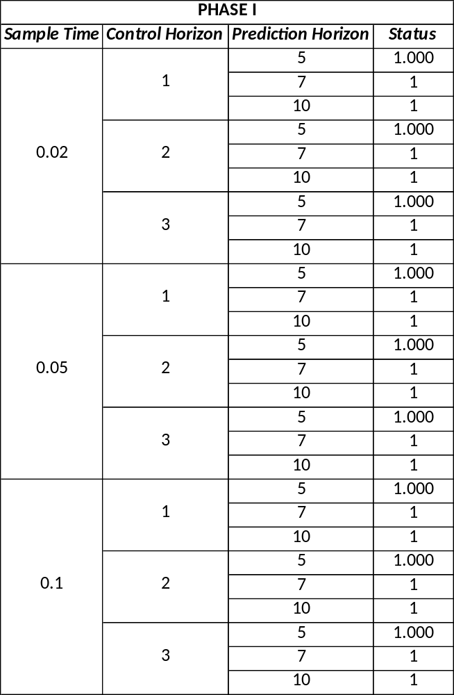
MPC Sensitivity Study
Three phase study for a closed-loop system of the plant, actuator, and MPC
  Phase 1
    u₀ = w_{f}
    y = N_{f}
  Phase 2
    u₀ = [w_{f}, VAFN, VBV]
    y = N_{f}
  Phase 3
    u₀ = [w_{f}, VAFN, VBV, M1, M2]
    y = N_{f}
Varying Parameters:
  Sample Time (Ts)
  Control Horizon (CH)
  Prediction Horizon (PH)
Notes:
After that MPC design overview, we can start talking about the MPC sensitivity study we conducted…
The simulation step time is 0.02 seconds
The sample time is used to determine at which rate the control algorithm is running.
The control horizon is a series of free variables chosen by the optimizer at each time step to follow the predicted future output.
The preview capability length, or length of time one is looking into the future for, is varied with the prediction horizon.
*

Slide 13
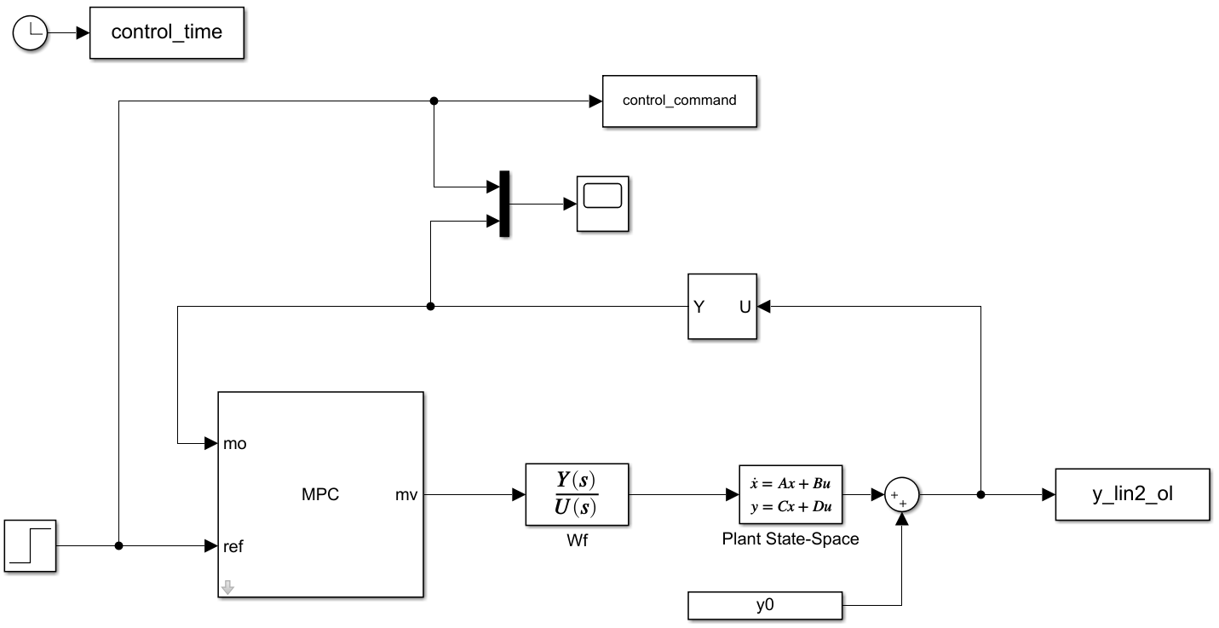
Phase I Controls Model
Controller
Output
Actuator
Plant
Input

Slide 14
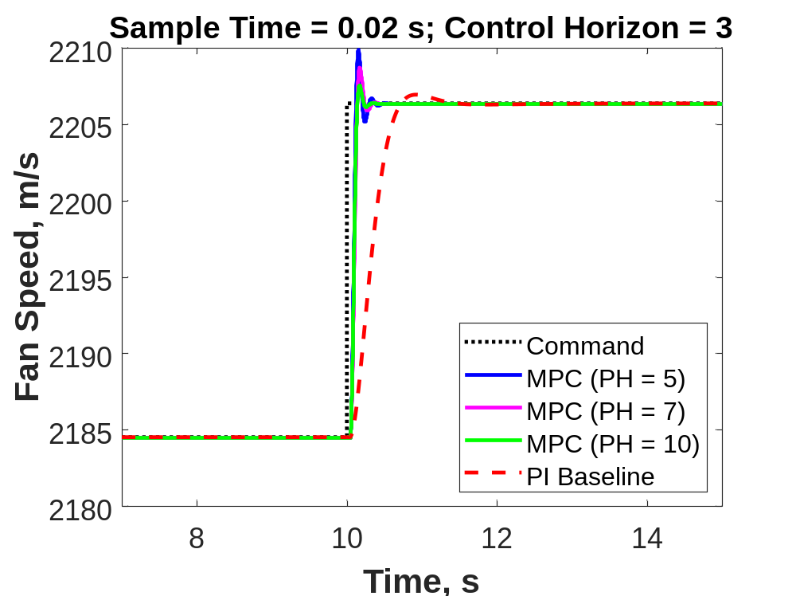
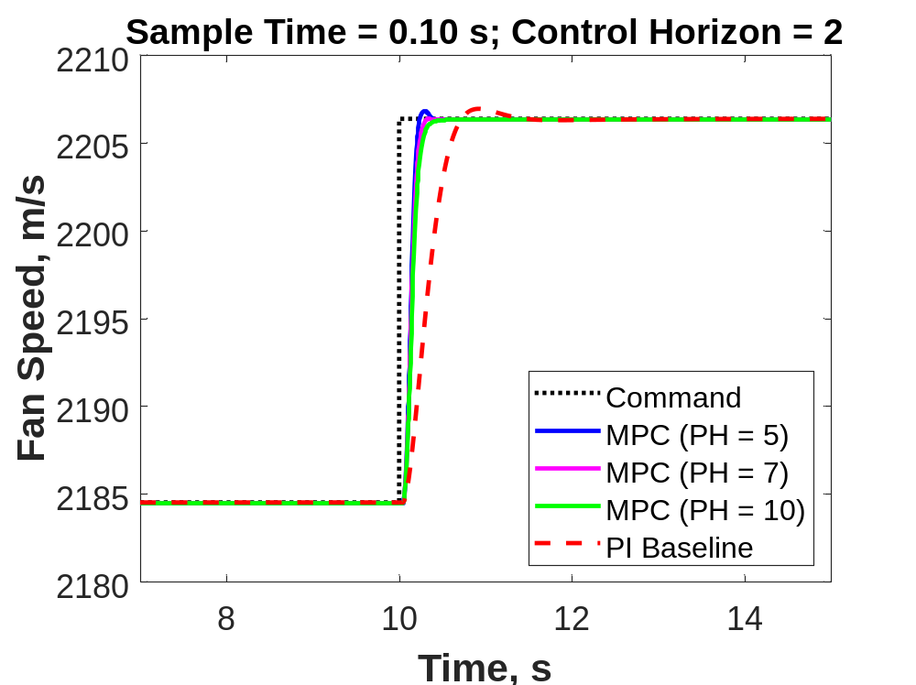
Phase I Summary
Notes:
From the phase I study, I pulled a plot representative of things to avoid when working with an MPC controller. You’ll see that on the left, that there is quite a bit of overshoot taking place for the MPC controllers. We saw this trend occurring when the sample time was too fine for our model, hence us using the sample time of 0.02s. Another trend that we noticed was that if the control horizon and the predictive horizon were too close in value, you would see more overshoot. You can see that in the case on the right as we choose the highest control horizon of the cases we tested. The image on the right has much less overshoot in all prediction horizon responses. We can see that when the PH is 5 we get more overshoot than the other two prediction horizons. We also notice that the response time for the PI baseline is much more gradual when compared to any of the MPC control settings

Slide 15
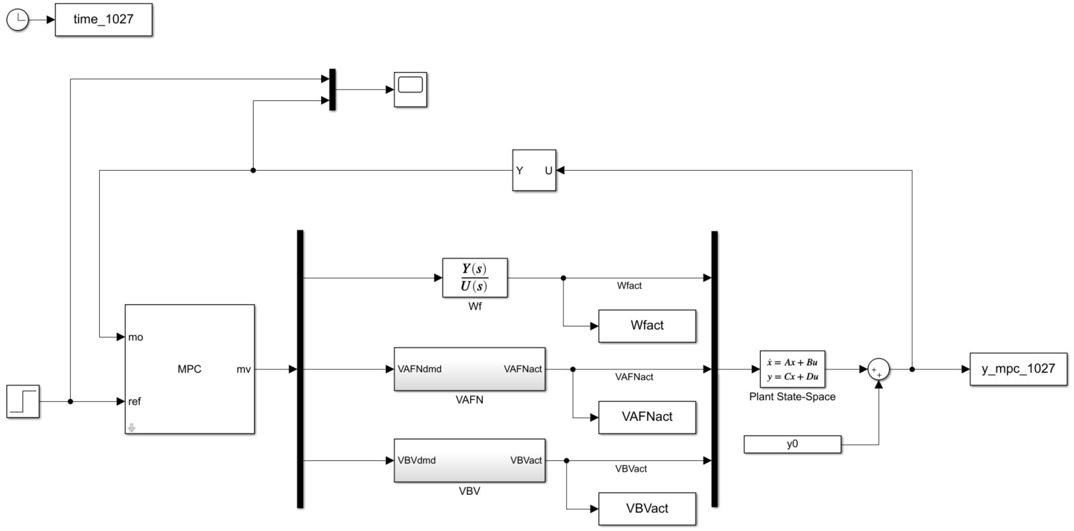
Phase II Controls Model
Actuators
Controller
Plant
Output
Input

Slide 16
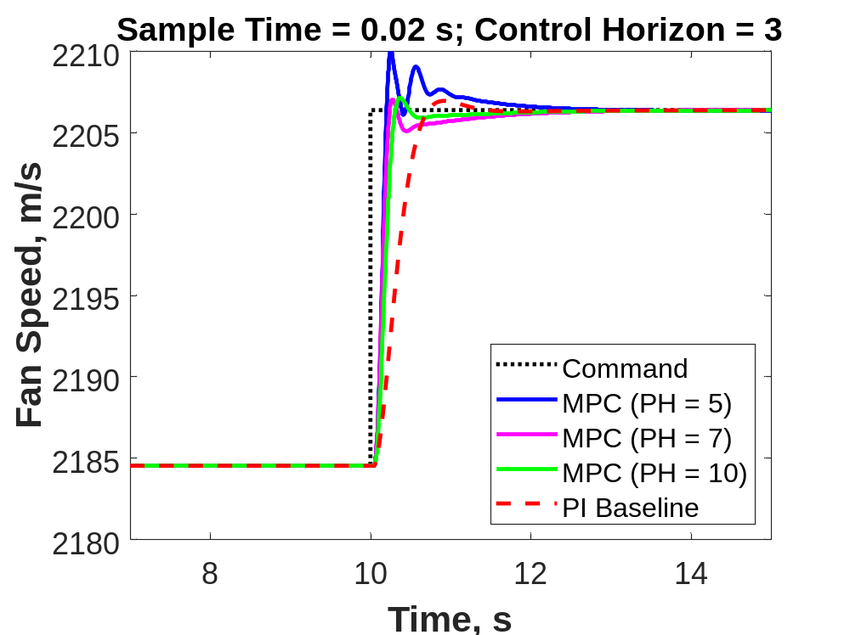
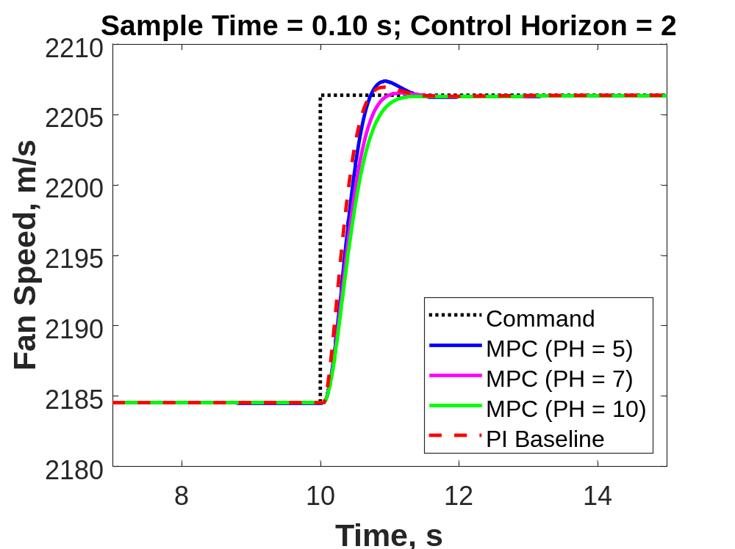
Phase II Summary
Notes:
Now as we look at the phase II summary, we can see that after the transient we have an oscillatory response that takes place. This oscillatory response was due to an issue we were having with the initial conditions of the actuators that we discovered when working on Phase III of the sensitivity study. We were able to remove this issue for the optimized model where we conducted our final performance analysis. If we take a look at the plot on the left, we are still able to see the trend between the control horizon and prediction horizon ratio here. The MPC controller set to a prediction horizon of 5 is less stable near the step when compared to the other two and PH equals 10 shows a more gradual, stable response. The optimized plot on the right begins to look more like the PI control response, where the PH = 5 shows greater overshoot and PH = 10 has almost no overshoot.

Slide 17
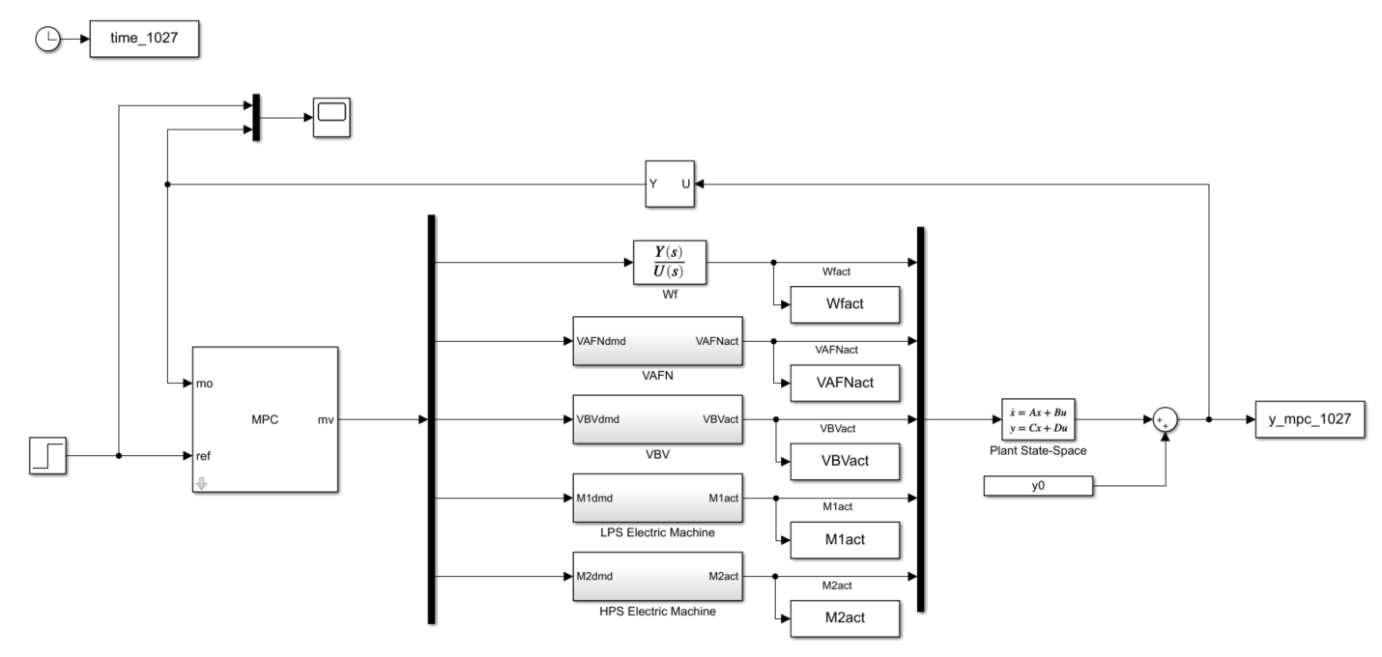
Phase III Controls Model
Controller
Plant
Output
Input
Actuators

Slide 18
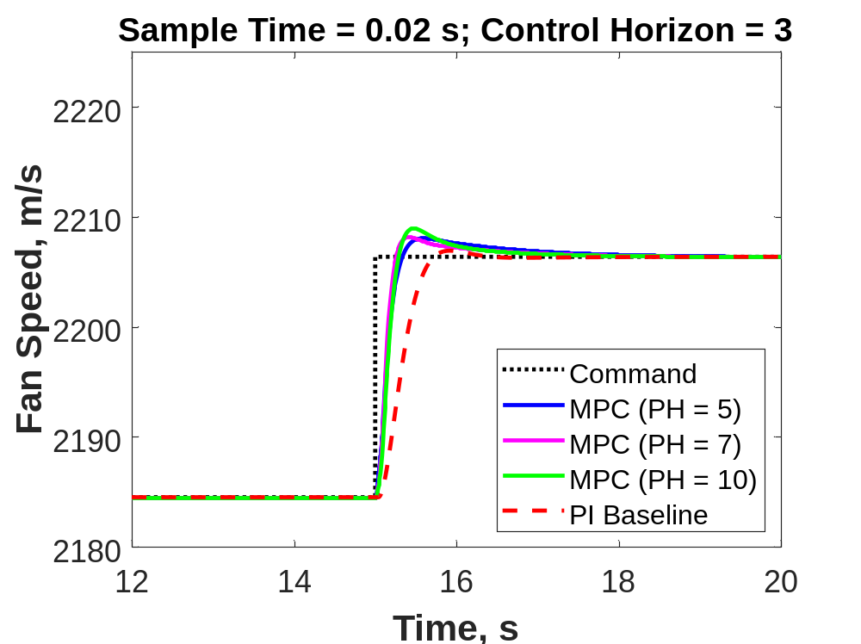
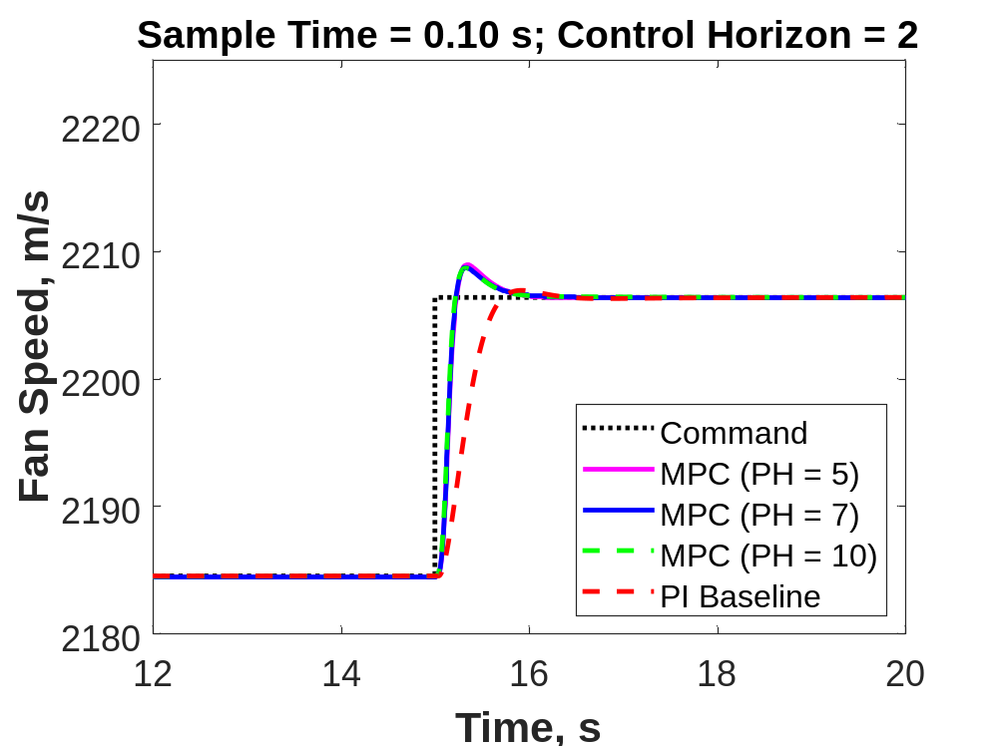
Phase III Summary
Notes:
We can see here that the response is not exactly following our previous trends. As I mentioned in the phase II summary, we discovered an issue we had with our actuator initial conditions and now you can see that our model no longer shows that oscillatory response we were seeing in phase II. With the added actuators we were also able to better meet our design response from the tuning parameters.

Slide 19
Sensitivity Final Parameters
Optimized MPC Parameters:
  Ts: 0.10 s
  CH: 2
  PH: 7
Outputs analyzed:
  Fan Speed (N_{f})
  Fan Stall Margin (Fan SM)
  Low Pressure Compressor Stall Margin (LPC SM)
  High Pressure Compressor Stall Margin (HPC SM)
Actuators analyzed:
  W_{f}
  VAFN
  VBV
  M1 and M2
Phase I
Phase II
Phase III

Slide 20
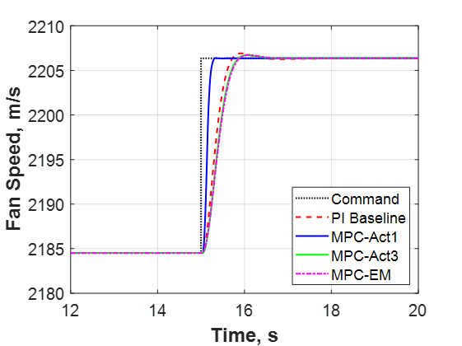
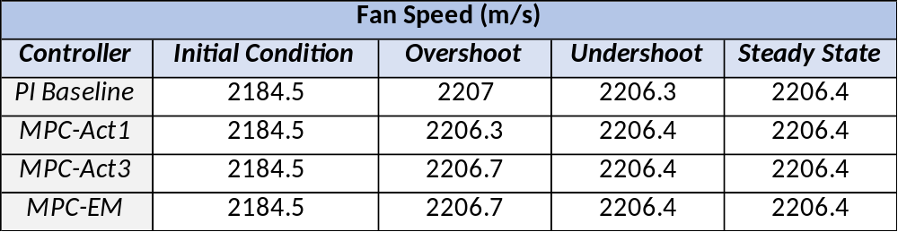
Fan Speed
PI Baseline, MPC-Act3, and MPC-EM follow similar trajectories with slight overshoot
MPC-Act1 responds and comes to steady state the quickest with no overshoot
All controllers return to steady state within required time range (<5s)
All systems are stable with respect to MPC design

Slide 21
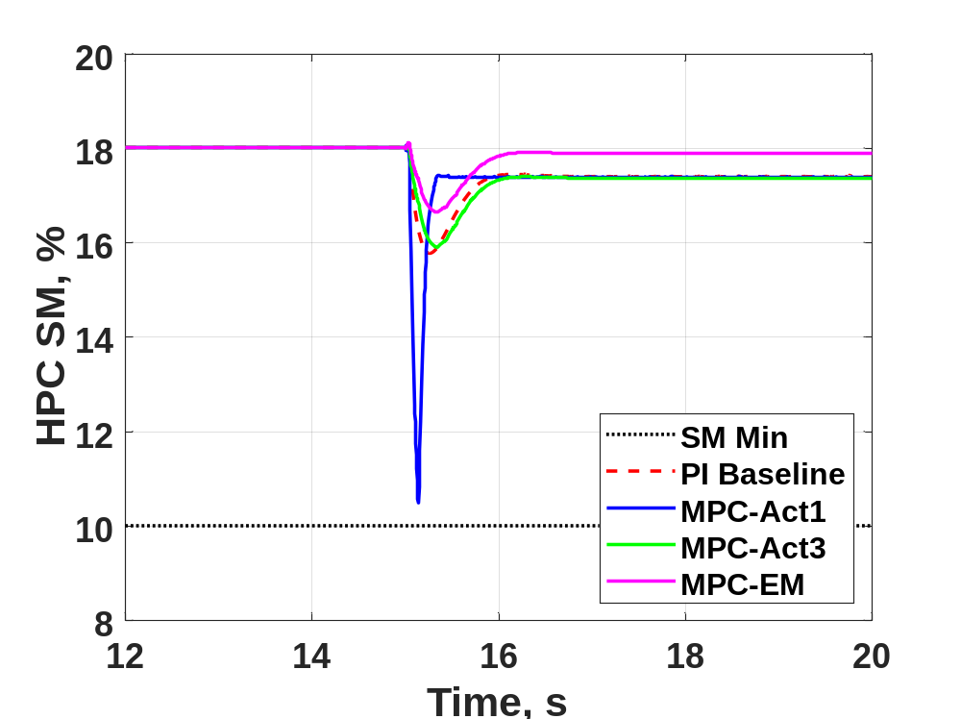
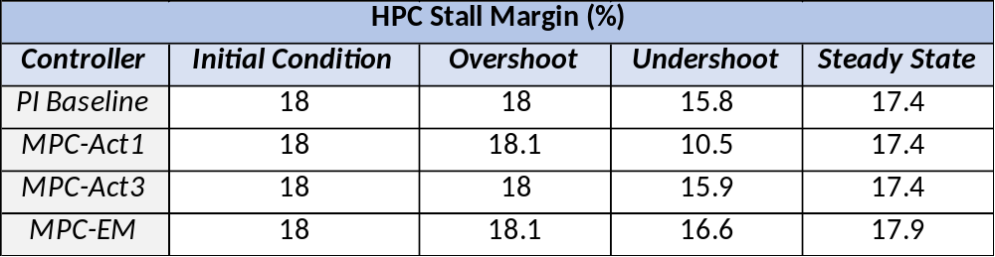
HPC Stall Margin
All controllers provide a response that stays above the minimum stall margin (10%)
  MPC-Act1 shows a drastic drop in HPC SM during transient
  MPC-EM shows the smallest drop and nearly comes back to initial condition
LPC SM decreases after disturbance

Slide 22
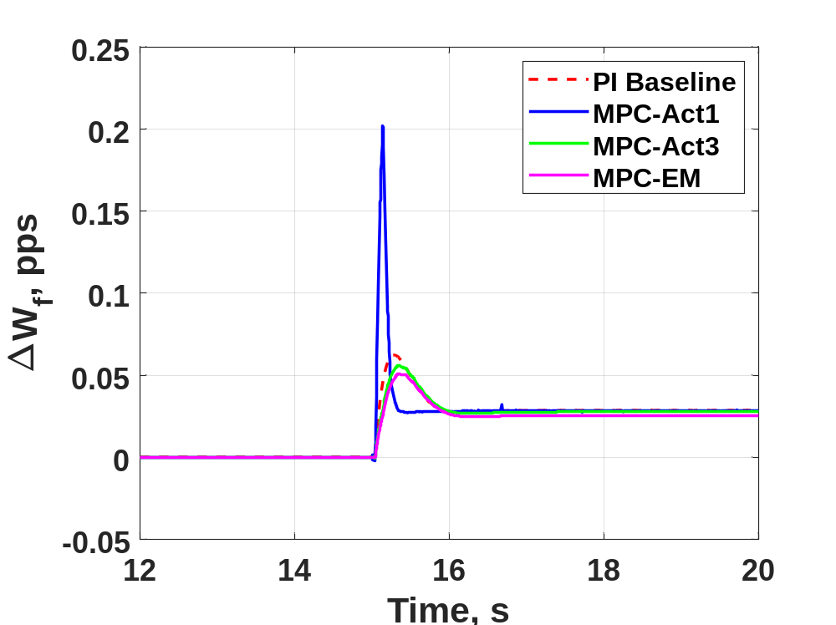
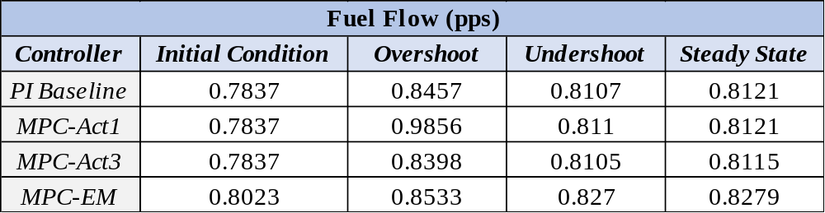
Fuel Flow Actuator
PI Baseline, MPC-Act3, and MPC-EM follow similar trajectories with slight overshoot
  MPC-EM produces the smallest amount of overshoot
MPC-Act1 responds and comes to steady state the quickest with large overshoot
All controllers return to steady state within required time range (>5s)

Slide 23
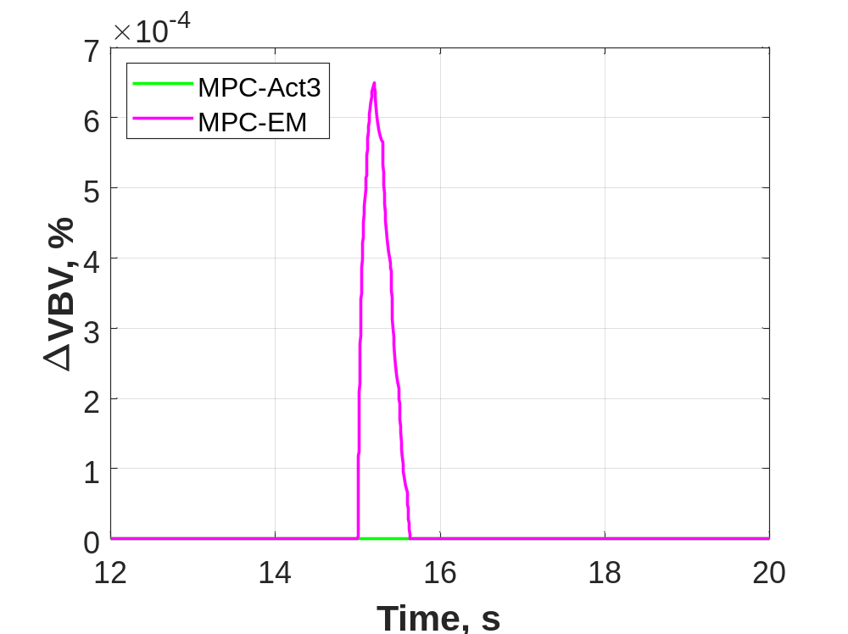
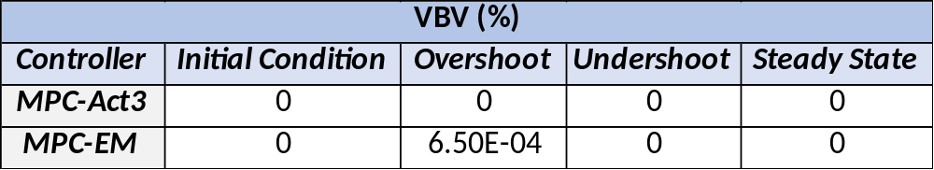
VBV Actuator
VBV is incorporated into system in Phase II of sensitivity study
MPC-Act3 does not utilize VBV
MPC-EM jumps to 6.50e-4% during transient and then drops back to 0%
Change in VBV is negligible

Slide 24
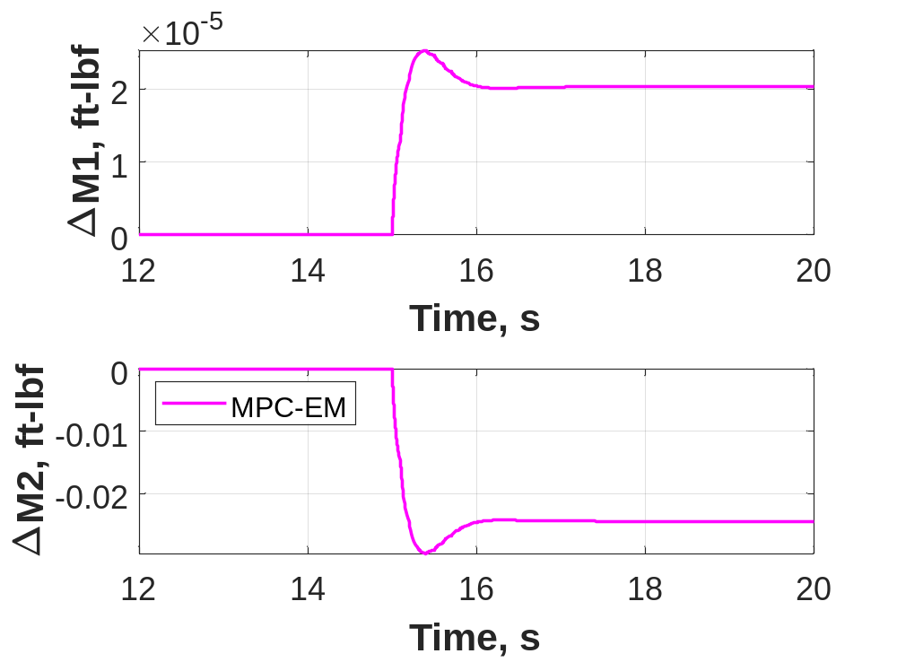
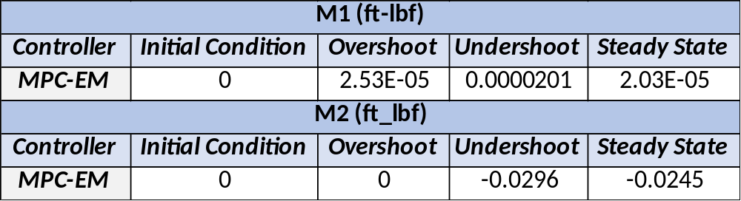
Motor Torque
M1 and M2 torques are incorporated into system in Phase III of sensitivity study
EMs are applying torque to LPS to extract power to the low pressure system
EMs are applying torque to HPS to insert power from the high pressure system
Notes:
Compressor is insertion (- torque)
Turbine is extraction (+ extraction)

Slide 25
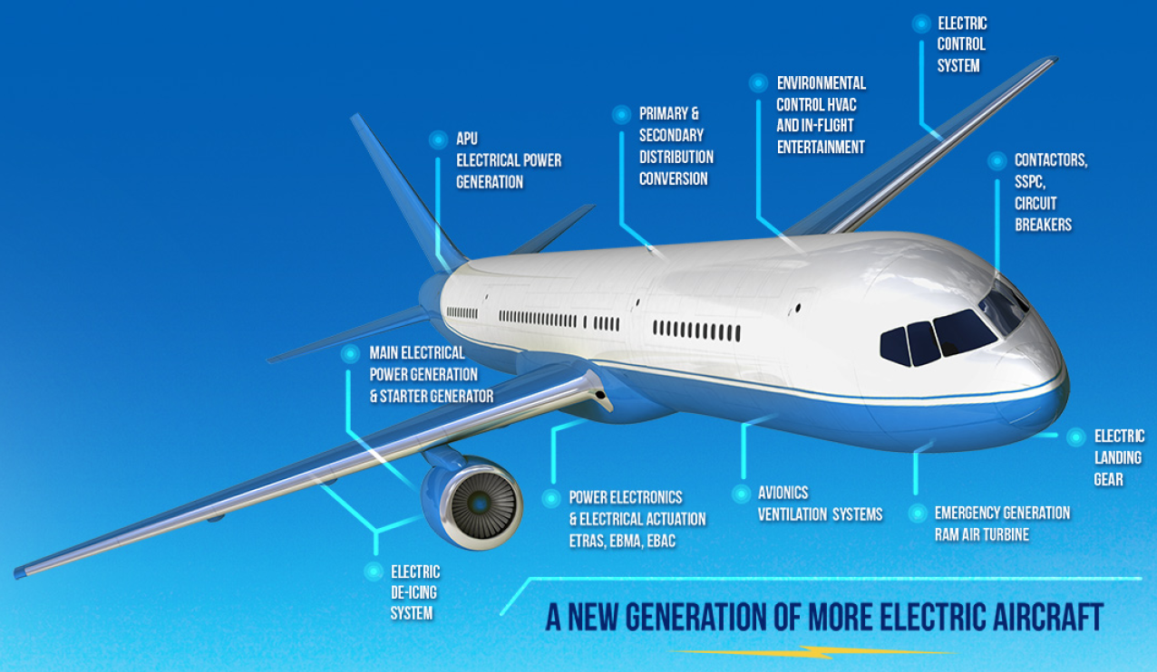
Summary and Future Work
Summary
  Initial control study conducted to set baseline system using PI controller
  Ran a three phase MPC sensitivity study to optimize MPC parameters and increase the degrees of freedom of the system
  The final system is a five actuator MPC controller
    Fan speed response is stable
    System is above 10% SM for fan, LPC, and HPC
    Power is being extracted from the LPS and is being inserted into the HPS
Continued Work
  Incorporate sensors into feedback loop
  Conduct study over complete flight profile
  Optimize control for hardware implementation
Systems/ components considered in electrification of aircraft designs²
Notes:
To summarize my work thus far, I have worked to build a baseline control model for the AGTF30 engine using a PI controller. I then ran a three phase MPC sensitivity study to optimize the parameters for each phase. The final tested system for my internship was a five actuator MPC model where we were able to produce a stable fan speed and all stall margins remained above the 10% minimum. We were also able to get a taste of the electric motor performance. Power was being extracted from the LPS and was inserted into the HPS. In future projects, it would be great to see sensors incorporated into the MPC feedback loop and conduct a study over the complete flight profile. It would also be great to begin working on hardware implementation for the optimized control.

Slide 26
Special Thanks To…
Joseph Connolly (Project Mentor)
Jonathan Kratz (Project Mentor)
Santino Bianco
Intelligent Control and Autonomy Branch - LCC
GRC Native American Advisory Group
Internship Peer Group
NASA GRC Internship Coordinators
Notes:
And that concludes my presentation! I’d like to thank my mentor and everyone at NASA for this amazing opportunity.

Slide 27
References
¹Simon, D.L., Connolly, J.W., and Culley, D.E., “Control Technology Needs for Electrified Aircraft Propulsion Systems,” Journal of Engineering for Gas Turbines and Power [online journal], Vol. 142, URL: https://asmedigitalcollection.asme.org/gasturbinespower/article/142/1/011025/1031169/Control-Technology-Needs-for-Electrified-Aircraft [retrieved Jan 2021].
²Dunham, W.D., “Advanced Predictive Control Strategies for More Electric Aircraft,” Ph.D. Dissertation, Aerospace Engineering Dept., University of Michigan, Ann Arbor, MI, 2019.
³AGTF30, Advanced Geared Turbofan 30,000, Software Package, Ver. 2.0, NASA Glenn Research Center, Cleveland, OH, 2020.
⁴Richter, H., Connolly, J.W., Simon, D.L., “Optimal Control and Energy Management for Hybrid Gas-Electric Propulsion,” Journal of Engineering for Gas Turbines and Power [online journal], Vol. 142, URL: https://asmedigitalcollection.asme.org/gasturbinespower/article/142/9/091009/1085515/Optimal-Control-and-Energy-Management-for-Hybrid
⁵Simon, D. L., “Coupled Design of Setpoint Controllers for the STARC-ABL Propulsion System,” Apr 2020, pp. 1-7.
Notes:
Are there any questions?

Slide 28
Appendix

Slide 29
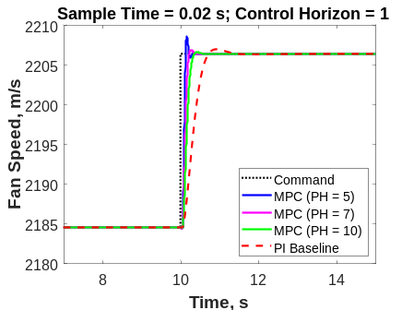
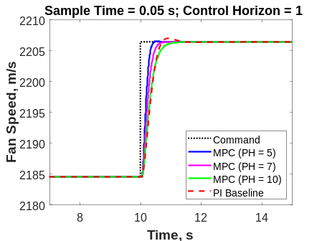
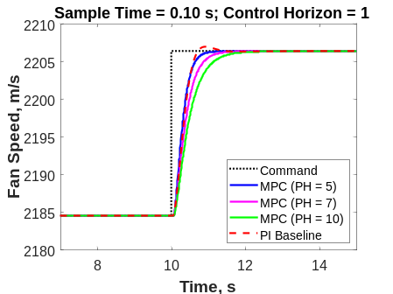
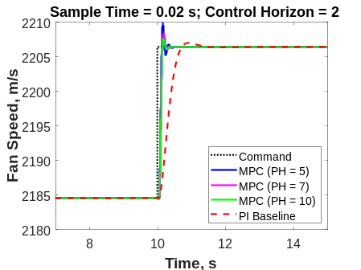

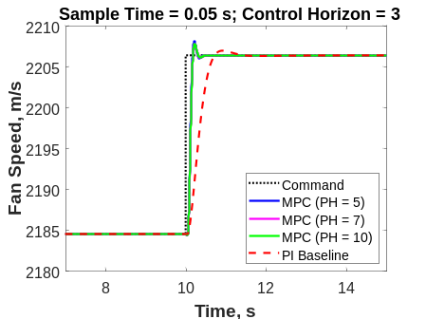
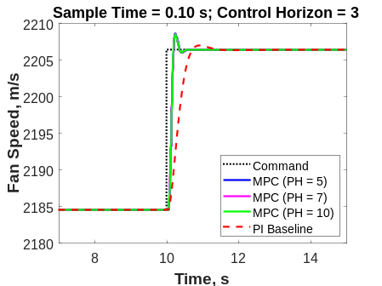
Phase I Summary
Sample Time = 0.02s
Sample Time = 0.05s
Sample Time = 0.10s
Control Horizon = 1
Control Horizon = 2
Control Horizon = 3
Notes:
Make this with two images
-one representative image of what we don’t want
- The best image we chose

Slide 30
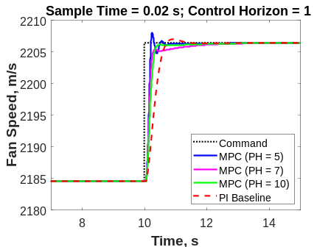


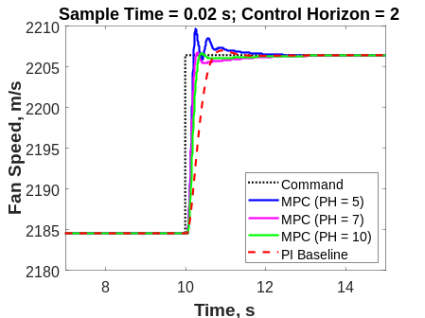


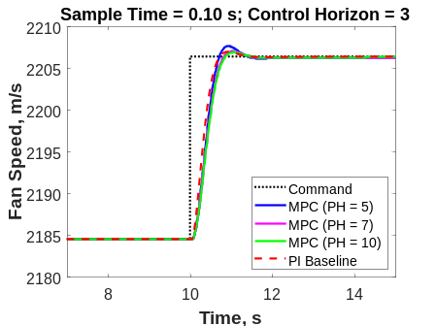
Phase II Summary
Sample Time = 0.02s
Sample Time = 0.05s
Sample Time = 0.10s
Control Horizon = 1
Control Horizon = 2
Control Horizon = 3

Slide 31
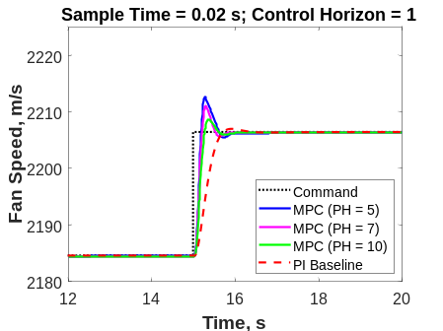
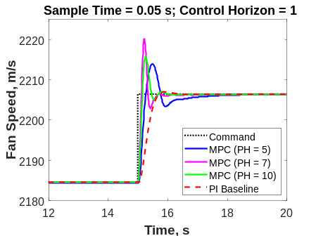
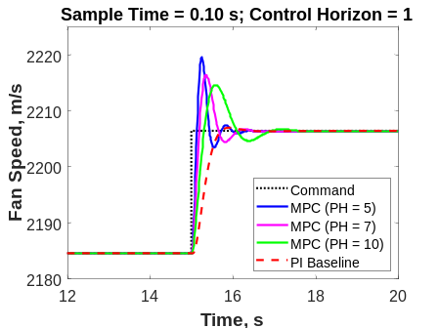
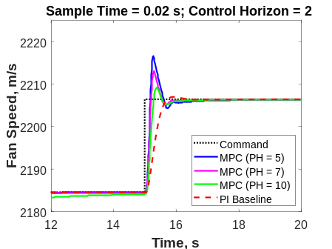
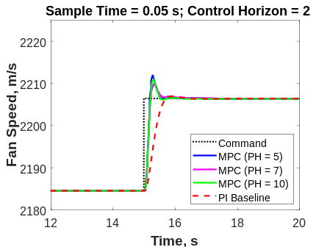
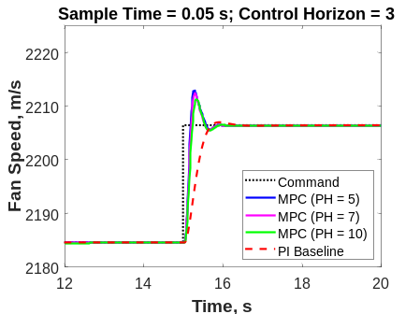
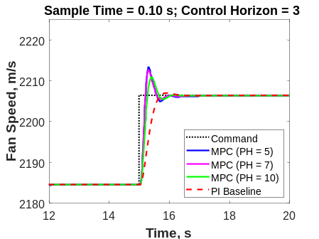
Phase III Summary
Sample Time = 0.02s
Sample Time = 0.05s
Sample Time = 0.10s
Control Horizon = 1
Control Horizon = 2
Control Horizon = 3

Slide 32
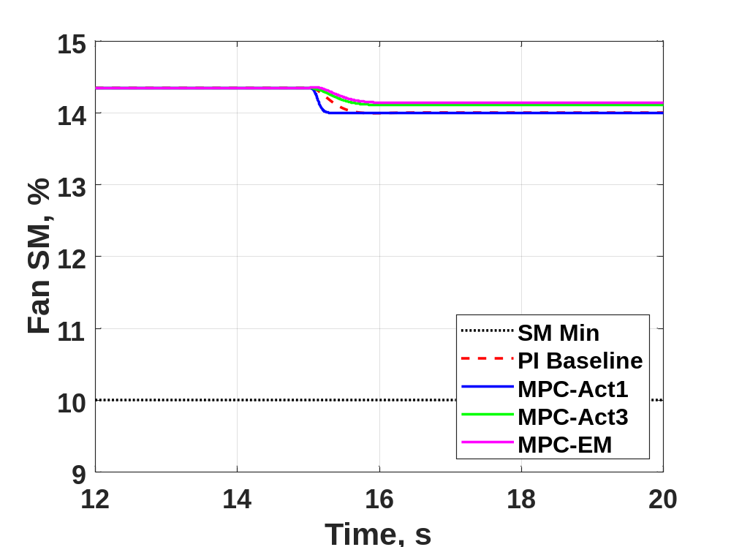
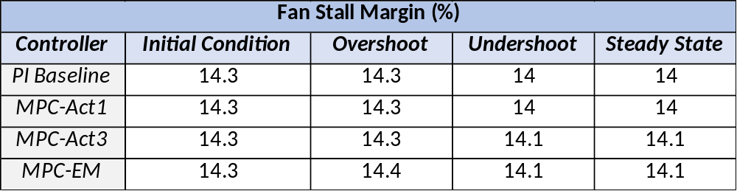
Fan Stall Margin
All controllers provide a response that stays above the minimum stall margin (10%)
MPC-EM SM shows a greater stall margin due to PLA estimation
Fan SM decreases after disturbance

Slide 33
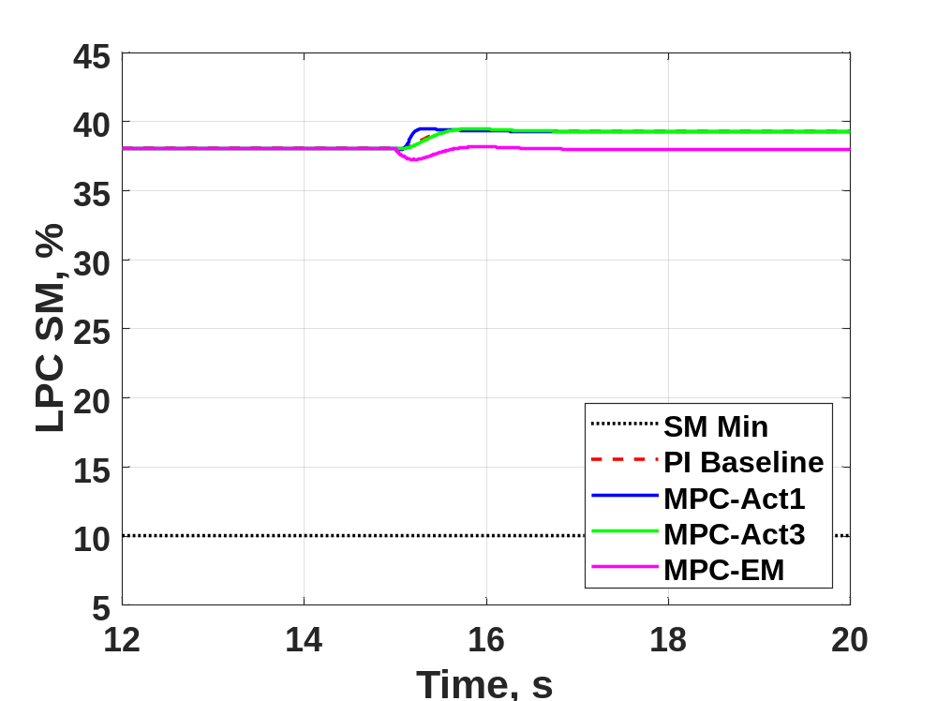
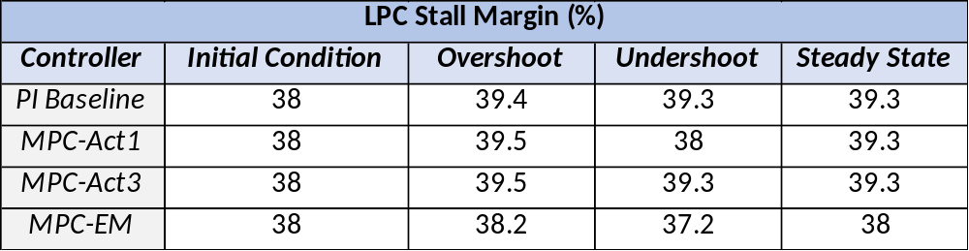
LPC Stall Margin
All controllers provide a response that stays above the minimum stall margin (10%)
MPC-EM SM shows a smaller stall margin due to PLA estimation
LPC SM increases after disturbance for PI Baseline, MPC-Act1, and MPC-Act3
LPC SM deviates from steady state at the transient but returns to initial condition

Slide 34


VAFN Actuator
VAFN is incorporated into system in Phase II of sensitivity study
VAFN increases slight during transient with a slight overshoot before returning to steady state
Change in VAFN is negligible

