Slide 1
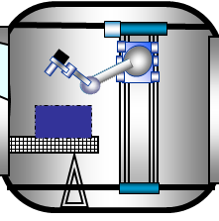
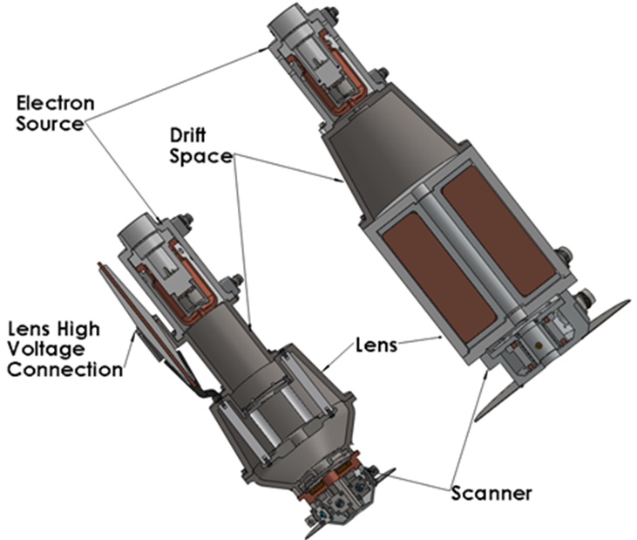
COSM Electron Beam Delivery System (CEBDS)
COSM
Project Overview
NASA’s Artemis program envisions establishing large-scale infrastructure assembled and serviced in space, on the Moon, and Mars. COSM is designing a new Electron Beam Delivery System that has beam current, spot size and multiplexed scan capability for high resolution imaging to enable wire-based 3D printing and welding in space. The CEBDS includes mechanical design for launch load and thermal excursions and compatibility with input power available from various space platforms, advancing the maturity to TRL 6.
Technical Approach
Design, build and test a CEBDS for performing Additive Manufacturing with integral real-time process control and identification of external and internal flaws, dimensional measurement data and other material attributes for certification concurrent with part fabrication.
Results/Summary
As of 3Q year 1 into a 2-year SBIR Phase 2 Sequential award, COSM has optimized electron beam optics, completed long-life filament design, assessed lens and scanning concepts, initiated design of the test stand, and developed block diagrams for the CEBDS control system and software.
a.
b.
a. CEBDS concept in lunar surface-based operations.
b. Electron beam gun design.

Slide 2
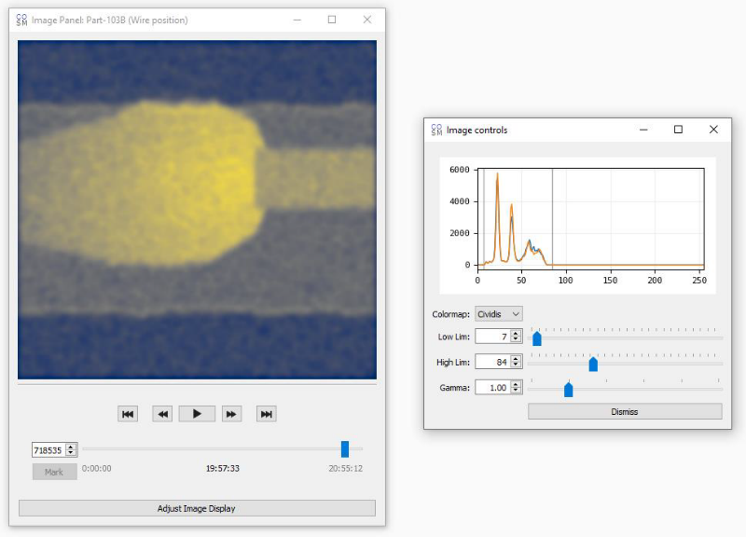
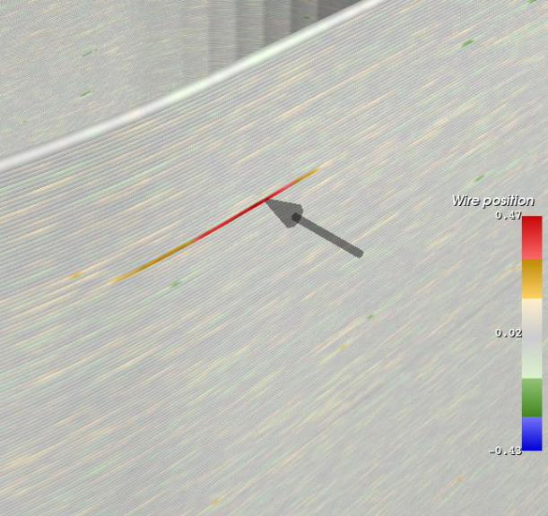
Contributing Partners
The Space Technology Mission Directorate contributes funding for CEBDS through the SBIR Phase 2 Sequential program. Work being performed by COSM Advanced Manufacturing Systems.
  www.cosmtd.com
Infusion and Transition Plan
NASA APPLICATIONS:
NASA’s technology taxonomy have identified advanced Additive Manufacturing with in-situ process control as being fundamentally necessary for extending our presence in space (ref TA07 and TA12). NRC's independent assessment placed this as #6 on their list across all technology roadmaps.
Applicable to on-orbit services, assembly and manufacturing (OSAM) objectives for space exploration, including ISS and Artemis missions.
NON-NASA APPLICATIONS:
COSM has done extensive research with a number of Fortune 500 companies to discuss the technical need and market opportunities for this innovation.
Commercial and military aerospace
Stamping dies, automotive industry
Rocket engine regenerative cooling channels
c.
d.
c. Real-time high-resolution images from integrated electron detector during electron beam/wire additive manufacturing.
d. Tracking of build location and defect identification capability.

