Slide 1

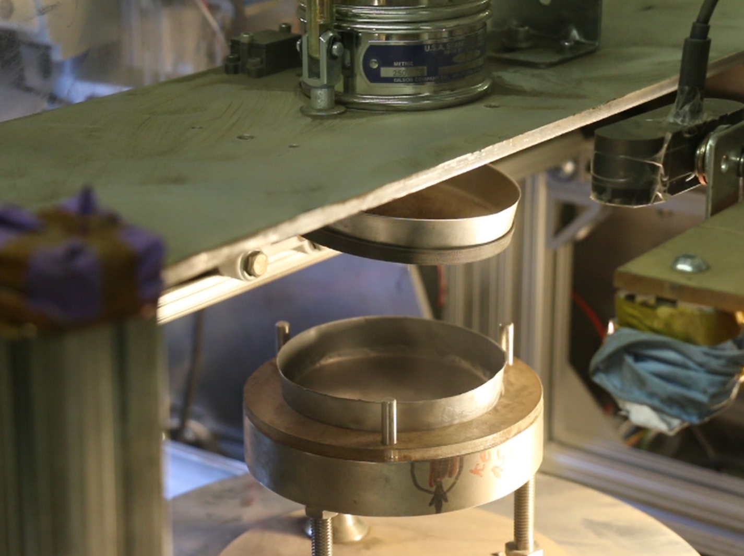
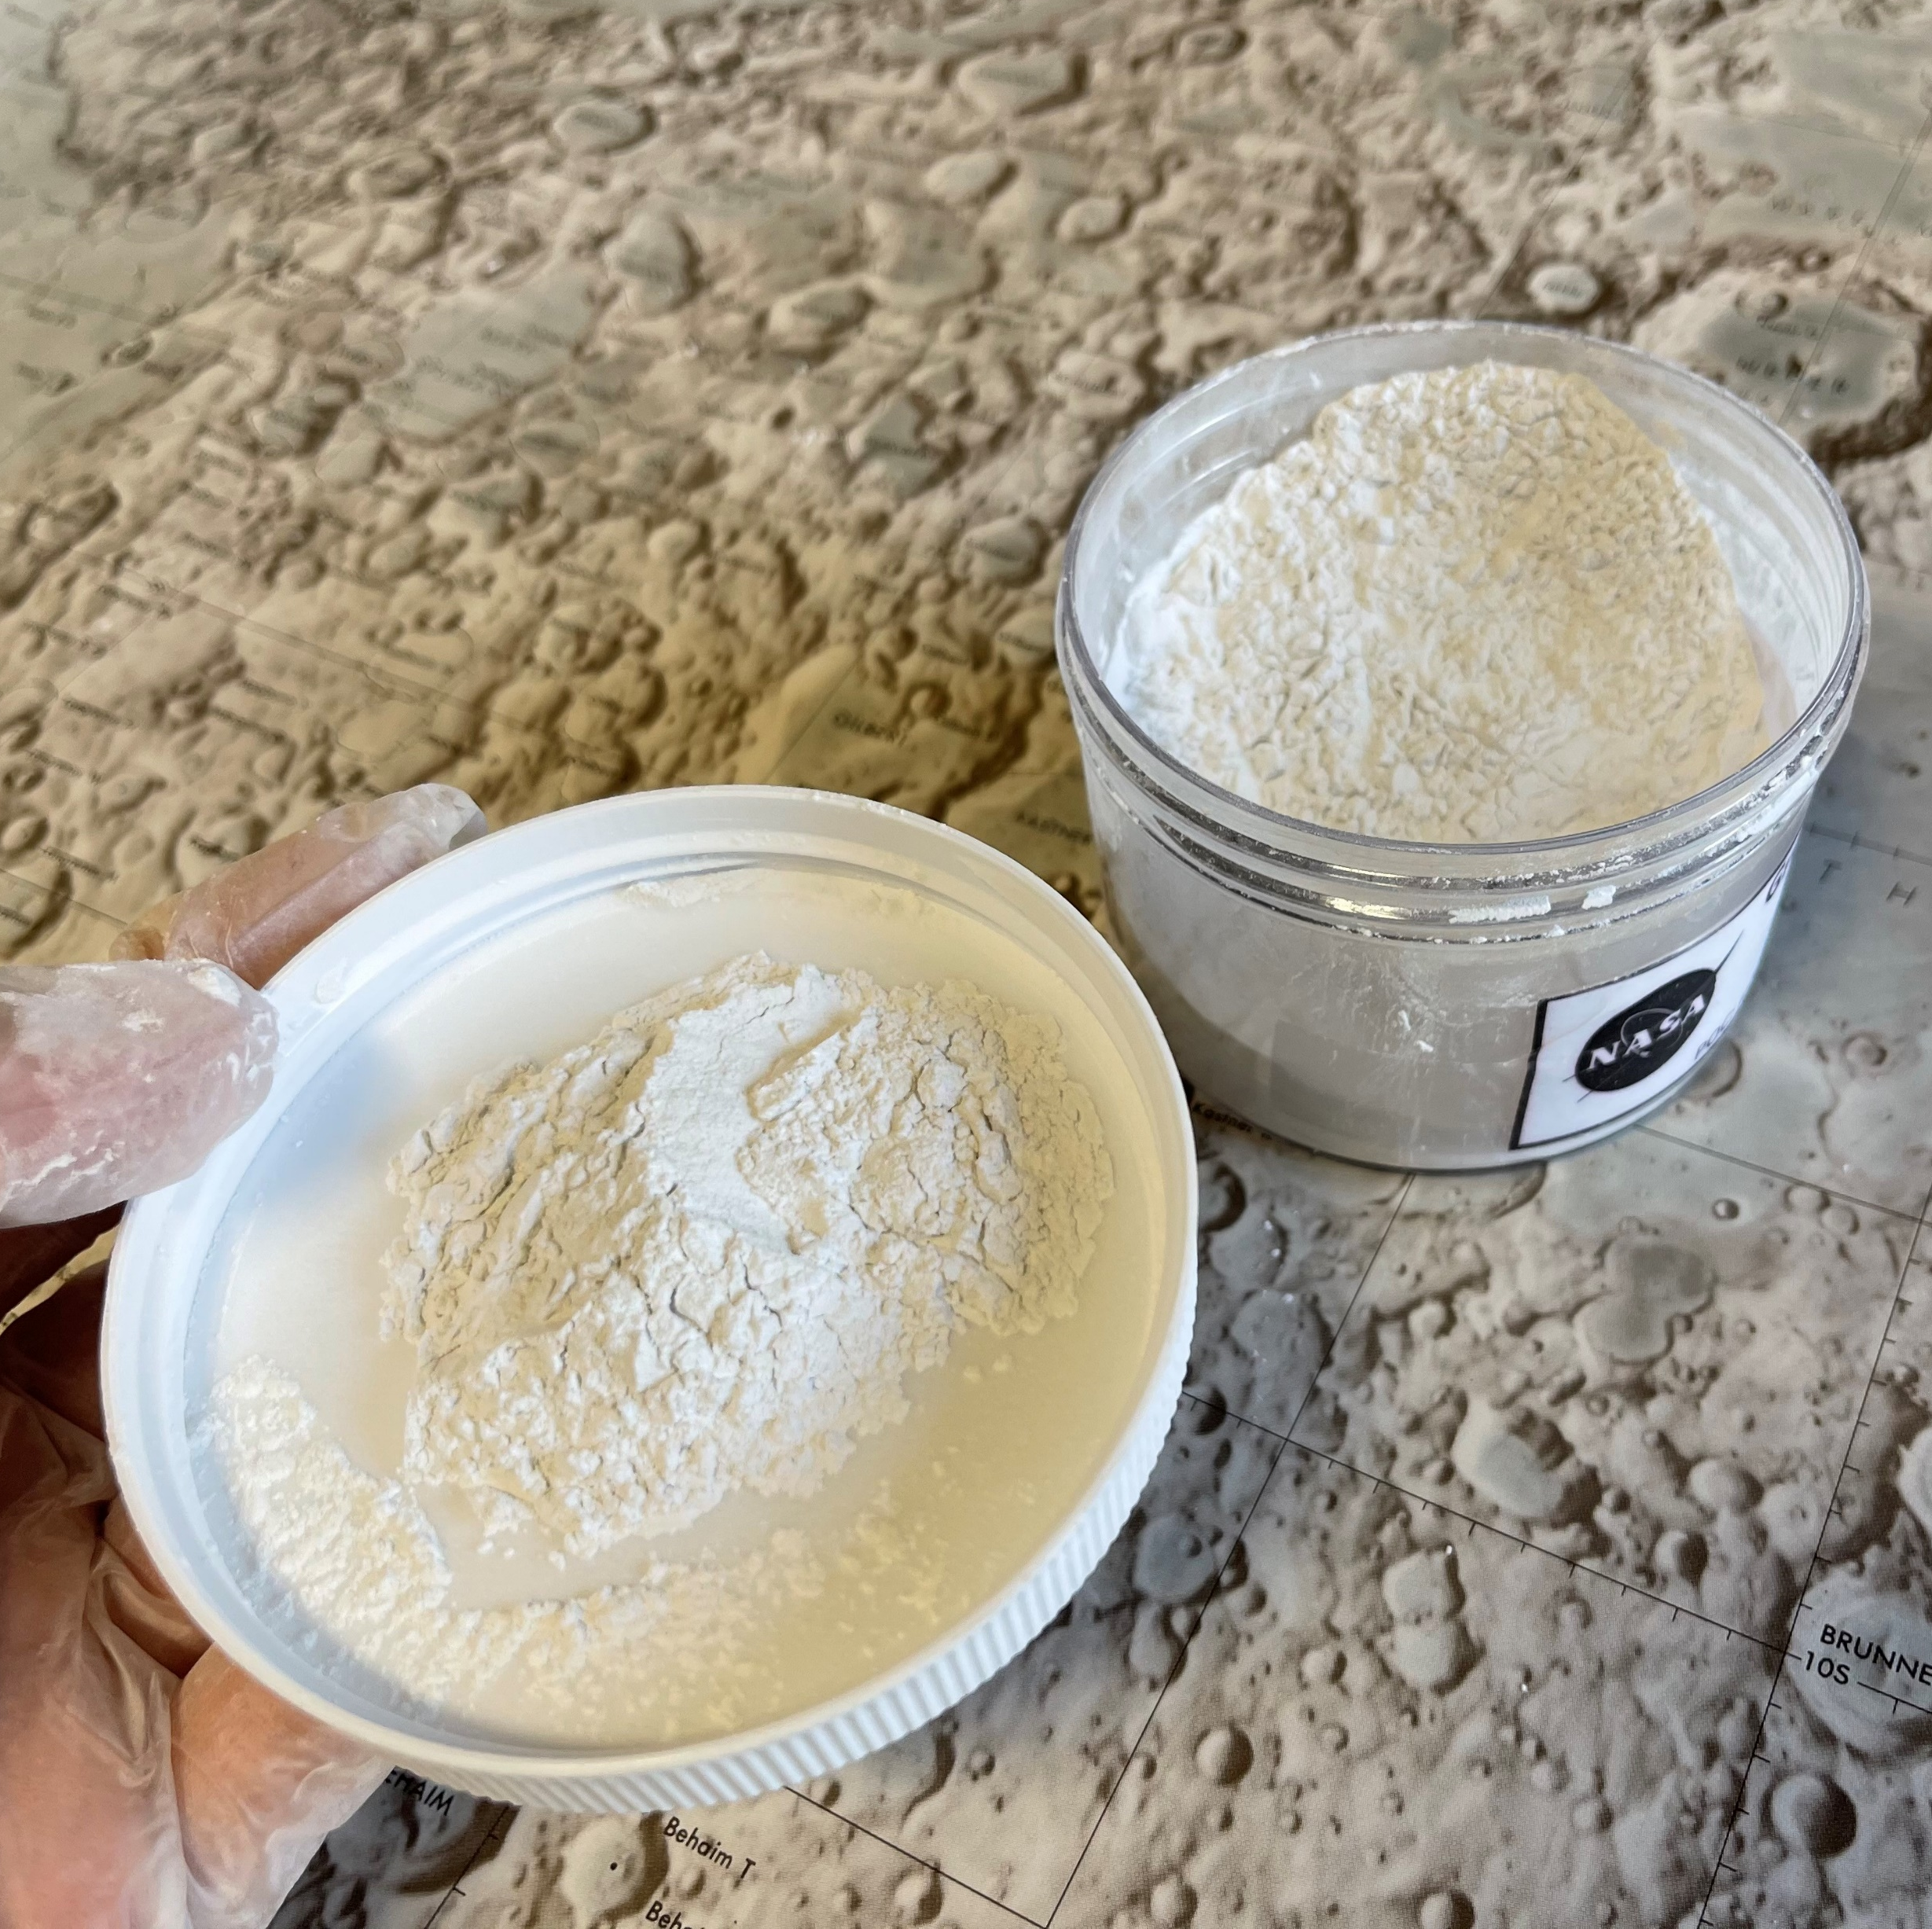
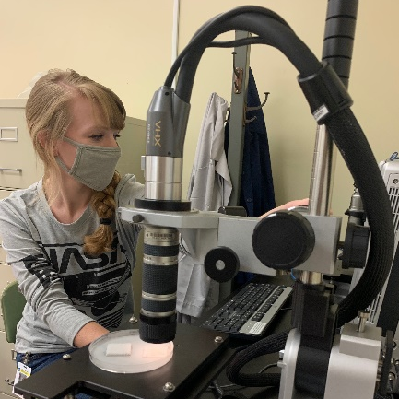
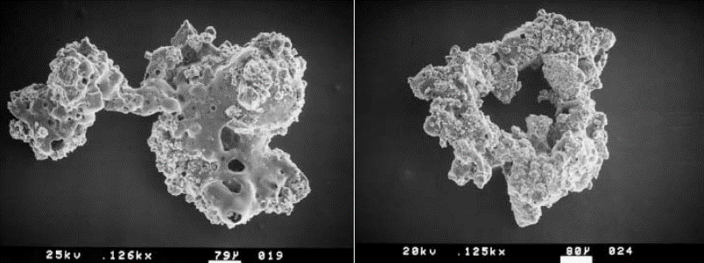
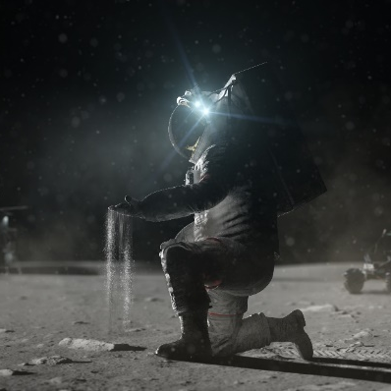
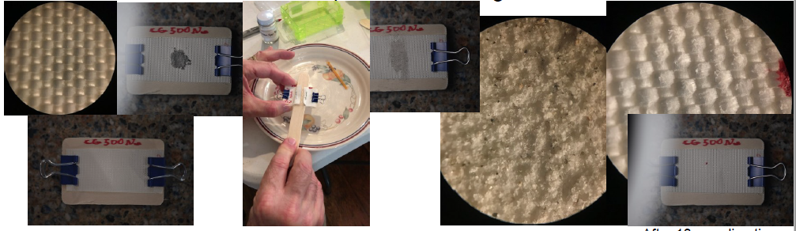
Space Technology Mission Directorate
Game Changing Development Program
Presenter: Charles (Chuck) Rogers | Moderator: Kristen John | FY21 Dust Mitigation Standards | Dusty Environments Classifications Task |
Annual Review Presentation | 09.15.21

Slide 2
STMD GCD Dust Projects
Dust Mitigation Standards Project
Dusty Environments Classifications Task
STMD GCD Dust Projects
Dust Mitigation Standards Project
Dust Mitigation Best Practices Guide Task
Dusty Environments Classifications Task
Dust Mitigation Development Project
Dust Mitigation Demonstration Project
Dusty Environments Classifications Document
Integrated Test Campaign for Lunar Dust Mitigation
Lo-DuSST Task
Dust Tolerant Mechanisms Task
Plume Surface Interactions Mini-Suite Task
Patch Plate Materials Compatibility Assessment Task
Electrodynamic Dust Shield Task

Slide 3
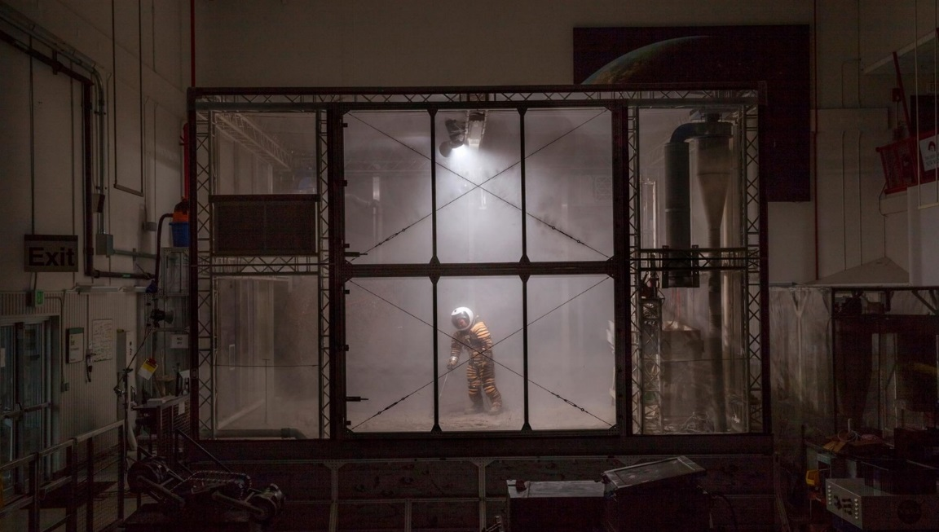
Dusty Environments Classifications Overview
Technology Product Capability
  Establish NASA Lunar Dust Classification Standards and Requirements for Testing Systems and Hardware Exposed to Lunar Dust
  Standards to be used in dusty environments for design and testing of all technologies, lunar surface systems and operations exposed to lunar dust
  Perform integrated tests in relevant environments
Technical Capabilities
  Form team of representatives across Agency to define standards
  Bring in SME’s as needed to review standards
Exploration & Science Applicability
  Publication and distribution of NASA-STD-1008, Classifications and Requirements for Testing Systems and Hardware to be Exposed to Dust in Planetary Environments
    For use by designers, commercial partners, and service providers
  Relevant to Artemis, CLPS, Gateway, HLS, LTV, etc.
Lunar dust is angular and abrasive
(Average particle size is 72 µm)
Regolith Test Bed at KSC Swamp Works
Notes:
Provide an overview of the Project/Task
The slide content is intended to remain static unless significant changes are made to the Project
Pictures are encouraged, please provide new pictures as frequently as possible

Slide 4

Dusty Environments Classifications
Technology Goals & Project Objectives
Technology Goals
Goal #1 | Develop NASA Lunar Dust Classifications Standards. Standards to be used in dusty environments for design and testing of all technologies, lunar surface systems and operations exposed to lunar dust.
Goal #2 | Apply Lunar Dust Classification Standards in an Integrated Test Campaign for Lunar Dust Mitigation.
Project Objectives
Objective #1 | Ensure that the Lunar Dust Classification Standards will be applicable to all Government Furnished Equipment (GFE) activities, as well as to all related contractor, subcontractor and commercial efforts that will be exposed to lunar dust.
Objective #2 | Determine the effectiveness of the Lunar Dust Classification Standards by applying the Standards in an Integrated Test Campaign for Lunar Dust Mitigation. Perform Integrated tests in relevant testing environments. Infuse technologies into various programs and projects based on testing-informed analysis.

Slide 5
Dusty Environments Classifications
Accomplishments and Current Status
Accomplishments
Completion of NASA-STD-1008; to be released this month
  NASA Centers completed review of NASA-STD-1008: Classifications and Requirements for Testing Systems and Hardware to be Exposed to Dust in Planetary Environments on Aug 2.
  JSC Export Control review completed August 16. Document will be publicly accessible.
  Final step for release of the document is Engineering Management Board (EMB) approvals expected Sept 9, followed by NASA’s Chief Engineer approval.
Continuing Test Planning for Part 2 of effort, applying Classifications and Standards to Dust Mitigation Testing, with first tests
  Test of a Vacuum Cleaner in a simulated lunar dust environment – ongoing – At JSC
  Tests of Brushes, Wipes and Tapes with lunar dust on material samples – ongoing – At GRC
  Study of dust mitigation in airlock – ongoing – At JSC
  Charge to mass ratio experiments – recently kicked-off – At KSC
Hired contractor at NASA GRC who is an aerosol expert for the Agency & purchased equipment for GRC GASP Lab
Purchased equipment for testing at JSC
Current Status
Estimating NASA-STD-1008 will be formally released in September. (Any day now!!!)
Ongoing testing efforts
Kicking off new testing efforts for FY22

Slide 6
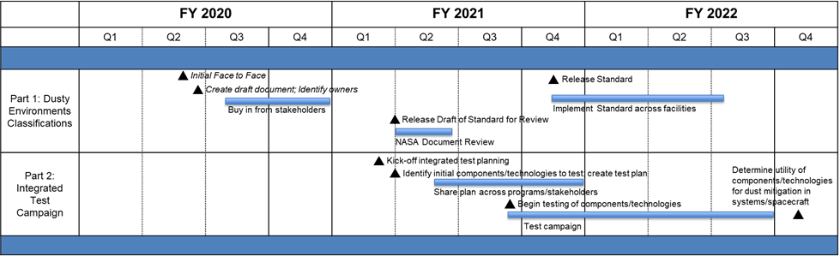
Dusty Environments Classifications Schedule
Dusty Environments Classifications Schedule
Notes:
Provide a title for the accomplishment
Element – Portfolio Project: Specific Facet. Other: Map to Tech Assessment / Tech Element / Tasks
Type – Milestone, EPO, Test, etc.. Provide your description. New Image for EPO – Yes – Project Overview Slide or No. Highlight Submitted – No, Yes, Will submit on XX/XX/XXXX.

Slide 7
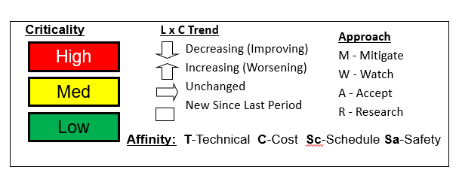
Dusty Environments Classifications
Risk Summary
L
I
K
E
L
I
H
O
O
D
5
Risk ID | Affinity | Description/Status | Proposed Mitigation | Trend
Currently No Risks
4
3
2
1
1
2
3
4
5
CONSEQUENCES

Slide 8
Dusty Environments Classifications Project Assessment Summary
Project Name | Performance |  |  |  | Comments
 | C | S | T | P
Mid Year | G | G | G | G | Technical - No technical issues at this time. Cost - No cost issues at this time. Schedule It is estimated that the release of NASA-STD-1008 will be 2.5 months late from the original milestone scheduled completion date. Document entered NASA-wide review on Jan 4, comments were due back on Feb 8, comments still coming in on Mar 1. Late release of document not considered an issue at this time. Programmatic - No programmatic issues at this time.
Annual | G | G | G | G | Technical - No technical issues at this time. Cost - No cost issues at this time. Schedule NASA Centers completed review of NASA-STD-1008: Classifications and Requirements for Testing Systems and Hardware to be Exposed to Dust in Planetary Environments on Aug 2. JSC Export Control review completed August 16. Document will be publicly accessible. Final step for release of the document is Engineering Management Board (EMB) approvals expected Sept 9, followed by NASA’s Chief Engineer approval. Programmatic - No programmatic issues at this time.

Slide 9
Dusty Environments Classifications Plans Forward and Infusion Plan
Forward Plan
Official release of NASA-STD-1008
Continue Vacuum Cleaner testing
Continue DM Slide (Brushes, Wipes and Tapes)
Continue charge to mass ratio experiments
Continue development of dust mitigation test objectives for airlock in an analog mission environment
Continue planning for future tests to begin in October
Bringing on team member to help coordinate testing efforts, with a focus on LTV test plans
Infusion
NASA-STD-1008 has made its way to several program managers and test leads
Formal document to be distributed
Several programs and projects will be kicking off dust mitigation testing efforts, using NASA-STD-1008 as a requirement, or in some cases, a reference
Our team will be available to assist programs/projects/test leads
We will also encourage any ongoing testing efforts to leverage this standard
We will communicate to facility owners about the release and expectations of the standard

Slide 10

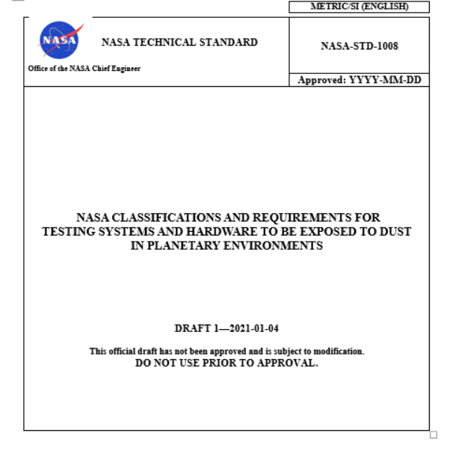
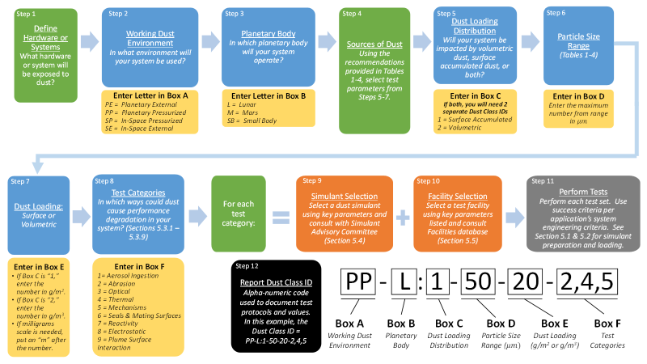
NASA-STD-1008 Document Overview
SECTION 4.
Dust Requirements & Standards
4.1 Dust Impact Assessment Process
4.2 Sources of Dust
a. Planetary External (PE)
b. Planetary Pressurized (PP)
c. In-Space Pressurized (SP)
d. In-Space External (SE)
SECTION 5.
Testing Methodologies & Best Practices
5.1 Simulant Prep & Storage
5.1.1 Particle Separation
5.1.2 Bake-out
5.1.3 Storage
5.2 Simulant Loading Definitions
5.2.1 Surface Accumulated Loading
5.2.2 Volumetric Loading
5.3 Testing Practices & Categories
5.3.1 Aerosol Ingestion
5.3.2 Abrasion
5.3.3 Optical
5.3.4 Thermal
5.3.5 Mechanisms
5.3.6 Seals & Mating Surfaces
5.3.7 Reactivity
5.3.8 Electrostatic Properties
5.3.9 Plume Surface Interaction
5.4 Simulants
5.5 Facilities
Notes:
Organization and approach

Slide 11
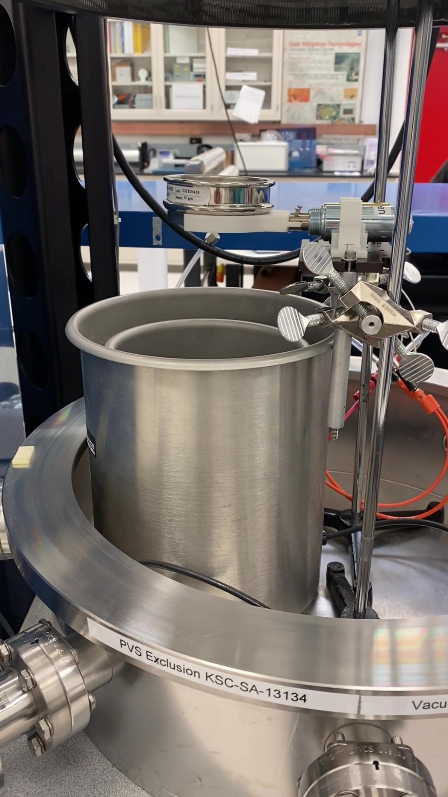
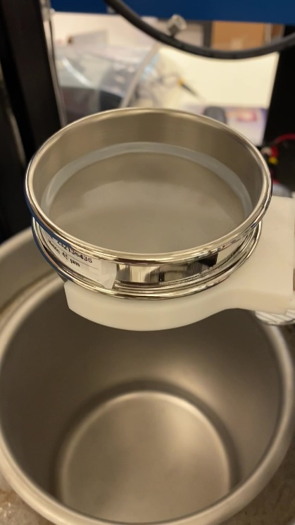
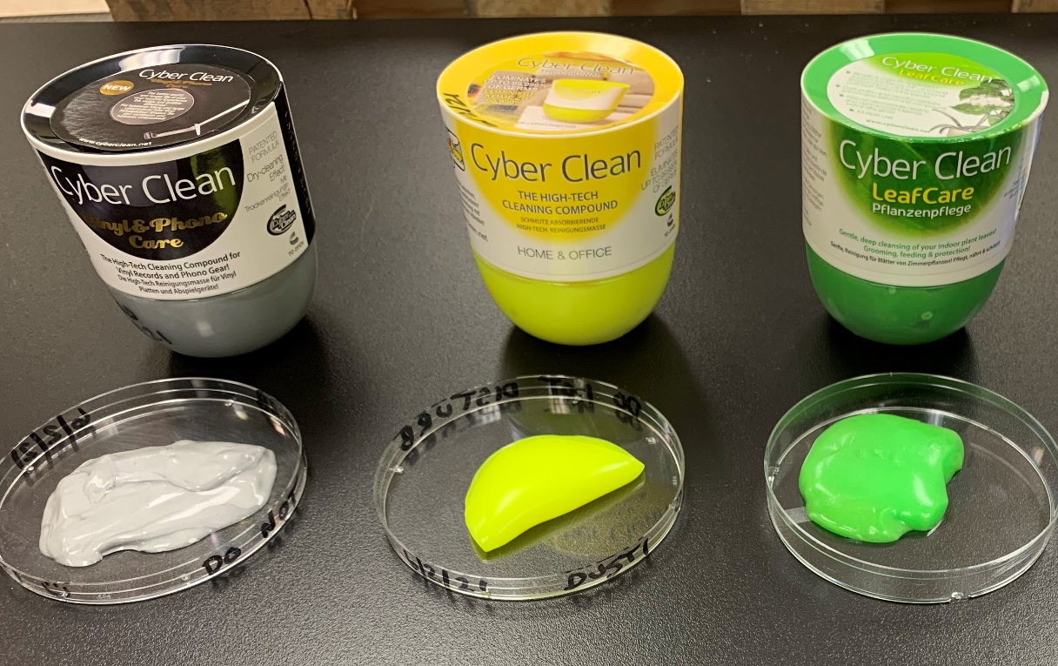
Integrated Test Campaign for Lunar Dust Mitigation
Vacuum Cleaner Testing
Dust & Airlocks
DM Slide
Charge to Mass Ratio Experiments
Lunar Dust Contamination on Spacesuit Fabrics
Simulant Bake-out Method Timescale Experiments
Tech 10
Cyclone Separators
Tech 8
Tech 9
Dusty Environments Classifications
Testing Overview
  SMEs at JSC, KSC, GRC, GSFC, MSFC, LaRC, & AFRC
  Testing at JSC, GRC, and KSC
  FY21 Technologies to Test
  (continuing in FY22)
  FY22 Technologies to Test

Slide 12
Dusty Environments Classifications
Summary
Close to releasing NASA-STD-1008
Testing efforts underway and more kicking off shortly

Slide 13
BACKUP

Slide 14
Dusty Environments Classifications
Annotated Cover Slide Images
Annotated Cover Slide Images
Fixture for depositing simulant
Lunar dust simulant
Microscope analysis of lunar simulant testing
Image of lunar dust which is angular and abrasive
Spacesuit fabric covered in lunar simulant
Illustration depicting astronaut in a dusty lunar environment

