Slide 1
Secure Airspace Overview
September 2021

Slide 2
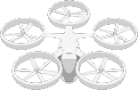
Secure Airspace Introduction
Challenge: The future urban air mobility (UAM) airspace will see numerous types of cyber security and physical attacks, requiring UAM systems to adapt using evolving cyber detection and prevention technologies.
Goal: To develop and demonstrate capabilities, in order to provide requirements for secure data integrity, resiliency and information privacy to Urban Air Mobility (UAM) environments.

Slide 3
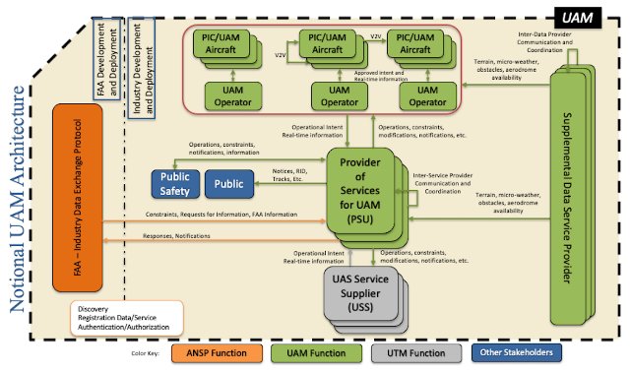
UAM Architecture Security Assessment
Urban Air Mobility (UAM), leveraging a service-based architecture for Secure Airspace solutions
UAM Environment :
Independent UAM operators leveraging diverse communications
Interactions (data exchange) between multiple PSUs and operators
Decentralized local computing and cloud environments requiring security
In support of the UAM Sub Project, Secure Airspace develops cybersecurity architectures and conceptual research solutions for technologies that provide resiliency, data integrity and information privacy to the systems operating in Urban Air Mobility (UAM) environments.

Slide 4
UAM Architecture Threat Landscape
Man-in-the-middle attack, leading to unauthorized access or data manipulation
Jamming, leading to the limitation of available data
Rogue UAS attempting to access UAM network
Victim of spear phishing, leading to the interaction with malicious content
Exploitation of valid accounts, leading to the loss of credentials and system access
Exploitation of valid accounts, leading to the loss of credentials and system access
Exploitation of public facing application, leading to corruption of data

Slide 5
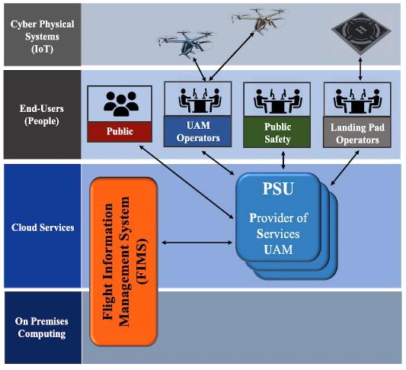
Threat Landscape
Cyber and physical threats to the service-based UAM architecture
Cyber Physical Systems
UAS vehicles, eVTOL landing pads and the associated data processing components
End Users
Operators of UAS and eVTOL landing pad operators, their associated systems and data
communications
Cloud Services
Providers of UAM services leveraging cloud services for compute and storage
On Premises Computing
Legacy on-premises computing integration into the future service-based UAM architecture

Slide 6
Secure Airspace Activities Initiated Under ATM-X UAM
Security Assessment of the UAM Architecture
Security Assessment of the Experimental Environments used by UAM in support of the X4 Simulations
Research of an Immutable Secure Data Exchange and Storage for UAM Environments

Slide 7

UAM Architecture Security Assessment
Delivered report, “Survey Threats for Selected UAM Airspace Services” to UAM Sub project management
Initiate research of security vulnerabilities of the UAM Architecture using UTM findings as a starting point
Periodic security assessments of the UAM architecture as it changes

Slide 8
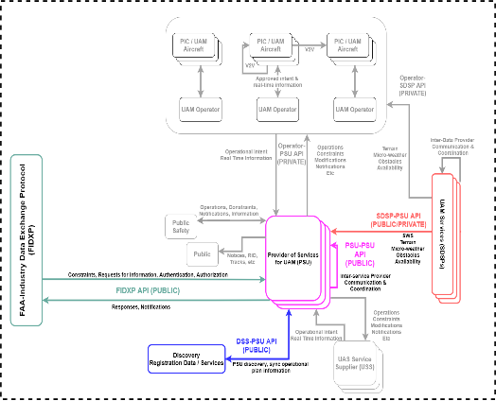
X4 Simulation Architecture
Review documentation on the X4 simulation environment
Develop the test procedures for the X4 environment
Perform security vulnerability tests throughout the X4 test cycle and provide a report of findings and recommendations
On going security assessment of future X test environments building toward the UAM technical challenge in 2025

Slide 9
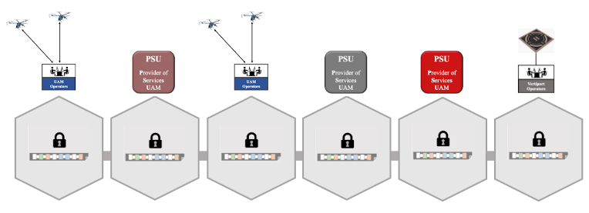
What is Blockchain?
Blockchain is the technology behind cryptocurrencies like Bitcoin
Blockchain provides an immutable distributed ledger made up of blocks
Immutability ensures that no one can alter the state of the blockchain data, preventing data manipulation
Blockchain technology provides is a method of maintaining security of transactions without the presence of a central authority

Slide 10
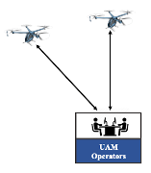




Immutable Secure Data Exchange and Storage for UAM Environments
Intent: Leverage a permissioned blockchain approach, in order to simulate secure data exchange and storage
Develop Immutable Secure Data Exchange and Storage
Test Immutable Secure Data Exchange and Storage in a simulated environment
Demonstrate Immutable Secure Data Exchange and Storage in a flight test scenario
Note: Blockchain approach is being infused into DRF Core architecture

Slide 11
Immutable Secure Data Exchange and Storage for UAM Environments
Scenario-1: Registration
Register each pilot into the network. (e.g. pilot name, licensing information, etc…)
Register each vehicle into the network.
Register each vertiport station into the network.
Key Threats Mitigated: Exploitation of public facing applications, insider threat, and spearfishing
Objectives of research:
Identify and implement the security controls to enable the confidential data exchange and data storage between UAM operators, vertiport operators and other service providers within a federated UAM environment

Slide 12



Immutable Secure Data Exchange and Storage for UAM Environments
Scenario-2: Telemetry
Each vehicle broadcasts its ID and Location to the network
Key Threat Mitigated: Man-in-the-middle attack
Objectives of research:
What data / security trade-offs are needed to ensure confidential information exchange between the PSU, Vertiport operators and the UAM operators in a federated UAM environment?
Simulate transmission
of vehicle telemetry
based on ADS-B
Translate telemetry
simulation data to
smart contract readable
information
Leverage DFW
Low Demand Traffic Routes
Write data to
blockchain

