Slide 1

Modeling Space-Radiation Induced Chromosome Aberrations
NIA Sandwich Seminar - September 13th 2021
Floriane Poignant¹, Ianik Plante², Tony C. Slaba³
¹National Institute of Aerospace, Hampton, VA 23666
²KBR, 2400 NASA Parkway, Houston, TX 77058
³NASA Langley Research Center, Hampton, VA 23681

Slide 2
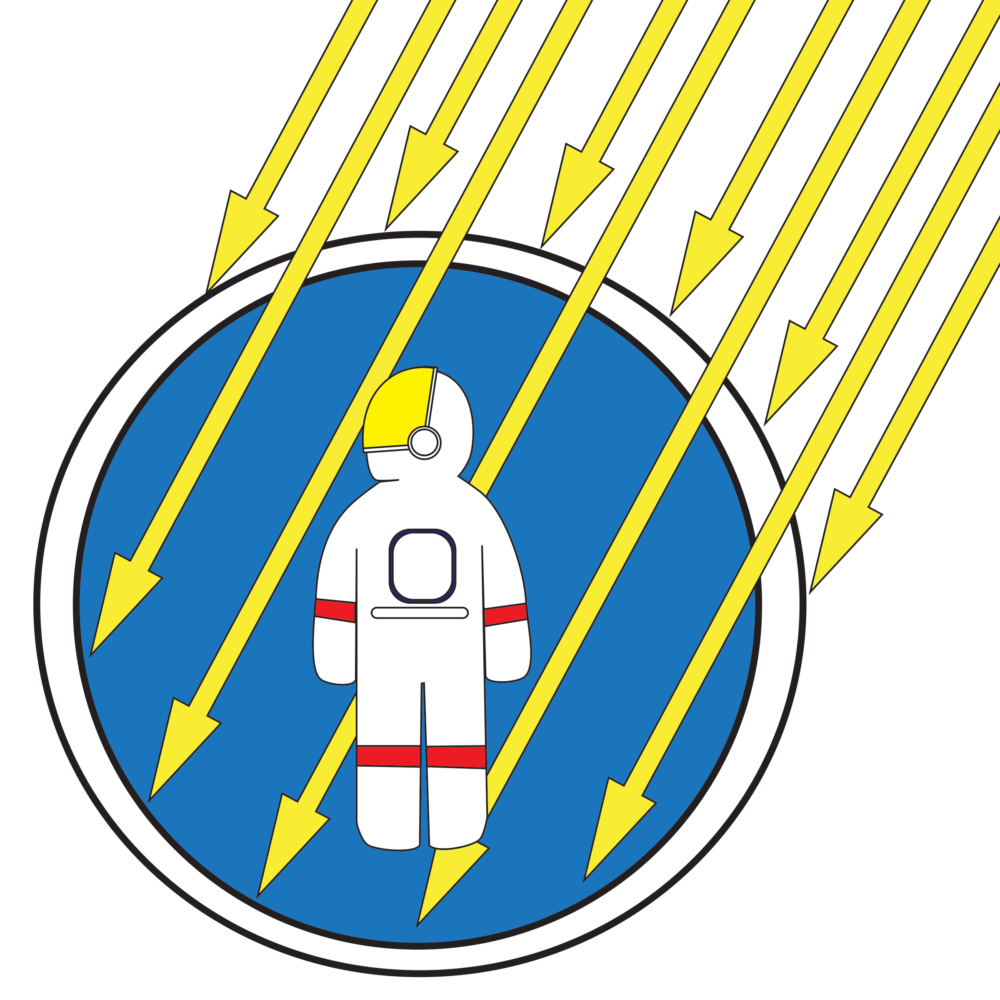

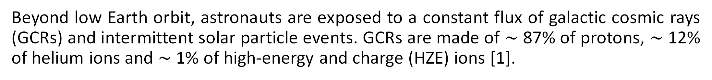
Context Method Results Conclusions
Space Travel Risks
The human research program has identified 5 main hazards for spaceflight*: space radiation, isolation, distance from Earth, gravity field and hostile/closed environment. Long-term consequences from exposure to ionizing radiation include carcinogenesis, cardiovascular disease and cognitive impairment.
Space Radiation Environment
Beyond low Earth orbit, astronauts are exposed to a constant flux of galactic cosmic rays (GCRs) and intermittent solar particle events. GCRs are made of $\sim$ 87% of protons, $\sim$ 12% of helium ions and $\sim$ 1% of high-energy and charge (HZE) ions [1].
* https://www.nasa.gov/hrp/hazards
[1] Cucinotta et al. (2013) NASA TP 2013–217375.

Slide 3
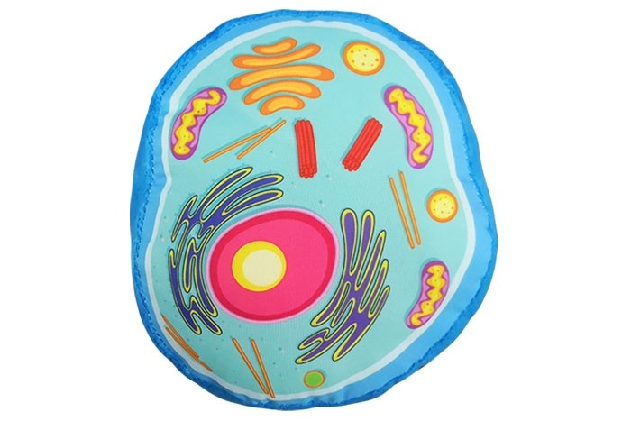
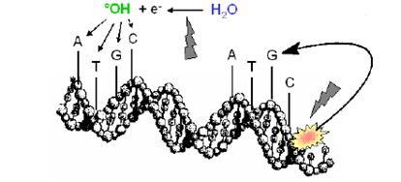
Context Method Results Conclusions
Radiation-induced damages: mechanisms
GCRs typically have enough energy to penetrate human tissues. At a cellular scale, ions that make up GCRs deposit energy by interacting with atoms and molecules that make up the cell. The dose is defined as the amount of energy deposited in the cell from all those interaction events (ionization/excitation), divided by its mass (Gy).
They create,
  direct breaks in the DNA
  highly-reactive, toxic chemical species that can further react with the DNA and create additional breaks.
Cells have DNA repair mechanisms. However, some breaks may be improperly repaired, leading to the formation of chromosome aberrations (CAs). If the cells survive the injury, divide and pass CAs onto daughter cells, it leads to the formation of mutations, some of which can evolve into cancer [2,3].
Ionization
[2] Kronenberg et al. Radiation Research 172, no. 5 (2009): 550-557.
[3] Kronenberg et al. Radiation Research 179, no. 5 (2013): 511-520

Slide 4
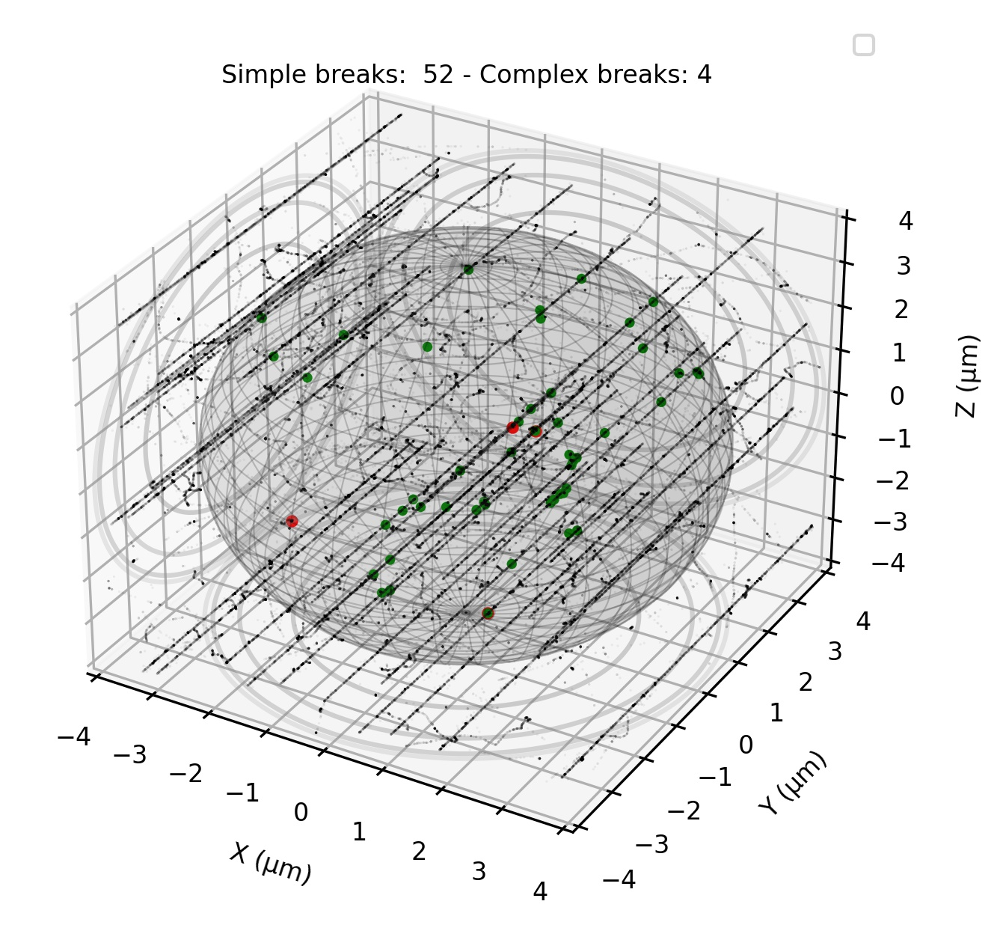
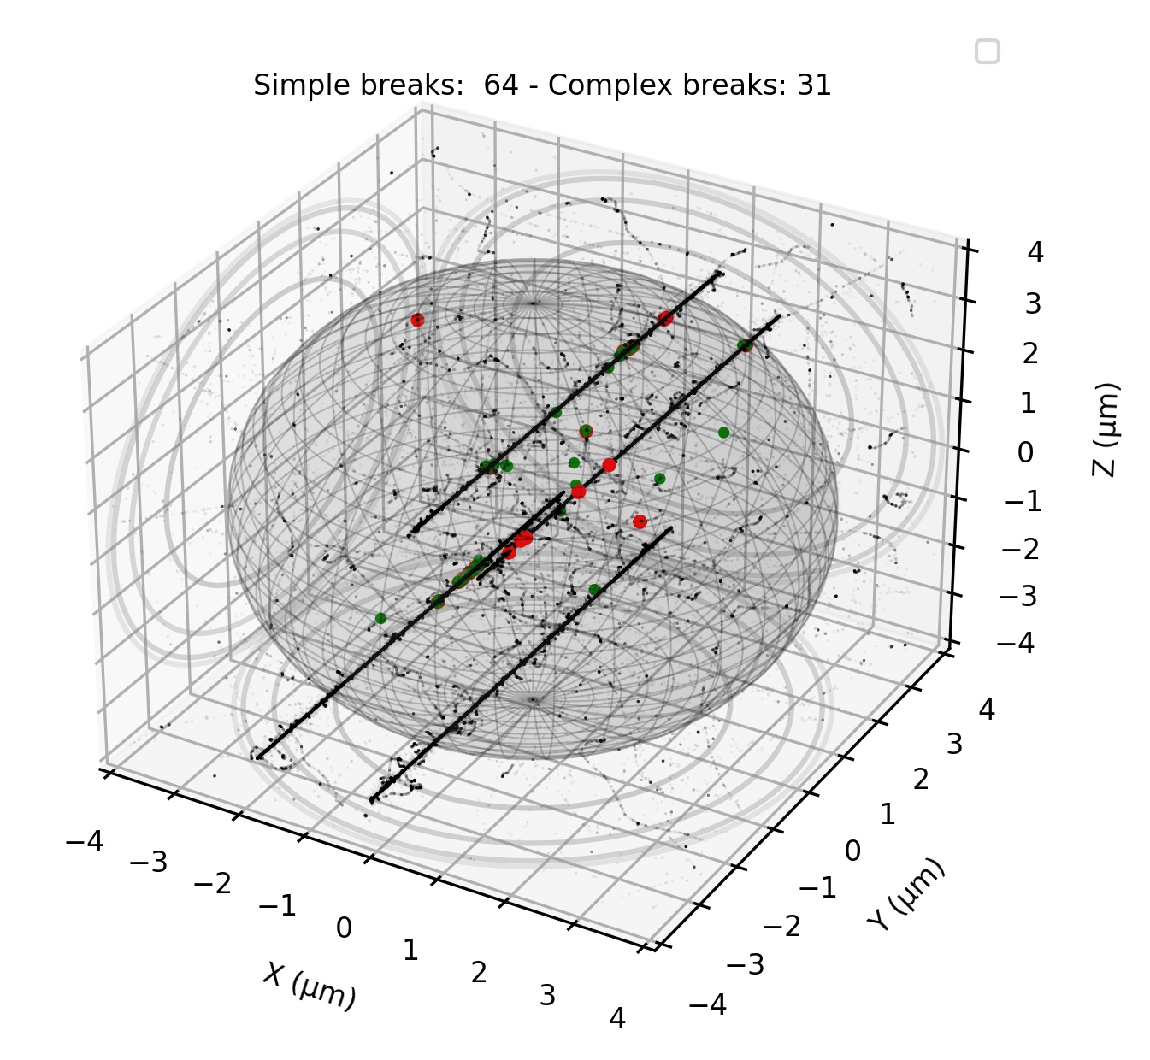
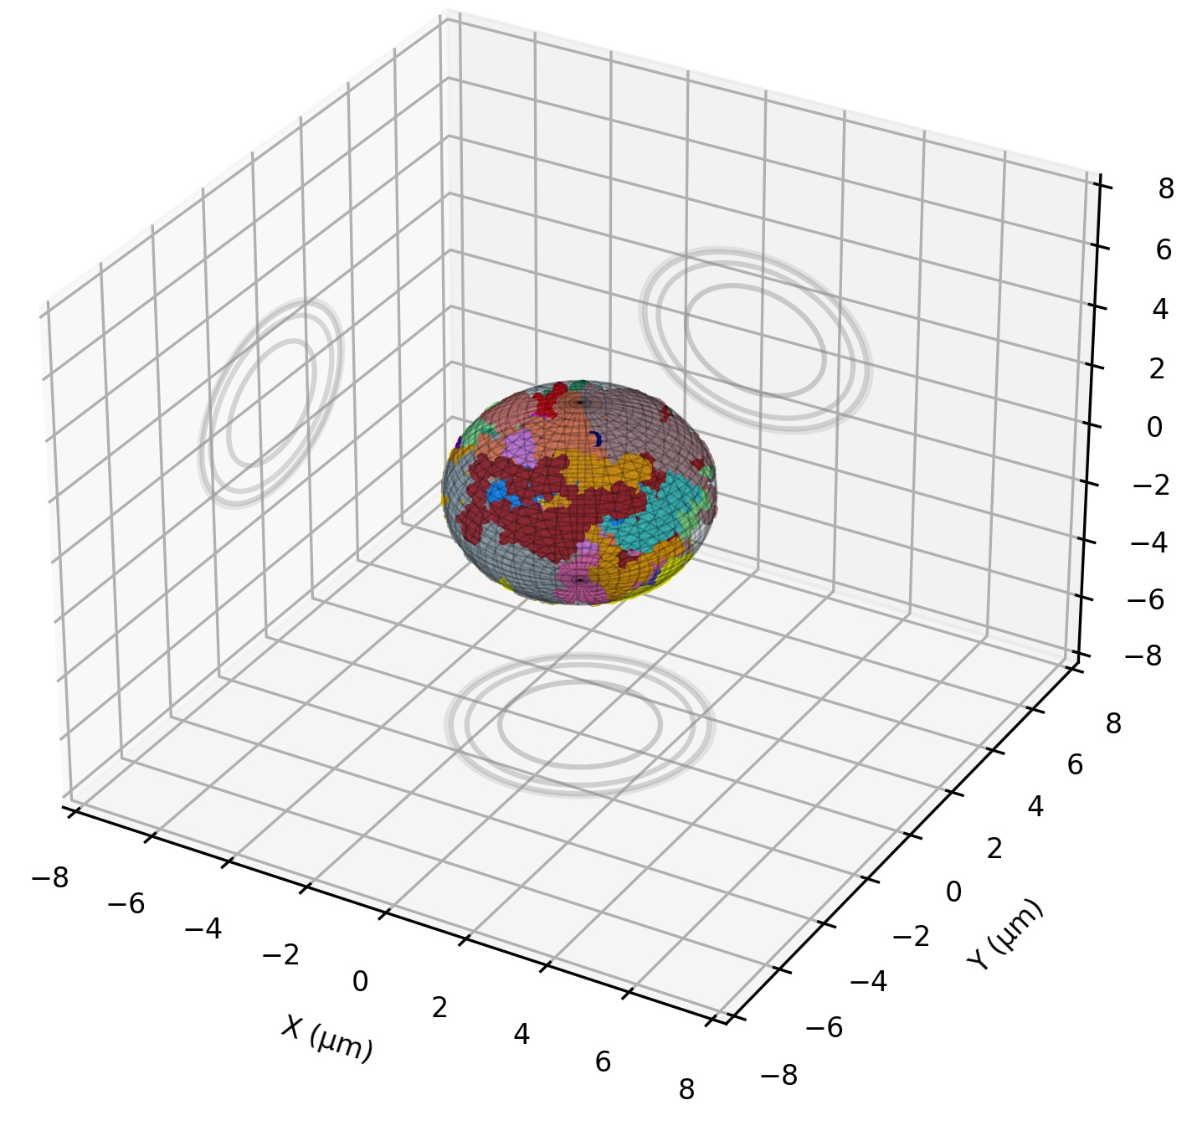
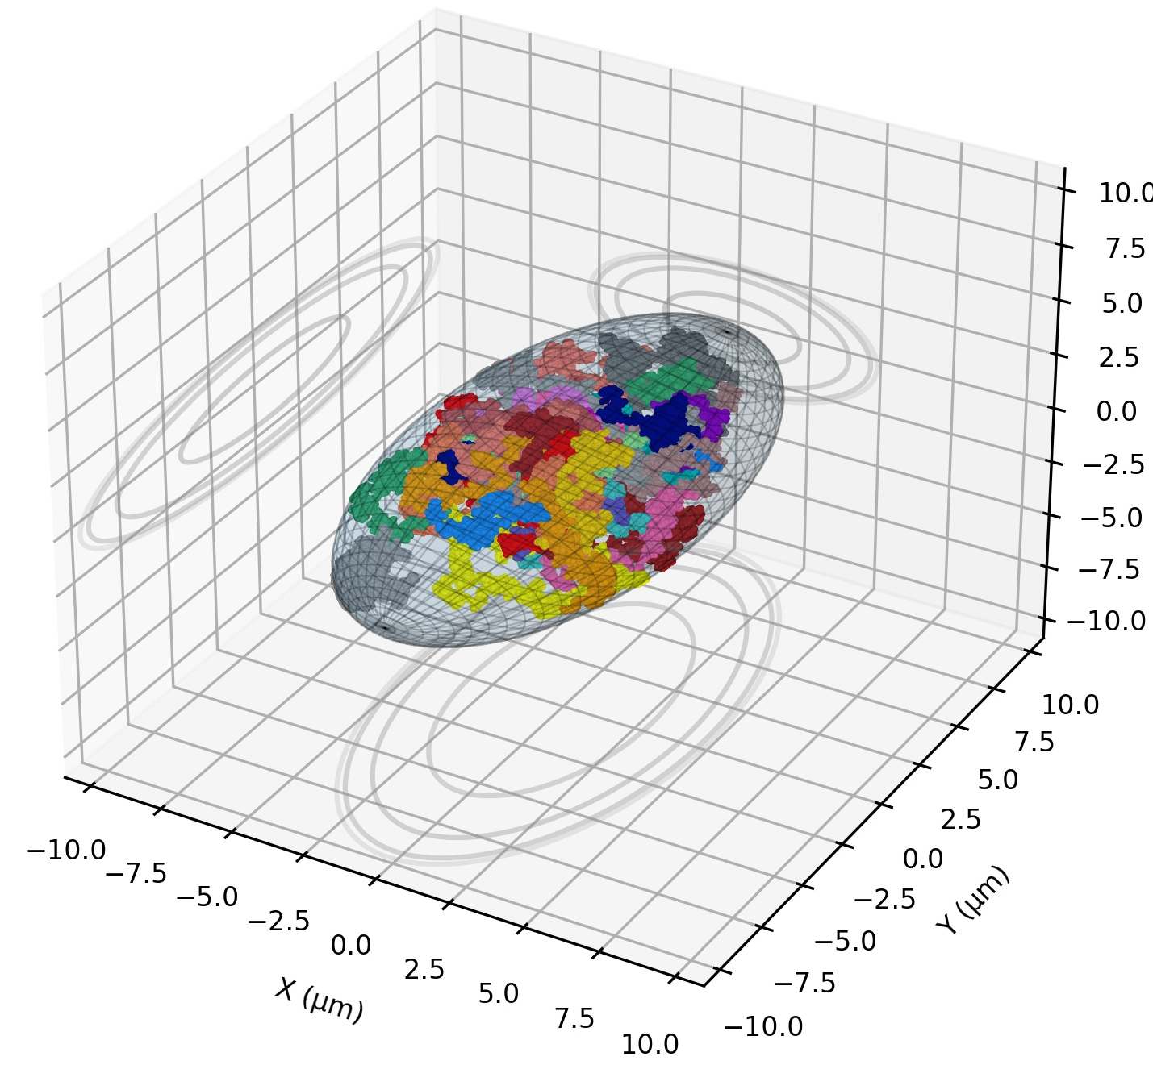
Context Method Results Conclusions
Radiation-induced damages: parameters
  Physical parameters: ion energy and type, and notably ion linear energy transfer (LET). Typically, CA yields peak for LET values around 100 keV/µm.
  Biological parameters: biological endpoint, cell type, etc. Different cells have different dimensions.
  Impact of nuclear geometry on CAs?
Same dose of 1 Gy
Lymphocyte spherical
R = 3 µm
Fibroblast ellipsoidal
(semi axis 5.1, 10.2 and 3 µm)
290 MeV/n C (LET = 12.9 keV/μm)
1000 MeV/n Fe (LET = 149.2 keV/μm)

Slide 5
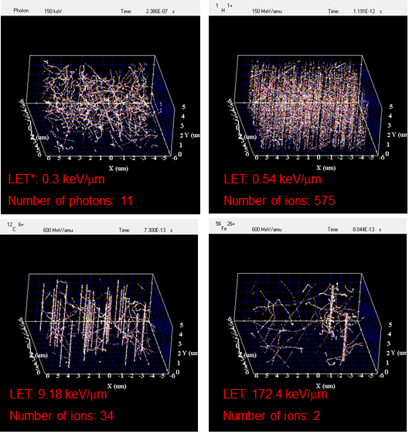
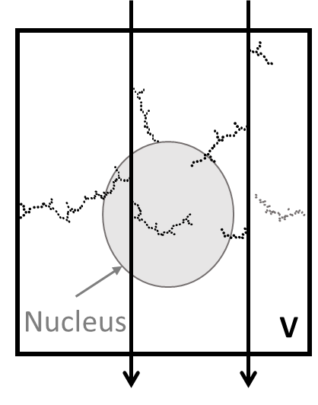
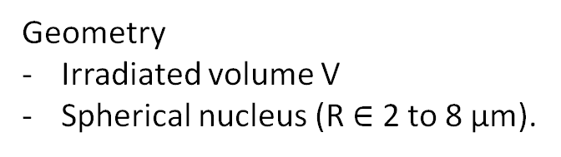
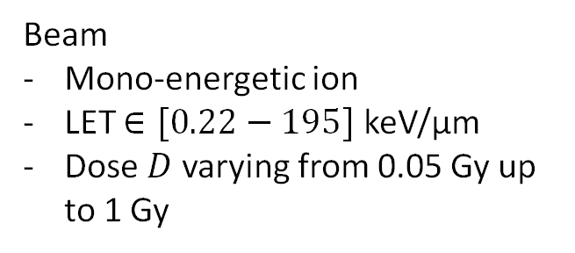
Context Method Results Conclusions
$$D \left(Gy\right)=1.6 ×{10}^{9}φ \left(p∙cm^{−2}\right) LET (keV/μm)$$
RITRACKS [4]
1. Irradiation
Geometry
Irradiated volume V
Spherical nucleus (R $∈$ 2 to 8 μm).
Beam
Mono-energetic ion
LET $∈[0.22−195]$ keV/μm
Dose $D$ varying from 0.05 Gy up to 1 Gy
[4] Plante and Cucinotta In Mode CB (Ed), InTech (2011).

Slide 6
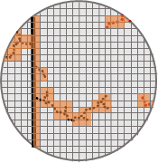
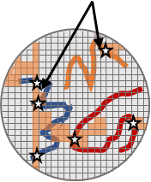
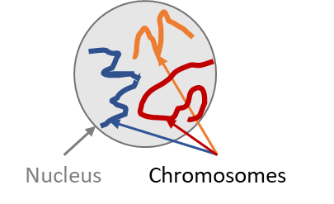
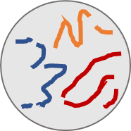
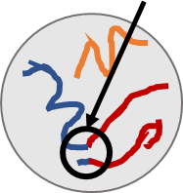
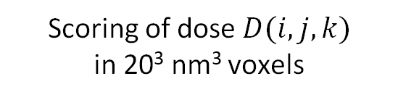
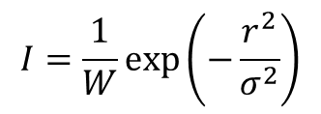
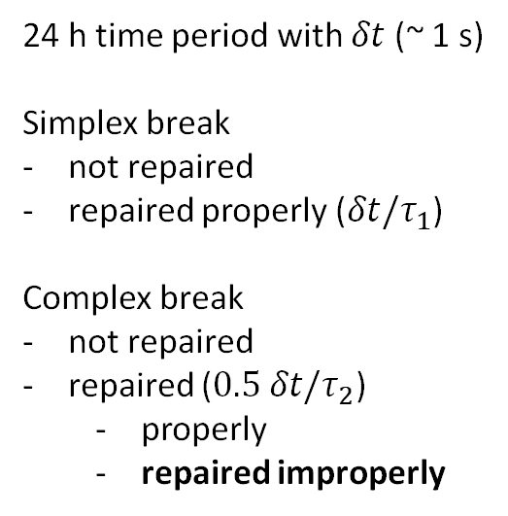
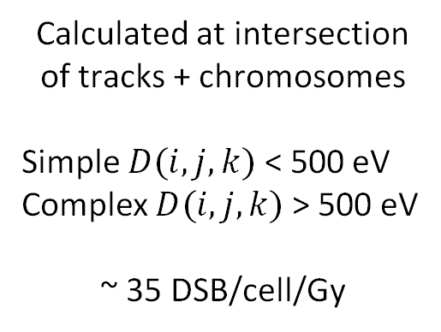

Context Method Results Conclusions
RITRACKS [4]
RITCARD [5]
1. Irradiation
2. Nanodosimetry
4. DNA breaks
5. DNA repair
6. Classification
Geometry
Irradiated volume V
Spherical nucleus (R $∈$ 2 to 8 μm).
Scoring of dose $D(i,j,k)$
in 20³ nm³ voxels
Calculated at intersection of tracks + chromosomes
Simple $D(i,j,k)$ < 500 eV Complex $D(i,j,k)$ > 500 eV
~ 35 DSB/cell/Gy
24 h time period with $δt$ (~ 1 s)
Simplex break
not repaired
repaired properly ($δt/τ_{1}$)
Complex break
not repaired
repaired ($0.5 δt/τ_{2}$)
  properly
  repaired improperly
Classify all fragments: intact, properly repaired, chromosome aberrations
Simple exchange (SE). involve 2 breaks in 2 chromosomes
Complex exchange (CE). involve > 2 breaks in 2 or more chromosomes
Beam
Mono-energetic ion
LET $∈[0.22−195]$ keV/μm
Dose $D$ varying from 0.05 Gy up to 1 Gy
+
3. Random walk
DNA DSBs =
2 free ends
$$I=\frac{1}{W}\exp\left(−\frac{r^{2}}{σ^{2}}\right)$$
Model of 46 chromosomes
Simple exchange
$$r$$
[4] Plante and Cucinotta In Mode CB (Ed), InTech (2011).
[5] Plante et al. Genes, no. 11 (2019):936.

Slide 7
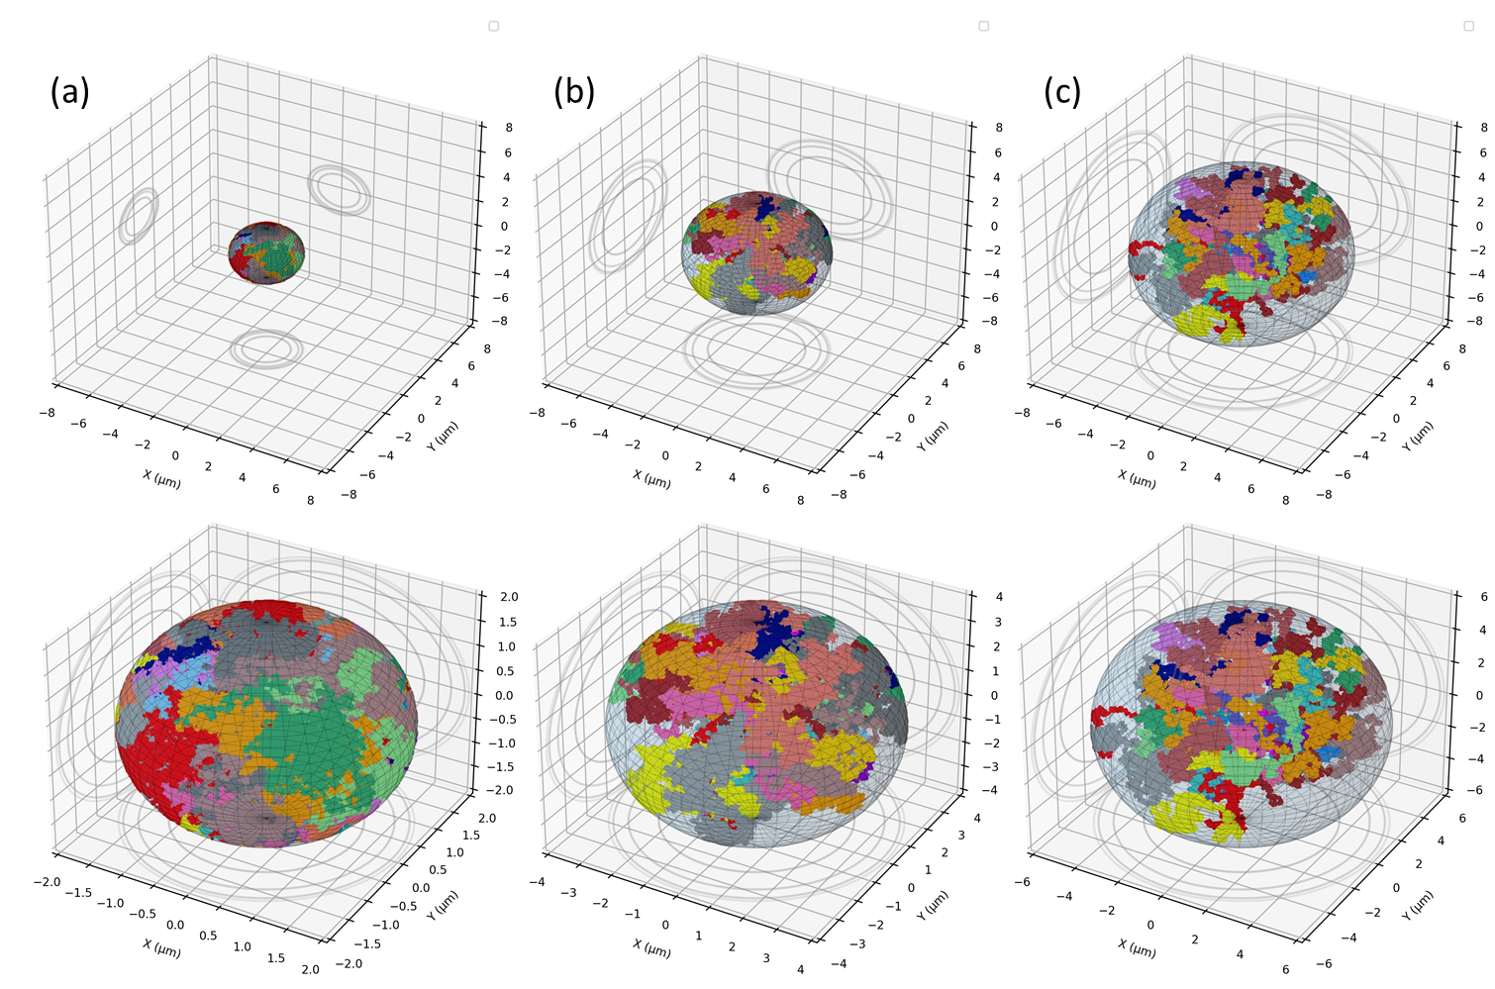
Context Method Results Conclusions
R = 2 µm
R = 4 µm
R = 6 µm

Slide 8
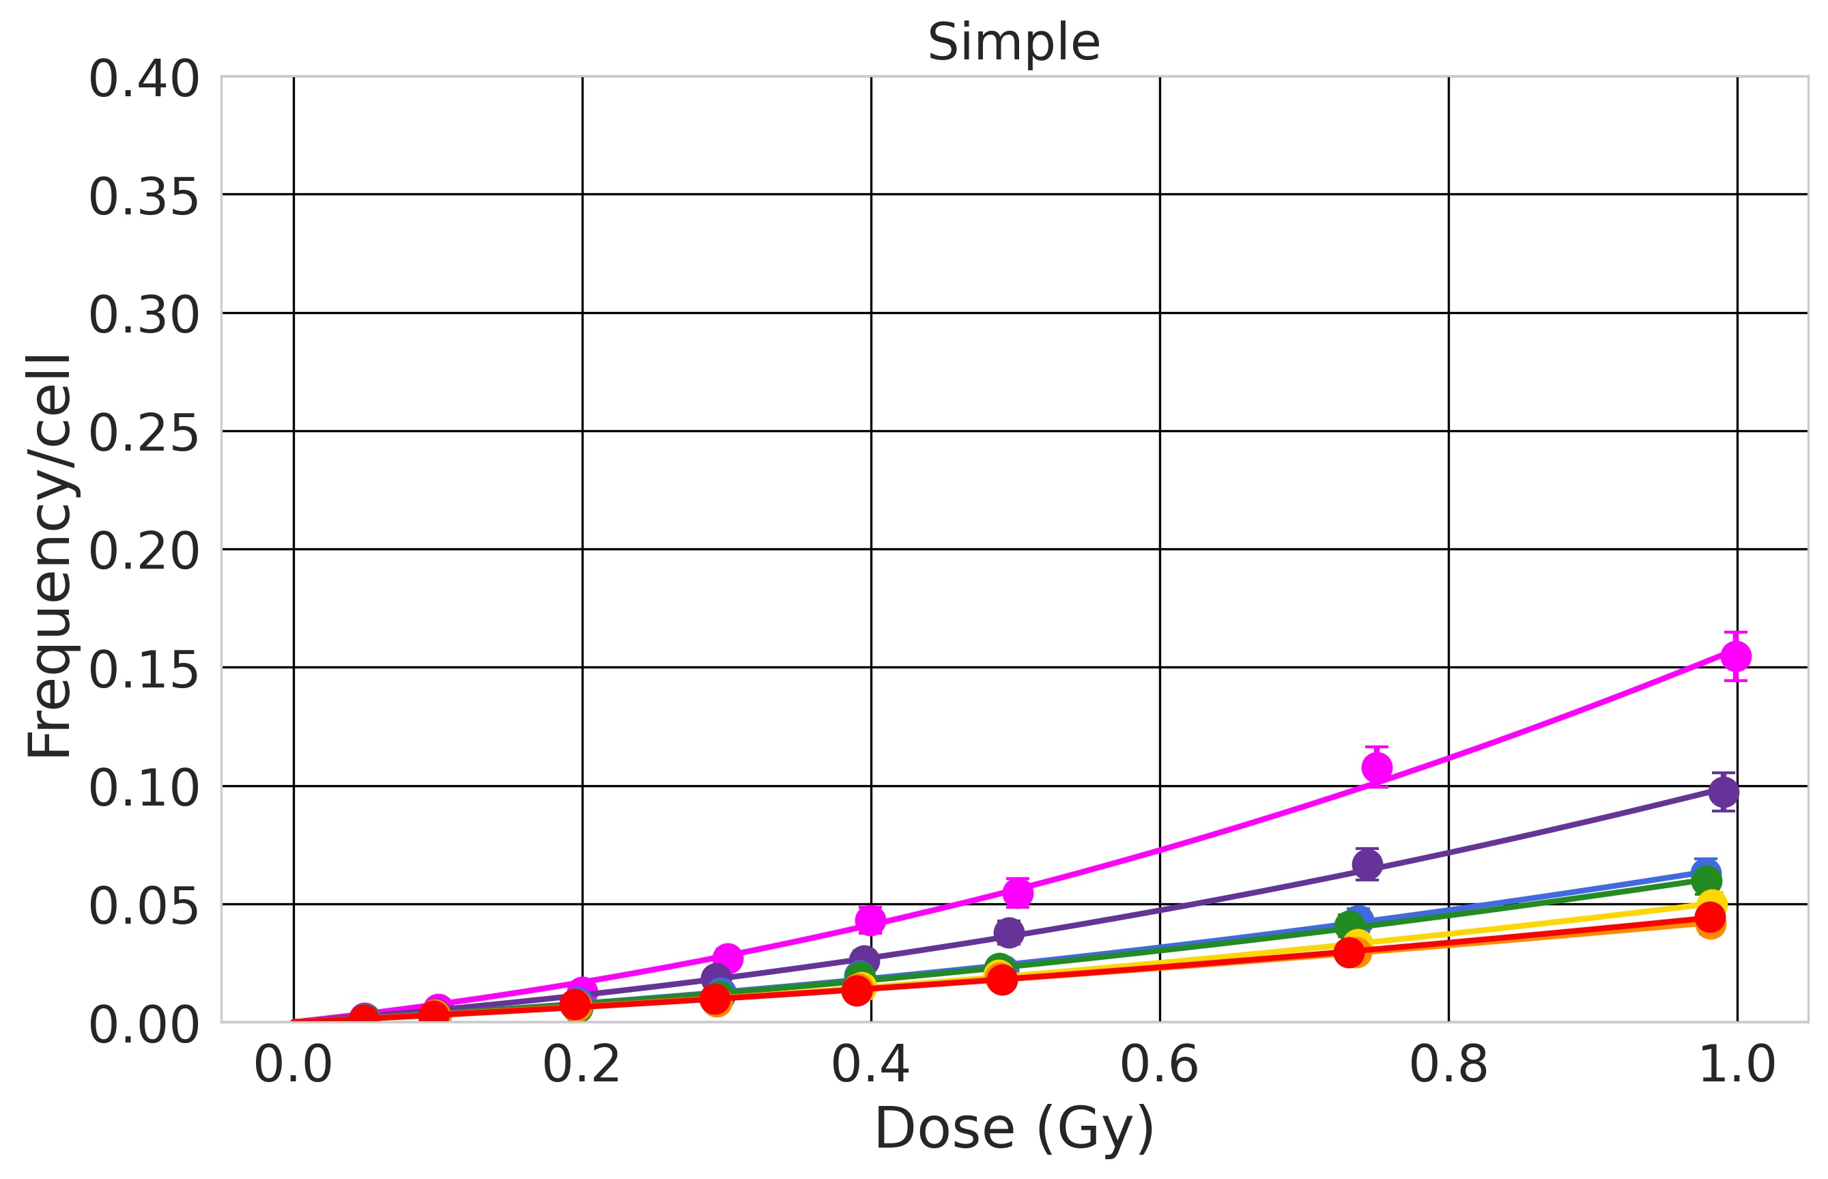
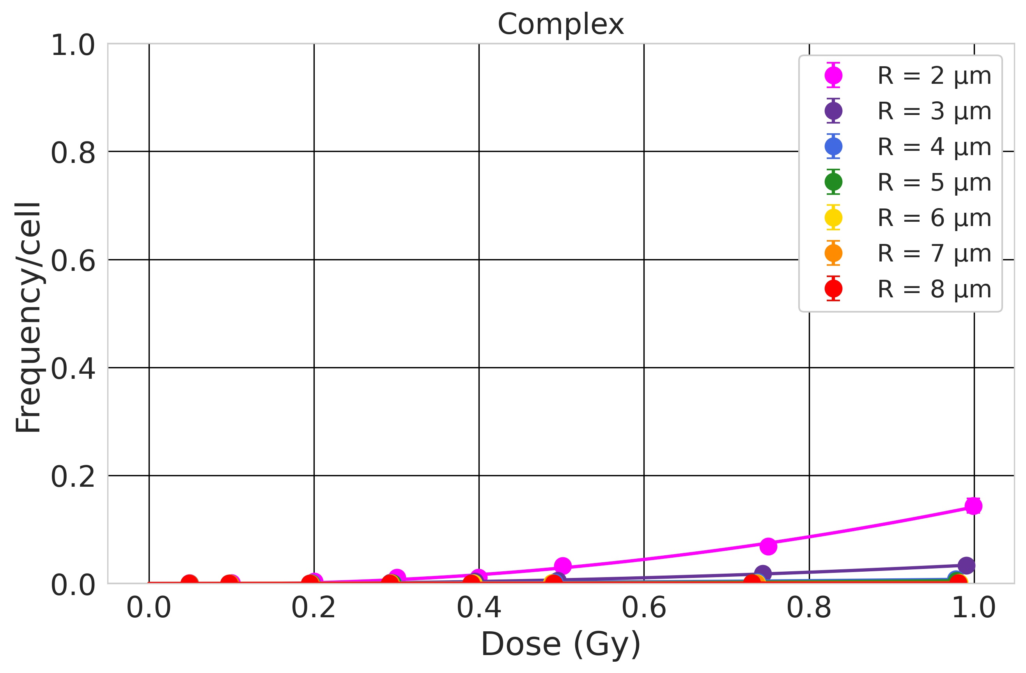
Context Method Results Conclusions
Results: dose-response relationship $y= αD+ βD^{2}$
H 1000 MeV/n – LET = 0.22 keV/μm
Low-LET: small SE and CE. Small dependence on nucleus size. SE and CE larger for smaller nuclei.

Slide 9
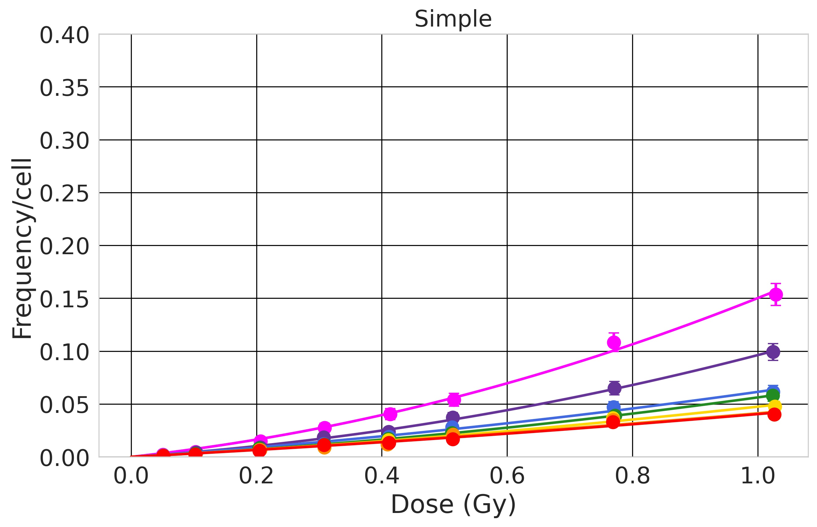

Context Method Results Conclusions
Results: dose-response relationship $y= αD+ βD^{2}$
He 250 MeV/n – LET = 1.56 keV/μm
Low-LET: small SE and CE. Small dependence on nucleus size. SE and CE larger for smaller nuclei. No strong dependence on the LET.

Slide 10
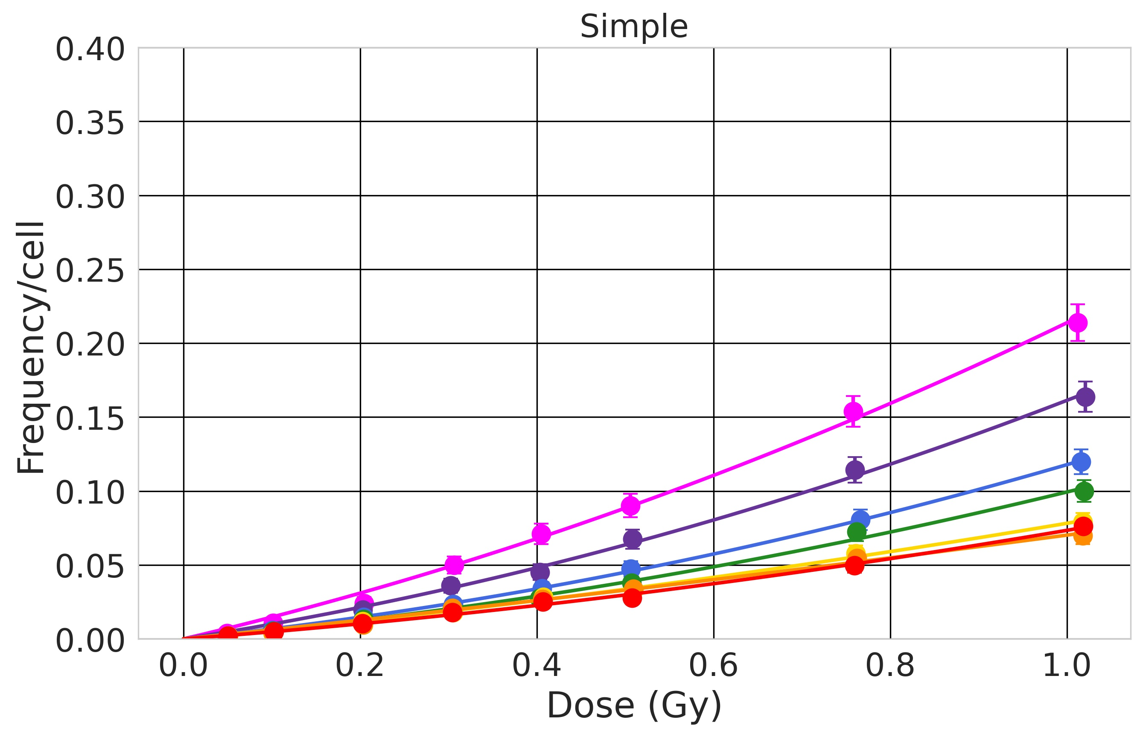
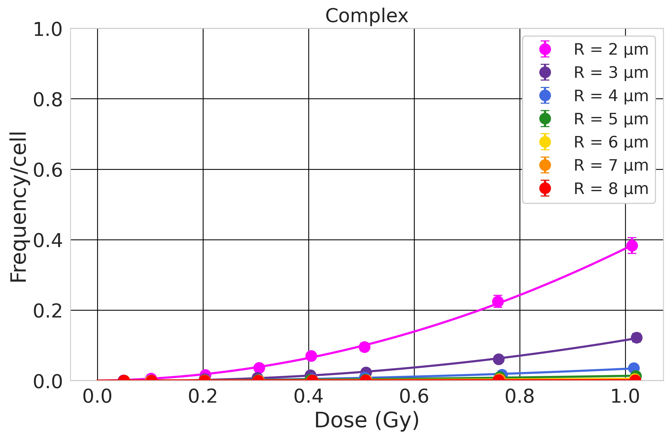
Context Method Results Conclusions
Results: dose-response relationship $y= αD+ βD^{2}$
C 290 12.9 MeV/n – LET = keV/μm
Low-LET: small SE and CE. Small dependence on nucleus size. SE and CE larger for smaller nuclei. No strong dependence on the LET.
Middle-LET: CE/SE starts increasing. Dependence on the nucleus size becomes stronger.

Slide 11
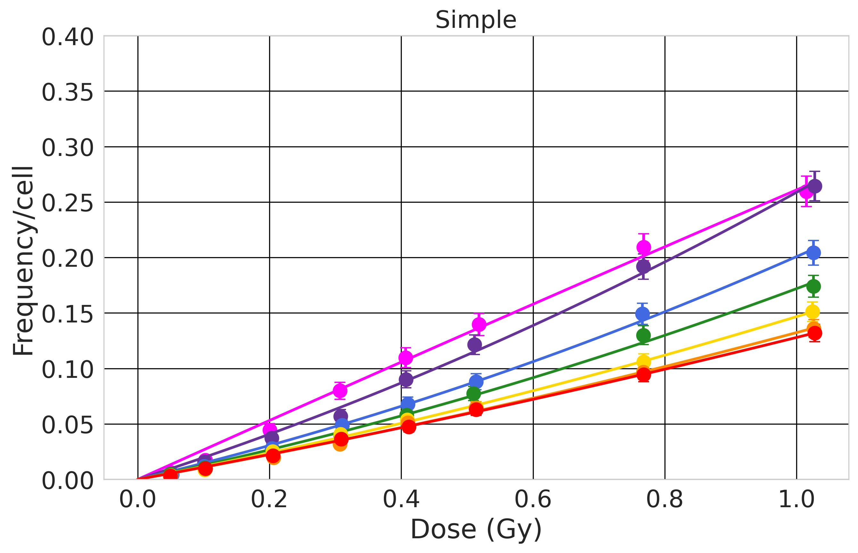
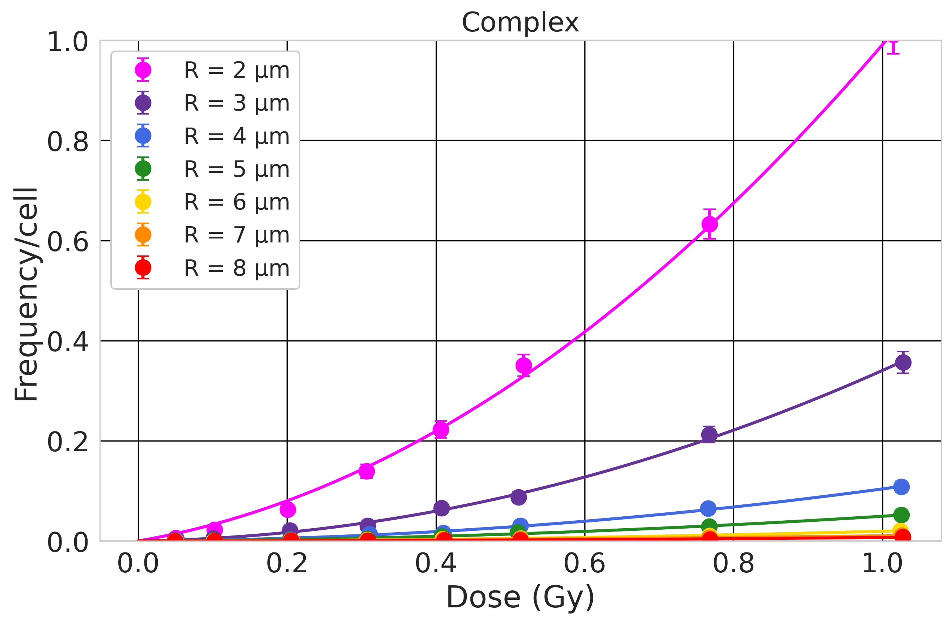
Context Method Results Conclusions
Results: dose-response relationship $y= αD+ βD^{2}$
O 250 MeV/n – LET = 25 keV/μm
Low-LET: small SE and CE. Small dependence on nucleus size. SE and CE larger for smaller nuclei. No strong dependence on the LET.
Middle-LET: CE/SE starts increasing. Dependence on the nucleus size becomes stronger.

Slide 12
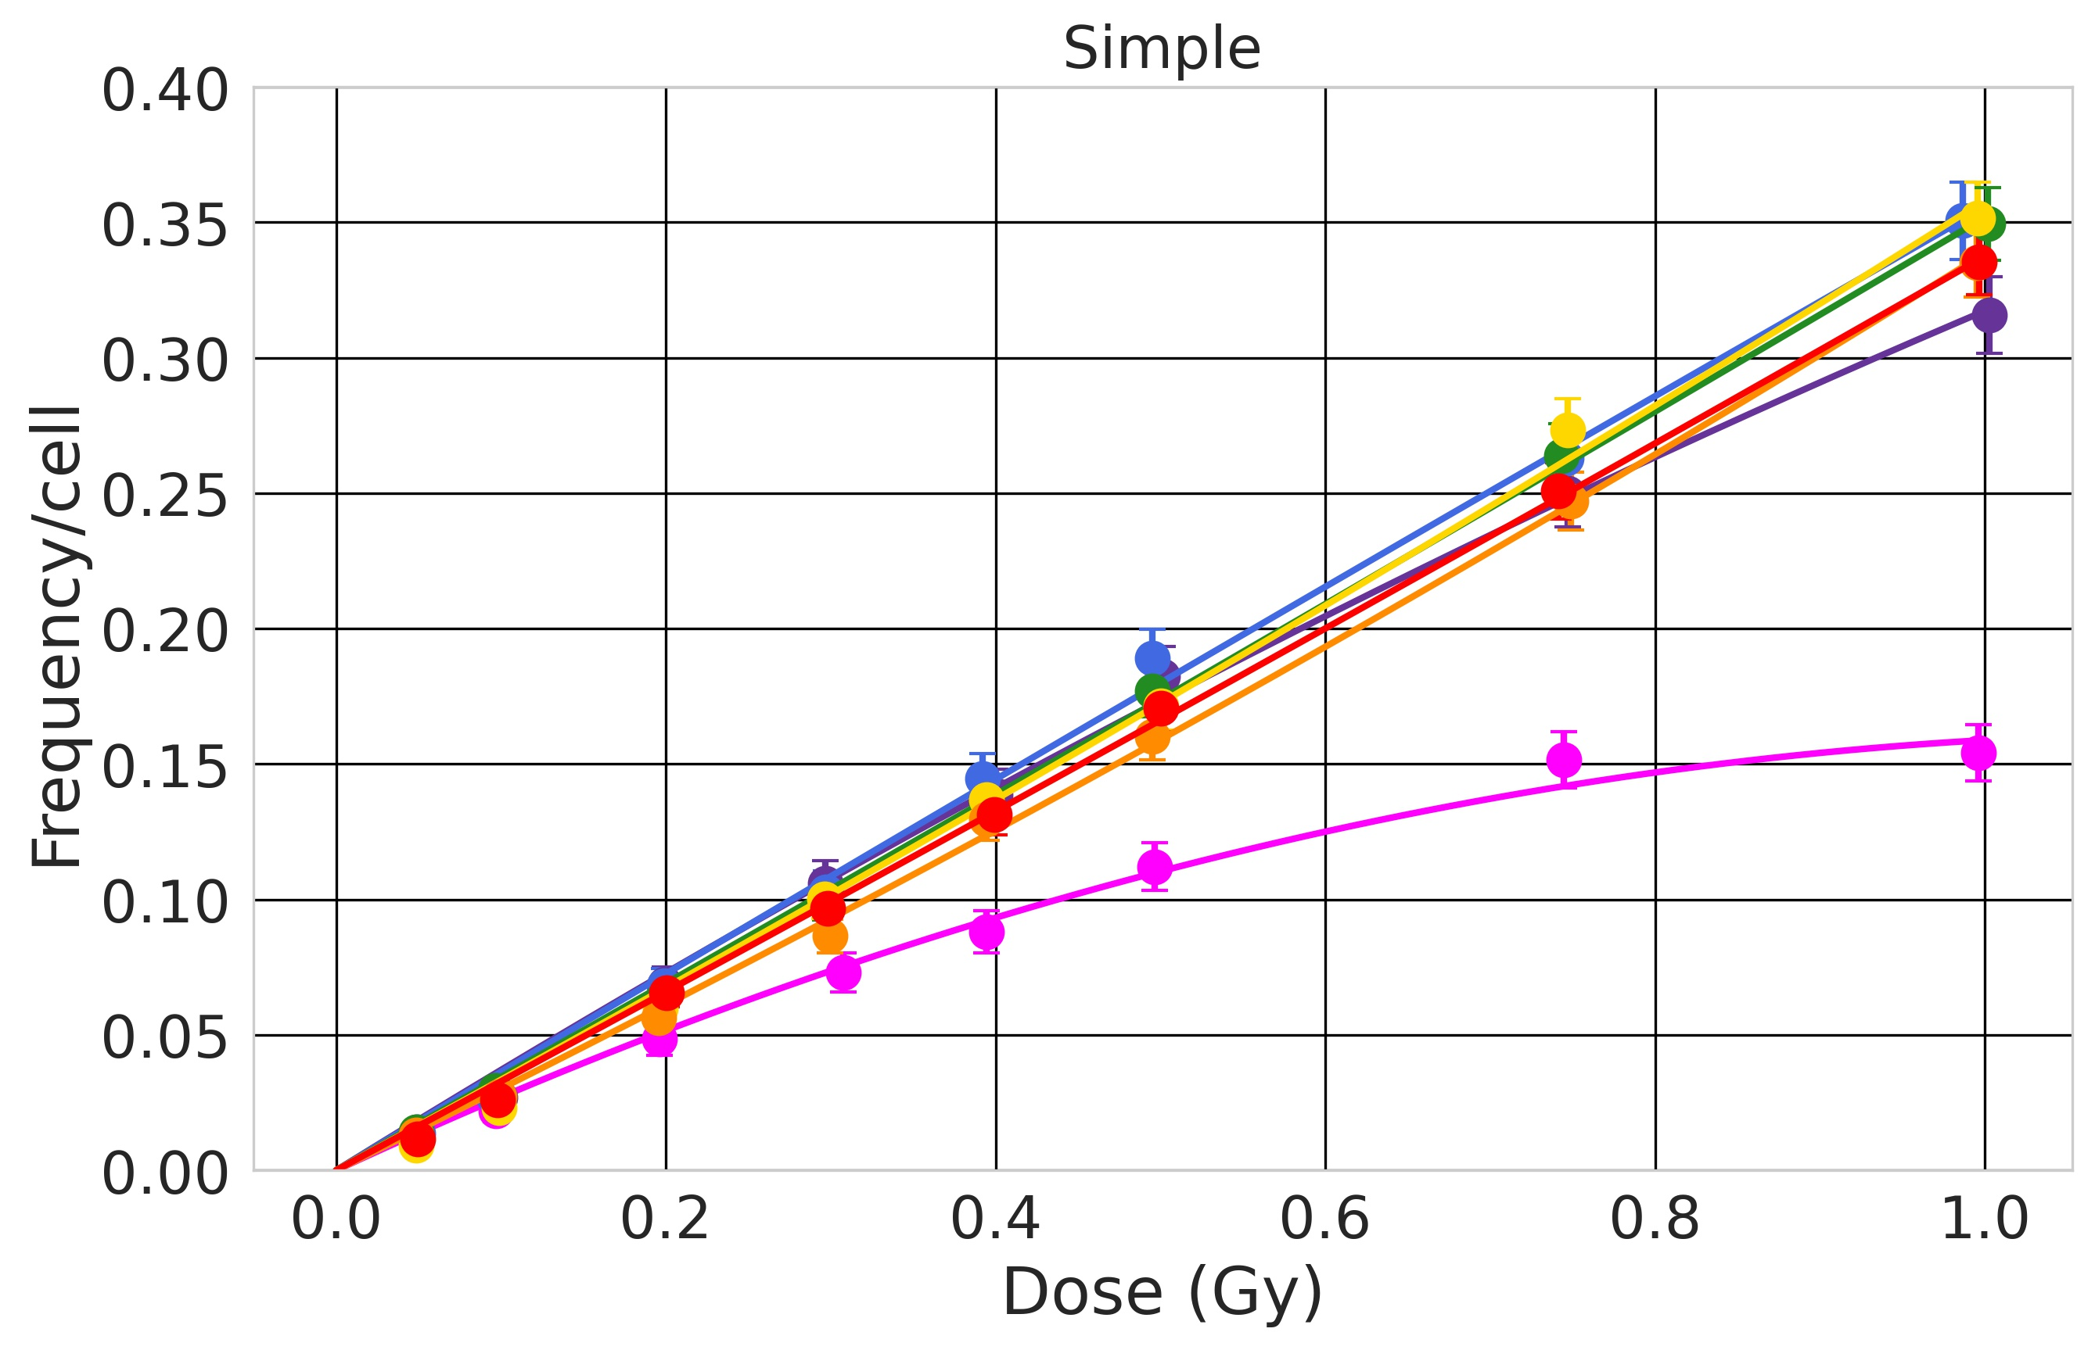
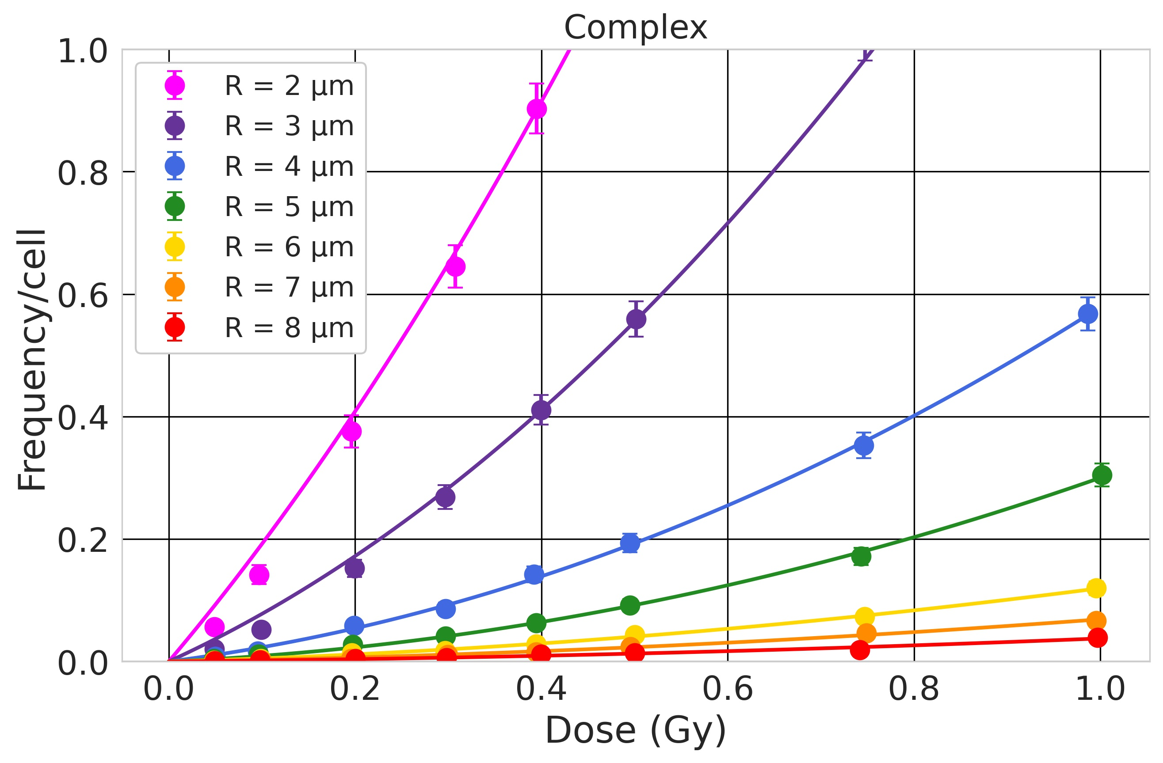
Context Method Results Conclusions
Results: dose-response relationship $y= αD+ βD^{2}$
Si 600 MeV/n – LET = 50 keV/μm
Low-LET: small SE and CE. Small dependence on nucleus size. SE and CE larger for smaller nuclei. No strong dependence on the LET.
Middle-LET: CE/SE starts increasing. Dependence on the nucleus size becomes stronger. Around LET = 50 keV/µm, SE becomes larger for larger nuclei. CE remain larger for small nuclei.

Slide 13
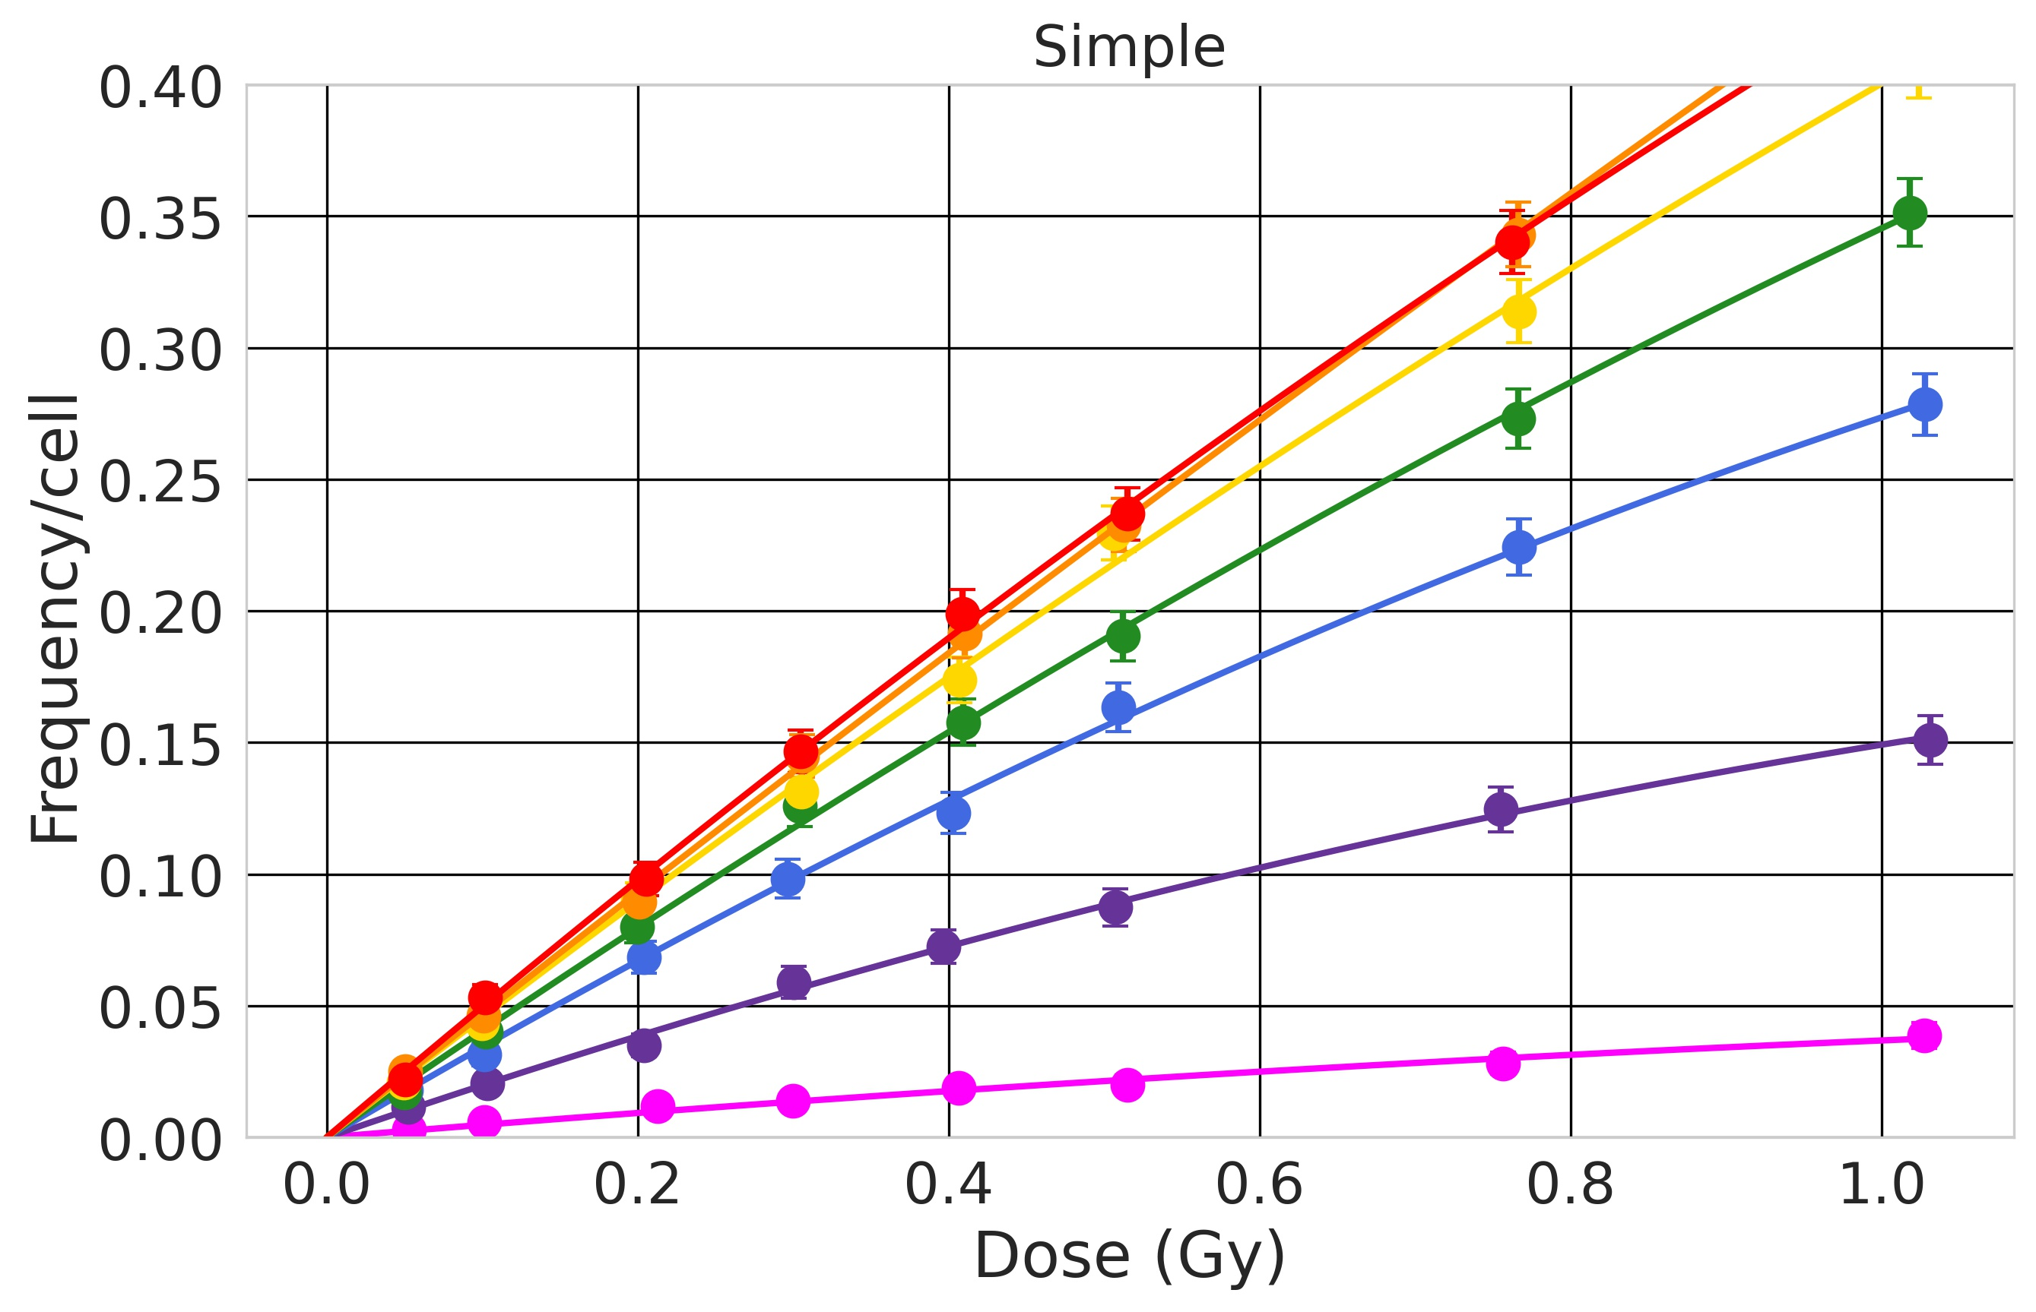
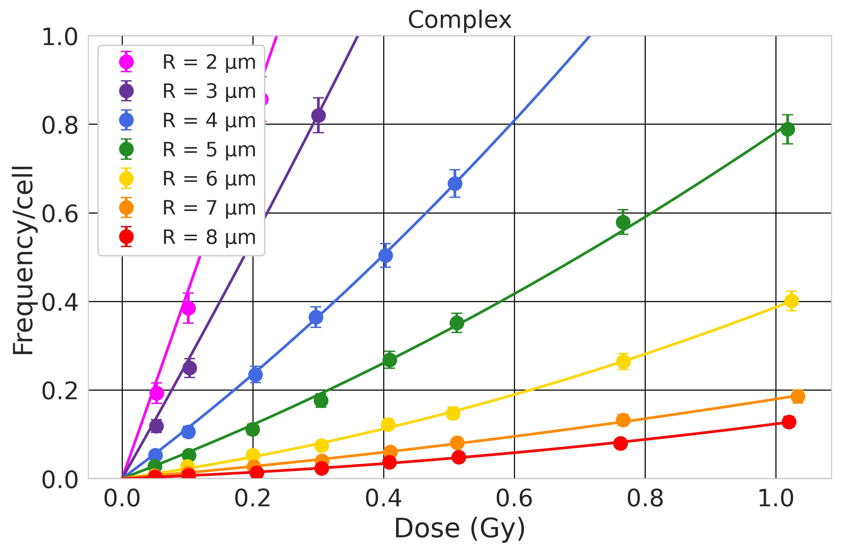
Context Method Results Conclusions
Results: dose-response relationship $y= αD+ βD^{2}$
Si 170 MeV/n – LET = 99 keV/μm
Low-LET: small SE and CE. Small dependence on nucleus size. SE and CE larger for smaller nuclei. No strong dependence on the LET.
Middle-LET: CE/SE starts increasing. Dependence on the nucleus size becomes stronger. Around LET = 50 keV/µm, SE becomes larger for larger nuclei. CE remain larger for small nuclei.
Large-LET: CE/SE show very strong dependence on the nucleus size.

Slide 14
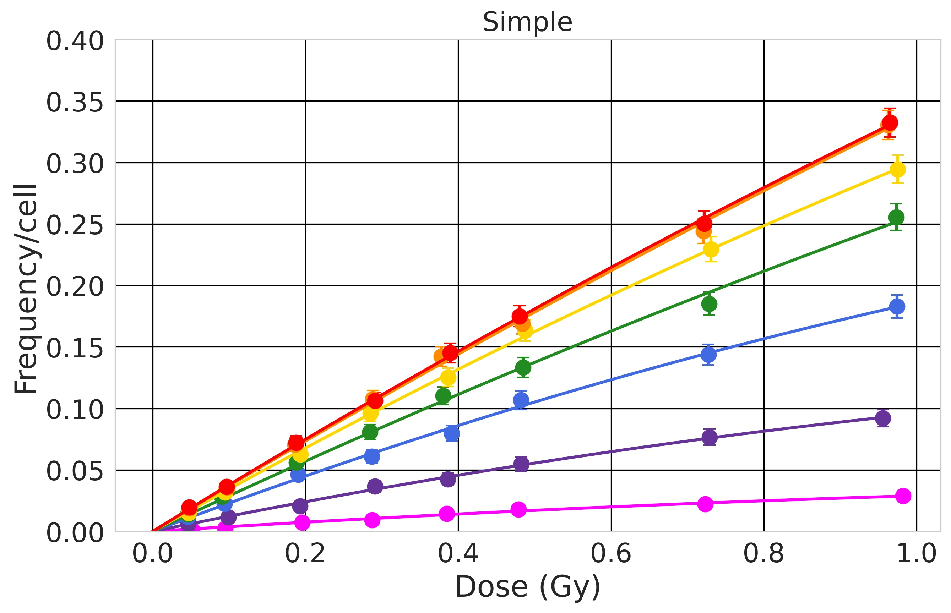
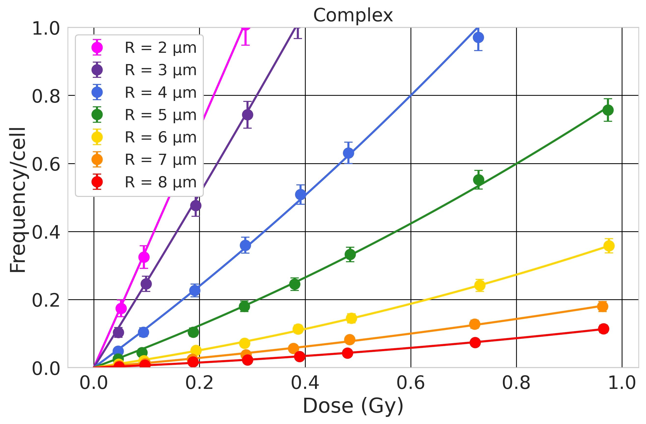
Context Method Results Conclusions
Results: dose-response relationship $y= αD+ βD^{2}$
Fe 1000 MeV/n – LET = 149.2 keV/μm
Low-LET: small SE and CE. Small dependence on nucleus size. SE and CE larger for smaller nuclei. No strong dependence on the LET.
Middle-LET: CE/SE starts increasing. Dependence on the nucleus size becomes stronger. Around LET = 50 keV/µm, SE becomes larger for larger nuclei. CE remain larger for small nuclei.
Large-LET: CE/SE show very strong dependence on the nucleus size. SE starts decreasing with increasing LET.

Slide 15
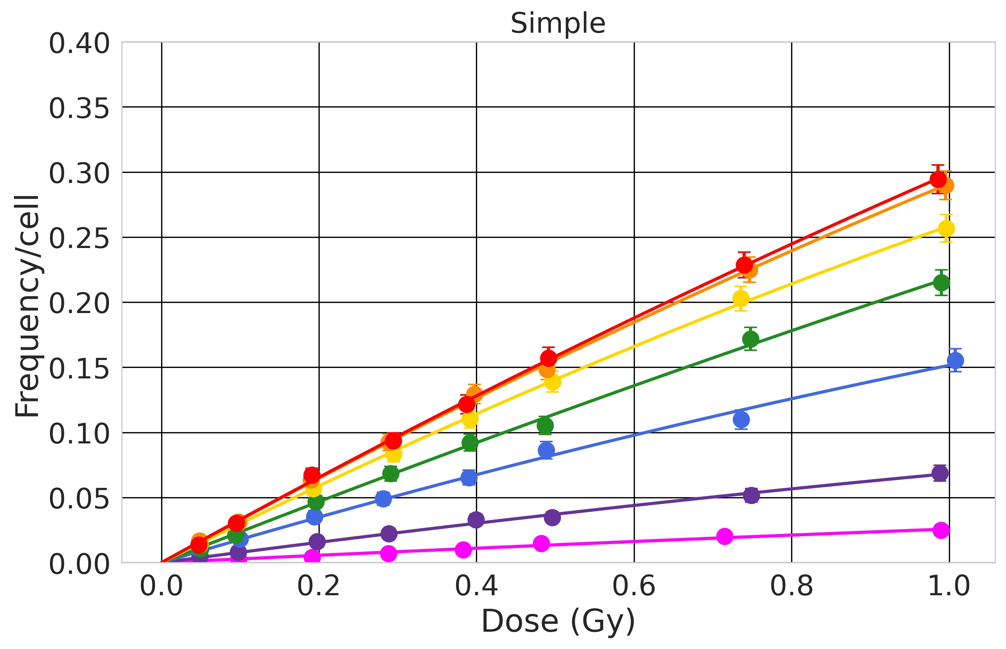
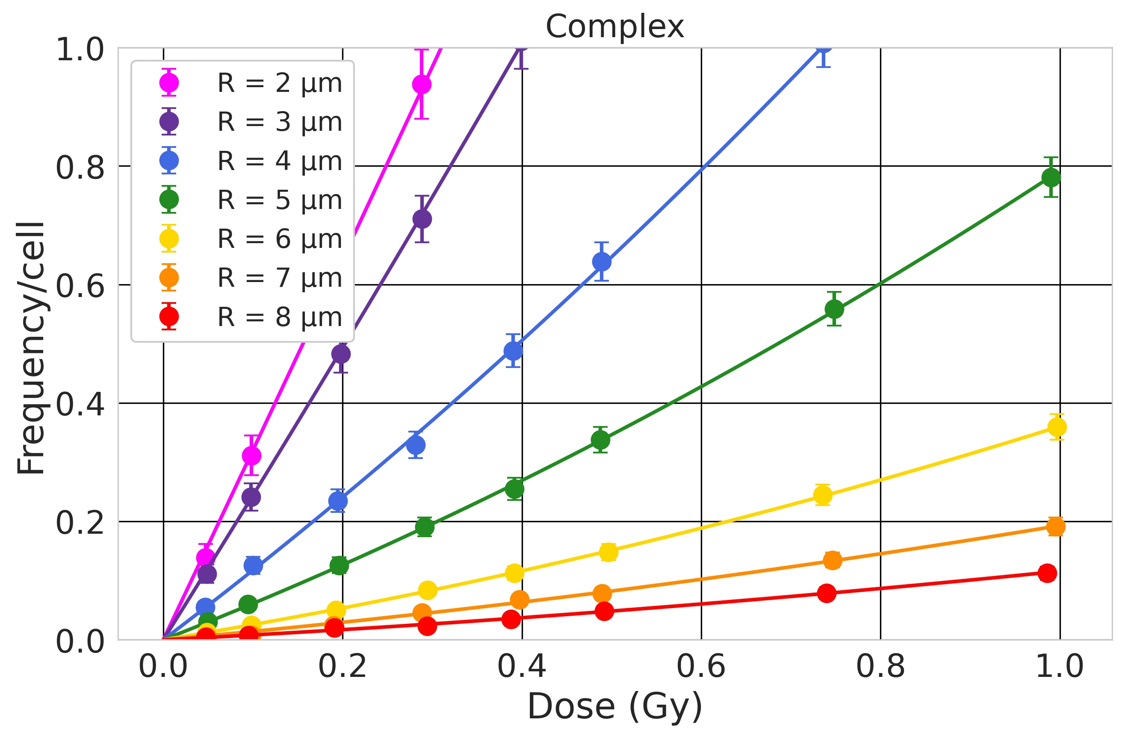
Context Method Results Conclusions
Results: dose-response relationship $y= αD+ βD^{2}$
Fe 600 MeV/n – LET = 174 keV/μm
Low-LET: small SE and CE. Small dependence on nucleus size. SE and CE larger for smaller nuclei. No strong dependence on the LET.
Middle-LET: CE/SE starts increasing. Dependence on the nucleus size becomes stronger. Around LET = 50 keV/µm, SE becomes larger for larger nuclei. CE remain larger for small nuclei.
Large-LET: CE/SE show very strong dependence on the nucleus size. SE starts decreasing with increasing LET. CE shows a saturation.

Slide 16
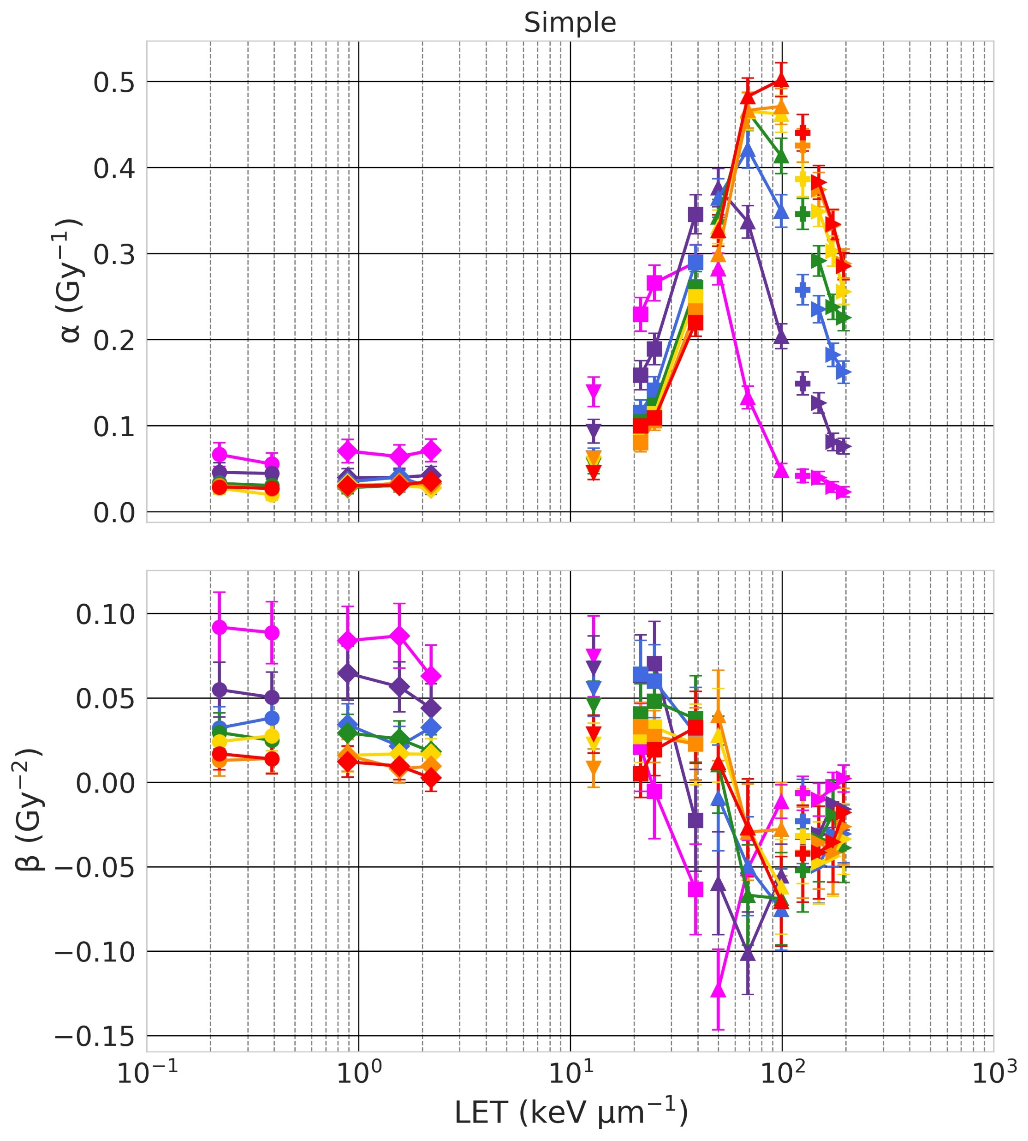
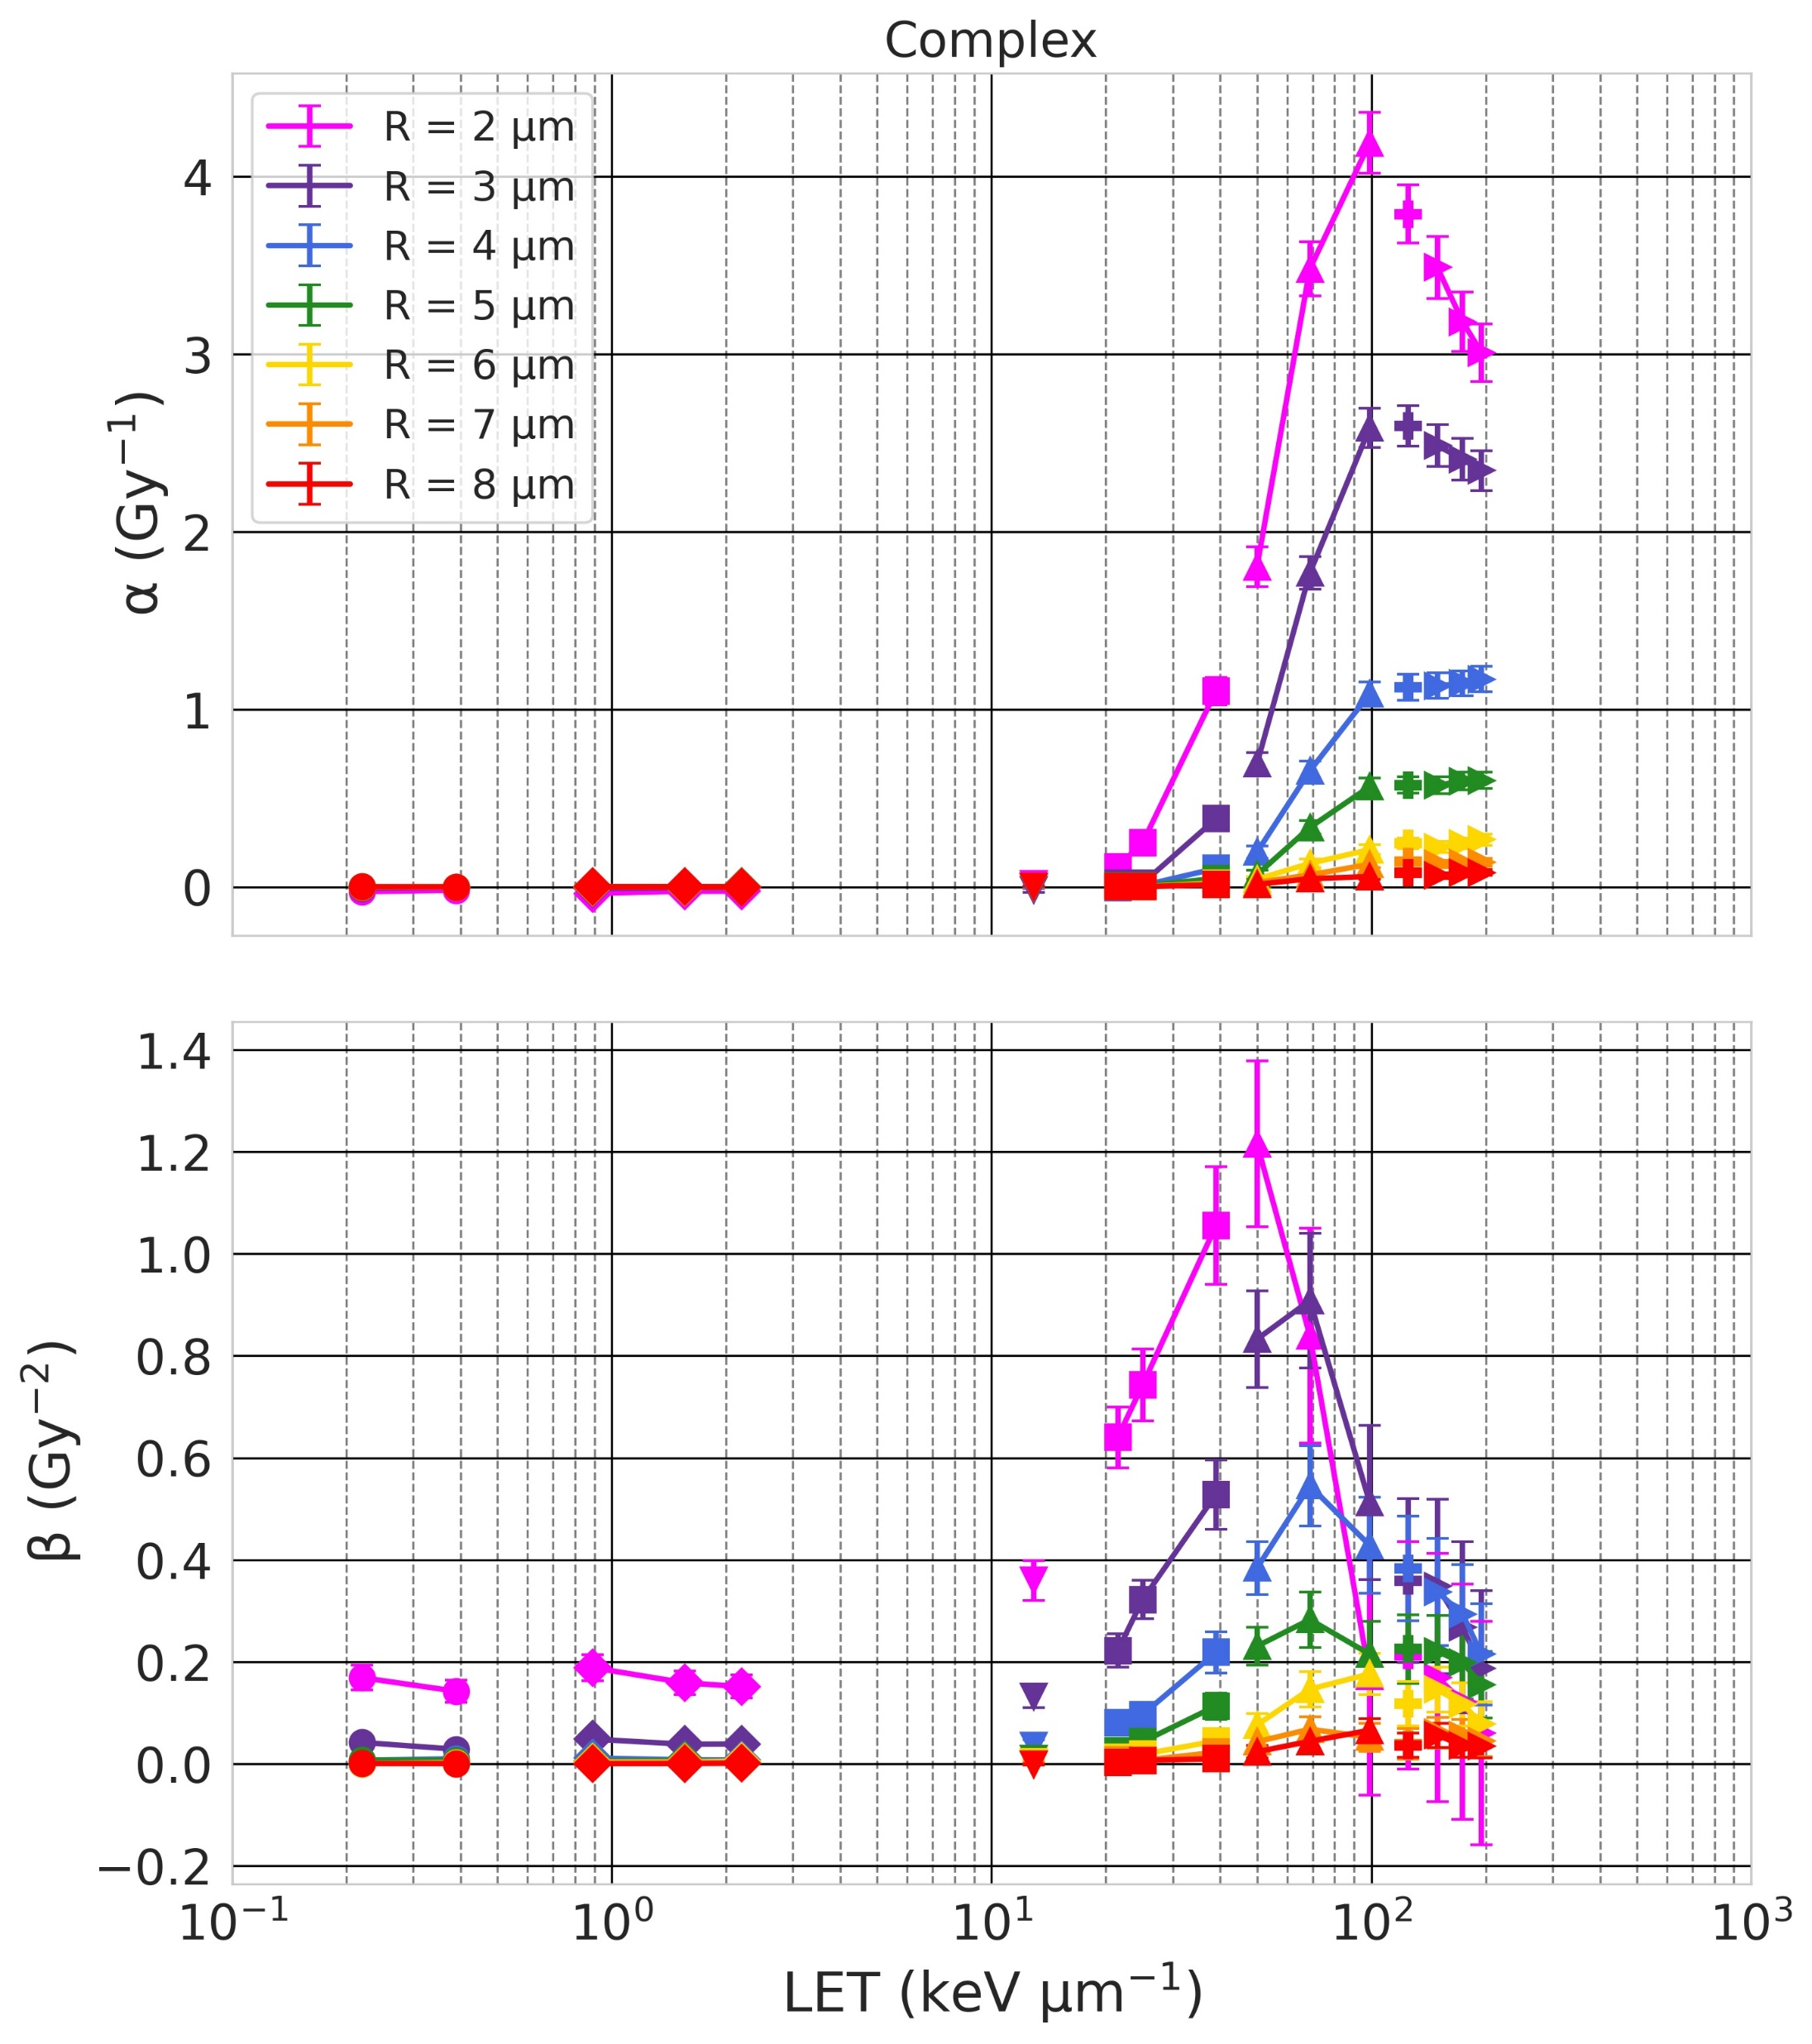
Context Method Results Conclusions
Results: $α$ and $β$ as a function of the ion LET
Larger yields for large radii and a shifted peak
Sharp increase, peak around 100 keV/µm,
then decrease or reach a plateau. Larger yields for smaller radii.
Larger yields for small radii
Negligible yield

Slide 17
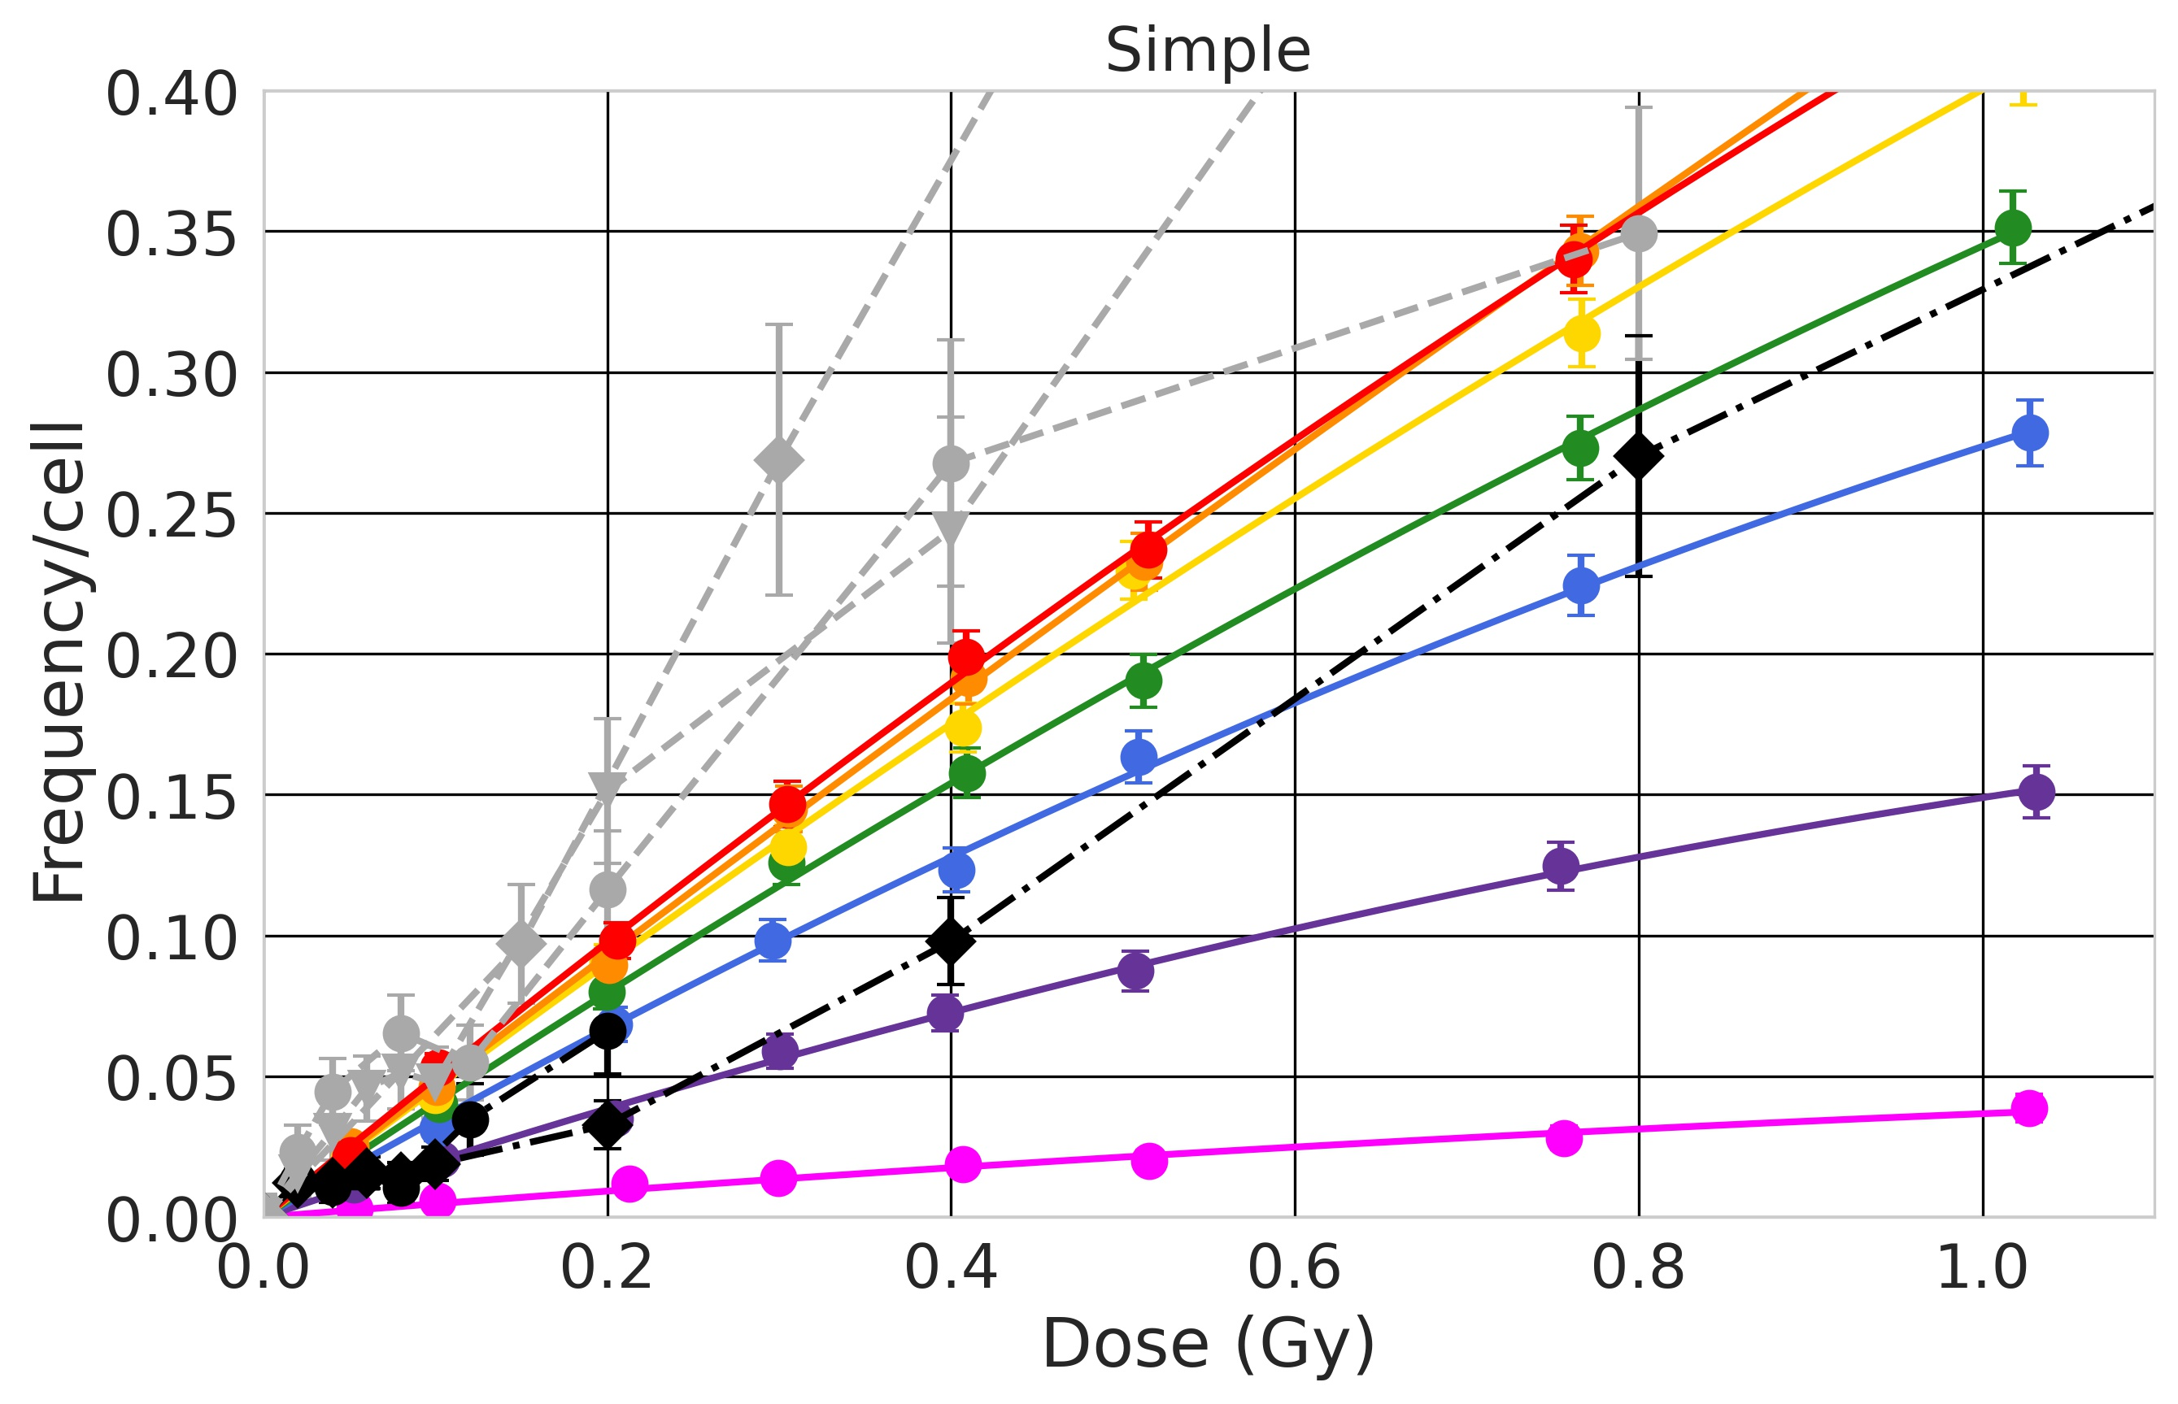
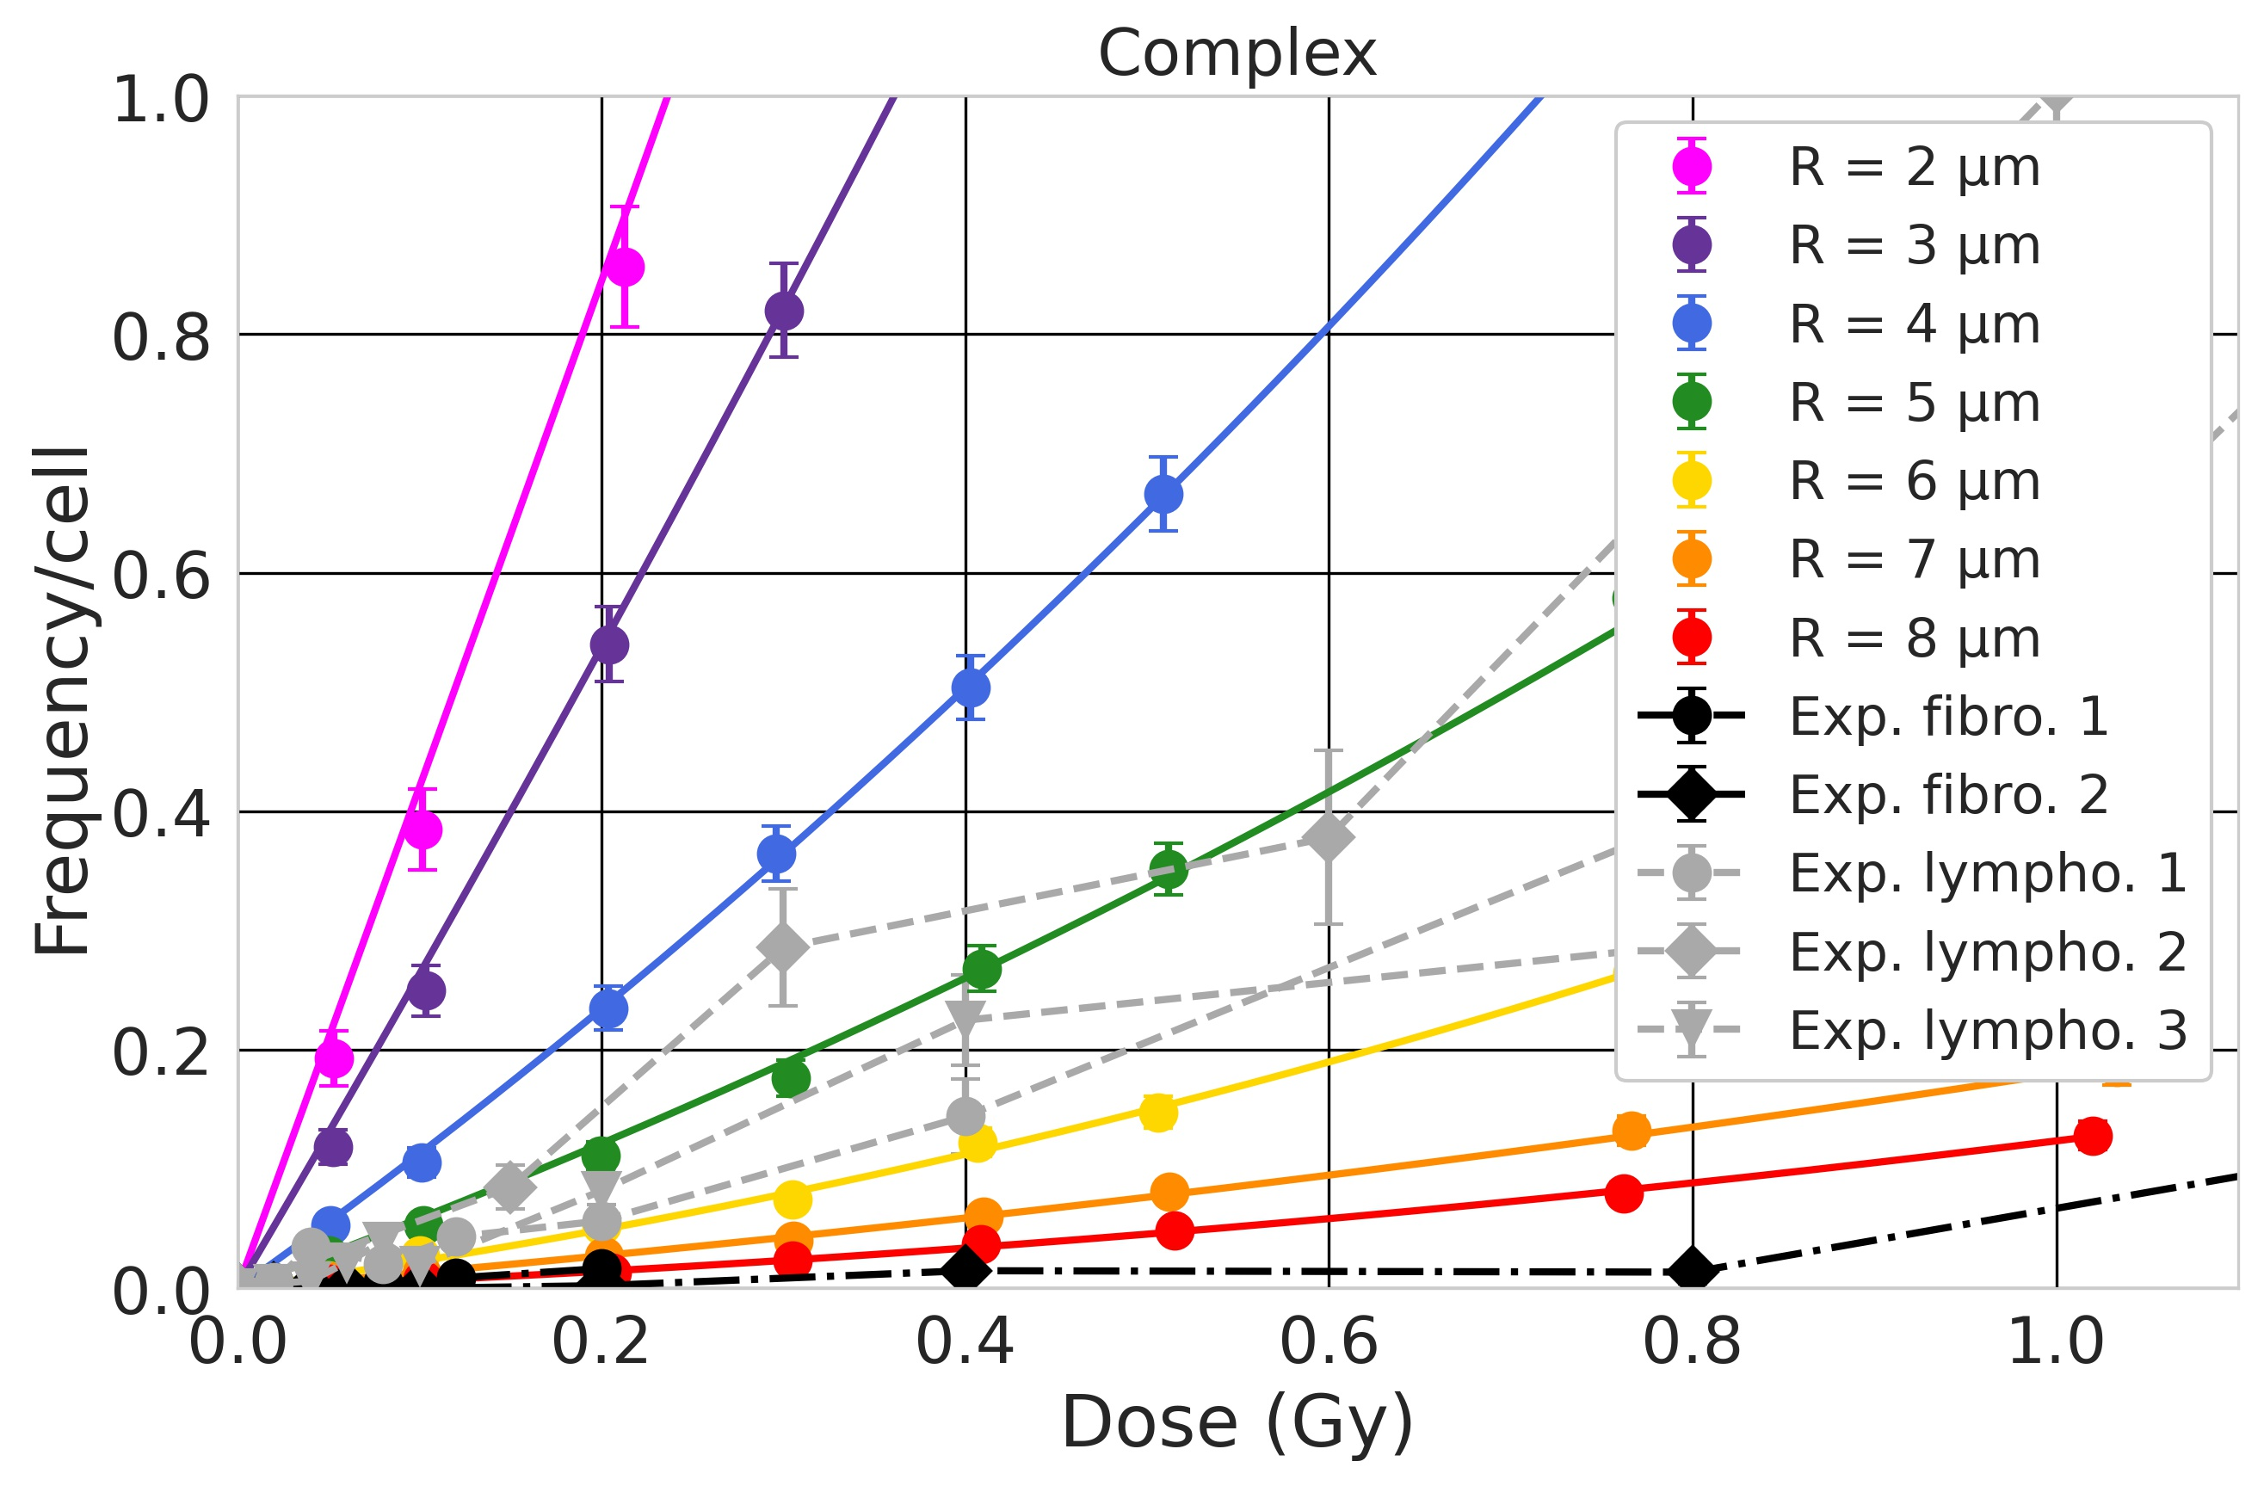
Context Method Results Conclusions
On the effect of nucleus size …
Our model predicts that the size of the nucleus is a major parameter in the yield of chromosome aberrations. The shape of the nucleus (spherical vs flat) also impacts the yield (not shown).
It is important, as in vitro cells can be adherent and thus have an elongated shape that is different than in vivo, but also because cells have distinct sizes.
On the experimental side, lymphocytes (spherical, R = 3 μm, V ~ 113 μm³) show a higher number of complex damages than fibroblast (ellipsoidal, V ~ 654 μm³), though trends are different for simple damages.
If I had the funding, the big problem I would like to pursue is …
Improve 3D nuclear geometries, and more experimental data!

