Slide 1

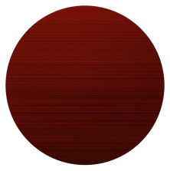
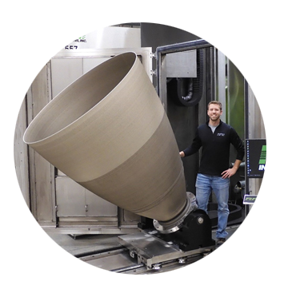
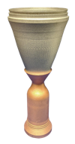
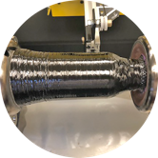
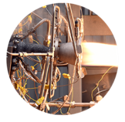
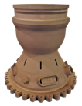
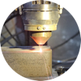
Space Technology Mission Directorate
Game Changing Development Program
Allison Clark | Rapid Analysis and Manufacturing Propulsion Technology | CAMX 2021 | 10.19.21

Slide 2

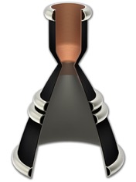
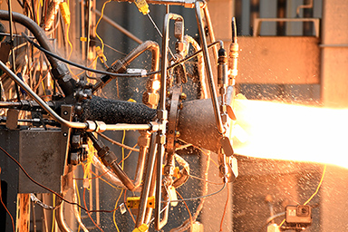
RAMPT Technology Overview
Project Description
  The RAMPT project will mature novel design and manufacturing technologies to increase scale, significantly reduce cost, and improve performance for regeneratively-cooled thrust chamber assemblies, specifically the combustion chamber and nozzle for government and industry programs.
Technology Product Capability
  The RAMPT project is developing and advancing multi-metallic freeform manufacturing, composite overwrap techniques, and analysis capabilities required to implement them to reduce design and fabrication cycles for large scale lightweight regeneratively-cooled liquid rocket engine components.
  RAMPT is reducing design, fabrication, assembly schedules while allowing for reduced parts, increased reliability, significant weight reduction and creating a healthy American supply chain.
  Four technology areas being developed: 1) Freeform Blown Powder Nozzle; 2) Composite overwrap structural jacket; 3) Bimetallic radial deposition for manifolds; and 4) Modeling and analysis tools for additive and regeneratively-cooled design.
Project Objective
  Develop composite overwrap techniques to significantly reduce weight and provide structural capability for a large Thrust Chamber Assembly (TCA).
RAMPT Team:
  NASA MSFC, ARC, GRC, LaRC, & Auburn University
Customer(s): Game Changing Development (GCD), Space Launch System (SLS), DoD, space industry and commercial companies.
Bimetallic Deposited Manifolds
3D printed Copper Chamber
Composite Overwrap
Thrust Chamber Assembly
Integrated Large Scale Freeform
Manufacturing Freeform Deposition Regen-Cooled Nozzle

Slide 3


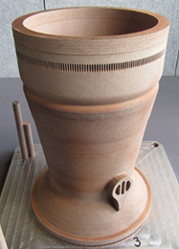
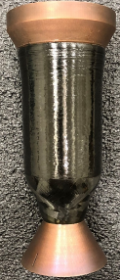
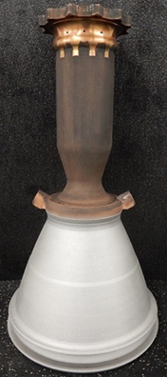
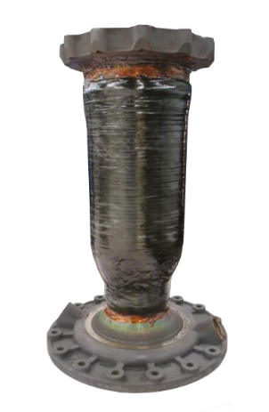
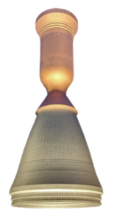
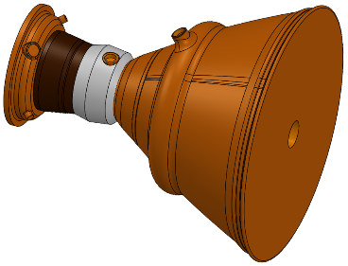
Rapid Analysis and Manufacturing Propulsion Technology (RAMPT)
Hardware Overview
2k-lb_{f}
7k-lb_{f}
40k-lb_{f}
Decoupled chamber
Decoupled chamber
Decoupled chamber
Coupled chamber
Coupled chamber
Coupled chamber

Slide 4
Rapid Analysis and Manufacturing Propulsion Technology (RAMPT)
Material Characterization
The material thermal requirements varied among the 2k, 7k, and 40k chambers, but it was the high-end of the temperature range experienced by 7k chambers during hot-fire test that drove resin selection.
  2k lb_{f} and 40k lb_{f} are LOX/LH2 and have composite overwrap interface temperatures of -400 to +150 F
  7k lb_{f} COMET hardware is LOX/LCH4 and has interface temperatures -230 to + 450 F
The large temperature gradient and rapid heating/cooling cycles of startup and shut down could lead to high stresses on the composite and ultimately micro-cracking of the resin and/or delamination of the overwrap. To accommodate both the upper and lower temperature extremes, Solvay®’s 5250-4 toughened bismaleimide (BMI) resin was selected for manufacturing development.
  Characterization of Solvay® 5250-4 BMI neat resin blocks as well as composite laminates using Dynamic Mechanical Analysis (DMA) across the temperature experienced by the composite overwrap is underway. Results to be published in future works.
The chambers show significant surface roughness from the additively manufactured process and curing the overwrap directly on the chamber leads to a bonded overwrap. This was not ideal due to CTE mismatch between the metallic chamber and the composite overwrap. The metallic chamber shrinks and pulls away from the composite during the initial cool-down of the hot-fire tests which could lead to delamination or tearing damage of a bonded composite. Ultimately the goal is an unbonded overwrap.
  All chamber surfaces are polished with aluminum free 80 grit then 120 grit sandpaper to remove surface roughness and oxidation. The surfaces are washed clean with ethanol then treated with multiple coats of Frekote NC700 mold release agent.

Slide 5
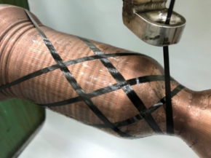
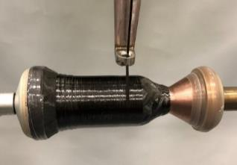
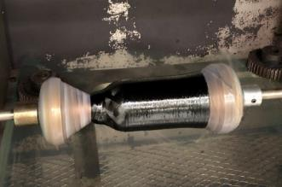
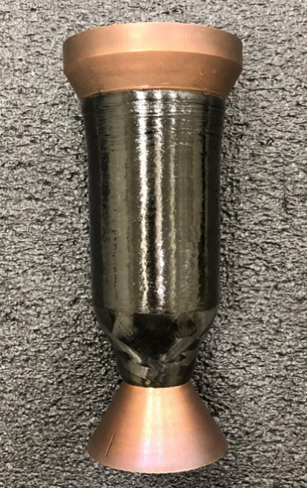
Rapid Analysis and Manufacturing Propulsion Technology (RAMPT)
2k lb Thrust Manufacturing
The composite overwrap was manufactured on with 4-axis filament winder with IM7, 12K tow carbon fiber and EPON 828/W epoxy (2k chamber) resin.
2k Decoupled Process
Polish & apply release agent to liner
Apply 1st helical layer
Apply 1st hoop layer (2-plys)
Apply 2nd helical layer
Apply 2nd hoop layer (2-plys)
Trim overwrap from injector side of liner
Rotisserie Oven Cure
Helical
Hoop
Trimmed
Final 2k Part

Slide 6
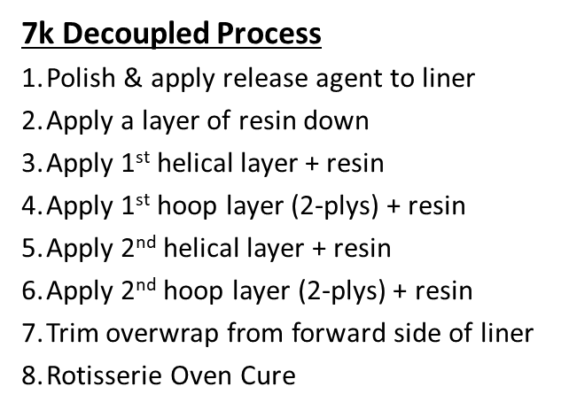
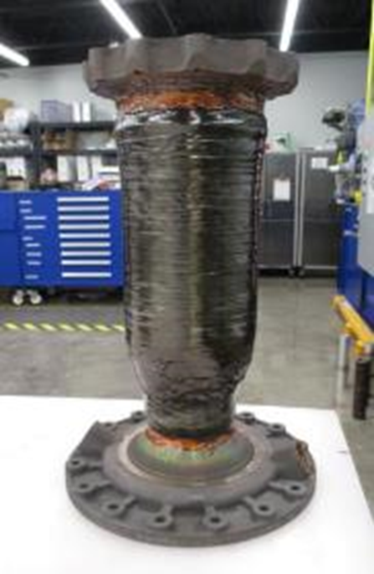
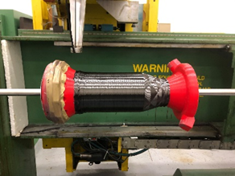
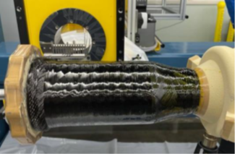
Rapid Analysis and Manufacturing Propulsion Technology (RAMPT)
7k lb Thrust Manufacturing
The composite overwrap was manufactured on with 4-axis filament winder with IM7, 12K tow carbon fiber and Solvay® 5250-4 BMI (7k chamber) resin.
Once the fiber layup was successfully defined using a plastic 3D model, a high temperature foam (FR-4718) closed cell polyurethane model that had been machined with a representative geometry was used for wet-winding and cure trials
3D Printed Plastic Model
High temperature Foam Model

Slide 7
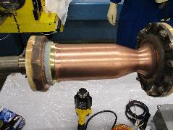
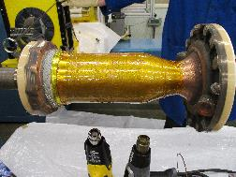
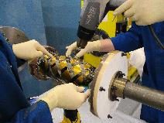
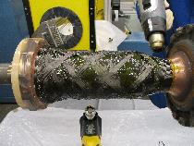
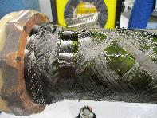
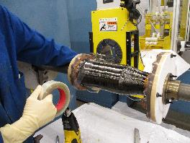
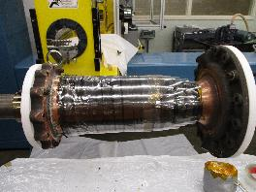
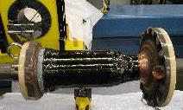
Rapid Analysis and Manufacturing Propulsion Technology (RAMPT)
7k lb Thrust Manufacturing
Surface Prep
Resin Application
Helical Layer
Helical Layer
Hoop Layer
Hoop Layer
Shrink Wrap
Final Part before Oven

Slide 8
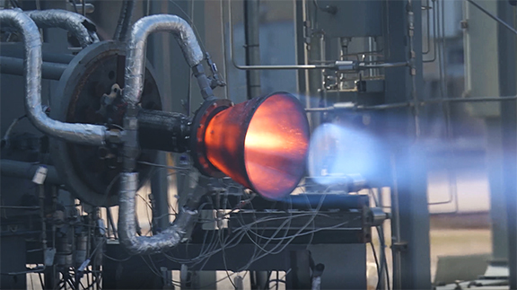
Rapid Analysis and Manufacturing Propulsion Technology (RAMPT)
Piggyback Hot Fire Test
Kord Technologies in Huntsville, Alabama completed the composite overwrap structural jacket on a 7k lb_{f} additive manufactured GRCop-42 chamber
This manufacturing technology demonstration (MTD) for the composite overwrap structural jacket was completed in January and was used as a piggyback test article.
Piggyback test: 2/25/2021
Ran for ~ 10 seconds
Composite was shown to be completely unbonded before the test
The composite was also exposed up to greater than 450 °F during testing
Piggyback Hot Fire Test of 7k lb_{f} Composite Overwrap Structural Jacket MTD

Slide 9
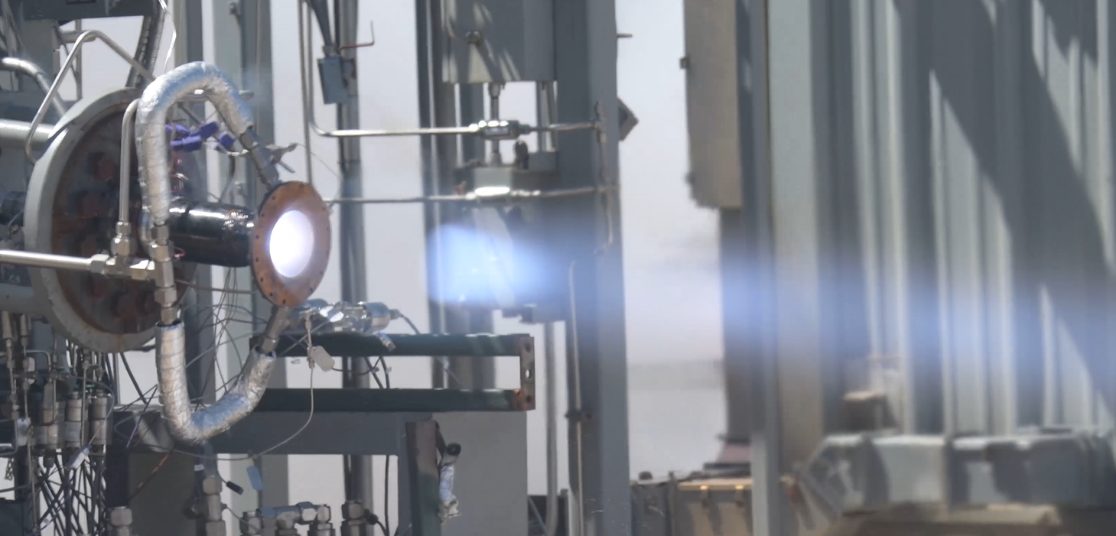
Rapid Analysis and Manufacturing Propulsion Technology (RAMPT)
Piggyback Hot Fire Test 2
Piggyback test: 4/2/2021
For a total of 3 starts at 125 seconds cumulative mainstage duration.
Successful throttling was demonstrated at 100% power down to a 6.5:1 throttle point (15% power) for 1 second.
The final two tests were throttled down to 40% power for 3 seconds and then 5 seconds.
The last test achieved a chamber pressure of 755 psi and was able to withstand a high mixture ratio of 3.57 for over 60 seconds.
Maximum skin temperature measurement of 380 F was observed near the coolant outlet but only when chamber hardware was pushed to a long duration, a low throttle point, and high mixture ratio.
Piggyback Hot Fire Test 2 of 7k lb_{f} Composite Overwrap Structural Jacket MTD

Slide 10
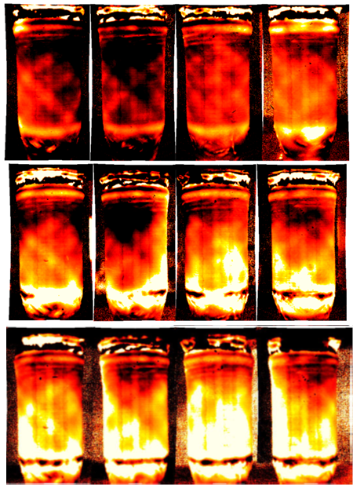
Rapid Analysis and Manufacturing Propulsion Technology (RAMPT)
NDE on 7k Manufacturing Demonstration Chamber
Before and after the hot-fire tests of the 7k lb_{f} piggyback article, MSFC was able to accomplish NDE on the composite.
Figure : shows results of flash thermography (cooling rate) from before the hot fire test, after the first hot-fire test, and following second hot-fire tests. The first row is the before and the second row is the after the first test in Feb of 2021, while the third row is after the second test in April 2021.
The color map is from -0.4 (black) to -0.9 (bright red), such that a flatter slope (aka cooling rate) (closer to -0.4) is assigned a darker color and a steeper negative slope (closer to -0.9) is assigned brighter red color. With a flatter slope, the darker areas indicate less intimate contact between the overwrap and chamber as a gap between overwrap and chamber slows cooling. With a steeper negative slope, the brighter areas indicate more intimate contact between the overwrap and chamber because of the rapid cooling caused by the underlying copper chamber.
3

Slide 11
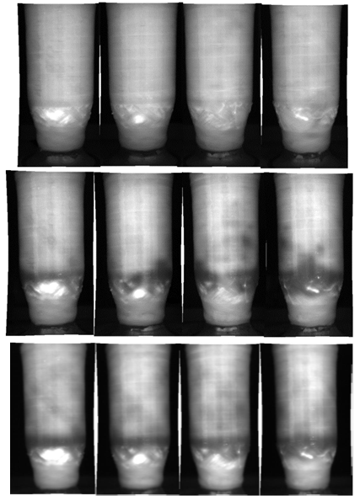
Rapid Analysis and Manufacturing Propulsion Technology (RAMPT)
NDE on 7k Manufacturing Demonstration Chamber
Figure 2 shows results from the flash thermography (cooling amplitude aka temperature) test from before the hot fire to after the first and second hot fire tests. The first row is before the test, while the second row is after the first test, and the third row is after the second round of hot fire tests.
The main piece of information learned on this NDE test is the high porosity and/or delamination areas (seen as white areas in the images) near the aft end of the chamber. The high temperatures (white color) at these areas during the cooling process indicate that heat is being trapped in the overwrap, which is an indication of a defect (e.g., porosity, delamination) in the composite overwrap.
This is most likely caused by a slip in the shrink tape used when curing the overwrap. The area of high porosity and/or delamination appears to grow after each of the hot fire tests.
3

Slide 12
Rapid Analysis and Manufacturing Propulsion Technology (RAMPT)
Paper Acknowledgements
NASA
Allison Clark – Co-Lead of composite technology development for RAMPT
Tyler Hudson - Co-Lead of composite technology development for RAMPT
Sandi Miller – Ceramic and Polymer Composite Engineer
Cheol Park – Composite Structural Materials Research Engineer
Chris Protz – RAMPT Principal Investigator
Kord Technologies
Sarah Edrington – Composite Engineer
3

