Slide 1
A Multi-Disciplinary Analysis Framework for the Design of Small Launch Vehicles
Presenter: Dr. Bradford Robertson

Slide 2
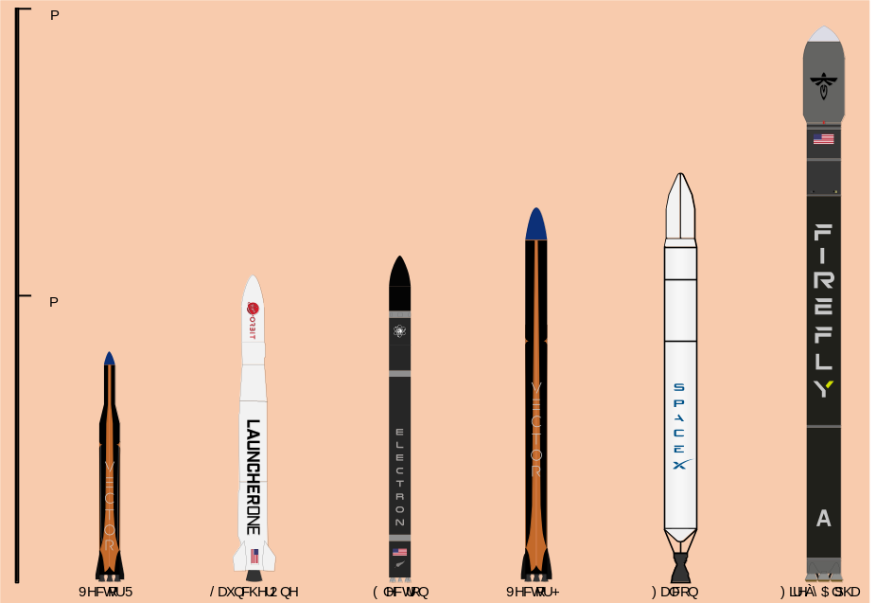
Small Launch Vehicles
Introduction
As spacecraft become smaller and less expensive, the need for small launch vehicles increases^{[14]}
  Launching small payloads with medium/large vehicles results in disproportionately large and unnecessary costs
Number and rate of launches of small payloads expected to increase^{[14]}
Small launch vehicles have low costs and short lead time^{[11], [12]}
Ability to conduct research in areas inaccessible by satellites (sounding rockets)
Small launch vehicles do not require full launch pads^{[13]}
  Ground launch: temporary launch sites
  Air launch
  Weather balloon launch
Design Environment
Sample Problem
Results
Conclusion

Slide 3
Framework
Introduction
Introduction
Construct a flexible environment for physics-based launch vehicle (LV) sizing utilizing multi-disciplinary analysis (MDA)
Disciplines are synthesized and their respective tools can be integrated to size a launch vehicle
In order to analyze the DOE options, a set of analysis capabilities are necessary
  These are defined by what is needed to correctly predict the behavior of the LV
The main part of the LV is the motor
  Mass Properties
  Propulsion Profile
To figure out the achievable acceleration
  Drag of the LV
  Overall Mass
Calculating the best path to orbit
Discipline 1
Design Environment
Discipline 2
Sample Problem
Sample Problem
Discipline 3
Discipline 4
Results
Propulsion
Conclusion
Aerodynamics
Structures
Trajectory

Slide 4
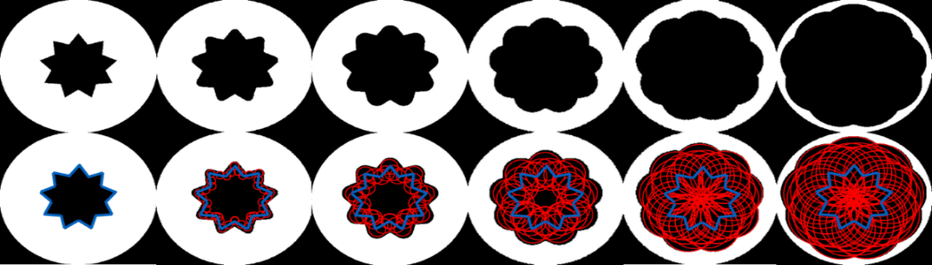


Propulsion: Solid Motor Analysis Code (SMAC) [1]
Introduction
Introduction
SMAC is a preliminary design tool for solid rocket motors
Its capabilities include
  Mass estimation through regressions
  Geometric burn simulation
  Ballistic analysis
  Prediction of thrust performance
Design Environment
Sample Problem
Sample Problem
Burn Progression Through Time
Results
Propellant Properties
Performance
Conclusion
Grain Geometries
Weight Regressions
Nozzle Design
SMAC
P(t), T(t), $\dot{m}$(t)
Operational Characteristics
Burn time
Materials
Nozzle Size

Slide 5
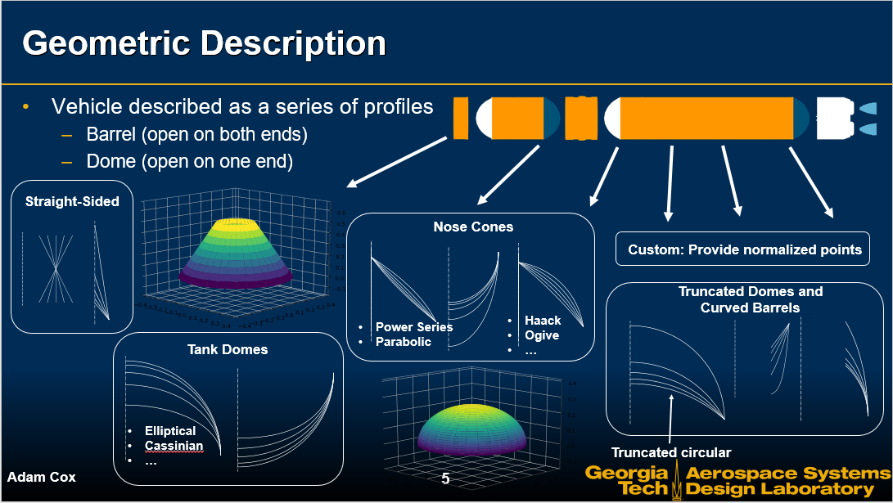
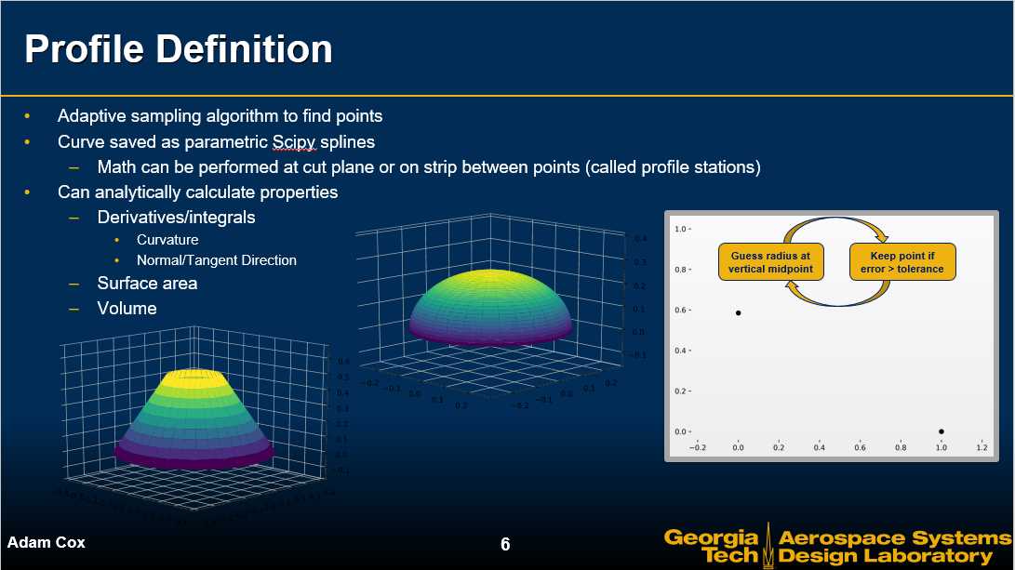
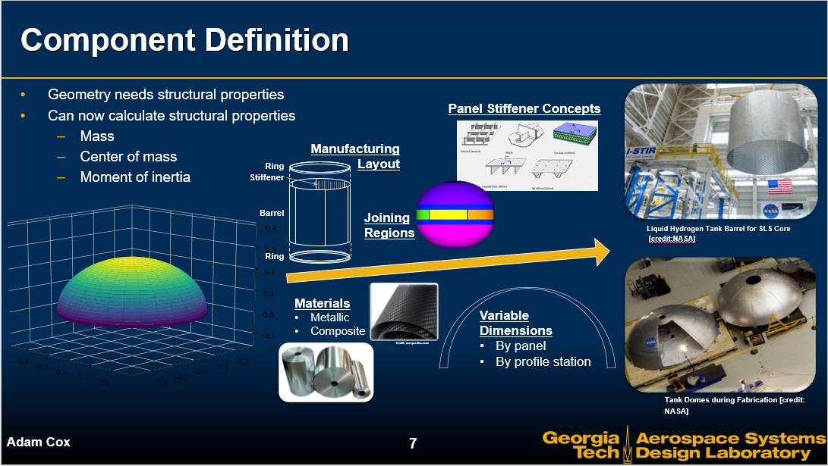
Structures: Launch Vehicle Structural Analysis (LVSA)
Introduction
Introduction
Focuses on structural dynamic analysis with sizing capability
Assumes axisymmetric structures
No longer relying on CAD descriptions of structure
Covers most launch vehicles: missiles, core/boosters, etc.
Allows for analytical representations
Core functionality is describing vehicle
  Geometric description
  Profile definition
  Component definition
  Assembly definition/layout
  Load initialization
Design Environment
Sample Problem
Sample Problem
Results
Conclusion

Slide 6
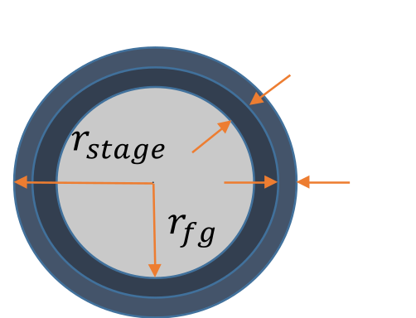

SMAC/LVSA Loop
Introduction
Introduction
The DOE-provided variable is the diameter of the stage
  Need to know allowable space for the fuel
Between SMAC and LVSA there is a loop that converges on radius of the fuel grain ($r_{fg}$)
  SMAC determines insulation thickness ($t_{i}$)
  LVSA determines casing thickness ($t_{c}$)
  $$r_{fg}=r_{stage}−(t_{c}+t_{i})$$
After $r_{fg}$ for a stage is within allowable tolerance between the runs that stage is considered to have converged
  Process results if a converged $r_{fg}$for each stage
SMAC
4
Design Environment
8
LVSA
Sample Problem
Sample Problem
Convergence Loop
Results
Conclusion

Slide 7
Aerodynamics and Trajectory
Introduction
Introduction
Missile DATCOM is an aerodynamic design tool that was created for preliminary missile design
  The code is flexible enough to be used to analyze small launch vehicles^{[2],[3]}
  Ability to incorporate fins and wings if required
POST2 enables trajectory analysis of vehicles operating near one attracting body
  Attempts to target the desired orbit
  Optimizes Payload Mass
Design Environment
Sample Problem
Sample Problem
Results
Conclusion

Slide 8

Integration
Introduction
Introduction
Inputs
Design Environment
1
2
3
Sample Problem
Sample Problem
SMAC
4
6
7
Results
5
LVSA
8
9
Convergence Loop
Conclusion
Missile DATCOM
10
POST

Slide 9
Sample Problem
Introduction
Introduction
Goal: Exercise the MDO environment for an SLV sample problem
Steps taken to achieve this:
  Develop a methodology to support SLV design
  Demonstrate methodology for a design analysis
Requirements for sample problem
  Target orbit:
    Inclination: 47 deg
    3636.6 by 3651.4 nautical mile orbit
    Launched from Wallops Launch Facility
  Design Constraints:
    Four Stage
    All solid rocket motors
    Axisymmetric body
    Uniform diameter
Design Environment
Sample Problem
Sample Problem
Results
Results
Conclusion

Slide 10
DOE Setup
Introduction
Introduction
DOE
Per Stage (x4) | Stage 1 | Stage 2 | Stage 3 | Stage 4
Stage Length | 8 - 10 ft | 4 - 6 ft | 2 - 4 ft | 0.5 - 2 ft
Outer Fuel Diameter | 0.05 - 0.1 | 0.1 - 0.15 | 0.1 - 0.15 | 0.1 - 0.15
MEOP target | 1000 - 1500 | 1000 - 1200 | 500 - 700 | 500 - 700
Inner Fuel Diameter | 0.05 - 0.07 | 0.07 - 0.1 | 0.07 - 0.1 | 0.07 - 0.1
Nozzle Length | 0.2 - 0.8 ft | 0.2 - 0.8 ft | 0.2 - 0.6 ft | 0.1 - 0.3 ft
Grain Type | bates, finocyl, star | bates, finocyl, starocyl, star | bates, finocyl, starocyl, star | bates, finocyl, starocyl, star
Propellant | TP-H-1148 | TP-H-1202, TP-H-3340, TP-H-1148 | TP-H-1202, TP-H-3340, TP-H-1148 | TP-H-1202, TP-H-3340, TP-H-1148
With of Fuel Fin | 0.03 - 0.05 | 0.05 - 0.07 | 0.05 - 0.07 | 0.05 - 0.07
Fuel Star Points | 2,3,4 | 2,3,4 | 2,3,4 | 2,3,4
Overall
Launch Vehicle Diameter | 1.5 - 2 ft
Nose Shape Parameter | 0.2 - 0.4
Design Environment
Continuous and Discrete variables
Sample Problem
Sample Problem
Results
Results
D
Conclusion
I.
II.
III.
IV.
D

Slide 11
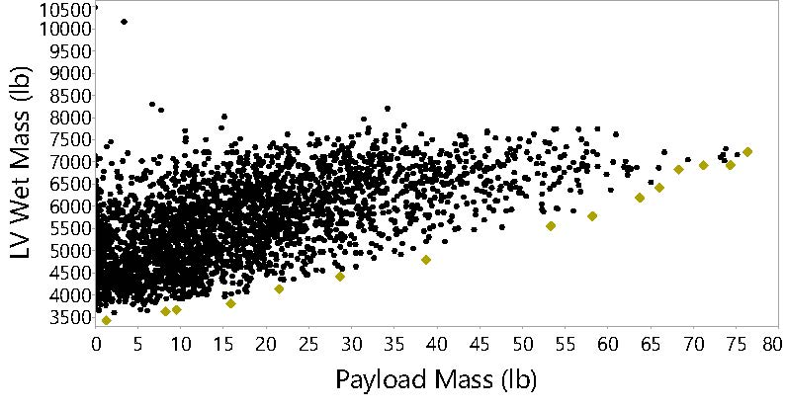
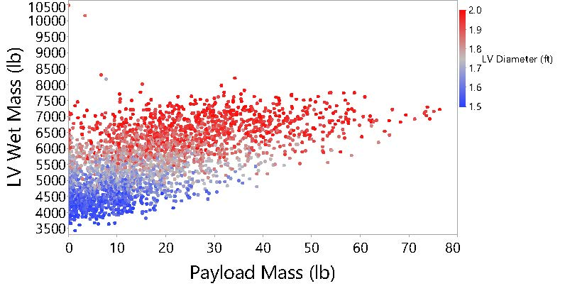
Results
Introduction
Using a value function
  Min LV Mass
  Max Payload Mass
There is no single architecture that could be considered “the best”
The results show that there is a trade off to be made, with the solution space forming a Pareto Frontier
The space can also be discretized based on SLV Diameter forming 3 clear bands
  Based on this decisions can be made on what diameter ranges should be further exploded based on the designers desired payload and SLV mass
Design Environment
Sample Problem
Introduction
Design Environment

Slide 12
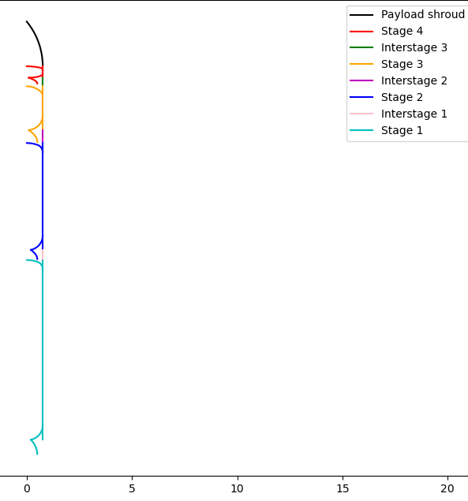



Case: SLV 4855
Introduction
DOE
Variable Name | Stage 1 | Stage 2 | Stage 3 | Stage 4
Stage Length (ft) | 9 | 6 | 3.23 | 1.15
Outer Fuel Diameter (% of total) | 0.098 | 0.15 | 0.13 | 0.11
MEOP target (psi) | 1174.5 | 1017 | 548.8 | 511.15
Inner Fuel Diameter (% of total) | 0.059 | 0.094 | 0.096 | 0.087
Nozzle Length (ft) | 0.59 | 0.23 | 0.52 | 0.19
Grain Type | Star | Starocyl | Finocyl | Star
Propellant | TP-H-1148 | TP-H-1202 | TP-H-1148 | TP-H-1202
With of Fuel Fin (%of total) | 0.03 | 0.06 | 0.054 | 0.051
Fuel Star Points | 4 | 3 | 2 | 2
Overall
Launch Vehicle Diameter | 1.7 ft
Nose Shape Parameter | 0.23
TP-H-1202
Design Environment
TP-H-1148
Sample Problem
TP-H-1202
Introduction
Design Environment
TP-H-1148
 | Dry Mass (lb) | Fuel Mass (lb) | Payload Mass (lb)
Stage 1 | 425 | 1916 | 38.73
Stage 2 | 210 | 1286
Stage 3 | 95 | 601
Stage 4 | 36 | 232
Total | 766 | 4035 | 38.73

Slide 13
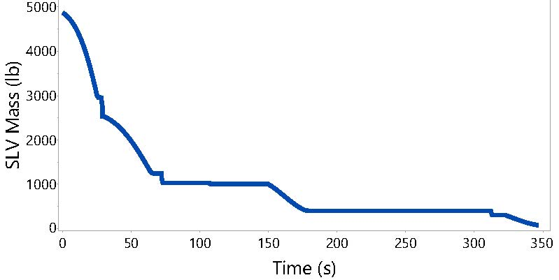
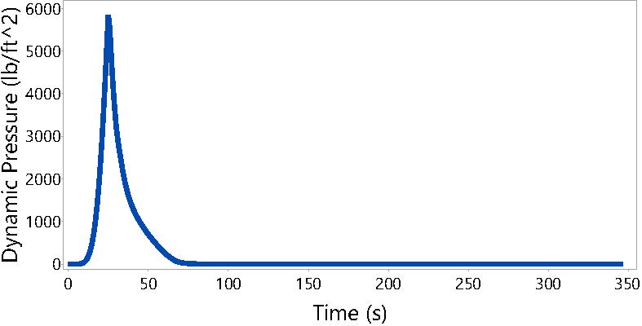
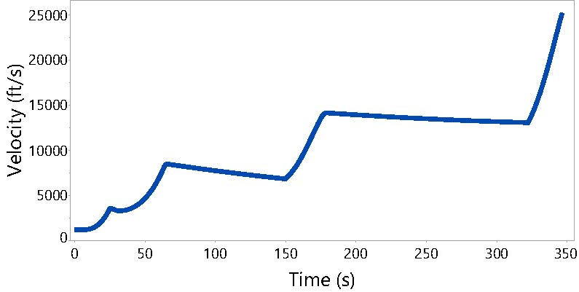
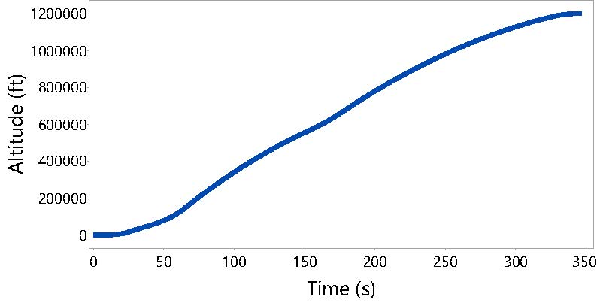
Case: SLV 4855
Introduction
Design Environment
Sample Problem
Introduction
Design Environment

Slide 14
Summary
Introduction
There are numerous possible design alternatives for an SLV
  Without exploring the design space, it is impossible to say just how optimal the solution is
  It is also infeasible to perform a detailed design for each option
Our methodology leads to a manageable exploration of the design space
  As part of the methodology, an analysis tool was developed that integrates physics-based tools for:
    Propulsion (SMAC)
    Aerodynamics (Missile DATCOM)
    Structures (LVSA)
    Trajectory (POST2)
Design Environment
Sample Problem
Created a methodology capable of analyzing/reducing the design space
Results
Conclusion
The output of our sample problem leads to a selection of Pareto optimal designs that can be graduated to subsequent design cycles for further analysis

Slide 15
Citation
Ritter, Paul Andreas, "Optimization and Design for Heavy Lift Launch Vehicles. " Master's Thesis, University of Tennessee, 2012. https://trace.tennessee.edu/utk_gradthes/1197
Bushnell, P. S., Jr, Busse, J.R.,Kraft, G.E Leffler,M.T., “A compendium of NASA Aerobee sounding rocket launchings for 1966” NASA Goddard Space Flight Center Greenbelt, July 1, 1967
Bodies of Revolution having Minimum Drag at High Supersonic Airspeeds; Eggers Jr, A. J.; Resnikoff, Meyer M.; Dennis, David H.; NACA Technical Report 1306, 1957.
4. Zapata, Edgar, "Nano-Launcher Technologies, Approaches, and Life Cycle Assessment" NASA Kennedy Space Center Cocoa Beach, October 16, 2014
NASA Technical Reports Server (NTRS). (n.d.). Retrieved September 11, 2020, from https://ntrs.nasa.gov/search.jsp?R=20150004148 2019-08-31T11:16:10 00:0
Jones, Jonathen E., Kibbey Timothy P., Cobb, C. Brent, Harris, Lawanna L., “Enabling Dedicated, Affordable Space Access Through Aggressive Technology Maturation”, Conference: Space Propulsion 2014, May 10,2014
Bhat, B. N. (2018). Aerospace Materials and Applications. Reston, VA: American Institute of Aeronautics and Astronautics.
Matt Bille, Robyn Kane, “Practical Microsat launch Systems: Economics and Technology”, Conference: Small Satellite Conference, 2013
https://bisresearch.com/industry-report/global-small-launch-vehicle-market.html
Orbital ATK., Minotaur IV User Guide., 2015.
NASA Sounding Rocket Program. NASA. 24 July 2006. Retrieved 10 October 2006.
What is a Sounding Rocket?. Research Aircraft. NASA. Retrieved 10 October 2006.
General Description of Sounding Rockets. Johns Hopkins University Sounding Rocket Program. Retrieved 10 October 2006.
National Research Council. 2000. The Role of Small Satellites in NASA and NOAA Earth Observation Programs. Washington, DC: The National Academies Press. https://doi.org/10.17226/9819.
Foust, J., “Ten companies bid for NASA small launch vehicle contract,” SpaceNews Available: https://spacenews.com/ten-companies-bid-for-nasa-small-launch-vehicle-contract/.

