Slide 1



NASA Langley Research Center
Flight Simulation Facilities Overview
Jessica Friz
Simulation Development and Analysis Branch
9/1/2021

Slide 2
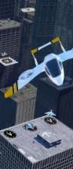
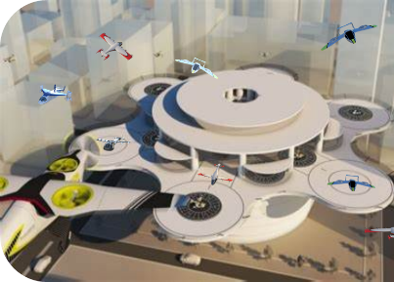
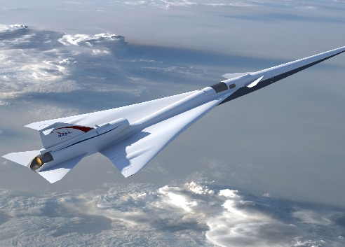
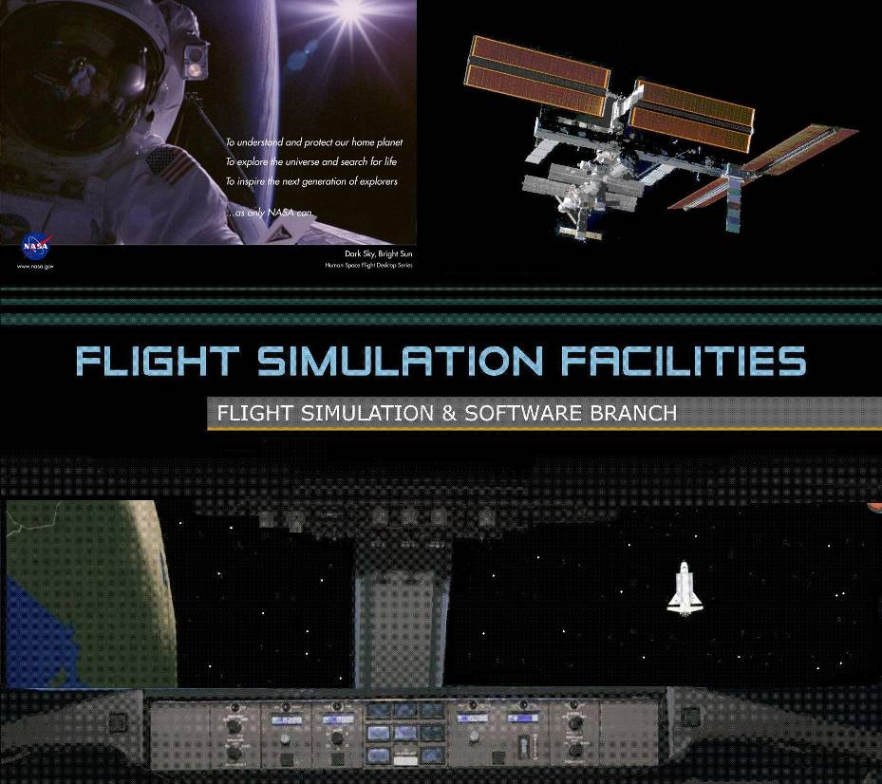
Flight Simulation Facilities (FSF)
Design and test concepts for aeronautics, space exploration, and scientific development since 1950s
Designated as national strategic assets for aerospace research
Users/Customers
  ARMD – Airspace, Aviation Safety, Subsonics, Supersonics, Hypersonics, and UAS
  HEOMD – Artemis, Orion (MPCV), Commercial Crew (Sierra Nevada), Ares IX, Ares I, Altair, Mars Scout.
  NESC – for simulation verification research
  Reimbursable – FAA, DoD, Embry-Riddle, Boeing, international partners (ICATEE, Delft)
  Collaborate with industry for new flight simulation technologies
  Integration with labs at LaRC and other NASA Centers, DOD, FAA, MITRE, industry, and universities to conduct large-scale multi-vehicle simulations

Slide 3
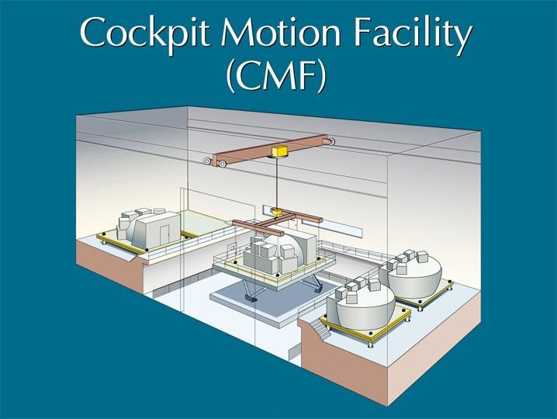
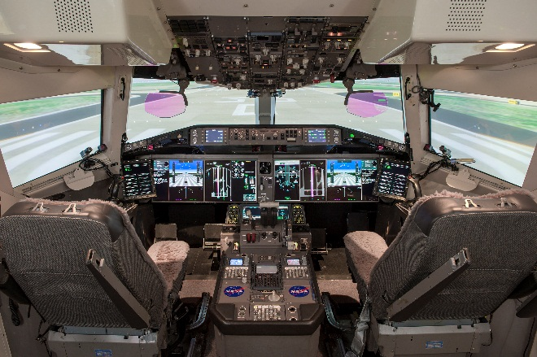
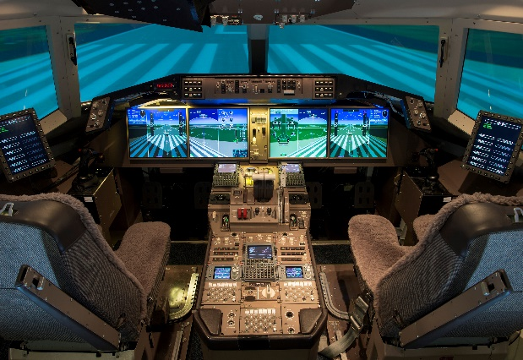
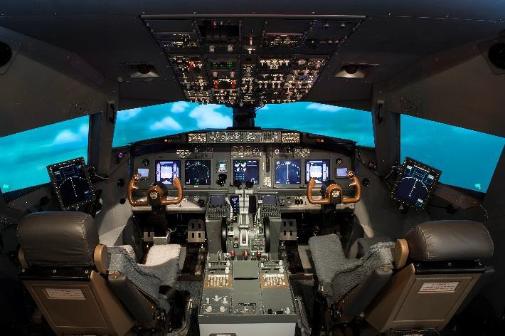
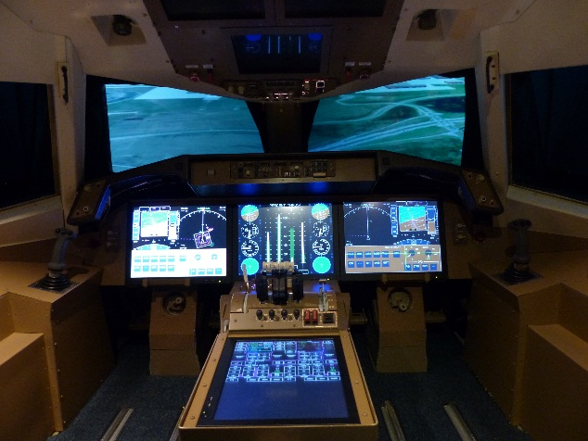
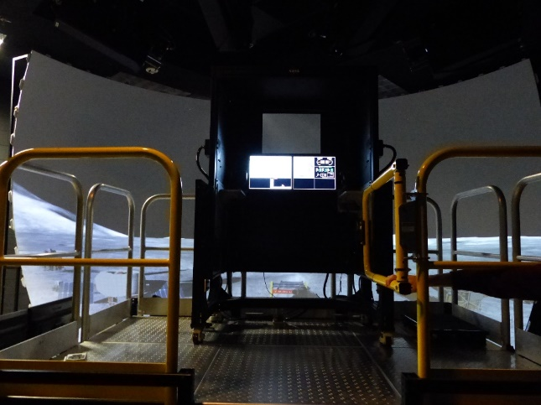
NASA Langley Flight Simulation Facilities
Cockpit Motion Facility
(CMF)
Research Flight Deck
(RFD)
Development and
Test Simulator (DTS)
Integration Flight Deck
(IFD)
Generic Flight Deck
(GFD)
Lunar Flight Deck
(LFD) or
Test and Evaluation
Simulator
(TES)

Slide 4
LaRC Simulation Contributions
Preeminent state-of-the-art simulation technology in the nation
High quality, high reliability, and low operating costs
Hardware and software integration for flight tests
Average software reuse rate is >86% equivalent to ~$20 million savings over every 10 years (exceeds industry practice)
Software technologies releases to government and industry due to widespread interest
Contributed to major aerospace research technology transfer
Aeronautical Research Simulation
Urban Air Mobility
Unmanned Aircraft Systems/Vehicles
Commercial transport
General aviation
Fighters and helicopters
Futuristic designs including hypersonic and supersonic research
Space Flight Research Simulation
Lunar and Other Planetary Lander
Crew exploration and launch vehicle; rendezvous and docking
Lifting bodies
Lunar and Mars environments

Slide 5
Strengths in Engineering and Integration
Flight simulation for pilot-in-the-loop, urban air mobility, and unmanned aircraft systems
Wide choices of simulation fidelity (conceptual, prototype, validation)
Real Time or Fast Time (Time delay characterization)
Analyses or Batch; Monte Carlo Analyses
Part Task, Specific Conditions/Operations
Full Mission, End-to-End
Ride quality
Handling quality
Simulator Flight Deck Development (Part task or Full mission)
Human Factors Engineering simulation environment
Flight Avionics including Display, Control, Communications, Command, and Data Handling
Guidance, Navigation, Controls, and High-Fidelity Vehicle Modeling
Vehicle Dynamics
Multiple Vehicle Operations with Human-in-the-loop
Flight Dynamics due to Control Surface Effects
Vehicle/Crew Recovery at Adverse Conditions
Human-Machine Interface (HMI) and Crew Operations
Integration with Eye Tracker, Head Tracker, Head-Worn Display
Efficient Data, Video, and Audio Acquisition and Recording for Analyses

Slide 6
Experiment Modes
LaRC Simulation Facilities are available for use by other NASA centers, government agencies (DOD, FAA, DHS, etc), industry, and academia on a reimbursable basis
Examples
Experiments involving industry-supplied equipment integrated with vehicle systems--retrofit experiments
Experiments involving industry-supplied equipment integrated with advanced technology
  Integration of various electronics flight bags, flight management computers, flight control computers, etc.
Concept validation using only software
  System algorithm and modeling
Experiments that use the airframe as a platform
  Atmospheric and other remote sensors
  Aerodynamic structures evaluations of existing airframe

Slide 7
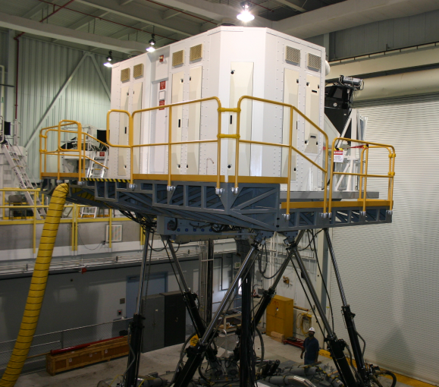

Cockpit Motion Facility (CMF)
Motion System
  6 degree-of-freedom synergistic motion system
  76-inch leg stroke
  22,000 pounds maximum payload
State-of-the-art motion cueing algorithms and advanced algorithms
Facility can support simultaneous operation of two fixed based simulators and one motion-based simulator
  Research Flight Deck (RFD) Simulator
  Integration Flight Deck (IFD) Simulator
  Generic Flight Deck (GFD) Simulator
  Available space for a 4th simulator
Any of the simulators can be moved to the motion platform for motion simulation
State-of-the-art Infrastructure
  Real-time computers for aerospace vehicle and environment modeling
  Display and graphics computers for flight deck instrumentation
  High performance visual scene image generation computer systems for out-the-window scenery
  Fiber optic video distribution
  High speed fiber optic data communications
  Hydraulics and power systems
System Integration Laboratory (SIL) for hardware-in-the-loop testing and evaluation

Slide 8
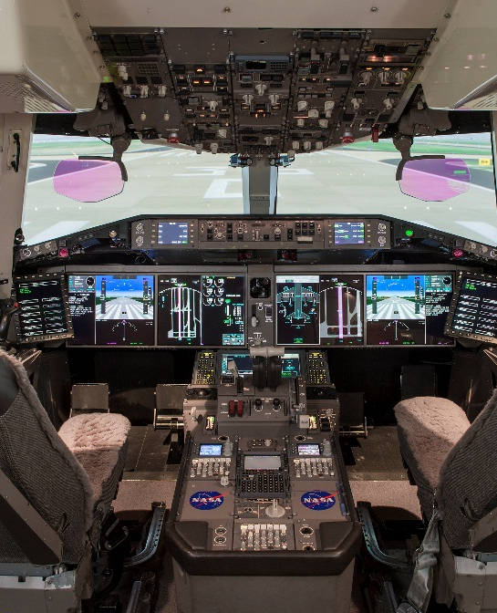
Research Flight Deck Simulator (RFD)
  Re-configurable to UAM handling and ride quality cab
  Full mission functionality; fixed or motion base
  Currently configured as commercial transport with Overhead Panel, Main Instrument Panel, Mode Control Panel, Electronic Flight Bags
  Unobtrusive low-profile remote oculometers
  Control Aisle Stand with 757-type throttle quadrant
  Five (5) Heads-down displays (HDD) - all instrumentation/symbology generated by computer graphic
  Dual Head Up Display (HUD)
  Programmable, digital 3-axis side arm and rudder control loader systems (pilot and co-pilot)
  Audio cue provided by digital sound system. Voice Over IP for intercom/radio simulation.
  Capable of interfacing selected flight systems for testing (hardware-in-the-loop)
  Panorama Display System (200H x 40V deg FOV); 3-channel visual scene allows cross-cockpit viewing
  Control Display Units for Guidance and Navigation Flight Management
  Studies include AAM eVTOL, NextGen Aviation Safety, Airspace Systems, Orion avionics display and control design, Lunar Lander, and spacecraft rendezvous and docking

Slide 9

Integration Flight Deck Simulator (IFD)
Re-configurable to UAM handling and ride quality cab
Full mission functionality; fixed or motion base
Currently configured as commercial transport with Overhead Panel, Main Instrument Panel, Mode Control Panel, Electronic Flight Bags
Unobtrusive low-profile remote oculometers
Control Aisle Stand with 737-type throttle quadrant
Six Heads-down displays (HDD) ARINC-D sized displays
Programmable, digital 3-axis wheel/column and rudder control loader systems (pilot and co-pilot)
Audio cue capability provided by digital sound system
Voice Over IP for intercom/radio simulation
Capable of interfacing selected flight systems for testing (hardware-in-the-loop); Supports aircraft Line Replacement Unit’s
Panorama Display System (200H x 40V deg FOV); 3-channel visual scene allows cross-cockpit viewing
Studies include development and support of urban air mobility, NextGen Aviation Safety, Airspace Systems, flight tests in commercial, business, and general aviation aircraft

Slide 10
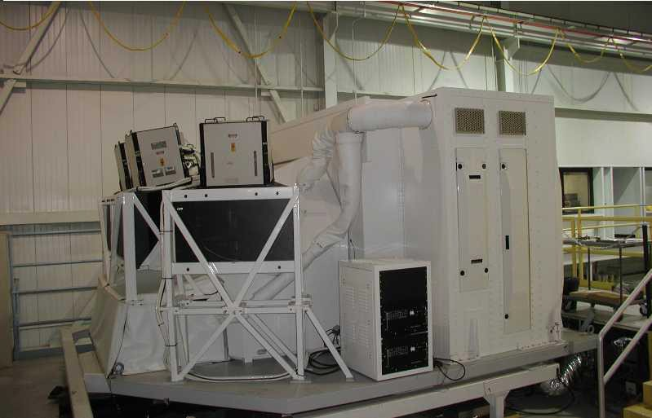

Generic Flight Deck Simulator (GFD)
Operating in fixed-base mode or in motion-base mode
Re-configurable to UAM handling and ride quality cab
Advanced all “glass” generic cockpit which can be used to represent a large range of vehicle types
Three (3) large Head Down Displays (HDD) in main instrument panel and two (2) HDD in center aisle stand
Three (3) HDD in overhead panel
All HDD equipped with touch sensitive functionality
Visual system (four (4) wide angle collimated – two (2) forward & two (2) side window units)
Audio cueing capability provided by digital sound system. Voice Over IP for intercom/radio simulation
Supports Hardware-In-The-Loop testing of flight hardware
Studies include Dream Chaser (Sierra Nevada), Blended Wing Body, High Speed Civil Transport, supersonic studies, Lunar Lander and Orion rendezvous and docking

Slide 11
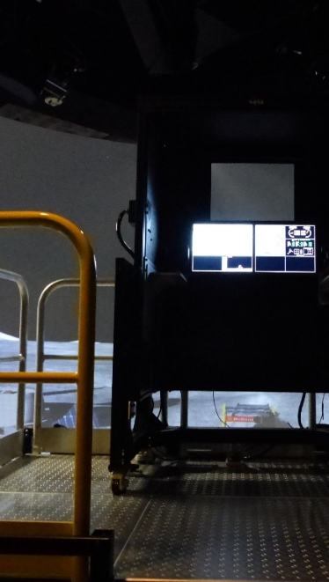
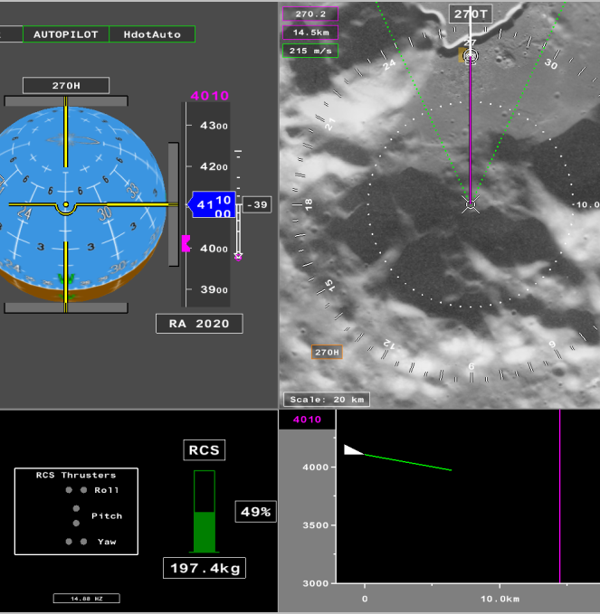
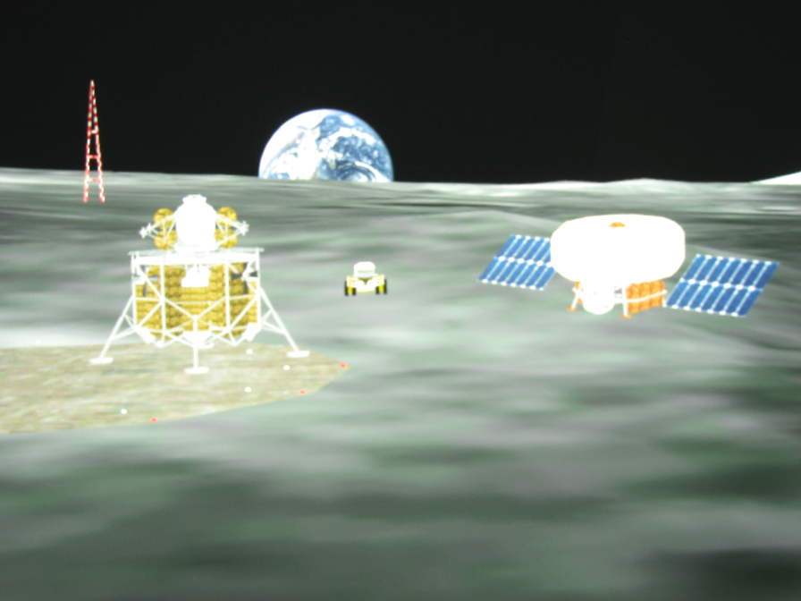
Lunar Flight Deck (LFD) or Test and Evaluation Simulator (TES)
Generic medium fidelity simulator for rapid prototyping research
Modular and Reconfigurable for either planetary or aeronautics research
Currently configured as Lunar Flight Deck (LFD)
Audio cueing capability provided
Voice Over IP for intercom/radio simulation
Mounted displays (with adjustable viewing angles)
Equipped with translation hand controller (THC) and rotation hand controller (RHC)
Wide panoramic 3.25m spherical screen visual system - 135°H x 67.5°V FOV
Large “look down” angle for lunar landing
Architecture that allows integration of Human Machine Interface (HMI), Cognitive Decision Aiding (CDA), and Man-Unmanned Teaming (MUM-T) technologies
Research included Spacecraft Handling Qualities simulation, Unmanned Aircraft Systems, Rotorcraft flight decks, and In-space Assembly

Slide 12

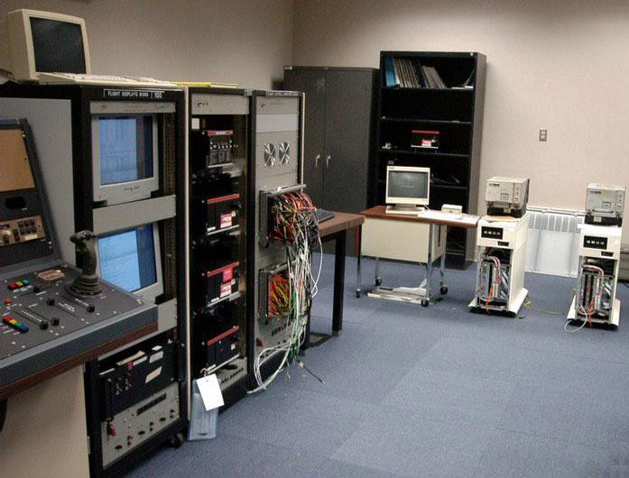
Systems Integration Lab
Human-in-the-Loop Simulator integrates with System Integration Lab for Hardware-in-the-loop, End- to-End Mission Simulation
Hardware Systems for testing include Avionics; Command, Control, Communications, and Information (C3I); Audio, Voice, and Video
Equipment interfaced directly with simulator facilities
  High speed communications network – Ethernet and SCRAMNet
  Video and audio distribution
  Full simulation of actual vehicle signal busses (ARINC, discretes, analogs, serial, telemetry)
Lab has communication and navigation capabilities via roof mounted
  VHF blade, L-band, and GPS antenna
Virtually any avionics hardware or protocol can be integrated into lab
  Flight management computers
  Flight control computers

Slide 13
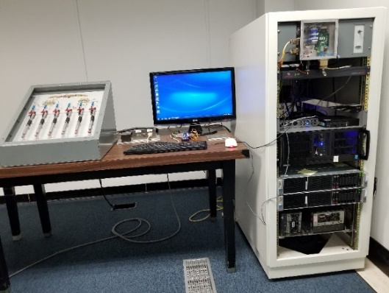
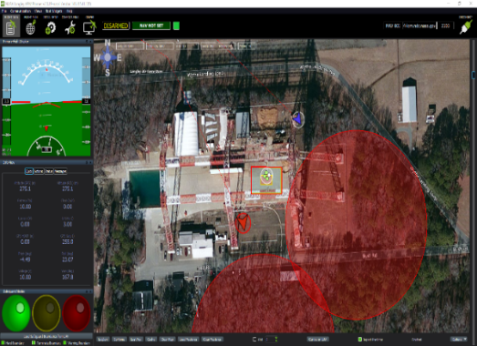
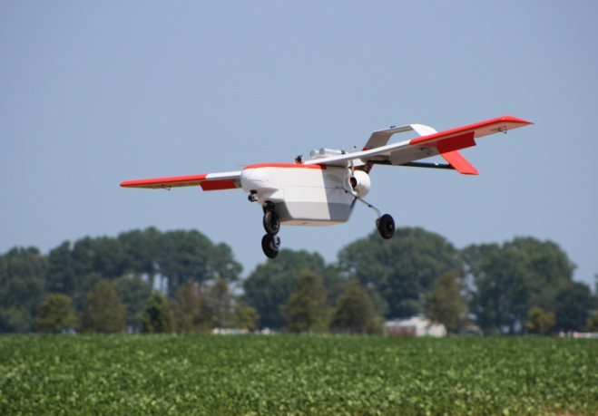
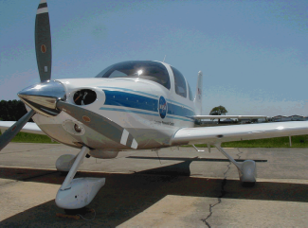
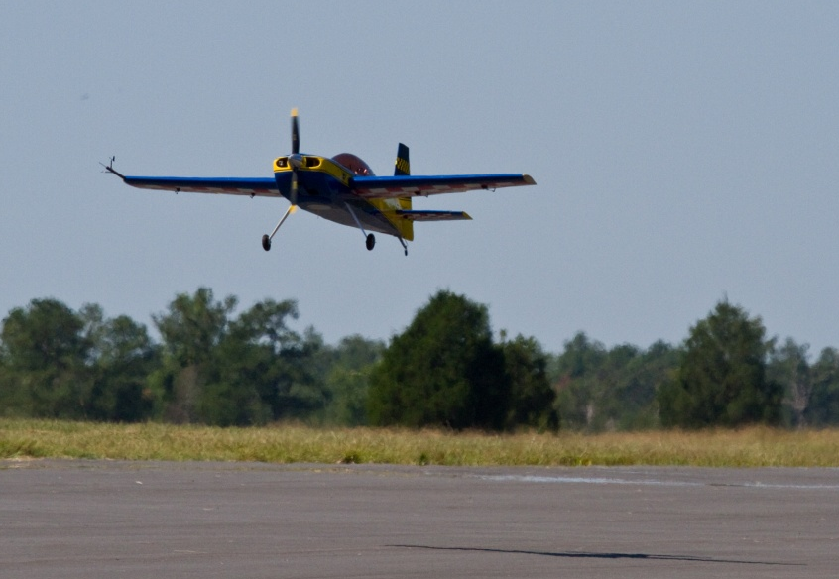
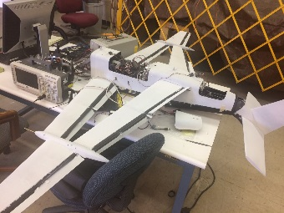
UAS-Systems Integration and Validation Lab (SIVL)
HWITL Simulation Capability
Avionics systems and software integration & deployment
  Rapid integration of user-provided Simulink models or algorithms for test and evaluation
  Generic/common interfaces with servos, sensors, communication links for seamless integration with users-provided avionics
  Failure modes and effects, latency, and propagation
  Reliability and safety studies
Real-time visualization of data, traffic, and test environments
Extensive and reliable data/video collection and playback capabilities for event reconstruction
Monte Carlo and batch testing utilizing models of UAV vehicle dynamics, flight controls, engine, avionics, winds, & turbulence
Multiple research were supported:
  Collision detection, avoidance, and control of UAS during Visual Line of Sight operation.
  Avionics and software interface for autopilot, communications, and data collection for UAV such as GL-10 and Learn-to-Fly airplane models
  Hardware-in-the-loop testing, ground station visualization software, and Monte Carlo simulations for determining performance and safety requirements for UAV operating in restricted “geo-fencing” containment environment
  Autonomy Operating Systems for UAS for prognostics decision making in contingency management
SAFEGUARD Hardware-in-the-Loop Testing
UTM Bat-4 flight tests
SAFEGUARD Ground Control Testing
Before Deployment at Gantry
FDC Flight Tests
UAS Simulation - EdgeAOS
Learn-to-Fly

Slide 14
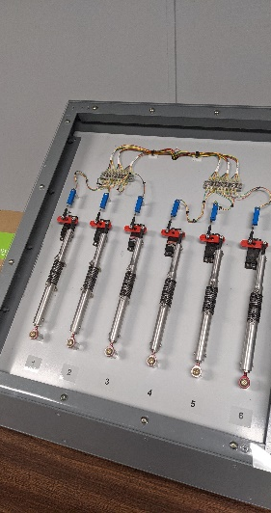
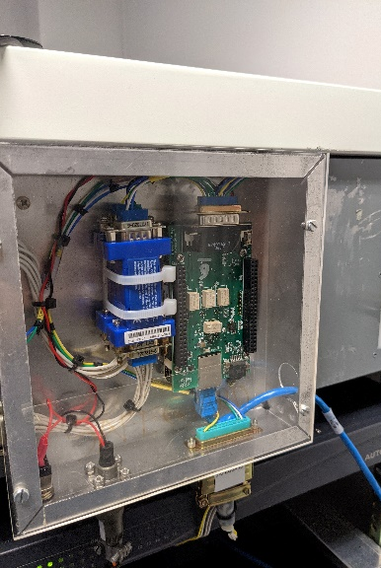
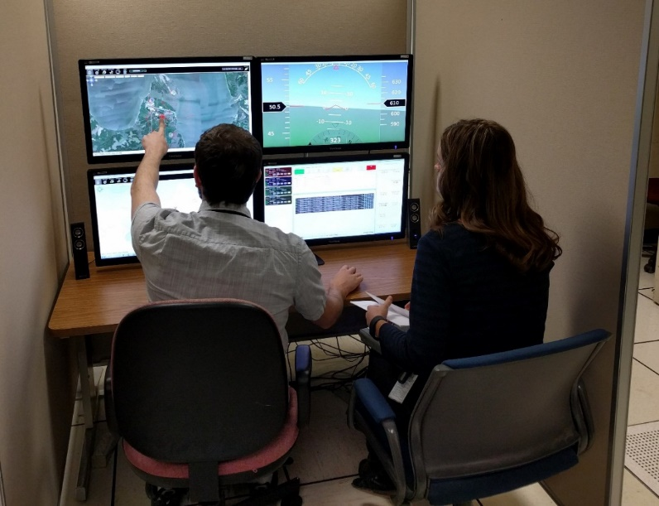
Multi-UAV Control Capability
Real-time and Monte Carlo simulations with hardware-in-the-loop
UAV math models (AirSTAR T2, Bat-4, Octocopter)
Control and monitor multiple simulated UAVs simultaneously
  Open-source modifiable ground control station software
  Allows hand-offs to/from Generic GCS and visual inner loop control of UAS
  Beyond visual line-of-sight operations
  Synchronous flight plan upload and download
  Multiple ground stations interface with multiple UAVs simultaneously
  PFD, satellite map, raw data displays available for each UAV
  Integration with Live Virtual Constructive distributed traffic data

Slide 15

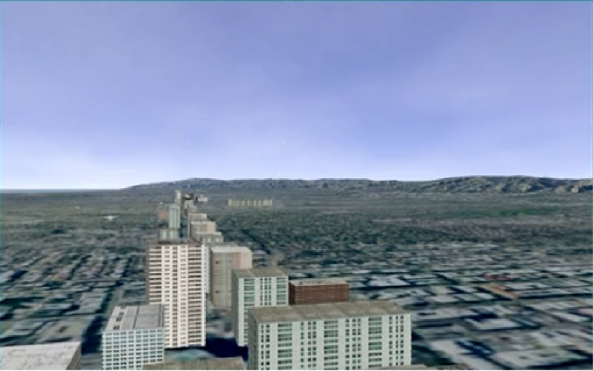

Urban Air Mobility (UAM) Simulation
Collaboration with FAA in supporting fly-by-wire pilot-in-the-loop simulation – evaluating handling qualities, pilot-vehicle interaction considerations, task performance for eVTOL UAM operations.
Safety monitoring and alerting tools, integrated predictive technologies, and safety assurance decision-support for UAM operations
Human-autonomy teaming research in high fidelity fully immersive simulators for certification of non-determinant autonomy and pilot training
Motion cockpit simulation scenario for intra-city flight
Takeoff and landings from and onto building tops and terrain.
Simulated flight into and out of runways including takeoffs and landings. Start times and durations are programmable.
Involving large massive traffic including UAM, UAS, GA, and transport aircraft.
Visual scene includes high detailed graphics:
  Building, mountain terrains, trees, helipad overlay on building tops, and airport environment
  Weather effects: clear, fog, rain, snow, lightning
  Time of day
Heads-down graphics screen provides Primary Flight Display, Navigation Display, mission planner, and traffic map

Slide 16
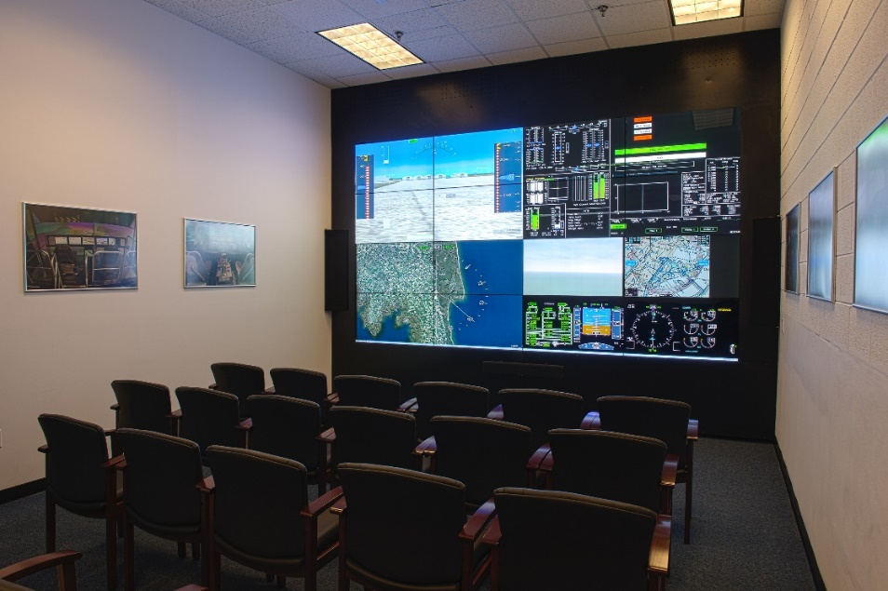
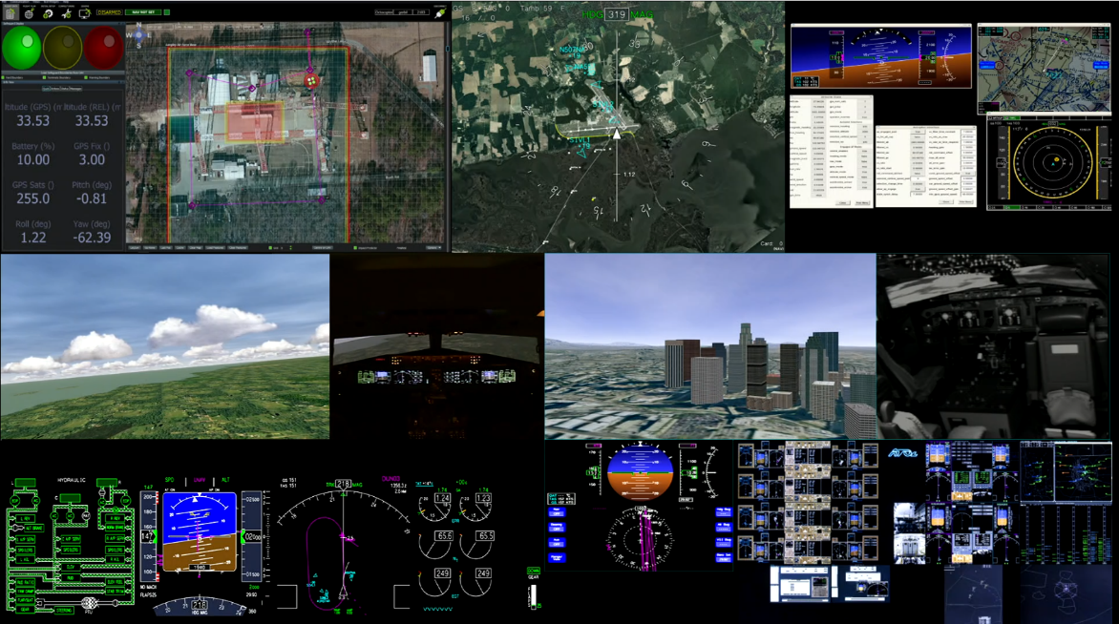
Live, Virtual, Constructive (LVC) Capabilities
LVC capabilities for collaborative, distributed, and integrated simulation as well as flight tests for common connectivity among assets at different geographical locations
  Efficiency in testing concepts, technologies, and their integration and interoperability
  Real/live, virtual, constructive and hybrid-mode operations to simultaneously operate with real and virtual vehicles (aircraft, UAS, UAM, etc) and massive traffic
  Leveraging performance and operational feasibility and benefits to support a variety of advanced research for aeronautics and space exploration.
Available to extend the LVC capabilities for collaborative research with FAA, DoD, industry, and academia.

Slide 17

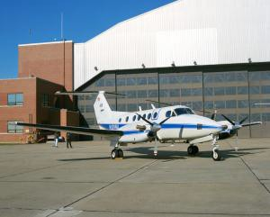

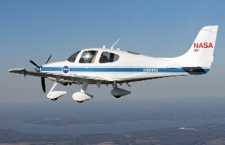
Simulation-to-Flight Validation
Research products migrate from desktop to flight test without re-writing code
SIMULATION
FLIGHT VALIDATION
Utilizing Common Development Systems for Simulation-to-Flight Testing
Hardware/Software
Data Systems
Communication and
Interface Systems
Simulator
B200
System Integration Lab
Efficient, Synergistic, & Realistic Testing Capability
Evaluating research concepts and systems in simulation and flight for
Flight deck designs
Crew procedures
Sensor performance
Cirrus SR22 Surrogate UAV
Conceptual Model and Algorithm Development
Human-in-the-Loop and Hardware-in-the- Loop Evaluation
Instrumentation Development and Integration
System Test and Evaluation
Flight Ops Support Center

Slide 18
NASA LaRC Modeling and Simulation
Implementing comprehensive systems engineering, design, and development
A highly successful simulation software framework with object-oriented technology applicable to large-scale, complex systems or missions
Proven quality, reliability, usability, flexibility, and performance for multiple, varying missions, objectives, and applications
Achieving exceptional levels of software reuse (>86% reuse)
Delivers cost effective and innovative technologies
Provides V&V in reducing risk as products move from concept to flight
Designed for long term maintainability

Slide 19
Questions?
SDAB Branch Head
Victoria Chung · victoria.i.chung@nasa.gov · 757-864-6406
SDAB Assistant Branch Head
Miguel Alvarez · miguel.a.alvarez@nasa.gov · 757-864-6405

