Slide 1

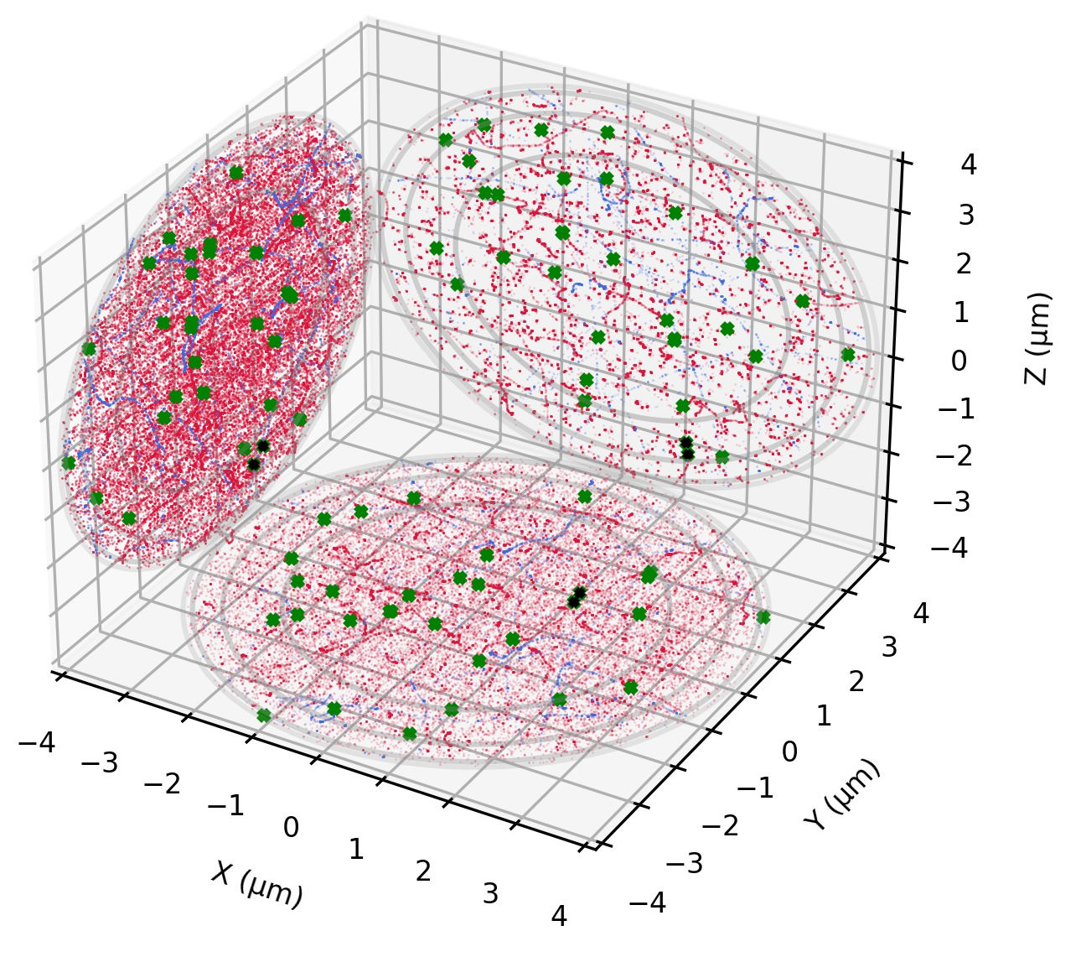
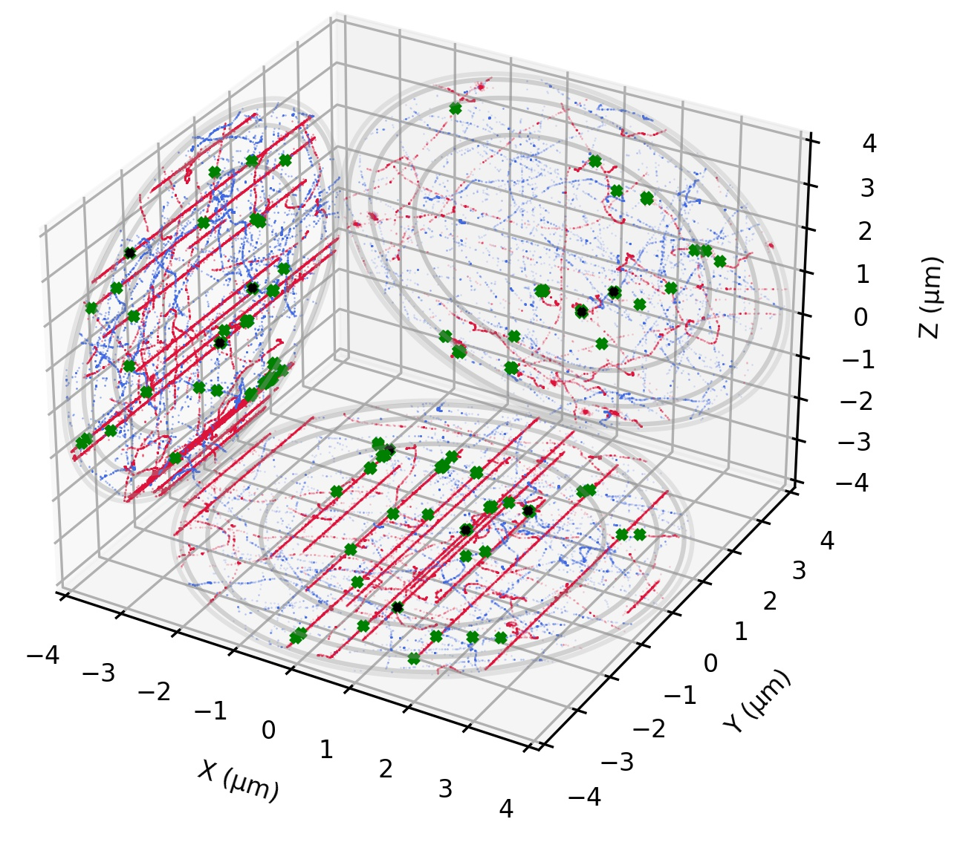
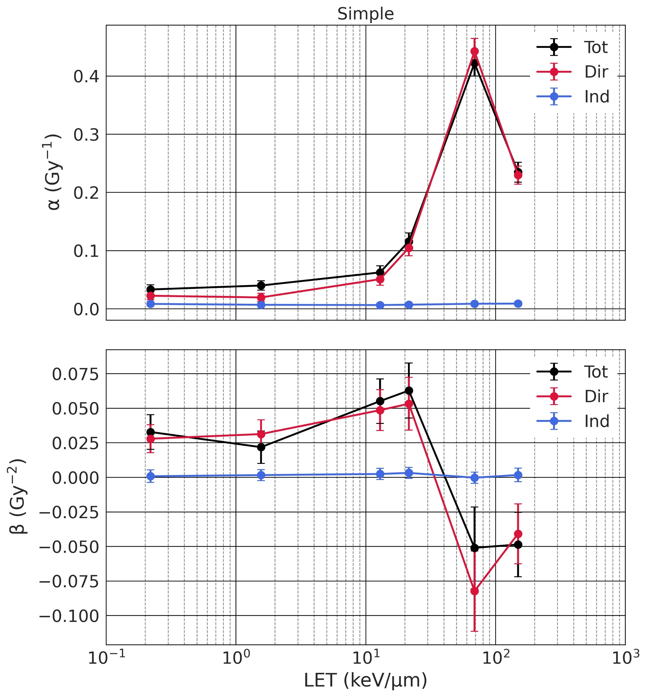
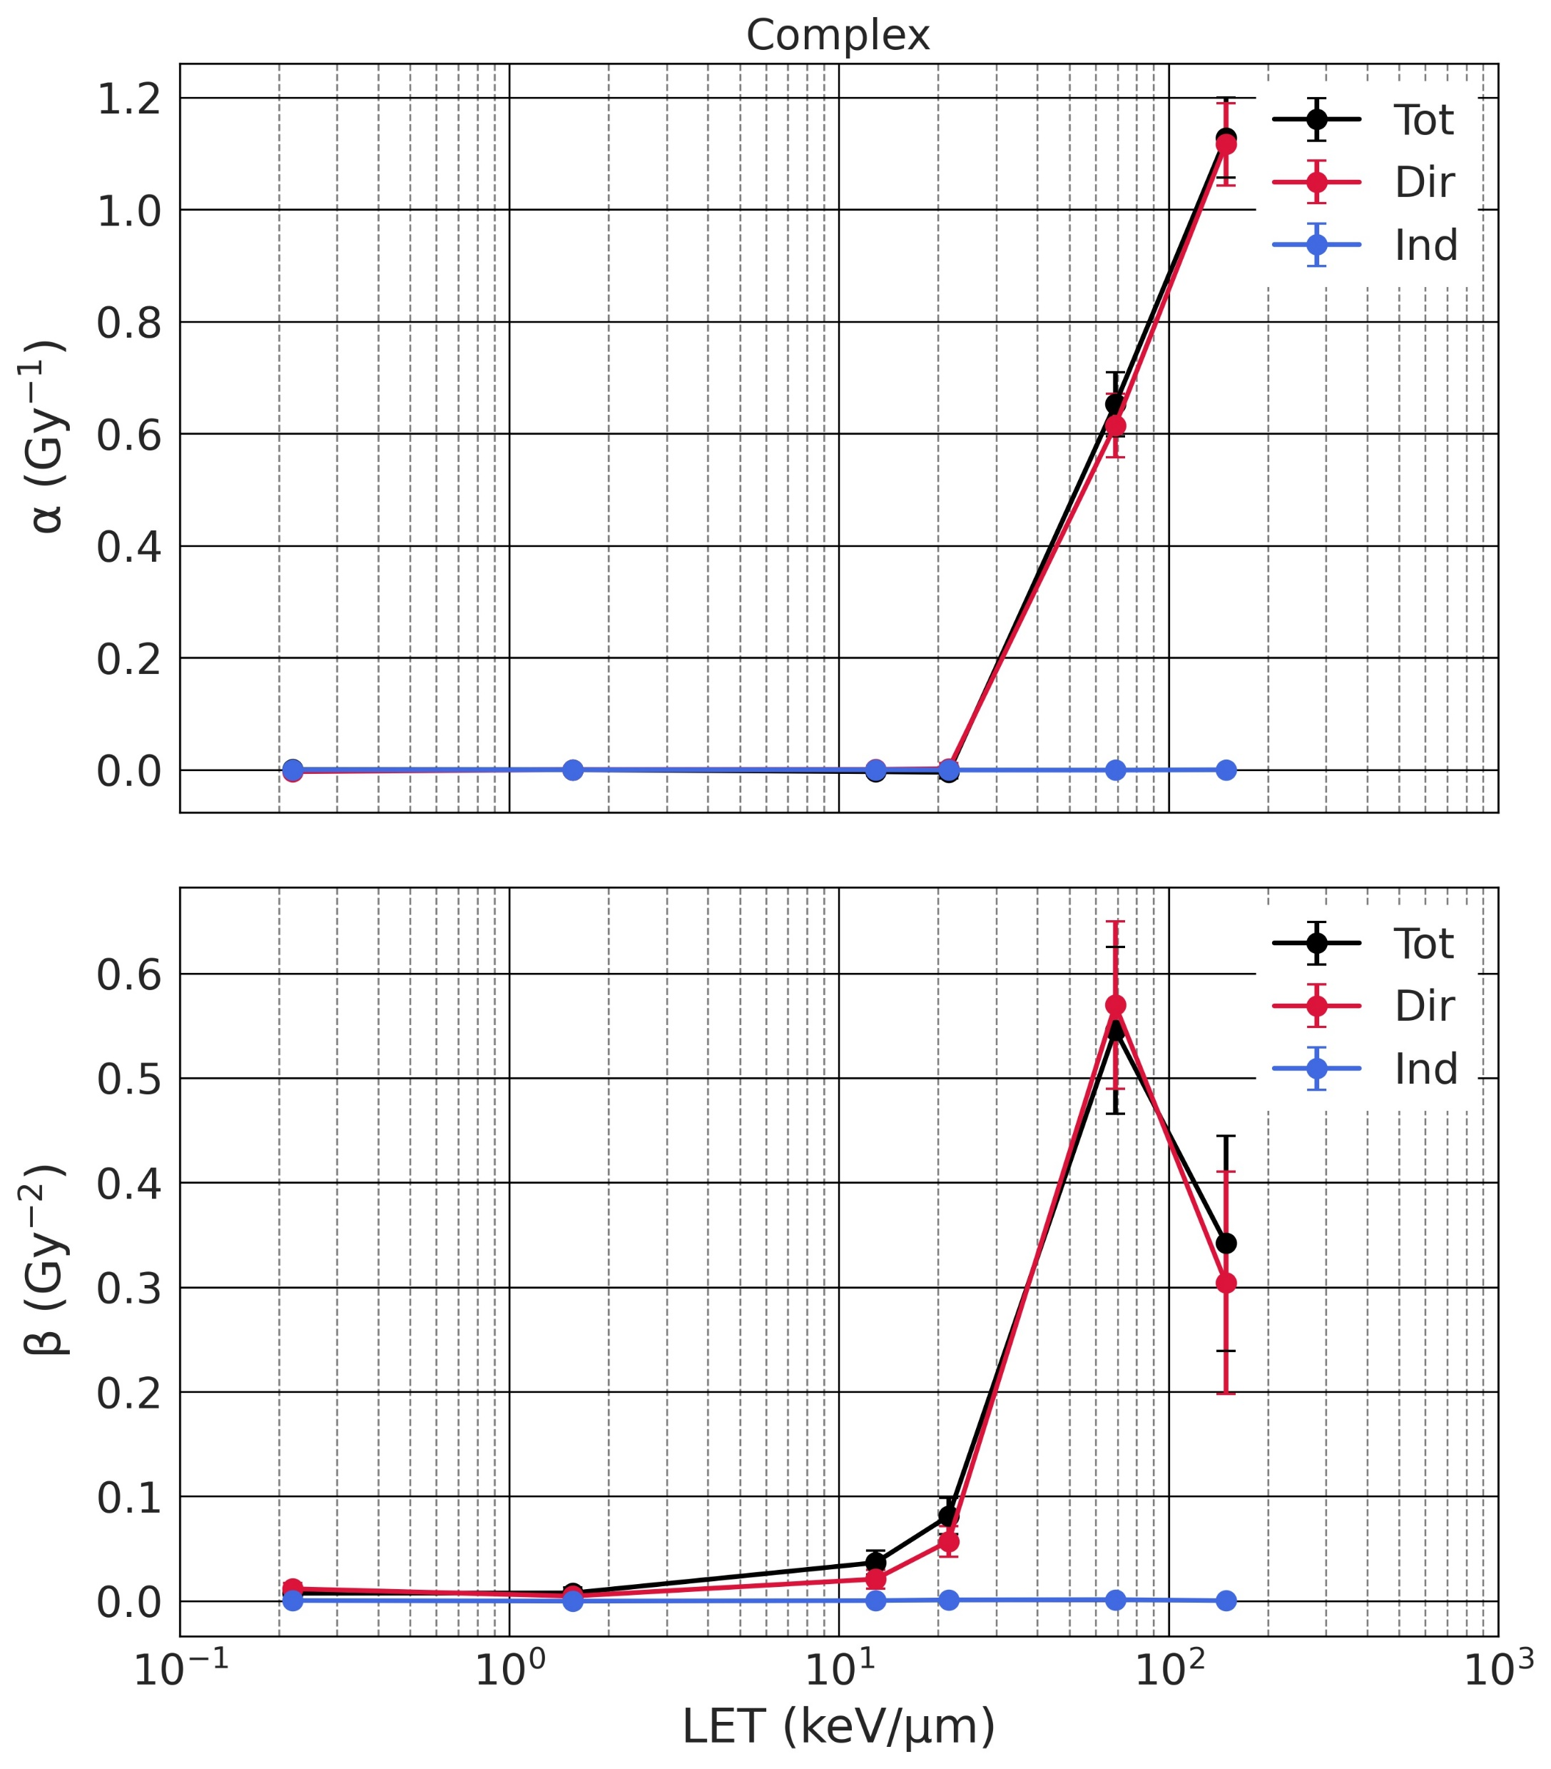
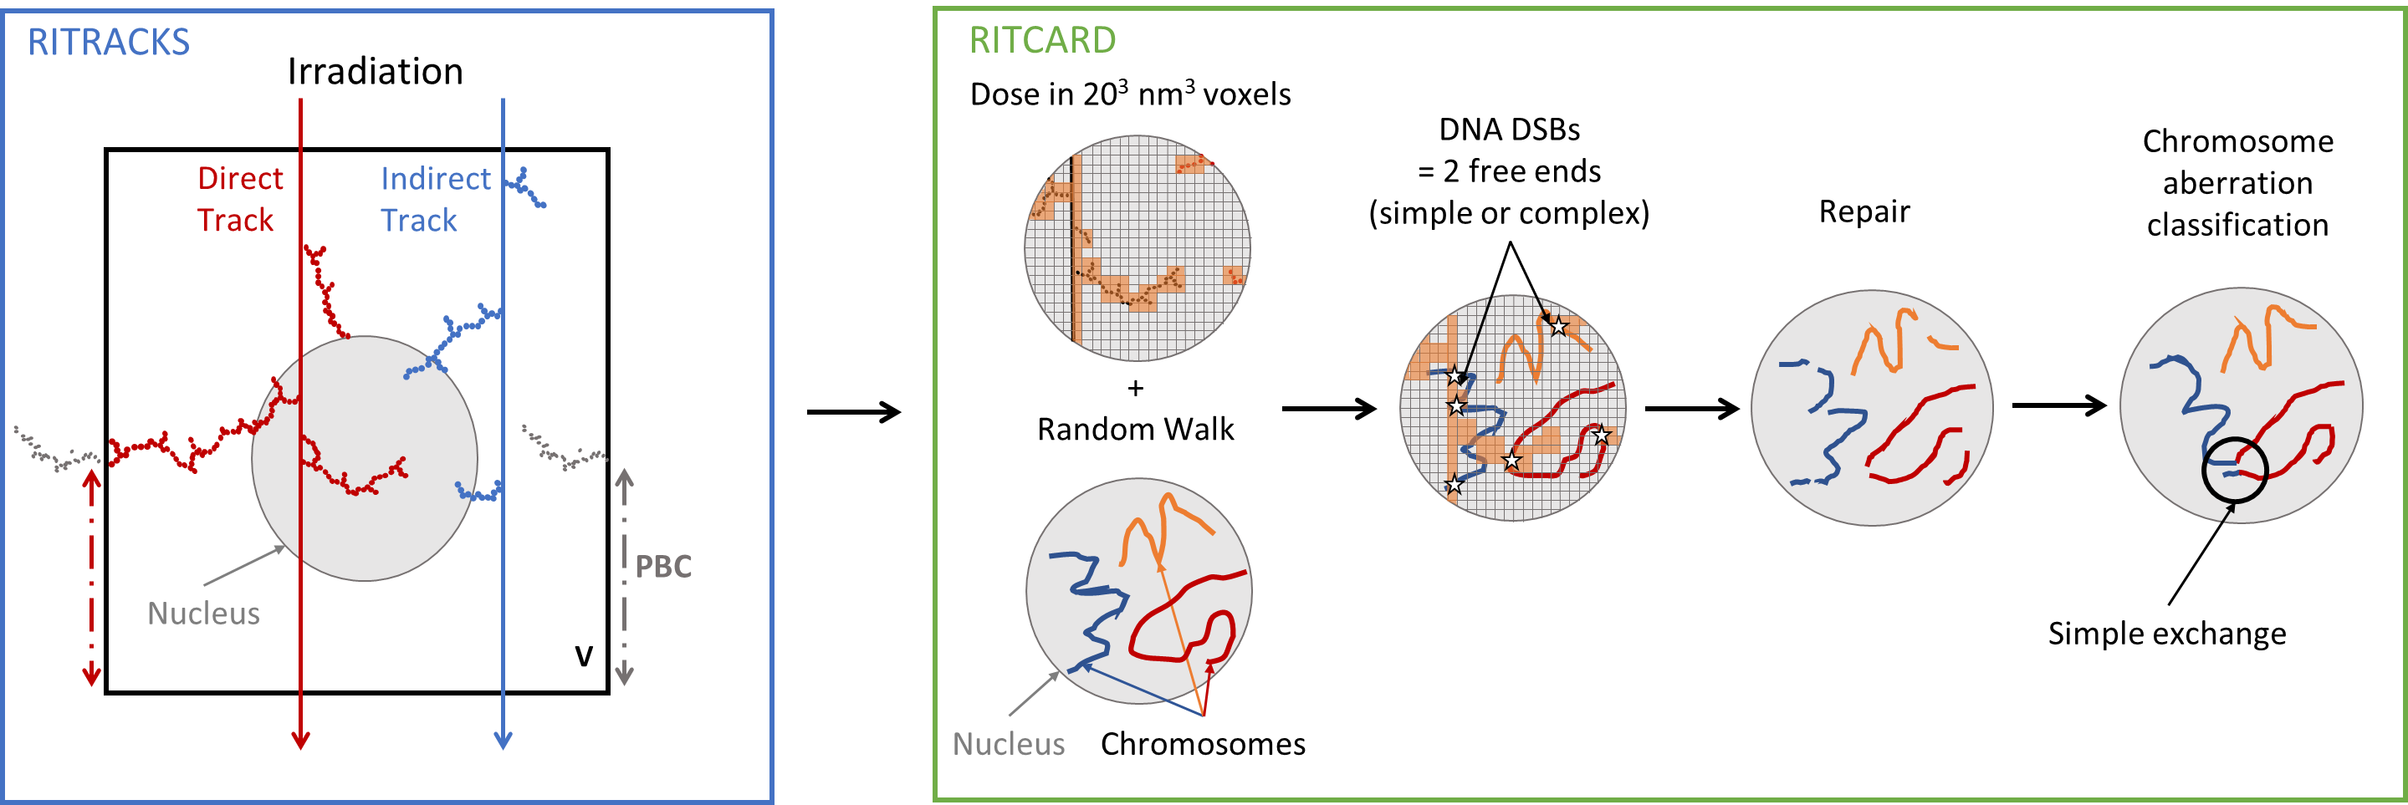
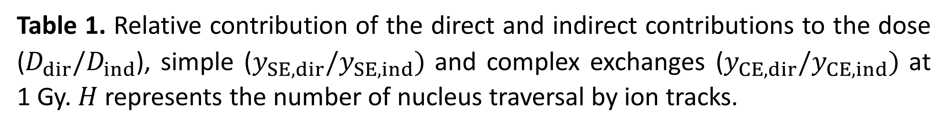

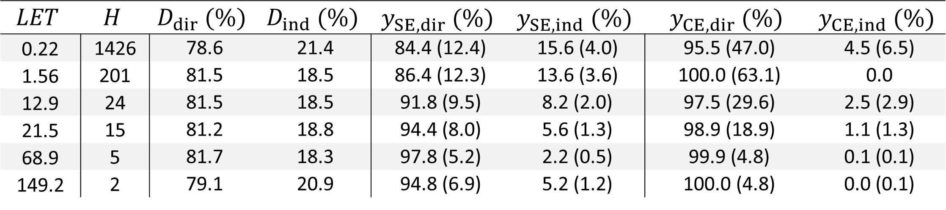

Monte Carlo study of the formation of chromosome aberrations by direct ion traversal vs. delta-electrons
Floriane Poignant¹, Ianik Plante², Tony C. Slaba³
¹National Institute of Aerospace, Hampton, VA 23666, ²KBR, 2400 NASA Parkway, Houston, TX 77058, ³NASA Langley Research Center, Hampton, VA 23681
1. Context
2. Modeling Chromosome Aberrations
Space radiation constitutes a major risk for the safety of space travel. Galactic Cosmic Rays (GCRs) are made of high energy protons (87%), high energy helium ions (12%) and high-charge and energy (HZE) ions [1]. At a cellular scale, HZE ions display a characteristic pattern of energy deposition, known as the ion track, that correlates with the ion linear energy transfer (LET). These energy deposition events (ionizations/excitations) create DNA breaks that, if misrepaired, lead to the formation of chromosome aberrations (CAs). Compared to low-LET terrestrial radiations (X-rays and γ-rays), high LET ions are known to create complex, clustered DNA breaks that are particularly efficient at forming CAs. Indeed, ion tracks are usually described as a dense ionization core, where clustered breaks are formed, and a penumbra, made of low-LET δ-electrons that have sufficient energy to travel across many cells and induce breaks that are more homogeneously distributed. In this work, we investigated the formation of CAs, and separated them into two contributions (direct ion traversal of the nucleus vs. δ-electrons), to elucidate to which extent δ-electrons contribute to CA formation.
We used the Monte Carlo tool RITRACKS/RITCARD [2,3], the main steps of which are explained in figure 1. RITRACKS allows the transport of ions of various energy and atomic numbers, and the cascade of secondary electrons produced in liquid water. An irradiation volume $V$ is defined, that encompasses a spherical nucleus of radius fixed to 4 µm in this study. The number of ions $n$crossing $V$was sampled using a Poisson distribution of average $λ= φA$, where $A$ is the area of irradiated surface and $φ$is the fluence obtained for a given dose, $D$, by $D \left(Gy\right)=1.6 ×{10}^{9}φ \left(cm^{−2}\right) LET (keV/μm)$. A track was defined as direct if it crossed the nucleus, and indirect otherwise. As δ-electrons can have paths beyond mm, we applied periodic boundary conditions (PBC) to mimic the contribution of δ-electrons coming from tracks generated outside of $V$. RITCARD consisted of 5 steps. First, the dose was scored in cubic voxels of side length equal to 20 nm, that mapped the nucleus. Direct and indirect contributions were calculated by switching on/off the energy deposition events coming from direct/indirect tracks. In parallel, a random walk algorithm allowed us to obtain the 3D distribution of the 46 chromosomes. Each chromosome was modeled as a sequence of monomers of lattice period equal to 20 nm and containing 2 kbp of DNA. The number of DNA double-strand breaks (DSBs) in a monomer of spatial coordinates $i,j,k$ was determined by sampling a Poisson distribution, $p\left(N\right)=λ^{N}\exp{−λ}/N! and λ= Q∙D(i,j,k)$. $D\left(i,j,k\right)$ is the dose in the voxel of spatial coordinates $(i,j,k)$ in lattice units, and $Q=1.14 ×{10}^{−5}$ Gy⁻¹. We obtained on average 35 DSBs/cell/Gy. DSBs were classified as simple or complex based on a voxel energy threshold of 500 eV. The next step consisted of a repair algorithm over a 24h time period with a time step $δt$ ($\sim$1 s). During each $δt$, simple breaks were either not repaired, or repaired properly with a probability $δt/τ_{1}$ ($τ_{1}=1.7$ h). Complex breaks were either not repaired, or repaired with a probability $δt/{2τ}_{2}$ ($τ_{2}=23.7$ h). When repaired, free ends coming from complex breaks could either be properly or improperly repaired, with a probability of any 2 ends to repair equal to $I=1/W\exp\left(−r^{2}/σ^{2}\right)$, where $r$ is the Euclidian distance between the selected free ends, and $W$ and $σ^{2}=0.89$ μm² are parameters. At the end of the 24 h time period, all the fragment sequences were classified. Classifications include intact chromosomes, properly repaired chromosomes, deletions and CAs. In this work, we focused on simple exchanges (exchanges involving 2 breaks in 2 chromosomes) and complex exchanges (exchanges involving more than 2 breaks, in more than 2 chromosomes). Simulations were done for 6 ion beams (H 1000 MeV/n, He 250 MeV/n, C 290 MeV/n, O 325 MeV/n, Si 300 MeV/n and Fe 100 MeV/n) of LET ranging from 0.22 to 149.2 keV/µm. For each ion, CAs were calculated for 7 dose points ranging from 0.05 to 1 Gy, with each dose point consisting of 10,000 histories. The final dose-response of simple or complex exchange frequency was fitted by a linear quadratic model, $y_{SE/CE}= αD+ βD^{2}$.
3. Results
H 1000 MeV/n - LET = 0.22 keV/µm
Si 300 MeV/n - LET = 68.9 keV/µm
Figure 2. 3D projected tracks and damages in a cell nucleus (grey circles) for a dose of 1 Gy. Red: direct tracks, blue: indirect tracks, green: simple breaks, black: complex breaks.
Figure 2 shows examples of simple (green) and complex (black) break distributions within the nucleus for two beams. We can see that damages get clustered together along the core of the tracks as the LET of the beam increases. The direct and indirect tracks are displayed in red and blue. The indirect tracks are exclusively from δ-electrons and show relatively similar energy deposition patterns across the whole nucleus, regardless of the beam LET. Direct tracks display dense ionization cores as the LET of the beam increases.
Figure 1. Scheme of the different steps in RITRACKS/RITCARD for chromosome aberration calculations.
Figure 3. Linear quadratic $α$ and $β$ coefficients for simple (left) and complex (right) exchanges as a function of the beam LET
4. Conclusion & Perspectives
The $α$ and $β$coefficients of simple and complex exchanges are plotted in figure 3 as a function of the ion LET. The indirect contribution induces a negligible number of complex exchanges, and a low, but significant number of simple exchanges in a way that is independent of the beam LET. The direct contribution, on the other hand, strongly depends on the LET and is responsible for the majority of both simple and complex exchanges. As shown in table 1, the indirect contribution represents $\sim 20 \%$ of the dose, and therefore induce $\sim 20\%$ of the breaks. The relative indirect contribution to simple exchanges is thus close to $\sim 20 \%$ for low-LET and decreases as the LET increases.
We investigated the formation of simple and complex exchanges by ions of LET varying from 0.22 to 149.2 keV/µm. The yields were separated into 2 contributions: that due to ion tracks directly crossing the nucleus, and that due to δ-electrons coming from distant tracks. The direct contribution shows dense energy deposition patterns accountable for ~ 80% of the energy deposition within the nucleus. It creates clustered, complex DNA breaks that are responsible for the majority of both simple and complex exchanges. The indirect contribution, accountable for ~ 20% of the energy deposition, therefore induced ~ 20% of the breaks. They were however not sufficient, and too sparsely distributed to induce complex exchanges. However, they induce a low, but significant number of simple exchanges, accounting from ~ 20% (low-LET) to ~ 5% of the total number. This shows that clustered DSBs are necessary for CA formation.
Table 1. Relative contribution of the direct and indirect contributions to the dose ($D_{dir}/D_{ind}$), simple ($y_{SE,dir}/y_{SE,ind})$ and complex exchanges ($y_{CE,dir}/y_{CE,ind})$ at 1 Gy. $H$ represents the number of nucleus traversal by ion tracks.
$$LET$$ | $$H$$ | $$D_{dir} (\%)$$ | $$D_{ind} (\%)$$ | $$y_{SE, dir} (\%)$$ | $$y_{SE, ind} (\%)$$ | $$y_{CE,dir} (\%)$$ | $$y_{CE,ind} (\%)$$
0.22 | 1426 | 78.6 | 21.4 | 84.4 (12.4) | 15.6 (4.0) | 95.5 (47.0) | 4.5 (6.5)
1.56 | 201 | 81.5 | 18.5 | 86.4 (12.3) | 13.6 (3.6) | 100.0 (63.1) | 0.0
12.9 | 24 | 81.5 | 18.5 | 91.8 (9.5) | 8.2 (2.0) | 97.5 (29.6) | 2.5 (2.9)
21.5 | 15 | 81.2 | 18.8 | 94.4 (8.0) | 5.6 (1.3) | 98.9 (18.9) | 1.1 (1.3)
68.9 | 5 | 81.7 | 18.3 | 97.8 (5.2) | 2.2 (0.5) | 99.9 (4.8) | 0.1 (0.1)
149.2 | 2 | 79.1 | 20.9 | 94.8 (6.9) | 5.2 (1.2) | 100.0 (4.8) | 0.0 (0.1)
References
[1] Cucinotta et al. (2013) NASA TP 2013–217375.
[2] Plante and Cucinotta (2011) In Mode CB (Ed) Applications of Monte Carlo Methods in Biology, Medicine and Other Fields of Science, InTech.
[3] Plante et al. (2019) Genes, no. 11:936.
Acknowledgement
This work was supported by NASA Human Health and Performance (HHPC) contract number NNJ15HK11B (IP) and by the NASA Langley Cooperative Agreement 80LARC17C0004 (FP). This work is supported by the Human Research Program under the Human Exploration and Operations Mission Directorate at NASA (TS).

