Slide 1
Plasma Reduction of Regolith for Oxygen Liberation
Ryan Gott, Elspeth Petersen, Kenneth Engeling, Nilab Azim, Carolina Franco, Joel Olson
Gaseous Electronics Conference, October 6th, 2021

Slide 2
Background
Lunar regolith is composed of 40% oxygen (by weight)
Need oxygen for fuel and life systems
Bonds holding the oxygen require high temperatures, large amounts of energy, or strong reducing agents to separate the oxygen from the regolith
Silicates, which are prevalent at the poles, require extreme high temperatures in the current state of the art
Path needed for producing oxygen
At any lunar location
Without consumables
At temperatures below melting and sintering

Slide 3
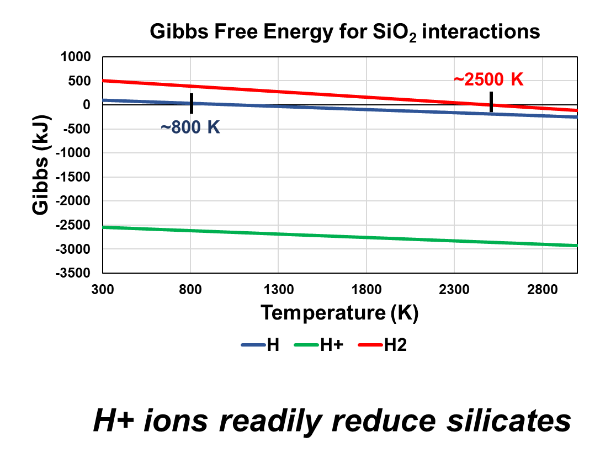
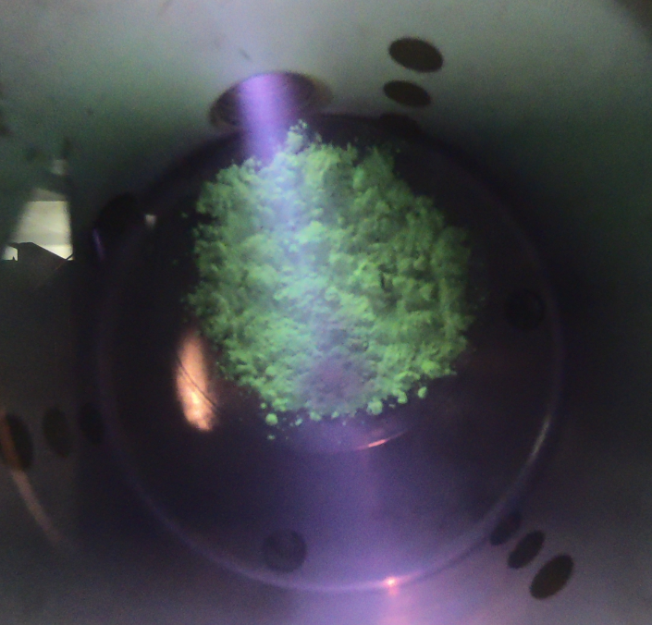
Plasma Treatment
Hydrogen plasma produces H+ ions, which reduce silicates
H₂ reduction creates water
Electrolysis can extract O₂
Avoids consumables and high temperatures

Slide 4
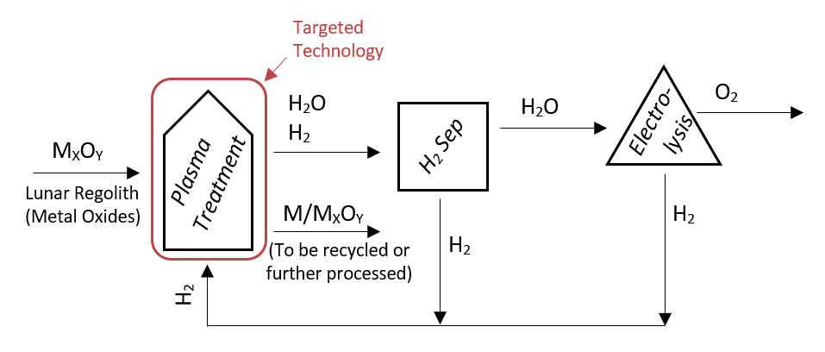
Concept
4

Slide 5
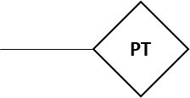
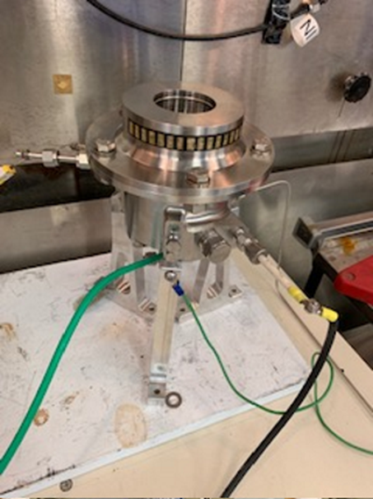
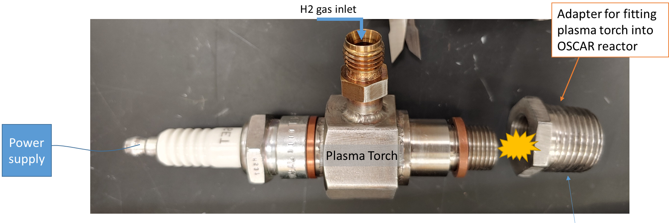
Sample line to RGA/Mass Spec
Optical Emission Spectrometer (outside)
Experimental Setup
Vent to hood
Power supply
Gas Exit
H₂ gas inlet
Vacuum pump
TC
Regolith
Plasma Torch
Extract oxygen from regolith using H₂ plasma
Reactor and regolith remain at near-ambient temperature
Reactor is at 5 Torr
High Voltage DC Power Supply from Applied Plasma Technologies Corp gave ~100 W of power
H₂ plasma plume passes over regolith then pulled out to vacuum pump
Optical Emission Spectrometer and Mass Spec monitor reaction/plasma conditions
H₂ gas inlet

Slide 6
Measurements
Three Concurrent Measurements in Chamber
GoPro Video
Residual Gas Analyzer (RGA)
Optical Emission Spectroscopy (OES)
N₂
Water
Oxygen
Si I
N₂⁺
H
N₂⁺
H
N₂
OH

Slide 7
Plasma Treatment of Lunar Highland Simulant

Slide 8
RGA Water Signal
LHS=flat layer of regolith High LHS= piled regolith, so substrate interacted with plasma cloud more directly

Slide 9
Optical Emission Spectroscopy (OES)
Identify species
H, OH, N₂, Si, N₂ ⁺
Interference (N₂ leak)
OES Interpretations
OH from water dissociation
Possible addition from air leak
Si I/ Fe II suggests reduction
N₂ shows leak (air)
Si I N₂⁺
H
N₂⁺
N₂
OH
N₂⁺
H

Slide 10
OH Results
N₂
OH

Slide 11
OH Comparison

Slide 12
OH Comparison
*
*
The High LHS* partially blocked the plasma, causing a reduction in light intensity.
*Lunar Highland Simulant (LHS)

Slide 13
Summary
RGA/Mass spec and OES measurements show clear production of water
Increasing plasma contact area increases reactions
Many variables left to explore
Packing of regolith/torch orientation
Chamber temperature
Varying pressure
Need to quantify water production and O₂ removal efficiency
Compare to higher TRL systems: Carbothermal Reduction and Molten Regolith Electrolysis

Slide 14
Thank you!

Slide 15
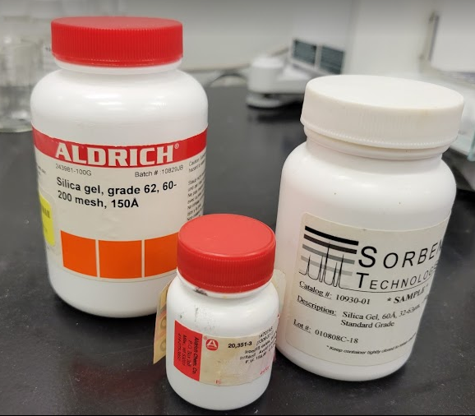
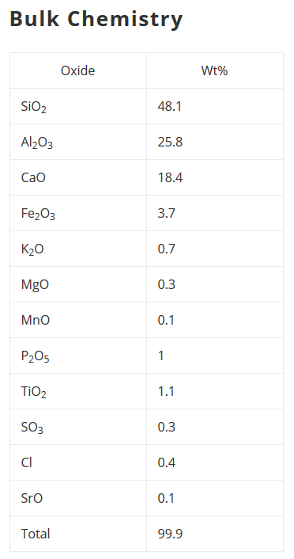
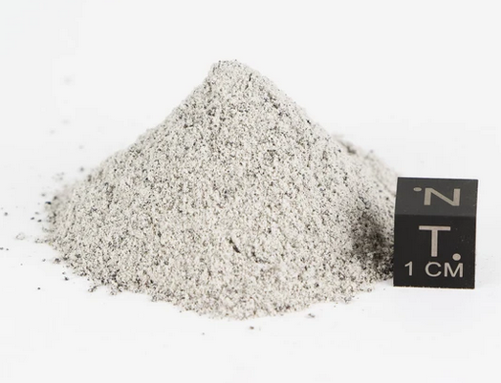
Silica selected as a regolith analog for ease of characterization
Backup Slide: Substrates
←Silica gel (74-250μm) SiO₂
← Fine Silica (32-63μm) SiO₂
↓Lunar Highland Simulant (60μm) LHS-1 from Exolith

Slide 16
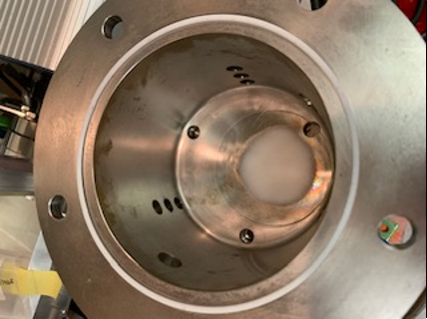
Backup Slide: Testing Parameters
Chamber Pressure
Pump down to 200 mTorr
Flow 15-75 sccm H₂
25 sccm H₂ brings pressure to ≈4.5 Torr
Thermodynamic behaviors increase with pressure to ≈ 7 Torr
Plasma Parameters
High Voltage DC Power Supply from Applied Plasma Technologies Corp.
0 – 10 kV, 8 Amp max supply
The resulting power draw was 80-100 W
Operating Temperature
Gas in chamber max 50°C
Torch housing max 250°C
Test Simulant Masses
Initial tests with 1.5 grams
‘Piled’ test of 17 grams
Silica Sample in Chamber (on watch glass)

Slide 17
Backup Slides: RGA Results
Water
N₂/Si
Oxygen
Water
N₂/Si
Oxygen

