Slide 1
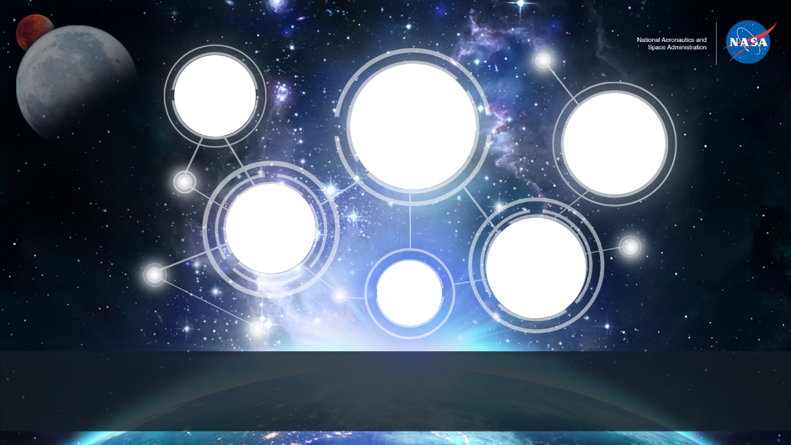
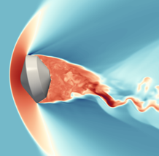
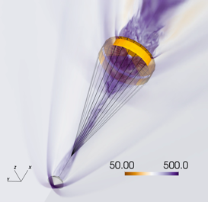

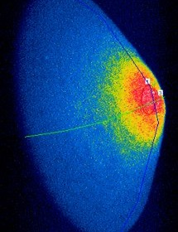
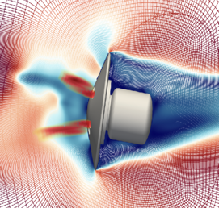
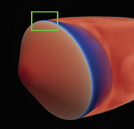
Space Technology Mission Directorate
Game Changing Development Program
Michael Barnhardt | Aaron Brandis | FY21 Entry Systems Modeling Annual Review Presentation | 09.14.2021

Slide 2
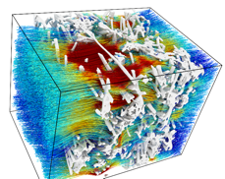
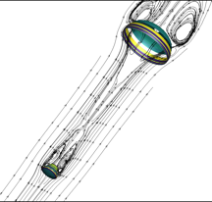
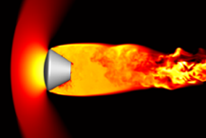
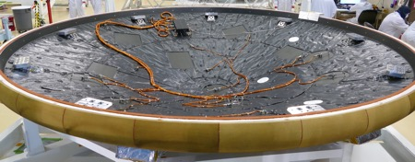
Entry Systems Modeling (ESM)
Project Overview
Technology Product Capability
  Cross-cutting tools and technologies for modeling entry systems that improve performance, reduce mission risk, and enable new system capabilities across the Solar System
Technical Capabilities
  Predictive Material Modeling: Multiscale models of thermal protection material performance and reliability
  Shock Layer Kinetics & Radiation: High-temperature gas physics of entry systems, from quantum to engineering scales
  Computational & Experimental Aerosciences: Parachute dynamics, entry vehicle dynamics and stability, turbulent heating, advanced computational methods
  Guidance, Navigation & Control: End-to-end simulation capability for multiple mission entry, descent, and landing concepts of operations
  Ground Test Validation: Focused ground testing at all scales to support uncertainty quantification across technical areas; requires unique facilities and specialized diagnostics
Multiscale Materials
Parachute Dynamics
Entry Vehicle Heating & Dynamics
Mars 2020/MEDLI2 Instrumentation
Post-flight V&V
Three new starts added to portfolio in FY21:
MEDLI2 Deep Dive
TPS Certification by Analysis
Hypersonic Wake Flows (partial funding)
Notes:
Provide an overview of the Project/Task
The slide content is intended to remain static unless significant changes are made to the Project
Pictures are encouraged, please provide new pictures as frequently as possible

Slide 3

Mission Infusion & Partnerships
ESM is a successful, multi-year collaboration between STMD and SMD
Centers
Ames
Langley
Johnson
Glenn
Universities
6 Early Career Faculty
7 Early Stage Innovations
1 Space Technology Research Institute
10 NSTGRO
6 EPSCoR
6 ESM grants
OGA
Air Force Office of Scientific Research
Office of Naval Research
Missile Defense Agency
Sandia
Lawrence Berkeley
Lawrence Livermore
International
German Aerospace Center
JAXA
Ecole CentraleSupelec
Von Karman Institute
University of Queensland
Oxford University
Instituto Superior Tecnico
SBIR/STTR
Scientific Simulations, LLC
Corvid Technologies
Exploration & Science Applicability
  Orion [Ongoing]
  Mars 2020 [Completed]
  Mars Sample Return – Earth Entry Vehicle and Sample Retrieval Lander [Ongoing]
  Dragonfly [Ongoing]
  DAVINCI+ [Potential]
  STMD technology projects: MEDLI2, LOFTID, and others as warranted

Slide 4

















Academic Partnerships

Slide 5
Entry Systems Modeling
Technology Goals & Project Objectives
Technology Goals
Goal #1 | Produce high-fidelity TPS material models to reduce mission risk and improve design reliability
Goal #2 | Develop physics-driven models of high-temperature gas chemistry and radiation relevant to EDL missions
Goal #3 | Develop tools for simulating complex, unsteady aerodynamic phenomena
Goal #4 | Create end-to-end simulation capability for multiple mission EDL concepts of operation
Goal #5 | Deliver tools & capabilities to stakeholders with quantified uncertainty models
Project Objectives
Objective #1 | Develop and validate next-gen PATO, Icarus, PuMA, and SPARTA codes for multiscale material modeling
Objective #2 | Generate comprehensive chemistry and radiation databases for all Solar System EDL targets using computational chemistry and testing in the Electric Arc Shock Tube
Objective #3 | Develop and validate next-gen CFD methods for analysis of unsteady flows: Wake flows, jet interactions, vehicle dynamics, parachute dynamics, high-order numerical schemes
Objective #4 | Implement multi-threading in POST2 simulation software and develop interoperability framework to couple with external applications

Slide 6

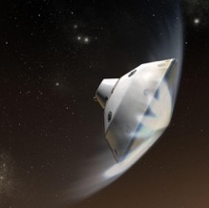
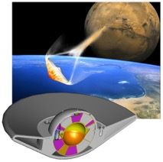
FY21 Mission Infusion Summary
Orion
  Training Orion staff on PuMA and SPARTA software for Avcoat analysis
  Defining and calibrating flight spectrometer
  Parachute modeling
Earth Entry System
  Mission-relevant roughness heating correlations
  Supporting FUN3D NESC assessment
  Developing models for fracture & failure of woven TPS
  Dynamic stability analysis and simulation of TDT test
  Multi-dimensional modeling of woven TPS
  Understanding MMOD impact on TPS design
  Modeling of mechanical erosion due to ablation
Sample Retrieval Lander
  PICA-NuSil response model
  Deep dive into MEDLI2 data -> margins assessment
  Mission-relevant roughness heating correlations
  Impact of dust particles on TPS erosion
Dragonfly
  Shock tube-informed bias to quantify aerothermal uncertainties
  3-D TPS sizing tool, Icarus
  Dynamic stability analysis with free-flight CFD

Slide 7
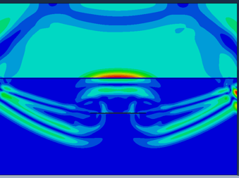
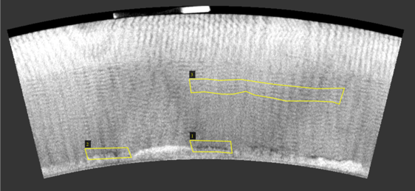
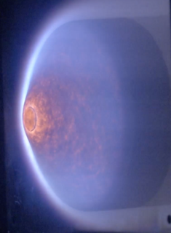
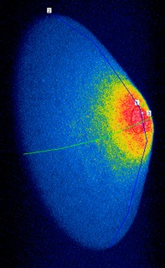

Accomplishments (Materials)
Key FY21 Technical Accomplishments:
  Three-day AHF arc jet test of PICA and PICA-NuSil specimens for a range of heat loads. Data used to update PICA-NuSil material response model.
  A model for PICA pyrolysis was developed at high heating rates using PATO and the optimization software Dakota.
  Methods developed to identify deep cracks and debonds at structural interfaces in woven TPS. Reduce risks to a successful entry and should be identified in the certification process.
J. Meurisse et al.
KPP for matching PICA pyrolysis products as a function of temperature
HEEET Ultrasound Model
HEEET CT Scans Showing Faults
crack
J. Haskins et al.
J. Haskins et al.
Computational NDE: Inform ultrasound settings needed to identify faults
Machine Learning Fault Detection: identify faults from low-res. tomography
B. Bessire
AHF PICA-NuSil testing
Notes:
Three-day AHF arc jet test of PICA and PICA-NuSil specimens for a range of heat loads measuring in-depth temperature, surface IR and pyrometer temperatures. Data used to update PICA-NuSil material model.

Slide 8
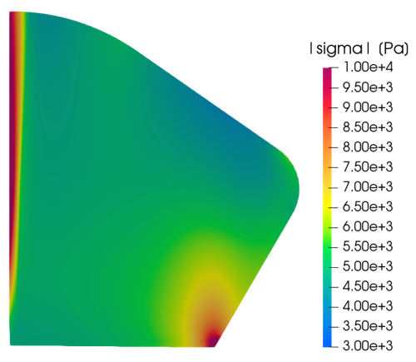
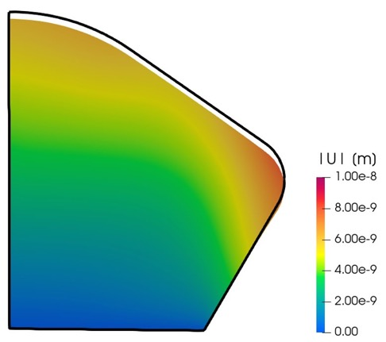
Accomplishments (Materials - EES)
Key FY21 Technical Accomplishments:
  High enthalpy arc jet flow simulated over an MMOD impacted wedge. A 3D Icarus simulation highlighted that near the cavity, multi-dimensional heat conduction is required.
  Framework for simulating mechanical erosion due to high shear EES entry conditions developed in PATO. Models added include a stress solver, failure criteria model, mass removal model and 3MDCP mechanical properties.
  3-D TPS sizing in Icarus given a maximum bondline temperature constraint.
Mechanical erosion for EEV: Modeling stress within the TPS
TPS displacement due to shear stress
J. Meurisse et al.
O.Schroeder, E. Stern
3-D material response on MMOD impacted FiberForm sample

Slide 9
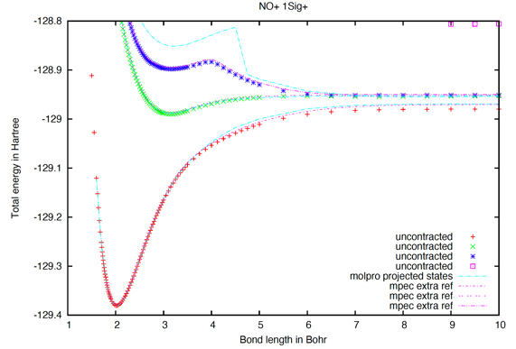
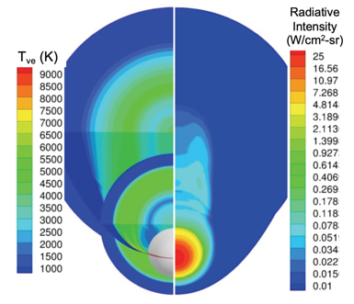
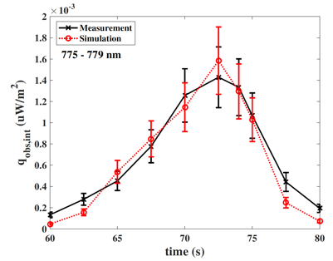
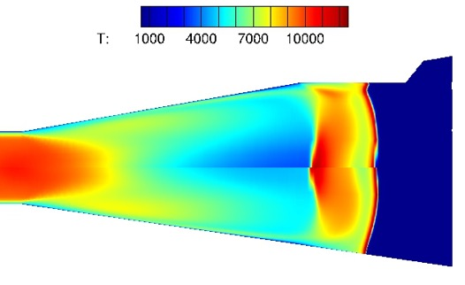
Accomplishments (SLKR)
Key FY21 Technical Accomplishments:
  Simulations of the Hayabusa 2 entry observation showing very favorable agreement (collaboration between ESM/SCIFLI)
  Initial expanding flow shock tube testing in air, with comparisons to simulations
  MPEC: New quantum chemistry code developed and released
  Partnered with Orion & EES on Artemis 1-4 flight spectrometers
NO+
D. Schwenke
Improved agreement with reference solutions using MPEC
Total Energy
Reference soln
Molpro (old code)
MPEC (new code)
Bond Length
C. Johnston
Atomic Oxygen
A. Tibere Inglesse, K. Bensassi, B. Cruden
Flowfield around Hayabusa 2
Excellent agreement for simulations of Hayabusa 2 observation data
Informing understanding state of expanding flow in EAST and impact of optical windows with CFD

Slide 10
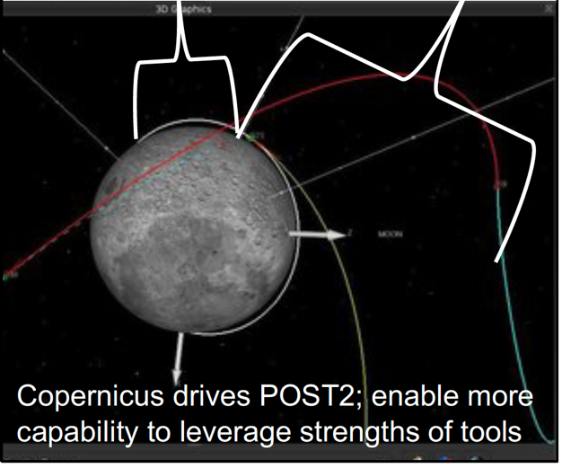
Accomplishments (GN&C)
Program to Optimize Simulated Trajectories II (POST2)
  NASA’s workhorse flight mechanics simulation tool
  Primary tool used to assess spacecraft flight performance across the solar system
  Motivation for ESM: Improvements, particularly HPC, are necessary to accelerate implementation of SoA GN&C algorithms and higher-fidelity vehicle models
  FY21-22 plan: Modify POST2 data structures and algorithm to be thread-safe and enable interoperability with other programs
  Current status: Architectural changes were made to POST2 memory handling to ensure that memory is only accessible by a single thread and trajectory simulations maintain integrity when run in parallel
ESM Goal: Create Launch-to-Landing GNC capability
POST2
Copernicus

Slide 11
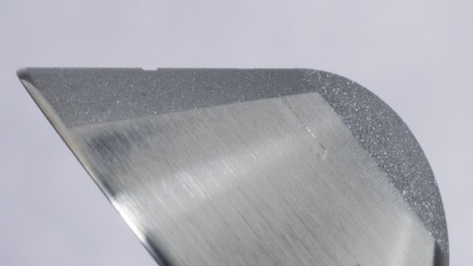
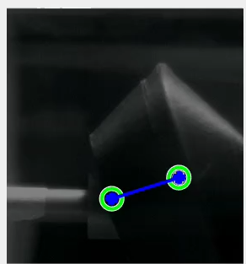
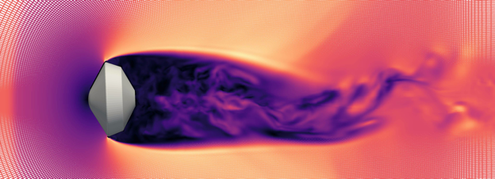
Accomplishments (CEA)
Key FY21 Technical Accomplishments:
  Measurements of turbulent rough-wall heat flux to characterize heat flux augmentation for woven & block TPS with MMOD-like features
  Utility for deriving dynamic stability coefficients from CFD with validation against Genesis aeroshell ballistic range data. Direct tie to Dragonfly.
  Independent design review for the supersonic magnetic suspension wind tunnel. Recommendation to focus efforts on developing a more capable and robust subsonic system as a technical pathfinder to guide supersonic design.
  Orion AA-2 flight test simulated with free-flight dynamic CFD. Good agreement with total AoA and velocity profile.
Ballistic-Range Model with MMOD Cavities
Depth, d = 0.1 mm
L/d = 7.2
Depth, d = 0.04 mm
L/d = 18.8
M. Wilder
M. Schoenenberger
Tracking a Genesis aero-shell model in MSWT
J. Brock
J. Brock
Free-flight CFD of Orion AA-2 flight test
Free-flight CFD of Genesis

Slide 12
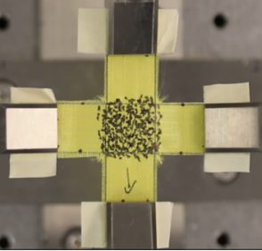
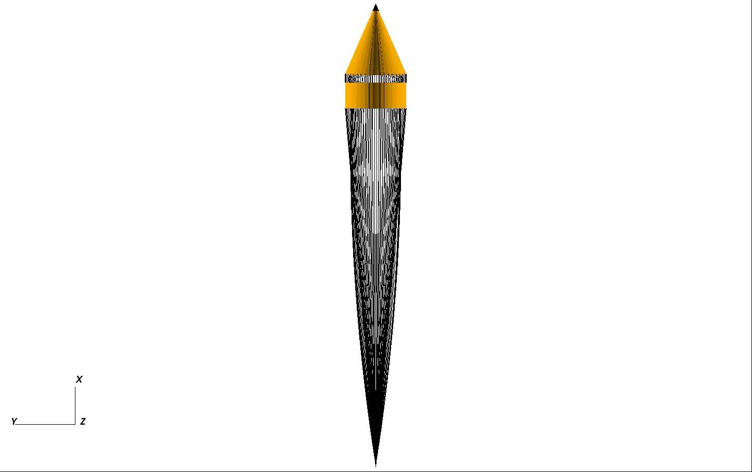
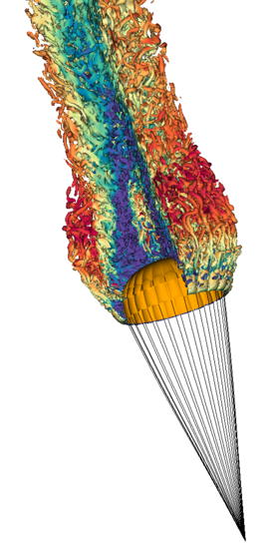
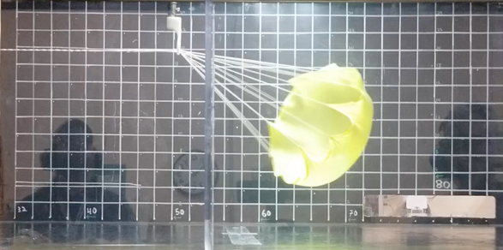
Accomplishments (CEA)
Key FY21 Technical Accomplishments:
  Demonstration of (self-)contact identification and enforcement on the folded ASPIRE parachute canopy
  Parachute “shakedown” testing in NASA ARC fluid mechanics lab
  FSI Capability for a Single Canopy Parachute work continues:
    High-order monolithic FSI solver running subsonic parachute configuration with updated preconditioning and embedded boundaries
    NASMAT multiscale fabric solver extended for failure and biaxial loading
  Biaxial testing:
    Funded at NASA GRC, pending personnel availability and access
    Initial testing performed at UMass-Lowell (ESI) with dynamic biaxial rig
Setup for dynamic biaxial fabric testing
S. Murman
Ring-traverse mechanism demonstrated for repeated deployments of stable and unstable canopies
Building up parachute FSI modeling capability to simulate supersonic inflation
S. Murman
J. Boustani, C. Kiris

Slide 13
Entry Systems Modeling Project
Lifecycle TRL Advancement
Project Milestone
GCD (Key) Milestone
Controlled Milestone
TRL/SRL/MRL Progression
FY20 | FY21 | FY22 | FY23 | FY24 | FY25 | FY26
6
5
N/A:
ESM is a portfolio project with continually evolving content and associated TRL advancement. TRL of current content summarized on subsequent charts.
4
TRL / SRL / MRL
3
2
1
Notes:
Chart purpose: show TRL/SRL/MRL advancement over the project lifecycle schedule. Show TRL advancements as whole integer increases. Show how Key and Controlled milestones align with TRL advancement.
TRL/SRL/MRL may not advance at each milestone. Often several milestones are required to produce a step increase in TRL/SRL/MRL.
There can be one, or more, of these charts per project as needed.
For projects with fewer technical elements, the TRL/SRL/MRL data can be combined on one chart.
For more complex projects, the TRL/SRL/MRL progression can separated into multiple charts by project technical area.
Show TRL, SRL, and MRL data for each technical element on the same chart.
Delete TRL/SRL/MRL axis-labels that do not apply – e.g., remove SRL/MRL for projects/technical areas where SRL and MRL do not apply.

Slide 14
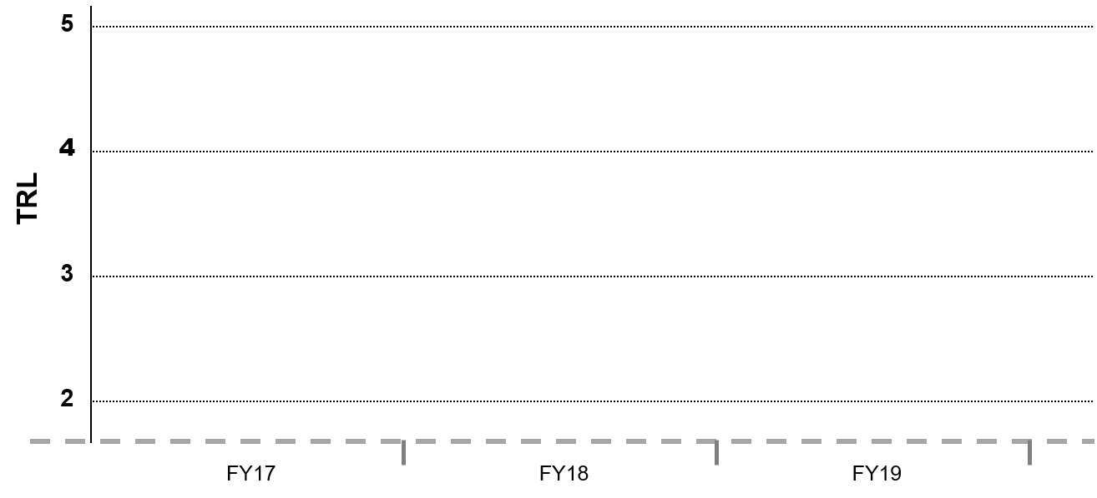
SRL Progression
PMM
Project Milestone
GCD (Key) Milestone
Controlled Milestone
TRL Progression
High shear TPS mass loss
Update PATO mechanical erosion model
Solver for modulus of elasticity
Release of Icarus v1.3
3D Sizing
PuMA v3.0 release
PATOx v1.0 release
SRL
PATO SRL
PuMA SRL
Icarus SRL
FY20
FY21
FY22

Slide 15
MRL Progression
PICA-NuSil / MEDLI2 Deep Dive
Project Milestone
GCD (Key) Milestone
Controlled Milestone
TRL Progression
AHF/SPRITE validation
MEDLI2 Post Flight with updated PICA-N
Characterization of PICA-N gas-surface interactions
Type 3 PICA-N model update
TRL/MRL
Specify Finite-rate model for PICA-N
Graded material model TRL
Demo initial Type 3 PICA-N model
Erosion model for SiO₂ TRL
PICA-NuSil Ends.
Finite-rate chemistry TRL
MEDLI2 Deep Dive Begins
-->
NuSil coating process MRL
FY20
FY21
FY22

Slide 16
TRL/SRL Progression
SLKR
Project Milestone
GCD (Key) Milestone
Controlled Milestone
TRL Progression
Air expansion test
Comparison to EAST air data
Simulation of expansion section
Initial air testing
TRL/SRL
Expanding Flows
Simulation capability SRL
Experimental capability TRL
FY20
FY21
FY22

Slide 17
TRL/SRL Progression
CEA
Project Milestone
GCD (Key) Milestone
Controlled Milestone
TRL Progression
MSWT Subsonic Data
Cluster canopy simulation
Subsonic Validation
Single canopy simulation
TRL/SRL
Mesh motion and 6-DOF capability
Magnetic Suspension Wind Tunnel (MSWT) TRL
Free-flight CFD SRL
Parachute FSI SRL
FY20
FY21
FY22

Slide 18
SRL Progression
GNC
Project Milestone
GCD (Key) Milestone
Controlled Milestone
TRL Progression
Paper on updated 6-DOF model for mid L/D configuration
6-DOF EDL performance comparison of HIAD and Mid-L/D concepts
Incorporate ECF algorithms
SRL
GN&C Task Re-planned for FY21+. New technology elements will be tracked with release of TRAIT
Morphing Shape SRL
Flaps SRL
FY20
FY21
FY22

Slide 19
Technical Assessment
Technical Elements | TRL |  |  |  | AD²
 | Entry | Current¹ | Exit | Verification* | Entry | Current
SLKR: Obtain and Optimize Experimental Data | 3 | 4 | 5 | 698/6038 | 8 | 6
CEA: MSWT Transverse Magnetized MSBS | 4 | 4 | 5 | FY21-MSWT-K1 (Not in Master Schedule) | 8 | 6
CEA: MSWT Dynamic Stability Data Reduction | 3 | 4 | 5 | FY21-MSWT-K1 (Not in Master Schedule) | 8 | 7
Technical Elements | SRL |  |  |  | AD²
 | Entry | Current¹ | Exit | Verification* | Entry | Current
GNC: Flaps | N/A | N/A | N/A | N/A | N/A | N/A
GNC: Moveable Mass | N/A | N/A | N/A | N/A | N/A | N/A
GNC: Shape Morphing | N/A | N/A | N/A | N/A | N/A | N/A
SLKR: Simulation Capability | 3 | 4 | 5 | FY21-SLKR-K1: (Not in Master Schedule) | 6 | 6
PMM: Icarus Baseline Capability | 4 | 5 | 5 | FY21-Icarus-1 (Not in Master Schedule) | 6 | 5
PMM: Icarus Multi-Physics Coupling | 2 | 3 | 5 | 686/7281 | 6 | 6
TASK REPLANNED
*Milestone ID Key in Backup
Date of last Technical Assessment was 2/23/2021

Slide 20
Technical Assessment
Technical Elements | SRL |  |  |  | AD²
 | Entry | Current¹ | Exit | Verification* | Entry | Current
PMM: PuMA Predicting Porous Material Microstructure Based Material Properties | 2 | 4 | 5 | FY22-TPSCert-5 (Not in Master Schedule) | 6 | 6
PMM: PuMA Predicting Microscale Material Response | 2 | 4 | 5 | FY22-TPSCert-5 (Not in Master Schedule) | 7 | 7
PMM: PATO Environment Coupling | 2 | 4 | 5 | FY-21-PMM-EEV-K1 (Not in Master Schedule) | 7 | 7
PMM: PATO Moving Mesh | 2 | 2 | 5 | FY-21-PMM-EEV-K1 (Not in Master Schedule) | 6 | 6
CEA: MSWT Control Algorithm | 4 | 4 | 5 | FY21-MSWT-K1 (Not in Master Schedule) | 8 | 6
CEA: FF Mesh Deformation Rigid Multi-body Dynamics | 4 | 4 | 5 | 722/7288 | 7 | 7
CEA: FF Mesh Deformation | 4 | 5 | 5 | 722/7288 | 6 | 5
CEA: Parachute FSI Structural Capability | 3 | 3 | 5 | 738/7301 | 8 | 7
CEA: Parachute FSI Meshing | 2 | 3 | 5 | 738/7301 | 8 | 7
CEA: Parachute FSI Integration | 3 | 4 | 5 | 738/7301 | 8 | 7
*Milestone ID Key in Backup
Date of last Technical Assessment was 2/23/2021

Slide 21
ESM Key Performance Parameter (KPP) Status: Active

Slide 22
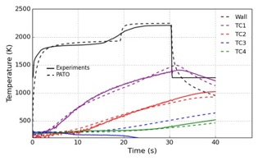
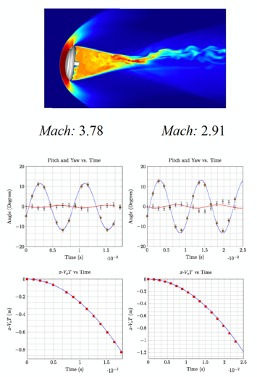
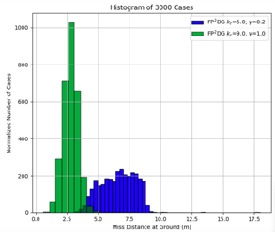
ESM Key Performance Parameter (KPP) Status: Closed - Met
Comparison of NEQAIR and HARA versus EAST
Comparison of in-depth TC measurements
Miss distance for Mid-L/D vehicle landing on Mars.
Comparisons of free-flight CFD with range experiments

Slide 23
ESM Key Performance Parameter (KPP) Status: Closed - Programmatic

Slide 24
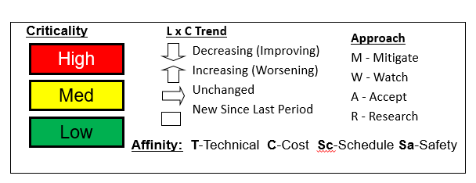
Risk Summary
L
I
K
E
L
I
H
O
O
D
 |  | 36 40
Risk ID | Affinity | Description | Status | Trend
56 | Sc | MRR: Facility Availability | Realized
53 | R,M/T | PICA-N: Model Accuracy | Accepted
40 | M/T | HVST: Data Interpretation of Expanding Flow Expt. | Shock tube is down again | Unchanged
36 | M/T | HVST: Expansion Cone Flow Quality | Shock tube is down again | Unchanged
5
4
3
2
1
1
2
3
4
5
CLOSED (since FY20 APR):
ESM will reassess risk methodology once guidance is received by GCD in response to TAPR board finding.
CONSEQUENCES
ID | Date | Title | Outcome
56 | 03/01/2021 | MRR: Facility Availability (Realized) | Risk effectively realized: Facility became operational and testing completed in Q3.
53 | 03/01/2021 | PICA-N: Model Accuracy (Accepted) | Risk accepted at the March 2021 TAPR. Mitigated with MEDLI 2 Deep Dive task.

Slide 25
Project Assessment Summary
Project Name | Performance |  |  |  | Comments
 | C | S | T | P
Mid Year |  |  |  |  | C: Project experienced across-the-board underruns due to continuing resolution and COVID-related delays S: Schedule heavily impacted by COVID. Most delays were mitigated through RTOW plans at affected Centers.
Annual |  |  |  |  | C: Project was able to recover and obligate nearly all funds by EOY. Some funds swapped to FY22 in re-phasing for COVID-related delays. S: Project has largely returned to normal operations, with two exceptions: (1) Electric Arc Shock Tube (ARC) and (2) HYMETS (LaRC) remain down for repairs, impacting key milestones.

Slide 26
EPO Update: Forward Looking
Upcoming significant events:
  Post-flight radiometer analysis of Artemis/Orion flight test (end of year launch)
  Entry Systems Modeling Project 2021 Workshop – Oct 18, 20, 21
  Space Technology Research Institute (STRI) Advanced Computational Center for Entry System Simulation (ACCESS) kick-off – Oct 26-27
  Joint ESM/Air Force Office of Scientific Research (AFOSR) test in EAST in Q2
  Parachute modeling of ASPIRE flight test using LAVA
  Parachute fabric biaxial stress/strain testing - will be first of its kind data to support computational models
  HYMETS testing: Test one – NuSil testing; Test two – Feeds into the MEDLI2 deep dive plan to examine attenuation of the radiometer signal from ablation products
Planned FY 22 Conferences:
  ESM Project TIM: Oct 2021
  Venus Exploration Analysis Group (VEXAG): Nov 16, 2021
  AIAA SciTech: Jan 3 – 7, 2022
  Outer Planets Assessment Group (OPAG): Feb 7, 2022
  IEEE: Mar 7, 2022
  Mars Exploration Program Analysis Group (MEPAG): Mar 31, 2022
  AIAA Aviation: Jun 6 – Jul 1, 2022
  International Planetary Probe Workshop (IPPW): Jun 2022
  Ablation Workshop: Aug 30, 2022
  OPAG: Sep 16, 2022
Planning for 40+ students/professor collaborations in FY22

Slide 27
Plans Forward and Infusion Plan
Infusion/transition Strategy
  Application to all NASA Entry, Descent, and Landing (EDL) missions, with demonstrated impacts to improve performance and reduce risk for missions across the Solar System
  Partner with impacted missions where possible
  Coordinate technology development and transition planning with line organizations who steward modeling technology after project completion
  Sponsor technical interchanges across Centers and Programs to foster community consensus and knowledge transfer to stakeholders
  Coordinate and partner with Departments of Defense and Energy to leverage hypersonics investments across the government
Looking Ahead
Bridge from MEDLI2 post-flight to the MEDLI2 Deep Dive. Multiple ground test entries.
Backshell radiation validation testing in expanding air using the Electric Arc Shock Tube (EAST)
Design and documentation of validation experiments for parachute modeling
New-look GNC: 3-year plan formulated in response to TAPR action
Demonstration of multiscale thermostructural models for MSR heatshield material

Slide 28
Summary
ESM continues to deliver impactful capabilities for NASA missions on budget and (mostly) on time
Outreach
  35 papers and presentations in FY21 despite cancellation of many conferences & workshops
  50+ academic collaborators
Kicked off three new starts: MEDLI2 Deep Dive; TPS Certification by Analysis; and Hypersonic Wake Flows
Building partnerships
  Mars Sample Return: EES and SRL
  Dragonfly
  Tighter collaboration with Orion/JSC on Avcoat modeling, Artemis spectrometers, parachutes
  New Space Act Agreement signed with CentraleSupelec (France); SAA with Instituto Superior Tecnico (Portugal) awaiting signatures
Lessons Learned
Improved tracking and planning of supporting experiments across portfolio to avoid surprises & delays
Need to establish project policy for consistent uncertainty quantification across tasks
Workshops are a great venue to identify blind spots and build consensus

Slide 29
BACKUP

Slide 30
Technical Assessment Milestone ID Key
Technical Element | ID/Unique ID | Name
SLKR: Obtain and Optimize Experimental Data | 698/6038 | Initial Expansion Cone Shock Testing in Air Chemistries
SLKR: Simulation Capability | Not in Master | FY21-SLKR-K1: Simulation of flow through expansion section
PMM: ICARUS Baseline Capability | Not in Master | FY21-Icarus-1: 1-D Sizing in Icarus
PMM: ICARUS Multi-Physics Coupling | 686/7281 | 3-D Sizing in Icarus FY21-Icarus-4: Icarus/US3D Coupling
CEA: FF Mesh Deformation Rigid Multi-body Dynamics | 722/7288 | Free Flight Tool FY20-FF-C1: Prototype simulation of EDL separation event FY22-FF-3: MADAM Integrated grid adaptation
CEA: FF Mesh Deformation | 722/7288 | Free Flight Tool FY21-FF-K1: Report on Genesis analysis. FY22-FF-3: MADAM Integrated grid adaptation
CEA: Parachute FSI Structural Capability | 738/7301 | FSI Capability for a Single Canopy Parachute
CEA: Parachute FSI Meshing | 738/7301 | FSI Capability for a Single Canopy Parachute
CEA: Parachute FSI Integration | 738/7301 | FSI Capability for a Single Canopy Parachute
PMM: PuMA (All) | Not in Master | Validation of Mechanical Models for Nominal 3MDCP
PMM: PATO (All) | Not in Master | Analysis of High-Sheer TPS Mass Removal
CEA: MSWT (All) | Not in Master | Phase 2 Supersonic MSBS PDR
Most relevant key or controlled milestone for each readiness level shown in bold when in master schedule. Other relevant milestones have also been listed in standard font.

Slide 31
PICA-N Model
PICA-N Model Accuracy – B. Bessire
Risk ID #
53
Trend
Criticality
Current L/C
Affinity Group
Technical, Schedule
Planned Closure
3/21/2021
Open Date
06/30/2018
Risk Statement : Approach: Research/Mitigate
Given the lack of precedent for modeling silica coatings on TPS materials, it is possible that there are unanticipated challenges or gaps in the development plan, resulting in an inability to deliver a model with sufficient accuracy to satisfy MEDLI2’s requirement.
Context
While the ESM material modeling team, in coordination with MEDLI2, has assembled a detailed plan for high-fidelity model development of the PICA-N system, there are a number of unknowns that raise the possibility that the planned effort cannot achieve its goal of meeting MEDLI2’s accuracy requirement. For example, Lockheed’s NuSil application spec for MSL is incomplete and ESM will therefore have to analyze the system parametrically in order to infer traceability for validation. Also, the MEDLI2 requirement was developed under assumption of a less complicated, NuSil-free system, which may be too constraining given the added complexity of silica coating.
Status
2/25/2021 Our MEDLI2 deep dive effort will assess the PICA-N model against the flight data. Will look to accept this risk at the TAPR, and recognize it as a KPP goal.
1/12/2021 Materials property testing has been set back by stage 4 status. However, the team gained access to external facilities and will resume testing soon.
8/11/2020 The AHF test campaign has been delayed to October. Will use MEDLI-2 test results in place of AHF.
CLOSED
CLOSED
CLOSED
CLOSED: Risk accepted at the TAPR.
Mitigation Steps | Dollars to implement | Trigger/ Start date | Schedule UID | Completion Date | Resulting L/C
MEDLI2 Deep Dive New Start Begun FY21 |  | 3/2021 |  | 10/1/2021 | 1x3

Slide 32
CEA: MRR
Wind Tunnel Testing at LaRC – B. Hollis
Risk ID #
56
Trend
Criticality
Current L/C
Affinity Group
Schedule
Planned Closure
3/03/2021
Open Date
02/25/2020
Risk Statement : Approach: Realize
Given limitations of the facility availability, it is possible that the Blocked-TPS test program (which is only 2/3 complete) will not be completed this Spring, resulting in delays to MRR project goals.
Context
Infrastructure at LaRC, particularly high-pressure air supply required to operate facilities is “stressed”. Frequently unable to operate all LaRC tunnels simultaneously, leading to time-sharing and drawn-out schedules. Additionally, AETC implement new costing model for wind tunnel testing leading to drastic reduction for internal NASA programs has led to large increase in test requests. LaRC hypersonic tunnel requests for 2020-2021 expected to be 150% of optimal capacity.
Status
03/03/2021. Risk was effectively realized due to COVID-induced closure of facility throughout FY20 and early FY21. Project has accepted impact to schedule and the test has now been scheduled for Q3 of FY21 with the reopening of the Langley wind tunnel.
04/23/2020. MMR testing is 100% affected by NASA being at Stage 4. Risk mitigation is on hold until centers re-open.
02/25/2020. Flight programs (e.g. LOFTID and BOLT) will retain highest priority in scheduling and infrastructure improvements are a long-term issue. Therefore, schedule slip is almost a certainty.
CLOSED
CLOSED
CLOSED
CLOSED: Risk realized. Testing completed late March 2021.
Mitigation Steps | Dollars to implement | Trigger/ Start date | Schedule UID | Completion Date | Resulting L/C
Track milestones and delays and continuously update LaRC RD and LaRC OD on issues | $0 | 2/25/2020 |  | 3/3/2021

Slide 33
SLKR
Data Interpretation of HVST Expanding Flow Exp: Brandis/Cruden
Risk ID #
40
Trend
Criticality
Current L/C
3x3
Affinity Group
Technical
Planned Closure
12/31/2021
Open Date
11/02/2016
Risk Statement : Approach: Mitigate
Given the lack of predictive simulations for HVST, there is a possibility that the expanding flow experiments will not produce useful data, resulting in data that does not support backshell radiation model development.
Context
ESM is adding an expanding section to the HVST for the purpose of measuring emission in an expanding flow representative of the backshell environment. While some simulations and analysis have indicated feasibility, confidence in available tools is low and significant uncertainty remains. For the measurements to be useful, even if the diagnostic uncertainty is low, they must be tied to a well-characterized flowfield state.
Status
8/24/2021. First shots now planned for early September.
8/3/2021. First shots tentatively planned for the end of August.
6/22/201: Simulation of windows is more challenging (needing a 3-D simulation to model the actual window) than anticipated, resulting in an increase in likelihood.
Med
Mitigation Steps | Dollars to implement | Trigger/ Start date | Schedule UID | Completion Date | Resulting L/C
Variable enthalpy flow | $0 | 5/2021
Driver gas to be included in simulations | $0 | 3/2021
Analysis of window modeling | $0 | 5/2021

Slide 34
SLKR
Data Quality of HVST Expanding Flow Exp: Brandis/Cruden
Risk ID #
36
Trend
Criticality
Current L/C
3x3
Affinity Group
Technical
Planned Closure
12/31/2021
Open Date
09/19/2016
Risk Statement : Approach: Mitigate
Given the lack of predictive simulations for the High Velocity Shock Tube (HVST), there is a possibility that the design of the expanding flow experiments will not replicate relevant backshell environments, resulting in data that does not support backshell radiation model development.
Context
ESM is adding an expanding section to the HVST for the purpose of measuring emission in an expanding flow representative of the backshell environment. While some simulations and analysis have indicated feasibility, confidence in available tools is low and significant uncertainty remains. This could result in a design of experiment that does not produce an environment relevant to typical backshell radiation environments, and thus data that are not valuable for development of flight-relevant models. Until we conduct the experiments and improve confidence in characterization of the shock tube flowfield, we will not know for sure the data quality.
Status
8/24/2021. First shots now planned for early September.
8/3/2021. First shots tentatively planned for the end of August.
6/22/2021. Tunnel is still down, and won’t get the throughput that we had hoped for, resulting in increased likelihood.
Med
Mitigation Steps | Dollars to implement | Trigger/ Start date | Schedule UID | Completion Date | Resulting L/C
Scored diaphragm | $0 | 1/11/2021
30” driver configuration | $0 | 1/11/2021
Buffer tube | $0 | 1/11/2021
Add tracer gas to driver gas | $0 | 3/9/2021

Slide 35



Entry Systems Modeling– Annotated Cover Pictures
Caption: Free flying computational fluid dynamics simulation of the Genesis aeroshell geometry
Caption: Temperature field from a LAVA simulation of scaled Viking capsule with trailing parachute
Caption: Arc jet testing of PICA-NuSil thermal protection material reveals peeling of the NuSIl coating during heating
Caption: Dynamic stability sensitivity to OML changes. Back shell geometry changes can affect dynamic stability at low speeds
Caption: Active control free flying computational fluid dynamics simulation using supersonic retro propulsion
Caption: Thermal image of NuSil coated PICA model in the Ames Arc Jet
Notes:
MAKE SURE THE PICTURES HAVE BEEN APPROVED BY YOUR CENTER FOR PUBLIC RELEASE
Provide an annotated description of the project images on the front cover slide

Slide 36
GCD Project Performance Evaluation Criteria
 | Technical/Performance
Green | Project is demonstrably making progress on the Learning Trajectory (e.g. milestones met, knowledge advanced) or advancing TRL. Project is on track to meet L1 requirements.
Yellow | Project is making progress on the Learning Trajectory or advancing TRL with issues. Project is on track to meet L1 requirements but issues exist that may threaten achievement.
Red | Project has ceased to make progress on the Learning Trajectory or advance TRL. Project is unable to meet one or more L1 requirements.
 | Cost
Green | Project can meet its commitments with its planned/allocated budget.
Yellow | Project cannot meet its commitments within its planned/allocated budget but will not be requesting additional budget from Program. Mitigation plans have been developed.
Red | Project cannot meet its commitments within its planned/allocated budget and will be requesting additional budget from Program.
 | Schedule
Green | Project can meet its commitments within its planned/allocated schedule baseline for critical milestones.
Yellow | Project cannot meet its commitments within its planned/allocated schedule baseline but mitigation plans have been developed to pull it back in.
Red | Project cannot meet its commitments within its planned/allocated schedule baseline.
 | Programmatic (Institutional, Internal/External Dependencies **)
Green | Relevance of technology to stakeholders and/or technology infusion path is maintained. Mission sponsor still actively interested. No issues exist with workforce, test facilities, etc.
Yellow | Relevance of technology to stakeholders and/or technology infusion path are threatened. Mission sponsor backing off. Issues exist with workforce, test facilities, etc. but plans to mitigate are available.
Red | Relevance of technology to stakeholders and/or technology infusion path are not projected to be met, or has lost relevance to stakeholders. Mission sponsor cancelled interest. Issues pertaining to workforce, test facilities, etc. are preventing progress along the Learning Trajectory.
Source: BPR Assessment Criteria for NASA R&T Projects, OCE/S. Hirshorn, 09/17/2015

Slide 37
EPO Backup

Slide 38
Education/Public Outreach, FY21 Summary
35 publications and presentations, despite many conference cancellations due to COVID
Conferences:
ESM poster at OPAG; Abstract submitted to VEXAG
Grants
  6 funded by ESM
  15 funded by Space Technology Research Grants with oversight/collaboration from ESM
  4 funded by EPSCoR program with oversight/collaboration from ESM
50+ Students and Professors:
  Support 6 post-docs
  Support 5 Pathways students
  Research collaborators for 8 NSTRF/NSTGRO
  30+ summer interns
Conference Name | Papers/Posters/Panel Discussions
Jan 2021 | AIAA SciTech (16 presentations)
Jan 2021 | COSPAR
Jun/Jul/Aug 2021 | IPPW (7 presentations/posters)
Jul 2021 | USNCCM (4 presentations)
Aug 2021 | AIAA Aviation (2 presentations)

Slide 39
Publications
Title | Primary Author | Venue | Date
Anisotropic analysis of fibrous and woven materials part 2: Computation of effective conductivity | Semeraro, Federico | Computational Materials Science | 01/01/21
Micromechanics Modeling of Textiles for Re-Entry Parachute Applications | Hearly, Brandon | NASA TM | 01/01/21
Time integration considerations for the solution of reacting flows using discontinuous Galerkin methods | Bornhoft, Brett | SciTech (Nashville, TN virtual) | 01/11/21
Discontinuous Galerkin simulations of dusty flows over a full-scale capsule during Mars atmospheric entry | Ching, Eric | SciTech (Nashville, TN virtual) | 01/11/21
Characterization of Radiative Heating Anomaly in High Enthalpy Shock Tunnels | Cruden, Brett | SciTech (Nashville, TN virtual) | 01/11/21
Three-Body Collision Based Recombination Rate Constants from Quasi Classical Trajectory Calculations | Geistfeld, Eric | SciTech (Nashville, TN virtual) | 01/11/21
Analysis of Chemical Kinetic Parameters for Hydrogen Atmospheres | Hansson, Kaelan | SciTech (Nashville, TN virtual) | 01/11/21
Aerodynamic Shape Optimization using an Embedded Boundary Method with Smoothness Guarantees | Ho, Jonathan | SciTech (Nashville, TN virtual) | 01/11/21
An Immersed Boundary Method for Hypersonic Viscous Flows | McQuaid, Joel | SciTech (Nashville, TN virtual) | 01/11/21
Objective molecular dynamics of dissociating nitrogen under high temperature conditions | Pahlani, Gunjan | SciTech (Nashville, TN virtual) | 01/11/21
Investigation of In-Depth penetration of Radiative Heating in Thermal Protection System (TPS) | Poovathingal, Savio | SciTech (Nashville, TN virtual) | 01/11/21
On the Energy Transfer Mechanisms for the Supersonic Mode | Saikia, Bĳaylakshmi | SciTech (Nashville, TN virtual) | 01/11/21
Preliminary Measurement of Pitch Damping of Blunt Entry Vehicles in a Subsonic Magnetic Suspension Wind Tunnel | Schoenenberger, Mark | SciTech (Nashville, TN virtual) | 01/11/21
Operational Experience with the Electromagnetic Position Sensor (EPS) for the NASA 6-inch MSBS | Schott, Timothy | SciTech (Nashville, TN virtual) | 01/11/21
A coupled ablation approach using Icarus and US3D | Schroeder, Olivia | SciTech (Nashville, TN virtual) | 01/11/21
High-Fidelity Simulations of HyMETS Arc-Jet Flows for PICA-N Modeling | Ventura Diaz, Patricia | SciTech (Nashville, TN virtual) | 01/11/21
A Digital One Degree of Freedom Model of an Electromagnetic Position Sensor | Weinmann, Michelle | SciTech (Nashville, TN virtual) | 01/11/21
Turbulent Heat Transfer Experiments in Hypersonic Free Flight on Surfaces Representative of Woven TPS Materials | Wilder, Michael | SciTech (Nashville, TN virtual) | 01/11/21
Overview of the NASA Entry Systems Modeling Project and its Impact on Planetary Mission Design | Brandis, Aaron | COSPAR (Sydney, Aus, virtual) | 01/29/21
An immersed boundary fluid–structure interaction method for thin, highly compliant shell structures | Boustani, Jonathon | Journal of Computational Physics | 4/24/2021
Impact of NASA's Entry Systems Modeling Project on Planetary Mission Design | Brandis, Aaron | IPPW 2021 (virtual) | 06/17/21
Dust Particle Aeroheating Calculations for Mars Entry Hypersonic Flows | Sahai, Amal | IPPW 2021 (virtual) | 06/17/21
3D material response of the MSL heatshield using NuSil-coated PICA | Meurisse, Jeremie | IPPW 2021 (virtual) | 06/17/21
Analysis of the MSL/MEDLI Entry Data with Coupled CFD and Material Response | Thornton, John | IPPW 2021 (virtual) | 06/17/21
Revisiting MEDLI with Improved Modeling and Simulation Tools | Prabhu, Dinesh | IPPW 2021 (virtual) | 06/17/21
Towards Thermal Protection System Certification by Analysis: Identification and Implication of Features | Haskins, Justin | IPPW 2021 (virtual) | 06/17/21
Towards Supersonic Parachute Inflation Capabilities within the Launch, Ascent, and Vehicle Aerodynamics (LAVA) framework. | Boustani, Jonathon | IPPW 2021 (virtual) | 06/17/21
Predictive Modeling of Carbon Ablators Using Micro and Macro-Scale Modeling | Thornton, John | National Space and Missile Materials Symposium (NSMMS) | 06/21/21
On the behavior of entropy stable schemes in the low mach regime | Gouasmi, Ayoub | USNCCM | 07/25/21
An effiicient preconditioner for a monolithic high-order fluid-structure interaction solver | Franciolini, Matteo | USNCCM | 07/25/21
Ablating Woven Thermal Protection System Materials Under High Shear Flow Conditions | Gopalan, Krishnan | USNCCM | 07/25/21
Computing the effective elasticity of anisotropic porous media from X-ray computed micro-tomography images | Semeraro, Federico | USNCCM | 07/25/21
Efficient preconditioning of a high-order monolithic solver for multiphysics problems | Franciolini, Matteo | AIAA Aviation 2021 | 08/02/21
Validation and Sensitivity Analyses of Arc-Jet Performance of Woven Thermal Protection Entry Systems | Raghunandan, Pratibha | AIAA Aviation 2021 | 08/02/21

Slide 40
FY21 Students and Professors
Mentor | Student | School
Scott Murman/Evan Pineda | Brandon Hearley | N.C. State
Scott Murman | Kihiro Bando | Stanford
Alireza Mazaheri | Dean Yuan | University of Michigan
Alireza Mazaheri | Abraham Flores | UC San Diego
Alireza Mazaheri | Keyrim Yung | Germanna Community College
Cetin Kiris | Jonathan Boustani/Christoph Brehm | University of Kentucky
NASA Research Collaborator: Jeremie Meurisse | Przemyslaw Rostkowski | University of Illinois at Urbana-Champaign
Justin Haskins/Lauren Abbott | Chloe Zeller / Ellad Tadmor | University of Minnesota
Ruth Miller | Kristen Price | University of Kentucky
Chris Karlgaard | Tyler Stroffle | University of Kentucky
Grant Palmer | Vincent Lee | University of North Carolina
Jeremie Meurisse | Vishnu Oruganti | UIUC
Krishnan Gopalan | Mitchell Gosma
Dr. Brian Hollis | Jonathan Cheatwood / Dr. Kevin Schroeder | Virgina Tech
E. Stern | O. Schroeder/ G. Candler | U. Minnesota
E. Stern | M. Seif/ M. Beck | U. Kentucky
G. Bellas | A. Pendley / J. Koo | U. Texas, Austin
E. Stern | A. Zibitsker/ A Martin | U. Kentucky
E. Stern | M. Anderson/ I. Boyd | U. Colorado
Mark Schoenenberger | Tony Ramirez | ODU
Mark Schoenenberger | Desiree Johnson | ODU
Mark Schoenenberger | Forrest Miller | ODU
Mark Schoenenberger | Michell Weinmann | ODU
Mark Schoenenberger | Kristen Carey | ODU
 | Colin Britcher (Professor) | ODU
Mentor | Student | School
Joseph Brock | Thomas Whalen | University of Maryland
Joseph Brock | Quincy McKown | Stanford
Brett Cruden | Augustin Tibere-Inglesse | NASA Postdoc
Georgios Bellas | Avery Pendley | University of Texas, Austin
Eve Papajak | Alex Plumadore | Illinois State
Rich Jaffe | Eric Geistfeld | University of Minnesota
Amal Sahai | Michael Kroells | University of Minnesota
Khalil Bensassi | Chiara Amato | University of Minnesota
Brett Cruden | Caroline Anderson | Central Florida
John Thornton | Kirsten Ford | University of Kentucky
Federico Semaro | Ben Ringel | University of Illinois Urbana-Champaign
Magnus Haw | Julian Ornelas | Stanford
Magnus Haw | Koushik Chennakesavan | University of Texas, Austin
Magnus Haw | Giselle Onofre | Rowan University
Aaron Brandis | Alex Mori Carrol | Caltech
Brett Cruden | Tyler Dean | Texas A&M
Joey Schulz | Jens Rataczak | Colorado
Khalil Bensassi | Joey Habek | University of Minnesota
Justin Haskins | Joseph Ferguson | Stanford
Eric Stern | Mujan Seif | University of Kentucky
Justin Haskins | Victoria Arias | Univeristy of Illinois Urbana Champaign
Lauren Abbott | Aaron Allred | University of Colorado, Boulder
Nichole Carder | Tiago Costa | San Jose State University
 | Destiny Fawley | Univeristy of Illinois Urbana Champaign
 | Colby Azersky | Tufts University
 | Max Pawlick | Georgia Institute of Technology
Justin Haskins / Lauren Abbott | Chloe Zeller | Univestiy of Minnesota
Federico Semeraro / Brody Bessire | Kian Kekmatnejad | Homestead High School
Trenton Ricks | Zhong Hu | South Dakota State Univ.

Slide 41
FY21 Education/Public Outreach Activities

