Slide 1
Space Technology Mission Directorate
Game Changing Development Program
Robert Maddock | Chi Nguyen | FY21 SCALPSS 1.1 Annual Review Presentation | 09.14.2021

Slide 2


Project Overview
Stereo CAmera for Lunar-Plume Surface Studies (SCALPSS) 1.1 is a “re-fly” of SCALPSS (1.0) incorporating lessons learned & minor design modifications (including the addition of 2 long-focal length cameras) to further reduce risk and enhance science return.
Motivation:
  The behavior of dust and blast ejecta is Category “D” of the Lunar Strategic Knowledge Gap Theme III, “Understand how to live and work on the lunar surface.”
  The size and shape of the crater or craters formed during landing, and the ejecta from that formation, will affect the risk to the landing vehicle, the science to be achieved there, surface operations, and nearby assets.
Technology Product Capability: Stereo imaging of plume surface interactions during CLPS lunar landing with high altitude stereo imaging prior to interactions onset. “Re-flight” of SCALPSS payload developed for NPLP/CLPS TO2 mission (launch in Q1 CY22). Data to be used to validate computational models needed for lander design and nearby asset safety.
Technical Capabilities:
  stereo photogrammetry in lunar environment
Launch: CLPS Flight 19D, July-August 2023

Slide 3
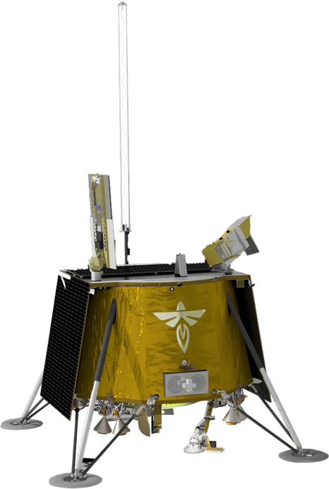
Mission Infusion & Partnerships
NASA
Commercial Lunar Payload Services (HQ/SMD)
Langley Research Center (Hampton, VA)
Marshall Space Flight Center (Huntsville, AL)
Jet Propulsion Laboratory (Pasadena, CA)
Public/Private Partnerships
Firefly Aerospace (Cedar Park, TX)
Cardinal Systems (Huntsville, AL)
Firefly Aerospace
Blue Ghost Lander

Slide 4
SCALPSS 1.1
Technology Goals & Project Objectives
Technology Goals
Goal #1 | N/A
Project Objectives
Objective #1 | Design, build, and test, stereo camera system to be delivered and flown on CLPS lander
Objective #2 | Demonstrate the capture of landing site morphology, prior to, during, and following plume surface interactions (PSI)
Objective #3 | Demonstrate ability to detect onset of PSI
Objective #4 | Demonstrate ability to detect altitude at which ground obscuration occurs
Objective #5 | Demonstrate methods for determining ejecta sheet structure
SCALPSS (1.0) is intended to capture only Objective #1 and Objective #2.

Slide 5
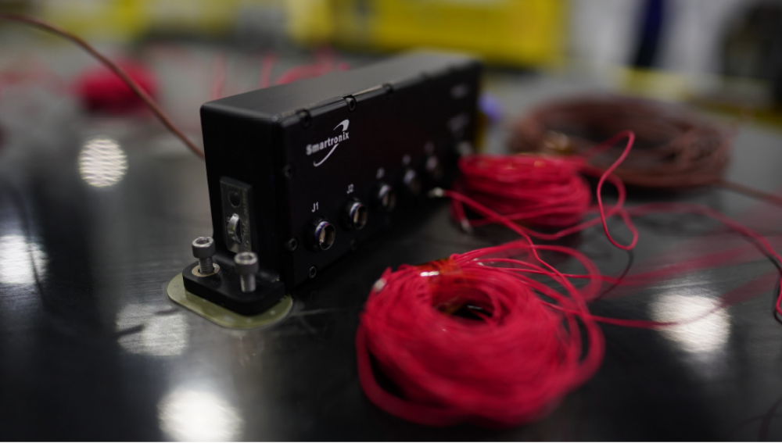
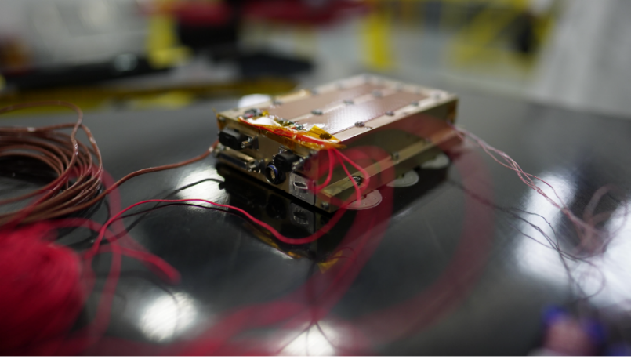
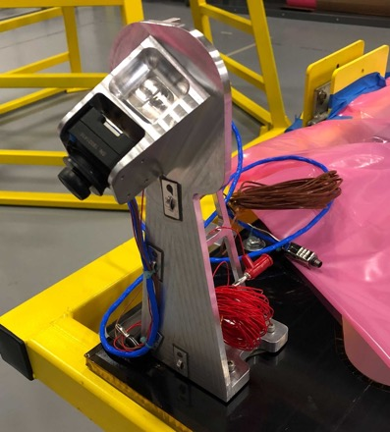
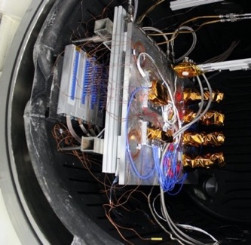
SCALPSS 1.0 Status
USB Hub
Flight hardware was delivered to NPLP/CLPS and Intuitive Machines for integration onto their NOVA-C lander in April 2021.
All flight hardware has been successfully fit-checked with the lander.
The flight hardware has successfully completed two tests with the lander FSW testbed (FlatSat).
  A third test is also planned.
Lander integration is currently planned for the week of 20 September 2021.
Launch anticipated in Q1 of CY22.
Data Storage Unit (DSU)
Flight hardware ready
for TVAC testing
Camera (in mount, x4)

Slide 6
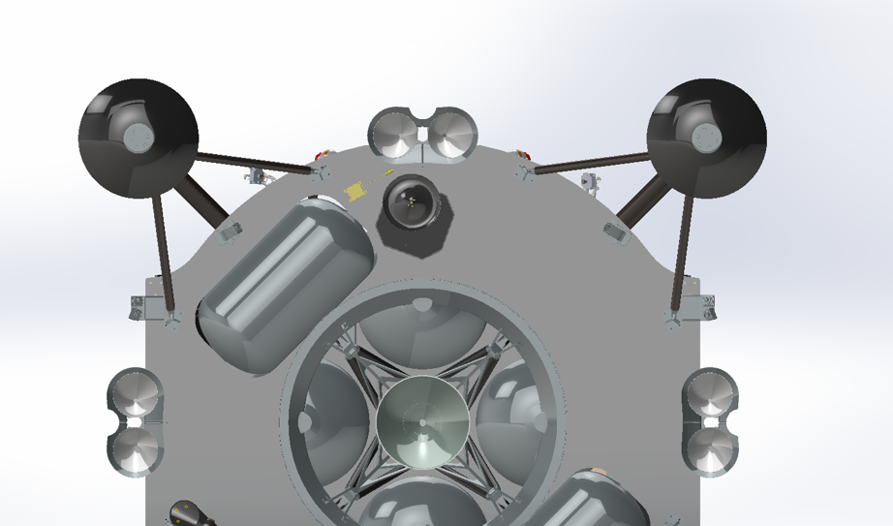
Accomplishments
Project start was 1 October 2020
Project Initiation Briefing provided in December 2020.
System Design (Peer) Review successfully completed in May 2021.
Approved and released Project Plan and Product Assurance Plan.
Payload requirements have been baselined in a draft ICD with Firefly Aerospace.
Baseline lens selection and camera configuration has been completed.
Much of the flight hardware has been procured (using much of the same hardware and vendors as SCALPSS 1.0).
Initial pre-flight predictions of plume-surface interactions / erosion has been completed.
SCALPSS 1.1 camera configuration on Firefly Blue Ghost Lander
North
↑
+Y
+Z
3
4
SFL Single
Bracket
LFL and SFL Combo Bracket
B2
2
B3
5
1
B1
B4
6
Bracket # | Description | Identification
B1 | Bracket holding the East Short and Long Focal Length Cameras | East Bracket
B2 | Bracket holding the North-East Short Focal Length Camera | NE Bracket
B3 | Bracket holding the North-West Short Focal Length Camera | NW Bracket
B4 | Bracket holding the West Short and Long Focal Length Cameras | West Bracket
Camera # | Description | Identification
1 | East Short Focal Length | ES
2 | East Long Focal Length | EL
3 | North-East Short Focal Length | NE
4 | North-West Short Focal Length | NW
5 | West Long Focal Length | WL
6 | West Short Focal Length | WS

Slide 7
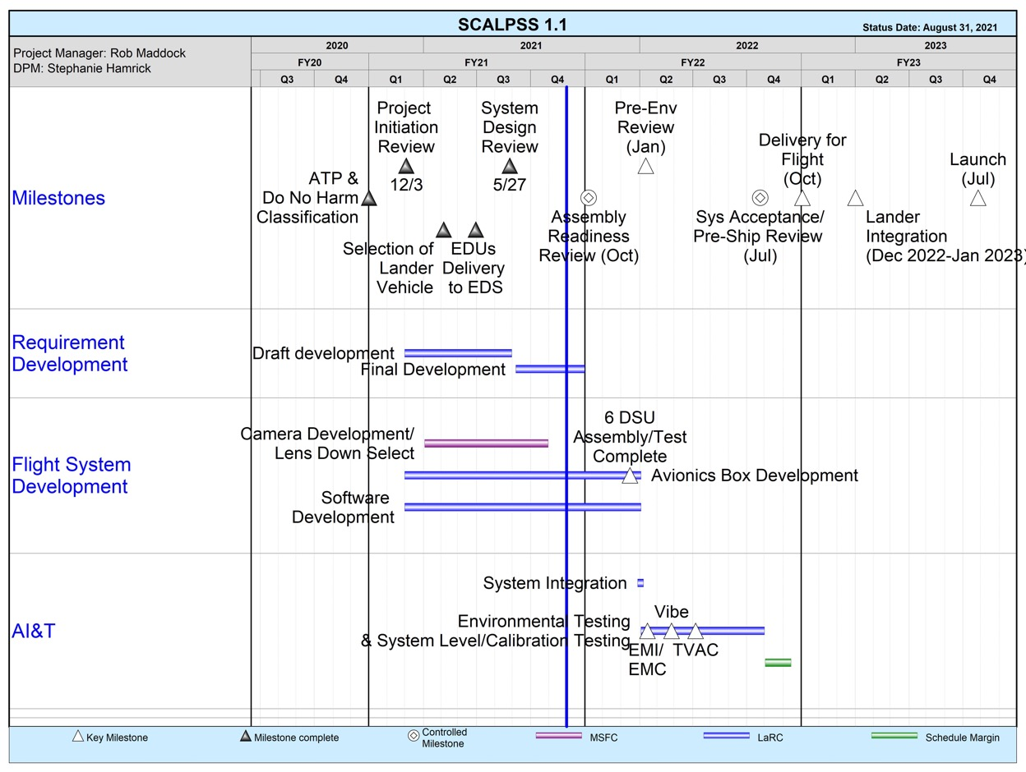
SCALPSS 1.1
Development and Implementation Schedule

Slide 8
Technical Assessment
Technical Elements | TRL |  |  |  | AD²
 | Entry | Current¹ | Exit | Verification | Entry | Current
Element 1 | N/A | N/A | N/A | Milestone ID# N/A | N/A | N/A
Element 2 |  |  |  | Milestone ID#
Element 3 |  |  |  | Milestone ID#
SCALPSS is not in itself performing TRL Advancement. Payload utilizes same COTS hardware and design as that used on the Mars 2020 EDLCam (TRL 9). The project objective is to make measurements to advance the TRL of plume surface interaction prediction.
Next technical review milestone will be the Assembly Readiness Review targeted for early October 2021.

Slide 9
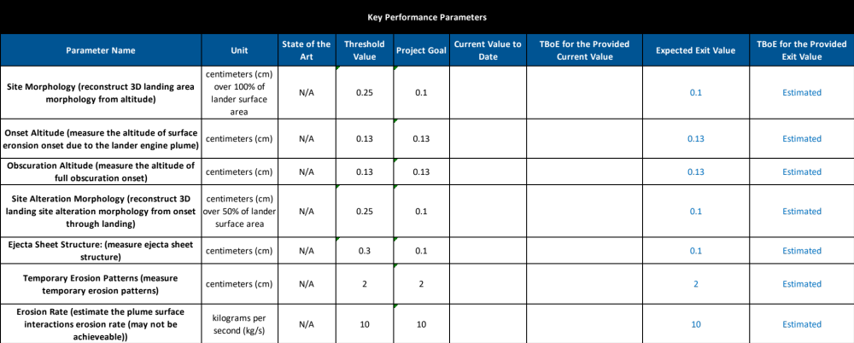
SCALPSS 1.1 Key Performance Parameter (KPP) Status
*
* NO dedicated lunar PSI measurements have been made to date. (Awaiting flight of SCALPSS 1.0.)

Slide 10
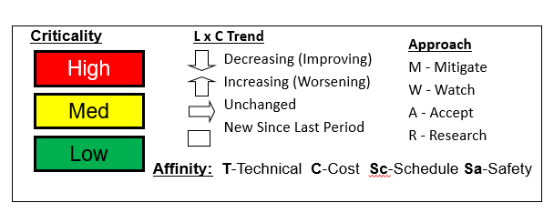
Risk Summary
L
I
K
E
L
I
H
O
O
D
 |  | 007
 | 005, 001
 |  | 030 | 006
 |  |  | 004
Risk ID | Affinity/ Approach | Description/Status | Trend
007 | C,Sc / M | Electronics Part Shortage | ☐
006 | T / R | Vibration Environment Interferes with Long Focal Length Camera Imaging | ☐
030 | T / R | Restrictions in (Thermal) Modeling and Testing of LFL Lenses | ☐
004 | T / R | Thrust Profile May Not Cause Detectable Plume Surface Interactions | ↓
005 | T / W | Lens Mounting Fault Tolerance | ☐
001 | T / M | Uncertainty in Hardware Temperature Limits | →
5
4
3
2
1
1
2
3
4
5
CONSEQUENCES

Slide 11
Project Assessment Summary
Project Name | Performance |  |  |  | Comments
 | C | S | T | P
Mid Year | G | G | G | G | Technical – Working with CLPS lander on camera placement, payload requirements and ICD development. Working with PSI project to quantify level of PSI to expect. Beginning assessment of DSU modifications to improve thermal and vibration performance. Cost – CR funds received; awaiting final approval of OP and GCD budget guidelines Schedule – Based on SCALPSS 1.0 “as executed” with updates based on schedule provided by selected CLPS provider (Firefly Aerospace) Programmatic – Project team continues to work well transitioning between SCALPSS 1.0 and 1.1 projects. RTOW has been approved for SCALPSS 1.1 development.
Annual | G | Y | G | G | Technical – Baselining lens selection and lander camera configuration. Negotiating final payload requirements. Firefly Payload Integration Planning Review successfully completed. Minor DSU mechanical design changes complete; continuing thermal testing. Cost – Full budget authority approved. Worked with GCD on FY21/22 funding “swap”. Schedule – DSU interface board assembly being delayed (due to parts shortage and personnel availability). Schedule margin impacted but sufficient margin remains. Lander schedule continues to be very solid. Programmatic – Beginning preparations for center/IRT-led Assembly Readiness Review targeted for October 2021.

Slide 12
EPO Update
Past conferences and articles:
  “Tiny NASA Cameras to Watch Commercial Lander form Craters on Moon”, NASA.gov feature article (January 2021)
  AIAA SciTech 2021 Forum, “Stereo Camera Simulation for Lunar Surface Photogrammetry” (January 2021)
  Podcast: NASA EDGE@ Home with Michelle Munk (February 2021)
  International Planetary Probe Workshop 2021, “Simulation And Optimization Of A Lunar Plume-surface Interaction Measurement System” (July 2021)
  LSIC Excavation and Construction Workshop: PSI briefing, including SCALPSS flight instrumentation (August 2021)
Upcoming conferences and events:
  AIAA SciTech 2022 Forum, “Design of a lunar plume-surface interaction measurement system” (January 2022)
  Launch of SCALPSS 1.0 on Intuitive Machines NOVA-C mission (1st Quarter CY2022)
    heritage payload upon which SCALPSS 1.1 is based
    post-flight analysis and data will be shared with SCALPSS 1.1 and the PSI project, as well as archived on the PDS.

Slide 13
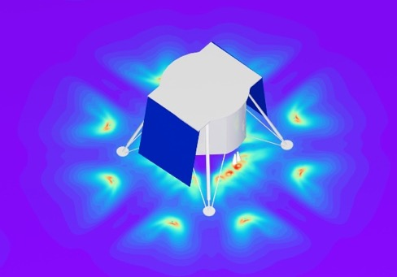
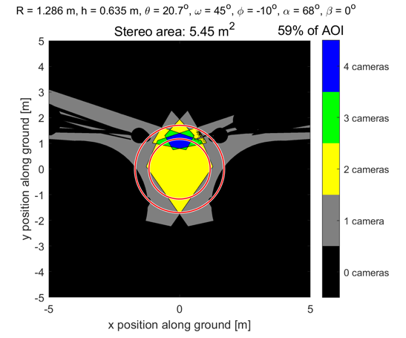
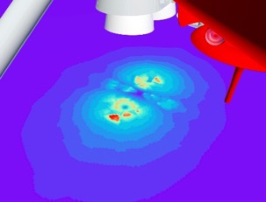
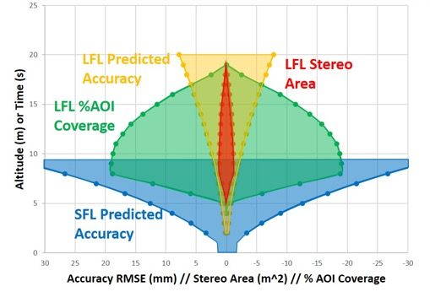
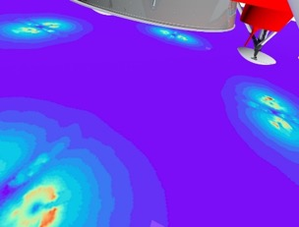
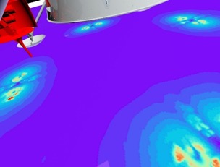
Plans Forward and Infusion Plan
Predicted erosion based on CFD analysis.
Generated stereo area coverage plot for the selected configuration
Project Assembly Readiness Review : October 2021
Hardware assembly complete : January 2022
Pre-Environmental Review : January 2022
Environmental testing begins : February 2022
Project System Acceptance / Pre-Ship Review : July 2022
Delivery “in-place” : July 2022
Payload delivery to Firefly Aerospace : September 2022
Payload / lander integration : December 2022
Integrated lander environmental testing : February – April 2023
Launch (NET) : July 2023
Landing : September 2023
Descent Profile Accuracy for
Selected Configuration
Simulated camera views at landing with surface shear stress CFD solution (Will Krolick, Andrew Weaver, Jeff West)

Slide 14
Summary
SCALPSS 1.1 is a “Do No Harm” project with the expectation of carrying high technical risk in exchange for low cost and rapid development and delivery.
The project relies heavily on not only the same design, but also the lessons learned from its predecessor, SCALPSS 1.0 (due to launch in early 2022).
Significant progress has been made to-date in the procurement of the flight hardware, system trade studies (including lander configuration), and pre-flight predictions.
FY22 will be focused on assembly and environmental testing of the flight hardware, with delivery for CLPS Flight 19D to Firefly Aerospace. Lander integration and testing, and flight are then to follow in FY23.

Slide 15
BACKUP

Slide 16
SCALPSS 1.1
Uncertainty in Hardware Temperature Limits - Scammell
Risk ID #
001
Trend
→
Criticality
Current L/C
4x2
Affinity Group
Technical
Planned Closure
10/01/2021
Open Date
02/09/2021
Risk Statement: Given lack of information on the M2020 build/qualification of SCALPSS build-to-print hardware, coupled with the constraints on SCALPSS to conduct its own testing (due limited resources), there is a possibility that the SCALPSS team will enter final thermal design and environmental testing without a clear understanding of temperature limits of the DSU and camera components which could result in technical impacts such as unknowns related to camera pixel loss and DSU overheating.
Approach: Mitigate
Context: The M2020 documentation showed that the DSUs were tested between -45C and +70C. The cold temperature should be directly applicable to our unit as the parts are all the same. The hot temperature may also be in the ballpark, but without information on how they ran the DSU, it is hard to say for sure. Given the COTS nature of the parts and uncertainties in power dissipations, our thermal model shows components may overheat; but it could also be conservative, as was M2020’s model. This test would provide valuable thermal data prior to TVAC when there could still be time to address an issue. Furthermore, it shouldn’t require much extra time as the DSU will already be in the cascade oven at vacuum for bakeout. Also, all GSE used will be needed later for TVAC.
Status:
8/9/21: Due to lack of personnel availability, hw/sw preparations have been delayed. Estimated date to complete DSU testing is 08/24/21.
7/7/21: Provided conservative thermal environments to Firefly. This testing will possibly improve margins. Results are needed by PIPR.
6/7/21: Waiting on thermal spacers for remaining testing.
5/10/21: 1st thermal imaging of DSU complete. Additional tests planned for June. Continue to watch.
4/12/21: First of 3 tests is next week and 2nd & 3rd will likely occur in the June-July timeframe. Continue to watch.
3/8/21: Continue to watch.
Mitigation Steps | Dollars to implement | Trigger/ Start date | Schedule UID | Completion Date | Resulting L/C
(Note: The Schedule UID is the unique id no of the mitigation step in your schedule if appropriate.
Dollars to implement are not extra approved $ from the Program Office but $ set aside as part of project budget to mitigate.)

Slide 17
SCALPSS 1.1
Thrust Profile May Not Cause Detectable PSI - Munk
Risk ID #
004
Trend
↑
Criticality
Current L/C
2x4
Affinity Group
Technical
Planned Closure
10/01/2021
Open Date
02/09/2021
Risk Statement: Given that the Firefly Aerospace Ghost Lunar Lander descent architecture utilizes a thrust profile (8 distributed 110N thrusters) and the resulting plume(s) may not result in detectable plume surface interaction, there is a possibility that the SCALPSS science data will be significantly degraded.
Approach: Research
Context:
Status:
8/9/21: Still awaiting final results from the 200N engines. On 7/30/21, the PSI team showed us that their analysis of the 200N engine, based on what Firefly had given them, did not match up (the thrust and mass flow rate and chamber pressure were inconsistent). Analysis is moving forward with reasonable assumptions, and results should be available in next two weeks. Ongoing PSI testing can also confirm cratering will be observed.
7/7/21: Reduced likelihood based on continued assessment. Awaiting 200N assessment to determine impact.
6/7/21: No update.
5/10/21: Reduced likelihood based on PSI project initial assessment. Study to continue with added fidelity. Lander is likely to increase thruster size to 200N.
4/12/21: Continue to research, configuration trades work ongoing and PSI project ongoing assessment.
3/8/21: Task established with the PSI project for pre-flight predictions; early April report out is expected.
Mitigation Steps | Dollars to implement | Trigger/ Start date | Schedule UID | Completion Date | Resulting L/C
(Note: The Schedule UID is the unique id no of the mitigation step in your schedule if appropriate.
Dollars to implement are not extra approved $ from the Program Office but $ set aside as part of project budget to mitigate.)

Slide 18
SCALPSS 1.1
Lens Mounting Fault Tolerance - Lueg
Risk ID #
005
Trend
☐
Criticality
Current L/C
4x2
Affinity Group
Technical
Planned Closure
11/01/2021
Open Date
02/09/2021
Risk Statement: Given that the project does not meet the 2-fault tolerant capture requirement for the lens mounting, there is a possibility that the threaded camera lens adapter and lens may require secondary locking features to satisfy DNH requirements which could impact the lens mounting final design.
Approach: Watch
Context:
Status:
8/9/21: Goal is to identify a new adapter to provide 2-fault tolerant req or confirm 1.0 lens mounting design approach is adequate with the larger lens. Complete evaluation of 50mm lens by early November.
7/7/21: Not in draft ICD, however the 2-fault tolerant is best practice. Still need to determine implementation for 50mm lens.
6/7/21: MSFC looking at adapter options for 50 mm lens (C-mount).
5/10/21: Continue to watch.
4/12/21: Continue to watch.
3/8/21: Continue to watch.
2/9/21: Opened risk; carried over from SCALPSS 1.0
Mitigation Steps | Dollars to implement | Trigger/ Start date | Schedule UID | Completion Date | Resulting L/C
(Note: The Schedule UID is the unique id no of the mitigation step in your schedule if appropriate.
Dollars to implement are not extra approved $ from the Program Office but $ set aside as part of project budget to mitigate.)

Slide 19
SCALPSS 1.1
Vibration Environment Interferes with Long Focal Length Camera Imaging –
Sturgis / Manginelli
Risk ID #
006
Trend
☐
Criticality
Current L/C
3x4
Affinity Group
Technical
Planned Closure
10/01/2021
Open Date
05/27/2021
Risk Statement: Given that the long focal length cameras must be extended from the lander as far as practical (to maximize resolution), there is a possibility that the camera mounts, if designed to minimize mass, may be not be stiff enough to ensure vibration during descent does not interfere with imaging from those cameras.
Approach: Research
Context: It is being assumed that Firefly will not allow camera mounting directly to the lander legs (would be viewed as a "delta requirement"). Since these cameras need to be separated as far as possible to improve resolution, the resulting brackets needed to eliminate vibration concerns may be prohibitively high in mass.
Status:
8/9/21: Given a more mature camera mount design, the deflection of the LFL cameras is 0.016” during launch load environments. The lunar landing environments will be less significant, however need to run the data first to provide a number to share.
7/7/21: Review M2020 descent stage images. Changed LxC to 3x4 based on new camera locations proposed by Firefly. Continue to work with Firefly on obtaining descent vibration data.
6/7/21: Suggested risk from ERB during SDR. Will work with predicting likely deflection during launch loads to determine loss of uncertainty. Will also ask Firefly for landing vibration environments (if available). Will also look at M2020 performance to understand effects.
5/27/21: Opened risk.
Mitigation Steps | Dollars to implement | Trigger/ Start date | Schedule UID | Completion Date | Resulting L/C
(Note: The Schedule UID is the unique id no of the mitigation step in your schedule if appropriate.
Dollars to implement are not extra approved $ from the Program Office but $ set aside as part of project budget to mitigate.)

Slide 20
SCALPSS 1.1
Electronics Parts Shortage - Lueg
Risk ID #
007
Trend
☐
Criticality
Current L/C
5x3
Affinity Group
Technical
Planned Closure
10/01/2021
Open Date
07/07/2021
Risk Statement: Given the state of the semiconductor industry, there is a shortage of some semiconductor parts, including 3 integrated circuits (ICs) required for the DSU. Alternatives for these parts do exist but will lead to a possible partial redesign of the interface card. This could impact the SCALPSS schedule.
Approach: Mitigate
Context: There are 3 specific ICs that are affecting the build of the DSU. The earliest re-order of these parts is 48 weeks. Alternative sources for these parts are being investigated but has low likelihood of resolving this issue.
Status:
8/11/21: Decision to pursue “dead-bugging” option for using replacement parts. Will also continue to look at re-design (if it becomes necessary)
8/9/21: Reduced the parts down to 2. Meeting with another engineer (name TBC) on 8/11/21 to evaluate this issue and come up with alternatives.
7/7/21: Opened risk.
Mitigation Steps | Dollars to implement | Trigger/ Start date | Schedule UID | Completion Date | Resulting L/C
(Note: The Schedule UID is the unique id no of the mitigation step in your schedule if appropriate.
Dollars to implement are not extra approved $ from the Program Office but $ set aside as part of project budget to mitigate.)

Slide 21
SCALPSS 1.1
Electronics Parts Shortage - Lueg
Risk ID #
030
Trend
☐
Criticality
Current L/C
3x3
Affinity Group
Technical
Planned Closure
10/01/2021
Open Date
08/09/2021
Risk Statement: Given the proprietary nature and complexity of the planned long focal length lenses (Schneider Xenoplan 2.8/50), detailed thermal modeling of the lens (typically done for larger optical assemblies) may not be available, therefore the consequence is reduced ability to predict thermal gradients within the lens which could lead to loss of focus in flight.
Approach: Research
Context:
Status:
8/9/21: Opened risk.
Mitigation Steps | Dollars to implement | Trigger/ Start date | Schedule UID | Completion Date | Resulting L/C
(Note: The Schedule UID is the unique id no of the mitigation step in your schedule if appropriate.
Dollars to implement are not extra approved $ from the Program Office but $ set aside as part of project budget to mitigate.)

Slide 22
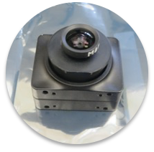
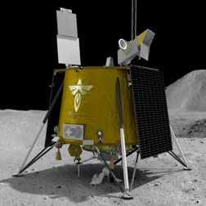
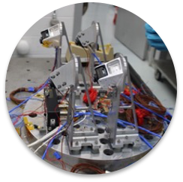
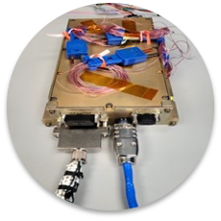
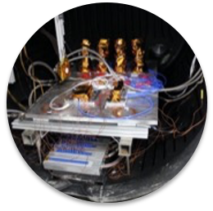
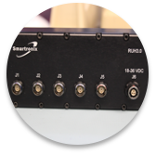
SCALPSS 1.1 - Annotated Cover Pictures
SCALPSS (1.0) FLIR
Flight Camera
Artist conception of Firefly Aerospace
Blue Ghost Lander
SCALPSS (1.0) Flight Camera
Assemblies mounted for vibe testing
SCALPSS (1.0) Flight DSU
SCALPSS (1.0) Flight
USB Hub
SCALPSS (1.0) Flight Hardware
ready for TVAC testing

Slide 23
GCD Project Performance Evaluation Criteria
 | Technical/Performance
Green | Project is demonstrably making progress on the Learning Trajectory (e.g. milestones met, knowledge advanced) or advancing TRL. Project is on track to meet L1 requirements.
Yellow | Project is making progress on the Learning Trajectory or advancing TRL with issues. Project is on track to meet L1 requirements but issues exist that may threaten achievement.
Red | Project has ceased to make progress on the Learning Trajectory or advance TRL. Project is unable to meet one or more L1 requirements.
 | Cost
Green | Project can meet its commitments with its planned/allocated budget.
Yellow | Project cannot meet its commitments within its planned/allocated budget but will not be requesting additional budget from Program. Mitigation plans have been developed.
Red | Project cannot meet its commitments within its planned/allocated budget and will be requesting additional budget from Program.
 | Schedule
Green | Project can meet its commitments within its planned/allocated schedule baseline for critical milestones.
Yellow | Project cannot meet its commitments within its planned/allocated schedule baseline but mitigation plans have been developed to pull it back in.
Red | Project cannot meet its commitments within its planned/allocated schedule baseline.
 | Programmatic (Institutional, Internal/External Dependencies **)
Green | Relevance of technology to stakeholders and/or technology infusion path is maintained. Mission sponsor still actively interested. No issues exist with workforce, test facilities, etc.
Yellow | Relevance of technology to stakeholders and/or technology infusion path are threatened. Mission sponsor backing off. Issues exist with workforce, test facilities, etc. but plans to mitigate are available.
Red | Relevance of technology to stakeholders and/or technology infusion path are not projected to be met, or has lost relevance to stakeholders. Mission sponsor cancelled interest. Issues pertaining to workforce, test facilities, etc. are preventing progress along the Learning Trajectory.
Source: BPR Assessment Criteria for NASA R&T Projects, OCE/S. Hirshorn, 09/17/2015

