Slide 1
Study of Spacecraft Deployables
Failures
Alejandro Rivera
Deployables Analysis Engineer
NASA Goddard Space Flight Center
19th European Space Mechanisms and Tribology Symposium
September 24th, 2021

Slide 2
DISCLAIMER
The views and opinions expressed in this presentation are those of the author and do not necessarily reflect the official policy, procedures or position of NASA Goddard Space Flight Center or the National Aeronautics and Space Administration.

Slide 3
MOTIVATION
Deployables failures still taking place at an average of 1 every two years
Loss of mission goals and spacecraft performance
Desire to understand what have historically been the most common modes of failure of deployables
How can we prevent these from happening
Share our findings with ESMATS Community

Slide 4
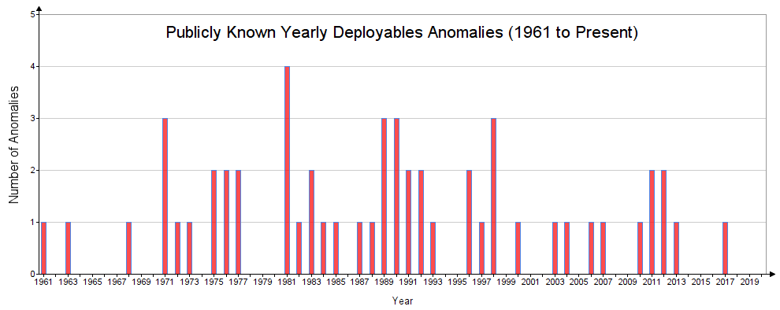
YEARLY ANOMALIES DISTRIBUTION

Slide 5
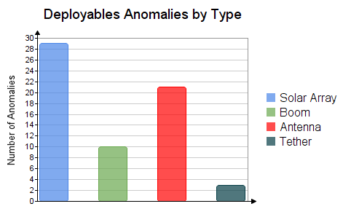
ANOMALIES BY TYPE
Solar Array anomalies most common (54%)
High Gain Antenna (37%)
Booms (18%)
* Based on published information. Actuals may differ.

Slide 6
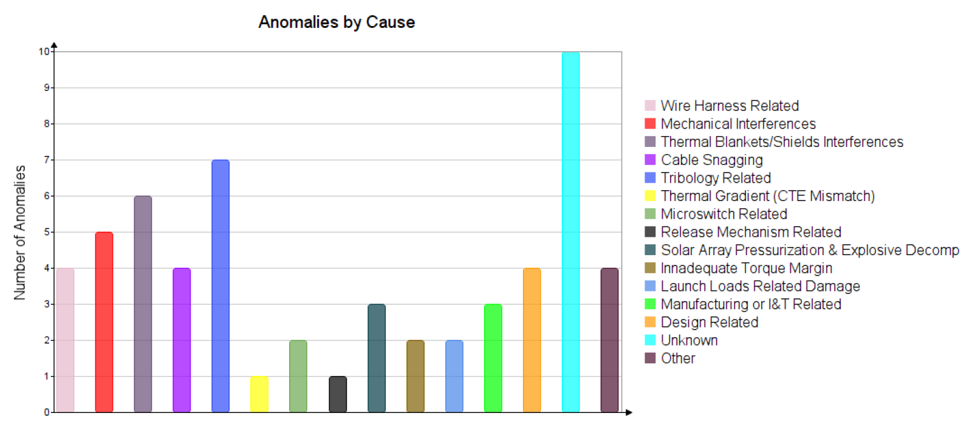
MAIN ANOMALIES AND FAILURES CAUSES
* Based on published information. Actual root causes may differ.

Slide 7
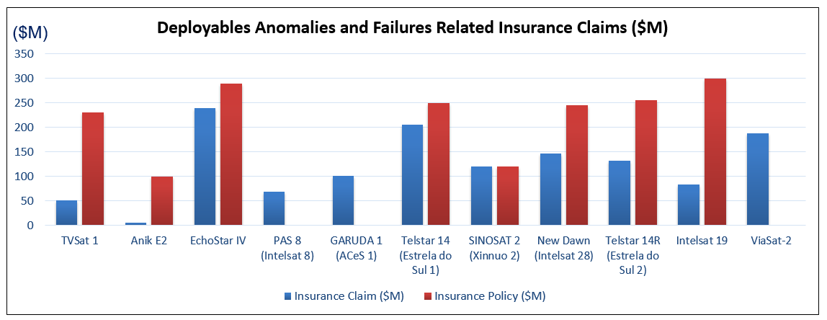
INSURANCE CLAIMS
* Based on published information. Actuals may differ.

Slide 8
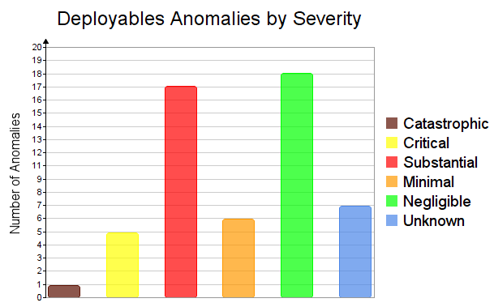
SEVERITY
Vast majority of Spacecraft (68%) suffer some degree of mission and / or performance degradation
32% of anomalies results in partial loss of mission or substantial reduction of spacecraft performance
* Based on published information. Actuals may differ.

Slide 9
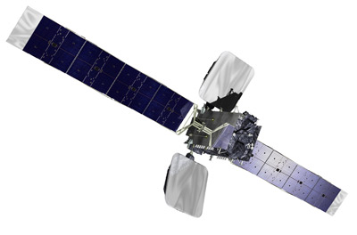
Thermal Blankets / Shields Interferences
New Dawn / Intelsat 28
Launch Date: April 22, 2011
Anomaly #1: Ku-band antenna fails to deploy
Cause: deployment mechanisms interference with sunshield
Resolution: motor-driven deployment mechanism moved up and down to free antenna from sunshield
Anomaly #2: unable to deploy its C-band reflector antenna
Cause: antenna’s spring-loaded deployment mechanism got caught in the billows of its sunshield
Resolution: Shaking of the SC unsuccessful
Consequences: Mission Life reduced by 2 years
Insurance Claim: $146M

Slide 10
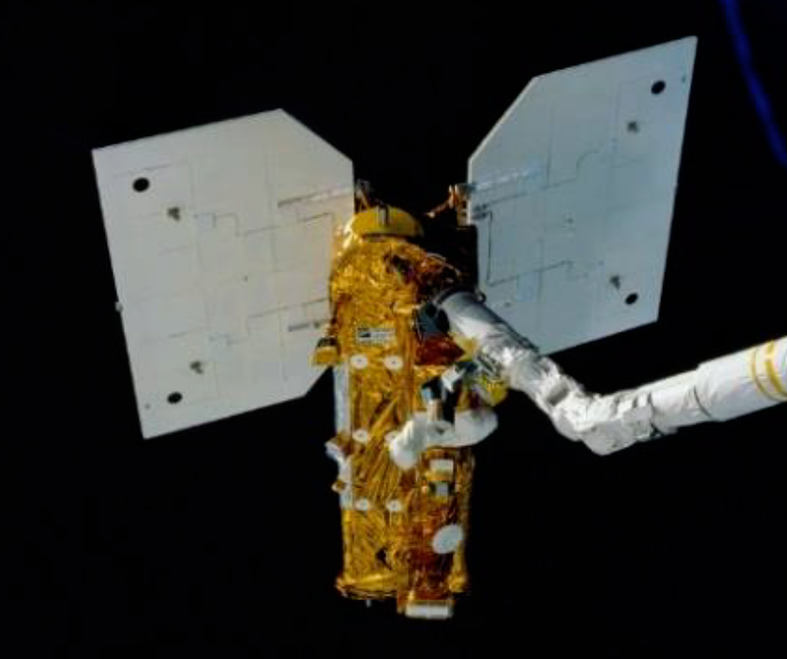
Solid Lubricant Earth Radiation Budget Satellite
Launch Date: October 10, 1984
Anomaly: One of the Solar Arrays failed to deploy
Cause: MoS2 exposed to excessive humidity before launch resulting in excessive bearing friction in the space environment
Trouble shooting: exposure to sun until temperature above 0 °C

Slide 11
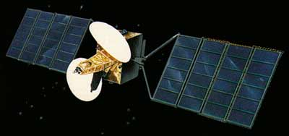
Ground Handling TV-Sat 1
Launch Date: Nov 21, 1987
Anomaly: One of the Solar Arrays failed to deploy
Trouble shooting: Attempts to free it by spinning or shaking the satellite not successful.
Cause: Some of the hold down clips used to secure the SA panel during ground handling were not removed
Consequences: SC placed on a graveyard orbit. Total Mission Loss
Insurance Claim: $51M

Slide 12
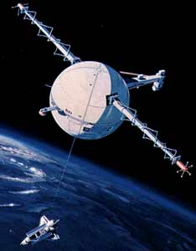
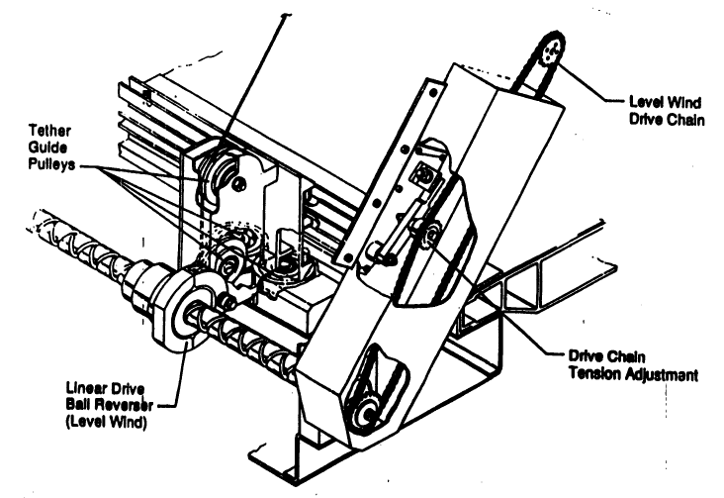
Last Minute Changes Tethered Satellite System (TSS-1)
Launch Date: Feb 25, 1996
Anomaly: Reel-out mechanism jammed. Tether only released to about 256 m out of the planned 12.5 miles (20.1 Km)
Cause: Bolt added for structural margin to address a last minute concern, interfered with a traveling ball nut and thwarted satellite deployment.
Consequences: Total Mission Loss
Tether
Added Bolt

Slide 13
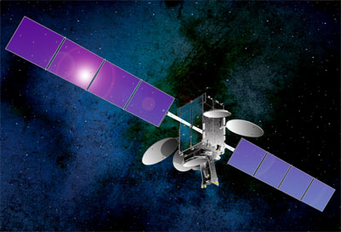
SA Explosive Decompression Telstar14, 14R, Intelsat 19
Launch Dates: 2004, 2011, 2012
Anomaly: SA partially deployed (14, 14R) or failed to deploy (IS-19)
Cause: Inadvertent solar array pressurization and explosive decompression damaged the arrays’ deployment mechanism
Consequences: all of them remained in service but with serious reductions in capacity
Insurance Claims: $205M, $132.7M, $84M
($421.7M total)

Slide 14
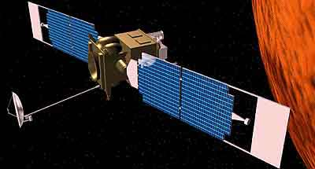
Mechanisms Failure Mars Global Surveyor
Launch Date: November 7, 1996
Anomaly: Solar Array fails to latch
Cause: input shaft of the damper sheared during SA deployment
Consequences: Aerobraking maneuvers had to be modified to put less pressure on solar panels.
New aerobraking schedule delayed reaching final polar science mapping orbit by 1 year.

Slide 15
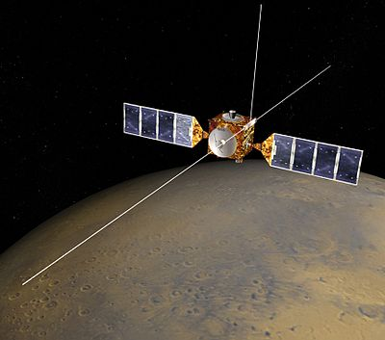
Dynamic Analysis Simulations Mars Express Issues
Launch Date: June 2, 2003
Anomaly: MARSIS antenna booms’ deployments delayed
Cause: Simulation refinements indicated potential risk that booms could back lash and damage SC
Trouble shooting: additional contingency simulations performed to assess risks; Mitigation scenarios defined.
Resolution: 1st boom failed to deploy until after exposure to sun; 2nd and 3rd deployed successfully.

Slide 16
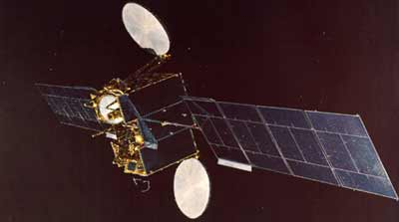
Contingency Maneuvers Anik E2
Launch Date: April 4, 1991
Anomaly: Ku-Band Antenna deployed after 2 days
C-Band Antenna did not fully deploy
Cause: Thermal blanket interference
Trouble shooting: long list of SC contingency maneuvers supported by remarkable ground team analysis and technical ingenuity
Resolution: C-band antenna deployed and mission saved
Consequences: Rescue maneuvers used a year’s worth of fuel
Insurance Claim: $208M

Slide 17
Prevention and Resolution Failures & Anomalies
Good Practices
Interferences
Pre-Flight Contingency Ops
Computer simulations of contingency and worst case scenarios
In-Space Contingency Ops
Firing of thrusters to spin or shake the SC
Tribology
Torque Margin
Space Environment
Launch Loads
Assembly & Integration
Testing
Modeling / analysis/ simulation
Orienting SC to sun
Commanding motor back and forth (if motor driven)
Inertial load maneuvers supported by dynamic simulation analysis and ground testing if deployable mockup available
Final Stow Inspections
FUTURE: Robotic Servicing ?
  Preliminary studies conducted at NASA GSFC

Slide 18
FINAL THOUGHTS
Spacecraft Deployables anomalies are a complex problem
Sharing of information would be very beneficial
Collaboration between space agencies
Public disclosures by manufacturers that have experienced anomalies

