Slide 1
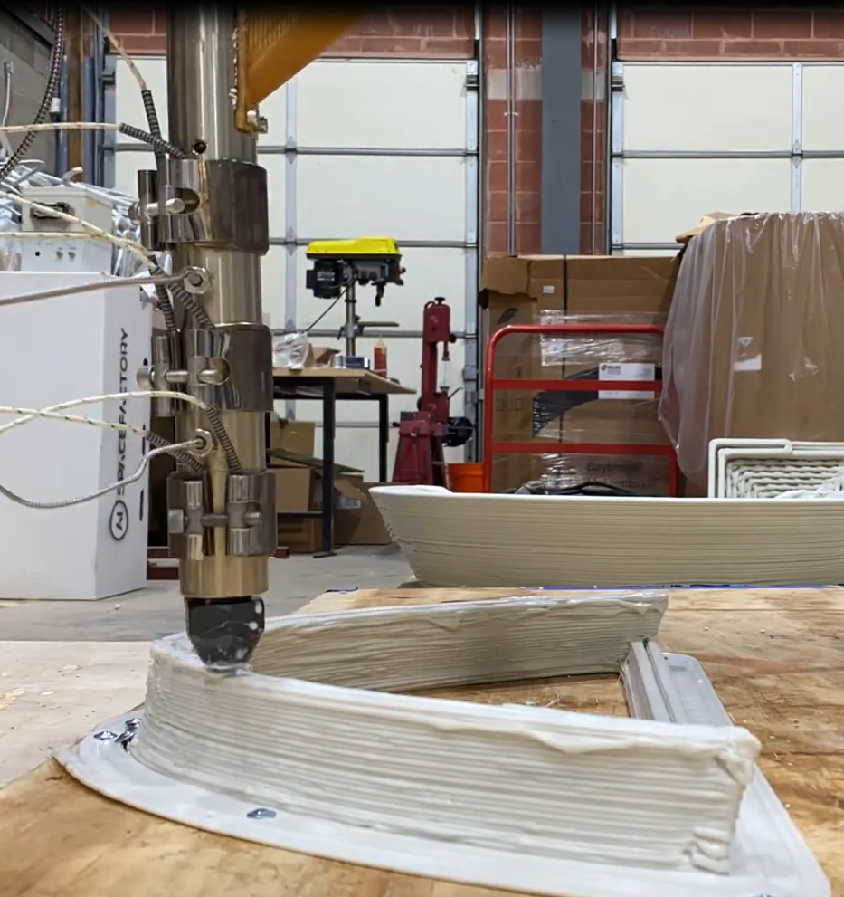
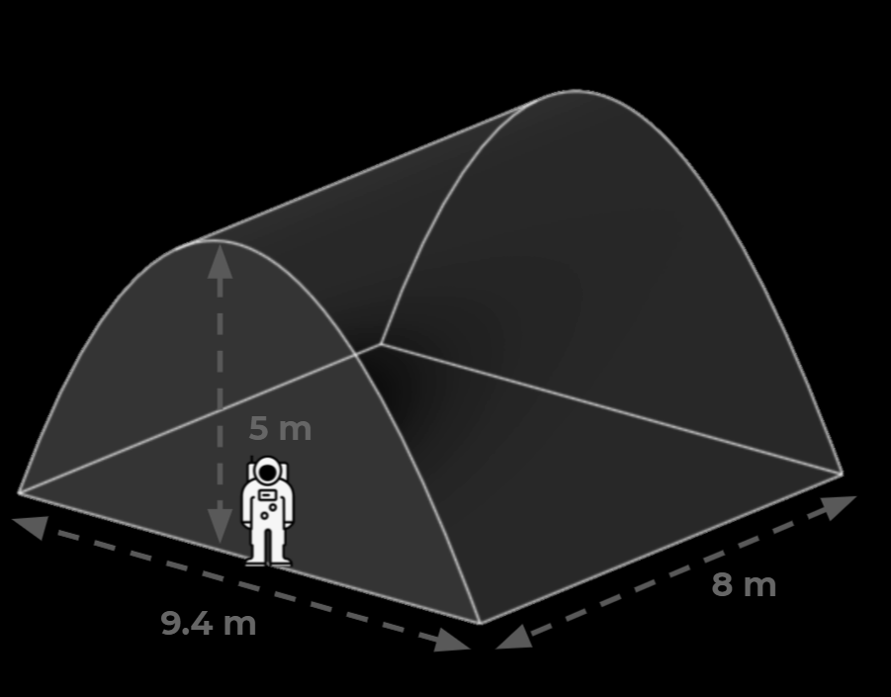
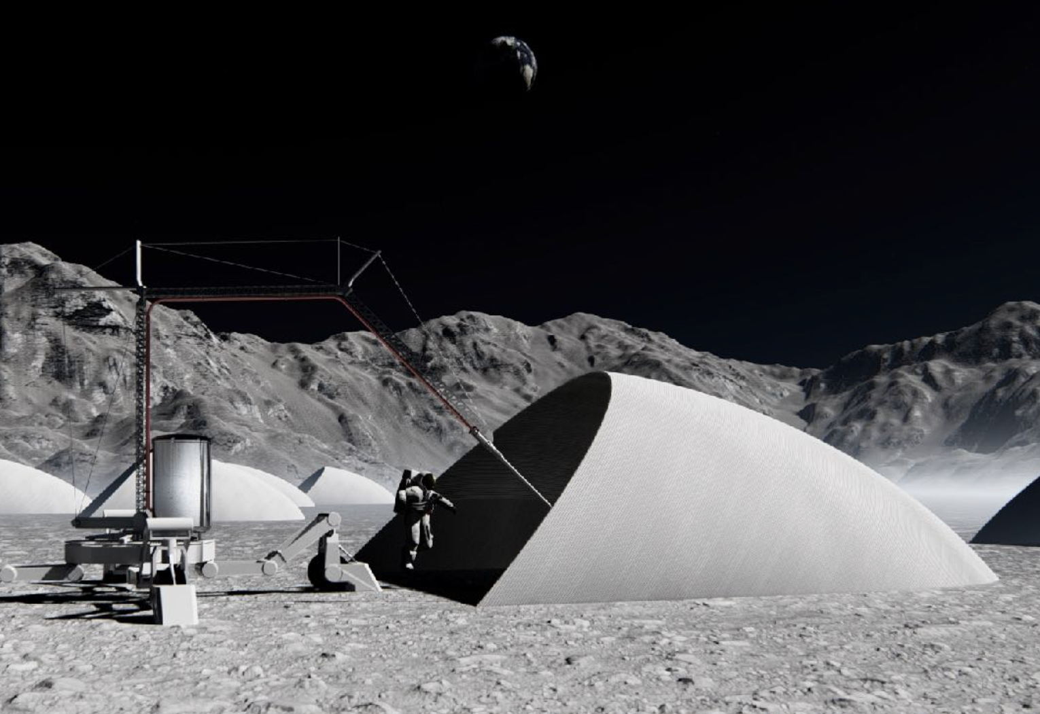
Relevant Environment Additive Construction Technology (REACT)
Project Overview
This project is focused on developing technologies that enable construction of a Lunar Safe Haven type structure on the moon. A full scale architectural and structural design will be completed based on lunar conditions and Artemis mission needs. A scaled structure will be 3D printed in simulated lunar environments.
Technical Approach
Polymer bound regolith composite materials will be developed and characterized for lunar additive construction applications. A full scale architectural and structural design will be completed based on the latest scientific data on lunar environments including radiation, meteoroids, thermal conditions, reduced gravity, and moonquakes. The project will culminate with a demonstration of additive construction in simulated lunar vacuum, thermal, regolith, and UV conditions.
Results/Summary
Preliminary material specifications have been developed and an initial batch has been produced. A first iteration of the architectural and structural designs have been completed. Hardware for 3D printing in simulated lunar conditions is under development.
a
a
b
b
Initial Extrusion Testing
b. CAD of the Thermal Vacuum 3D Printing System
c. Scale of the Structure
d. Artist Conception Depicting Additive
Construction of a Lunar Shelter
c
c
d
d

Slide 2
Contributing Partners
AI Space Factory – Winner of the NASA 3D Printed Habitat Centennial Challenge
Infusion and Transition Plan
On-surface construction of infrastructure is a critical capability of the sustainable phase of the Artemis Program and eventual sustainable human presence on Mars. It provides the ability to create protective shelters on-demand using local resources. The 3D-printing technology will achieve TRL 6 in 1g/vacuum tests with thermal/UV exposure in this project. CLPS missions will be pursued for infusion to demonstrate vertical construction with lunar regolith and conditions. Modeling and simulation will be used to define the pilot-scale shelter construction mission for long-term exposure on the lunar surface to validate the system for Artemis operational deployment.
.
a
a
b
b
Initial Extrusion Testing
b. CAD of the Thermal Vacuum 3D Printing System
c. Scale of the Structure
d. Artist Conception Depicting Additive
Construction of a Lunar Shelter
c
c
d
d

