Slide 1
NASA Flood Presentation
Ronan Lucey, Lori Schultz, Garrett Layne
September 14, 2021

Slide 2
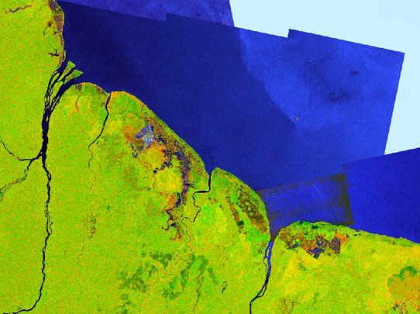
Quick overview of floods and their impact
Flooding is the most common natural disaster worldwide – 44% of all natural disasters have been associated with floods over the past 50 years (WMO, 2021)
Often floods lead to cascading hazards – loss of power, damage to infrastructure, landslides, food insecurity, and more
Globally, billions of dollars in damages annually due to flood events
Flooding in Guyana, June 2021
Notes:
Near Real-Time Products update anywhere from every 3 hours to daily or weekly depending on the product.

Slide 3
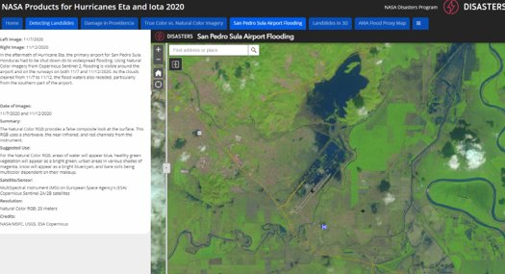
NASA data throughout flood disaster cycle
Mitigation – minimizing the potential effects of a future flood event
Preparedness – preparing to handle an imminent flood event
Response – responding to an active flood event
Recovery – recovering from a flood event
Flooding at airport in Honduras, November 2021
Notes:
Near Real-Time Products update anywhere from every 3 hours to daily or weekly depending on the product.

Slide 4
Using NASA data to inform decisions
Connecting remote sensing data with socioeconomic data through partnerships to better assess risk and exposure for humans and infrastructure
  Building footprint data
  Land cover data
  Proximity to critical infrastructure
Informing stakeholders about ongoing events through technical interchange meetings and development of partnerships to help develop methods designed to be impactful
Creating content through data visualization techniques and narrative to inform about ongoing events
  StoryMaps
  Interactive articles
Notes:
Near Real-Time Products update anywhere from every 3 hours to daily or weekly depending on the product.

Slide 5
How to access / download / use NASA data
NASA Disasters Mapping Portal (maps.disasters.nasa.gov)
  Can connect to the data through a WMS or download through link provided in metadata
Earthdata (https://urs.earthdata.nasa.gov/) - the search and discovery application for NASA's Earth Observing System Data and Information System (EOSDIS)
  Registration required, but it is free
Google Earth Engine (code.earthengine.google.com) – can work with many NASA datasets in a JavaScript environment, without needing to download the data to your machine
  Registration required, but it is free
Notes:
Near Real-Time Products update anywhere from every 3 hours to daily or weekly depending on the product.

Slide 6
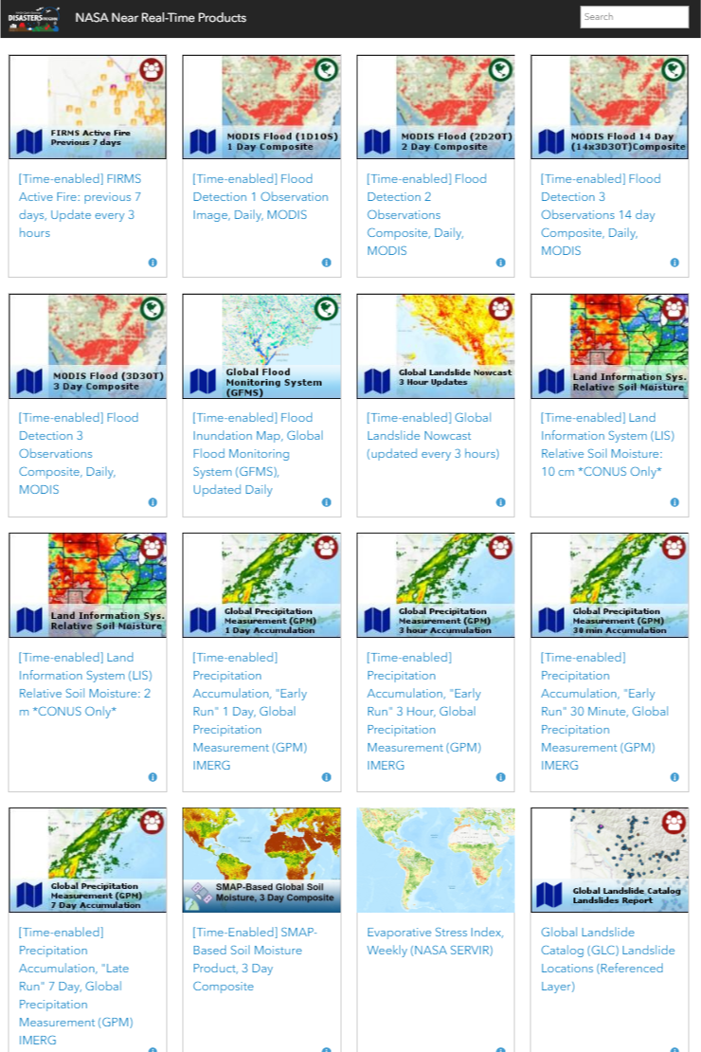
Selection of Near Real-Time Products on the NASA Disasters Portal
Global unless noted otherwise
Flood Detection – 1, 2, 3 Observations (MODIS)
Precipitation Accumulation – 30 min, 3 hour, 1 day (Global Precipitation Measurement)
Soil Moisture and Soil Moisture Anomaly– 3 day composite (SMAP)
Notes:
Near Real-Time Products update anywhere from every 3 hours to daily or weekly depending on the product.

Slide 7
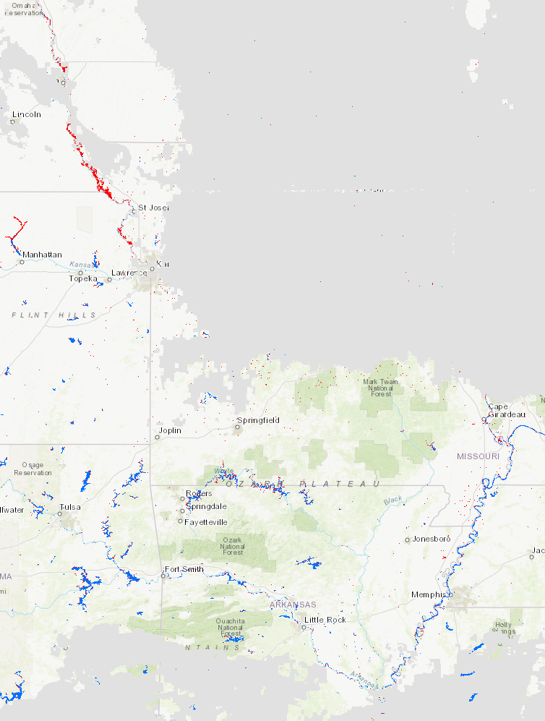
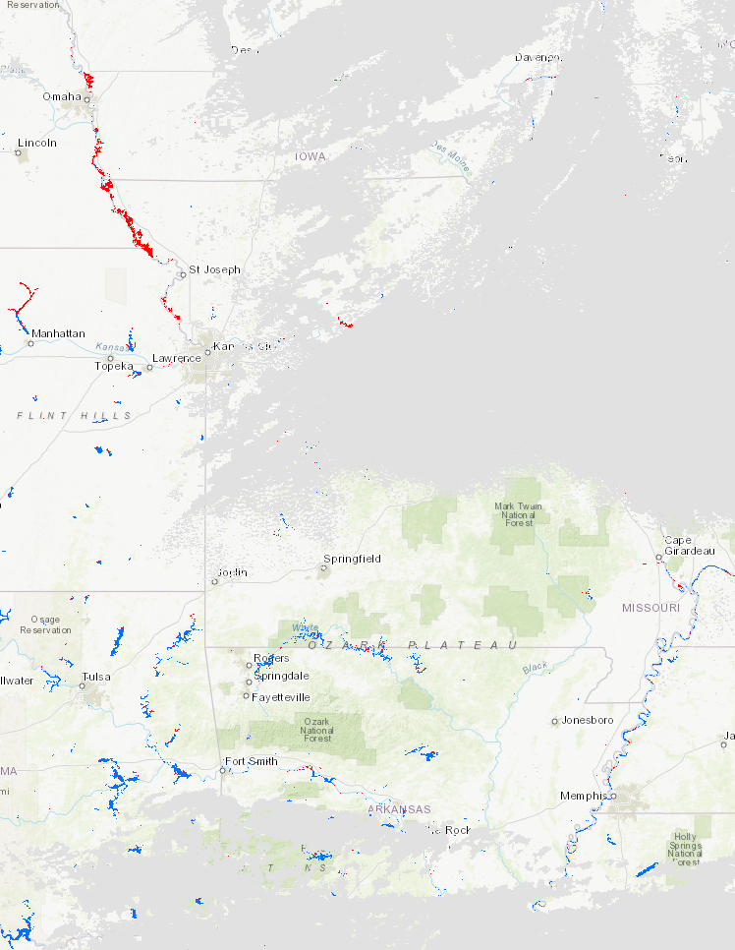
MODIS Flood Products
Updated Daily
1, 2, 3-day products
Resolution: 250 m
1-day – CONUS, Global tiles available upon request
2, 3-day - Global
1-Day
2-Day

Slide 8
Global Precipitation Measurement (GPM)
Updated every 3 hours
30 min, 3 hour, 1 day, 7 day
Resolution: 0.1 degrees

Slide 9
Soil Moisture Products
  Soil Moisture
    3-day composite, updated every 3 days
    Resolution: 0.25 degrees
  Soil Moisture Anomaly

Slide 10
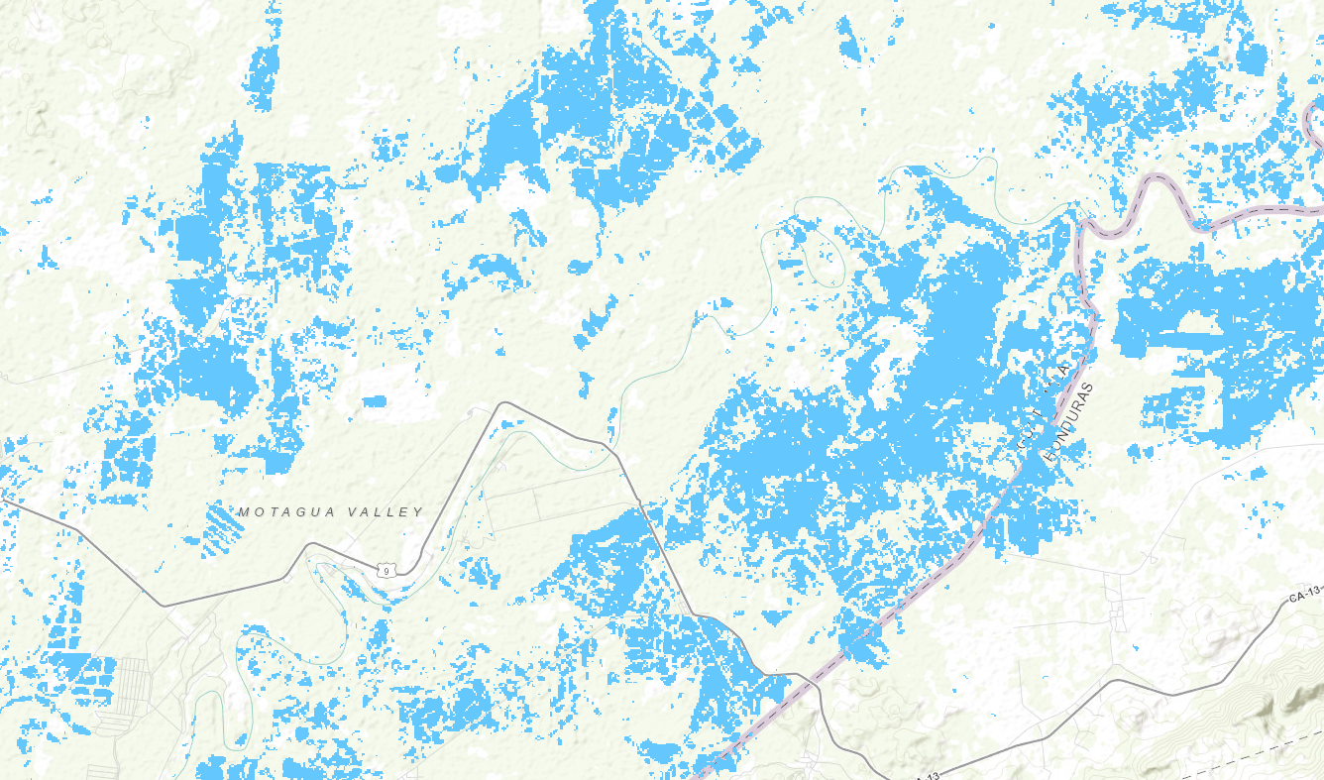
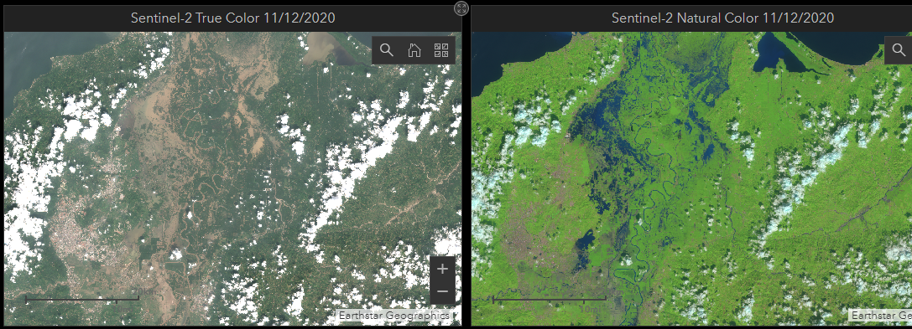
Selection of Event-Specific Products
Synthetic Aperture Radar (SAR) Flood Products
  Composite
  Flood proxy map (FPM)
Optical Flood Products
  Natural Color
  True Color
  Modified Normalized Difference Water Index
FPM for Motagua Valley, Guatemala
November 2021
Flooding in San Pedro Sula, Honduras, November 2021
Notes:
Near Real-Time Products update anywhere from every 3 hours to daily or weekly depending on the product.

Slide 11
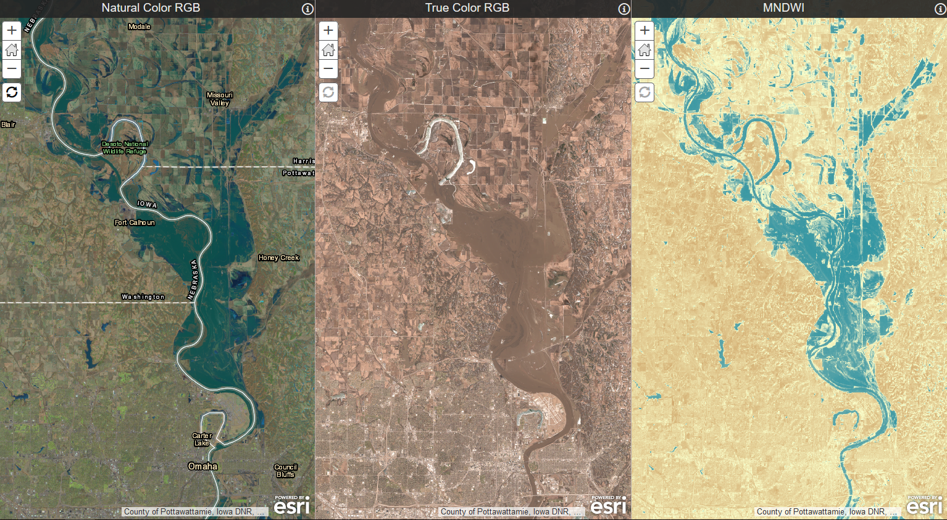
Optical Flood Products
Natural Color
  Water is blue
True Color
  Actual color
Modified Normalized Difference Water Index (MNDWI)
  Water is blue
  Saturated soil is lighter brown

Slide 12
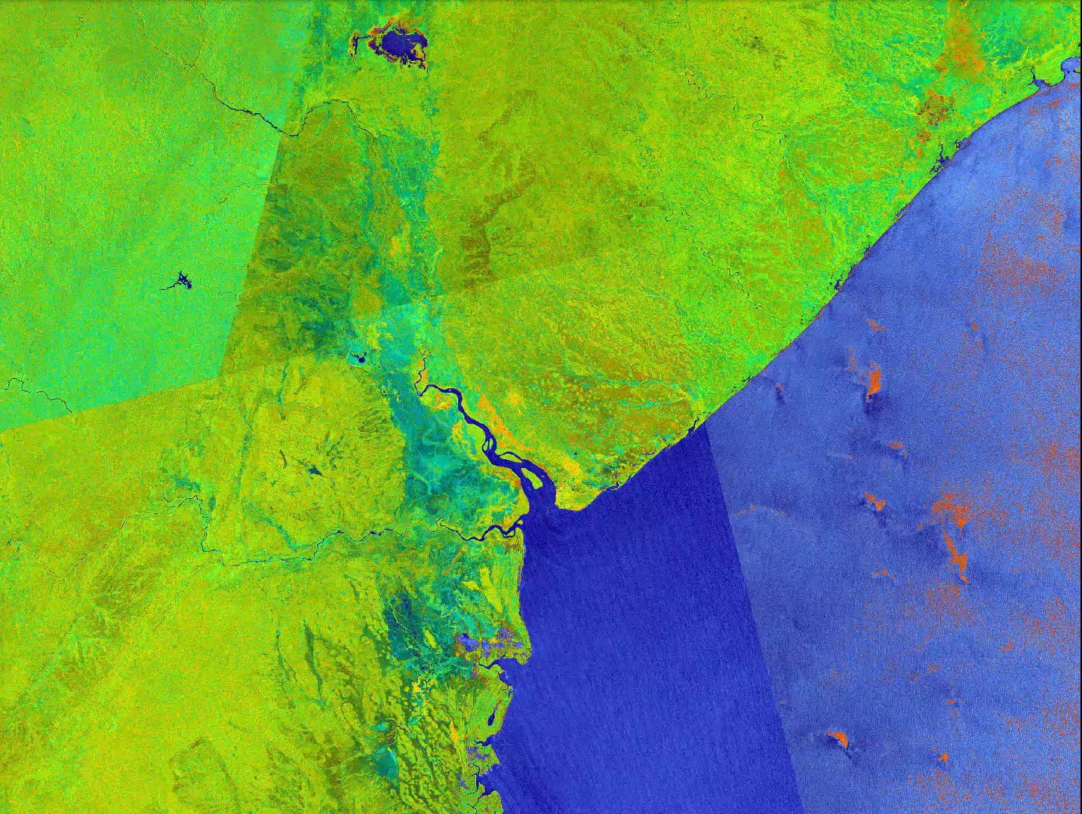
SAR False Color Composite
Quick turnaround
Resolution: 30m
Useful for water detection
Sources: Sentinel-1, ALOS-2, IceEye, Radarsat-2

Slide 13
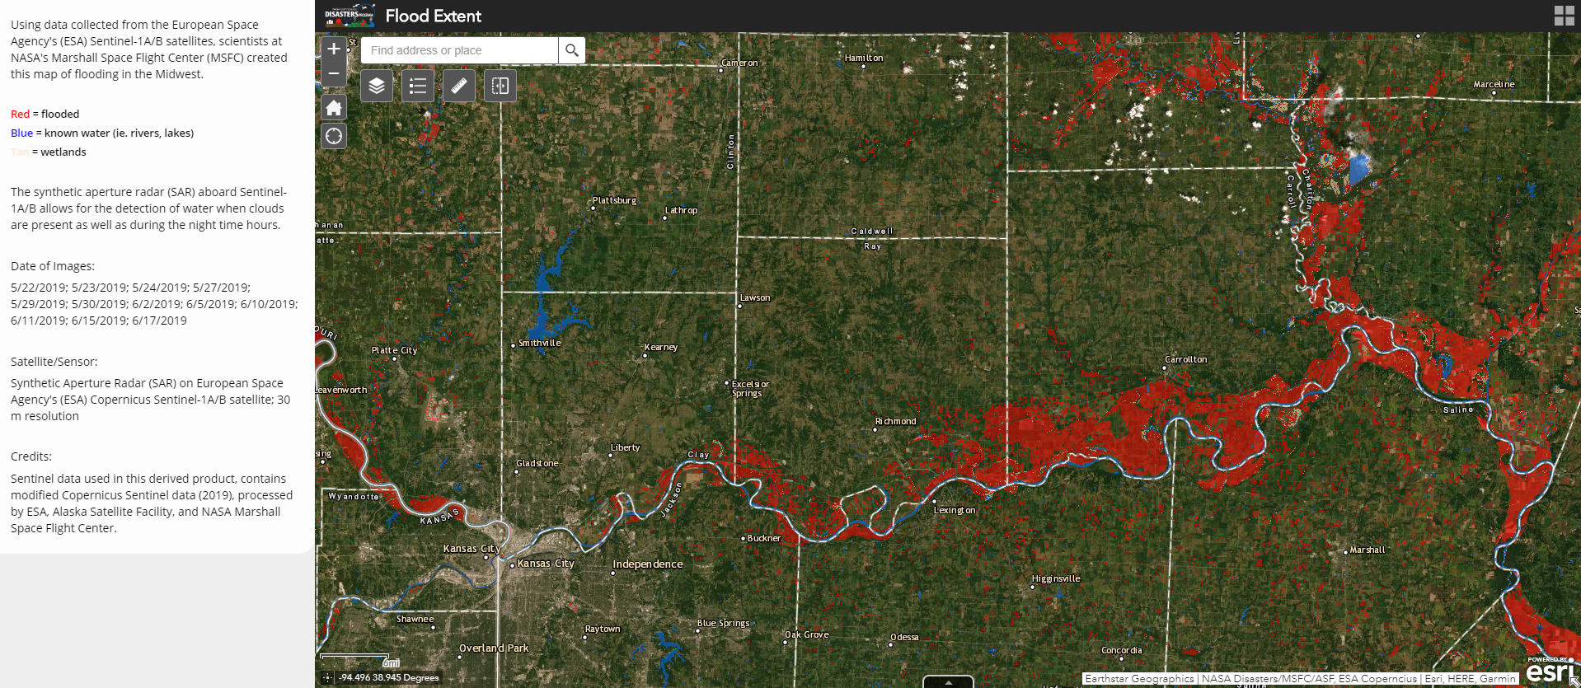
Flood Proxy Maps

Slide 14
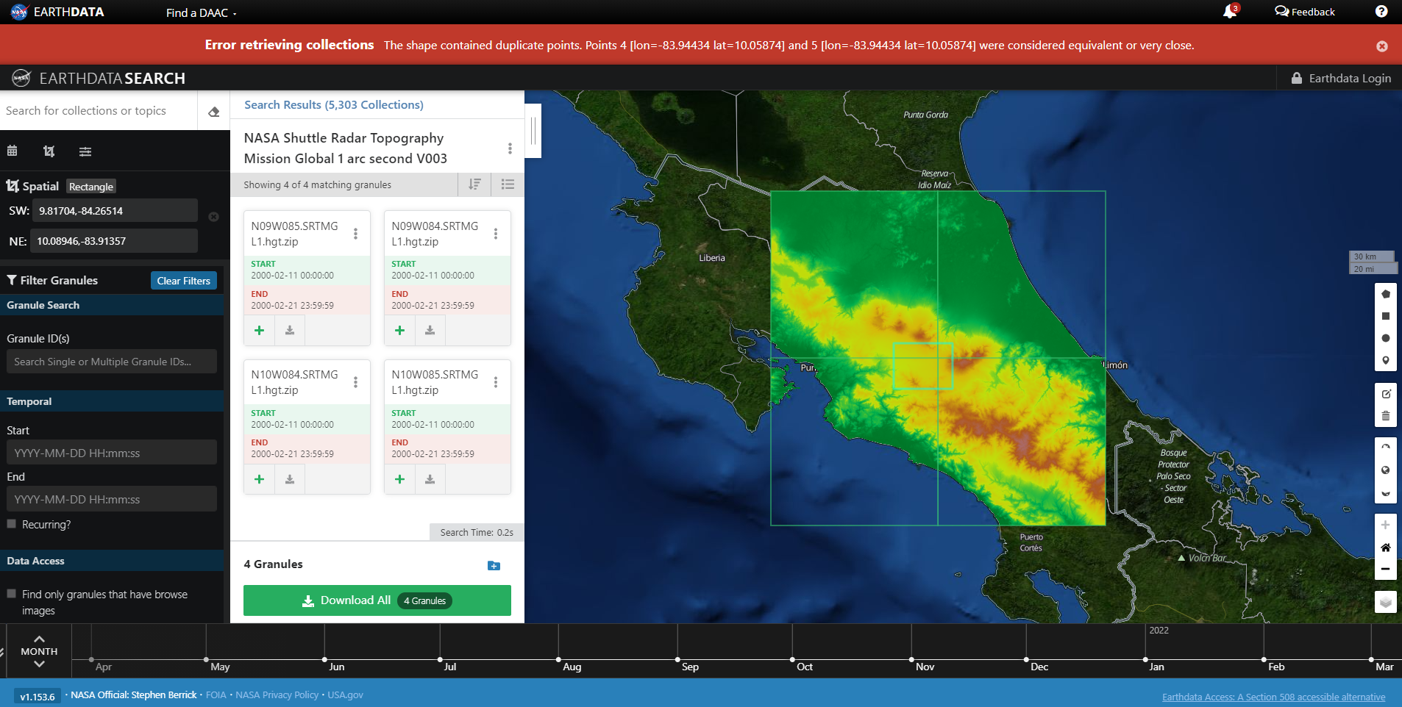
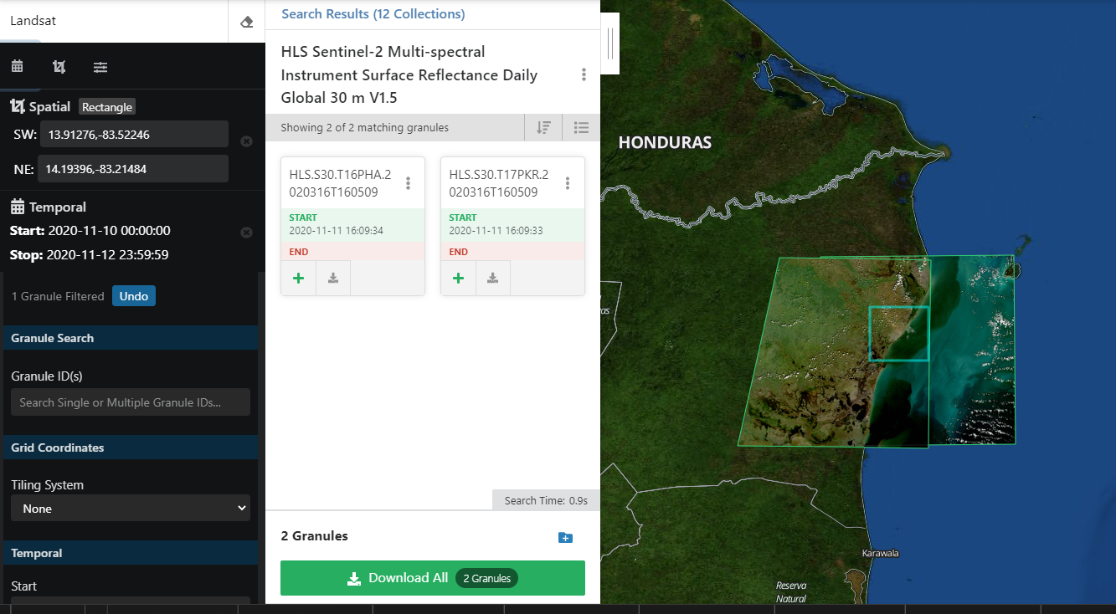
A quick look at the Earthdata interface
earthdata.nasa.gov
Can also download historical flood event data
Below example: Nicaragua post-Eta, November 2020
Interface to search for, visualize, and download data
Above example: NASA SRTM data, Costa Rica

Slide 15
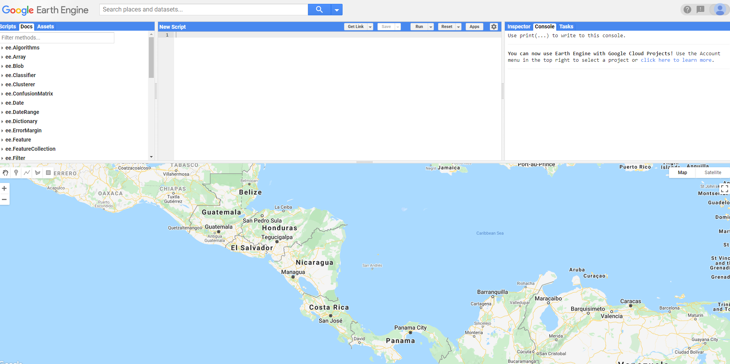
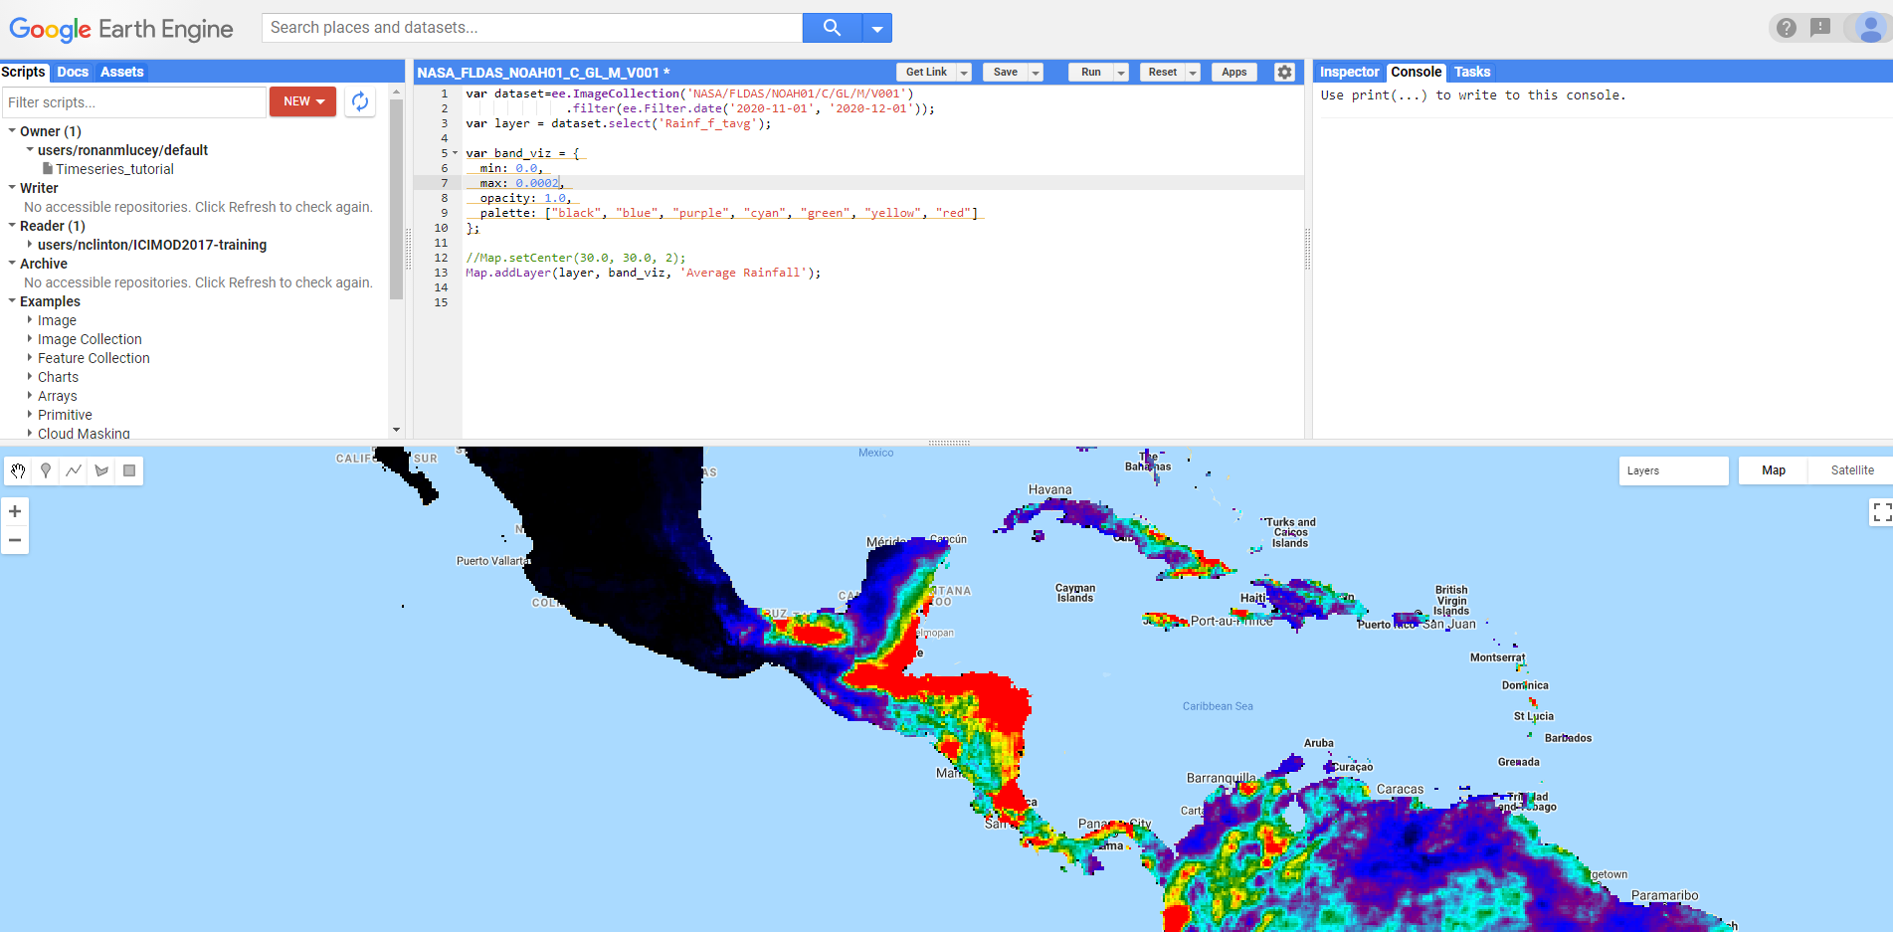
A quick look at the Google Earth Engine interface
code.earthengine.google.com
Scripts can be written to visualize, process, download data
Below: Rainfall in Central America post-Eta, November 2020
Google Earth Engine (GEE) combines a multi-petabyte catalog of satellite imagery and geospatial datasets with planetary-scale analysis capabilities in an open-source environment
Above: GEE Interface

Slide 16
Resources and Links
NASA Earth Applied Science Disasters Program Website: https://appliedsciences.nasa.gov/what-we-do/disasters
NASA Disasters Program Geospatial Portal: maps.disasters.nasa.gov
Earthdata Website: https://urs.earthdata.nasa.gov/
Google Earth Engine: code.earthengine.google.com
Notes:
Near Real-Time Products update anywhere from every 3 hours to daily or weekly depending on the product.

Slide 17
Contact information & questions
Ronan Lucey
ronan.m.lucey@nasa.gov
Notes:
Near Real-Time Products update anywhere from every 3 hours to daily or weekly depending on the product.

