Slide 1
Ali H Omar
NASA Langley Research Center
Illinois Institute Of Technology Seminar
Notes:
STILL-option 1

Slide 2
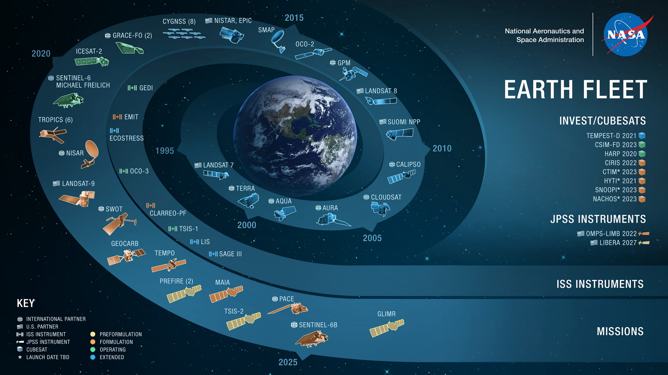
05.25.21

Slide 3
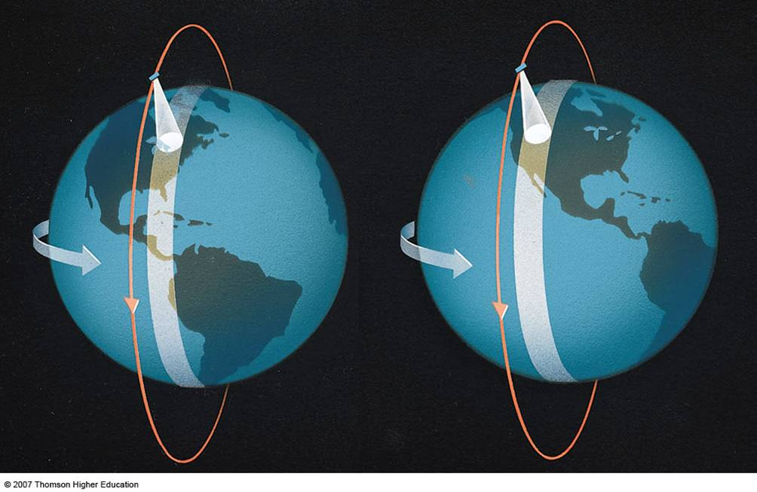
Polar Orbiting Satellite
Field of View moves from the East to the West coast as the Earth rotates below a fixed orbit

Slide 4
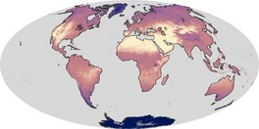
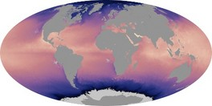
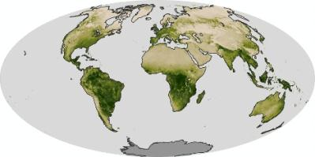
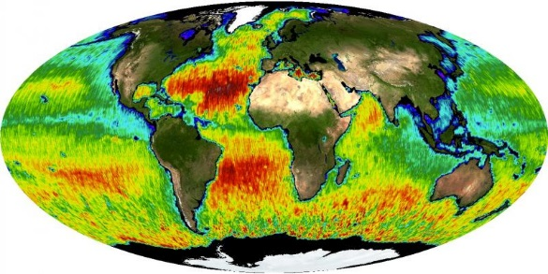
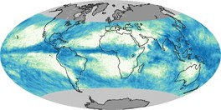
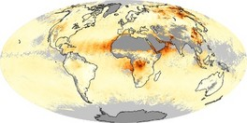
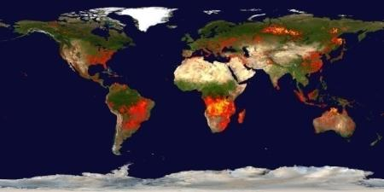
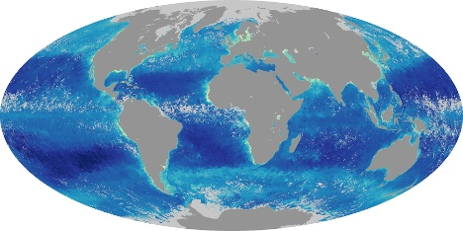
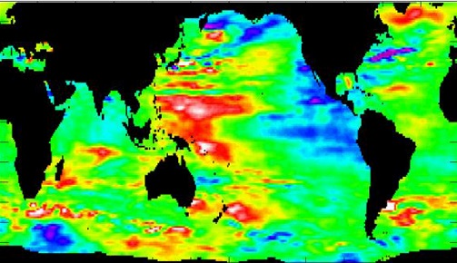
Various Types of Earth Observations…and many are critical for Health and Air Quality Applications
All data are free and open access at: https://earthdata.nasa.gov/
Land Temperature Sea Surface Temperature Vegetation
Sea Surface Salinity Total Rainfall Aerosols
Fires & Thermal Anomalies
Chlorophyll
Sea Surface Height
Notes:
All data are free and open access at: https://earthdata.nasa.gov/

Slide 5
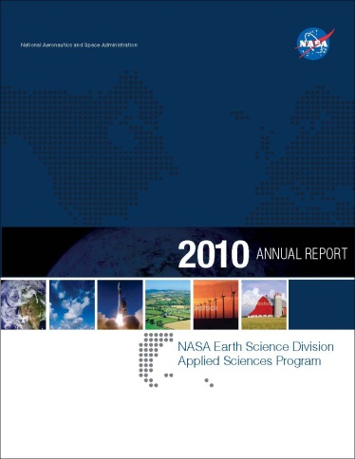
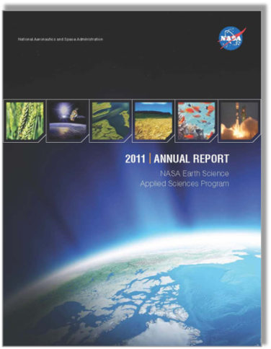
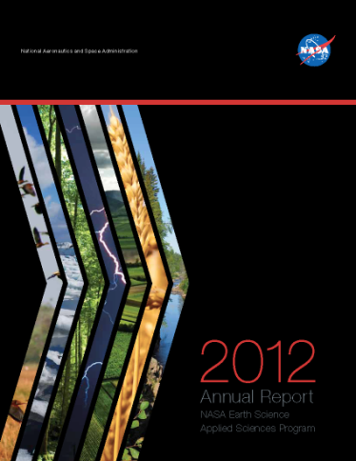
NASA Applied Sciences Program
Discovering and demonstrating innovative and practical uses of
Earth observations in organizations’ policy, business, and
management decisions.
http://AppliedSciences.NASA.gov
Applications
Prove-out, develop, and transition applications ideas
for sustained uses of Earth obs. in decision making.
Capacity Building
Build skills and capabilities in US and developing countries to access Earth observations to benefit society.
Mission Planning
Identify applications early in mission lifecycle and integrate end-user needs in mission design and development.

Slide 6



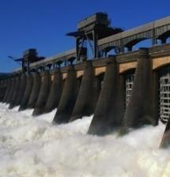


APPLICATIONS AREAS
All areas incorporate aspects of climate and weather.
Wildfires is covered by
Eco. Forecasting: Pre-fire & Post-fire phases
Health & Air Quality: Active-fire phase
Disasters: Active-fire & Post-fire phases
Agriculture
Ecological Forecasting
Disasters
Ad Hoc Activities
Full programs
Routine solicitations
Active investment portfolios
Energy
Transportation & Infrastructure
Health & Air Quality
Water Resources
Urban Development
NASA: https://appliedsciences.nasa.gov/

Slide 7
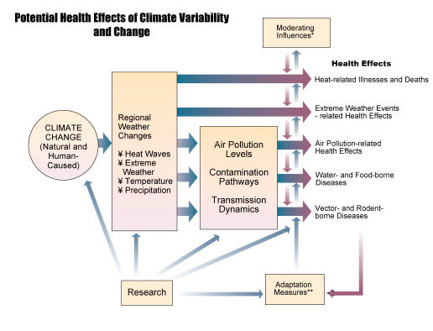
Why Health & Air Quality?
Source: GEO, 2003
Patz et al., 2000
http://www.usgcrp.gov/usgcrp/Library/nationalassessment/healthimages.htm

Slide 8
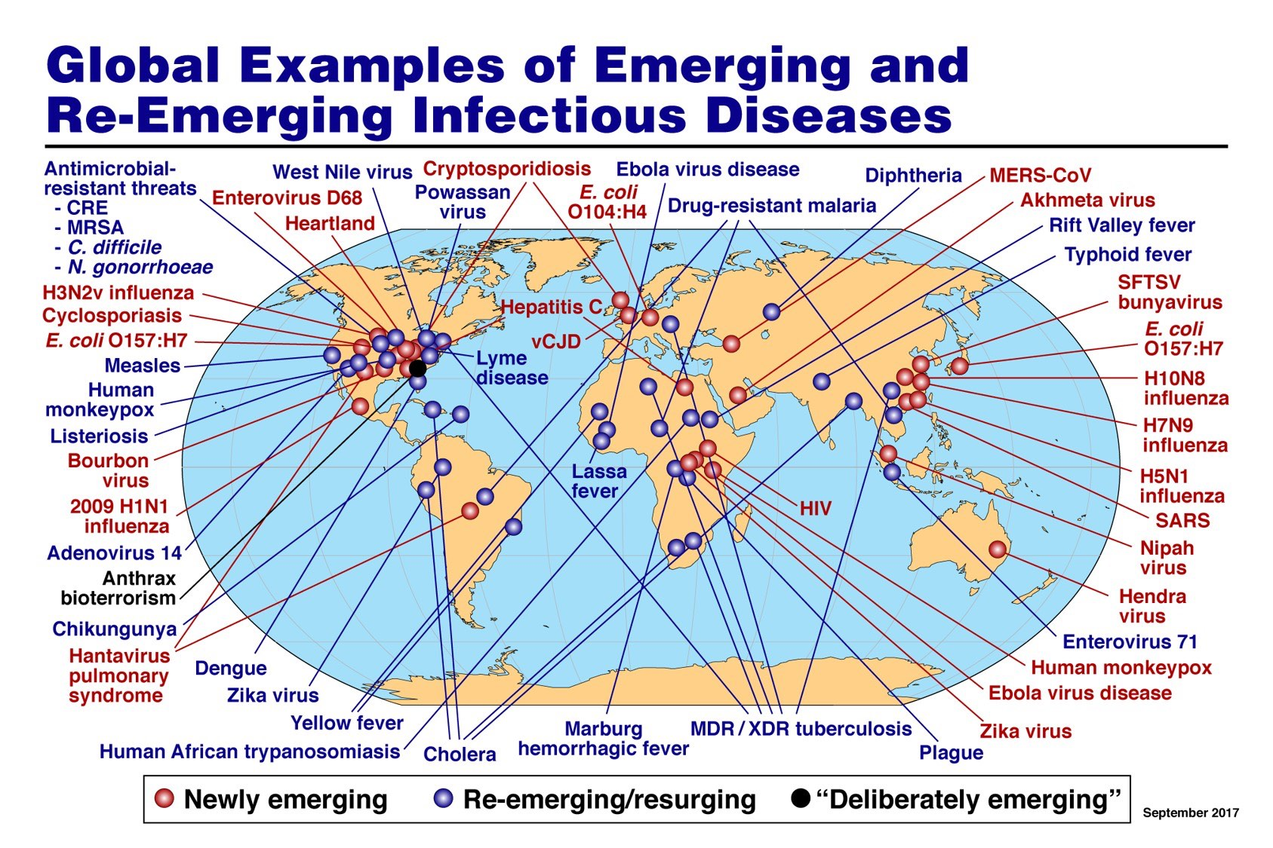

Credit: NIAID,

Slide 9
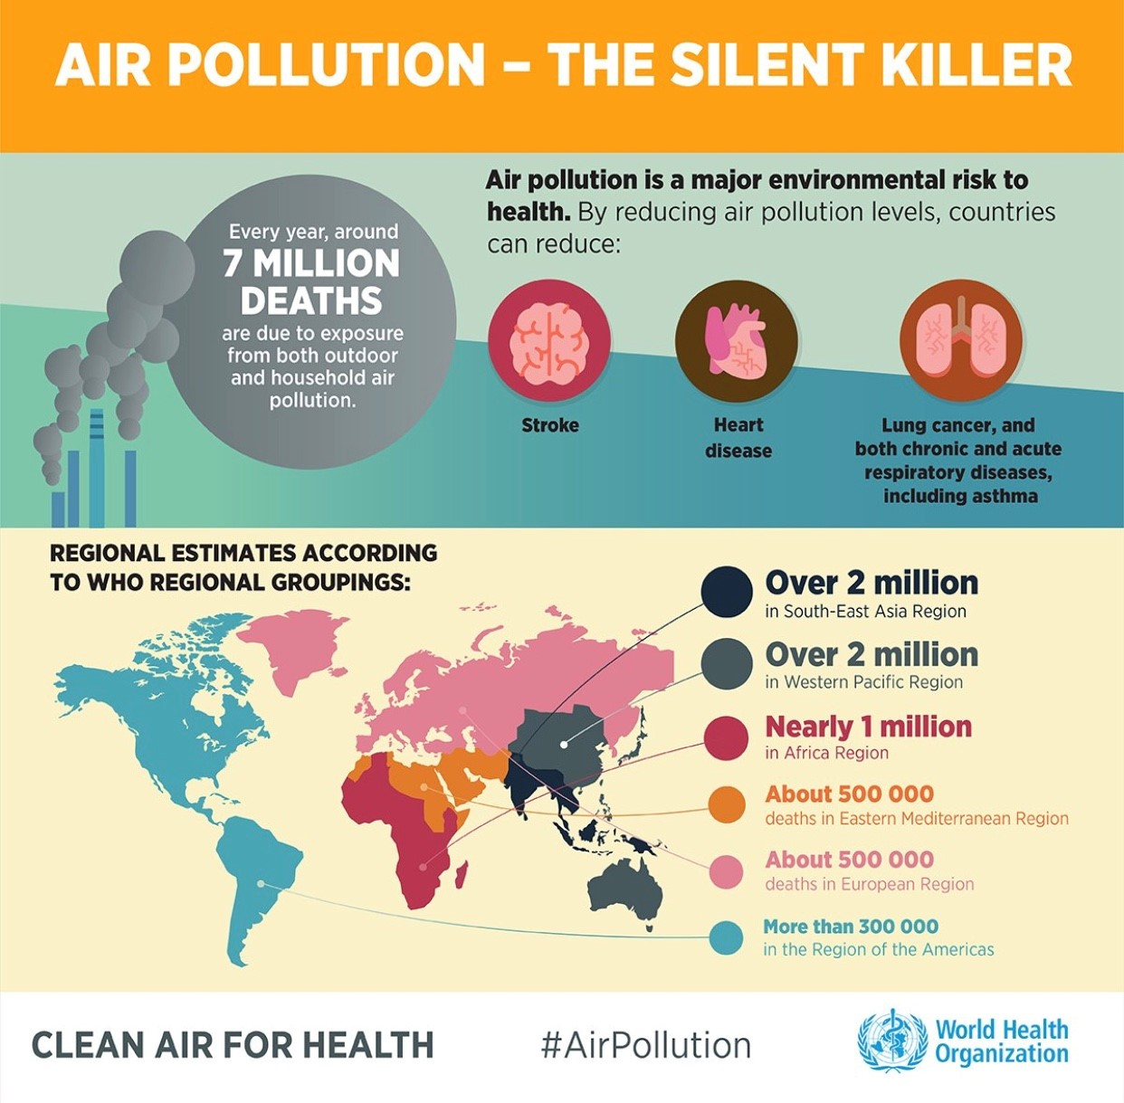

Slide 10
Health & Air Quality
Objectives:
NASA’s Health & Air Quality Applications Area supports the use of Earth observations in air quality management and public health, particularly regarding infectious disease and environmental health issues.
The area addresses issues of toxic and pathogenic exposure and health-related hazards and their effects for risk characterization and mitigation.
The area promotes uses of Earth observing data and models regarding implementation of air quality standards, policy, and regulations for economic and human welfare.
The Health & Air Quality Applications Area also addresses effects of climate change on public health and air quality to support managers and policy makers in their planning and preparations.
Major Partners include International (e.g., GEO, WHO, UNICEF, PAHO), Federal (e.g., CDC, EPA, NIH, NOAA), State (e.g., South Dakota, California, Texas), and Private sectors (AER, Inc.).

Slide 11

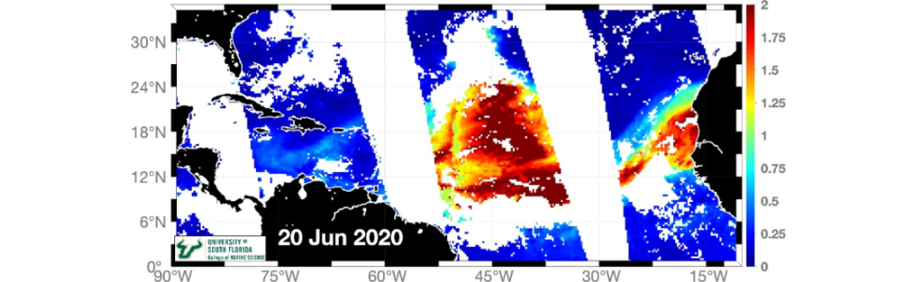
June 20, 2020
June 23, 2020
Saharan Dust Plume
San Juan, PR
Forecasting Poor Air Quality Events in the Caribbean
Saharan dust storms crossing the Caribbean adversely impact air quality and human health. Robust applied research and community partnerships were developed in Puerto Rico to build an air quality forecasting tool that will inform policy decisions, educate the public on health risks related to dust storms, and safeguard population health.
Credits: NASA/Pablo Méndez-Lázaro
NASA Web Feature: https://www.nasa.gov/feature/nasa-helps-puerto-rico-prepare-for-saharan-dust-impacts
Suomi NPP VIIRS data (AOD/dust concentration)
Notes:
Pablo Mendez-Lazaro (University of Puerto Rico) - Early Warning of Synoptic Air Quality Events to Improve Health and Well Being in the Greater Caribbean Region
This HAQ highlight (ARL 7) is timely due to the historic Saharan dust cloud of June 2020, demonstrates team resilience (including hurricane/earthquakes), and showcases very committed partnerships with over 19 stakeholders in air quality and human health.
Objective: To develop a forecasting tool to guide surveillance, early warning, and risk assessment of African Dust events and diesel particulate matter in the Caribbean.
Earth Observations: MODIS, VIIRS, (NOAA) GOES-16 (EAST)
Progress to date: The team has analyzed data from on-the-ground air monitors and EO (MODIS, VIIRS, GOES-16 EAST), matched and compared timescales, and completed installation, calibration, and testing of instrumentation. The project is currently at ARL 7 (application prototype functionality demonstrated in partner’s decision making). Some research activities have been delayed due to the COVID-19 pandemic.
**Committed Partnerships: Multidisciplinary partnerships with 38 participants from 19 different organizations from public sector (NASA Goddard; National Weather Service, San Juan, EPA Caribbean Region), private sector (private health clinics), and academia (USF; UPR). Three Working Groups – 1) Resilience, Public Health, and Well Being; 2) Atmospheric Forcing and Air Quality; and 3) Decision Support Tool: Computation and Visualization – support research objectives and fill existing gaps between science and decision-support tools using EO.
**Team Resilience: These efforts were achieved despite resolving short- and long-term challenges related to recent natural hazards (Hurricane Maria, earthquakes, COVID-19 pandemic).
Public health application: Public health officials can use this forecasting tool to inform decision-making and develop community interventions that educate the public on health risks related to dust storms.

Slide 12
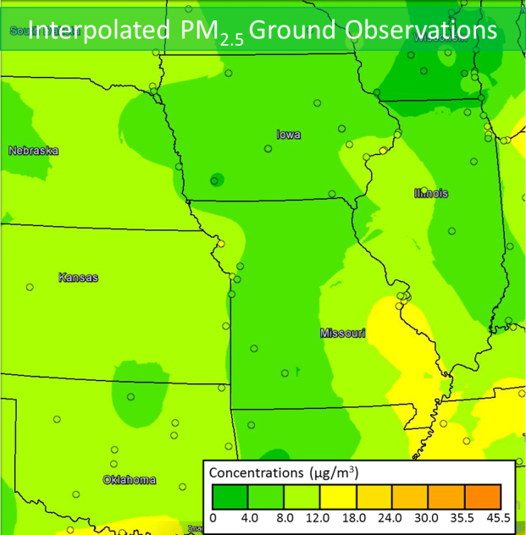
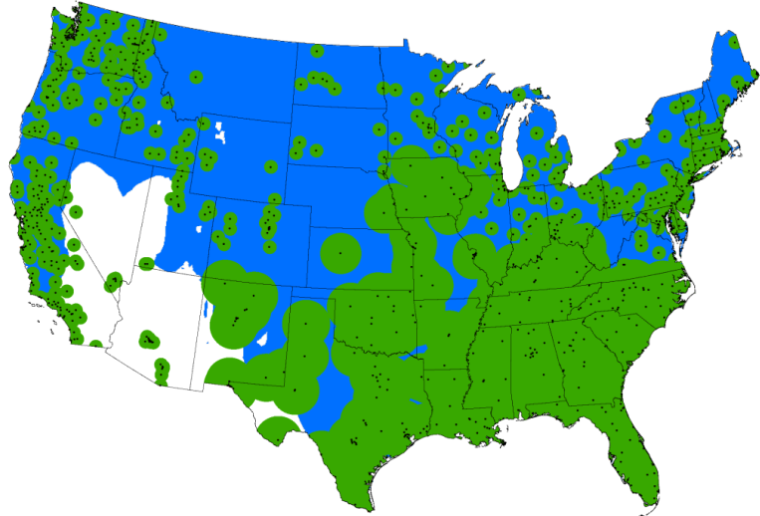
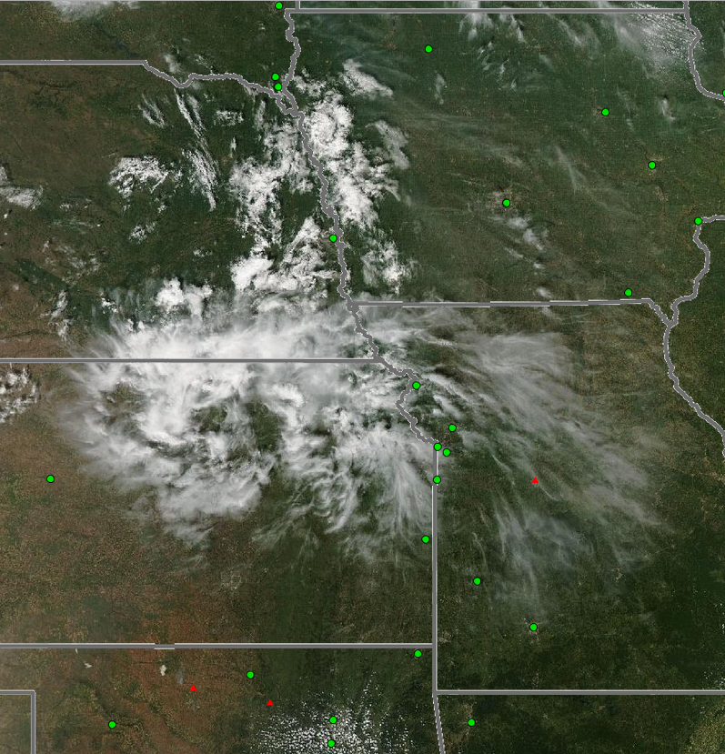
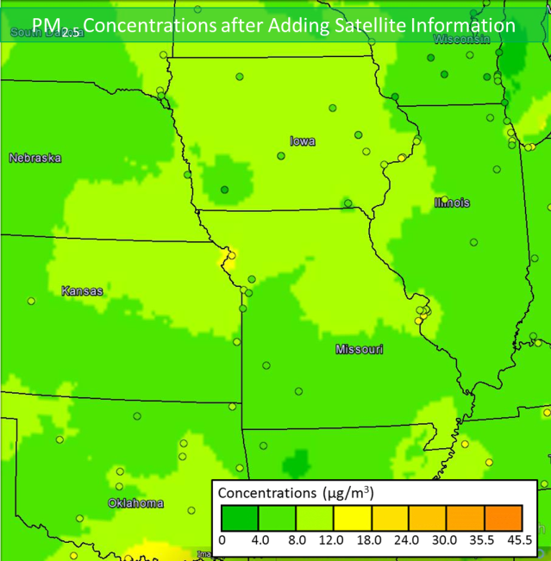
Improving Air Quality Maps with Satellite Data
PI: Phil Dickerson, EPA
GROUND-BASED + SATELLITE
COVERAGE OF AIR QUALITY
PM2.5 FROM GROUND BASED DATA
Northern Missouri fires - Sept. 4, 2013
SMOKE
MISSING
NE
IA
Green = ground-based PM_{2.5}
Blue = AirNow Satellite-based PM_{2.5}
White = no coverage
SMOKE
PM2.5 GROUND+SATELLITE DATA
KS
MO
SMOKE
INCLUDED
MODIS image
“This is the best tool I have seen so far that integrates satellite data with information from ground monitors.”
Cassie McMahon, Minnesota Pollution Control Agency
Notes:
Unmonitored areas are home to 18 million people
Satellite data provide PM2.5 data to 82% of people in unmonitored locations for free.
Ground monitors in every city of > 25,000 people would…
Cost $25 M over 5 years
Cover only 44% of people in unmonitored areas
First Column: If we estimated the concentration of particulate material (PM) from ground monitors (the small dots on the far left figure) the area of coverage would be limited only to the areas shaded green. The MODIS Satellite coverage, shown by the blue areas, helps to fill most of the gaps (but not all) –nearly half of the uncovered population (18.1 million) now have AQ information. Some of the white areas are because the surface albedo is so high that the MODIS retrievals are saddled with large uncertainties.
Second and Third Column: A case study showing the problem (the fire image) , the solution (PM2.5 from ground based data), and NASA’s contribution (PM2.5 from Ground + Satellite Data). In the nominal solution because the ground monitors in this region are very few, the interpolated PM2.5 data shows relatively good Air Quality (AQI of 0 – 4). The addition of satellite data shows that the Air Quality as a result of the
Fires is poorer at AQI = 4-8.0; This shows a case where the satellite data has real value in producing an Air Quality Index that actually protects the public from harm by allowing them make decisions
that protect their health and wellbeing. If the satellite data were not there, the would be no indication of this poorer air quality.
Yellow box : Testimonial from a user at the Minnesota pollution Control Agency
In the Missouri fires case (see http://www.youtube.com/watch?v=ycYp2-XtoxE) the addition of satellite data leads to identification of poorer air quality by including satellite observations of smoke in an otherwise unmonitored area of Northern Missouri.

Slide 13

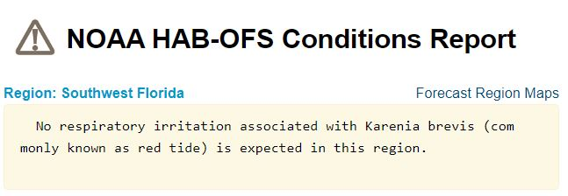
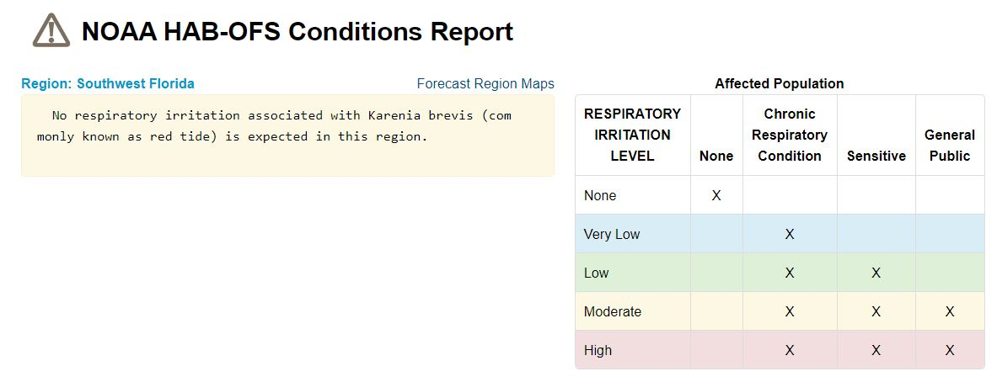
Improving Forecasts of Respiratory Hazards from Toxic Algal Blooms in Florida
Through a partnership with NOAA, the Florida Fish and Wildlife Conservation Commission, the Gulf of Mexico Coastal Ocean Observing System (GCOOS), and NASA’s Health and Air Quality Applications program, scientists integrated satellite and HABscope smartphone app data (obtained by citizen scientists) to monitor the presence and extent of harmful algal blooms in the Gulf of Mexico. Since these algal blooms release toxic aerosols, the results are assimilated into the 24-hour Experimental Red Tide Respiratory Forecast, now updated every three hours, to identify affected Florida beaches, helping beach communities better understand their risk and take appropriate precautions.
Observations from Terra (MODIS), JPSS/S-NPP (VIIRS), and Copernicus Sentinel-3 were integrated with HABscope smartphone app data to enhance forecasts of respiratory hazards from toxic algal blooms along the Florida Gulf Coast (https://habforecast.gcoos.org/).
NASA Web Feature: https://www.nasa.gov/feature/space-views-aid-florida-red-tide-health-alerts-1
Notes:
Along the coastal waters, red tides can result from the accumulation of the dinoflagellate Karenia brevis, which are toxic to human and marine health. As these toxins become airborne and are advected inland, they cause breathing difficulties to beach-goers – especially those with severe allergies and asthma.
A collaboration between the National Oceanic and Atmospheric Administration, Florida Fish and Wildlife Conservation Commission, Gulf of Mexico Coastal Ocean Observing System, Pinellas County Environmental Management, University of South Florida, and NASA Earth Science’s Health and Air Quality Applied Sciences Team aimed to map the extent of algal blooms in the Gulf of Mexico and increase public awareness of the daily risk of red tide toxins.
Data from NASA’s Terra and Aqua satellites (MODIS), JPSS/S-NPP VIIRS, and the European Space Agency’s Copernicus Sentinel-3 satellite were used in conjunction with the HABscope smartphone app (video uploads by citizen scientists to map the extent of algal blooms along the Florida’s Gulf Coast).
The team developed a 24-hour Experimental Red Tide Respiratory Forecast (updated every three hours) along Florida’s Gulf Coast, focusing originally on Pinellas County. It builds on NOAA's Harmful Algal Bloom Forecast System and the Near Real-Time Integrated Red Tide Information System from the University of South Florida. The geographic extent of this forecast system has expanded to most of the central and southern Florida Gulf Coast since NASA support ended in 2019.
With updates on the harmful algal bloom forecasts on a mobile app, factsheet distribution, and physical warnings along the coast, persons visiting or working near beach communities can understand their risk and take appropriate precautions.
STORY LINK: https://www.nasa.gov/feature/space-views-aid-florida-red-tide-health-alerts-1

Slide 14
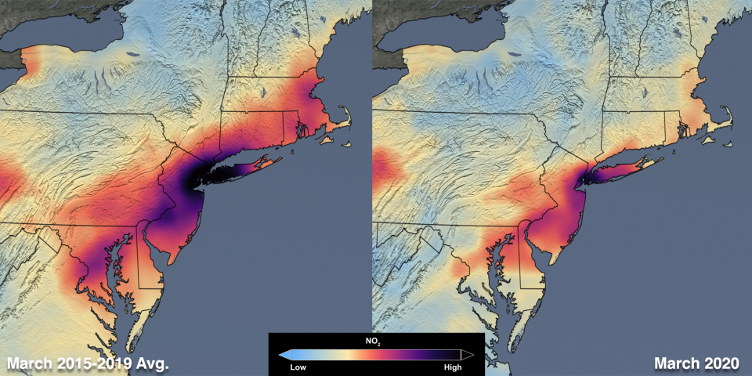
Air Quality Changes in Response to COVID-19 Mitigation Efforts
Nitrogen dioxide (NO₂) is a pollutant that is unhealthy to breath and contributes to the formation of unhealthy levels of surface ozone pollution. It is primarily emitted from tailpipes and smokestacks.
• Aura Ozone Monitoring Instrument (OMI) and ESA TROPOMI data show large decreases of NO₂ in areas where COVID-19 mitigation measures have been introduced. Ongoing observations of air quality have helped provide immediate examples of how Earth’s systems are responding to these changes in human behavior.
• The NASA OMI team created a portal to provide scientists an easy way to see how satellite NO₂ has changed in 2020 compared to the 2015-2019 average for the same 14-day period: https://so2.gsfc.nasa.gov/no2/no2_index.html
Aura OMI NO₂
2005
2016
Decreases in air pollution, specifically tropospheric nitrogen dioxide (NO2), over the Northeast United States due to COVID-19 response.
Credits: NASA/Science Visualization Studio
https://so2.gsfc.nasa.gov/no2/no2_index.html
Notes:
US NO_{x} emissions have decreased by about 50% since 2000 through a combination of controls on power plants and automobiles. For instance, see http://earthobservatory.nasa.gov/IOTD/view.php?id=83923 for a description of the impact of emission control devices on power plants.
The Ozone Monitoring Instrument (OMI) is on the Aura satellite (http://aura.gsfc.nasa.gov), which launched in 2004.
The OMI NO₂ data shown in the images were produced by the international OMI NO₂ Team (NASA NO₂ PI: Nickolay Krotkov, Lok Lamsal (GSFC, 614) and Dutch PI: Pepijn Veefkind (KNMI, Netherlands)). The data were processed and analyzed by Lok Lamsal (GSFC; 614) and Bryan Duncan (GSFC, 614), both of whom were partially funded by the NASA Health and Air Quality Applied Sciences Team (HAQAST); Bryan Duncan is a HAQAST member. The images were created by the NASA Goddard's Scientific Visualization Studio/T. Schindler.
Images can be downloaded from the following two sites: https://svs.gsfc.nasa.gov/12094 and https://airquality.gsfc.nasa.gov
OMI data also show that sulfur dioxide (SO₂), a precursor to acid rain and sulfate aerosols, has decreased significantly in the US over the Aura record: http://earthobservatory.nasa.gov/IOTD/view.php?id=76571
The NASA Air Quality Applied Sciences Team (AQAST) was created in 2011 by the NASA Applied Sciences Program to serve the needs of US air quality management through the use of Earth Science satellite data, suborbital data, and models. The program was expanded to include health management with a rename of AQAST to the Health and Air Quality Applied Sciences Team (HAQAST). HAQAST members have expertise in the wide array of Earth Science tools and data sets available from NASA and other agencies.
For more information on HAQAST, please visit: https://haqast.org/
This is the third year in a row that the EPA Air Trends Report has included NASA Earth observations.

Slide 15
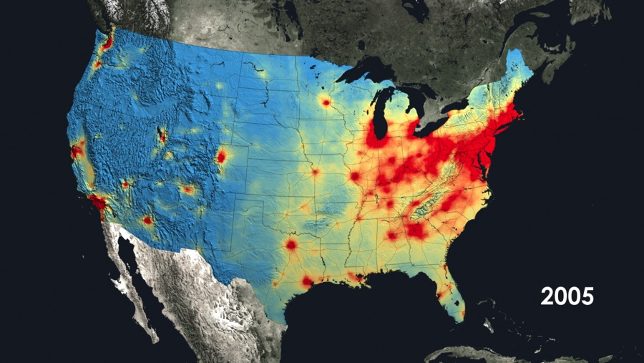
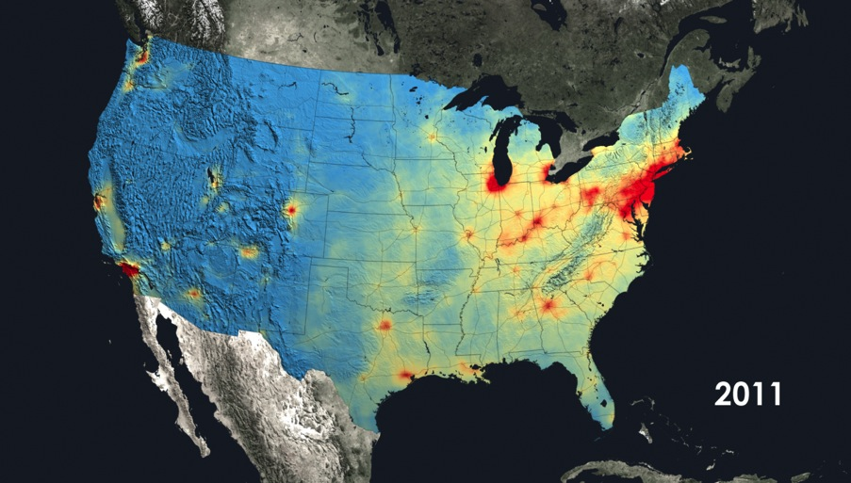
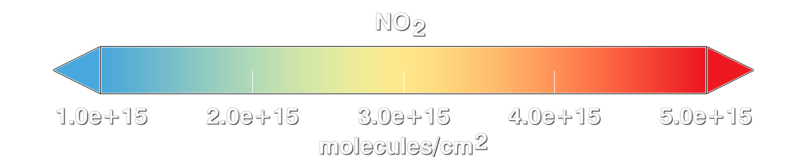
NASA Aura OMI Shows Air Quality is Improving
• OMI data show a 30-40% decrease in the pollutant nitrogen dioxide from 2005 to 2011.
• The NO₂ decrease is due to emission control devices on coal-burning power plants and more fuel-efficient cars.
• NASA AQAST members facilitate the use of satellite data by the air quality community, such as by demonstrating the effectiveness of state efforts to improve air quality.
NOx
NOx
Notes:
US NO_{x} emissions have decreased by about 50% since 2000 through a combination of controls on power plants and automobiles. For instance, see http://earthobservatory.nasa.gov/IOTD/view.php?id=83923 for a description of the impact of emission control devices on power plants.
The Ozone Monitoring Instrument (OMI) is on the Aura satellite (http://aura.gsfc.nasa.gov), which just celebrated 10 years since launch.
The OMI NO₂ data shown in the images were produced by the international OMI NO₂ Team (NASA NO₂ PI: Nickolay Krotkov (GSFC, 614) and Dutch PI: Pepijn Veefkind (KNMI, Netherlands)). The data were processed and analyzed by Lok Lamsal (GSFC; 614) and Yasuko Yoshida (GSFC, 614), both of whom were partially funded by the NASA Air Quality Applied Sciences Team (AQAST) via Bryan Duncan (AQAST member). The images were created by the NASA Goddard's Scientific Visualization Studio/T. Schindler.
OMI data also show that sulfur dioxide (SO₂), a precursor to acid rain and sulfate aerosols, has decreased significantly in the US over the Aura record: http://earthobservatory.nasa.gov/IOTD/view.php?id=76571
The NASA Air Quality Applied Sciences Team (AQAST) was created in 2011 by the NASA Applied Sciences Program to serve the needs of US air quality management through the use of Earth Science satellite data, suborbital data, and models. AQAST members have expertise in the wide array of Earth Science tools and data sets available from NASA and other agencies.
For more information on AQAST, please visit http://acmg.seas.harvard.edu/aqast/index.html.

Slide 16

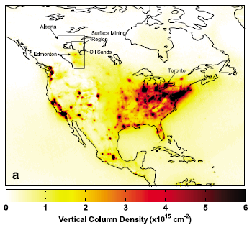
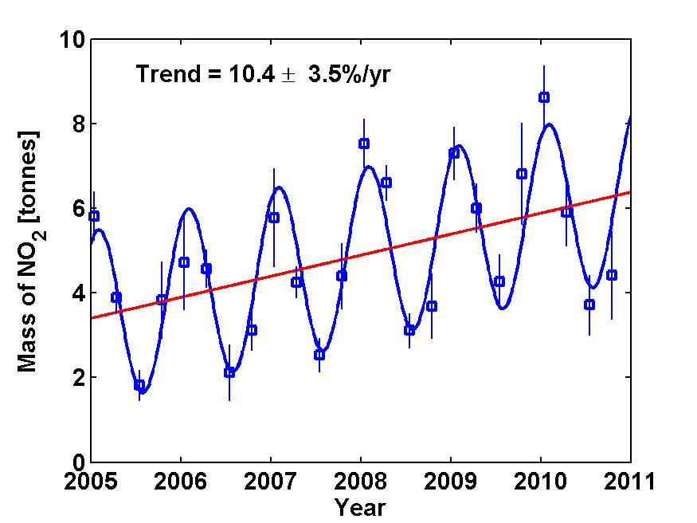
Using satellite observations to monitor growth in emissions from Canadian oil sands
Oil sand recovery In Alberta
OMI NO₂ columns, 2004-2010
Oil sand extraction requires much energy to extract and upgrade the bitumen.
Observations show an increase in NO₂ columns of ~10% per year.
McLinden et al. [GRL 2012]
AQAST PI: R.R. Dickerson

Slide 17
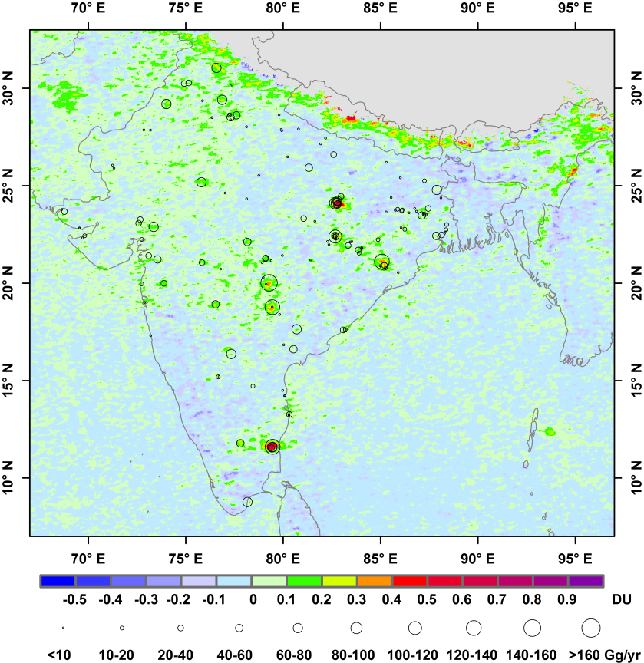

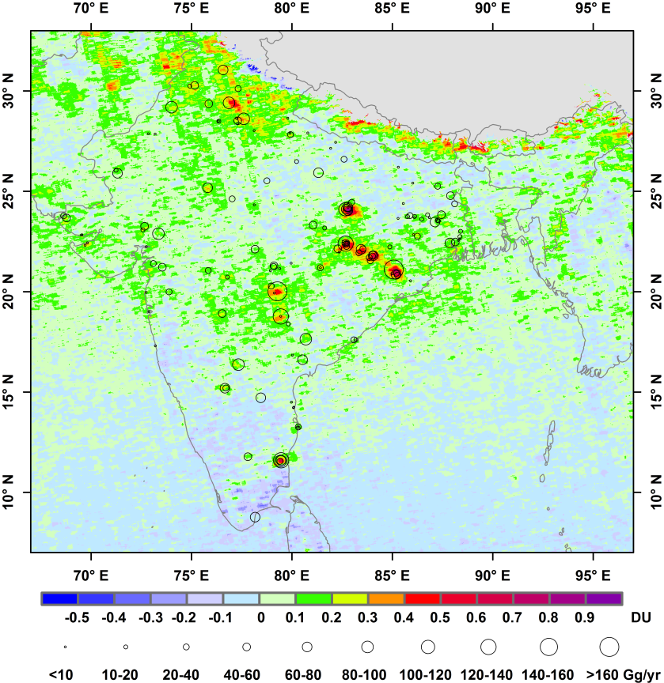
Aura/OMI Documents Increase of India's Sulfur Dioxide Emissions
India has 361 ground-based urban monitoring stations
Only 70 are in the industrial areas near power plants
Analysis of these sparse ground station data suggests a decrease in SO₂ emissions
By filling gaps in the ground-based network, OMI data show:
SO₂ emissions increased by >60% between 2005 and 2012
India surpassed the U.S. in 2010 to become the world's second largest emitter of SO₂, after China
2005
2011-2012
AQAST PI: D.G. Streets/ANL Dec 2013: Env. Sci. and Tech.
|‌ 17
|‌ 17
Notes:
The study was published online Dec. 5 in the journal Environmental Science & Technology. It was released as a NASA web feature on December 19 (http://www.nasa.gov/content/goddard/nasa-satellite-sees-increase-of-indias-sulfur-dioxide-emissions/#.U2lFgRDN58F).
Data captured by OMI documented that emissions of sulfur dioxide from Indian power plants have increased by more than 60 percent between 2005 and 2012.
India surpassed the United States in 2010 to become the world's second largest emitter of sulfur dioxide, after China, according to emission estimates previously published by NASA Air Quality Applied Science Team (AQAST) Principal Investigator David Streets of Argonne National Laboratory (ANL) and the EPA. That same research showed that about half of India's emissions come from the coal-fired power sector.
While India's Central Pollution Control Board noted in a 2012 report that the national mean concentration of sulfur dioxide has declined over the past decade, that estimate was based on data from 361 ground-based urban monitoring stations. Only about 70 stations in India collect measurements in the industrial areas near the source of power plant emissions. The rest are located in relatively clean rural areas or in urban areas with no power plants.
Emissions of SO2 are steadily increasing year over year, so 2011-2012 was not an unusual time frame. This is borne out in several studies. Economic growth and no regulations on SO2 emissions have combined to drive steadily increasing demand for power and increasing coal-fired production. Countering increased coal burning at power plants are a mandated switch from coal to LP gas for home cooking and lowering the sulfur content of diesel fuels. Diesel fuel in India has lost its sulfur gradually in recent years. Formerly 1% (1995), it has declined to 0.25% nationwide in 2000 and 350 ppm nationwide in 2010. Selected cities have more aggressive standards, with Delhi and other select areas now at 50 ppm S.
These findings came two years after researchers developed a method to observe power plant emissions from OMI in the US. This research “confirms that a technique shown to work in the United States can be applied for other countries where emissions [from ground-based measurements] are not well known," said Nickolay Krotkov (NASA/GSFC)
Sulfur dioxide reacts in the atmosphere by multiple chemical pathways to form sulfate and sulfuric acid. These contribute greatly to acid rain and fine particle pollution. Sulfate particles scatter light very efficiently, degrading visibility and altering atmospheric photochemistry. Sulfur dioxide also deposits directly onto the Earth’s surface, where it acidifies soils and water bodies. Fine particles such as sulfates have been linked to increased incidence of asthma, heart attacks and stroke.
2011 & 2012 were combined to account for the reduced number of pixels due to the row anomaly in the OMI sensor. Years prior to 2009 had sufficient coverage in each individual year. 2013 data will not be available for some time to come because the government of India will not release its data on plant operations until a few months from now. 2012 is therefore the most current inventory available.

Slide 18
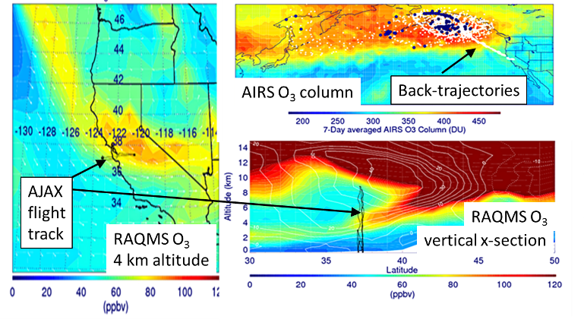
AQAST: Wyoming Exceptional Event Demonstration
Wyoming DEQ/AQD used RAQMS ozone analyses utilizing Aqua/AIRS data to issue an exceptional event demonstration package to the EPA for an ozone exceedance at Thunder Basin, June 6, 2012. This ozone stratospheric intrusion event was documented by the NASA AJAX flight campaign. EPA accepted in Summer 2014!
R.B. Pierce et al.
Notes:
This summer, the State of Wyoming Department of Environmental Quality/Air Quality Division submitted a document entitled, “Exceptional Event Demonstration Package for the Environmental Protection Agency -- Thunder Basin, Wyoming Ozone Standard Exceedance -- June 6, 2012,” to the US Environmental Protection Agency (US EPA) to demonstrate that surface ozone exceedances were due to an exceptional event associated with a stratospheric intrusion (SI). According to the US EPA, exceptional events are unusual or naturally occurring events that can affect air quality but are not reasonably controllable using techniques that tribal, state or local air agencies may implement in order to attain and maintain the National Ambient Air Quality Standards. AQAST members worked with Wyoming to provide substantiating data. In the exceptional event demonstration package, results from the Real-time Air Quality Modeling System (RAQMS) ozone analyses (utilizing AIRS O3 column measurements) were used to determine the genesis of a stratospheric intrusion (SI) event observed by the NASA Ames Alpha Jet Atmospheric eXperiment (AJAX) over California on June 5, 2012, that led to surface ozone exceedances on June 6, 2012, at the Thunder Basin ozone monitor in NE Wyoming. A final determination by the EPA is pending.

Slide 19


NASA Health and AQ Applied Sciences Team (HAQAST)
Tracey Holloway (U. of Wisconsin - Madison), Lead
Susan Anenberg (George Washington U.)
Bryan Duncan (NASA Goddard Space Flight Center)
Arlene Fiore (Colombia U.)
Pawan Gupta (Universities Space Research Association)
Yang Liu (Emory U.)
Jingqiu Mao (U. of Alaska, Fairbanks)
Randall Martin (Washington U. in St. Louis)
Jeffrey Pierce (Colorado State U.)
Armistead Russell (Georgia Tech)
Amber Soja (National Institute of Aerospace)
Daniel Tong (George Mason U.)
Christopher Uejio (Florida State U.)
Qian Xiao (U. of Texas Health Science Center at Houston)
NASA HAQAST: https://haqast.org

Slide 20
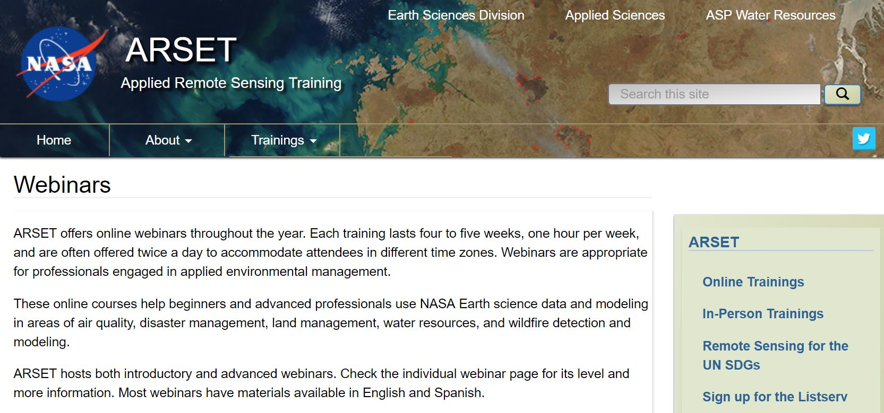
NASA Applied Remote Sensing Training Program (ARSET)
Dr. Ana Prados (NASA Goddard)
Online Courses
Presentations and hands-on guided computer exercises on how to access, interpret, and use NASA satellite images for decision-support
NASA ARSET: https://arset.gsfc.nasa.gov/webinars

Slide 21
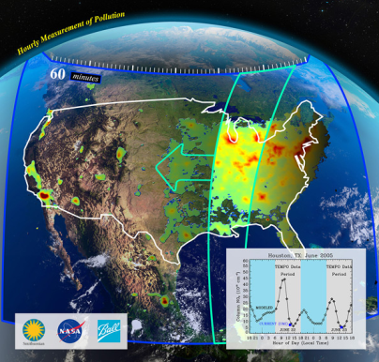
Earth Venture Instrument-1:
Tropospheric Emissions: Monitoring of Pollution (TEMPO)
“Monitoring the air we breathe, hour by hour”
TEMPO is a pathfinder to using hosted commercial payloads from GEO
Tropospheric pollution observations from Geostationary Orbit
  Ozone, NO₂, and CH₂O.
Forms a global Air Quality constellation in GEO with Copernicus Sentinel 4 and Korean GEMS.
The US EPA and NOAA are part of the science team.
Instrument delivered in 2018; Launch 2022
http://tempo.si.edu/overview.html

Slide 22
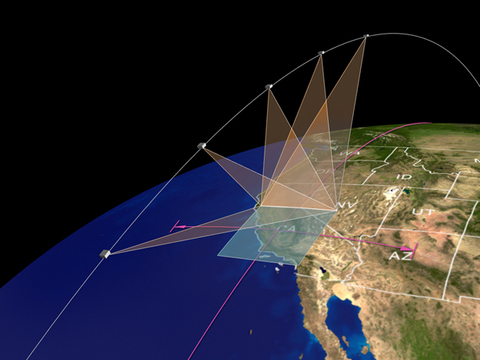
Earth Venture Instrument-3:
Multi-Angle Imager for Aerosols (MAIA)
MAIA represents the first time NASA has partnered with epidemiologists and health organizations on a satellite mission to study human health and improve lives.
Objective: Assess linkages between different airborne particulate matter (PM) types and adverse birth outcomes, cardiovascular and respiratory disease, and premature deaths.
Instrument: Multi-angle spectropolarimetric imaging instrument for operation in a sun-synchronous Earth orbit to measure the particle types, sizes, concentrations, and geolocation of atmospheric aerosols.
Launch expected in 2022.
https://maia.jpl.nasa.gov/

Slide 23
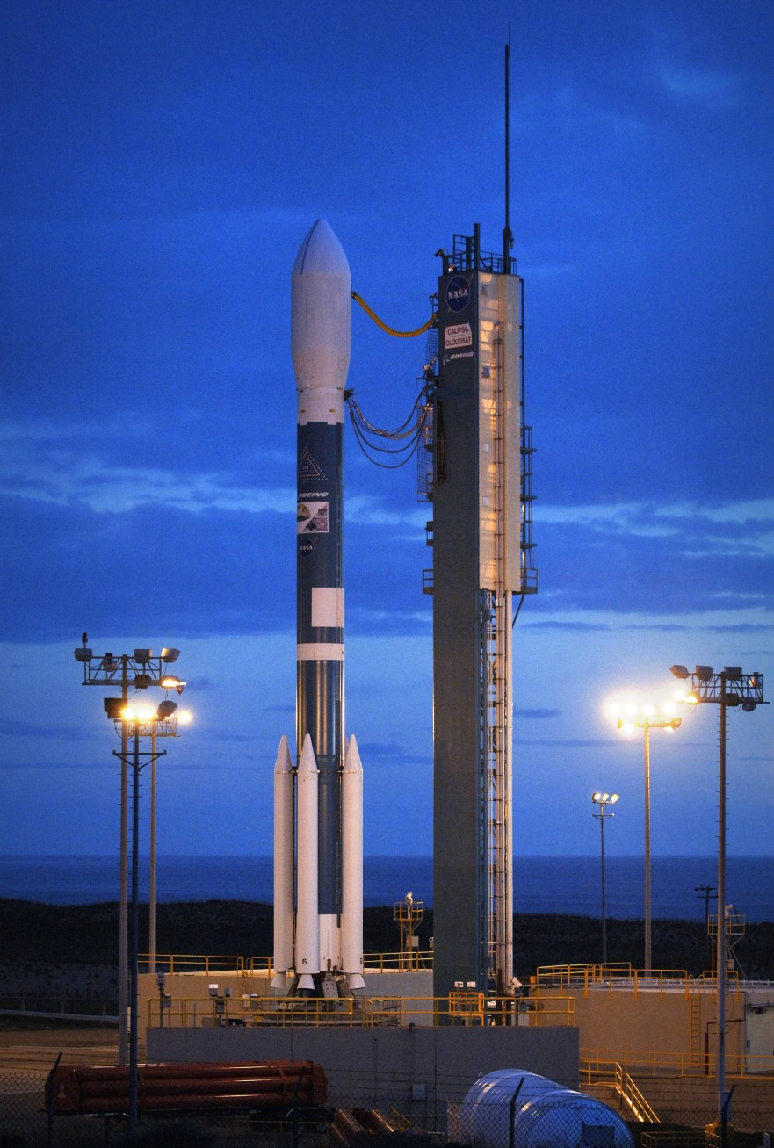
The Cloud-Aerosol Lidar and Infrared Pathfinder Satellite Observation (CALIPSO)
April 28th, 2006 ~ 0200 PST
CALIPSO, a joint mission between NASA and the French space agency, CNES, TO provide new insight into the role that clouds and aerosols (airborne particles) play in regulating Earth's weather, climate, and air quality.
CALIPSO is in its 16th year of a 3 year mission ~ 5+ Lifetimes!!

Slide 24
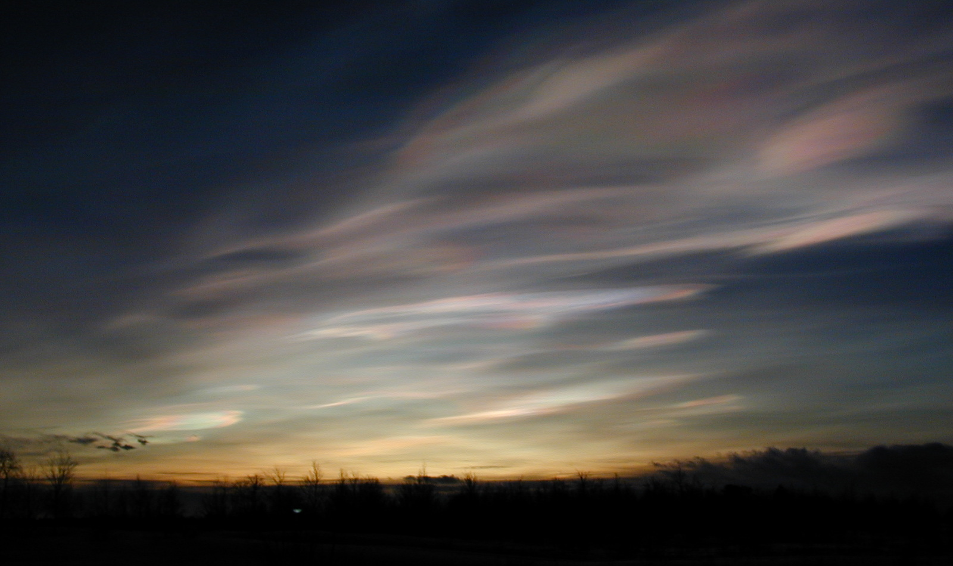
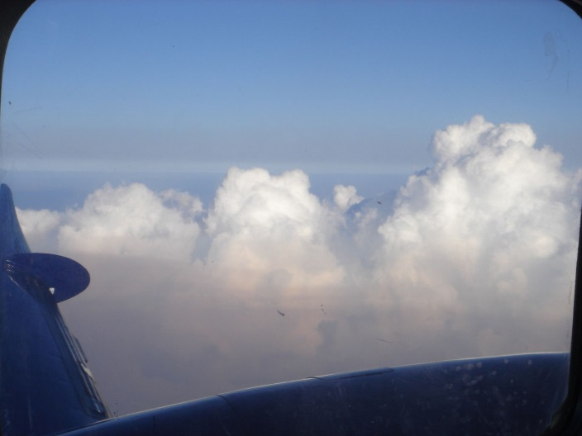
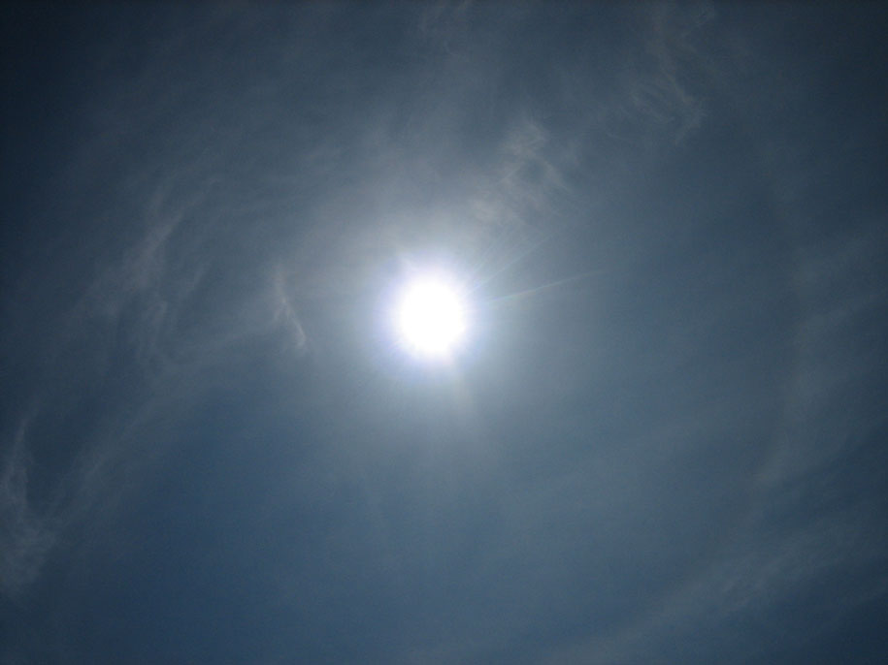


What can CALIPSO ‘see’ ?
Cumulus Embedded in Aerosol
Cirrus Clouds
Polar Stratospheric Clouds
Multi-Level Cloud Decks
Long Range Dust Transport
The retrieval challenge: detect and classify “Features of interest”

Slide 25
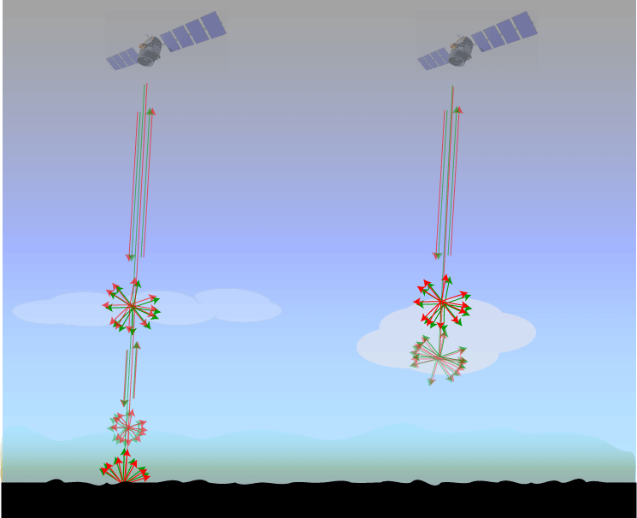
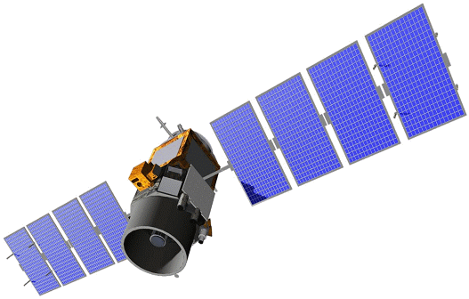


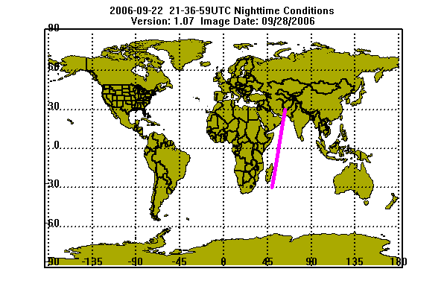
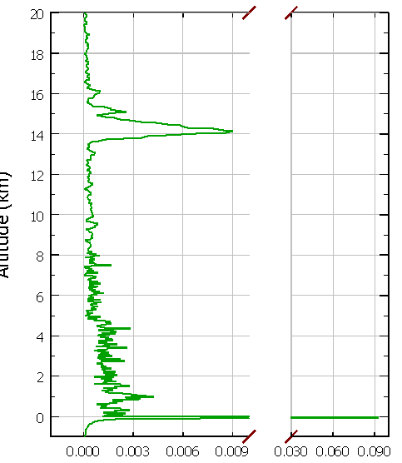
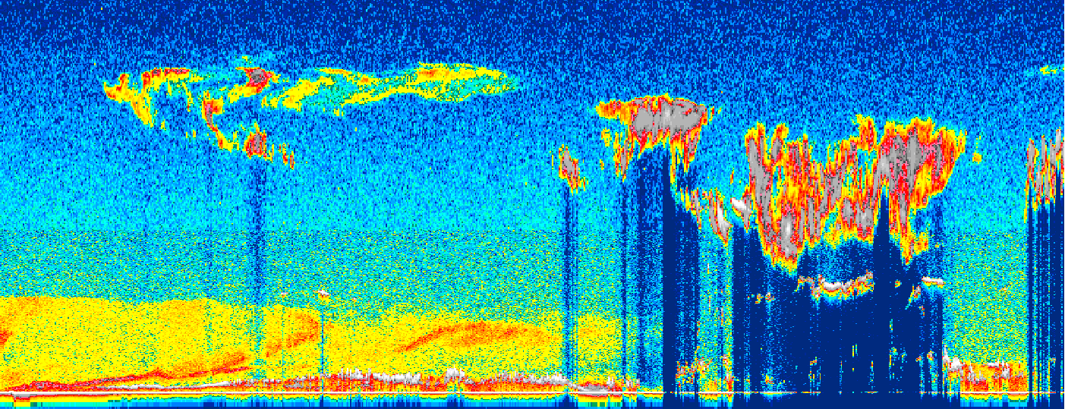
How CALIPSO Detects Clouds and Aerosols in the Earth’s Atmosphere
705 km Altitude
“Clear Air”
Aerosols
Clouds
Cloud
Altitude
Aerosol
Surface
20° N
15° N
10° N
5° N
0°
5° S
Notes:
quote from NASA’s Science Mission Directorate web site (http://science.hq.nasa.gov/earth-sun/science/index.html)
the public face of NASA is space exploration – bright & flashy rocket launches coupled with cool satellites. the “observation” part is well captured by NASA PR; however, the “understanding and modeling” aspects are less well known…

Slide 26
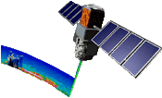
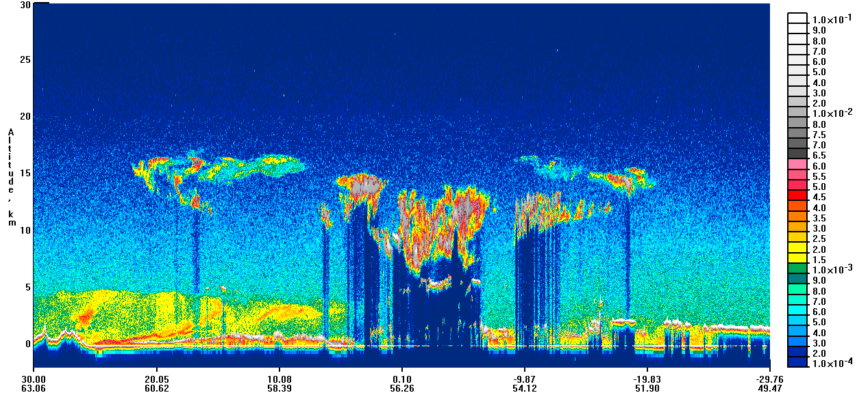
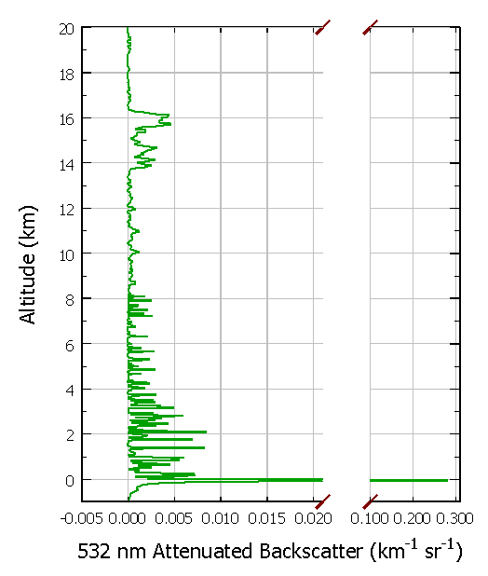
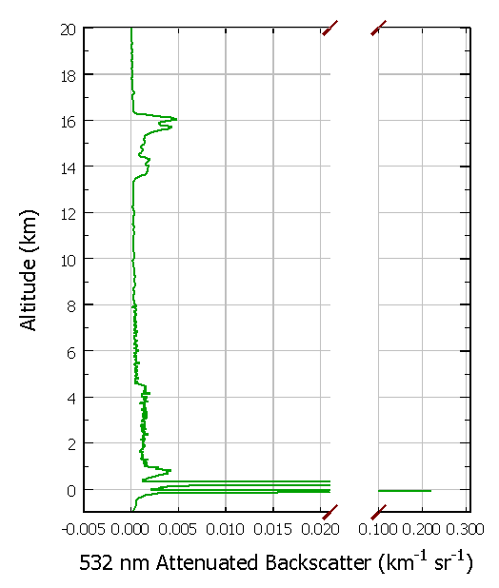
Challenge for Algorithms:
Where is it? How big is it? What is it?
532 nm Total Attenuated Backscatter (km ^{–1} sr ^{–1})
where is it? How big is it
what is it?
Notes:
must be able to identify features whose max backscatter intensity spans several orders of magnitude, from very faint aerosols to very vigorous clouds

Slide 27


Mean Level 3 AOD, August 2007, All-Sky, Night
CALIPSO Level 3 Aerosol Profile Product Overview
Contents of Level 3 Product:
Monthly average, quality-screened
Aerosol extinction profiles
Aerosol optical depth
Contents:
Derived from CALIOP level 2 aerosol extinction
Equal-angle gridded (2°lat x 5°lon)
Near-global coverage (85°S to 85°N)
Resolution:
2° latitude x 5 ° longitude, 85°S to 85°N
60 m vertical, -0.5 to 12 km
Sky conditions:
All-Sky
Cloud-Free
Above Cloud
Combined (cloud-free & above highest cloud)

Slide 28





Aerosol Vertical Feature Mask
532 nm Backscatter
20060812
Cloud Aerosol Discrimination
15-
Aerosol Subtypes
10-
Smoke
5-
Polluted Continental
0-
Marine
Dust
Polluted
Continental
Clean
Continental
Polluted
Dust
Smoke

Slide 29

Sahara Dust Event
Aug 17
Aug 18
Aug 19
Aug 20
Aug 21
Aug 25
Aug 22
5 km
Aug 28
3 km
Aug 23
Liu, Omar et al. 2007

Slide 30




Saharan Dust Transport to the Amazon Rainforest
in Tg
CALIPSO lidar reveals the 3-D characteristics of dust transport across Atlantic Ocean.
We used 2007-2013 CALIPSO data to estimate dust import into and export from Amazon Basin.
27.7 million tons of dust is deposited in the Amazon rainforest annually.
The Saharan dust feeds the Amazon rainforest with an estimated 22,000 tons of phosphorus, replenishing the leak of this plant-essential nutrient by rains and flooding.
in Tg
Yu et al., GRL 2015
Notes:
The finding (Yu et al., GRL 2015) was featured by NASA, which has generated many interests from scientists and news outlets around the world. Most recently the paper was highlighted in AGU EOS’s Research Spotlight.

Slide 31
Transpacific Transport of Asian Dust (April 2010)
GEOS-Chem (Fairlie et al.2007)
Asian dust is transported by westerly winds into the upper troposphere.
Negative pressure anomaly, located in the eastern Pacific Ocean led to complex flow
The main branch of the dust was transported into the Arctic, and looped back into the US Midwest
The southern branch was transported zonally into the western US
The lidar ratios show an evolution of the composition of the dust during transport
0.00 60.0 80.0 100 120 140 160 180 500 2000 [mg/m²]
CALIPSO Nighttime Orbits
7
5
6
8
1
2
4
3
Lidar ratio, Sa < 25 25-30 30-35 35-40 40-45 45-50 50-55 55-60 > 60
Notes:
Frequent dust emissions occurred in northwestern China in April 2010 because of stronger-than average near surface winds. Strong stable westerly winds then carried the dust eastward across the Pacific Ocean. A negative pressure anomaly, located in the eastern Pacific Ocean, hindered the air flow movement and yielded multiple transport pathways. This situation resulted in the complex yet spatially extensive dust structure over the North America. (Uno et. al., ACP, 2011)

