Slide 1
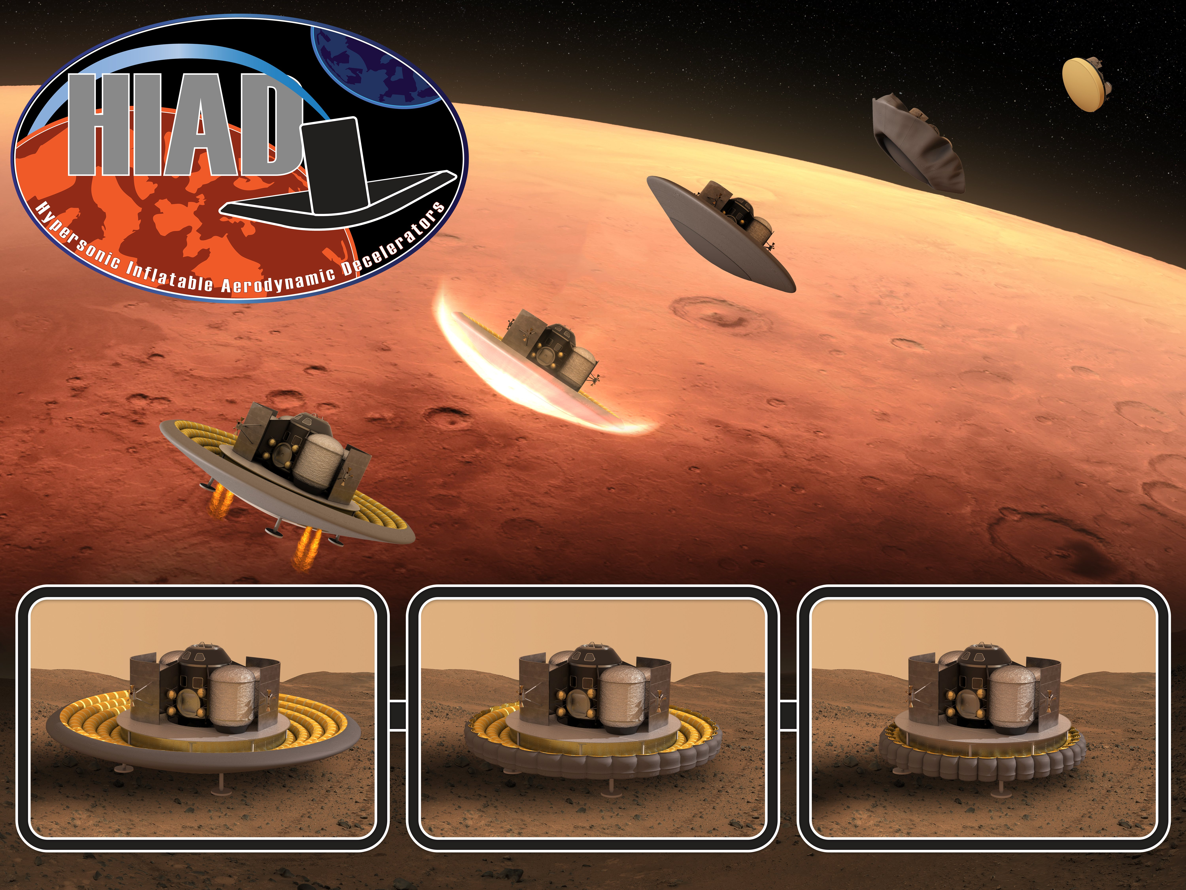
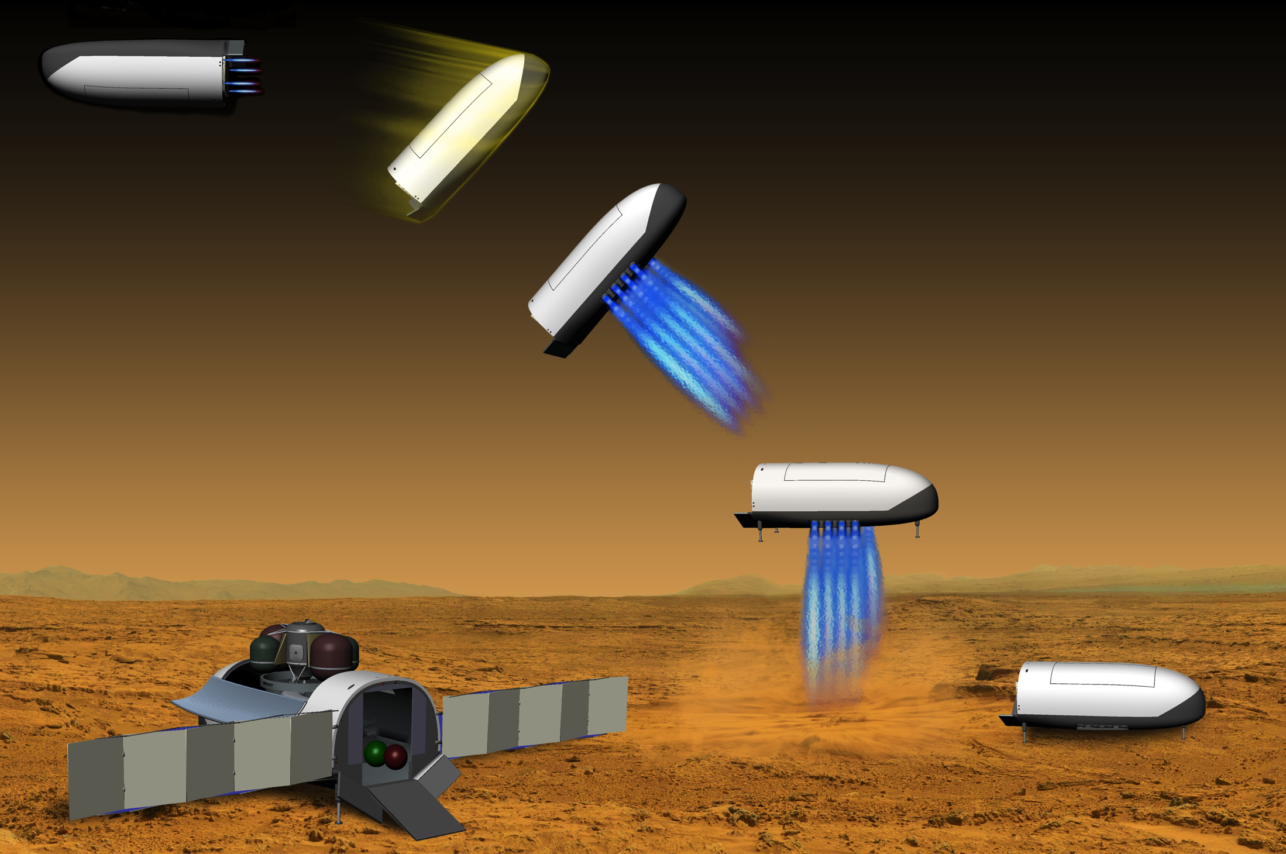
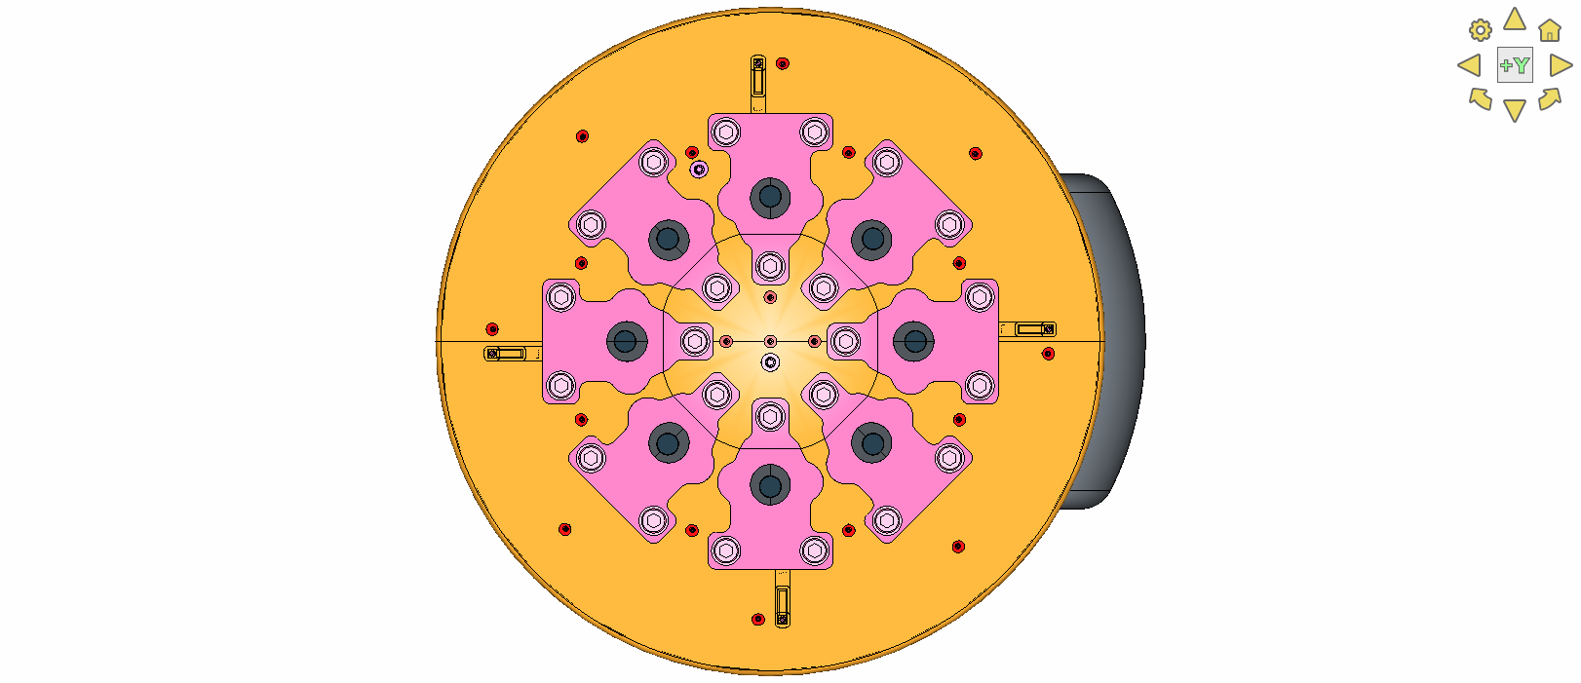
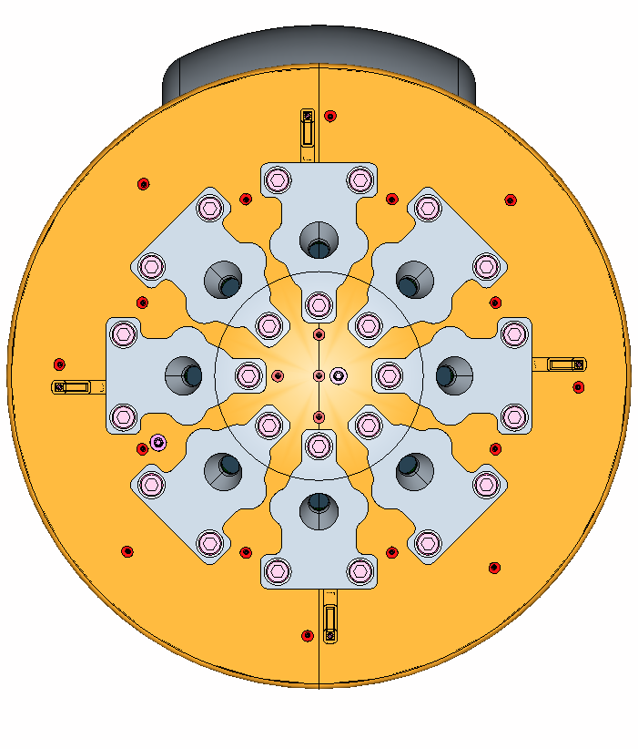
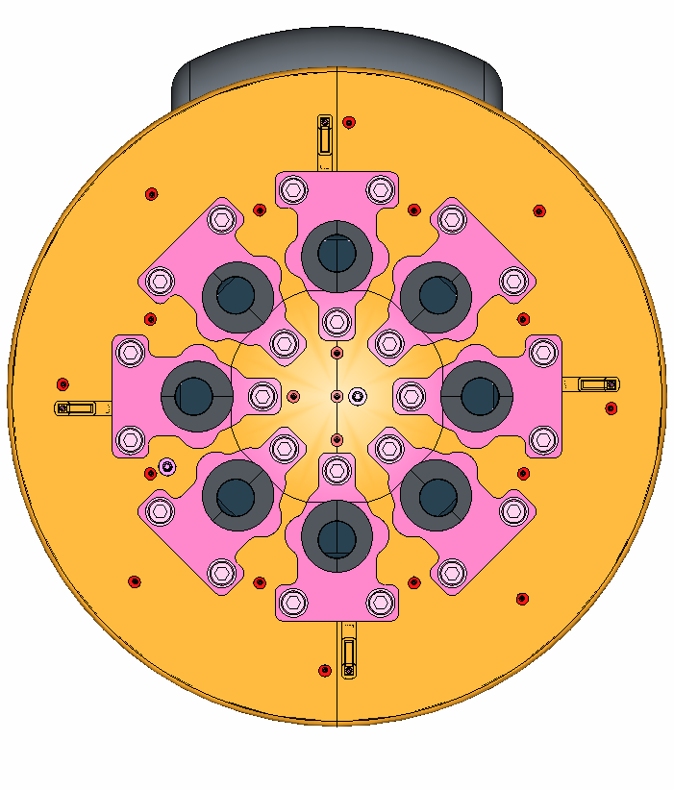

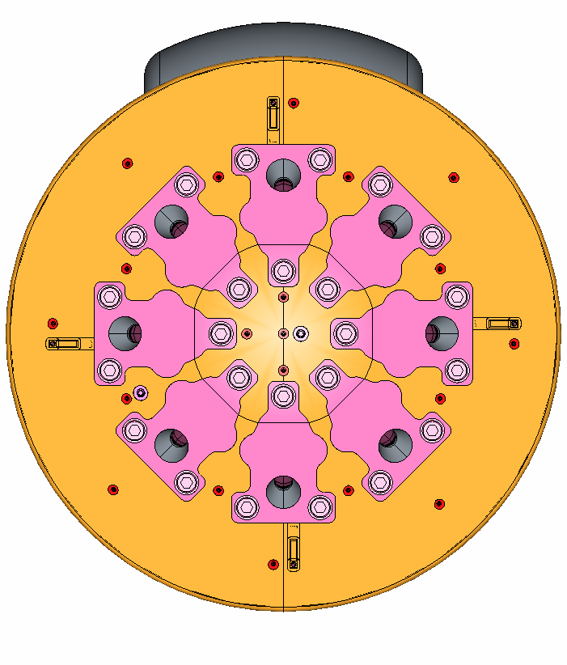
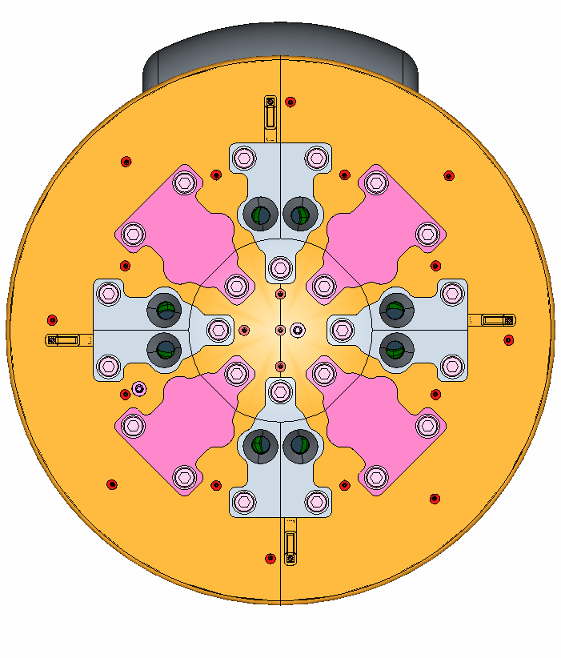
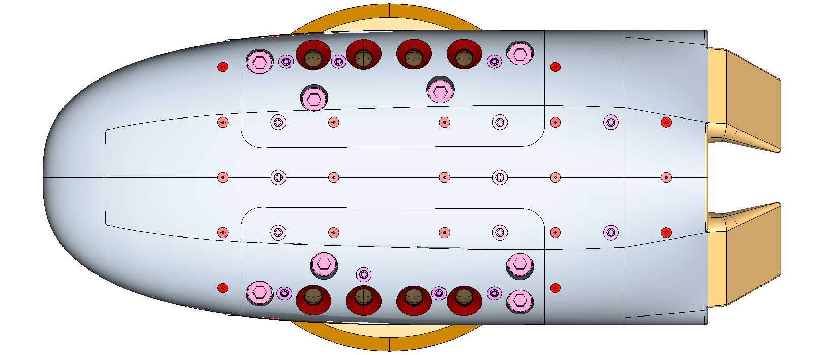
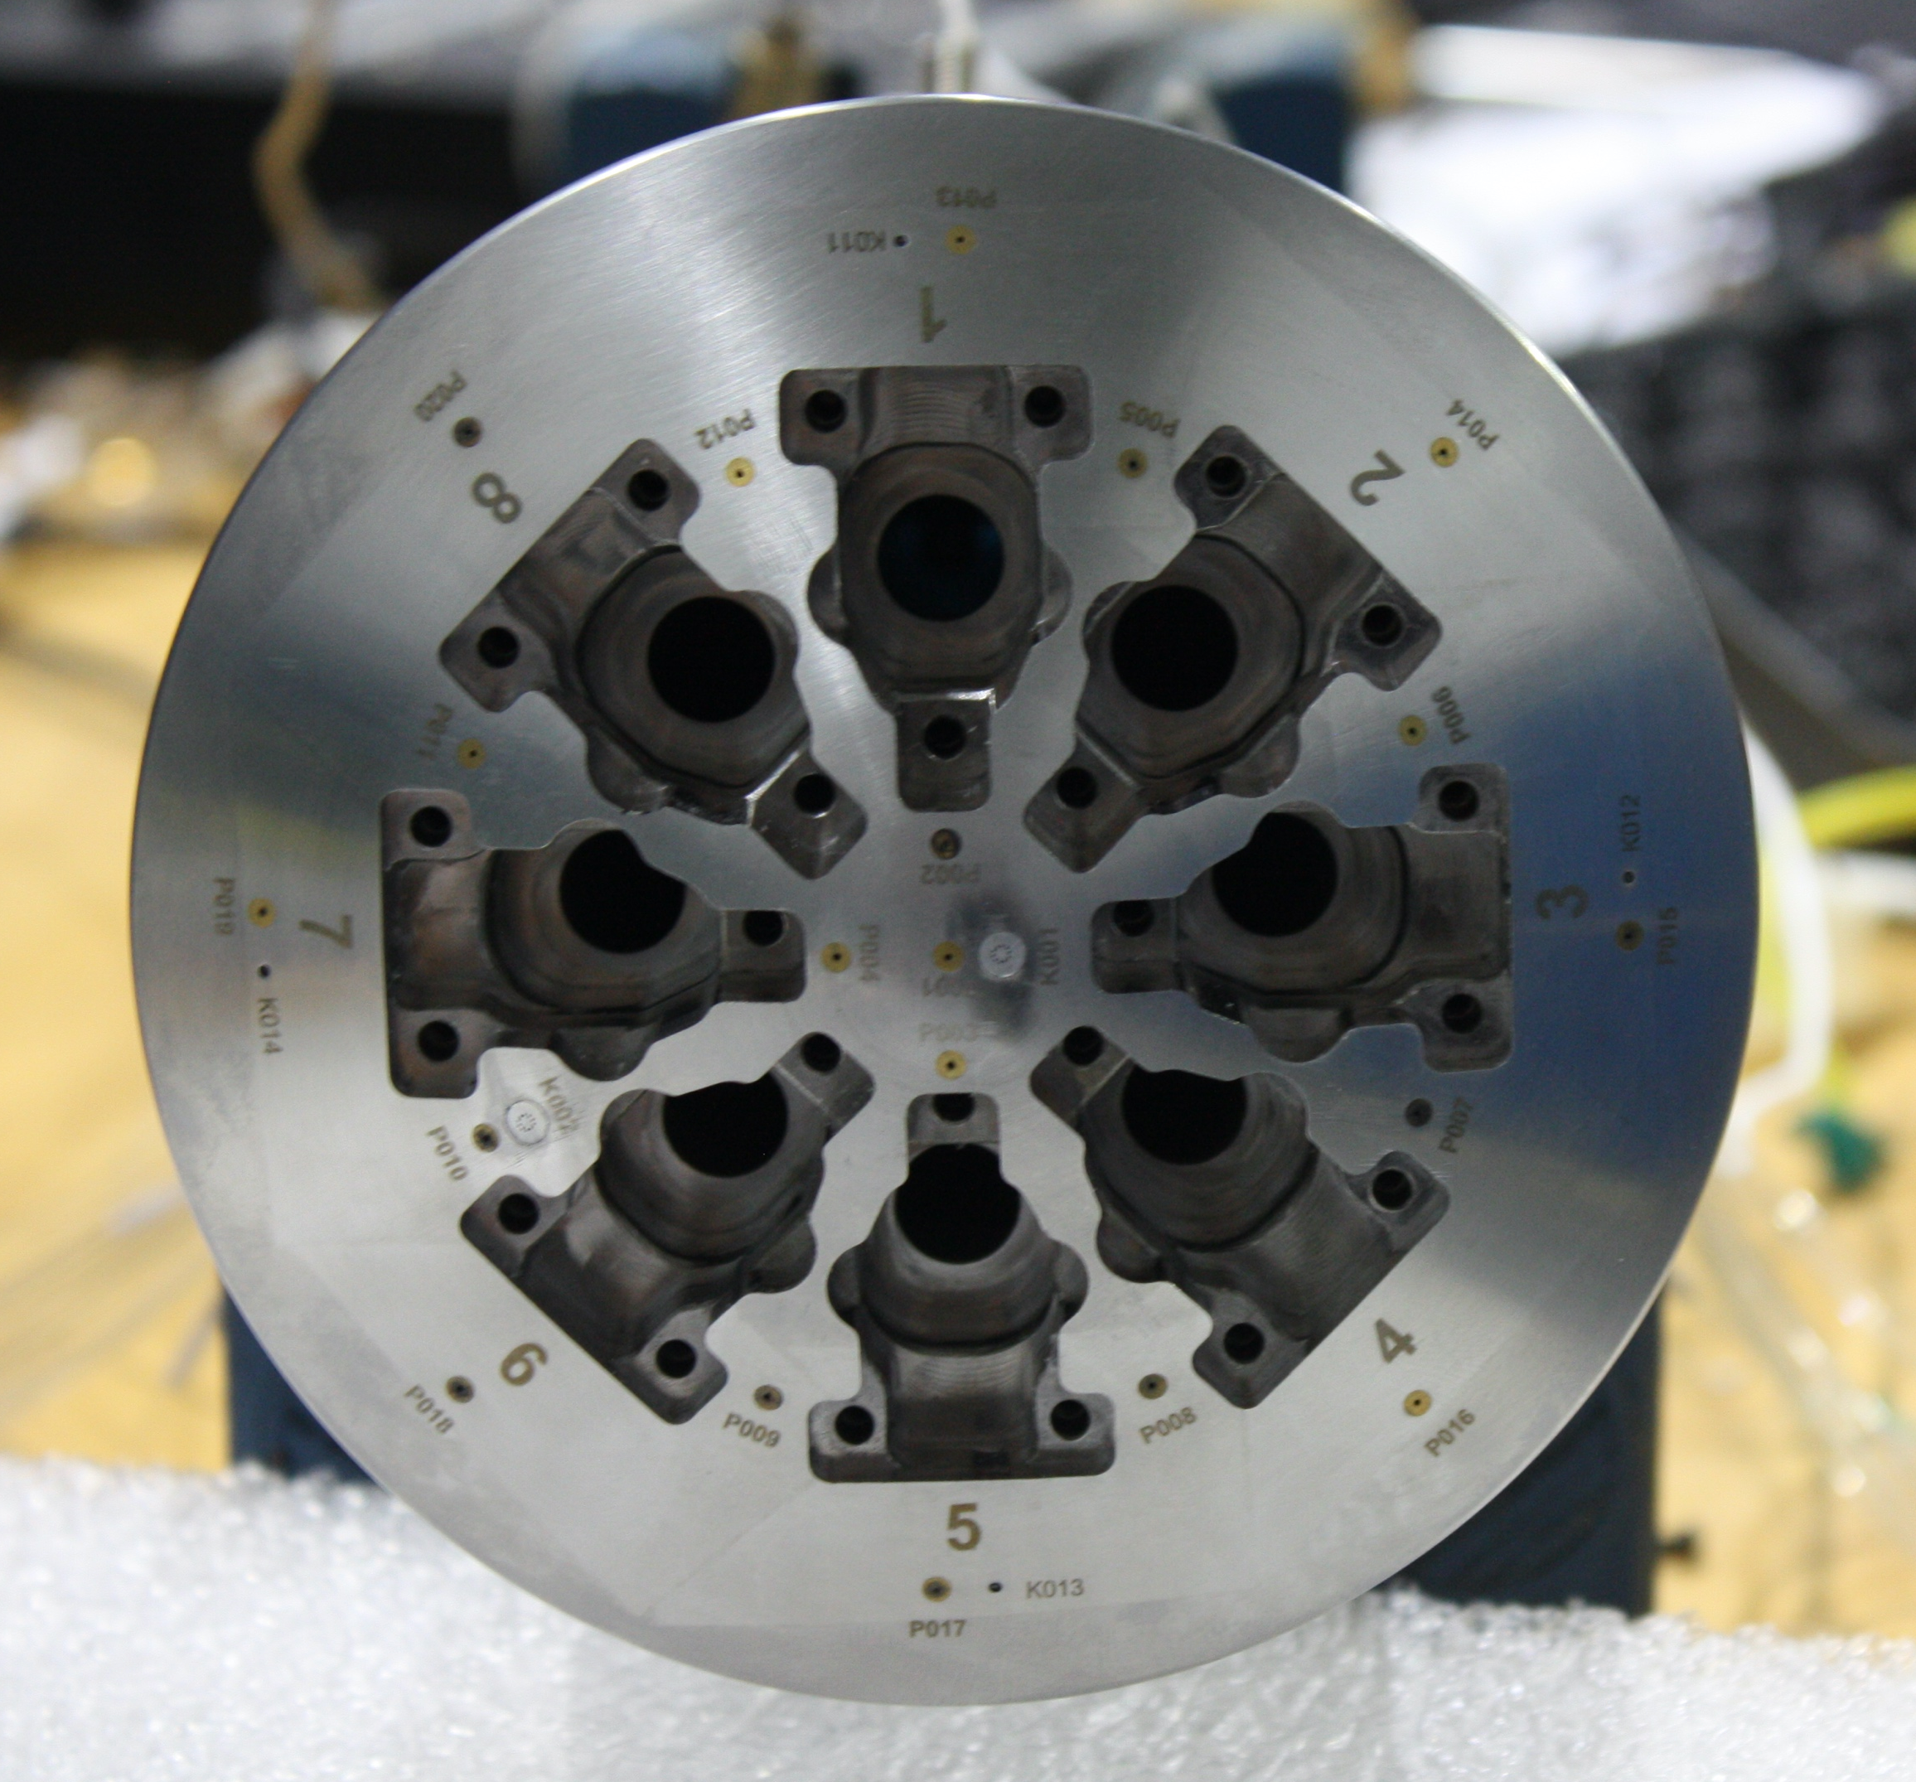
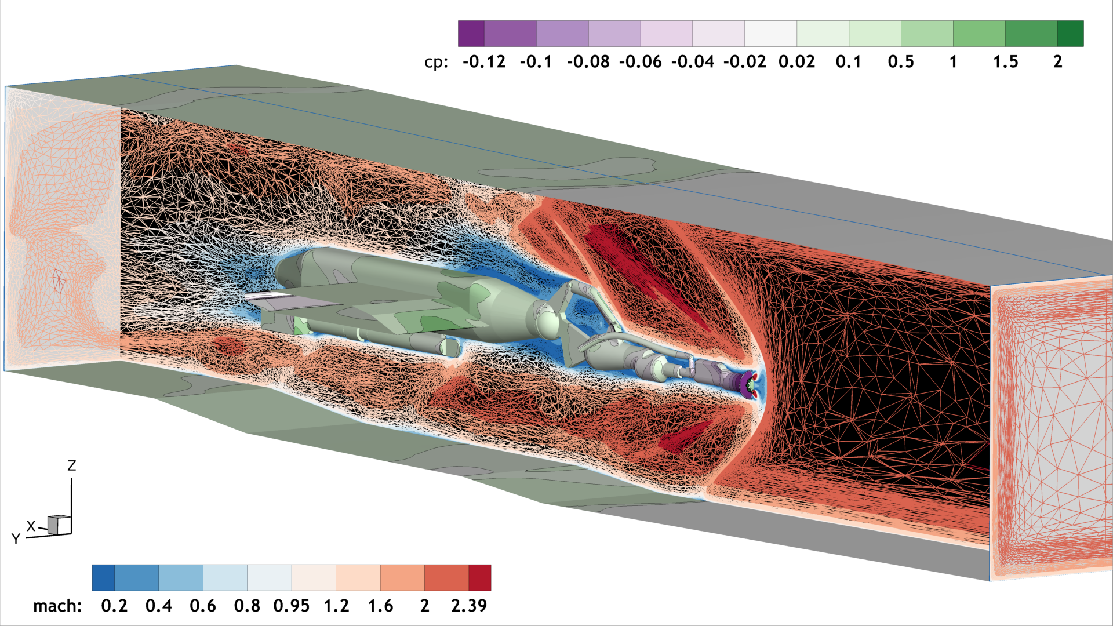
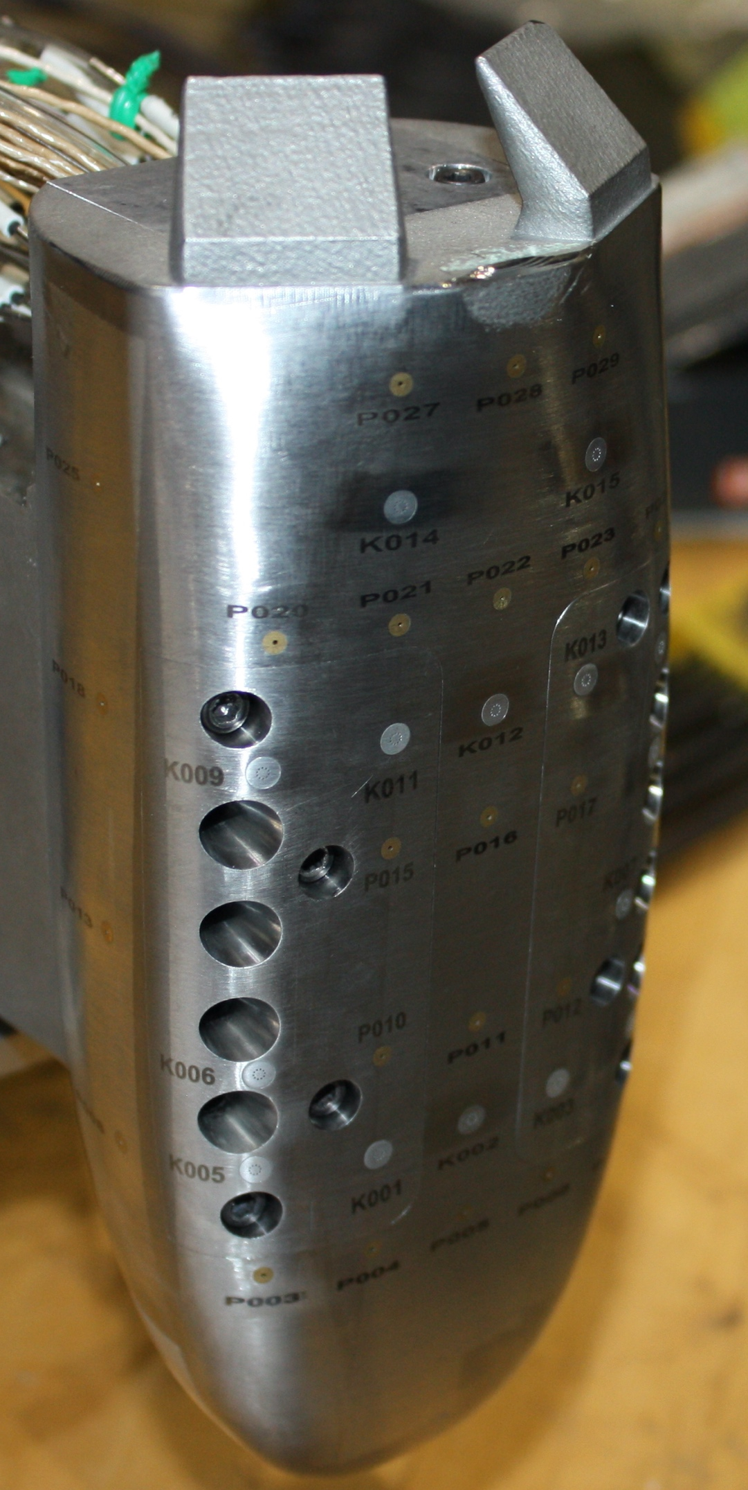
Descent Systems Study (DSS)
Project Overview
Previous NASA studies of landing human-scale payloads on Mars have concluded that supersonic retropropulsion (SRP), or using multiple retrorocket engines beginning at supersonic descent conditions, is an enabling technology. DSS is partnering with the Aerosciences Evaluation and Test Capabilities (AETC) office to conduct a SRP test in the Langley Unitary Plan Wind Tunnel (UPWT) to quantify the SRP prediction capabilities of multiple computational fluid dynamics (CFD) solvers for a range of model configurations, thrust magnitudes, and tunnel conditions.
Technical Approach
AETC funded model design and fabrication in FY20. In FY21, the DSS team has been running high-fidelity CFD simulations at conditions that are to be tested in FY22.
Results/Summary
To date, DSS analysts have completed ~350 high-fidelity CFD solutions for 7 different SRP model configurations and 3 UPWT Mach numbers, covering planned nozzle configurations, nozzle thrust, and model attitude
a
b
c
d
f
e
a. HIAD and b. COBRA flight concepts
c. Wind tunnel model configurations
d. HIAD model heatshield with nozzle inserts
e. COBRA model with nozzles
f. FUN3D CFD solution with HIAD model, model support hardware, and tunnel walls.

Slide 2
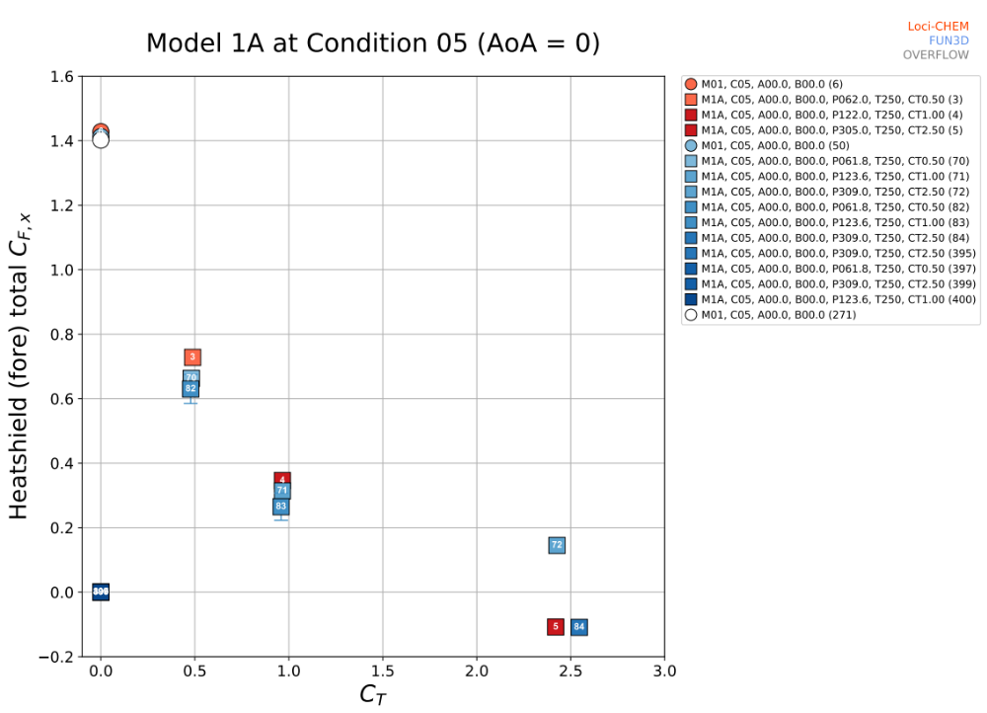
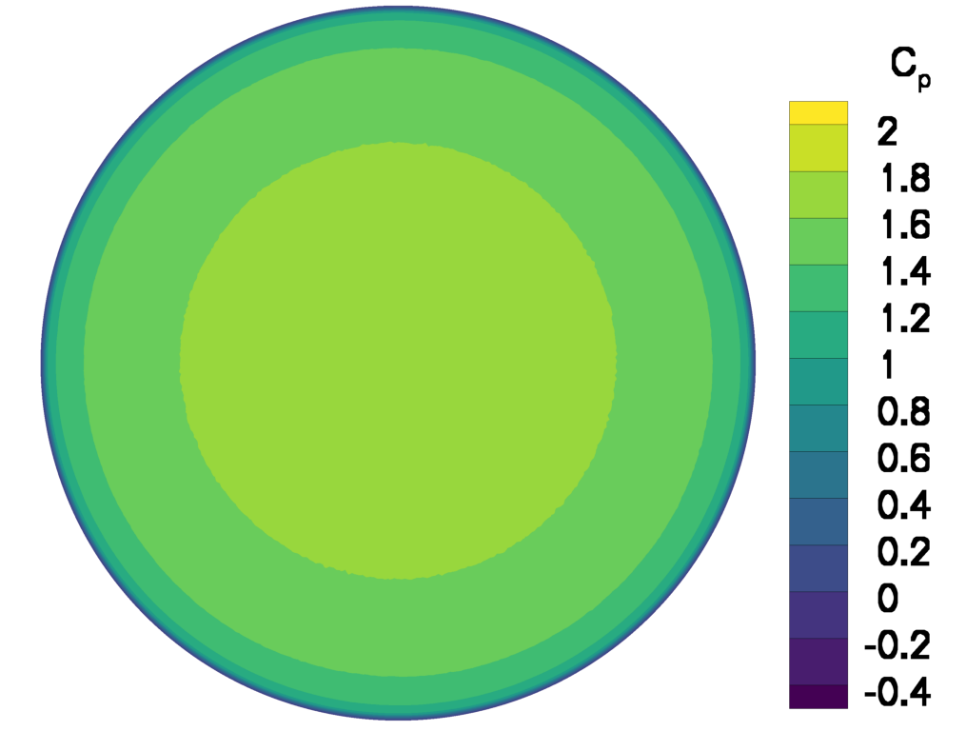
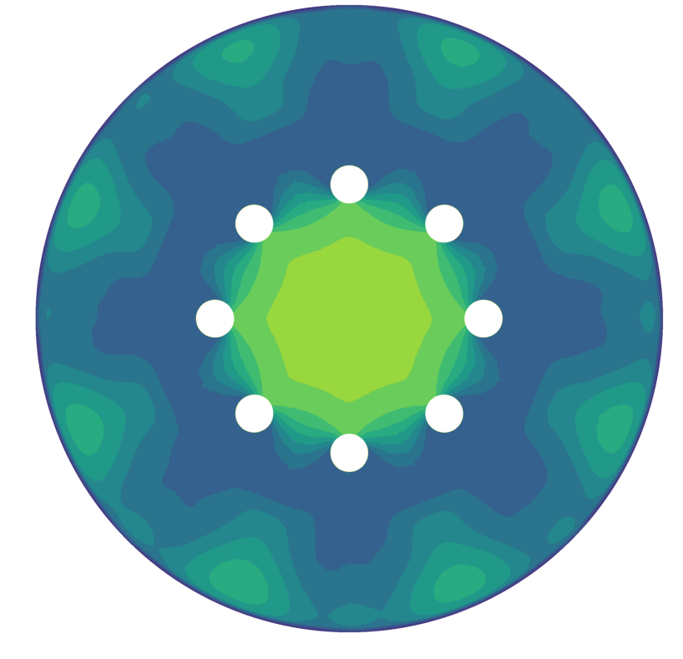
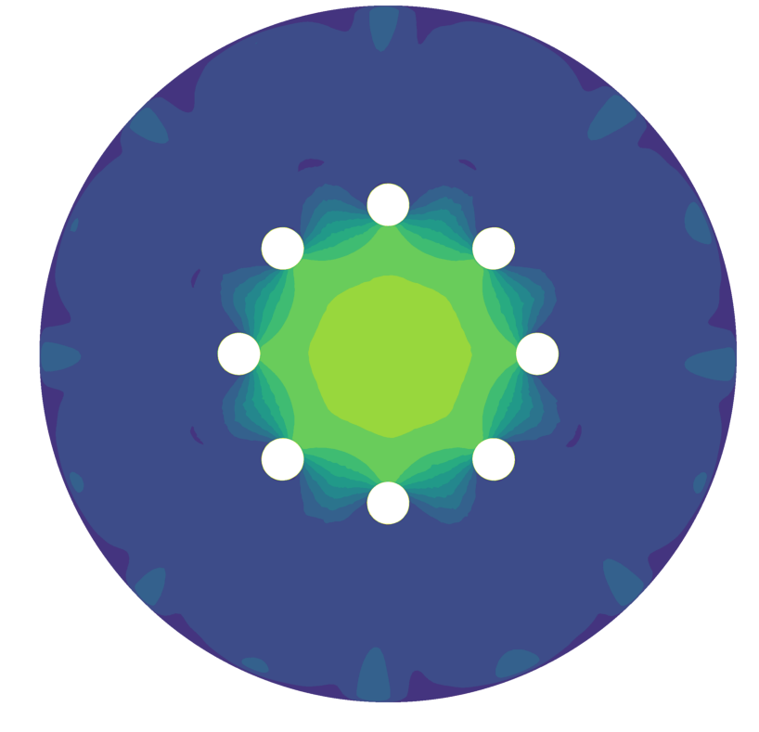
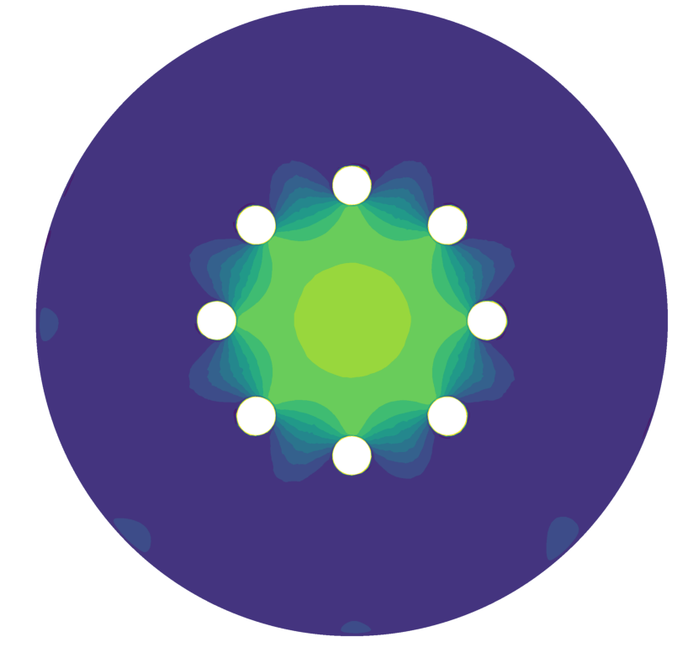
a
b
Contributing Partners
The AETC’s ”CFD as Surrogate for High Supersonic Wind Tunnel Testing” project funded the model design and fabrication in FY20, will fund the tunnel test time in FY22, and will deliver all data to DSS in FY22 for comparison to CFD analysis.
Infusion and Transition Plan
The DSS analysis of the SRP test will result in Uncertainty Quantification (UQ) of high-fidelity CFD solvers for SRP flowfields in a wind tunnel environment. The information will be used to:
Establish best practices for modeling SRP flowfields for three CFD solvers (FUN3D, OVERFLOW, Loci-CHEM)
Inform the planning of future wind tunnel tests with improved testing and measurement methods
Compare the total required resources required to execute the wind tunnel test and the CFD simulations
Form the basis for uncertainty estimation of CFD methods at Mars flight conditions
Results from 3
different CFD codes
Increasing aerodynamic drag
Increasing thrust
c
a. HIAD model 1A with 8 blowing nozzles
b. CFD prediction of thrust + aerodynamic axial force coefficient vs. non-dimensional axial thrust
c. CFD prediction of surface pressure with increasing thrust

