Slide 1

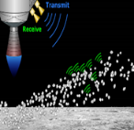
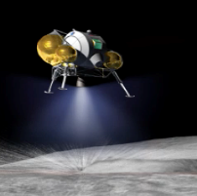
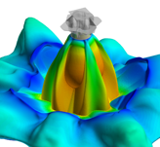
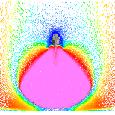
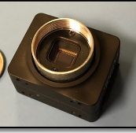
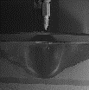
Plume Surface Interaction: Surface Excavation and Construction Impacts
Michelle M. Munk | EDL System Capability Lead | 08.20.21
1

Slide 2
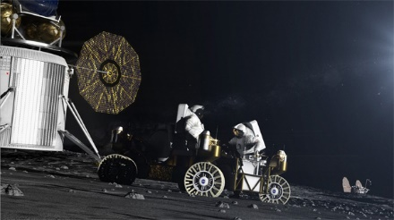
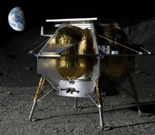
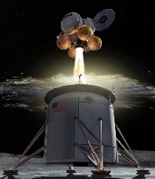
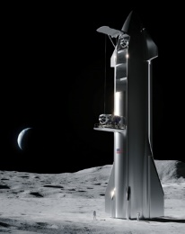
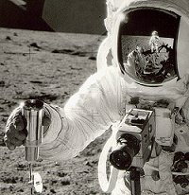
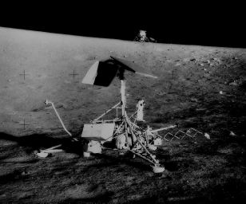
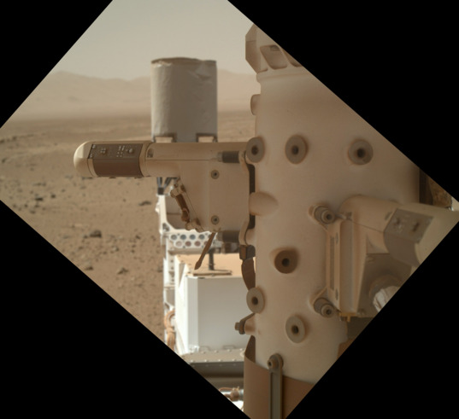
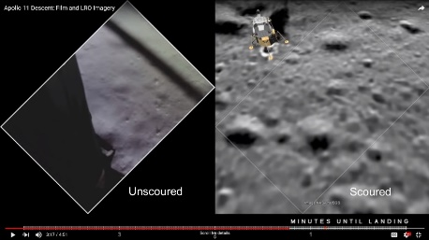
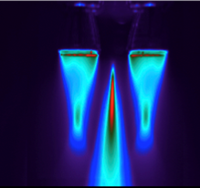
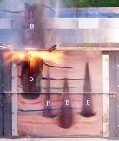
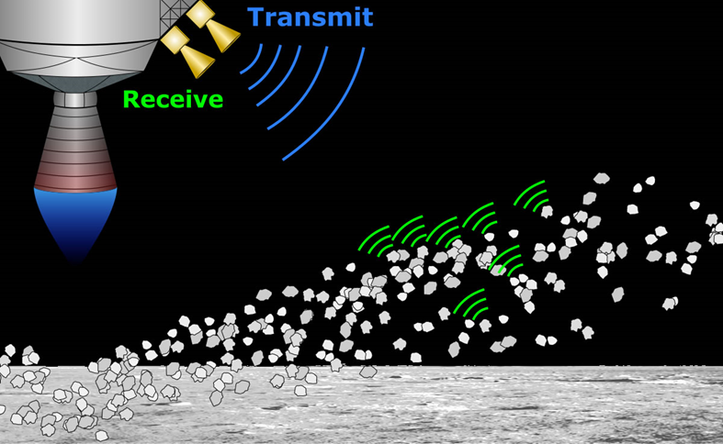
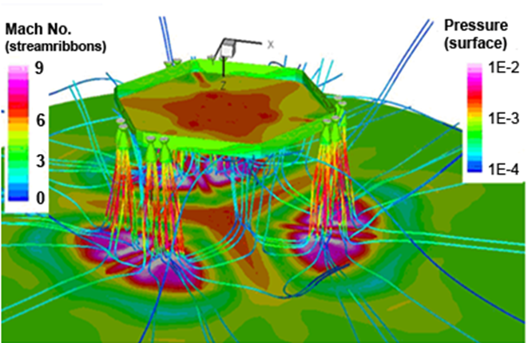
Lunar Lander Plumes are a Significant Source of Dust
Challenge: Lunar dust is a significant obstacle to achieving a sustainable human presence on the Moon, and lunar landers will be a major source of dust transport across the lunar surface.
Descent & Landing of Lunar Landers → Plume-Induced Cratering and Ejecta Particles
Impact Hazards for CLPS_landers, HLS LE/AE, and Gateway
Dust Mitigation Strategies
Lunar Surface Ops
(Inspection & Removal)
Chart Credit: Jim Mantovani, KSC
Understand
Previous studies of PSI effects relied on data from Apollo 12/Surveyor 3, analog Apollo video/images, and indirect evidence of damage (Curiosity)
Ejecta Plume Erosion Lander Environment

Slide 3
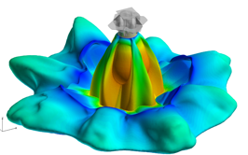
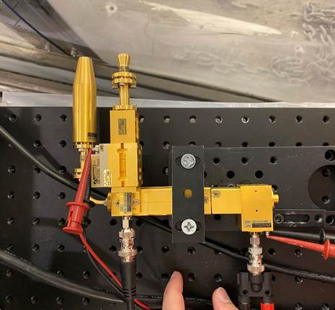
Plume Surface Interaction Project Overview
OBJECTIVE: Provide tools and data to better predict environments created by the impingement of descent thruster rocket plumes on planetary bodies, enabling improved design and risk analysis of landing vehicles and surface assets.
Partners:
MSFC (Lead)
LaRC
KSC
GRC
JPL
Johns Hopkins University, University of Michigan, University of Central Florida, University of California – Davis, Mississippi State University, Stevens Institute of Technology
Customers:
Space Technology (Game Changing Development Program)
Science (CLPS, Mars, other bodies)
Human Exploration and Operations (Human Landing System, Human Mars)
Commercial entities
International partners/coordination bodies
1
Predictive Simulation Capability
2
Ground Tests
3
Flight Instrumentation
Notes:
Add note to funding profile, additional resources requested in PPBE 23 cycle to cover LSGT

Slide 4
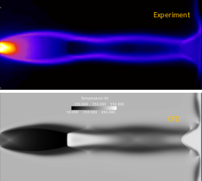
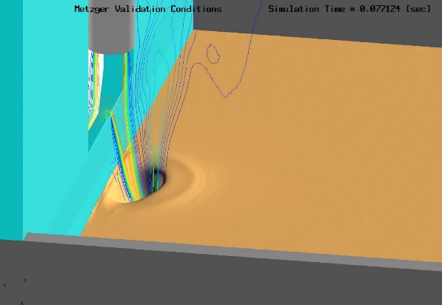
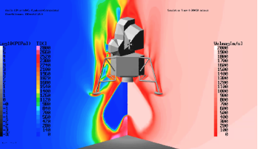
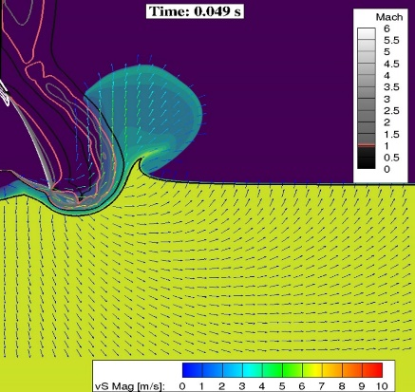
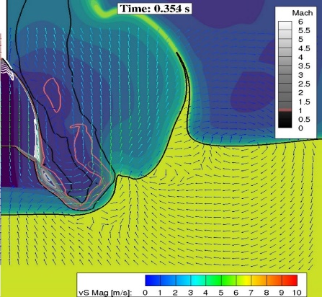
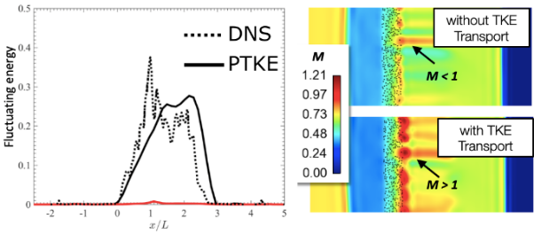
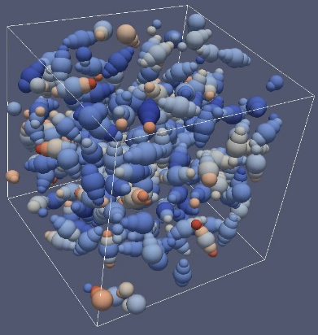
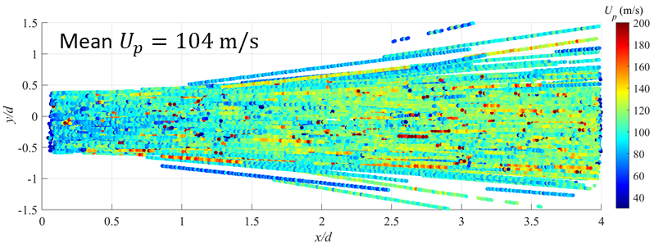
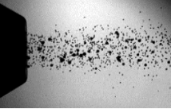
Predictive Simulation Capability Approach
Task 1: Plume Flow in Low-Pressure Environment
Task 2: Effect of Mixed Continuum/Rarefied Flow on Crater
Development and Ejecta Sheets
Lunar vacuum and Mars low pressure environments require mixed continuum-rarefied flow simulation capabilities.
Production CFD code has mixed continuum-rarefied (NS/Boltzmann) flow solver capability implemented; however, it has not yet been validated.
Strong dependence of plume induced crater size on flow rarefaction effects with first-order effect on ejecta streams and crater size/shape formation for Lunar environment.
Prediction simulation tool capability is advanced and validated against existing data and new PSI data.
Delivers a functional and validated mixed continuum/rarefied PSI simulation capability that accurately captures crater formation and ejecta transport.
JPL Research code is implementing a rarefied (DSMC) solver.
Plume simulations are progressively validated against existing data and PSI ground test data.
Task 3: Regolith Particle Phase Modeling
Task 4: Gas-Particle Interaction Modeling
Regolith particle phase modeling requires resolving complexities particular to extraterrestrial regolith surface material composition.
Erosion process and crater shape for Lunar regolith demonstrated to be strongly driven by two factors: irregular particle shapes and poly-disperse particle size mixture.
Particle phase models will be implemented into predictive simulation tools and matured.
Predictive simulation tools will be validated against data from PSC Task 2 and new ground test data.
Large uncertainties exist in gas-particle interactions models implemented in current simulation tools.
The suitability and accuracy of incompressible modeling formulations on modeling the compressible plume-induced erosion must be addressed; a model for gas-particle cloud kinetics has not been found.
Accurate gas particle interaction modeling is required for lunar environments and will be implemented through unit physics experiments and development of gas-particle interaction models.
Chart Credit: ER42 Team, MSFC
Notes:
LSGT will directly increase fidelity and directly support validation efforts for all four of these tasks, all of which together are required to have a validated, quantitative PSI predictive capability for lunar environments. SBIRs have been invaluable in funding all four of these tasks in the near term.

Slide 5
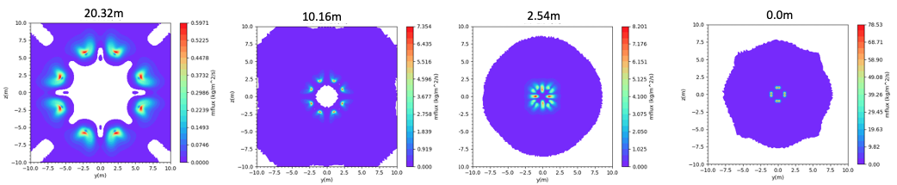
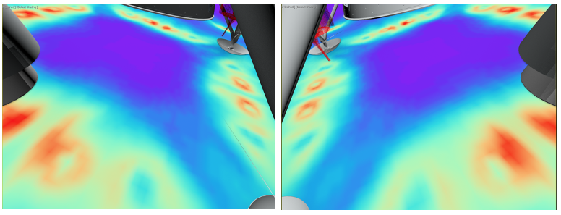
Erosion Predictions for CLPS Instrumentation
Firefly Blue Ghost Erosion Predictions with Altitude (updated from Lane and Metzger Apollo correlation):
Analysis by ER42, MSFC
SCALPSS Camera FOV
and
expected surface erosion
under Firefly Blue Ghost Lander
Analysis by Olivia Tyrrell, LaRC
Predictions will (hopefully) be confirmed by flight observations and validated with ground test data!

Slide 6
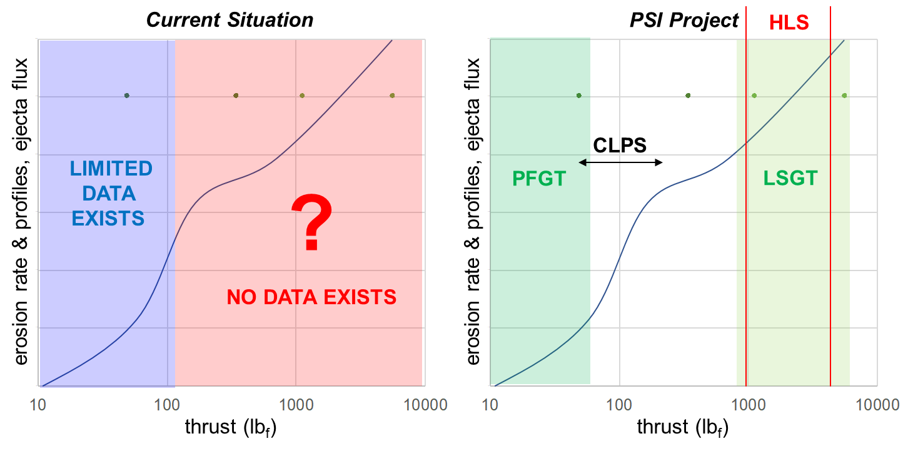
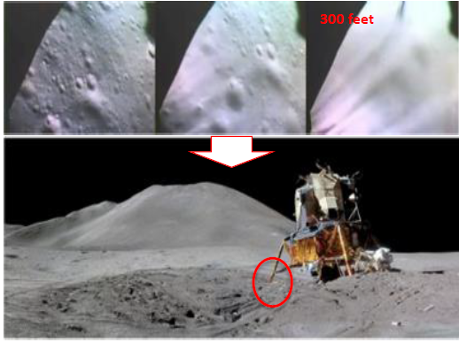
State of PSI Validation Data
Inadequate test data and validated modeling → large technical gaps in understanding landing environments
Computational results are largely qualitative, at present
Past Observations
Physics
Focused
Ground
Test
Large
Scale
Ground
Test
Chart Credit: Manish Mehta, MSFC
Notes:
Verbalize that

Slide 7
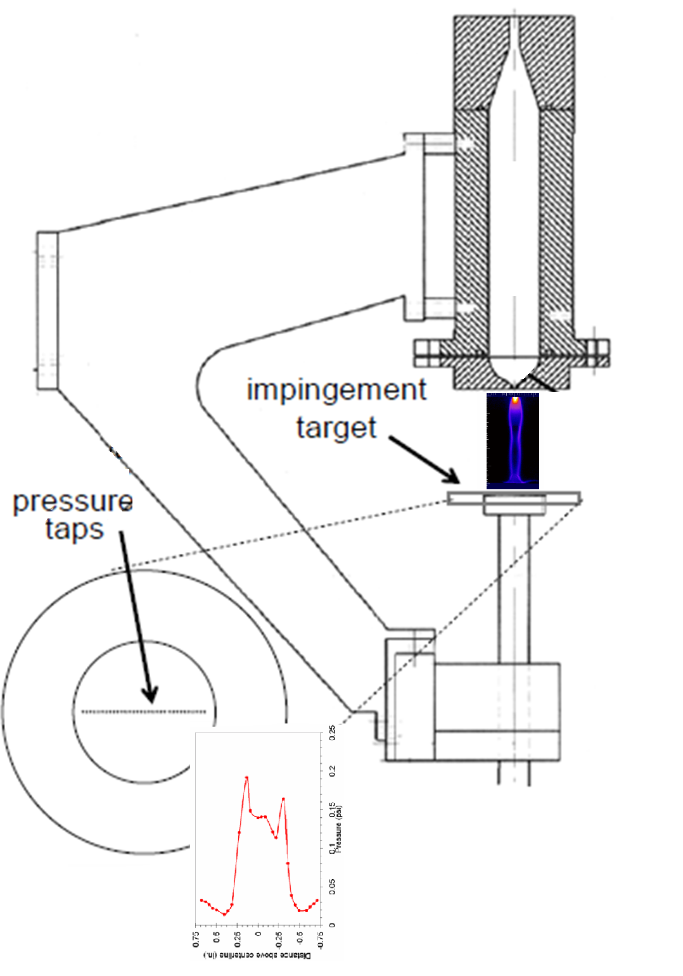
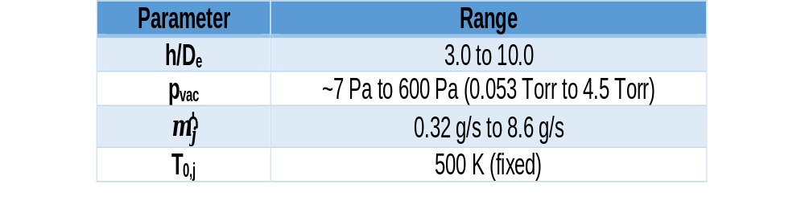
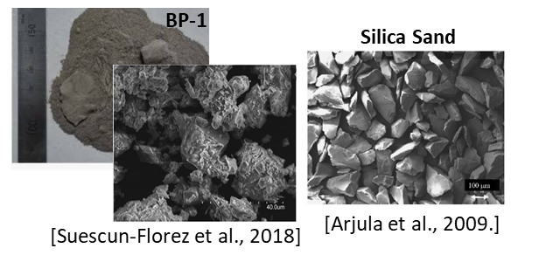
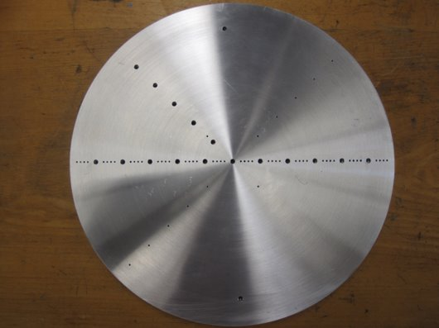
PFGT Objectives
Overall: Measure PSI cratering by collecting data for validating predictive capabilities and to inform future tests at larger scales and more relevant exhaust plume conditions. Using MSFC Test Stand 300 15’ chamber.
Test Series | Basic Description
Cratering | GN₂, split plume, vary quasi-steady flow/vacuum/altitude/regolith, HS/UHS imagery for crater growth and ejecta
Impingement | GN₂, split plume, vary quasi-steady flow/vacuum/altitude, surface pressure distribution
Supersonic Cratering (PFGT1)
To measure crater formation due to supersonic PSI at ambient atmosphere conditions ranging from Martian to those approaching the Moon.
Visual data will capture the temporal growth characteristics of crater formation and the behavior of ejecta, and sub-surface pressures will be measured within the regolith bed.
Supersonic Plume Structure/Impingement (PFGT2)
To visualize supersonic plume structure and to measure impingement pressures at reduced atmospheric conditions in the lunar range.
Data will be collected using an instrumented impingement plate to quantify gas phase boundary conditions with the same experimental setup used for the cratering and ejecta runs.
±10%
Chart Credit: Chad Eberhart, MSFC

Slide 8
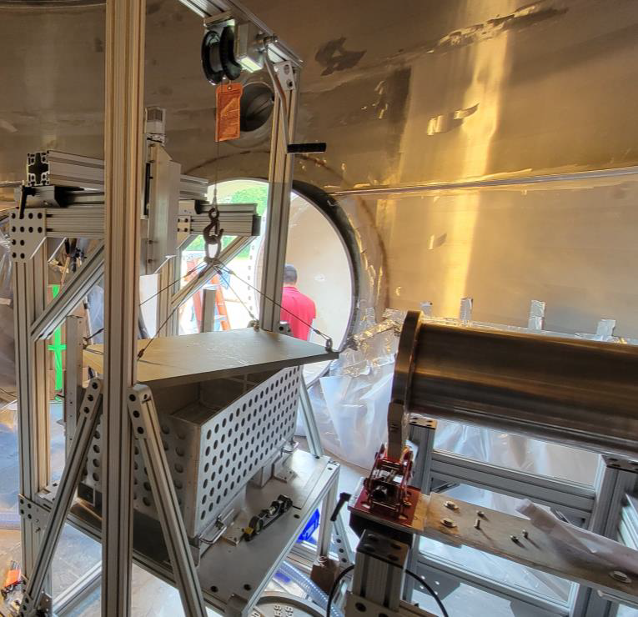
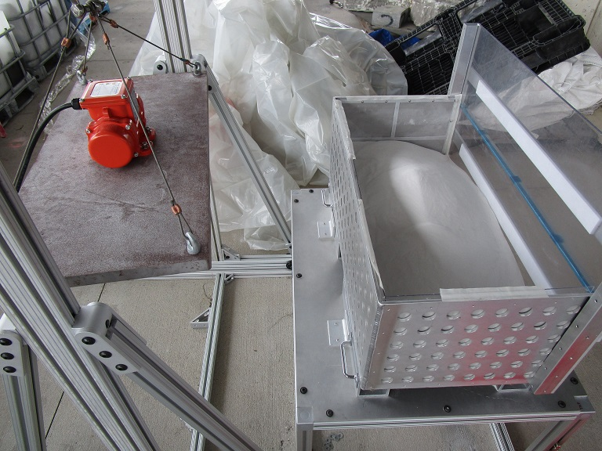
PFGT1 Simulants and Soil Bin
Simulant | Characteristics
Mono-disperse Sand | Silica 125-177 μm
Bi-disperse Sand | Silica; 50/50 45-53 μm 125-177 μm
Irregular | BP-1 212-350 μm
Tri-Disperse Mixture | Silica + BP-1
Full-Range Lunar | BP-1
Mono-disperse Spheres | Soda Lime 125-177 μm
PFGT soil bin setup at KSC (above) and later at MSFC (left).
Chart Credit: Jim Mantovani, KSC and Chad Eberhart, MSFC

Slide 9
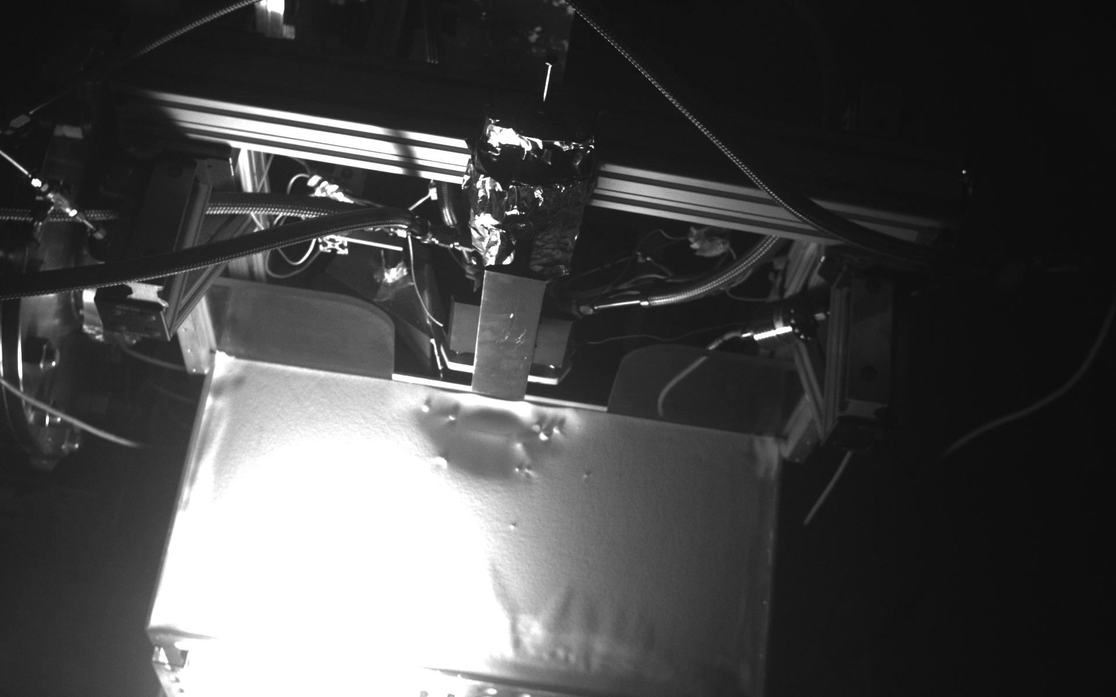
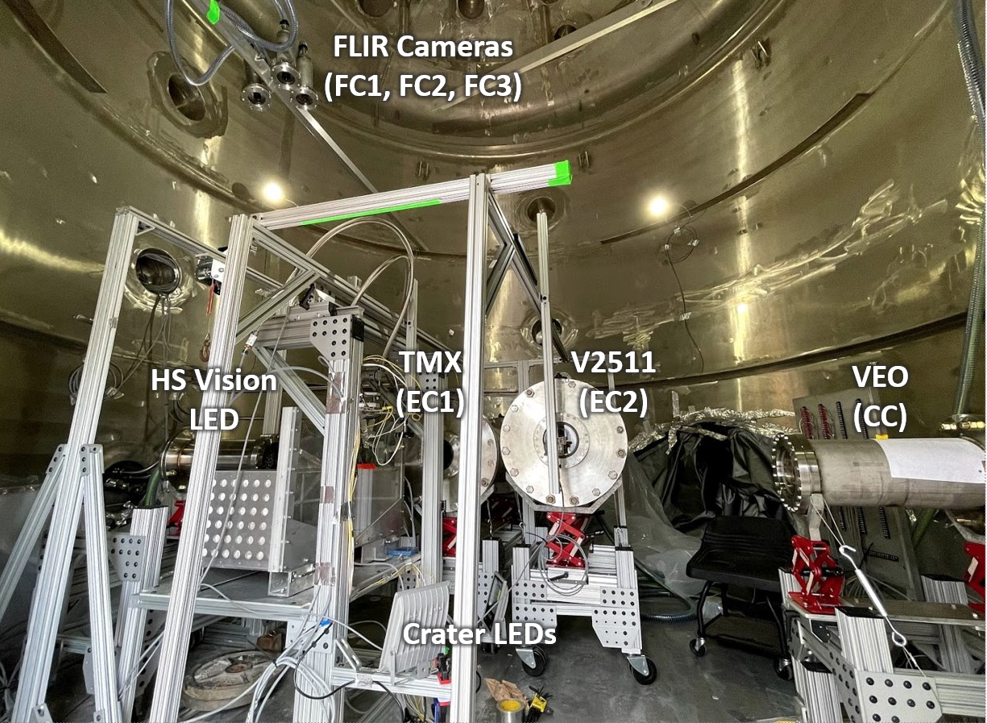
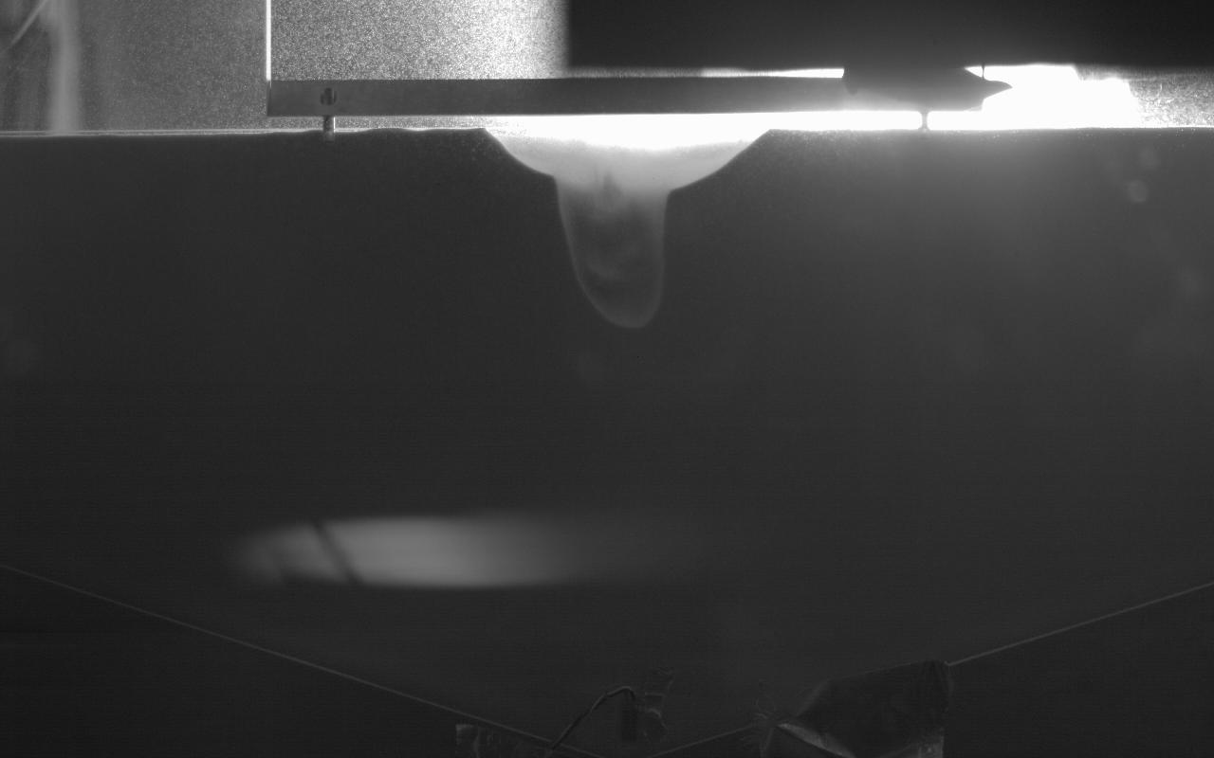


PFGT1 has Extensive Diagnostics
Photo credit: Johns Hopkins team

Slide 10
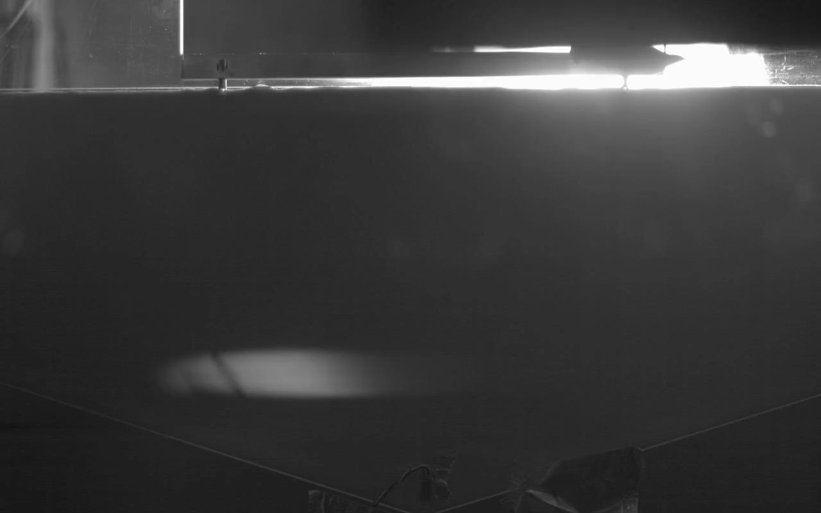
“Deep” Crater Formation in Sand
July 28 Test

Slide 11
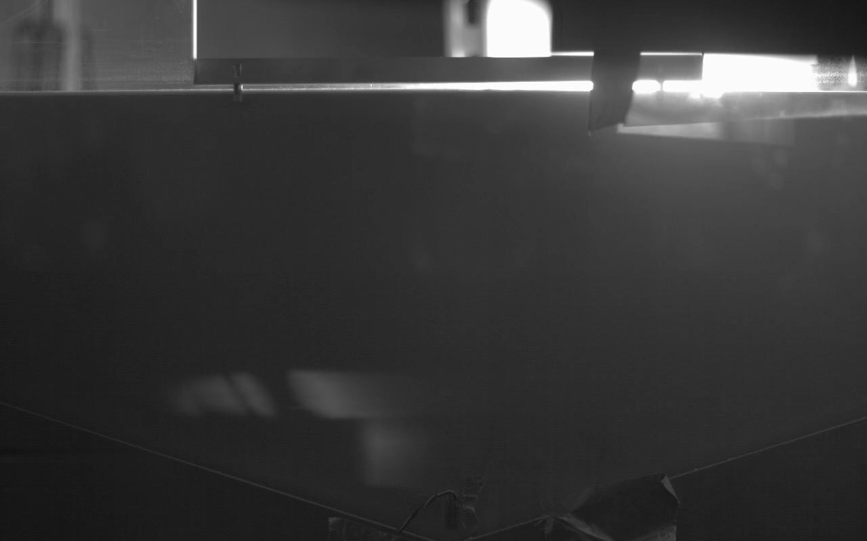
“Annular” Crater Formation in Sand
August 4 Test

Slide 12
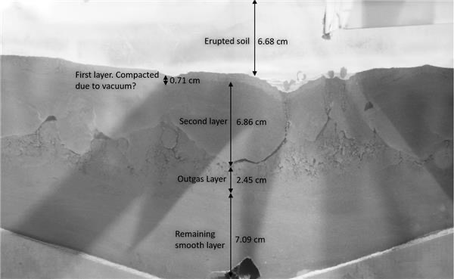
Next-Level Analysis of Soil Mechanics
August 13 BP-1 Test

Slide 13
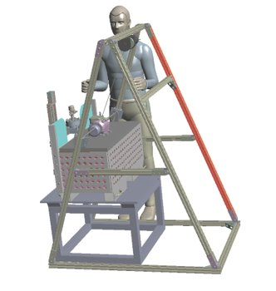
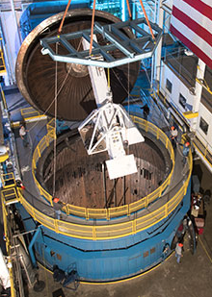
PSI Project – Overall Schedule
 | FY21 |  | FY22 |  | FY23 |  | FY24 |  | FY25
PSI Physics-Focused Ground Test (PFGT)
TRL 3
TRL 4
TRL 5
TRL 6
TRL 7
TRL 8
PFGT: Detailed Design
PFGT: Integration, TS300 Operations, Test Execution
PFGT: Data Analysis
PSI Large-Scale Ground Test (LSGT)
LSGT: Formulation and Conceptual Design → SRR
LSGT
PFGT
LSGT: Preliminary Design
LSGT: Detailed Design
LSGT: Assembly, Integration, Testing @ TS115
LSGT Hardware Procurements
LSGT: ISP Operations, Test Execution
LSGT: Data Analysis
Predictive Simulation Capability and Engineering Models
Infusion to
Artemis
Sustainment
Phase
Qualitative Metric Evaluation
Quantitative Metric Evaluation
Notes:
PFGT heated GN2 thruster, size of thumb
Mention that LSGT is meta 4x4 (confirm with Alber), leveraging propulsion investments that have been made over the years

Slide 14

Summary
Testing efforts will soon provide validation data for predicting plume and ejecta environments, providing inputs to Surface Excavation and Construction activities
The PSI efforts within STMD are using a 3-pronged approach of simulation, ground test, and flight test to validate models and advance the SOA in understanding landing and ascent induced environments
The ongoing Physics-Focused Ground Test (PFGT) will develop a high-fidelity parametric database of cratering behaviors in various regolith simulants (simple -> complex), followed by plume impingement plate tests
Learning valuable lessons about vacuum testing and regolith simulant use
Upcoming Milestones:
  PFGT Cratering/Ejecta Testing: through mid-September
  LSGT Propulsion System SRR: September
  PFGT Impingement Plate Testing: October/November
  SCALPSS on CLPS Intuitive Machines lander: March 2022
Forward work:
  PFGT Data Processing and Analysis, Model Updates
  SCALPSS 1.1 on CLPS Firefly lander: late 2023
  Large Scale Ground Test (LSGT) in Q4FY23
  Instrumentation development for CLPS flight in 2025

