Slide 1
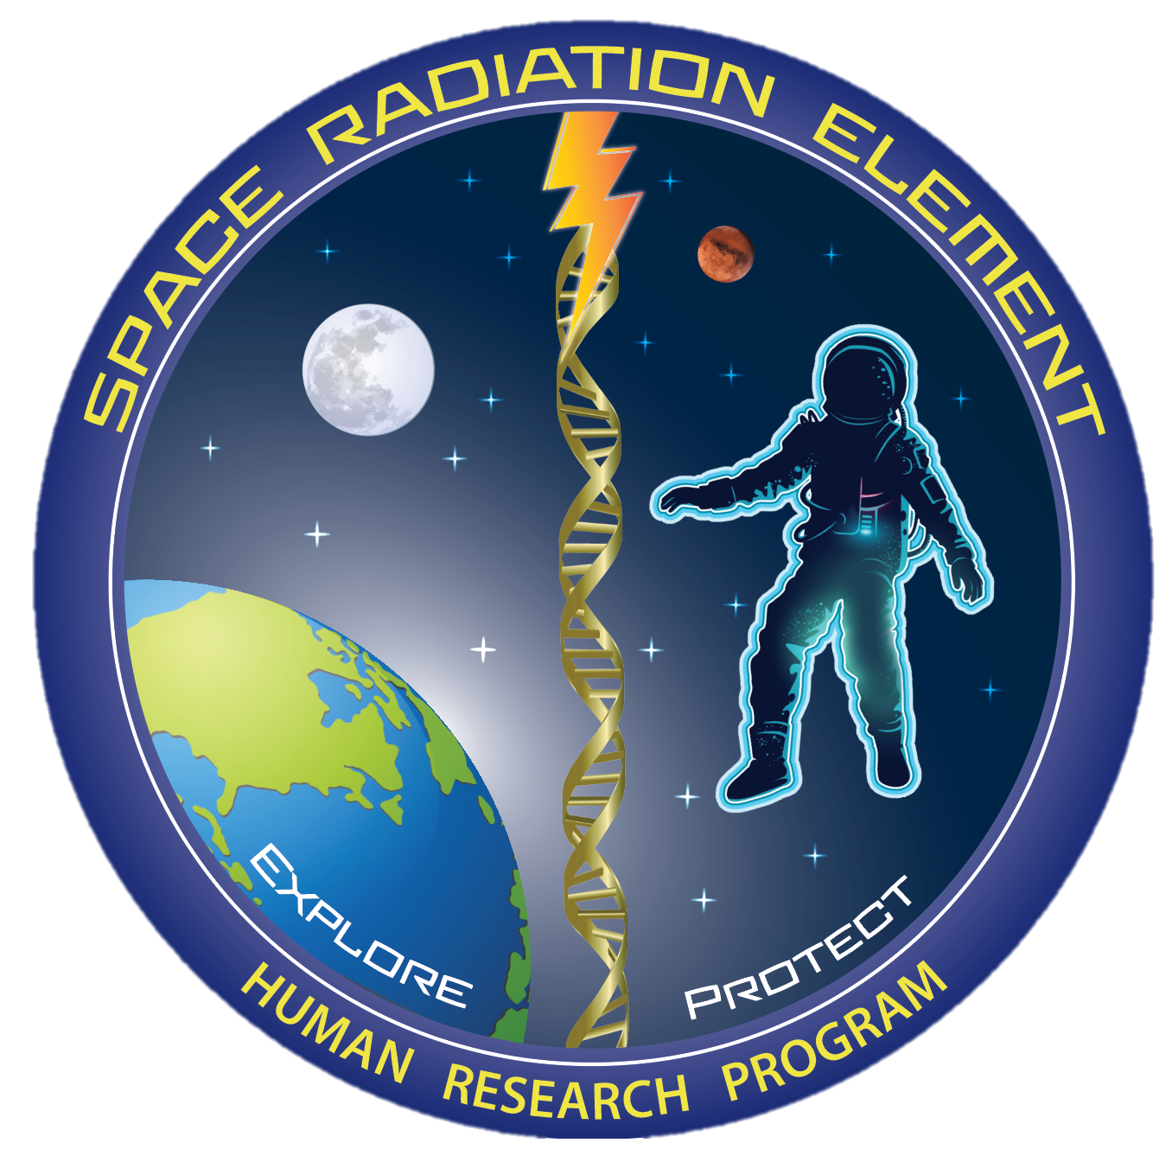
NASA’s Human Research Program (HRP)
Space Radiation Element (SRE)
S. Robin Elgart Ph.D.,
Space Radiation Element Scientist
NASA Human Research Program

Slide 2

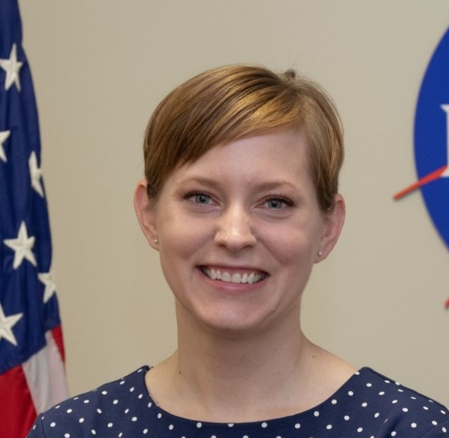
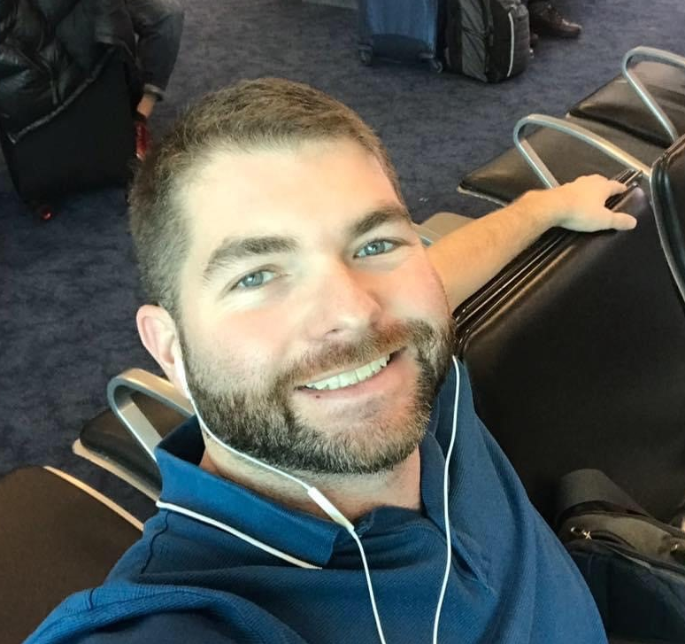


Space Radiation Element
Mission: Characterize and facilitate the management of the human health outcomes associated with space radiation exposure to protect astronaut health and wellbeing to enable human spaceflight
Science
S. Robin Elgart Ph.D., Element Scientist
Janice Zawaski Ph.D., Deputy Element Scientist
Gregory Nelson Ph.D., CNS Discipline Lead
Brock Sishc Ph.D., Cancer Discipline Lead
JP Saha Ph.D., Degenerative Tissues Discipline Lead
Management
Jason Weeks M.S., Element Manager
Nicholas Meyer M.S., Deputy Element Manager
Lisa Stephenson M.B.A., P.M.P., Science Integrator
jsc-hrp-space-radiation-element@mail.nasa.gov
Robin
Janice
Brock
Greg
JP

Slide 3

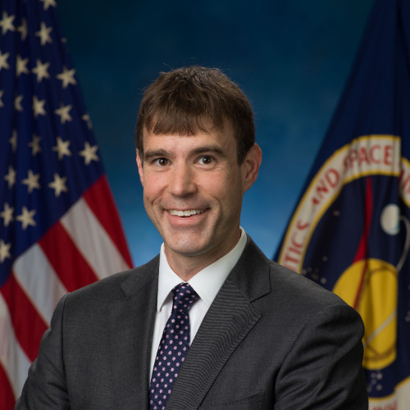
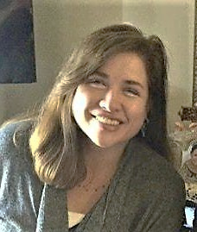
Space Radiation Element
Mission: Characterize and facilitate the management of the human health outcomes associated with space radiation exposure to protect astronaut health and wellbeing to enable human spaceflight
Science
S. Robin Elgart Ph.D., Element Scientist
Janice Zawaski Ph.D., Deputy Element Scientist
Gregory Nelson Ph.D., CNS Discipline Lead
Brock Sishc Ph.D., Cancer Discipline Lead
JP Saha Ph.D., Degenerative Tissues Discipline Lead
Management
Jason Weeks M.S., Element Manager
Nicholas Meyer M.S., Deputy Element Manager
Lisa Stephenson M.B.A., P.M.P., Science Integrator
jsc-hrp-space-radiation-element@mail.nasa.gov
Jason
Nick
Lisa

Slide 4
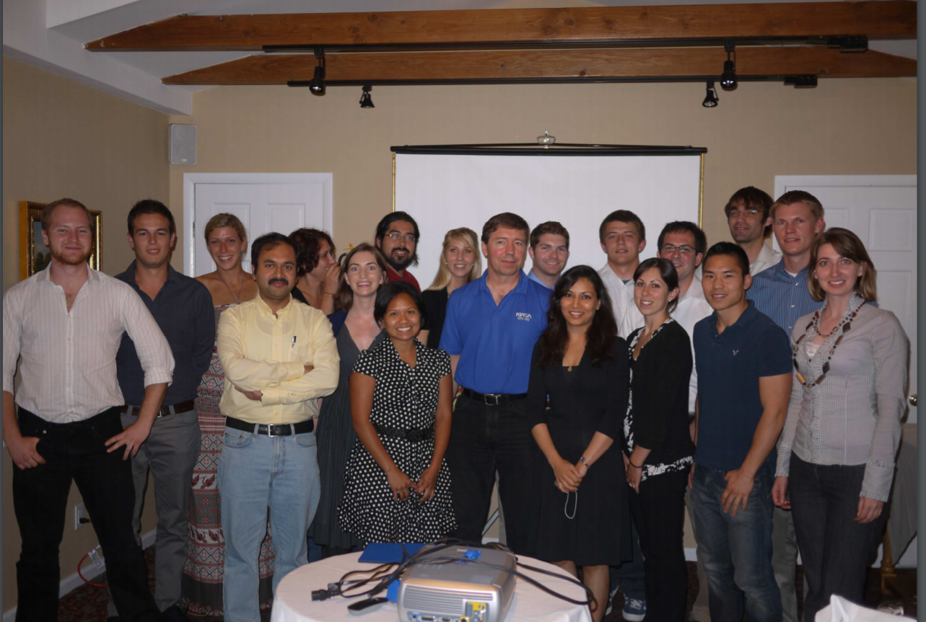
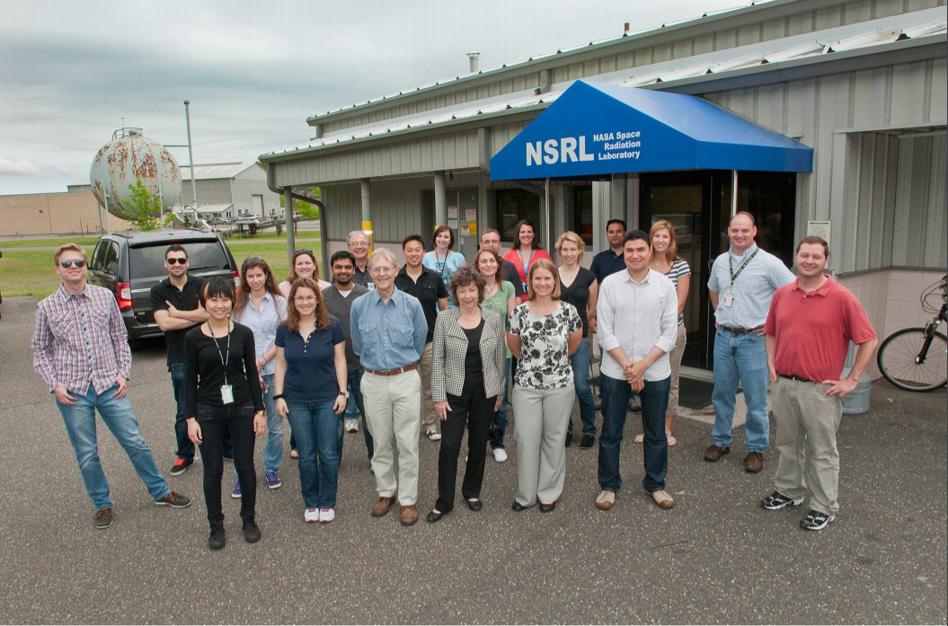
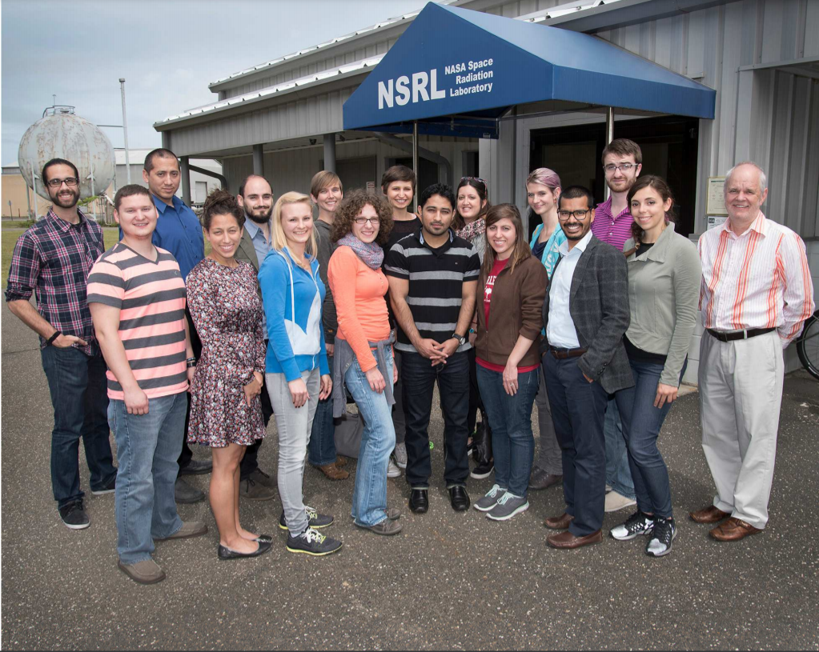
Educating the Next Generation Space Life Sciences Researchers
2011 (Brock)
2012 (JP)
2015 (Robin)

Slide 5
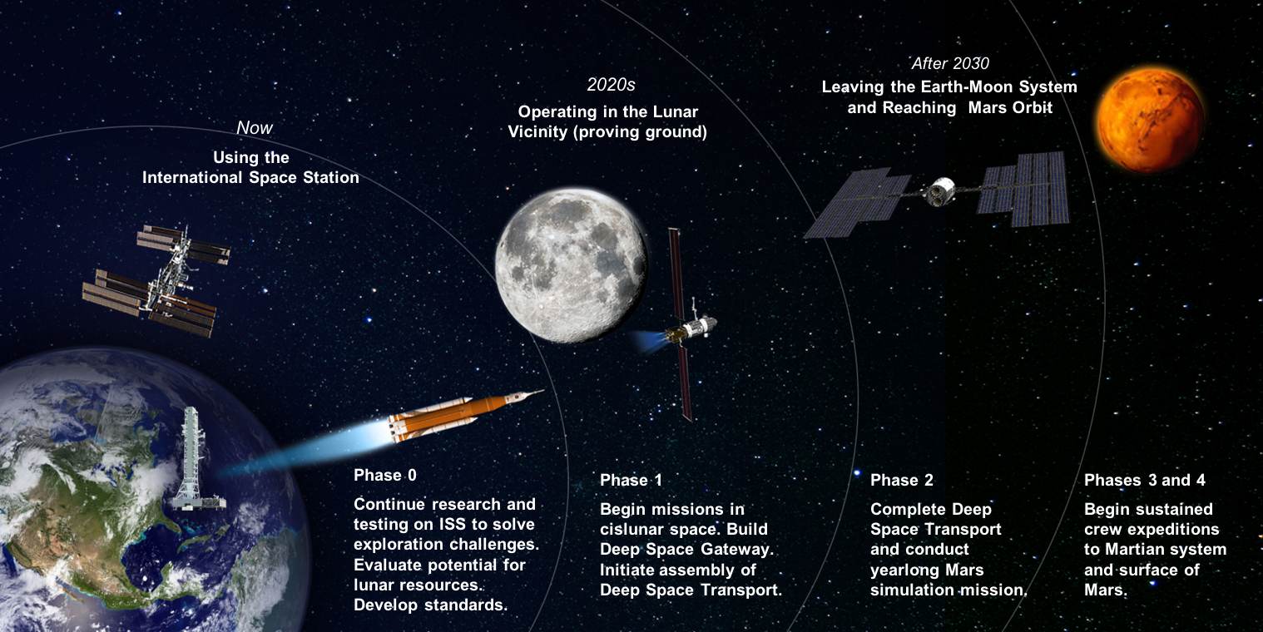
Planned Exploration Activities
Notes:
In terms of NASA’s planned missions, we are looking to use near term lunar missions as a stepping stone to our ultimate destination of Mars. Because a mission to Mars will take on the order of years, radiation exposures will be greater than those experienced today which makes it even more important that we improve our understanding of how these unique exposures impact astronaut health. It is critical we can adequately inform the crew and the agency of the risks associated with these types of exposures so they can make informed decisions when if comes to mission planning as well as long term health and well being of the astronaut corps.

Slide 6
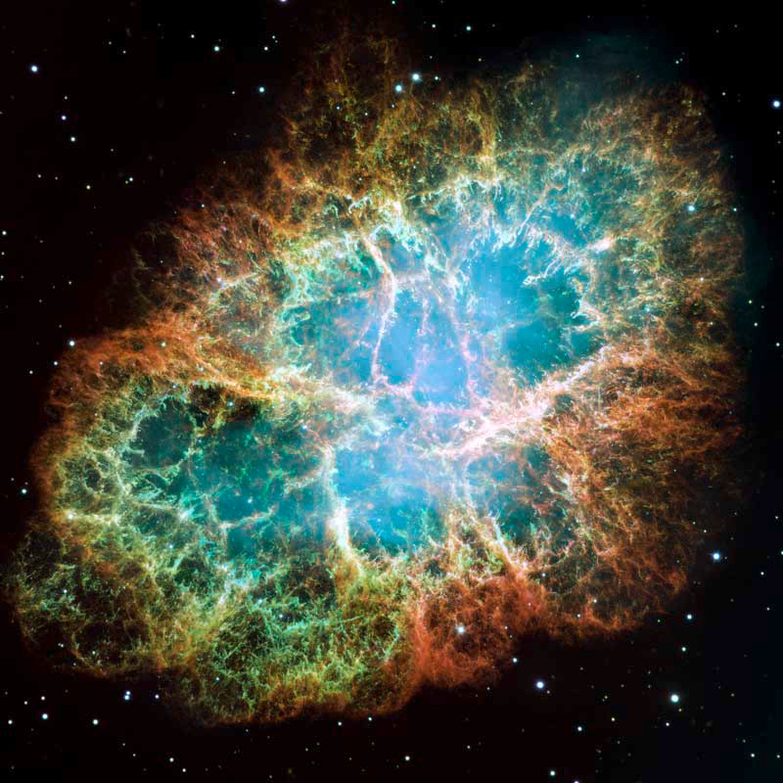
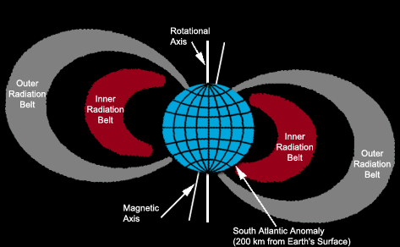
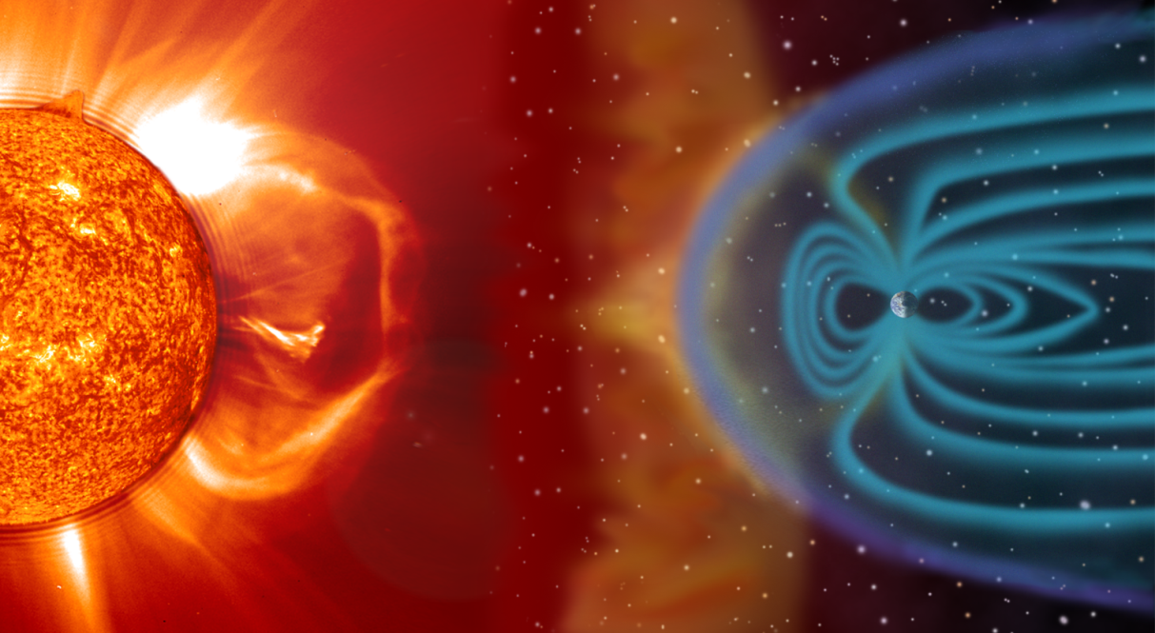

Space Radiation
NASA/ESA/Arizona State University
Radiation can cause damage when it interacts with cellular components
Why does NASA care about radiation?
  Space is a “radiation environment” → Workplace hazard
    Astronauts are radiation workers
Space radiation is different than terrestrial radiation
  Mainly high energy particles
    Galactic Cosmic Rays (GCR)
    Trapped Radiation
    Solar Particle Events (SPE)
Crab Nebula
More information about space radiation:
https://martzobservatory.org/dr-robin-elgart/
gif by Crazy Picture/CC BY-SA 3.0
Notes:
First let’s start with some basics – when I say “radiation” what I really mean is “ionizing radiation”. This is the type of radiation that has enough energy to ionizing matter which includes x- and gamma-rays as well as high energy particles. These ions can interact with cellular components and cause damage that can lead to health impacts.
So why does NASA even care about radiation? Well, because space is actually a radiation environment – meaning that anyone entering space will be exposed to more radiation than they typically would during a normal day down here on earth. Because space is a radiation environment and astronauts live and work in space, radiation is considered a workplace hazard and astronauts are considered radiation workers.
But the radiation in space is different than what we experience down here on the ground. Whereas we are used to x-rays and gamma-rays which are high energy electromagnetic waves, space radiation is composed of high energy particles that are moving at speeds close to the speed of light. These particles come from three major sources.
First are Galactic Cosmic Rays or GCR. These are theorized to be atomic nuclei accelerated into the universe by stellar explosions like supernovae. These include every type of particle on the periodic table. Earth’s magnetic field shields most of the planet from the majority of galactic cosmic rays but we still get remnants of these particles down here on the ground especially in the polar regions where particles can enter the atmosphere by travelling along magnetic field lines open to space.
Second is Trapped Radiation. These are protons and electrons that get trapped in Earth’s magnetic field and create large donut-shaped belts around the planet which are referred to as the Van Allen Belts. Travelling through the belts will expose you to increased levels of protons and electrons during your transit. For example the ISS on it’s current trajectory passes through what is called the South Atlantic Anomaly (or SAA) approximately 6-9 times a day. This region is where a portion of one of the Van Allen Belts dips closer to the Earth’s surface due to the offset between the magnetic and rotational axes of the Earth.
Third, and probably most well know are solar particle events. These occur when there are magnetic disturbances on the sun which result in a release of energy that accelerates particles out into the solar system. On Earth, our magnetic field protects us from these solar expulsions but if you are in space and event could increase your exposure if you are in the path.
Space radiation is an incredibly complex and interesting field and I don’t have time today to get into all the juicy details but if you want to know a little more i’ve included a link to a lecture I gave to the martz observatory this past year at the bottom of this slides.

Slide 7
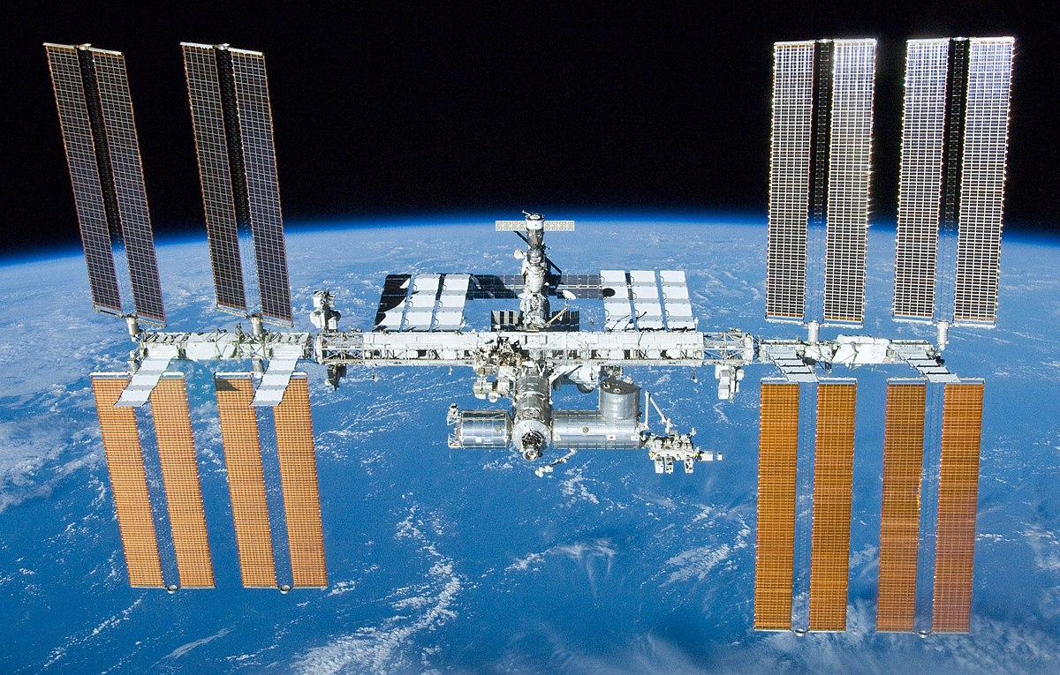
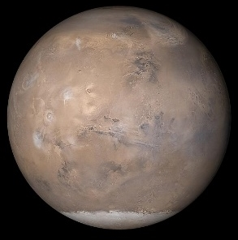
What’s Out There? The Space Radiation Environment
Exposure Type | ISS (51.6⁰ inclination) | Beyond Leo Earth Orbit
Galactic Cosmic Rays (GCR) | Limited to polar regions Fractionated low dose-rate ~ 87% protons, 12% Helium, 1% HZE | Continuous Chronic low dose-rate ~ 87% protons, 12% Helium, 1% HZE
Trapped Radiation | South Atlantic Anomaly (SAA) Fractionated low dose-rate Protons | Transit through Van Allen Belts Quasi-acute Protons
Solar Particle Events (SPEs) | Limited to polar regions Fractionated low dose-rate Protons | Full Event Quasi-acute Protons
Neutrons, Secondary Radiation | Shielding Chronic low dose-rate | Shielding Planetary (albedo) Chronic low dose-rate
Notes:
Space radiation is composed of mainly high energy particles from 3 primary sources. Galactic Cosmic Rays which are theorized to be the result of stellar explosions accelerating every known element on the periodic table across the universe. Then there are the protons and electrons that get trapped in Earth’s magnetic field – commonly referred to as the Van Allen Belts. These are responsible for the South Atlantic Anomaly – a region where the offset of Earth’s geomagnetic and rotational axes create an area where the inner radiation belts impinges into the atmosphere. And then finally, probably the most well known are the Solar Particle Events. These occur when localize magnetic fields on the Sun get so tangled that they reconnect and the energy released accelerates particles out into the solar system. Additionally Neutrons and Secondary radiation can be created inside a spacecraft, habitat, or on a planetary or lunar surface.
But of course the, contribution of each of these sources to a person’s dose is dependent on a number of factors, including where you are in space. For example….
However, on a per day dose rate basis, ISS and Beyond LEO exposures are roughly similar – but it is the composition of the radiation that is different and the fact that there is no geomagnetic protection from solar particle events beyond LEO.

Slide 8
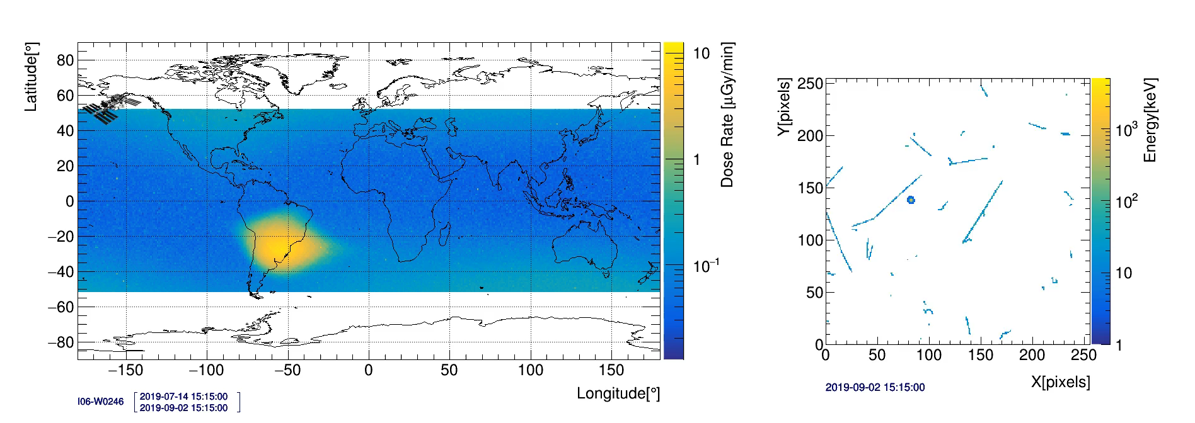
What’s Out There? The Space Radiation Environment
Doses depend on mission and solar parameters
  Duration
  Trajectory and shielding
    Determine source exposure
      Effects “quality factor”
    EVAs
  Solar cycle
    11-year cycle
    Modulates GCR and trapped radiation fluence, as well as SPE likelihood
Each crew member is badged
Active radiation area monitoring
Exposure Type | Dose Rate or Dose
ISS – IV: 51.6° @ 400 km | 300 – 450 μGy/day
ISS Trapped – IV*** | <0.1 – 20 μGy/min
GCR in “free space” in water CRaTER (2009 to present) | 250 – 550 μGy/day
1972 event – IV “free space” | 200 – 400 mSv
Sheltered 1972 event | ~ 80 mSv
*** Passes are at most ~20 min and only see peak dose rates for a fraction of the pass

Slide 9
What’s the Big Deal? Space Radiation Health Risks
Mission Success
  Acute effects
    Very large high-energy solar events
      Estimate ~ 200 – 400 mSv (unsheltered) for 1972 Event
      MILD symptoms IF they occur at all given doses
  Potential early neurological effects
    Behavior or memory decrements
    Observed only in animal models
Long Term Health
  Cancer
    Space radiation may cause unique impacts
  Degenerative
    Cardiovascular disease
    Cataracts
  Potential late neurological decrements
    Behavior or memory decrements
    Neurodegenerative disease
    Observed only in animal models

Slide 10
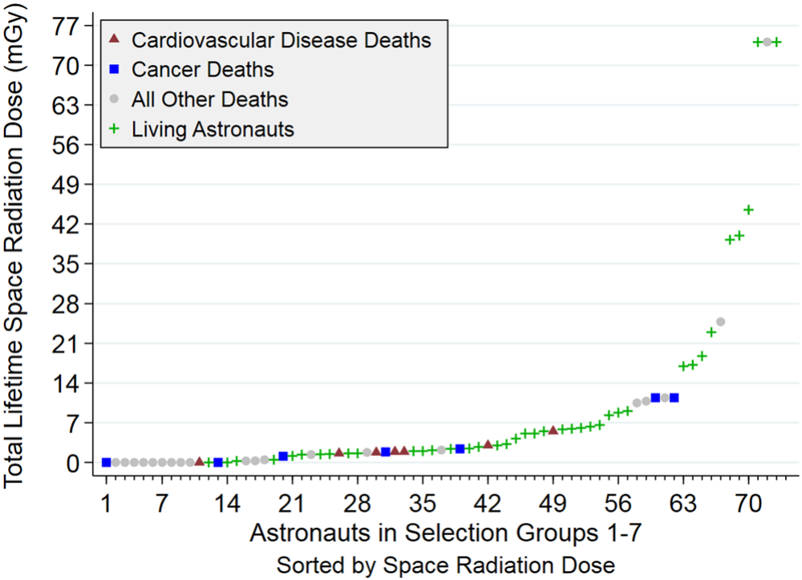
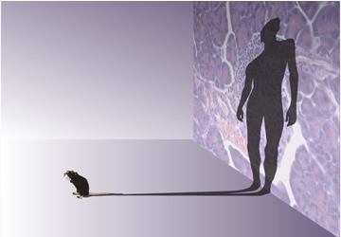
Challenges and Uncertainties in Risk Assessment and Research
Limited observed outcomes in astronauts
  Small population
  Low doses and dose rates
  Common outcomes
  Healthy worker and generally healthy
Limited knowledge of biological effects of space radiation
  Heavy reliance on animal studies
  Space radiation is unique
Broad Institute Communications
Notes:
First, I want to mention some challenge we have not only for radiation quality research but also for space radiation research in general.
One of the major challenges for assessing the impact of space radiation on humans is the fact that there just aren’t that many instances of the health outcomes associated with radiation observed in astronauts. There are a number of factors that contribute to this including the fact that space is the only place where we encounter space radiation which means we have a very small population with only around 500 people to have flown in space. Furthermore doses to date have been low and over long periods of time. For example we did a small study of the first 7 astronaut groups and all of their space radiation doses were under 100 mGy. With such low doses you wouldn’t expect to see increases in health outcomes especially given the fact that cancer and cardiovascular disease are very common outcomes in the US population in general. And on top of all that not only are the astronauts Healthy Workers which means that their health status is already improved compared to the general US population because of their ability to maintain employment in the workforce, but also they are generally healthy. Astronauts are some of the fittest on and off the planet.
Second is our limited understanding of the biological effects of space radiation on the human system. Because it would be unethical and impractical to conduct large scale human radiation experiments, space radiation research relies heavily on animal studies which increase our uncertainty of what our results mean for humans. Furthermore, it is impossible to fully replicated the space radiation environment on Earth so we do our best with analogs such as the NASA Space Radiation Laboratory or (NSRL) at Brookhaven National Labs.

Slide 11
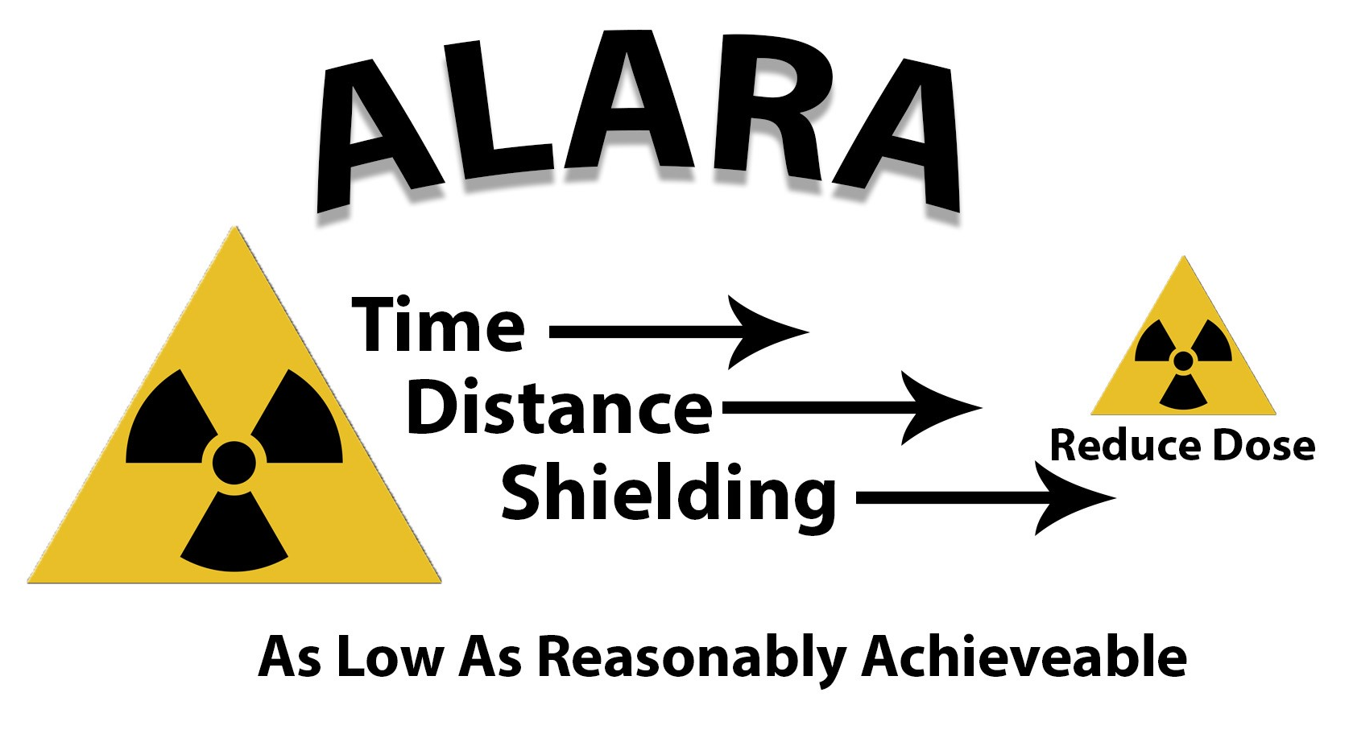
The Space Radiation Protection Challenge
Traditional terrestrial protection strategies fall
short in space:
  Time
    At some point you will always reach a limit
  Distance
    There is no point source to move away from
  Shielding
    Energetic particles are penetrating
    Secondary particles
NASA is exploring other countermeasure strategies
  Health surveillance including early disease detection
  Compound-based countermeasures
https://www.lsu.edu/camd/safety/training/radiationsafetytraining.php

Slide 12
What Do we Do? Space Radiation Element Research
Three primary health risks:
Carcinogenesis
Cardiovascular & Immune
Central Nervous System
Formally Degenerative Tissues now listed under the Cardiovascular (CVD) or Immune (IM) Risks
Integrated into the Behavioral Medicine (BMed) Risk
Characterization |  | Mitigation
Dose and Dose Rate Effects | Biomarkers | Countermeasure Identification
Radiation Quality | Individual Susceptibility | Countermeasure Validation
Species Translation | Combined Stressors
https://humanresearchroadmap.nasa.gov/
Notes:
The mission of the Space Radiation Element is to characterize and facilitate the management of the human health outcomes associated with space radiation exposure to protect astronaut health and wellbeing, and enable human spaceflight. The three major health risks the Element is focused on investigating are carcinogenesis, cardiovascular disease, and changes to the central nervous system that impact mission performance and long term health. For each of these health risks the Element is interrogating key scientific questions that will served to more fully characterize the risk due to the unique space radiation environment as well as develop tactical mitigation strategies. In space, traditional terrestrial-based radiation strategies fall short. On Earth, time, distance, and shielding, are the three main ways to reduce radiation exposure. However, in space there is no single point source to move away from and shielding heavy particles moving at near relativistic speeds is not currently feasible. Which only leave time as a method of limiting radiation exposure. But if we need to spend 3 years in space to successfully complete a mission to Mars, time starts to become a challenge as well. So the Space Radiation Element is exploring other strategies to provide protection to our astronauts on long-duration missions including health surveillance and early disease detection as well as identifying compound-based countermeasures.

Slide 13
Translating Basic Science to Applications (Example in Biomedicine)
Space Biology
Human Research
Basic
Translational Research
Applied
Study how life responds, adapts, develops, interacts and evolves in the space environment and across the gravitational continuum
Cell and Molecular Biology
Microbiology
Animal Biology
Plant Biology
Developmental and Reproductive Biology
Space Biology provides science data and findings that foster research and development
Animal Research
Cells and Tissues
Immunology
Wound Healing and Fracture repair
Bone and Muscle
Radiation/Micro-g Interactions
Microbiome of the Built environment
Identify, characterize and mitigate the risks to human health and performance in space
Exercise and Physiological Countermeasures
Space Radiation Biology
Behavioral Health and Performance
Space Human Factors and Habitability
Exploration Medical Capability
Environmental Monitoring
Basic Science
Medical Operations
Science Exploring
the Unknown
Science Addressing
the Known Risks

Slide 14
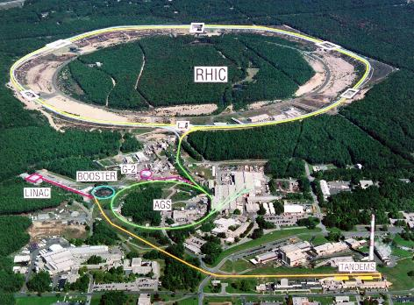
Ground Analog – NASA Space Radiation Laboratory
Personnel:
NSRL Liaison Physicist, Adam Rusek PhD
rusek@bnl.gov
Biology Support Scientist, Peter Guida PhD
guida@bnl.gov
NSRL Management, Lisa Simonsen PhD lisa.c.simonsen@nasa.gov
Capabilities:
Acute or fractionated exposures “chronic”
Single ions
Multiple ions
  Simplified GCR sim
    6 beams 5 ions: H (2 energies), Si, He, O, Fe
  GCR sim
    33 beams, 7 ions: H (14 energies), He (14 energies), C,O, Si, Ti, Fe
NASA Space Radiation Lab
https://www.nasa.gov/analogs/nsrl/about
https://www.bnl.gov/nsrl/
Notes:
To complete this important research down here on the ground we have the NASA Space Radiation Laboratory or NSRL. We have a great team managing this facility for us which resides at the Brookhaven National Laboratory on Long Island and a number of capabilities to help us better understand the impact of high energy particle radiation including acute or fractionated exposures to single or multiple ion beams. I’ve included a few links on the bottom left if you are interested in learning more.
14

Slide 15
International Collaborations
It IS possible to collaborate with international institutions (academia, industry, etc)
NASA canNOT provide funding to non-US institutions
NASA CAN provide funding to US institutions who employ non-US persons
Non-US institutions CAN submit to NASA solicitations if NO FUNDS are required
  Include letter of support from home-country agency/institution that will provide funding if a positive peer-review and programmatic selection is received
NASA CAN acquire services (non-research) from non-US institutions
  Requires sole-source justification

Slide 16
More Resources
Space Radiation Element https://www.nasa.gov/hrp/elements/radiation
NASA Human Research Roadmap – link to risks, gaps, and funding priority (green = low, red = high)
https://humanresearchroadmap.nasa.gov/
NASA Taskbook – Summaries of current and previously funded projects
https://taskbook.nasaprs.com/tbp/welcome.cfm
Life Science Data Archive – Can request past data and search tissue repository
https://lsda.jsc.nasa.gov/
https://lsda.jsc.nasa.gov/Biospecimen
Instructions - https://www.nasa.gov/hrp/elements/radiation/tissue-sharing
NASA GeneLab – Space-related omics database. Users can upload, download, share, store, and analyze spaceflight and spaceflight-relevant data from experiments.
https://genelab.nasa.gov/
The Health Risks of Extraterrestrial Environments (THREE) – Open access space radiation literature
https://three.jsc.nasa.gov/#section=main

Slide 17
Questions?
jsc-hrp-space-radiation-element@mail.nasa.gov

