Slide 1
Space Radiation: Opportunities for Tactical Collaboration
S. Robin Elgart, Ph.D.
Space Radiation Element Scientist
NASA Human Research Program
Notes:
Good morning, good afternoon, and good evening everyone. I’m Robin Elgart the Space Radiation Element Scientist for NASA’s Human Research Program. First I want to say thank you to the National Academies for inviting me to speak with y’all today. While NASA does not have a low-dose radiation research program there are a number of opportunities for synergistic tactical collaboration between NASA and the DOE if a low-dose radiation program were to be re-established. Next slide please

Slide 2
Introduction
Space is a radiation environment
NASA was given the authority by congress “to make, promulgate, issue, rescind, and amend rules and regulations governing the manner of its operations and the exercise of the powers vested in it by law”
  National Aeronautics and Space Act –1958 §203(b)(1)
  Astronauts considered radiation workers
    NASA limits excessive space radiation exposure (and has been since the 60s)
    NCRP 132 (2000) recommendations are the basis for current supplementary OSHA radiation standards in accordance with 29 CFR 1960.18
The Space Radiation Analysis Group (SRAG): operational astronaut radiation protection
The Space Radiation Element (SRE): executing research to characterize and mitigate the health risks due to space radiation exposure
Notes:
To start, I want to provide a little context for those not familiar with space radiation and some of the unique aspects of both the environment and how radiation protection is administered. The most important thing to note is that Space is a radiation environment and due to the known effects of radiation on human health, NASA has been regulating radiation exposure since the very beginnings of the space program. NASA was given the authority “to make, promulgate, issue, rescind, and amend rules and regulations governing the manner of its operations and the exercise of the powers vested in it by law” under the National Aeronautics and Space Act of 1958. Following the Occupational Safety and Health Act in 1980 NASA was given permission to submit supplementary radiation standards because the annual limit set by the Nuclear Regulatory Commission were too restrictive to enable human spaceflight. There are a number of groups responsible for radiation work for NASA but the two responsible for human health are the Space Radiation Analysis Group (or SRAG) and the Space Radiation Element. While SRAG is responsible for operational radiation protection including radiation monitoring and vehicle shielding analysis, the Space Radiation Element is responsible for executing a robust research strategy to charadccterize and mitigate the health risks due to space radiation exposure

Slide 3
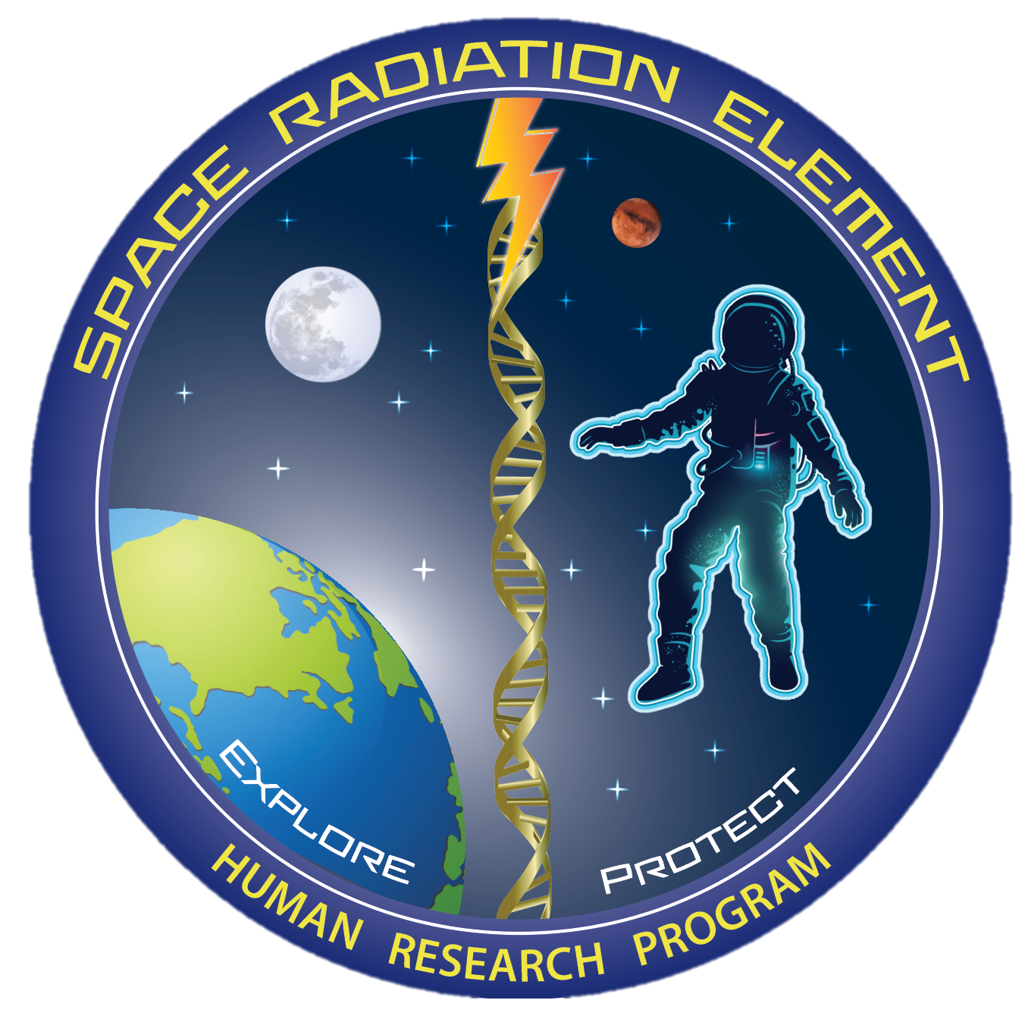
Three Major Questions
What’s Out There?
  The Space Radiation Environment
What’s the Big Deal?
  Space Radiation Health Risks
What Do We Do?
  Space Radiation Element Research
Notes:
There are three main questions I get asked on airplanes when people find out I do space radiation work with NASA (or at least I did in the before times). What’s out there, what’s the big deal, ad what do we do? I’ll use these questions as the backbone from the rest of my presentation today.

Slide 4
What’s Out There? The Space Radiation Environment
Range of dose profiles
  Individual mission doses can be <100 mSv
    Shuttle, ISS, Short Lunar, Short Deep Space
  Solar particle event doses may exceed 100 mSv
  Accumulated career doses can exceed 100 mSv
  Long-durations missions are anticipated exceed 1,000 mSv
Range of dose rates
  Protracted
  Fractionated
  Quasi-acute
Mixed-field environment
  Charged particles
  Neutrons
  Low-LET
  High-LET
Notes:
So let’s dive into what’s out there. The space radiation environment is complex. In terms of mission doses, these cover a range of dose profiles with the driver for these differences being the duration of the mission. Depending on the intensity and duration of a solar particle event, these can contribute
Low Dose is defined as than 100 mSv and dose rate as less than 5mSv/Hr

Slide 5
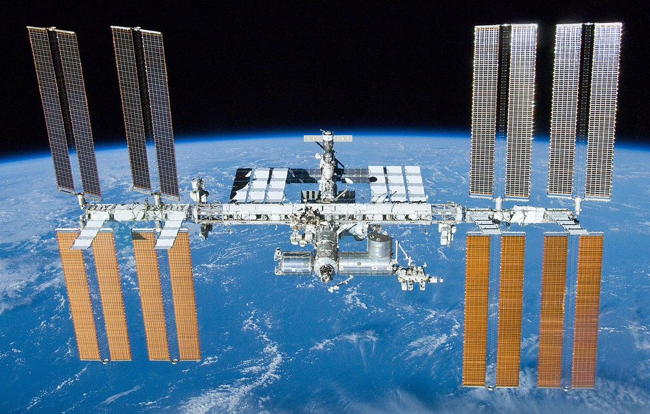
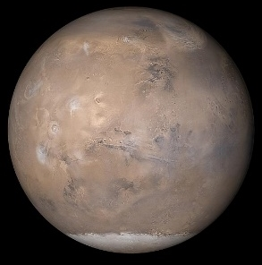
What’s Out There? The Space Radiation Environment
Exposure Type | ISS (51.6⁰ inclination) | Beyond Leo Earth Orbit
Galactic Cosmic Rays (GCR) | Limited to polar regions Fractionated low dose-rate ~ 87% protons, 12% Helium, 1% HZE | Continuous Chronic low dose-rate ~ 87% protons, 12% Helium, 1% HZE
Trapped Radiation | South Atlantic Anomaly (SAA) Fractionated low dose-rate Protons | Transit through Van Allen Belts Quasi-acute Protons
Solar Particle Events (SPEs) | Limited to polar regions Fractionated low dose-rate Protons | Full Event Quasi-acute Protons
Neutrons, Secondary Radiation | Shielding Chronic low dose-rate | Shielding Planetary (albedo) Chronic low dose-rate
Notes:
Space radiation is composed of mainly high energy particles from 3 primary sources. Galactic Cosmic Rays which are theorized to be the result of stellar explosions accelerating every known element on the periodic table across the universe. Then there are the protons and electrons that get trapped in Earth’s magnetic field – commonly referred to as the Van Allen Belts. These are responsible for the South Atlantic Anomaly – a region where the offset of Earth’s geomagnetic and rotational axes create an area where the inner radiation belts impinges into the atmosphere. And then finally, probably the most well known are the Solar Particle Events. These occur when localize magnetic fields on the Sun get so tangled that they reconnect and the energy released accelerates particles out into the solar system. Additionally Neutrons and Secondary radiation can be created inside a spacecraft, habitat, or on a planetary or lunar surface.
But of course the, contribution of each of these sources to a person’s dose is dependent on a number of factors, including where you are in space. For example….
However, on a per day dose rate basis, ISS and Beyond LEO exposures are roughly similar – but it is the composition of the radiation that is different and the fact that there is no geomagnetic protection from solar particle events beyond LEO.

Slide 6
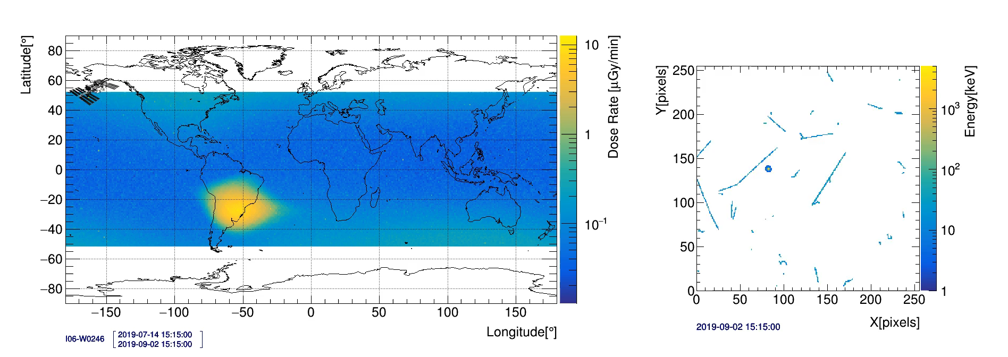
What’s Out There? The Space Radiation Environment
Doses depend on mission and solar parameters
  Duration
  Trajectory and shielding
    Determine source exposure
      Effects “quality factor”
    EVAs
  Solar cycle
    11-year cycle
    Modulates GCR and trapped radiation fluence, as well as SPE likelihood
Each crew member is badged
Active radiation area monitoring
Exposure Type | Dose Rate or Dose
ISS – IV: 51.6° @ 400 km | 300 – 450 μGy/day
ISS Trapped – IV*** | <0.1 – 20 μGy/min
GCR in “free space” in water CRaTER (2009 to present) | 250 – 550 μGy/day
1972 event – IV “free space” | 200 – 400 mSv
Sheltered 1972 event | ~ 80 mSv
*** Passes are at most ~20 min and only see peak dose rates for a fraction of the pass
KEY POINT: Space radiation is different than terrestrial radiation

Slide 7
Historical and Projected NASA Mission Doses
10000
Spacefaring Career
Badge Dose, mGy
650 mSv
NCRP Recommended Terrestrial Radiation Worker Lifetime Limit for 65 yo
1000
Effective Dose, mSv
Mars Mission
3 yr Mars Mission, mSv
30 yr Spacefaring Career, mSv
Skylab, Mir and ISS
100
50 mSv/yr
Terrestrial Radiation Worker Annual Limit
Mission Dose
Hubble Missions
10
Apollo and Shuttle
Gemini
3.6 mSv
Average US
Annual Dose
Mercury
1
Modified from Cucinotta et al. Radiat Res (2008)
0.1
0
200
400
600
800
Astronaut, i
KEY POINT: Moderate career doses at low dose-rates

Slide 8
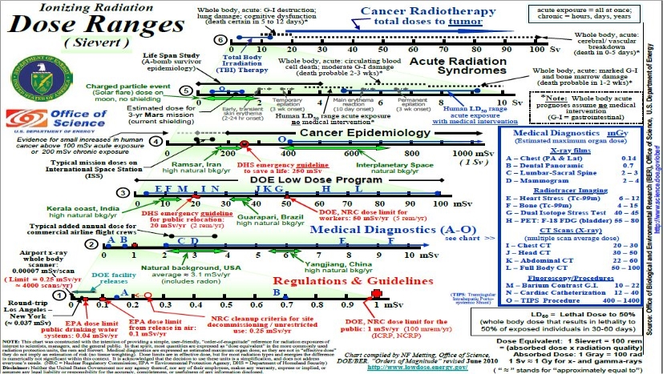
NIAID Countermeasures for Radiation Injury (Centers for Medical Countermeasures against Radiation)
NASA Space Radiation
Medical Diagnostic Doses have come down significantly since this chart was made
DOE Low-Dose Radiation Program

Slide 9
What’s the Big Deal? Space Radiation Health Risks
Mission Success
  Acute effects
    Very large high-energy solar events
      Estimate ~ 200 – 400 mSv (unsheltered) for 1972 Event
      MILD symptoms IF they occur at all given doses
  Potential early neurological effects
    Behavior or memory decrements
    Observed only in animal models
Long Term Health
  Cancer
    Space radiation may cause unique impacts
  Degenerative
    Cardiovascular disease
    Cataracts
  Potential late neurological decrements
    Behavior or memory decrements
    Neurodegenerative disease
    Observed only in animal models
Risks beyond the “low-dose” region
KEY POINT: Space radiation impacts in-mission and long-term health risks

Slide 10
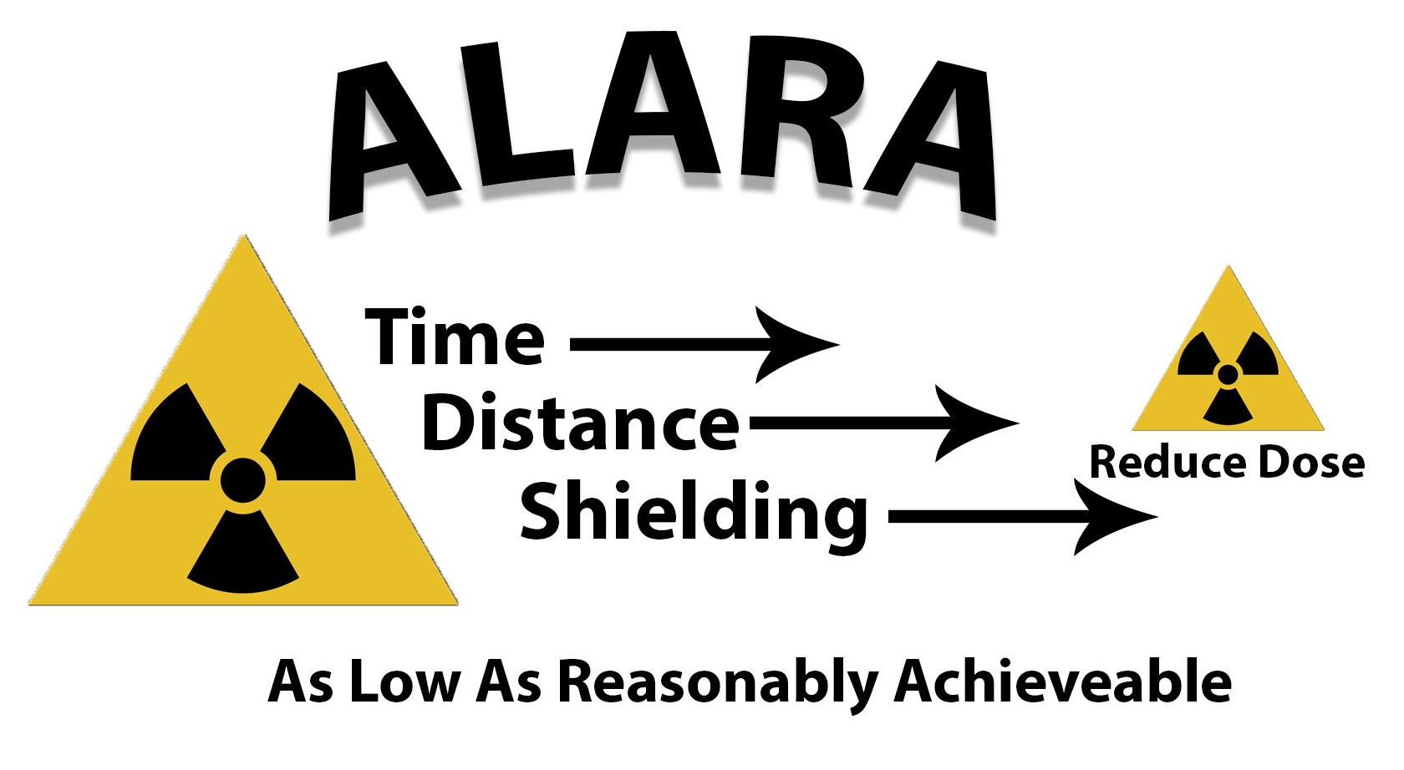
The Space Radiation Protection Challenge
Traditional terrestrial protection strategies fall short in space
  Time
    At some point you will always reach a limit
  Distance
    There is no point source to move away from
  Shielding
    Energetic particles are penetrating
    Secondary particles
NASA is exploring other countermeasure strategies
  Health surveillance including early disease detection
  Compound-based countermeasures
https://www.lsu.edu/camd/safety/training/radiationsafetytraining.php
Notes:
Due to the uniqueness of the space radiation environment, our understanding of the biological effects is still evolving and we have a heavy reliance of animal studies which makes for a hefty challenge when it comes to radiation protection. In space, traditional terrestrial-based radiation strategies fall short. On Earth, time, distance, and shielding, are the three main ways to reduce radiation exposure. However, in space there is no single point source to move away from and shielding heavy particles moving at near relativistic speeds is not currently feasible. Which only leaves TIME as a method of limiting radiation exposure to astronauts. But if we need to spend 3 years in space to successfully complete a mission to Mars, time starts to become a challenge as well. So the Space Radiation Element is exploring other strategies to provide protection to our astronauts on long-duration missions including health surveillance and early disease detection, as well as identifying compound-based countermeasures.

Slide 11
What Do we Do? Space Radiation Element Research
Mission: Characterize and facilitate the management of the human health outcomes associated with space radiation exposure to protect astronaut health and wellbeing, and enable human spaceflight
Three primary health risks:
Carcinogenesis
Cardiovascular & Immune
Central Nervous System
Formally Degenerative Tissues now listed under the Cardiovascular (CVD) or Immune (IM) Risks
Integrated into the Behavioral Medicine (BMed) Risk
Characterization |  | Mitigation
Dose and Dose Rate Effects | Biomarkers | Countermeasure Identification
Radiation Quality | Individual Susceptibility | Countermeasure Validation
Species Translation | Combined Stressors
https://humanresearchroadmap.nasa.gov/
Notes:
The mission of the Space Radiation Element is to characterize and facilitate the management of the human health outcomes associated with space radiation exposure to protect astronaut health and wellbeing, and enable human spaceflight. The three major health risks the Element is focused on investigating are carcinogenesis, cardiovascular disease, and changes to the central nervous system that impact mission performance and long term health. For each of these health risks the Element is interrogating key scientific questions that will served to more fully characterize the risk due to the unique space radiation environment as well as develop tactical mitigation strategies. In space, traditional terrestrial-based radiation strategies fall short. On Earth, time, distance, and shielding, are the three main ways to reduce radiation exposure. However, in space there is no single point source to move away from and shielding heavy particles moving at near relativistic speeds is not currently feasible. Which only leave time as a method of limiting radiation exposure. But if we need to spend 3 years in space to successfully complete a mission to Mars, time starts to become a challenge as well. So the Space Radiation Element is exploring other strategies to provide protection to our astronauts on long-duration missions including health surveillance and early disease detection as well as identifying compound-based countermeasures.

Slide 12
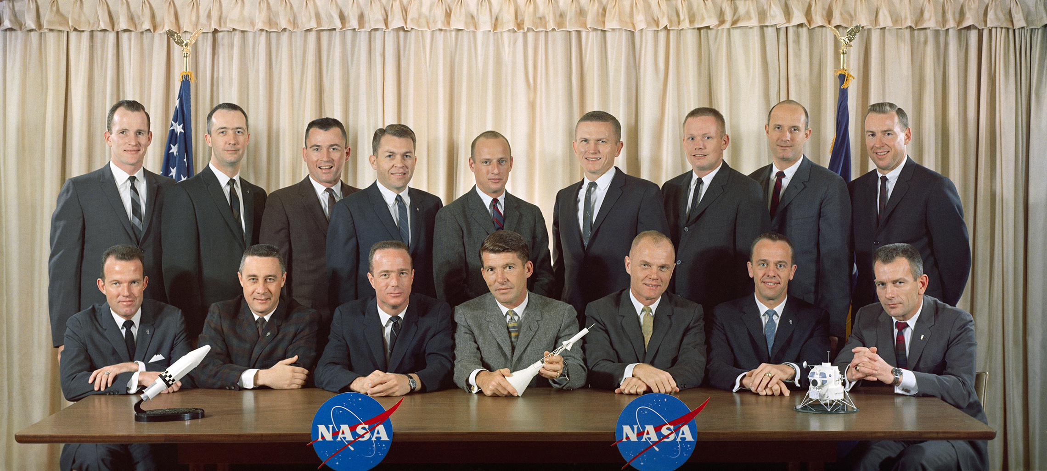
Unique Challenges for NASA and Risk Assessment
Limited observed outcomes in astronauts
VERY small, unique cohort
  Approximately 500 total
  Relatively young cohort
  Changing demographics
Generally small accumulated exposures to date
Healthy worker and generally healthy
  Recent study indicates lower risk of all-cause mortality and other expected outcomes in early NASA astronauts (Elgart et al. 2018)
MANY competing risks
https://humanresearchroadmap.nasa.gov/
Notes:
NASA does not have a low dose research program, but a space radiation health effects research program.
This program seeks to understand the health risks associated with exposure to space radiation (higher LET radiation compared to gamma) at mission relevant doses.
NASA doses are moderate for astronaut career (on order of 300 mSv), but dose rate is low, approximately 1mSv/day. NASA falls into low dose rate, but not low dose.
However, a possible future mission to Mars can expose astronauts to 1 sievert (Sv).
Additionally, NASA is concerned with a limited US astronaut population - middle age/healthy worker. DOE (NIAID, EPA) mission spans across all ages and cohorts.

Slide 13
The Big Picture
Space radiation is different from terrestrial radiation
  Exposure is unavoidable in space
  Doses depend on mission
NASA’s space radiation research is NOT a low-dose program
  Focuses on moderate total doses at low-dose rates
Space radiation impacts in-mission and long-term health risks
  Risks beyond those in the low-dose range: Acute, CVD, CNS
Astronaut radiation exposures are regulated via supplementary OSHA standards
  Enable human spaceflight
  Exceed annual terrestrial limits
Understanding of space radiation risks is incomplete and still evolving
Key cross-functional areas for collaboration between NASA and DOE
  Many areas outside DOE mission
Notes:
NASA does not have a low dose research program, but a space radiation health effects research program.
This program seeks to understand the health risks associated with exposure to space radiation (higher LET radiation compared to gamma) at mission relevant doses.
NASA doses are moderate for astronaut career (on order of 300 mSv), but dose rate is low, approximately 1mSv/day. NASA falls into low dose rate, but not low dose.
However, a possible future mission to Mars can expose astronauts to 1 sievert (Sv).
Additionally, NASA is concerned with a limited US astronaut population - middle age/healthy worker. DOE (NIAID, EPA) mission spans across all ages and cohorts.
NASA relies on findings from non-space radiation research, including low dose radiation research, to estimate risks to the astronauts and to set protection standards that are based on individual lifetime risk projections
Historically, DOE's Low Dose Program and NASA jointly fund new research to develop a better scientific basis for understanding risks to humans from exposures to low doses or low fluences of ionizing radiation.
Accordingly, there are significant areas of overlap where NASA would be very interested in collaborating with DOE Low Dose program.
Moving forward, these areas include epidemiological data sets, computational models, methodologies, high-fidelity biological models (cell, tissue chip, animal). That is, advanced approaches/models that have application at both low doses and moderate doses.
Fundamentally, NASA would leverage these low dose approaches/models by bring them into the NASA program, but expose/use at our mission relevant doses. These types of approaches/systems can be used to explore the dose response curve across low, moderate and high doses of end points in biological systems. Further, it is not unusual for research to start at moderate doses to detect and understand biological effects then move to lower doses.
The transfer and extrapolation of risks from non-space radiation studies introduces large uncertainties, and experts have questioned whether it is even appropriate (mechanistic differences between high and low dose).
NASA is particularly interested in highly translatable/immediately applicable information from low dose projects.
In particular, Human Epidemiology studies that look at dose response curves, whole dose range effects and associated modeling that extrapolates from moderate to low and high doses would be high priority for NASA. These types of collaborations would help NASA protect astronauts for long-duration exploration missions (Mars missions).
This would be hard data and information with immediate application to NASA relevant radiation risks models.

Slide 14
Key Cross-Functional Topics
Wide Energy Spectrum
Narrow Energy Spectrum
NASA Space Radiation
DOE Low Dose Program
High Energies
Dose-Rate
Lower Energies
Radiation Quality
Charged Particles
Gamma and Small Particles
Relevant Epidemiology
Limited Informed Population
Public and Workforce
High-Fidelity Biological Models
External Exposures
Risk Modeling
Internal Exposures
Communication and Outreach
Moderate Total Doses
Low Total Doses
Individual Dosimetry
Estimated Dosimetry
Notes:
There are many important differences between the environments and missions of NASA’s Space Radiation Research and the DOE Low Dose Program. The most salient of these is that the radiation exposures of primary interest to NASA for exploration are well above that of the low-dose region. Furthermore, NASA has a small limited and informed population that is heavily monitored at an individual level. While low-dose radiation is not the emphasis of NASA’s radiation research, there are a number of opportunities for synergistic tactical collaborations. The underlying mechanisms of the biological response to the physical damage are likely very similar. The NASA’s Human Research Program is an applied research program. We neither have the time nor the money to explore all the underlying mechanisms we would love to dig our teeth into. So I see this topic as one ripe for collaboration between our communities. And then two areas that I am personally very excited about are Early Disease Detection and Communication and Outreach. And when I say precision health I mean that in terms of preventative medicine as well as treatment following diagnosis.
NASA Priorities would be as follows:
NASA most interested in collaborating on joint epidemiology studies (Million Person Study) for risk translation of US healthy workers to (age, sex, and healthy) astronaut corps more similar than Japanese A-bomb survivors.
DOE Million Person Study – doses of cohorts span across regimes of interest (DOE, NASA, and slightly higher (although less data here))
The purpose is to provide information about low-dose radiation health risks when the exposures are received gradually over time and not instantaneously, as was the case for the 1945 atomic-bomb exposures in Japan.
This helps NASA with transferring from Japanese population to NASA astronaut population (helps DOD as well): Million person study is looking at healthy workers, adult population, US population
One topic of particular concern to NASA is the finding from the atomic bombing survivor studies that risk of radiation-induced lung cancer is greater for women than for men; this finding limits the time women can spend in space. NCRP has assembled a committee to assess the risk of radiation-induced lung cancer by examining findings under the Million person study from other exposed populations and experimental studies.
NASA supports mission enabling studies through NCRP (John Boice, shepherding Million Person Study) – 1. sex dependence on lung cancer incidence; and 2. is there any dose response of late CNS effects.
Potential biggest near-term impact to NASA crew operations – Hard data on how to protect our astronauts.
Second area of collaboration – risk modeling and extrapolation of experimental/human data to lower doses (shape of dose response curve)
Additional: High-fidelity biological models (cell, tissue chip, animal) to better assess biological risk of low/moderate doses and low fluences and Keystone molecular and cellular mechanistic type of work

Slide 15
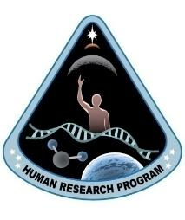
Thank You for Your Attention

