Slide 1
Analyzing the Subjectivity of Hole-Type Image Quality Indicators for Radiography
Erin Lanigan
NASA Marshall Space Flight Center
Nondestructive Evaluation Team
The 13th International Symposium on NDT in Aerospace 2021
5 October 2021

Slide 2
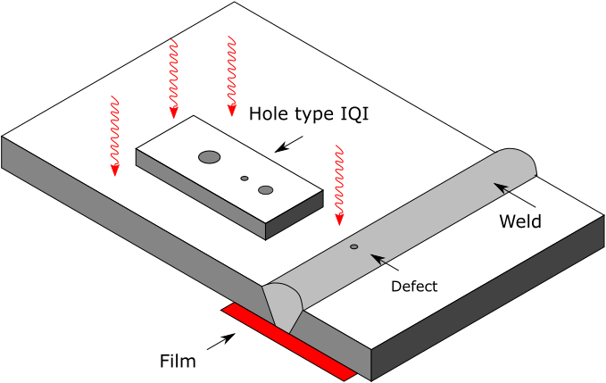
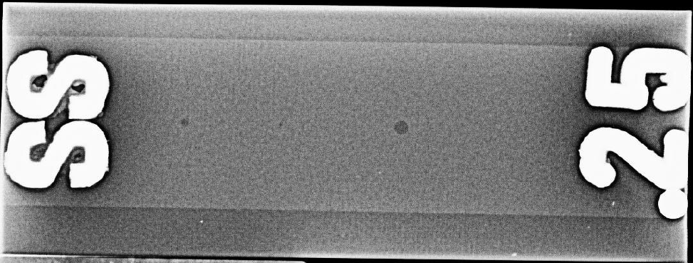
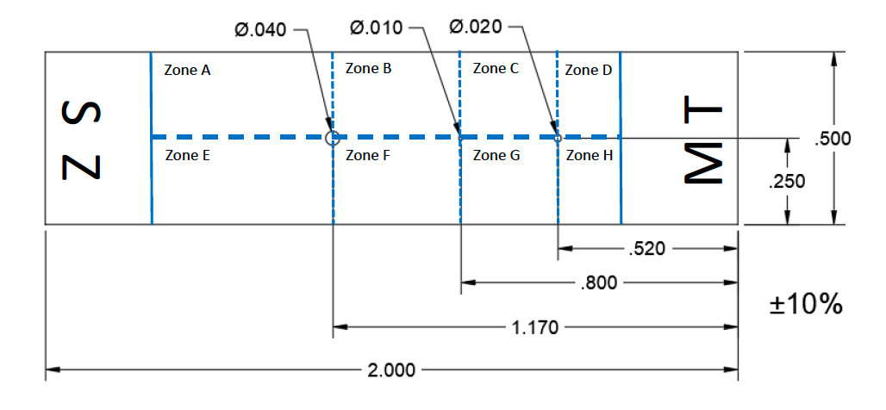
This presentation will explore the subjectivity of image quality indicators (IQIs) used for radiography.
Introduction to the Basis for IQIs
Subjectivity of Detection
Testing & Results

Slide 3
Image quality indicators are used to determine the sensitivity of a radiographic image.
ASTM E1742:
Radiographic Quality Level
2-1T
Ex:
Maximum IQI Thickness, %
Minimum Hole Diameter
Expressed as percentage of material thickness
Expressed as multiples of IQI thickness
1 or 2
1T, 2T, or 4T
From Apiexam.com “ASME V Radiology part 2.” Copyright Carlos F Melina. Used with permission.

Slide 4
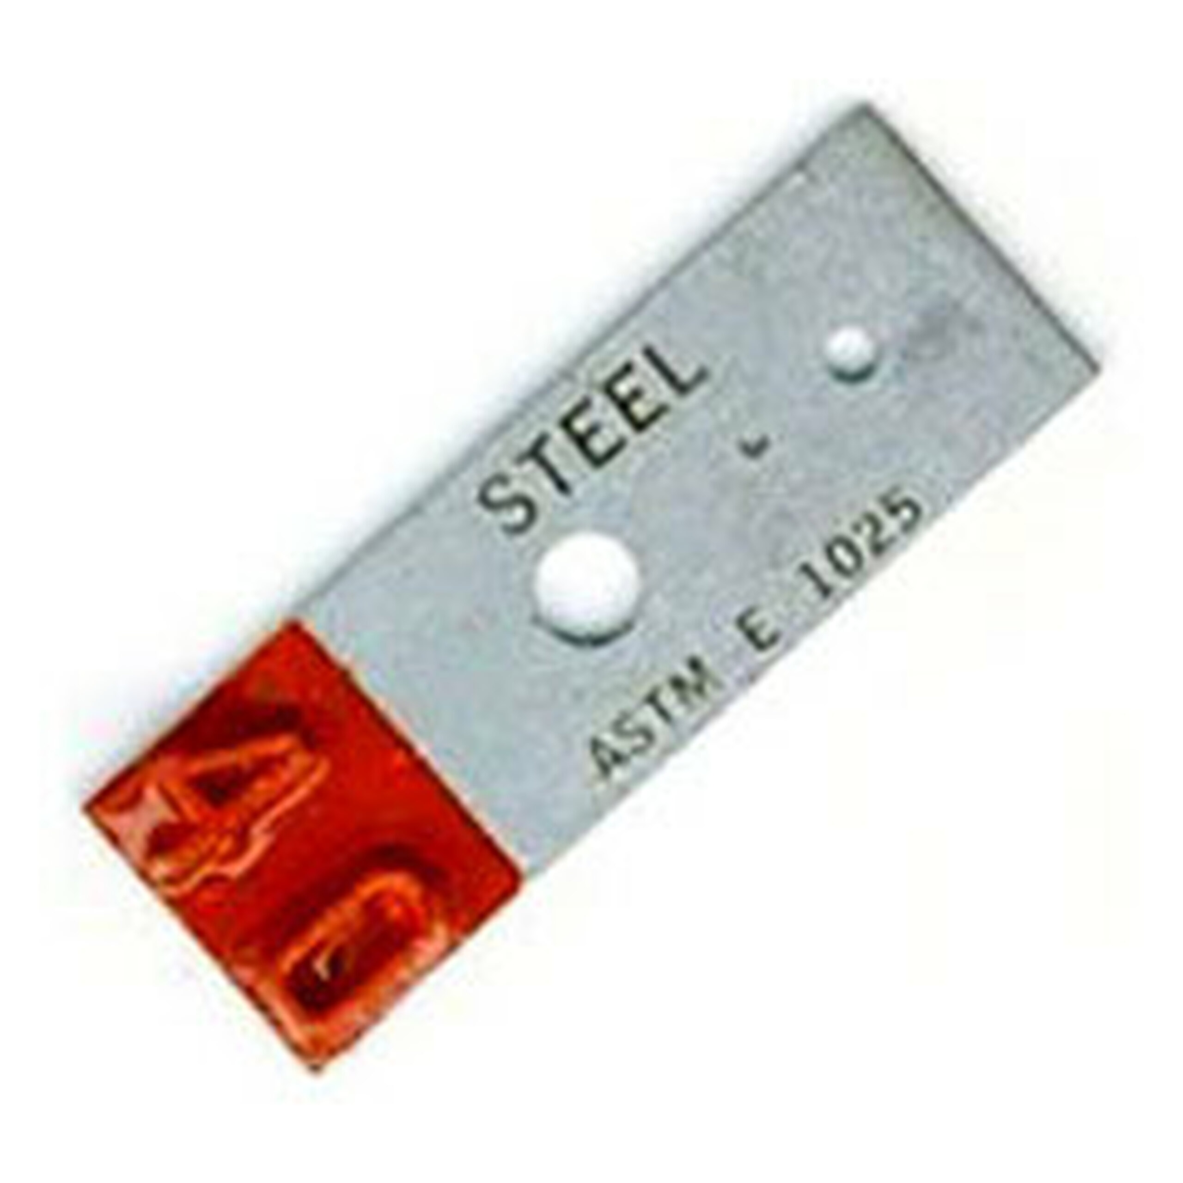
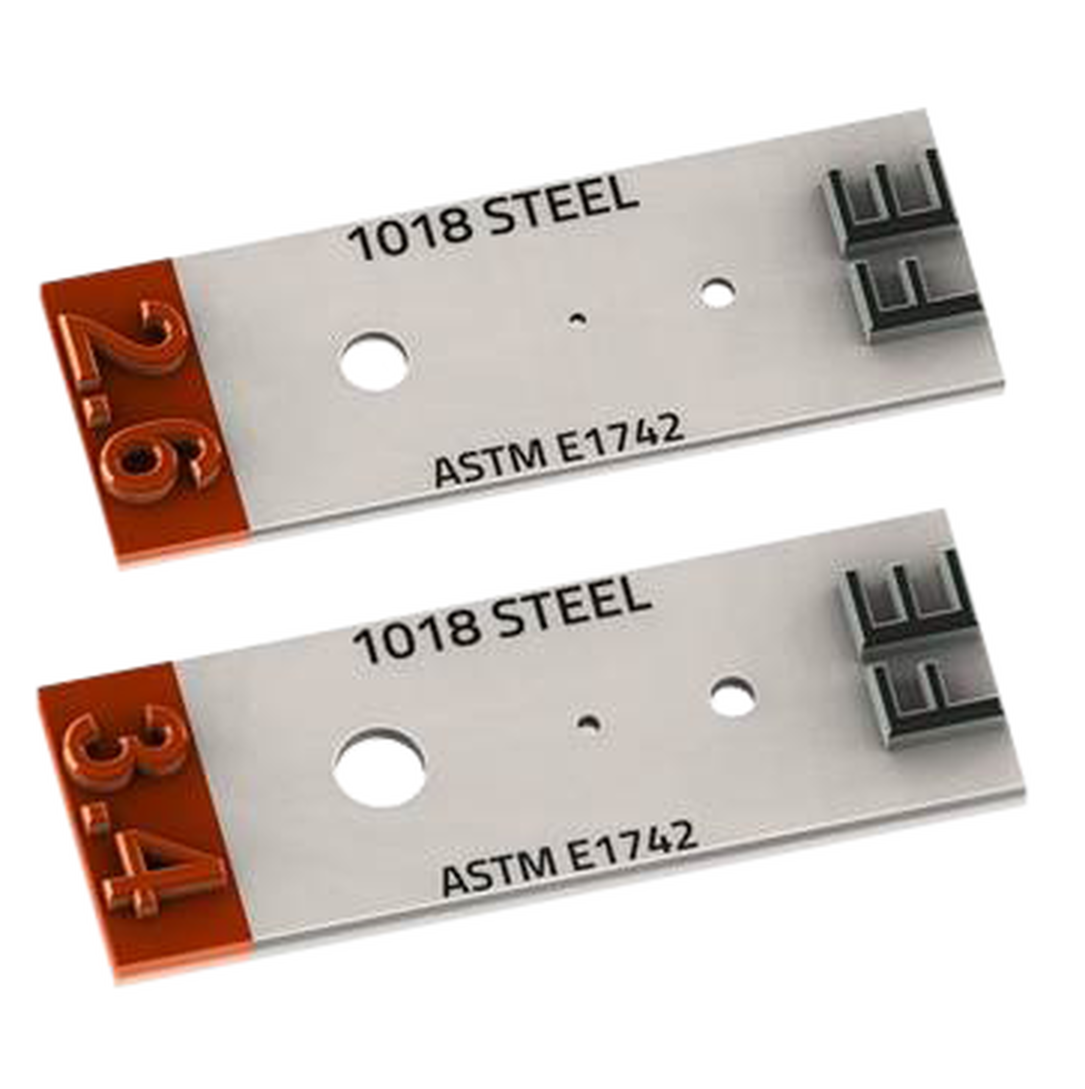
Hole-Type IQIs are designed per ASTM E1742 and E1025.
Alternate Design
ASTM E1025
ASTM E1742 Annex A1
2T
1T
2T
4T
1T
4T
Panel Thickness
ID #
From NDT Supply. “ASTM-E-1025”
From NDT Supply. “ASTM-E-1742”
1.5” x 0.75” for most thicknesses
2” x 0.5” for most thicknesses

Slide 5
NASA-STD-5009 requires detection of the 1T-sized hole.
ASTM E1742:
Radiographic Quality Level
1T
2T
2-1T
4T
Ex:
Panel Thickness
Maximum IQI Thickness, %
Minimum Hole Diameter
Expressed as percentage of material thickness
Expressed as multiples of IQI thickness
From NDT Supply. “ASTM-E-1742”
1 or 2
1T, 2T, or 4T

Slide 6
Oftentimes when the 1T hole is detected, it is still very low contrast.
From NASA Marshall Space Flight Center

Slide 7
The noise in the image is often around the same size, shape, and grey level as the 1T hole.
IQI for 0.125” thick stainless steel weld panel, 200 kV, computed radiography with Fuji scanner
From NASA Marshall Space Flight Center

Slide 8
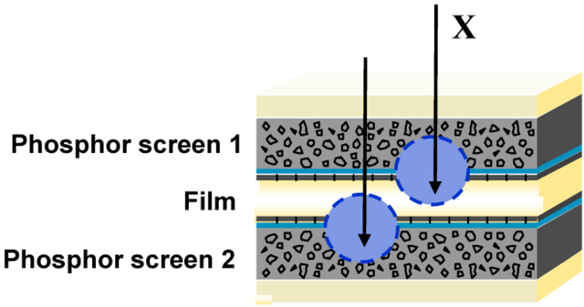
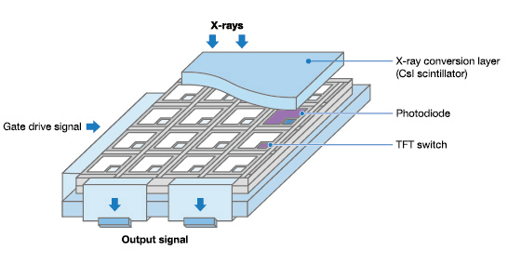
There are differences in film, computed, and digital radiography.
From NASA Engineering & Safety Center
From Leblans, P.; Vandenbroucke, D; Wilems, P. Wikimedia Commons. Creative Commons 3.0.
From Beevil. Wikimedia Commons. Creative Commons 4.0.
From Canon. “X-ray Flat Panel Detector.” Fair use.

Slide 9
Concept: randomize the 1T hole placement, to see if knowledge of its location is influencing detection.
From NASA Marshall Space Flight Center
From ASTM E1742:
For 2-1T:
“Minimum IQI thickness = 0.005 in. ± 10 %.”
“Minimum diameter for 1T hole = 0.010 in. ± 10 %.
(Hole is not 1T for thicknesses less than 0.010 in.)”
Corresponds to 0.25” or thinner
1T is technically 2T

Slide 10
To test this hypothesis, a probability of detection study was designed.
Want to achieve 90% probability of detection (POD) with 90% confidence
For a single defect size:
Must have at least 29 defects
Must have 3x as many non-defect zones
Must detect 29 defects
From NASA Marshall Space Flight Center
Used a random number generator to assign hole placements.
~120 total zones, 8 zones per IQI
15 IQIs needed

Slide 11
Adding 1T-sized holes requires very precise micro-machining.
Manufacturer’s 1T Hole
Too Large
Misshapen
0.0100”
0.0143”
0.0109”
Diam
0.010”
± 10%
Min
0.009”
Max
0.011”
Too Small, Incomplete (Front/Back)
MSFC 1T Hole
0.0081”
0.0068”
0.0101”
From NASA Marshall Space Flight Center
From NASA Marshall Space Flight Center

Slide 12
Aluminum computed radiography inspections showed poor detectability.
Al 2219, Tested on 0.125” Panel (IQI Thickness 4%)
Mini-Focus (120 kV, 4.5 mA)
Inspector | TP | Total | Detection | FP
1 | 10 | 31 | 32% | 31
2 | 10 | 31 | 32% | 17
Micro-Focus (120 kV, 0.3 mA)
Inspector | TP | Total | Detection | FP
1 | 18 | 31 | 58% | 12
From NASA Marshall Space Flight Center

Slide 13
Inconel computed radiography inspections had much better detectability.
In 718, Tested on 0.125” Panel (IQI Thickness 4%)
Mini-Focus (240 kV, 2.9 mA)
Inspector | TP | Total | Detection | FP
1 | 22 | 29 | 76% | 12
2 | 21 | 29 | 72% | 12
Micro-Focus (130 kV, 0.3 mA)
Inspector | TP | Total | Detection | FP
1 | 28 | 29 | 97% | 0
2 | 27 | 29 | 93% | 5
From NASA Marshall Space Flight Center

Slide 14
Film had about the same detectability as mini-focus CR, but better detectability than micro-focus CR.
Tested on 0.125” Panel (IQI Thickness 4%)
Al 2219
In 718
Mini-Focus (120 kV, 4.5 mA)
Mini-Focus (240 kV, 2.9 mA)
Inspector | TP | Total | Detection | FP
1 | 8 | 31 | 26% | 9
Inspector | TP | Total | Detection | FP
1 | 24 | 29 | 83% | 19
Micro-Focus (120 kV, 0.3 mA)
Inspector | TP | Total | Detection | FP
1 | 22 | 31 | 71% | 9

Slide 15
Digital radiography showed poor results due to low quality images.
Tested on 0.125” Panel (IQI Thickness 4%)
Al 2219
In 718
Micro-Focus (130 kV, 4.5 mA)
Micro-Focus (300 kV, 2.3 mA)
Inspector | TP | Total | Detection | FP
1 | 5 | 31 | 16% | 14
Inspector | TP | Total | Detection | FP
1 | 9 | 29 | 31% | 12
More testing is needed on this system.

Slide 16
None of the PODs rose to the 90/95 threshold used in NASA-STD-5009.
*Note: This is the POD threshold for flaw detection.
Adapted for use in this POD study.

Slide 17
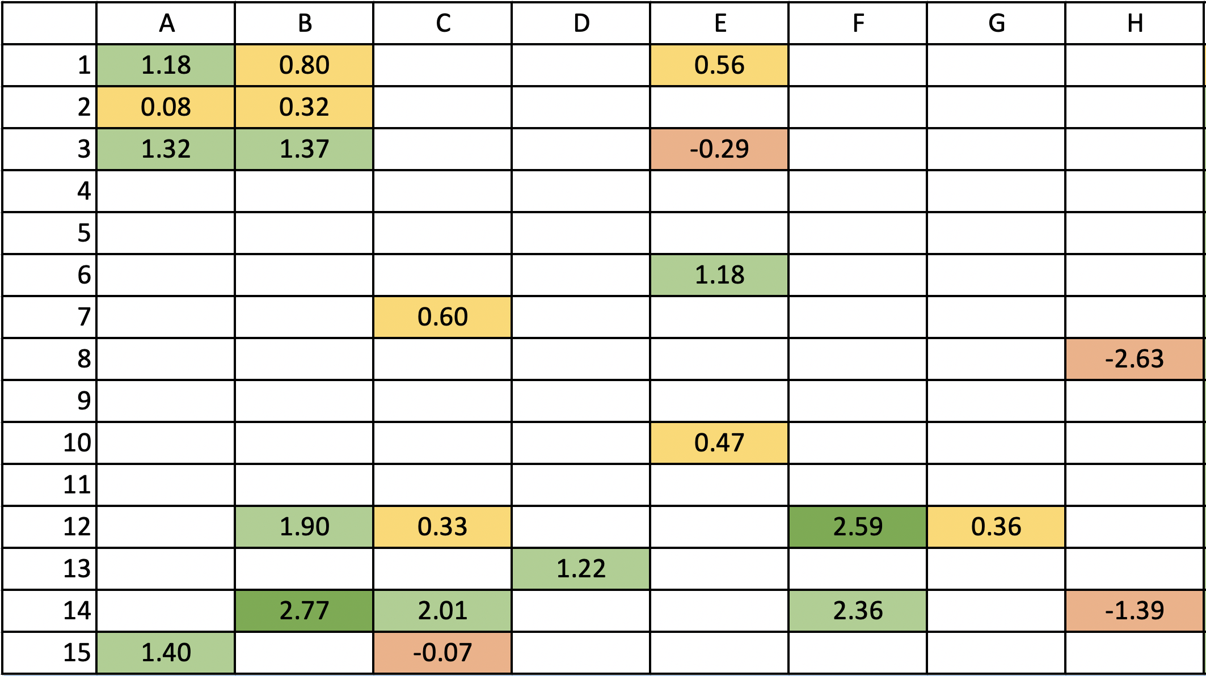
Contrast-to-noise ratio does not correlate well with visible detectability.
Zone
$$CNR=\frac{(Signal−Noise)}{Noise}$$
Signal below noise
$$CNR<0$$
IQI
#
Contrast below noise
$$CNR<1$$
Contrast above noise
$$CNR>1$$
Meets NASA-STD-5009b
$$CNR>2.5$$
From NASA-STD-5009b:

Slide 18
In conclusion, knowing the location of the 1T hole does influence the likelihood of detection.
This may be okay, if the 1T hole is actually visible.
The high rate of false positives indicates that noise is easily mistaken for 1T holes.
If the 1T hole is misidentified, the desired sensitivity may not be achieved.
Is the 1T sensitivity level attainable? Is it necessary?
Are there better indicators of image sensitivity?
Can CNR, SNR, etc. be using to quantify detectability?
Thank you for your time!
Questions?
What’s next?
More testing to validate findings
Test larger 1T hole sizes
Investigate sensitivity level needed to find defects of interest
Compare to other types of IQIs (ex: wire-type, crack IQI)
Procedures for optimizing sensitivity

