Slide 1
System-Level Model-Based Risk Determination for Lunar Mission Design
Matthew Wittal
Shaun Butts
Robotic & Autonomous Systems, Granular Mechanics and Regolith Operations Laboratory & Gateway Deep Space Logistics Project
NASA Kennedy Space Center
Fleet Manager, Gateway Deep Space Logistics Project
NASA Kennedy Space Center
2021 IAASS Conference

Slide 2
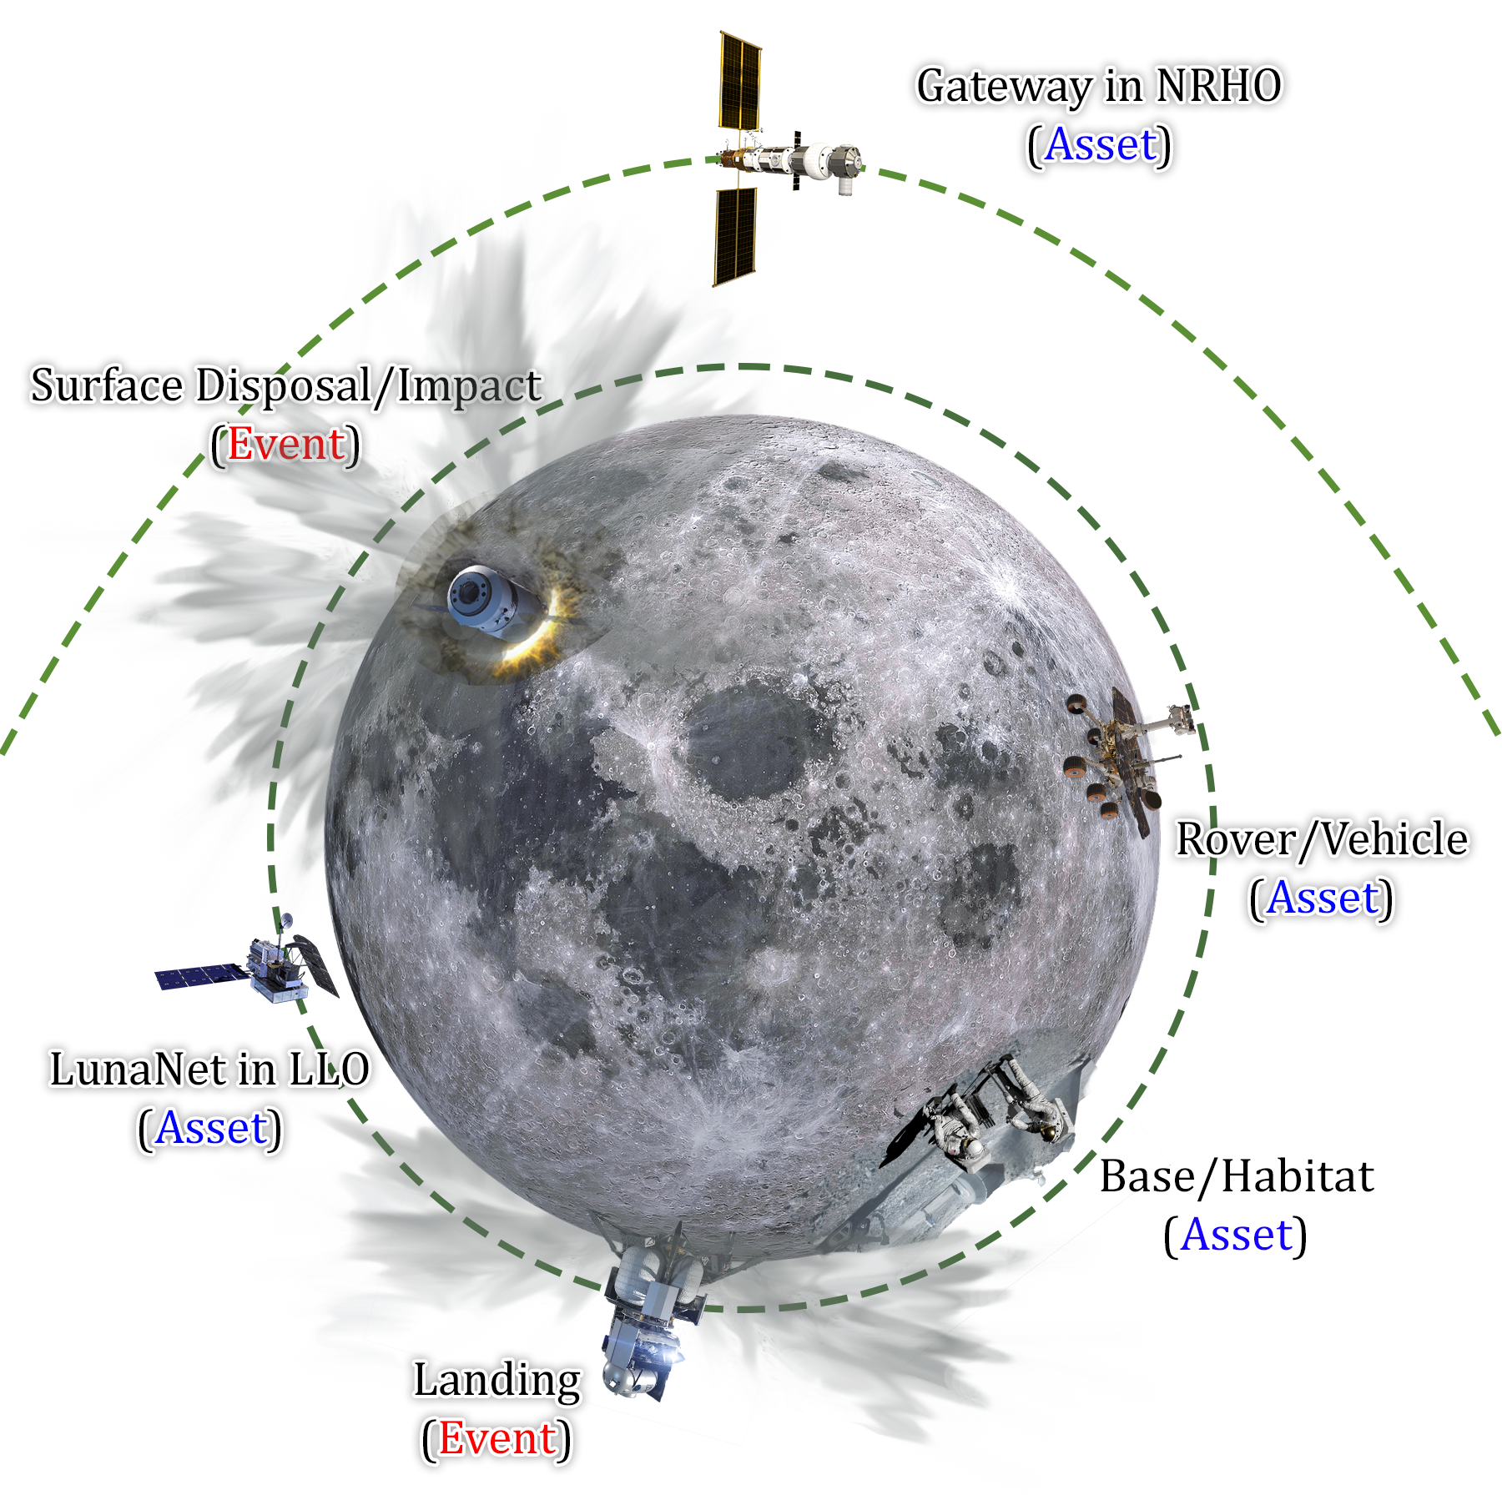
Background
Events on the lunar surface are not as isolated as they are on Earth.
High-velocity lunar dust from landings or impacts can affect assets on the ground or in orbit even on the opposite side of the moon.
It is of interest to consider the risk imposed by these events in the design of your spacecraft.
Generalized mathematical and system methodologies are not known to exist for lunar dust on this scale.
2021 IAASS Conference

Slide 3
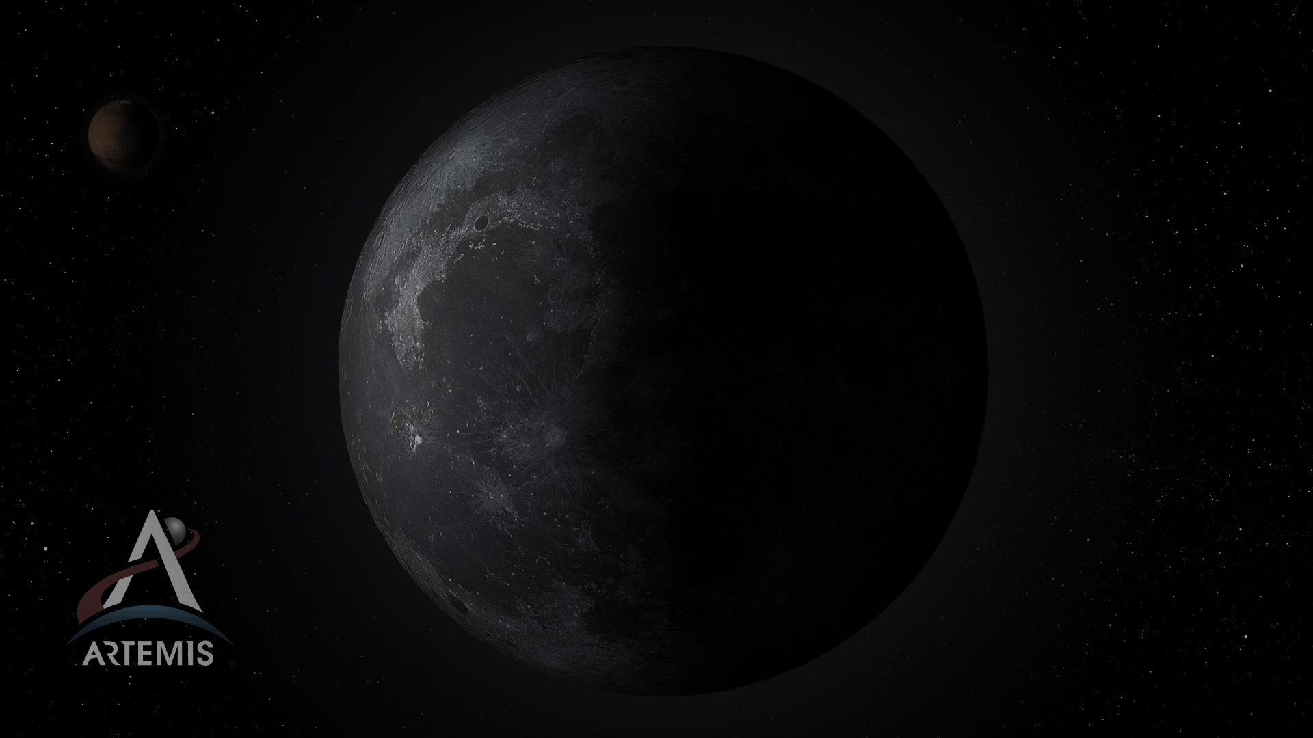
Objectives
This project seeks to develop a model-based approach for evaluating risk imposed by both natural and induced high-velocity lunar dust. This involves:
Developing a generalized mathematical methodology for an arbitrary ‘event’ as it relates to an arbitrary ‘asset’ at any location on or near the Moon.
Developing a generalized model-based methodology which can be applied to a system composed of an arbitrary number of ‘events’ and ‘assets’.
Quantify lifetime risk due to these events upon any asset.
2021 IAASS Conference

Slide 4
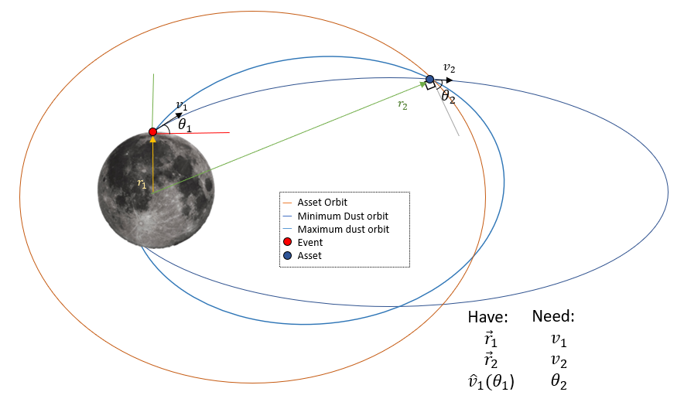
Assumptions
Mathematical model needed to generalize a range of trajectories as determined by departure vector from the lunar surface and constrained by the asset location.
Assumptions
  Asset is stationary
  Moving sufficiently slow relative to the difference in velocity from one trajectory to another.
  Asset is close to the Moon
  Only lunar gravity is considered due to the geometric approach of the solution.
  Event is binary in nature
  Either landing with ejecta angles between 1 and 3 degrees or impact with ejecta angles between 1 and 45 degrees
  Moon is spherical
  No geographical features or oblateness considered
  Space is black and empty
  No electromagnetic forces are considered, which plays a role in high-velocity particles below 10 microns.
2021 IAASS Conference

Slide 5



Mathematical Model 1
Mathematical models for lunar dust and ejecta are distinct, but related. We begin with the formula by Housen & Holsapple (2006):
Which holds for vertical impact events only. We can augment and simplify this for landing events if we know the Mass of the landing vehicle, based on experimental evidence from Lane & Metzger (2016):
Finally, by making a substitution to describe the “impactor” and scaling the dust mass based on the methodology described in Wittal et al (2020), we arrive at:
2021 IAASS Conference

Slide 6




Mathematical Model 2
Now that we have estimated the amount of mass ejected and it’s velocity distribution, we must calculate the specific velocities required to impact our arbitrarily located asset.
We begin with conservation of energy via the Vis Viva equation:
Which may be rearranged to yield:
We then move to conservation of angular momentum:
Which may be rearranged to yield:
2021 IAASS Conference

Slide 7


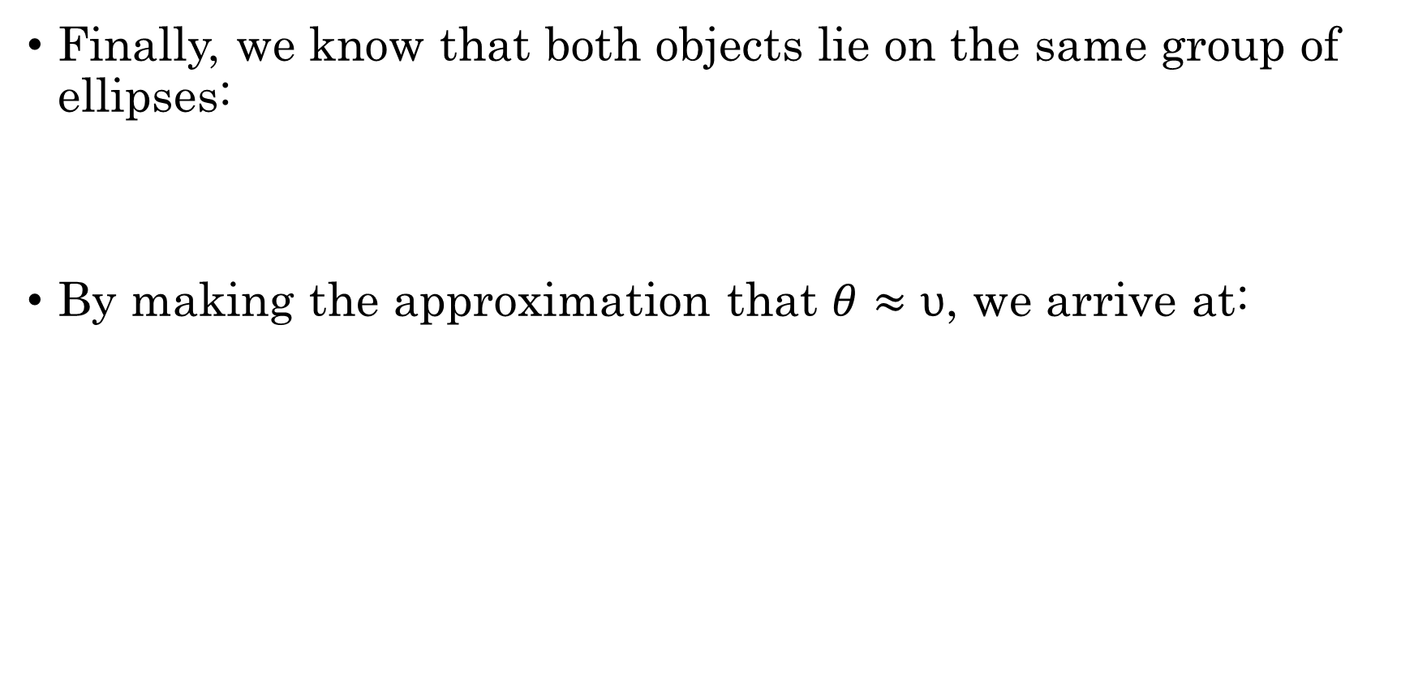
Mathematical Model 3
Finally, we know that both objects lie on the same group of ellipses:
By making the approximation that $θ≈υ$, we arrive at:
2021 IAASS Conference

Slide 8
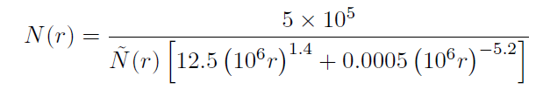
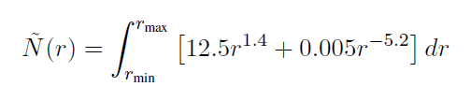
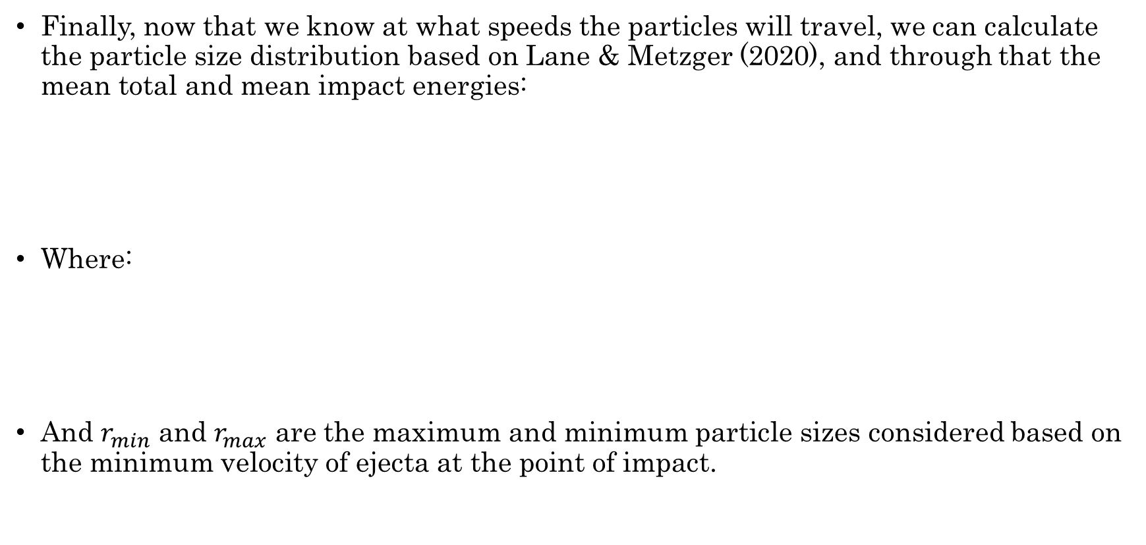
Mathematical Model 4
Finally, now that we know at what speeds the particles will travel, we can calculate the particle size distribution based on Lane & Metzger (2020), and through that the mean total and mean impact energies:
Where:
And $r_{min}$ and $r_{max}$ are the maximum and minimum particle sizes considered based on the minimum velocity of ejecta at the point of impact.
2021 IAASS Conference

Slide 9
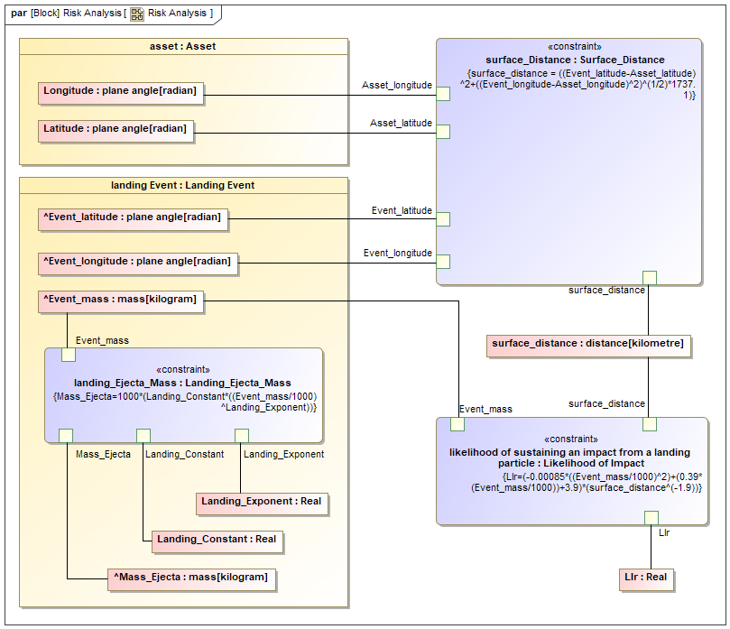
MBSE Model
Modeling for this project was performed in the Magic Draw software.
Each formula was modeled as a constraint.
Assets and Events were generalized and specified in instances that contained location and mass properties i.e.:
Events: HLS Landing, CLPS landing, Chang’e Landing, Logistics Module Impact, Meteor Impact, etc.
Assets: Apollo 11 Heritage site, Gateway, Lunar base, LunaNet, South Pole Base, etc.
2021 IAASS Conference

Slide 10
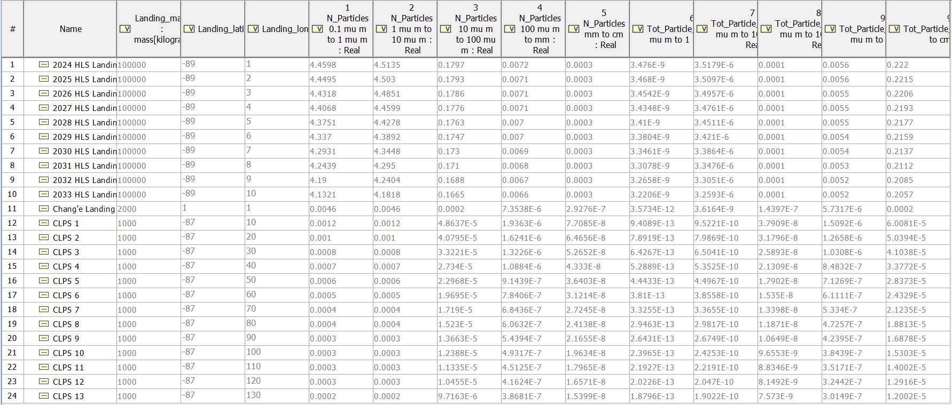
Results
2021 IAASS Conference

Slide 11
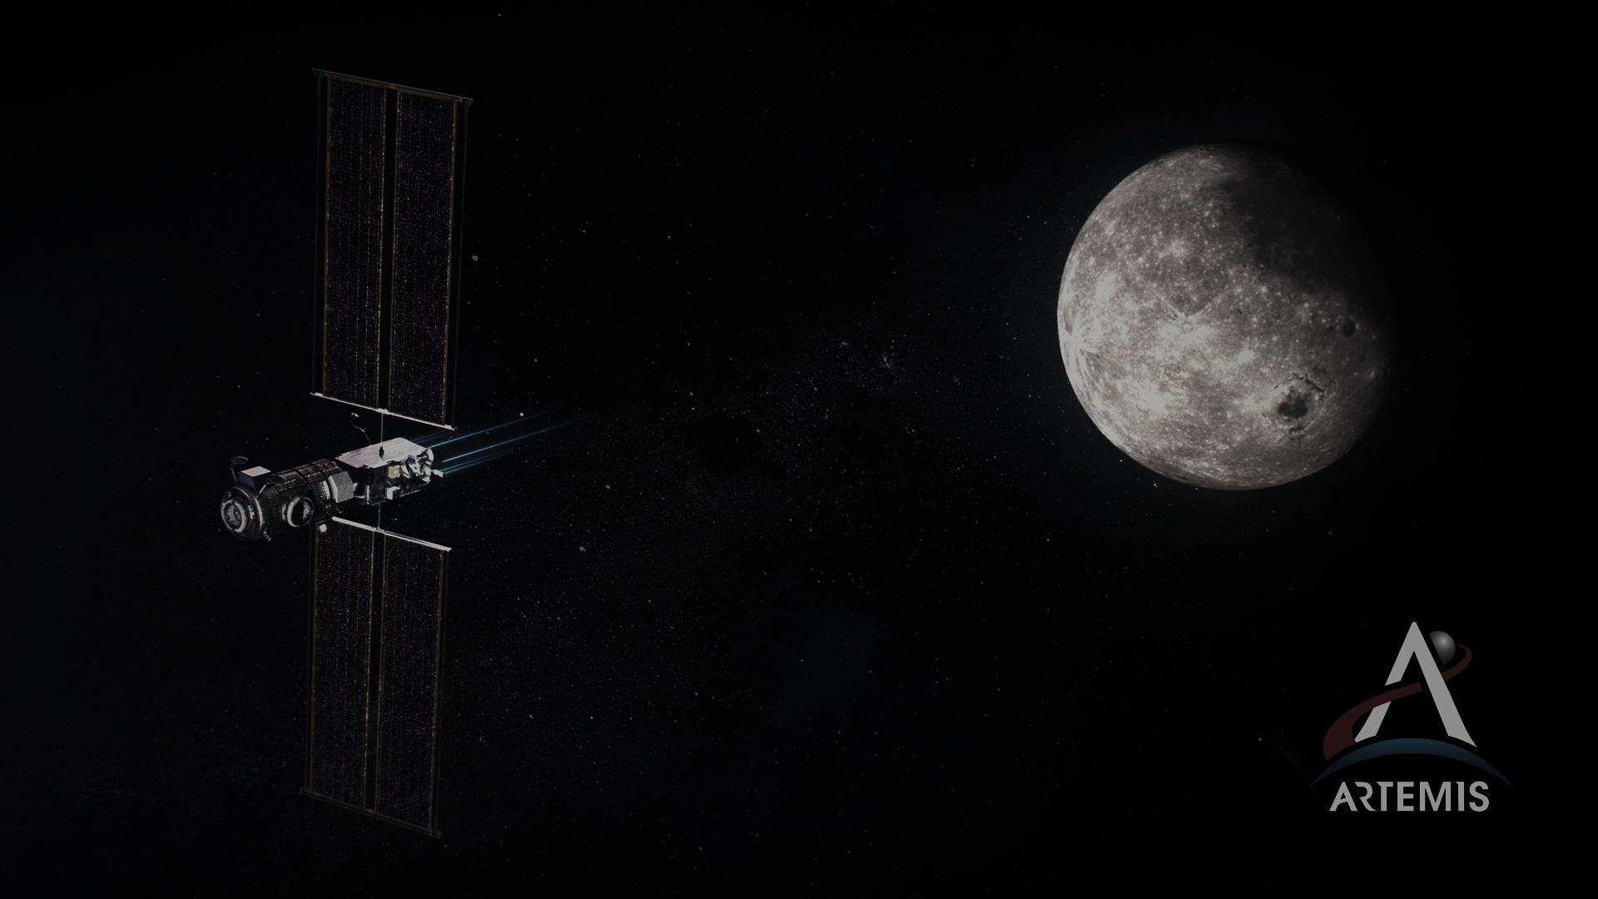
Discussion
Any surface-to-surface interaction can expect several impacts for any given event
Surface-to-orbit interactions can expect impacts based on relative location during event
Damage can be mitigated by minimizing cross-sectional area, or facing sensitive equipment away from oncoming particles
ANY asset not shielded by local topography or advantageous orbital geometry can expect to be hit by many high-velocity particles over its lifetime
2021 IAASS Conference

Slide 12
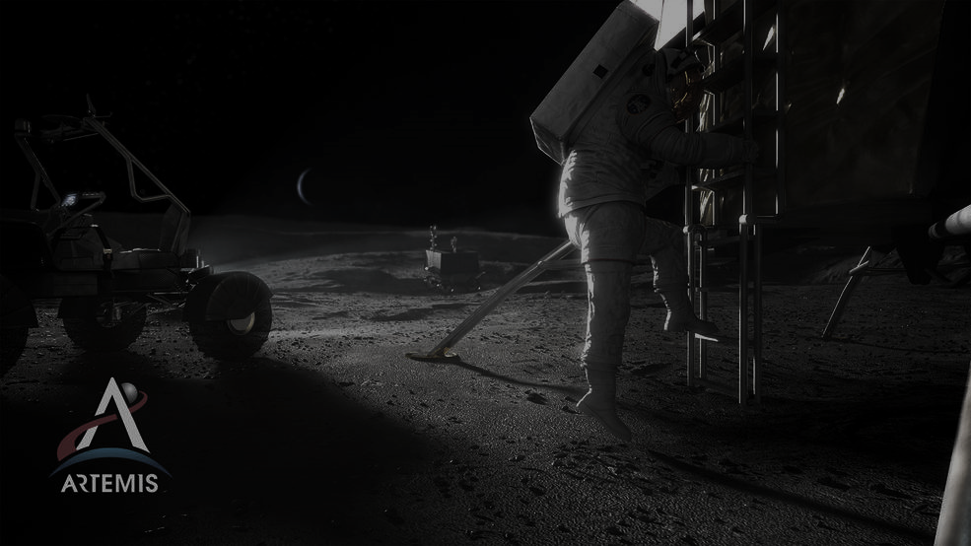
Future Work
Further generalize particle interactions and physics:
  Consider multibody dynamics
  Consider electromagnetic forces
  Build in a more robust mathematical model
Expand model-based approach to risk analysis and mitigation
  Expand scope to include more than just high-velocity dust
  Streamline model
  Improve usability and user-friendliness
  Eliminate the dependency on local Matlab Interpreter
Solicit and integrate input from the community about their needs and expectations for Lunar operations and activities.
2021 IAASS Conference

Slide 13
Thank you! Questions?
2021 IAASS Conference

