Slide 1
A-Train Exit Options
September 28, 2021
Aqua
Bill Guit
Aqua Mission Director - Code 584/428
Mission Validation and Operations Branch
Earth Science Mission Operations Project
NASA/Goddard Space Flight Center
William.J.Guit@nasa.gov

Slide 2
Background
2008: Afternoon Constellation Operations Coordination Plan (Rev 1)
  The apogee of a spacecraft that has exited the constellation must be at least 2 kilometers below the minimum perigee of all current constellation members
  To effectively exit the Constellation, the spacecraft’s maximum apogee must be lowered 19 km, to 692 km, which is below the constellation members’ minimum perigee
2009: PARASOL analyzed and demonstrated a 4 km exit was safe
2015: Ops Coordination Plan for the Morning and Afternoon Constellations
  Safe Constellation Exit is defined by being completely outside the “Constellation Envelope”
  To effectively exit the Constellation, exited spacecraft’s maximum apogee will be always at least 4 km below the Constellation Envelope
2016: CCR #17 Reduced the 4 km required separation to 2 km
2017: Aqua Extended Science Mission after A-Train Exit Proposed
  January 2022 Constellation Exit Maneuvers (CEMs) with immediate perigee lowering
  Near-circular exit of 4km plus 10% safety margin (4.58 km) – requires 4 CEMs
  Jan/Feb 2022 Perigee Lowering Maneuvers (PLMs) – 9 PLMs planned (12.3 km)
2020: Updated JSC ODPO DAS Solar Flux Model received in July 2020 meant that the approved Aqua Exit Plan no longer meets the 25-year reentry from end of science mission in late 2025.

Slide 3
Previous & Planned Exits
Missions that have exited the constellations:
  June 2005: SAC-C
  July 2006: EO-1
  December 2009: PARASOL
  June 2011: CloudSat (re-ascent completed in Summer 2012)
  January 2013: Landsat-5
  February 2018: CloudSat
  September 2018: CALIPSO
Missions planning to exit the constellations:
  January 2022: Aqua
  April 2022: Landsat-7
  October 2022: Terra
  Not Early Than (NET) July 2024: Aura

Slide 4
Summary of Options Analyzed
The EOS Flight Dynamics Support (FDS) Team analyzed several Aqua A-Train constellation exit options and Perigee Lowering Maneuver (PLM) options. The results have been compared to the Exit Plan that was presented at the Aqua Constellation Exit Review (CER) on May 17, 2021. Options analyzed include:
  1): 4.4-km Exit in Jan 2022 with immediate PLMs and passivation in Sep. 2025
    Presented at Aqua CER in May 2021 based on Aqua’s November 2020 Lifetime Analysis
    Updated 2021 version is now considered the new BASELINE
  2): 4.4-km Exit in Jan 2022 with PLMs delayed until passivation in Aug. 2026
  3): 2.2-km Exit in Jan 2022 with immediate PLMs and passivation in Sep. 2025
  4): 2.2-km Exit in Jan 2022 with PLMs delayed until passivation in Aug. 2026
  5): 4.4-km Exit in Mar 2023 with immediate PLMs and passivation in Sep. 2025
  6): 4.4-km Exit in Mar 2023 with Reduced Req. Power and passivation in Aug. 2026
  7): 4.4-km Exit in Mar 2023 with PLMs delayed until passivation in Aug. 2026
  8): Free-Drift Exit with PLMs in Jul 2026
  9): Free-Drift Exit with PLMs in Sep 2024
  10): Free-Drift Exit with PLMs in Jun 2024
See FDS derived parameters for each option on the next slide.

Slide 5
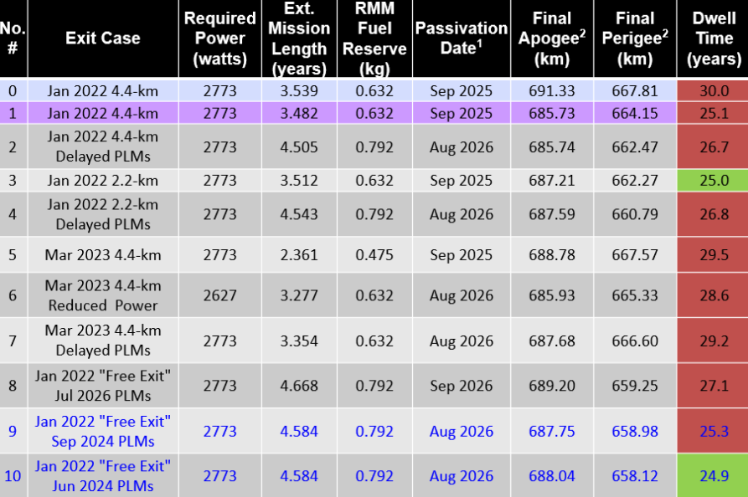
Summary of Options Analyzed
(9/1/2021)
Ref: FDS Aqua Lifetime and Decommissioning Analysis 9/1/2021 Presentation

Slide 6
Known Challenges and Lessons Learned
Since completion of the In Orbit Checkout (IOC) in August 2002, the spacecraft has never been in Earth Point Safe Mode nor Sun Point Survival Mode.
The MODIS Instrument has never had to close its Space View or Earth View Doors.
By design, the Aqua instruments have never been exposed to direct sunlight.
The spacecraft was designed to perform end of mission A-Train Exit and perigee lowering retrograde maneuvers on thrusters after completion of the science mission.
Aqua science collection is expected to continue after January 2022 which required evaluation on how to achieve best science and minimize risks to instruments.

Slide 7
New Aqua A-Train Exit Option
“Free-Drift/No-Exit”
The new Aqua A-Train “Exit” Plan that would provide the highest quality Aqua science data for the longest possible time is a “Free-Drift” approach.
Starting in January 2022, to conserve the maximum amount of fuel for lowering perigee, Aqua would only perform Risk Mitigation Maneuvers (RMMs) and delay PLMs. No DMUMs nor CEMs.
  PRO: Provides highest quality Aqua science data until PLMs
  PRO: Delays the Spacecraft Power Limitation from Sep. 2025 to Aug. 2026
  PRO: Provides additional time to work through technical challenges
    Battery DOD and End-of-Night (EoN) Load Bus Voltage (LBV) Under-voltage risk
    Shift of PLM location to orbital midnight requires additional analysis
Based on past “crossing” experience this approach is considered safe from an orbit conjunction/crossing perspective.
  Orbital Safety will be addressed at Delta-CER at November ESC MOWG
Additional PROs and CONs on the next slide

Slide 8
“Free-Drift/No-Exit”
PROs and CONs
Delaying/Eliminating the Constellation Exit Maneuvers (CEMs) and delaying the Perigee Lowering Maneuvers (PLMs) until June 2024 provides benefits and additional time to prepare.
Best for Science, Lowest Risk, Dwell Time < 25-Years (FDS # 24.9 years)
  PRO: Will not have to close the MODIS Doors in January 2022.
  PRO: Will delay exposing the Aqua instruments to direct sunlight. (maybe eliminate)
  PRO: Will not stress the EPS Battery beyond where it has been operating in Jan. 2022
  PRO: Delays the possibility of an unexpected undervoltage, instrument load shedding, and transition to Safe and/or Survival in Jan. 2022. (FOT testing to mitigate the risk)
  PRO: Provides additional time to prepare for an A-Train Exit simply by lowering the perigee.
    FDS analysis indicates that June 2024 PLMs followed by passivation in August 2026 will meet 25-year Reentry Requirement.
  CON: Would require that the Aqua End of Mission Plan (EOMP) be updated.
  CON: Doesn’t satisfy the Constellation Envelope Equation.
    Aqua is NOT Exiting the Constellation
  CON: Requires another Constellation Exit Review (Delta-CER)
  CON: It’s a new and different approach.

Slide 9
Aqua No A-Train Exit in 2022
June 2024 PLMs, continue science until Aug 2026
PROs
Will not have to close the MODIS doors in January 2022 or maybe ever.
Will not expose the Aqua instruments to direct sunlight in January 2022.
Will not stress the EPS Battery beyond where it has been operating. (12-13 % DOD)
Eliminates the possibility of an unexpected undervoltage, instrument load shedding and transition to Safe and/or Survival in Jan. 2022. FOT Testing to mitigate this risk – either case
Provides additional time to prepare for an A-Train Exit based on the 13:45 mission MLT requirement or possibly later date. PLMs in June 2024, with science operations until August 2026, results in a Dwell Time of 24.9 years. (No Waiver Required – a “PRO”)
CONs
Will have to close MODIS doors in June 2024.
Will likely in June 2024, but a change in PLM location to orbital midnight should minimize the instrument exposure. (Terra-based approach)
PLMs in June 2024 will stress EPS/Battery.
Require that the Aqua End of Mission Plan (EOMP) be updated. [DONE – Under Review]
Doesn’t satisfy the Constellation Envelope Equation.
Requires a Delta Constellation Exit Review.
It’s a new and different approach. (But Safe)

Slide 10
Aqua Spring 2021 Lifetime and Decommissioning Analysis
9/1/2021 – v1
Plots & Tables
Compilation of Selected Plots
Aqua
Ref: FDS Aqua Lifetime and Decommissioning Analysis 9/1/2021 Presentation
Notes:
3

Slide 11
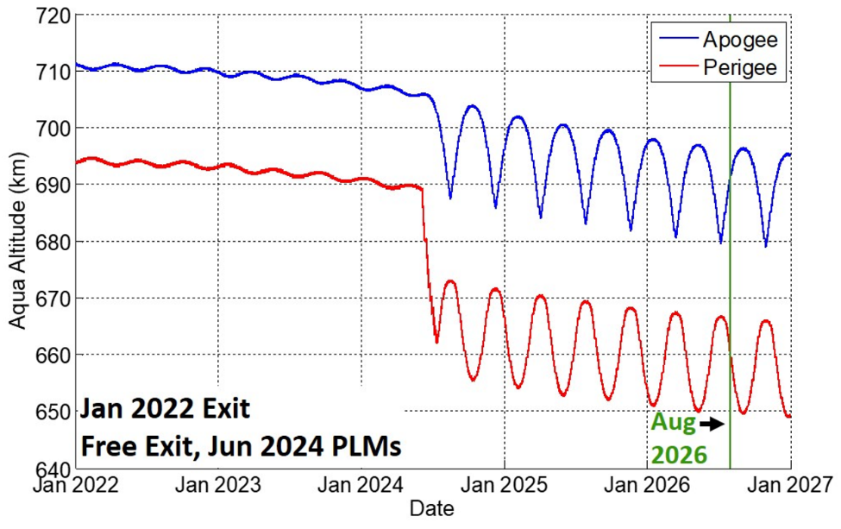
January 2022 Free-Drift/No-Exit
June 4th – July 12th, 2024 PLMs
Passivate/Decommission August 2026
Schatten Solar Flux Model (SFM)
DAS SFM
January 2022
Free-Drift/No-Exit
June 2024 PLMs

Slide 12
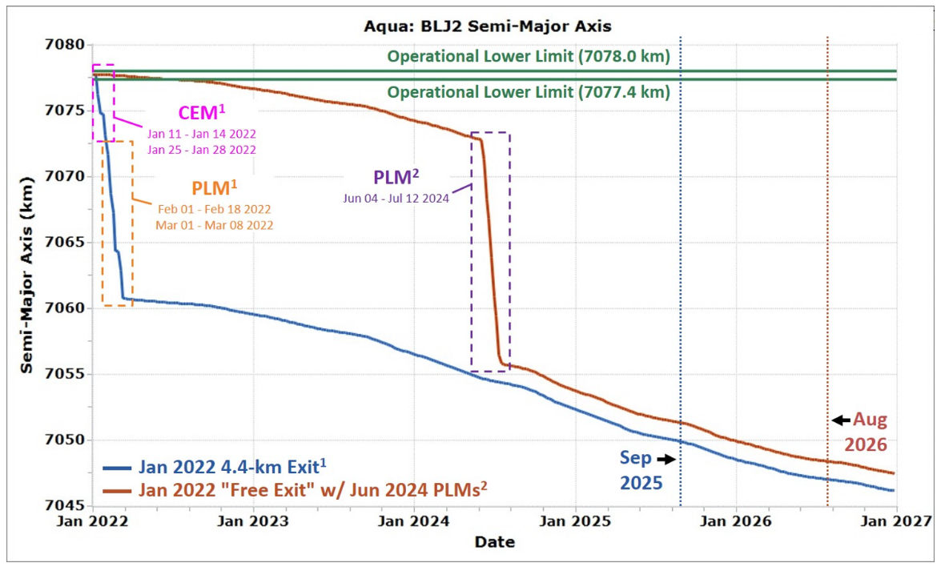
Semi Major Axis (SMA)
Jan 2022 Baseline vs. Free-Drift/No-Exit:
June-July 2024 PLMs

Slide 13
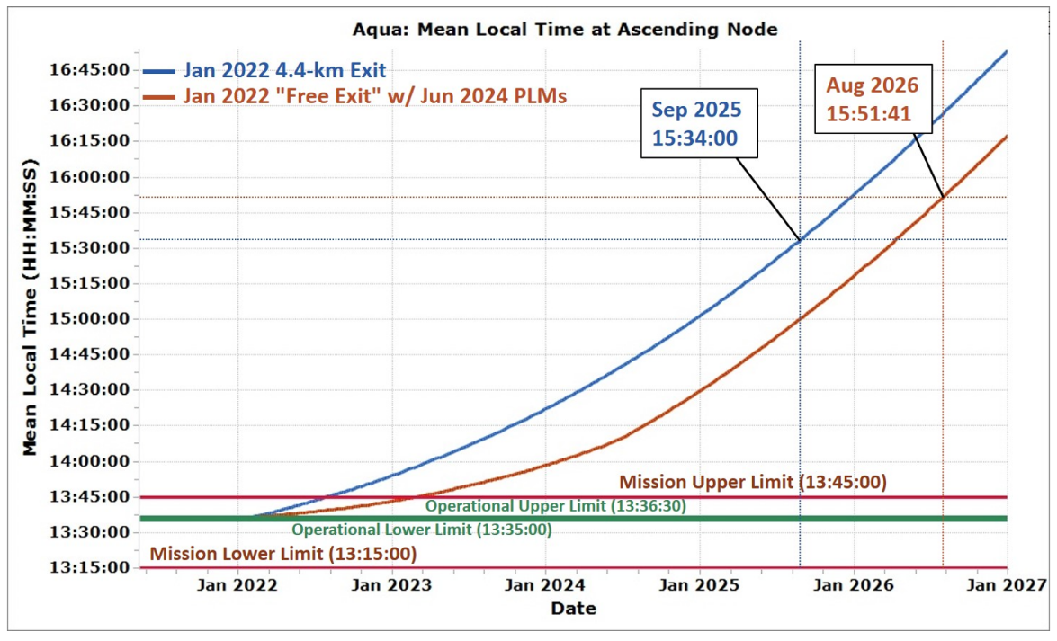
Mean Local Time (MLT)
Jan 2022 Baseline vs. Free-Drift/No-Exit:
June-July 2024 PLMs
Performing retrograde maneuvers causes the MLT rate to increase. By skipping CEMs and delaying PLMs to Jun 2024 we keep the MLT lower, which ultimately helps delay passivation to Aug 2026 in the "free-drift" case shown.

Slide 14
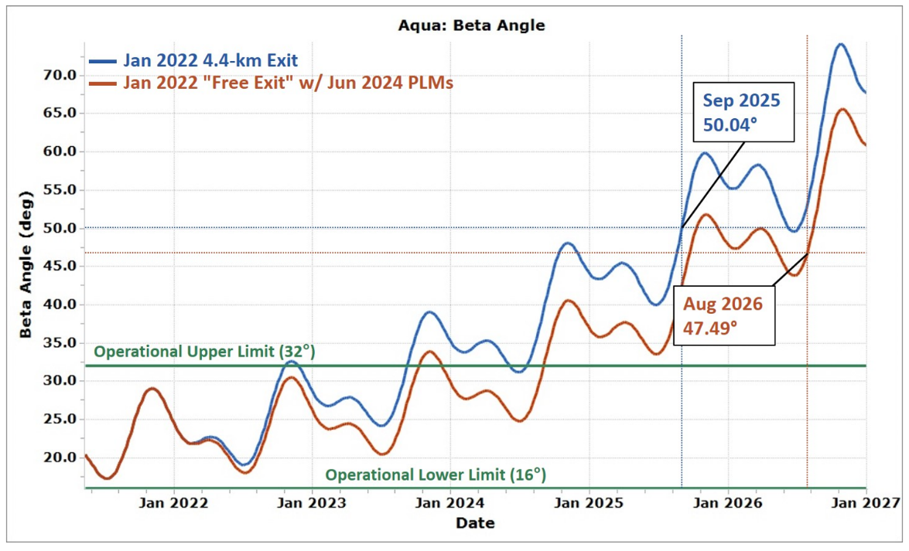
Solar Beta Angle
Jan 2022 Baseline vs. Free-Drift/No-Exit:
June-July 2024 PLMs
Performing retrograde maneuvers causes the beta angle to drift faster. By skipping CEMs and delaying PLMs to Jun 2024 we keep the beta angle lower and ultimately delay passivation to Aug 2026 in the "free-drift" case shown.

Slide 15
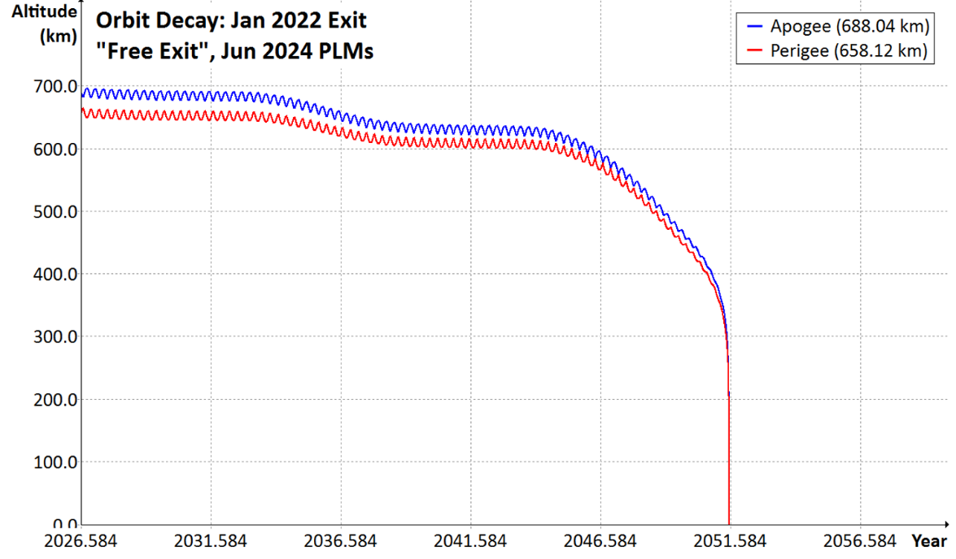
January 2022 Free-Drift/No-Exit
June 4th – July 12th, 2024, PLMs
End of Science Mission: August 2026
Apogee/Perigee in August 2026 for input to DAS
In August 2026, during passivation and the end of the fuel life, we will perform fuel depletion burns with the fuel being held as uncertainty (4.8 kg) and any remaining fuel allocated for RMMs (TBD kg). This will provide additional perigee lowering on top of those planned during the PLMs.

Slide 16
Next Steps
Gain approval of the Updated Aqua End of Mission Plan.
  GSFC
  NASA HQ - OSMA
  JSC ODPO
Ensure that ESC/A-Train International Partners accept and are agreeable with the proposed approach.
Gain approval from the ESC/A-Train Member Missions.
  Brief the Proposed Aqua Departure Plan (Today)
  If requested, generate Constellation Change Request.
  Conduct Delta Constellation Exit Review (Delta-CER) – Nov 15th
Monitor Aqua orbit decay rate to determine if adjustments need to be made.

Slide 17
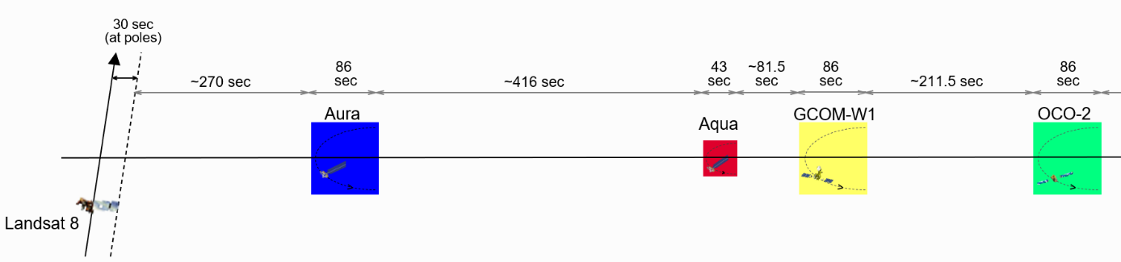
Orbit Evolution
Aqua vs. GCOM-W & OCO-2
1 January 2022 – 1 January 2024
If Aqua Stops Maneuvering
Aqua
Notes:
3

Slide 18
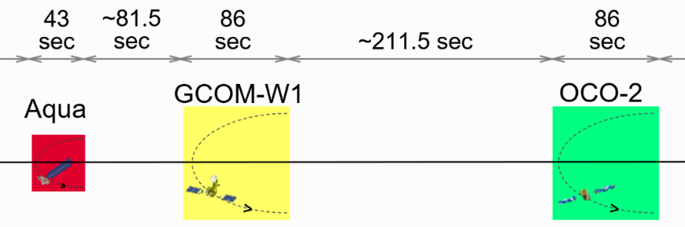
A-Train Control Box Spacing
What happens if Aqua stops performing drag make up maneuvers.
Aqua will slowly drag-down and exit the front of its Control Box and begin drifting towards GCOM-W1.
  Actual Drag in 2020: ~0.8 meters/day (~300 meters/year)
  Actual Drag in 2021: ~1.0 meters/day (~372 meters/year)
  Actual Drag in 2014: Solar Maximum (~2.3 km/year)
  Next Maximum predicted between Nov. 2024 and Mar. 2026

Slide 19
Aqua Stops Maneuvering
Scenario shown on the next few slides is just a sample analysis.
In this sample case study, Aqua stopped maneuvering with its last DMUM in November 2021. (date TBD)
Aqua will slowly drag-down and will exit the front of its +10-km control box.
Aqua will cross GCOM-W1 around 4/22/2022. (Min. Miss ~TBD km)
Aqua will drift away from GCOM-W1 slowly and cross OCO-2 around 6/28/2022. (Min. Miss ~TBD km) Aura crossings are predicted around 4/9/2023.
Aqua will cross GCOM-W1 again around 5/12/2023, OCO-2 around 5/20/2023 and Aura around 9/8/2023.

Slide 20
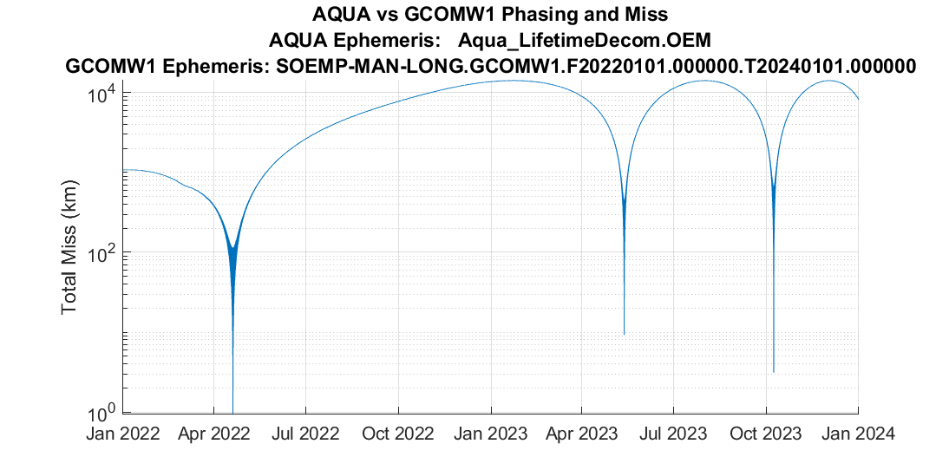
Aqua vs. GCOM-W1
Credit: SpaceNav
Phase angle approaches zero around the following dates: April 22, 2022, May 12, 2023, October 8, 2023

Slide 21
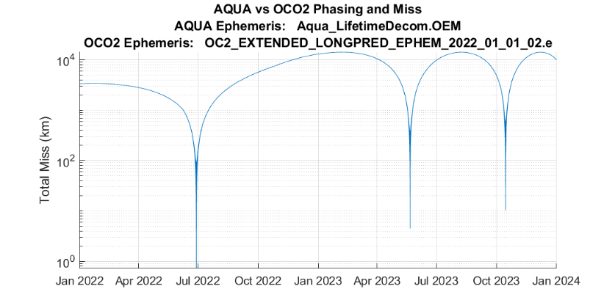
Aqua vs. OCO-2
Credit: SpaceNav
Phase angle approaches zero around the following dates:
  June 28, 2022, May 20, 2023, October 15, 2023

Slide 22
Backup Slides

Slide 23
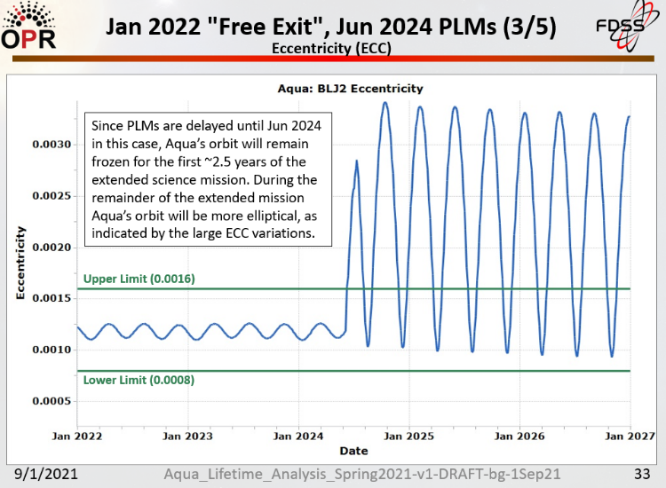
Ref: FDS Aqua Lifetime and Decommissioning Analysis 9/1/2021 Presentation

Slide 24
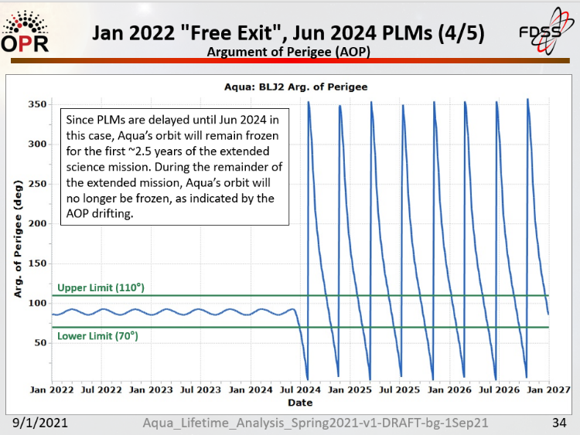
Ref: FDS Aqua Lifetime and Decommissioning Analysis 9/1/2021 Presentation

Slide 25
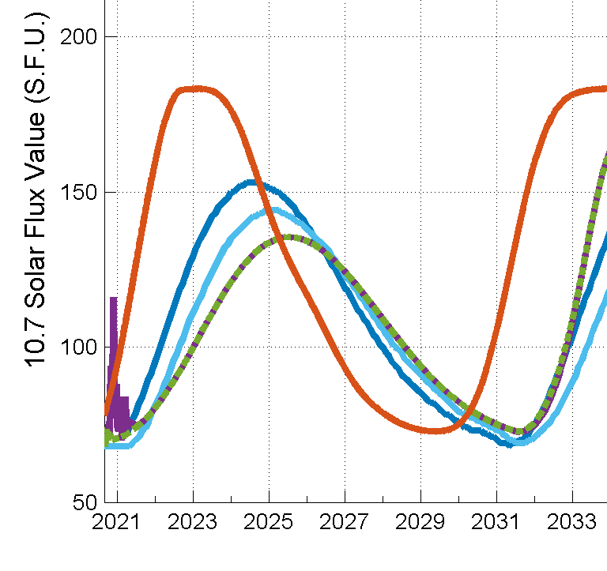

10.7cm Solar Flux Models Schatten and DAS
Potential Decommissioning
Sep 2025 or Aug 2026
Should Aqua lower its perigee in early 2024 to maximize drag

Slide 26
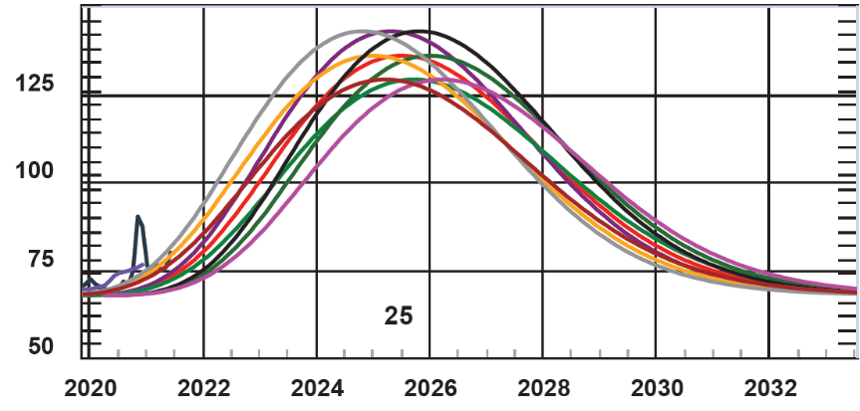
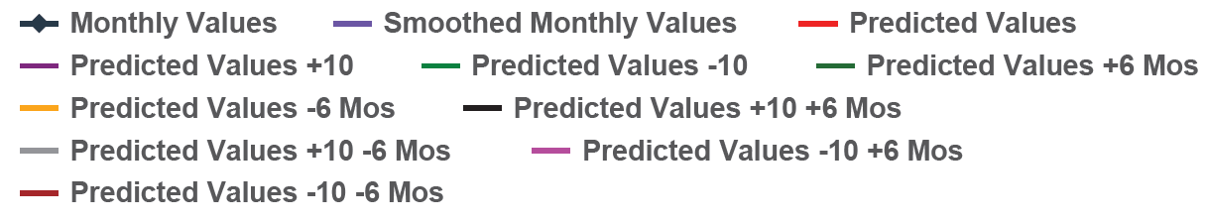
NOAA/SWPS 10.7cm
Solar Flux Models – Cycle 25

Slide 27
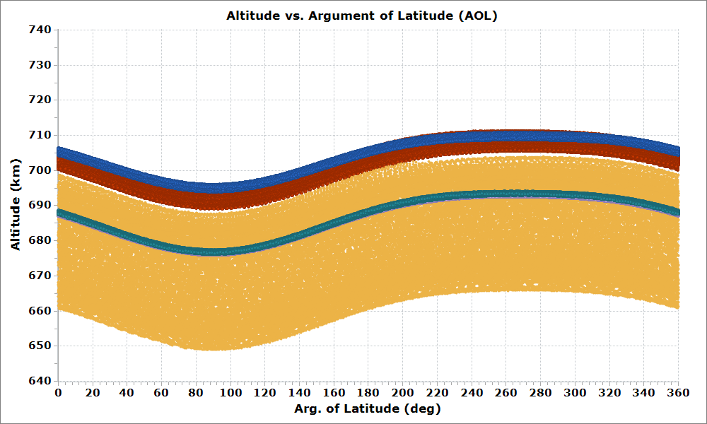
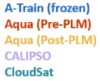
Aqua January 2022
"Free-Drift/No-Exit" Case
Ref: FDS Aqua Lifetime and Decommissioning Analysis 9/1/2021 Presentation
In this “Free-Drift" scenario, Aqua will drift through the A-Train until late-2023.
During that time there will be crossings with the remaining A-Train members.
After 2024 PLMs, Aqua will continue to drift until passivation in Aug 2026.
Aqua is not predicted to cross the C-Train altitude band before PLMs.
A-Train data is based on the ideal A-Train reference orbit.
Aqua data spans Jan 01, 2022 – Jan 01, 2027, excluding PLMs.
C-Train data uses ephemerides delivered for Aqua CER analyses and spans Jan 01, 2022 – Jan 01, 2023.

Slide 28
Abbreviations / Acronyms List
  AIRS – Atmospheric Infrared Sounder
  AOL – Argument of Latitude
  AOP – Argument of Perigee
  ATAT – After the A-Train
  CEM – Constellation Exit Maneuver
  CER – Constellation Exit Review
  CRMS – Collision Risk Management System
  DAM – Debris Avoidance Maneuver
  DAS – Debris Assessment Software
  DMU – Drag Make-Up
  DMUM – Drag Make-up Maneuver
  DOD – Depth of Discharge
  ECC or e – Eccentricity
  EO-1 – Earth Observing-1
  EOL – End of Life
  EOM – End of Mission
  EOMP – End of Mission Plan
  EOS – Earth Observing System
  EPS – Electrical Power System
  ESC – Earth Science Constellation
  ESMO – Earth Science Mission Operations
  FDS – Flight Dynamics System
  FDSS-III – Flight Dynamics Support Services III contract
  FOT – Flight Operations Team
  GCOM-W1 – Global Change Observation Mission for Water (1)
  GMT – Greenwich Mean Time
  GSFC – Goddard Space Flight Center
  HQ – Headquarters
  IOT – Instrument Operations Team
  JAXA – Japan Aerospace Exploration Agency
  JSC – Johnson Space Center
  kg – kilogram
  km – kilometer
  m – meter
  MD – Mission Director –
  MLT – Mean Local Time
  MODIS – Moderate Resolution Imaging Spectroradiometer
  MOWG – Mission Operations Working Group
  NASA – National Aeronautics & Space Administration
  NG – Northrup Grumman
  OCO-2 – Orbiting Carbon Observatory-2
  ODPO – Orbital Debris Program Office (NASA JSC)
  OSMA – Office of Safety and Mission Assurance (NASA HQ)
  Ops – Operations
  ORF – Orbit Reference Frame
  PARASOL – Polarization & Anisotropy of Reflectances for Atmospheric Sciences coupled with Observations from a Lidar
  PLM – Perigee Lowering Maneuvers
  PVT – Pressure, Volume, & Temperature
  RMM – Risk Mitigation Maneuver
  RW – Reaction Wheels
  RWA – Reaction Wheel Assembly
  s or sec – second
  SA – Solar Array
  SAC-C – Satelite de Aplicaciones Cientificas-C
  S/C – Spacecraft
  SCS – Stored Command Sequence
  SMA – Semi-Major Axis
  TBC – To Be Confirmed
  TBD – To Be Determined
  TSF – Thrust Scale Factor

