Slide 1
TRISH Orbit Rendezvous Teleconference
Artemis Medical System Overview
Christopher Haas, Flight Surgeon, UTMB/KBR
^{NASA Johnson Space Center}
^{September 22, 2021}

Slide 2
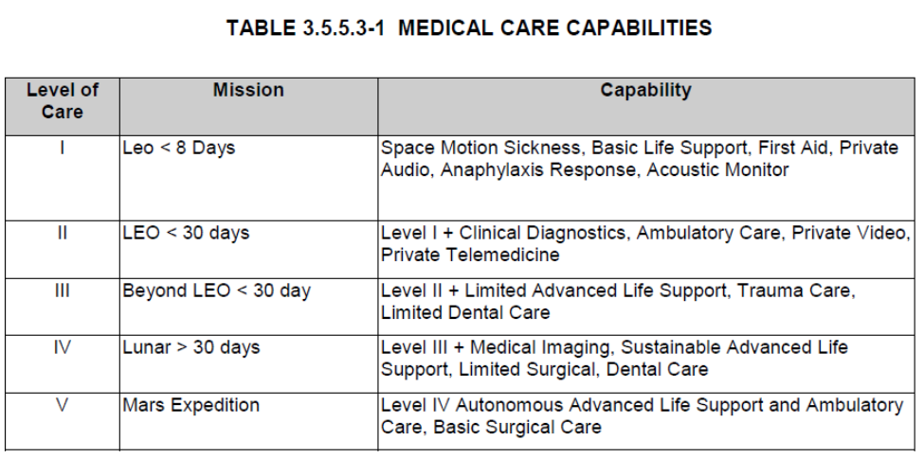
Medical System Scope: Mission Design & NASA Standard
Medical system definition is based upon several key factors:
Mission duration: launch to landing/recovery
Crew Size: 4 for Artemis missions
Mission Design (e.g., docking? lunar landing/EVA?)
Mission Architecture (e.g., vehicle volume/config, exercise equipment, ConOps and hardware for contingencies)
The scope is derived from NASA-STD-3001 but tailored by the Space Medicine Operations Division based on factors above and output from the Integrated Medical Model.
Artemis missions fall into either Level III or IV depending upon the mission.

Slide 3
Medical System Development
Artemis Medical System development effort ongoing
  Orion 21-day mission medical system design baselined and prototype built
  Deltas in work for addition of Gateway and the Human Landing System (HLS)
Goal is to balance crew health needs with mission constraints, while eliminating redundancy across vehicles
Lunar surface mission will add to medical risk
  Integrated Medical Model is based on ISS resources and scenarios, therefore does not reflect risks associated with lunar surface ops
    Principle comparison is with terrestrial disease and not physiological adaptations
  Series of flight surgeon interviews being used to appropriately scope added capabilities
  Medical ConOps to include entire mission ultimately (and all 3 vehicles – Orion, Gateway, HLS)
Priority at this stage remains defining capabilities → hardware → then vehicle impacts
Notes:
not physiological adaptations: especially when it comes to SANS/CO2

Slide 4
Medical System - Assumptions
      No EVAs planned for Orion-only mission (Artemis II)
      Integrated capabilities across programs are being pursued
        Gateway will only be occupied when Orion is present
        Gateway to leverage as much as possible from Orion medical capabilities
        HLS medical capabilities are for lunar sortie only
      Medical capability design for early Artemis missions:
        ~30-day duration
        Multi-day lunar sortie by 2 crewmembers, 2 remain in Lunar orbit
        Orion Medical System mass/volume allocation for initial phase will be similar for subsequent missions

Slide 5
Medical System Space-to-Ground Plan
For Orion (other Artemis communication plans TBD):
  Capability of audio +/- video connection with Ground expected majority of mission
    Ability for real-time consultation or remote guidance a desire for medical
  Private audio with flight surgeon for medical discussions is a requirement
  Videoconferencing during medical events expected, as time and bandwidth allow
    Private video can be diagnostic
  Medical procedures will be stored on main flight computer, also likely to be available on crew personal computing devices (Surface Pro 5s)
    Small number of paper cue cards provided for critical devices/procedures

Slide 6
Artemis II vs. Artemis Phase 1 Medical System
Artemis II
Orion Crewed Test Flight
Artemis Phase 1
Orion + Gateway + HLS
Lunar surface operations add new medical risks/scenarios that must be accommodated
For use during Orion dynamic flight
Seat Accessible Medical Items
Seat Accessible Medical Items
Orion Medical Accessory Kit*
Orion Medical Accessory Kit*
For use during Orion mission
*to be sized for Artemis II DRM and associated medical risks
*Medical Accessory Kits are personalized for individual crewmembers to address specific medical needs.
Orion Medical Kit System
(general supplies)
Orion Medical Kit System
(general supplies)
Gateway Medical Kit
Focus of Artemis Medical System (Phase 1) development
HLS Health Kit
Reserved for use during HLS Lunar sortie
HLS Medical Accessory Kit*
Launched on Orion—transferred to HLS

Slide 7
Orion Medical System Components
Orion Prime Medical Kit
(OPMK)
Hard-sided kit mounted to wall in open cabin
Only accessible in-flight
In-Suit Pill Delivery Tool
Tool for administering medication to a pressurized, suited crew
Used in event of a suited return contingency scenario
Orion Medical Kit System
(OMKS)
Orion Secondary Medical Kit (OSMK)
Additional stowed medical supplies
Only accessible in-flight
- Collective suite of hardware that includes multiple kits
Supplemental Oxygen
Oxygen hardware to treat smoke inhalation in the event of a fire
Use as directed by flight surgeons for additional scenarios
Orion Medical Accessory Kit (OMAK)
Similar to ISS Medical Accessory Kit (IMAK)
Contains personal/medical items unique to each crewmember
Stowed in lockers during launch and landing
Only accessible in-flight
Seat Accessible Medical Items (SAMI)
Medical items required to be accessible to a seated/restrained crewmember pre-launch, post-ascent and post-landing
Minimal supplies (small volume); few pills, pair of glasses, etc.
One kit per crewmember
Stowed in suit forearm pocket

Slide 8
Orion Med Kit Estimated Mass and Volume
1 OMAK and 1 SAMI
per Crewmember

Slide 9
Artemis Mission Medical Needs
Flown on Orion
Anti-inflammatory Medications |  | Antibiotic/Antiviral/Antifungal Medication |  | Therapeutics
Pain Medication |  | Anti-arrhythmia Medication |  | Splinting
Sleep Medication |  | Anticoagulant Medications |  | Wound Closure
Stimulant Medication |  | Bronchodilator Medication |  | Wound Dressing
Decongestant Medication |  | Pre-loading fluid support |  | Dental Repair
Anti-Histamine Medication |  | Allergic/ Anaphylactic Reaction Medications |  | Nasal Packing
Anti-Emetic Medication |  | Ophthalmic Medications |  | Saliva/Blood Absorbance
Laxative/Motility Medication |  | Progestin/Estrogen |  | Urinary Catheterization
Diagnostics |  |  |  | Airway Tailored to Mission and Care Levels
Lighted Imaging Capability* |  | Point-of-care Urinalysis |  | Manual Ventilation Method
Electrocardiography |  | Personal Protection (Equipment) |  | Collapsed Lung Decompression
Heart Rate Measurement |  | Antiseptic Surface Cleansing |  | Enriched Oxygen Breathing Gas Delivery
Pulse Oximetry |  | Corneal Evaluation
Body temperature measurement |  | Auscultation Method
Automated Blood Pressure Measurement
Flown on Gateway
Extended limb injury care: Finger and Joint
Ultrasonography
Semi-invasive Wound Care
Nail Trephination
Patient Restraint
Wound Care consumables (20-day supply)
Co-oximetry
Continuous Positive Airway Pressure (CPAP) Breathing Support

Slide 10
Medical System - Forward Work
  Orion Medical System Qualification / Flight Unit Production
  Finalize Orion Medical Data Packaging and Transmission Plan
    Devices may depend on portable computing device to view/record data
    Once on device, working on plan to save and transmit data to ground
  Artemis Medical System Development
    Completion of long-duration Lunar mission medical system ConOps
    Work cross program integration issues (mass, volume, etc.)
    Iterate on medical system design — modify/optimize as programs mature DRMs, ConOps, medical device updates, etc.
  HLS Medical System Development

Slide 11
Questions?

