Slide 1
JEDI-GEOS: NASA’s development pathway for coupled Earth system data assimilation
Ron Gelaro, Dan Holdaway, Ricardo Todling
NASA GMAO
Contributions from Virginie Buchard, Fabio Diniz, Jianjun Jin, Min-Jeong Kim
WWRP-WCRP Symposium on Data Assimilation and Reanalysis
Virtual, 13 – 18 September 2021

Slide 2
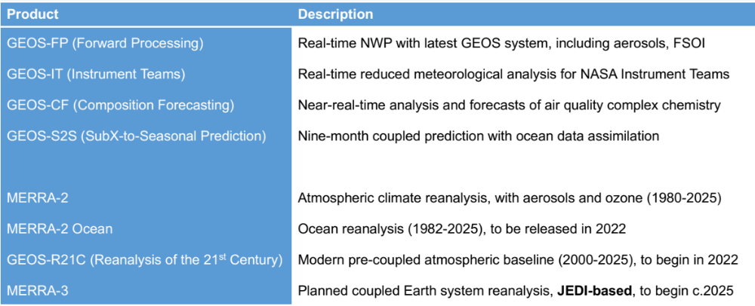
GMAO Core Products
hybrid 4D-EnVar, aerosol assimilation, FSOI
Prediction
Reanalysis
Notes:
GMAO is not an operational center, but functions like one in some key ways.
Highlight GEOS-FP, which we’ll talk more about during the first part of the presentation, and MERRA-3, and longer-term target.

Slide 3
Background
GMAO’s medium-term (~3 yr) goal is to develop a unified coupled data assimilation system, based on GEOS and JEDI, for weather analysis and prediction, reanalysis, composition forecasting, and S2S prediction.
The focusing vehicle for this effort is the JEDI-GEOS application – a continuously evolving, continuously functional testbed for instantiating end-to-end tests of new developments and establishing trusted baselines.
This talk briefly summarizes plans and progress toward:
    A first JEDI implementation
    Coupled data assimilation and MERRA-3
Notes:
No configuration details here, just general development plans (and some examples of the progress being made).

Slide 4
First implementation of JEDI – a phased approach
A major challenge will be the coordination of this effort with other GMAO priorities, including a major model upgrade in the coming year (physics, vertical resolution).
Target GEOS-FP hybrid 4D-EnVar for Q4 2022 (~1 year from now):
    JEDI components
    Central DAS, including UFO
    Background error formulation ...see Dan Holdaway talk (04-4B)
    Aerosol analysis
    FSOI
    Retained current components
    GSI-based EnKF for hybridization
    JEDI run within the existing GEOS-FP scripting
Notes:
Transition of JEDI to operations will happen in phases. Some of the phases will be in parallel, in order to allow for timely transitions and provide new features useful in research.
Other work will happen sequentially, in order not to overwhelm resources or attempt to use aspects of the JEDI systems prior to maturity.

Slide 5
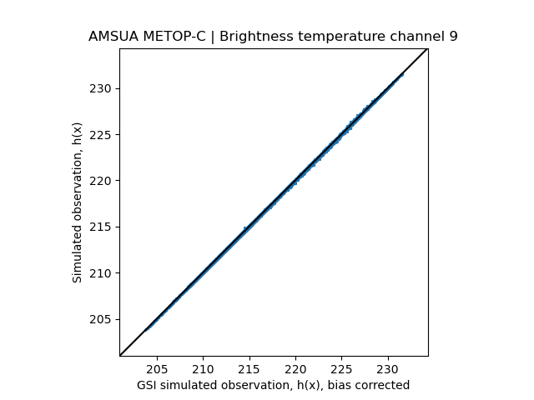
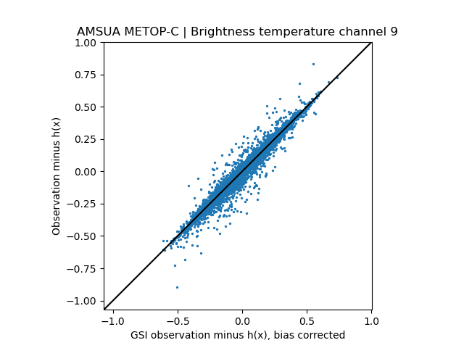
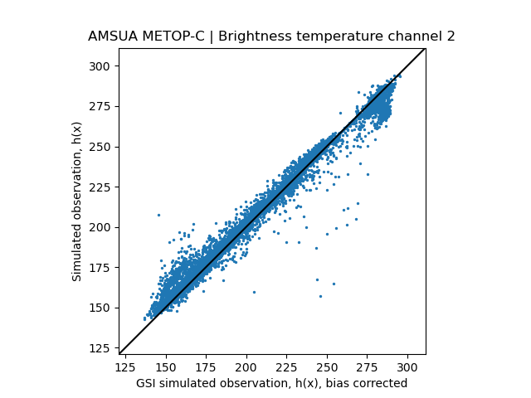
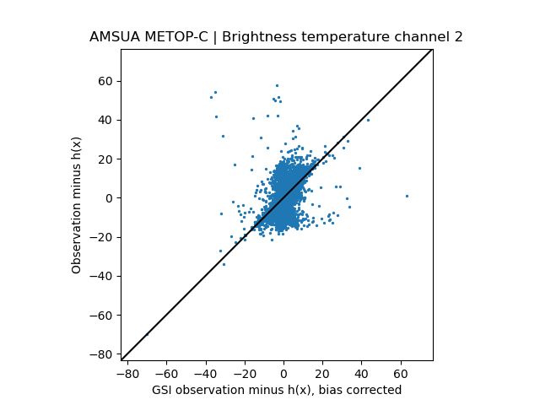
Evaluation of simulated observations
H(x)
O−F
Metop-C AMSU-A
Brightness Temperature
00UTC 15 Dec 2020
4D H(x), c360 resolution
6-h window, 1-h bins
Direct interp to obs locations
GSI background, bias corr
Ch.9
(upper troposphere)
GEOS JEDI H(x)
GEOS JEDI O−F
GEOS GSI H(x)
GEOS GSI O−F
Ch.2
(surface-sensitive)
GEOS JEDI H(x)
GEOS JEDI O−F
Still to do: Implement FOV calculation and confirm background sfc inputs are consistent
GEOS GSI H(x)
GEOS GSI O−F
Notes:
The next few slides provide simple examples of the work being done on key components for phase 1 implementation; work is in various stages of completion

Slide 6
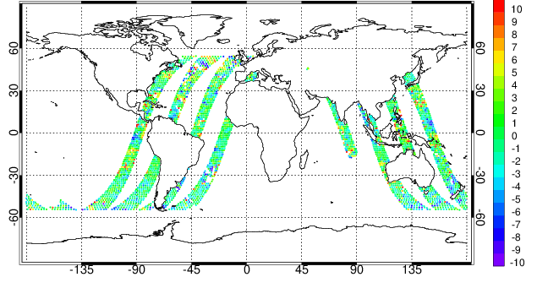
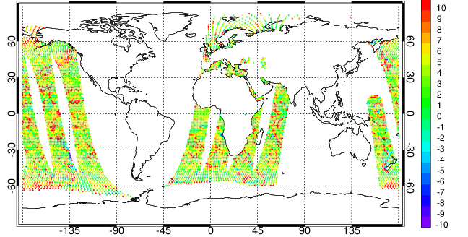
GMI and AMSR-2 all-sky radiance assimilation
GMI 23 GHz O-F 15 Nov 2020 00UTC
GMI and AMSR-2
Background departures
00UTC 15 Nov 2020
Assimilation infrastructure added to JEDI/UFO
  Updated operator to account for GMI channel-dependent physical views
  Control variables for rain, snow (plus cl_{liq}, cl_{ice})
  All-sky observational error functions, plus other UFO filters
  QC configurations
Background departures before bias correction for GMI (top) and AMSR-2 (bottom). GMI values generally less biased than AMSR-2 values.
[K]
AMSR-2 23 GHz O-F 15 Nov 2020 00UTC
[K]

Slide 7
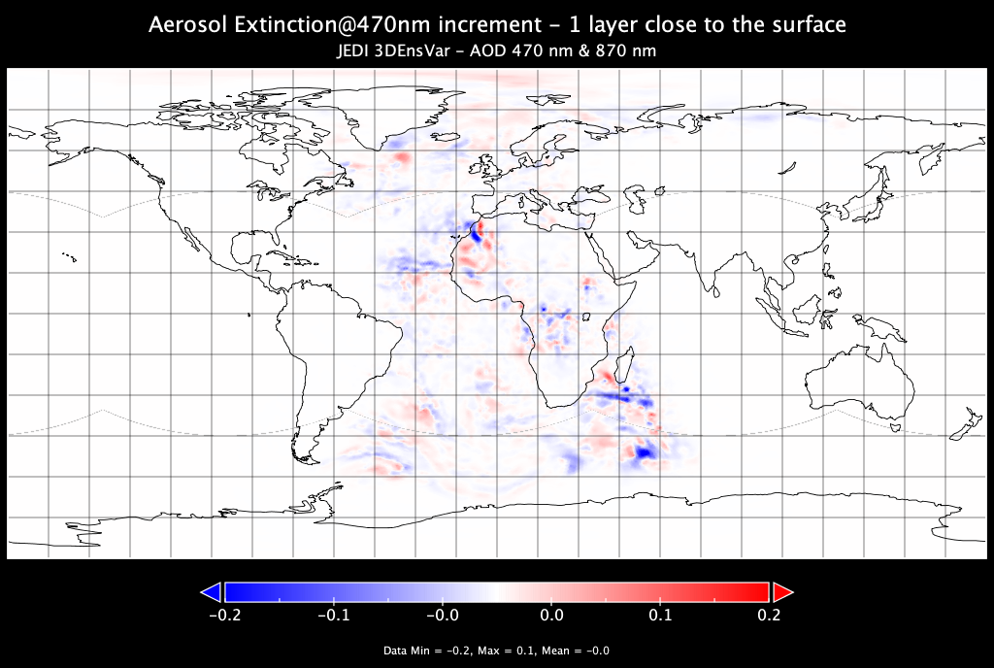
Aerosol data assimilation
GMAO is transitioning its aerosol DA scheme to a JEDI-based hybrid ensemble-variational scheme
Analysis splitting for computational efficiency, but with significant improvements:
  Upgraded 2D PSAS-based analysis to JEDI-based hybrid approach
  Upgraded control variable from 2D AOD to vertically resolved aerosol extinction
  Flow-dependent background error specification
  Allows observations of multi-wavelength AOD
Pathway to future observables: lidar, aerosol optical centroid height, radiances…
Aerosol extinction increments at 470 nm for near-surface model layer after one analysis cycle at C90 resolution. Observations are multi-wavelength NNR AOD at 470 & 870 nm.
Notes:
We are currently doing analysis splitting in FP and MERRA-2, in the first step we do a 2D analysis AOD using PSAS and then we need to ‘convert’ this 2D AOD increments into 3D
aerosol mass mixing ratio increments (the model prognostic variable). Tried 3D aerosol mass mixing ratio as a control variable (no need of analysis splitting) but it was computationally too expensive.
So our solution (explained in the slide) is to continue to do an analysis splitting by replacing PSAS by JEDI-based hybrid approach and upgrading our 2D AOD control variable by a 3D aerosol
extinction profile. Then we’ll need to upgrade GAAS to ‘convert’ the 3D aerosol extinction increments (obtained using JEDI, figure as an example) into 3D aerosol mass mixing ratio increments.
Another update is the inclusion of observations of multi-wavelength AOD (in FP we assimilate AOD at 1 wavelength (550nm)).
The figure is just an example of aerosol extinction increments for just 1 model layer obtained after using JEDI-based hybrid approach.

Slide 8
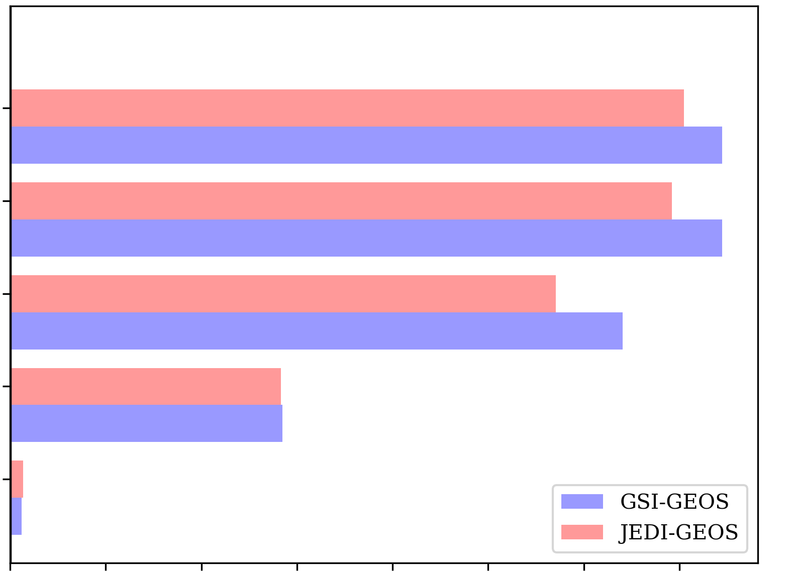
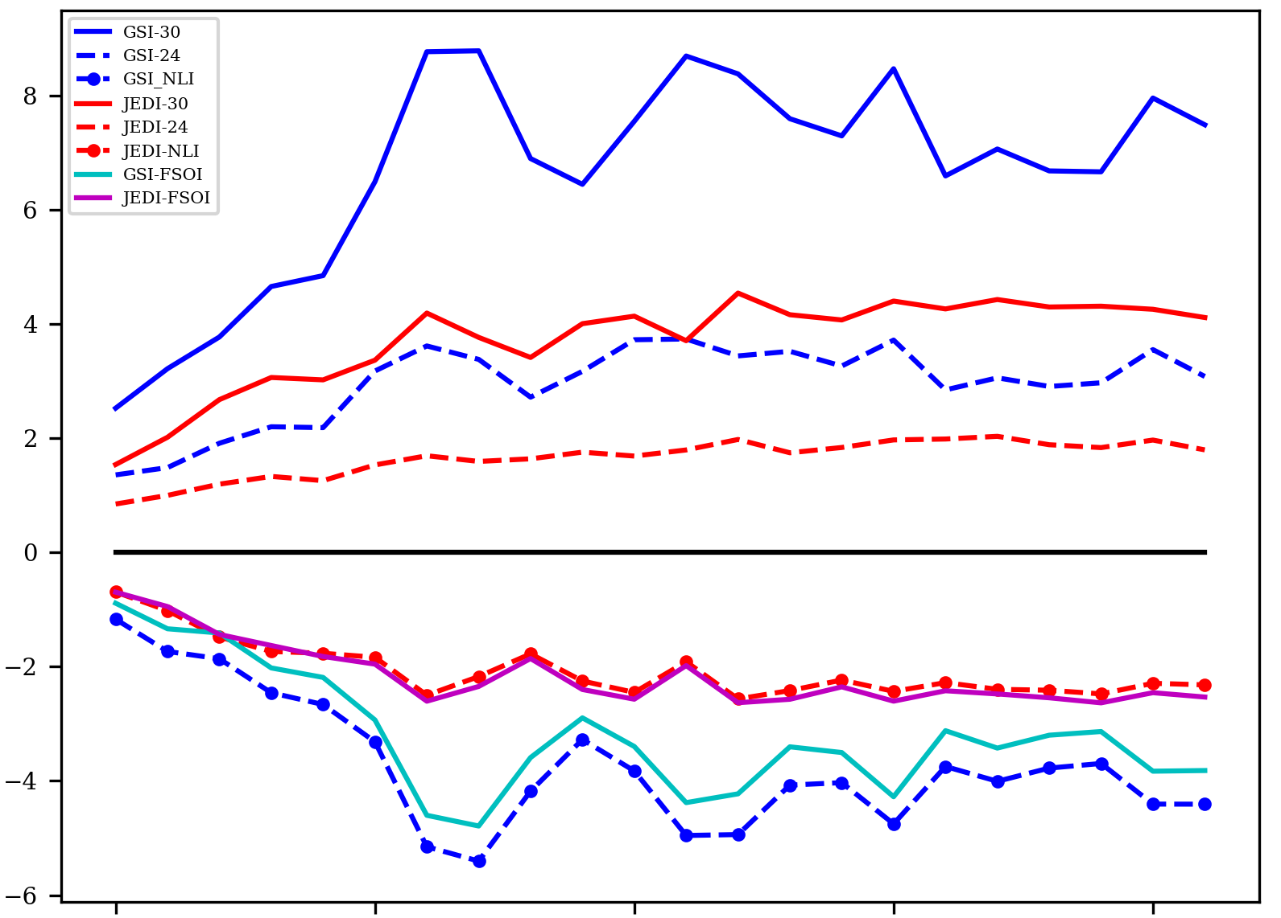
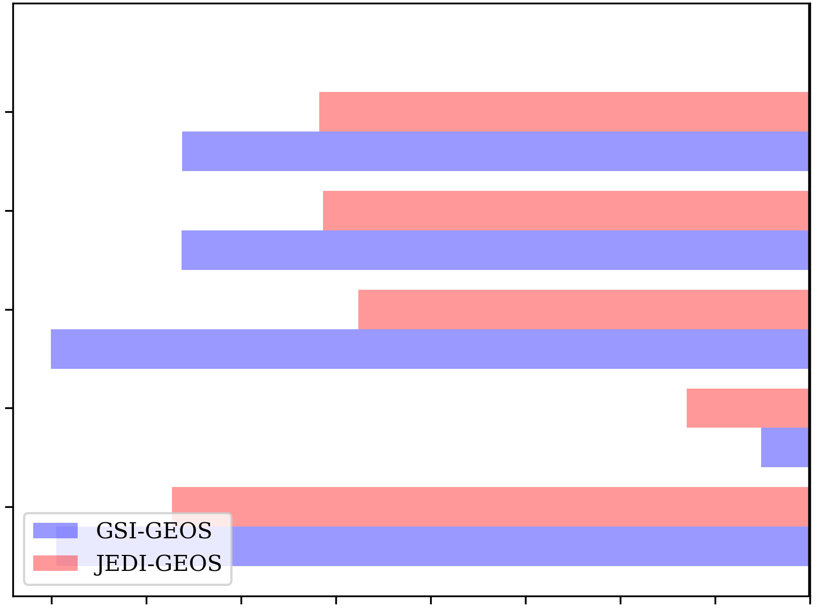
Forecast sensitivity-based observation impact (FSOI)
JEDI- versus GSI-based 3D-EnVar, radiosonde only, c90 resolution
Ensemble covariance replay to GSI control, single outer loop
24-h FSOI, moist energy norm, self-verification, 16 Dec2020 – 10 Jan2021
...see Fabio Diniz poster (P2)
Observation Count per Cycle (10³)
Raob V
Raob U
Forecast Error and Observation Impact
Raob T
Raob Q
GSI 30h
Raob Ps
GSI-GEOS
JEDI-GEOS
JEDI 30h
0
1
2
3
4
5
6
7
GSI 24h
Impact per Observation (J/kg)
Moist Total Energy (J/kg)
JEDI 24h
GSI-GEOS
Raob V
JEDI-GEOS
JEDI 24-30
JEDI FSOI
Raob U
GSI FSOI
GSI 24-30
Raob T
Raob Q
19 Dec 2020
24 Dec
29 Dec
3 Jan 2021
8 Jan
Raob Ps
Smaller forecast error and FSOI in JEDI-GEOS...weaker draw to observations
−40
−35
−30
−25
−20
−15
−10
−5
0

Slide 9
Toward coupled DA and MERRA-3
Planned significant upgrades beyond the first implementation of a JEDI-based GEOS-FP system
    I. Upon completion of first implementation:
      DA changes to accommodate additional model levels
      New ensemble methodology
    II. In parallel with first implementation:
      New workflow and workflow manager
      Extensions for weakly coupled data assimilation
Notes:
Beyond our first implementation, work is/will be undertaken both sequential to and in parallel with phase I. Work on coupled DA must be done in parallel to ensure functionality of JEDI-GEOS developments along the way and to meet aggressive timelines

Slide 10
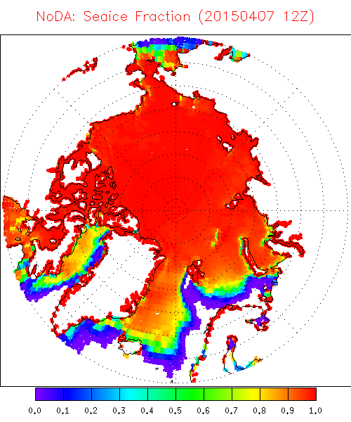
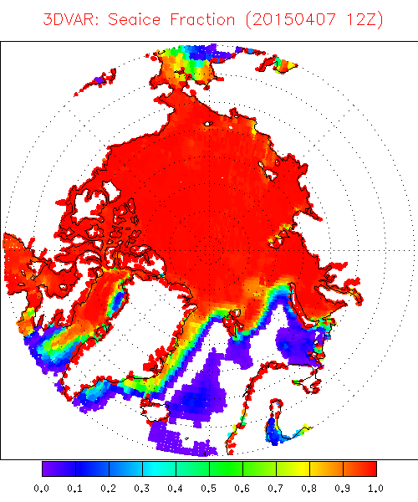
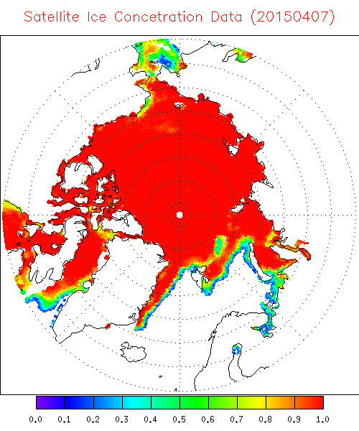
GEOS-MOM6 coupled assimilation of SSMIS sea-ice concentration
3DVar assimilation of SSMIS retrieved sea-ice concentration
GEOS-MOM6 Control – No DA
Observations
7 April 2015
7 April 2015
7 April 2015
Cycled GEOS-MOM6-CICE4 coupled model with SOCA 3DVar, MERRA-2 atmosphere replay
Experiment initialized 1 Apr 2015, 1º coupled model resolution, 24-h assimilation window

Slide 11
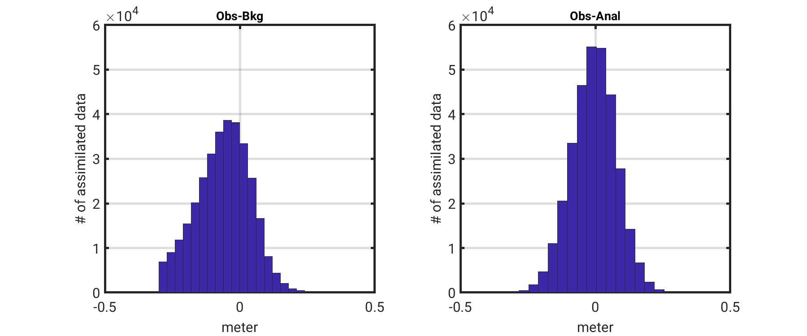
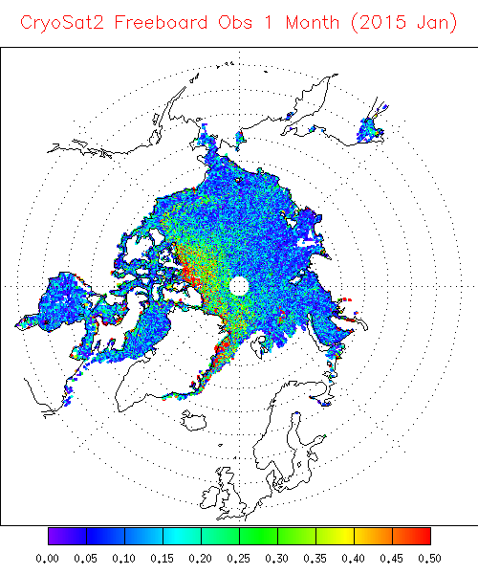
GEOS-MOM6 coupled assimilation of CryoSat2 freeboard
CryoSat2 Freeboard Observations
Obs − Forecast
Obs − Analysis
January 2015
GEOS-SOCA 3DVar as in previous slide but for Jan 2015
Improved forward operator and QC procedure yield a more normal O-F distribution with reduced bias
Assimilation moves GEOS coupled model forecast closer to observations

Slide 12
In summary
GMAO is developing a unified coupled data assimilation system based on GEOS and JEDI
A phased approach is being taken via the JEDI-GEOS application – a continuously evolving, continuously functional testbed for development
A first implementation for real-time NWP, using JEDI for the central analysis, is targeted for a year from now....Q4 2022
Extension of JEDI-GEOS toward coupled DA is occurring in parallel, with operational availability targeted for 2024 and the MERRA-3 reanalysis to begin in 2025

Slide 13
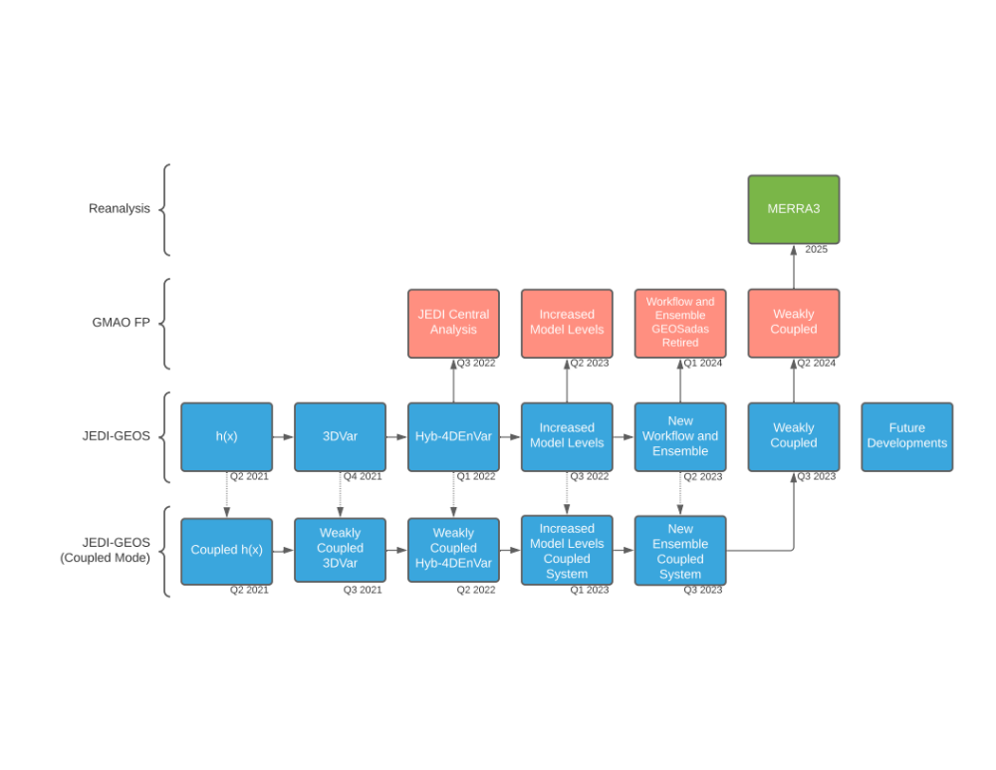
GMAO JEDI implementation roadmap
Available
Implemented
Enhancements for atmospheric DA
First implementation
Enhancements for coupled DA

