Slide 1
Engineering Directorate
Space Systems Department
Capabilities
Partnership Forum Presentation
September 2021
Tia Ferguson – Director
Tony Clark – Acting Deputy Director

Slide 2










Space Systems Department
ES10 - Systems Engineering & Integration
Lead Systems Engineers (LSE)
Systems Integration
Systems Engineering Implementation
Leads Avionics & SW Integration
Imagery
Science
SLS
AdvMan
In-Space
Prop
Lander
ECLS/Habitat
ES20 - Mechanical & Optical Design, Analysis and Fabrication
Mechanical Design
Stress, Thermal, and Loads Analysis
Optical Systems Design, Fabrication, & Test
Hardware Fabrication: Large Structures, Assembly, Cleaning, & Outsourcing
ECLS/Habitat
Science
SLS
AdvMan
Science
SLS
Avionics Design & Electrical Integration
Power Electronics Development
Electronics Fabrication & Failure Analysis
RF, E3, & GNC Analysis and Testing
Spaceflight Imaging Systems & Sensors
Lander
ES30 - Avionics
AdvMan
In-Space
Prop
Lander
SLS
ECLS/Habitat
ES50 - Flight & Ground Software & Simulation
Software Systems Engineering
Software Development
Hardware-in-the-loop and Simulation Development
ECLS/Habitat
Lander
Science
SLS
Science
ES60 - Systems Development, Integration, & Test
Testing of instruments, racks, payloads & subsystems
Design & development of specialized sensors & science instruments
Integrated ECLSS systems design, analysis and technology development for human space exploration missions
AdvMan
In-Space
Prop
Corporate Strategy
Areas
Lander
Distribution A – Approved for public release – distribution unlimited
ECLS/Habitat

Slide 3
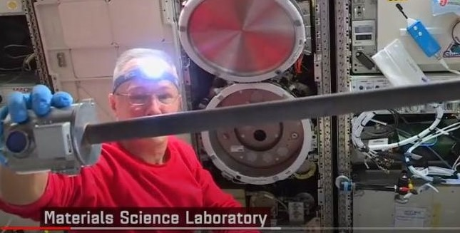
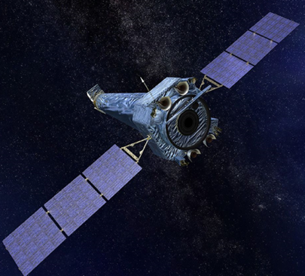
Systems Engineering & Integration Division
Key Capabilities
Plan for the application and management of Systems Engineering discipline expertise practices and principles to help solve complex science and engineering challenges
Identify, define, and plan the technical effort applicable to the product-line lifecycle
Provide technical management and coordinate across engineering
Integrate engineering resource requirements
Provide Department Lead Engineers
Coordinate the development of integrated avionics and software products
Provide technical integration expertise for the avionics architecture
Provide Systems Engineering work products
The Systems Engineering and Integration division provides projects value-added solutions to a broad spectrum of SE&I challenges from initial Formulation through Sustaining Engineering. The division is comprised of a Projects Engineering Branch, an Avionics Systems Integration Branch, and a Systems Engineering Branch. Together the branches integrate multi-disciplines to deliver products that meet the customer’s particular needs.
ES10 Division Contacts
ES10 Division Chief | Rex Graves | 544-2224
ES10 Assistant Manager | Neil Rainwater | 544-8918
SLS
AdvMan
ECLS/Habitat
Lander
In-Space
Prop
Science
Distribution A – Approved for public release – distribution unlimited

Slide 4
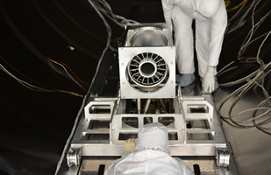
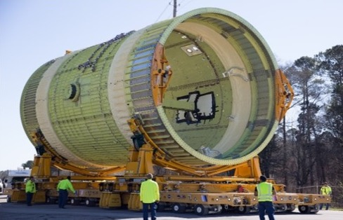
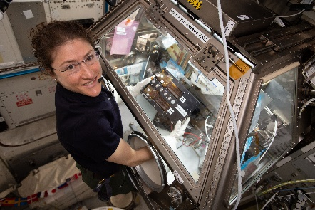
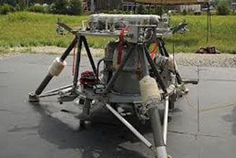
Mechanical & Optical Design, Analysis & Fabrication Division
Key Capabilities
Mechanical & structural space flight and development hardware including ground support equipment
Thermal control
Optical mirrors for grazing & normal incidence & light lightweight replicated optics
Structural & mechanical, GDT-based design
Strength, fatigue, fracture, loads, dynamics, vibroacoustics, microgravity, shock, & advanced payload isolation modeling & analyses
In-space thermal & pipe flow analysis
Development & verification test criteria/requirements, extensive test operations support, data processing/ correlation for thermal, strength, dynamics, acoustics and vibration
Opto-mechanical thermal design & analysis
The Mechanical & Optical Design, Analysis & Fabrication Division provides comprehensive mechanical and aerospace engineering expertise in design, analysis, fabrication, assembly and integration for advanced technology implementation, small spacecraft, critical ground hardware for human space flight programs, science investigations, and exploration initiatives.
ES20 Division Contacts
ES20 Division Chief | Dave Whitten | 544-7027
ES20 Assistant Manager | Jeff Farmer | 544-3179
SLS
AdvMan
ECLS/Habitat
Lander
Science
Distribution A – Approved for public release – distribution unlimited
Notes:
Still looking for a better lander image plus waiting for responses on other images from Jimmy (he is working on it). Not quite sold on including mighty eagle yet (or two lander pictures for that matter), but we also have ILN, HLS, CATALYST, etc. plus I might want to put a thermal model or contour plot in there instead of a structures model, but maybe at this level a model is a model. We could also go to the lander lab and take a photo of someone standing next to the pallet lander if we wanted a person in it. finally, I am still looking for the flying mighty eagle image (I would prefer that if I can find it).
Any other thoughts on images?
Another thought on how to display design or analysis or fabrication for that matter is to try to find an image (or start taking them) of people giving presentations with the graphics of the design, analysis or the fab tool in the image. Also in deciding which items to show we may also want to think about diversity considerations.
Citation on the LSF image (supplied by Brian): NASA astronaut Christina Koch works inside the Life Sciences Glovebox conducting research for the Kidney Cells investigation that is seeking innovative treatments for kidney stones, osteoporosis and toxic chemical exposures.
Other images IXPE mirror prior to final testing, SLS on GSE, Analysis of pallet lander, mighty Eagle lander after test flight, NeaScout Solar Sail and mechanism, 4b CO2 rack.

Slide 5
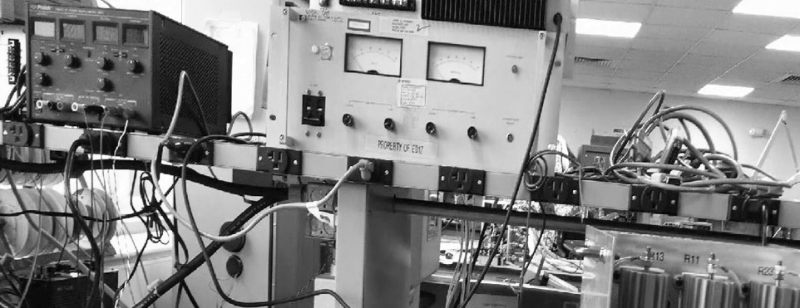
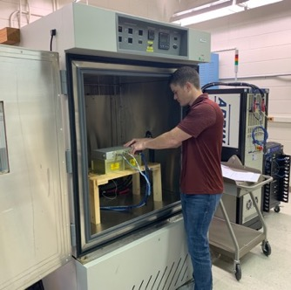
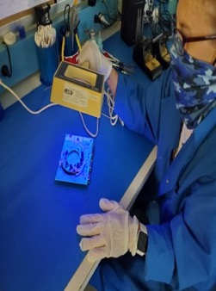
Avionics Division
Key Capabilities
Design and analysis of Flight data systems, Electrical integration, Motor and/or motor controllers, Signal conditioning, instrumentation, Power electronics controllers
Design, implementation, and test of imaging and video systems
FPGA logic design
EMI, ESD, lightning indirect effects, & power quality testing
Design, development, test, and analysis of RF communication systems and components, Power electronics, Electrical power systems and components
Assessments of Power quality, Electrical and physical power interface compatibility
EEE parts screening and physical analysis
Research in printed electronics
Electrical fabrication, assembly, and testing
Evaluation, selection, & test of GNC spaceflight hardware
Flat Floor Robotics Laboratory
The Avionics Division provides electrical design, development, fabrication, testing, and evaluation of avionics systems such as electronic control systems, data systems, power electronic systems, RF and Communication systems, flight instrumentation systems, inertial components for GN&C systems, flight instruments and sensors, and imaging systems. In addition, the division also provides for analysis and testing of Electromagnetic Environmental Effect, Electrical Failure Analysis, and EEE parts screening and analysis.
ES30 Division Contacts
ES30 Division Chief | John West | 544-6858
ES30 Assistant Manager | Jeff Wesley | 544-3393
ES30 Assistant Manager | Jeff Martin | 544-4217
SLS
AdvMan
ECLS/Habitat
Lander
In-Space
Prop
Science
Distribution A – Approved for public release – distribution unlimited

Slide 6
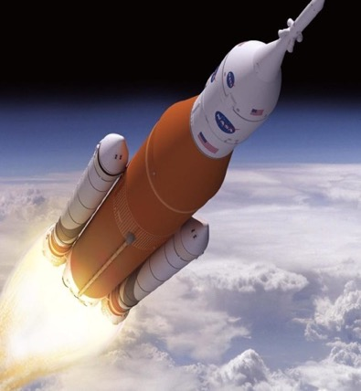
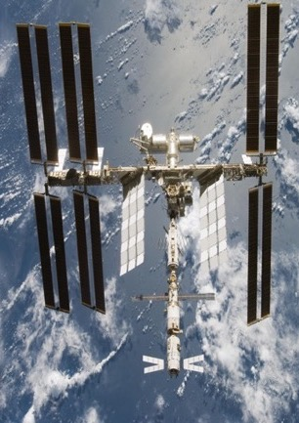
Flight & Ground Software & Simulation Division
Key Capabilities
Perform flight software requirements, design, development, integration, test and verification
Performs software configuration management for control and release of software deliverables operations
Provides flight software development and test facilities
Provides fully-qualified Human-Rated Class A Software utilizing voting architecture, autonomous and commanded operations, sensor data qualification
Provides ECLSS software
Provides simulations and models for avionics development and testing
Provides real-time simulation, lab control, and facility data acquisition software requirements, design, development, integration, test, and configuration management
Develops avionics and software ground systems test
Develops, operates, and maintains multiple system integration and test facilities
SLS FSW
ISS ECLSS
Flight & Ground Software & Simulation Division provides comprehensive engineering expertise for the development of flight and ground software, including software development facilities, avionics and software ground systems test facilities, and operation facilities. ES50 is a Maturity level 3 flight software rated organization.
ES50 Division Contacts
ES50 Division Chief | Deanna Whitehead | 544-8787
ES50 Assistant Manager | Tracey Reed | 544-5691
ES50 Technical Assistant | Terry Brown | 544-1626
ES50 Technical Assistant | Darrell Bailey | 544-2072
SLS
ECLS/Habitat
Lander
Science
Distribution A – Approved for public release – distribution unlimited

Slide 7
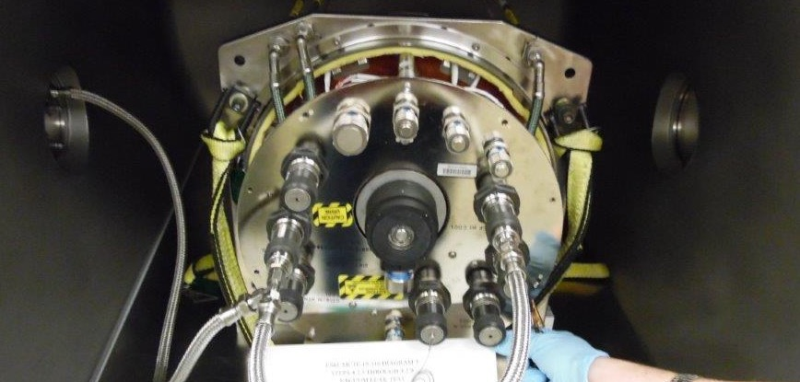
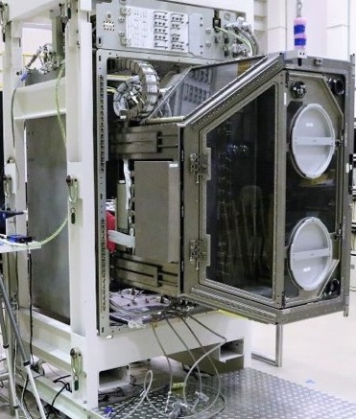
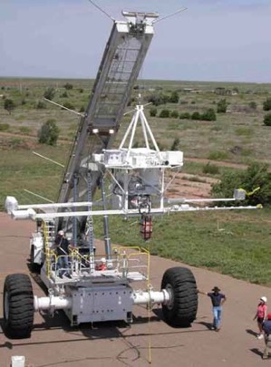
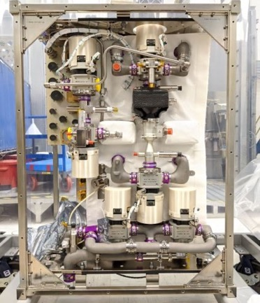
Systems Development, Integration, & Test Division
Key Capabilities
Design, development, testing, and evaluation of Environmental Control and Life Support Systems
Design and development of specialized science instruments and payloads
Planning and implementation of ground test programs for qualification and certification of flight instruments
Design and development of special test equipment and related software to test functionally of flight hardware
Development of hardware test beds to support proof of concept, breadboard, and subsystems/systems validation
Development of procedures, test conduction, data collection, data archival for analysis, and verification closeout as well as anomaly investigation/resolution
On-orbit control support
Ground station monitoring
Post-flight de-integration
The Systems Development, Integration, & Test Division provides testing of instruments, racks, payloads & subsystems, as well as design & development of specialized sensors & science instruments. The division contains subject matter experts in test methods, planning, procedure development, test data and test reporting with emphasis on Environmental Control and Life Support Systems (ECLSS), Space Launch System (SLS) and NMLS. Development activities include the definition, design, assembly, integration and operation of flight hardware utilizing a wide variety of disciplines located within the division focused specifically on orbital and suborbital payload, systems, and instrument development.
ES60 Division Contacts
ES60 Division Chief | Paul Tatum | 544-8596
ES60 Assistant Manger | Linda Jeter | 544-7392
SLS
AdvMan
ECLS/Habitat
Lander
In-Space
Prop
Science
Distribution A – Approved for public release – distribution unlimited

Slide 8


Space Systems Department Technology Development Focus Areas
Corporate Strategy
Areas
AdvMan
ECLS/Habitat
Lander
In-Space
Prop
Science
SLS
Artificial Intelligence / Machine Learning
Wireless Systems
Printed Electronics / Avionics
ECLSS (including ISRU)
Grazing Incidence Optics
Lunar Surface Survivability in Thermal Extremes
Solar Sail / Thin-Film Com/Power & e-Sail

Slide 9








nasamarshallcenter
www.nasa.gov
@NASA_Marshall
@NASA_Marshall
NASAMarshallTV
nasamarshall
https://nasa.sharepoint.com/sites/MSFC_Engineering/SitePages/Space-Systems-Department.aspx
9
Notes:
NASA Presentation Sign-Off Page

Slide 10
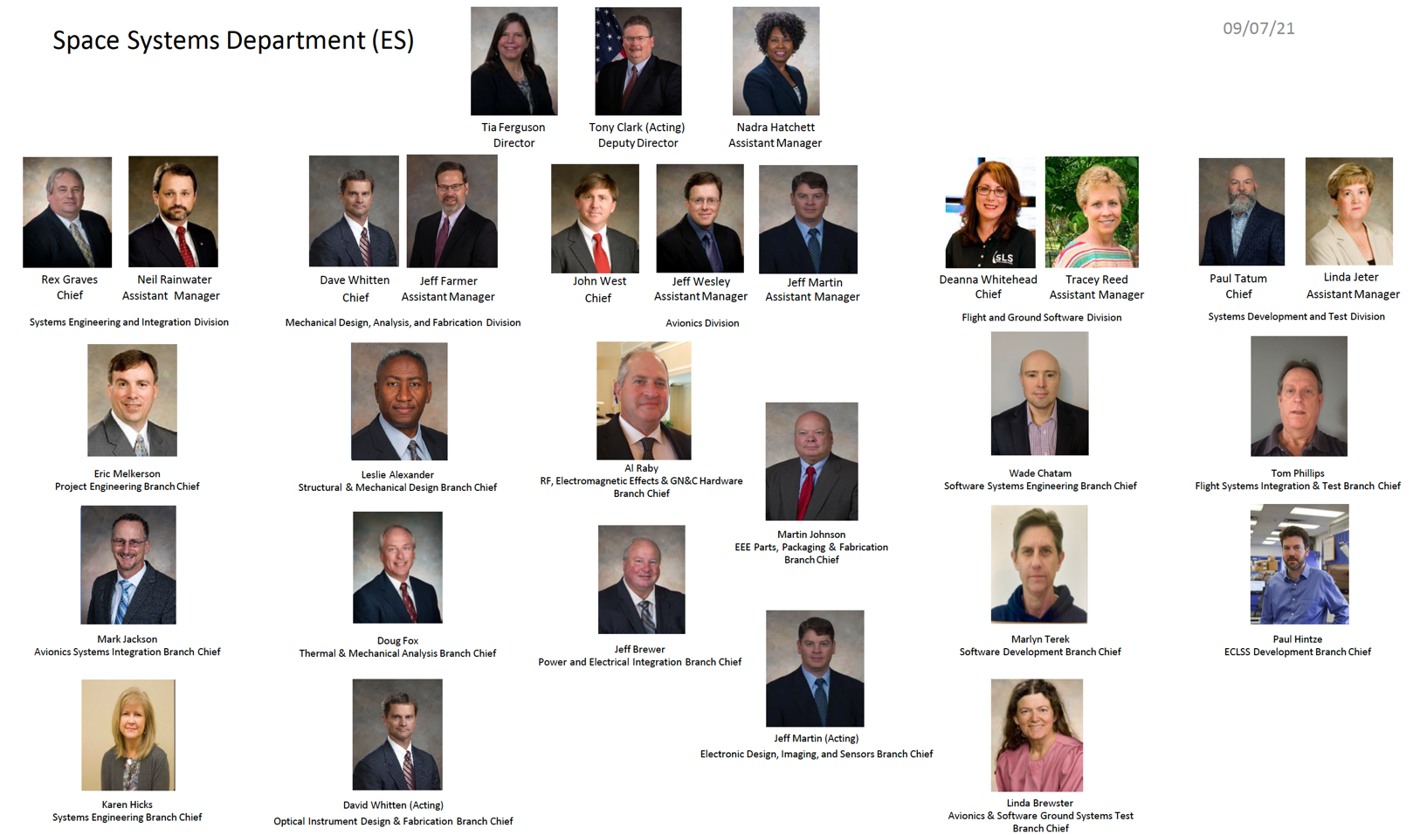
Org Chart

Slide 11
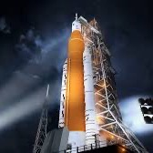

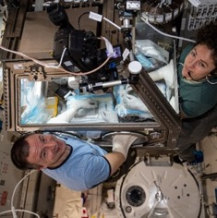
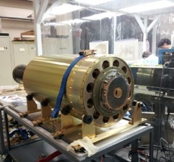
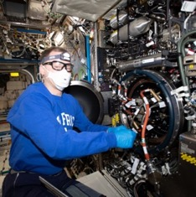
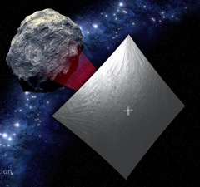
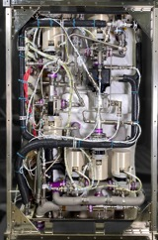
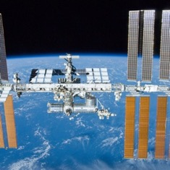
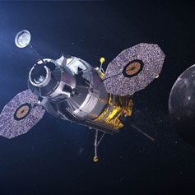
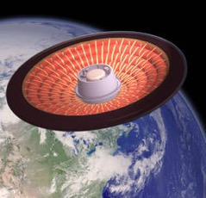
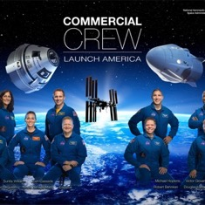
Space Systems Department
Supported Programs / Projects
Space Launch System
Imaging X-ray Polarimetry Explorer (IXPE) Telescope
Life Sciences Glovebox (LSG)
High Resolution Coronal Imager Flare (Hi-C)
Mars Ascent Vehicle (MAV)
Material Science Research Rack (MSRR)
Near-Earth Asteroid (NEA) Scout
Environmental Control and Life Support Systems (ECLSS)
ISS Payloads
Human Lander Systems (HLS) / Gateway Program
Lower-Orbit Flight Test of an Inflatable Decelerator (LOFTID)
Commercial Crew Program (CCP)

Slide 12
Space Systems Department Capabilities
ES10 - SYSTEMS ENG & INTEGRATION DIVISION | ES20 - MECH & OPTICAL DESIGN, ANALYSIS & FAB DIVISION | ES30 – AVIONICS DIVISION | ES50 - FLIGHT & GROUND SOFTWARE & SIMULATION DIVISION | ES60 - SYSTEMS DEVELOPMENT, INTEGRATION & TEST DIV
ES11 Systems Integration | ES21 Structures/Mech Functional Design | ES31 Electromagnetics | ES51 Software Systems Engineering | ES61 Leak Test Engineering
ES12 Avionics Systems Integration | ES21 Structures/Mech Design &Analysis | ES31 Radio | ES52 Software Design & Development | ES61 Payload Systems Test Engineering
ES12 Audio | ES21 Structures/Mech Detailed Design | ES31 GN&C Hardware | ES53 Software Ground Systems Test | ES61 Instrument Payload Development
ES13 Systems Engineering | ES21 Instrument Payload Development | ES32 Power Electronics |  | ES62 ECLSS Test Engineering
 | ES21 Manufacturing Engineering | ES32 Control Electronics |  | ES62 ECLSS Systems Engineering
 | ES22 Structures/Mech Analysis Dynamic Loads | ES32 Solar Sail, Elec-Sail, Tether
 | ES22 Structures/Mech Design & Analysis | ES32 Electrical Integration
 | ES22 Structures/Mech Analysis Stress | ES32 Electrical Power Systems
 | ES22 Structures/Mech Analysis Acoustic | ES33 Electrical Fabrication
 | ES22 Thermal Analysis | ES33 EEE parts
 | ES23 Optics - X-ray | ES33 Electronics Packaging
 | ES23 Optics – non-X-ray | ES33 Electronics 3D Printing
 |  | ES34 Flight Data Systems
 |  | ES34 Ground Data Systems
 |  | ES34 Sensors
 |  | ES34 Imaging

