Slide 1
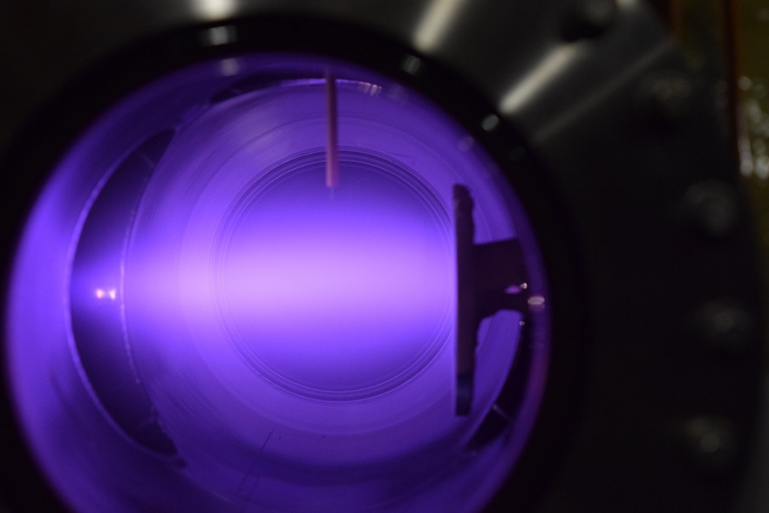
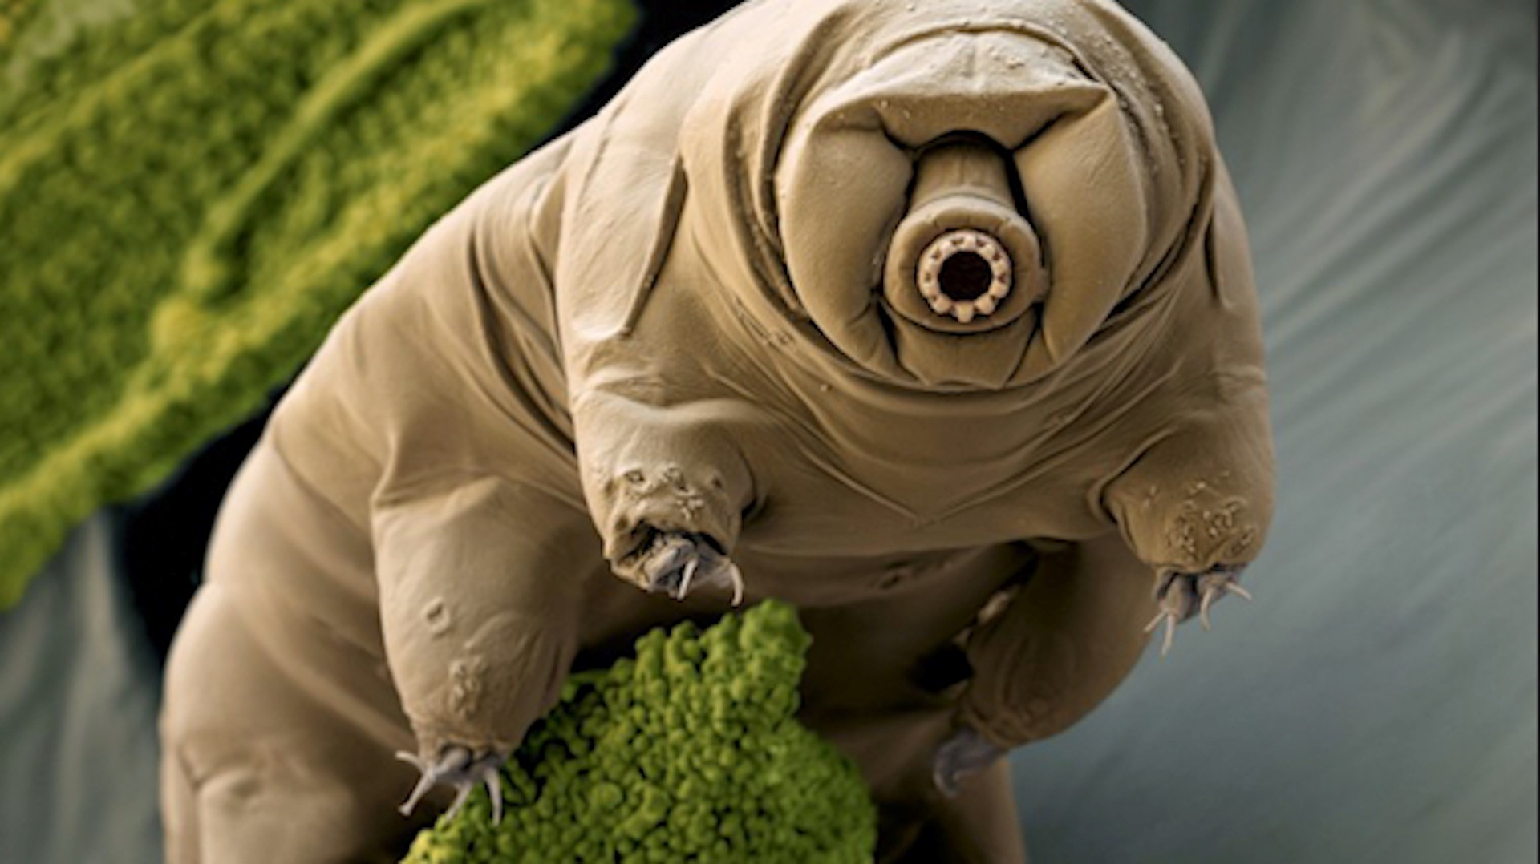
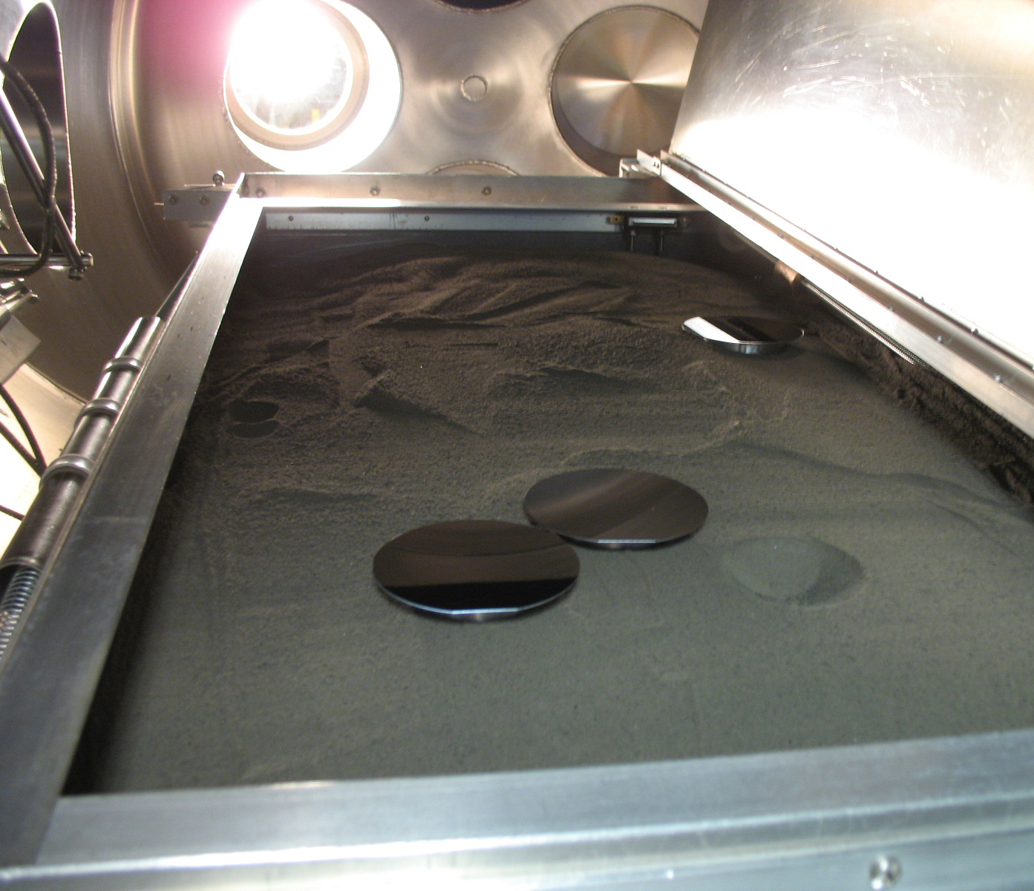
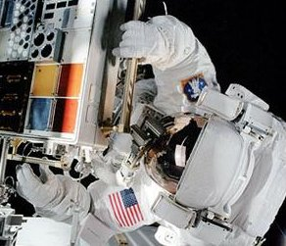
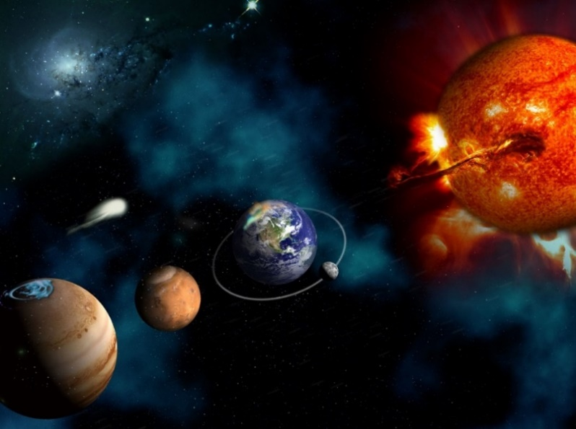
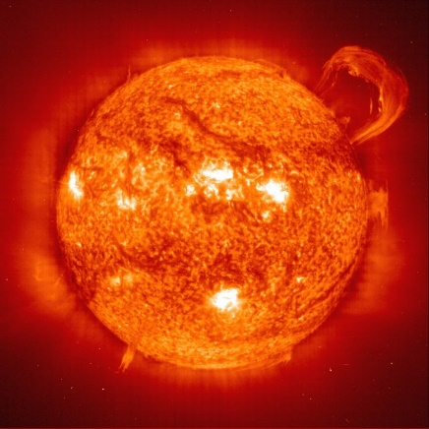
Space Environmental Effects
Testing Capabilities at MSFC
EM41: Nonmetallic Materials &
Space Environmental Effects Branch
Erin Hayward
erin.g.hayward@nasa.gov
Presented to LSIC Extreme Environments
October 2021
Notes:
Thank you! Today I’m going to be discussing the Space Environmental Effects Capabilities at Marshall Space Flight Center. We are part of EM41, the nonmetallic materials and space environmental effects branch
Fair warning, I’ll be going through a lot of capabilities and facilities really quickly today, so please feel free to reach out to me for more specific details on anything I talk about!

Slide 2
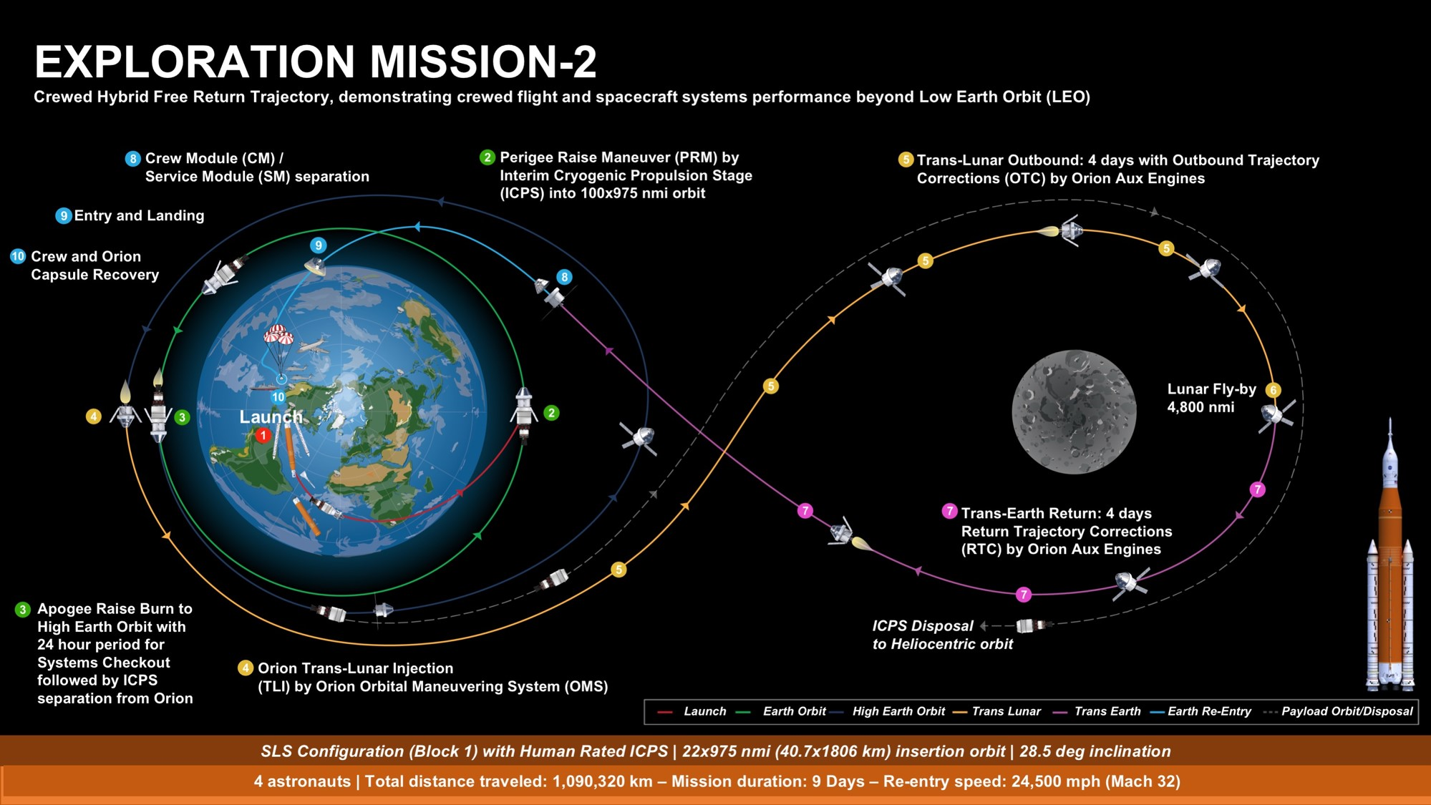
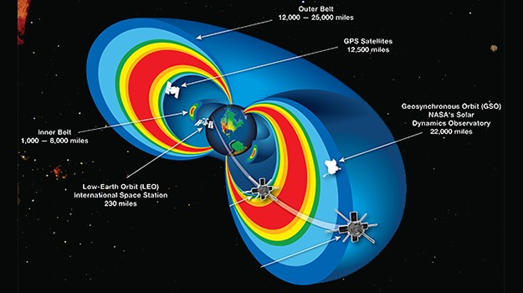
Space Environmental Effects (SEE)
The space environment is not just vacuum but includes a host of challenging conditions that affect spacecraft materials and systems.
The space environment varies by location, for example, one material suitable for Low Earth Orbit (LEO) might not survive in lunar and vice versa.
Testing will differ whether the spacecraft is in LEO, geosynchronous, lunar, Mercury, Mars, Jupiter, etc. and how much solar activity is predicted for the mission.
SEE Team’s test systems can be used to support projects and materials for any space environment from near earth to lunar to deep space.

Slide 3
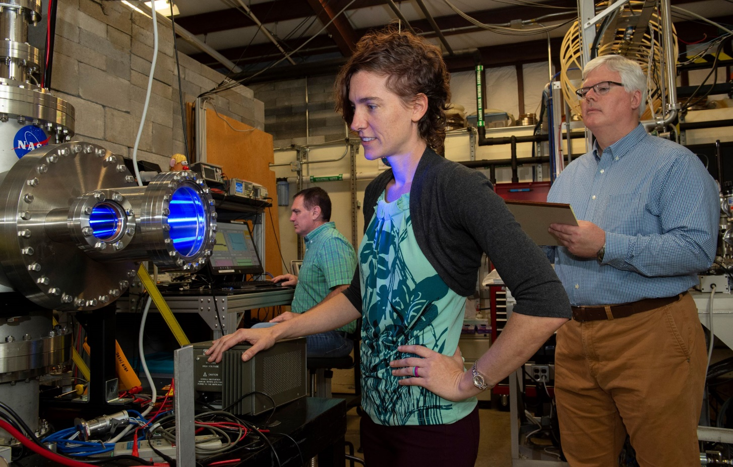
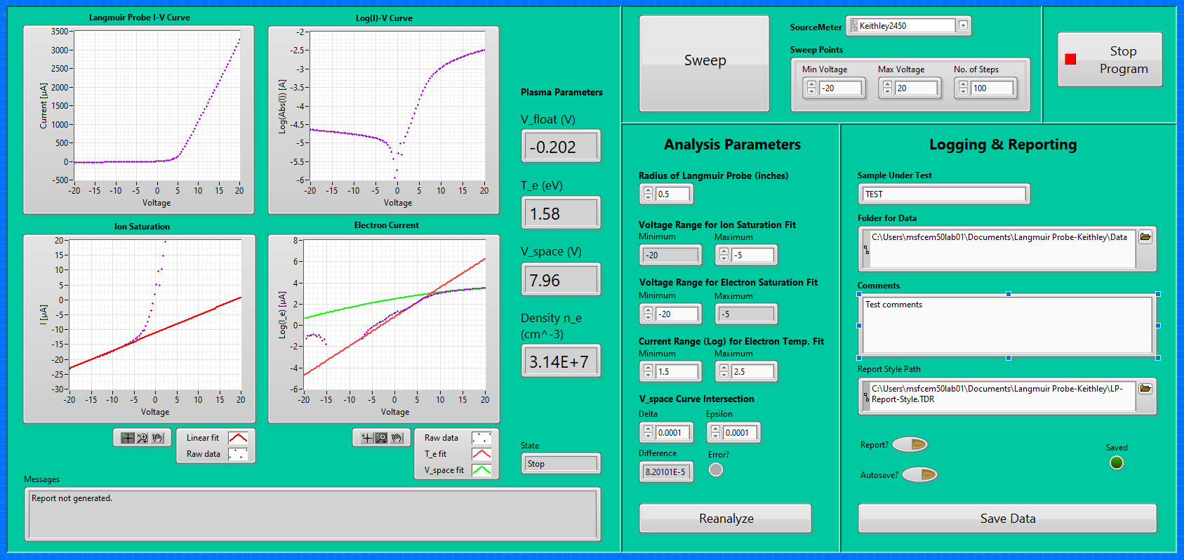
Space EnvironmentAL Effects (SEE)
MSFC has world class SEE expertise and test facilities to recreate the space environment in the lab.
Capabilities include individual and combined effects utilizing multiple unique test systems for the most complete SEE test capability available in the world.
MSFC’s ability to test all effects in one location is critical for minimizing the handling of sensitive material coupons after environmental aging.
Test systems can be rapidly adapted and reconfigured to customize tests to meet customers needs.
The SEE Team provides space-flight technology development programs the ability to elevate their hardware to TRL-6 “Qualification in a Relevant Environment”.
Notes:
So basically, we recreate space on earth. A big point of pride for us is our unique capability for combined effects testing. That means exposing materials and systems to lots of different effects at once, which really gives you a truer picture of how materials are going to act in space. It’s also great because we can handle everything in one location, minimizing shipping and handling issues.
I like to call our lab the mad scientist lab, because every test we run is a little bit different, and customized for the exact conditions needed. We can work with you to define your environment, help figure out the problems you likely need to test for, create custom test fixtures and software, and perform data analysis.
Pictured – RPCM safety assessment, where we generated molten metal and looked at how it damaged space suits
We do everything from low TRL R&D work up to providing programs the ability to elevate to TRL-6, “qualification in a relevant environment”

Slide 4
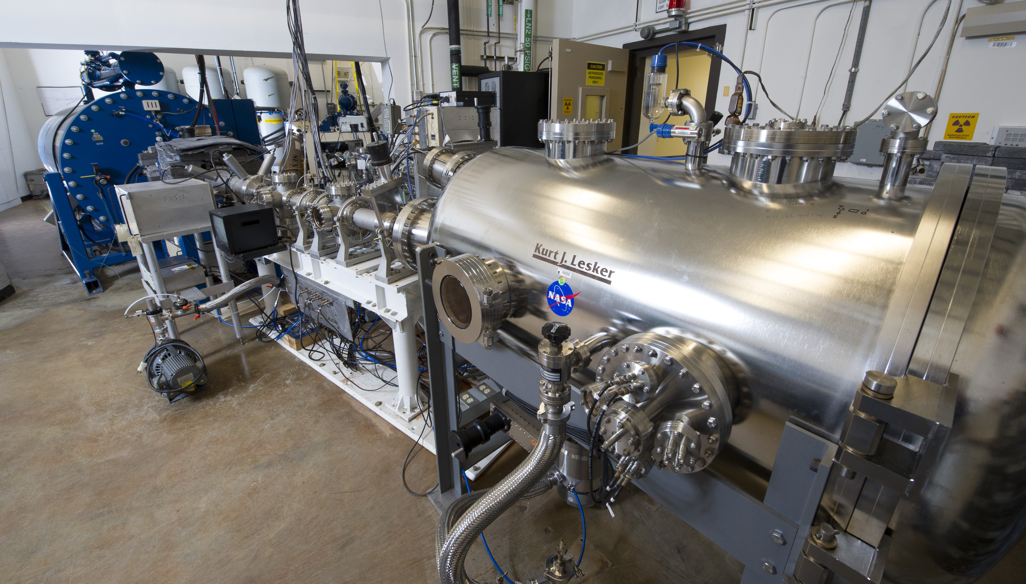
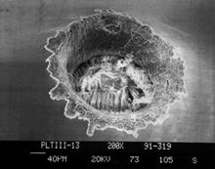
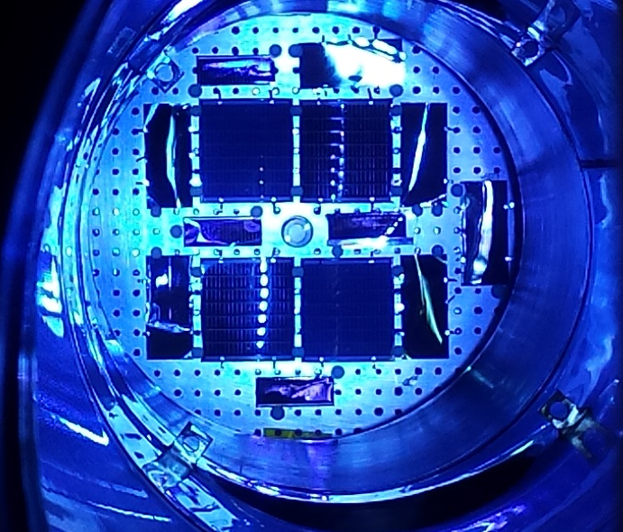
SEE Team Capabilities
Ultraviolet Radiation (UV & VUV)
Ionizing Radiation – Charged Particle (p+, e-), X-ray
  Total Ionizing Dose (TID)
Space Plasma Interactions and Spacecraft Charging
  Internal charging/iESD, surface charging
Thermal Extremes (hot to LN2 cryo)
Atomic Oxygen (AO)
High Velocity and Hypervelocity Impact
Planetary and Extraterrestrial Environments
Planetary Protection
Analytical Capabilities
High Temperature Emissivity Measurement System (HiTEMS)
Materials Flight Experiments
Notes:
These is a summary list of our capabilities, many of which can be combined into a single test – vacuum, UV and VUV, ionizing radiation, plasma, thermal extremes, etc. I’ll talk details on the following slides.
Thermal extremes…

Slide 5
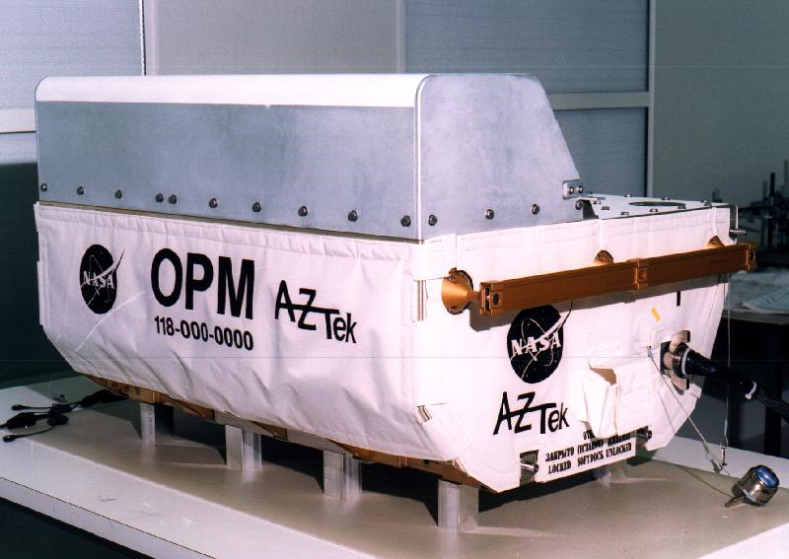
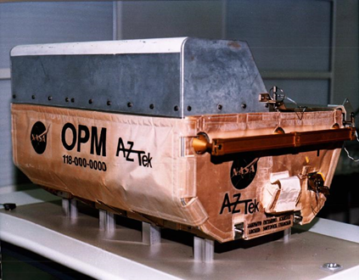
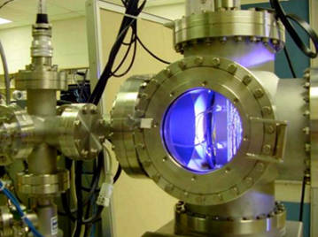
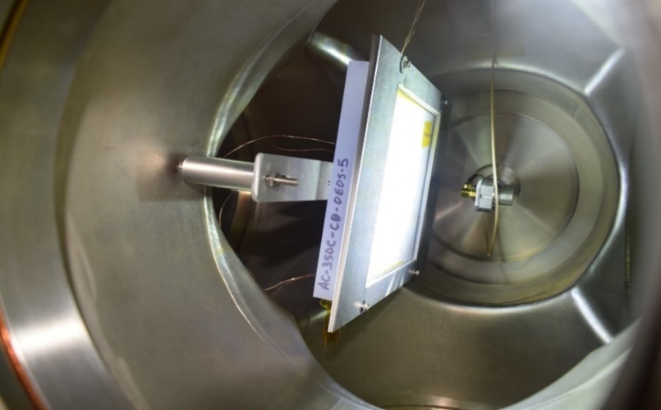
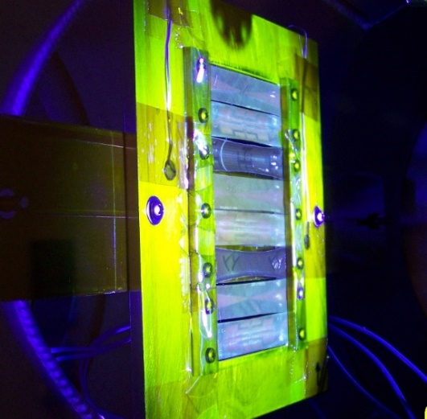
Ultraviolet (UV) Radiation
UV can change tensile properties of polymers and thermal properties of polymers, coatings, and optics. Increased effect in the presence of contamination/outgassing.
Two UV regions:
Near ultraviolet radiation (NUV)- wavelength range 200 nm to 400 nm
Vacuum ultraviolet radiation (VUV)- wavelength range 115 nm to 200 nm
VUV is absorbed by atmosphere and only found in space
Before space exposure
After space exposure
MSFC has many test systems sources for exposing materials to NUV radiation, VUV radiation and combined NUV and VUV radiation. These tests range from a month (24/7) to over a year.
Typical MSFC UV Test Facility
Spacecraft Window Material Under Test
Polymeric Material Under Test
Notes:
Ultraviolet radiation is particularly damaging to materials properties of polymers and composites, and can change optical and thermal properties of things like coatings and optics. Our lamps have a spectral range of 115 to 400 nm, which includes the vacuum UV range that’s typically absorbed by the atmosphere. We accelerate testing compared to what you’d see in space, but UV tests still tend to be pretty long, typically running 24/7 for a month or more.
Thermal control – UV lamps filter out most of the infrared and visible spectrum, but it runs a little hot, around 40C. Can be fixed to cold plate if needed.
Accelerate roughly 2x is the max recommended.
Often do “screening” test of 500 hrs of exposure on different materials.
Then do plateau tests where samples will be removed at different intervals… 1000, 1500, 2000 hrs (sun equivalent).
-> 2000 hr test is done in 1000 hrs (~42 days)

Slide 6
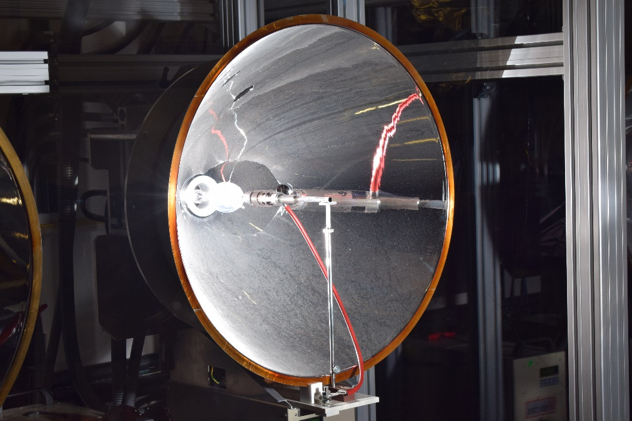
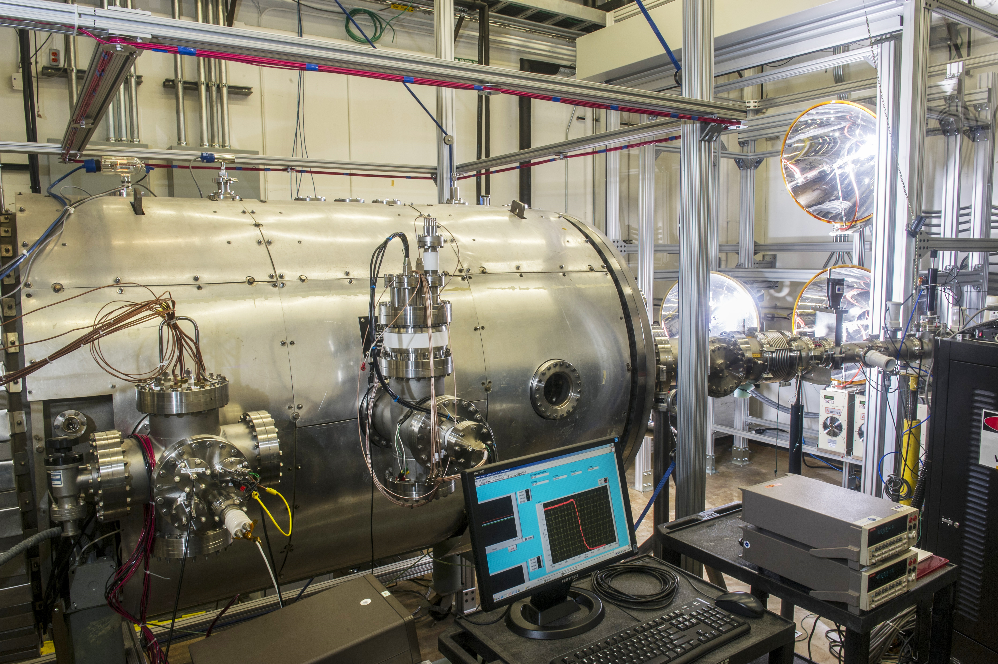
Solar Photon Radiation Including UV
High Intensity Solar Environment Testbed (HISET)
Able to produce intensity from 1 equivalent sun over a 2-foot beam spot to 600 equivalent suns over a 4-inch beam spot
  1 equivalent Sun is the illumination in earth orbit, compared to about 2 equivalent Suns at Venus and about 0.4 equivalent Suns at Mars
Able to simulate the effects of spacecraft flying towards the sun
Single 6.7 kW Xenon Lamp
HISET has Three 6.7 kW Xenon Lamps
Notes:
Our High Intensity Solar Environment Test chamber has three xenon arc lamps that are directed into ports in the chamber front, allowing us to simulate the illumination intensities up of to 600 suns! So this is incredibly useful for simulating effects on spacecraft working in the inner solar system, for example going into a solar orbit or doing a Venus flyby. This chamber has an LN2 shroud, and can be equipped with plasma sources and radiation guns as well. This is where the Parker Solar Probe Faraday cup was qualified, and we’ve recently been using it for solar panel testing for Gateway.
Not a perfect solar spectrum, but just about as close as you can get on earth
Tested Parker Solar Probe cup here, also PIMS instrument on Clipper…

Slide 7
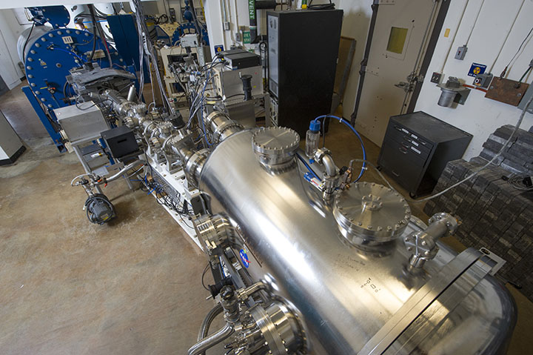
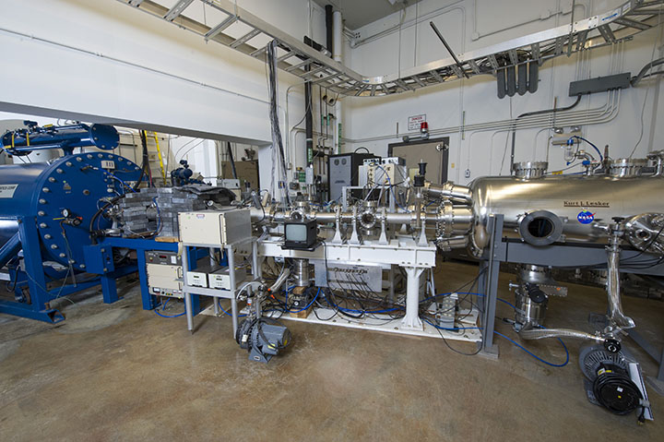
Ionizing Radiation: High-Energy Electrons and Protons
Charged particle radiation occurs naturally in space – GCR, SPE, SW
While we typically think of radiation being harmful to humans or causing single event effects in electronics, radiation can also damage materials.
Exposure to radiation can embrittle polymers through cross-linking or chain-scission. It also degrades solar array performance.
18-inch Beam Diameter
Top View of Target Chamber
Two Pelletron particle accelerators
  <= 2.5 MeV electrons (spot/beam)
  <= 700 keV protons (square/raster)
Both beam lines converge in single chamber
Single energy at a time, but can vary to do different profiles
Cryogenic capability
Test Types: total ionizing dose (TID), iESD
Side View of Pelletron beam line
Notes:
As you know, a lot of radiation in space is charged particles, electrons and protons. Our Pelletron facility has dual beam lines that feed into a single target chamber, so we can irradiate with both types of particles at once. In this facility, we have fairly high energy capability, with electrons going up to 2.5 MeV, and protons up to 700 keV. With this facility, we can study total ionizing dose, or charging effects. I do want to point out that while we can do some really interesting studies with these machines, we don’t have the full spectrum of energies you need to do true GCR or SPE shielding studies.

Slide 8
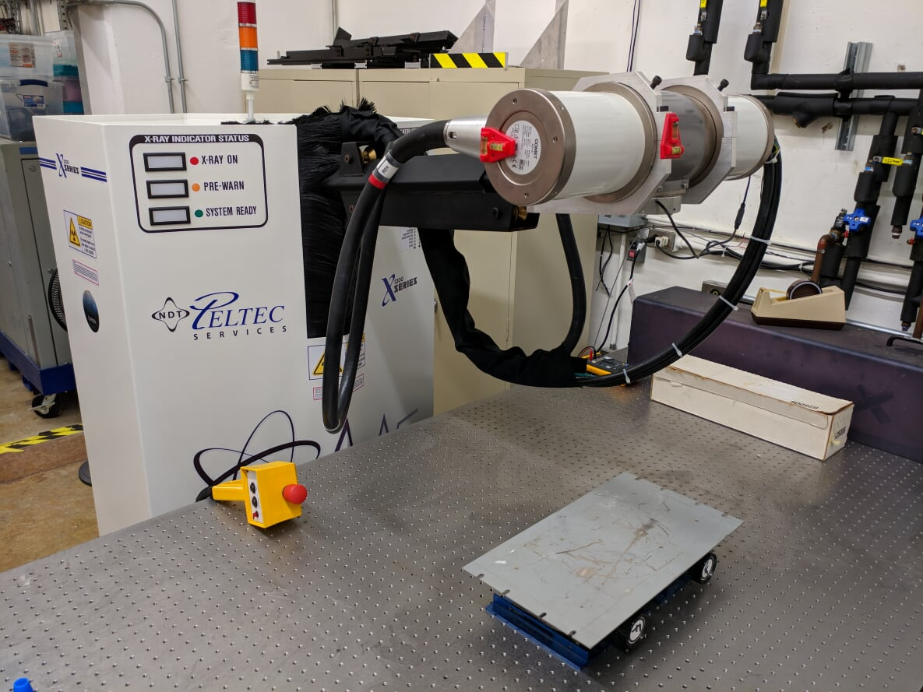
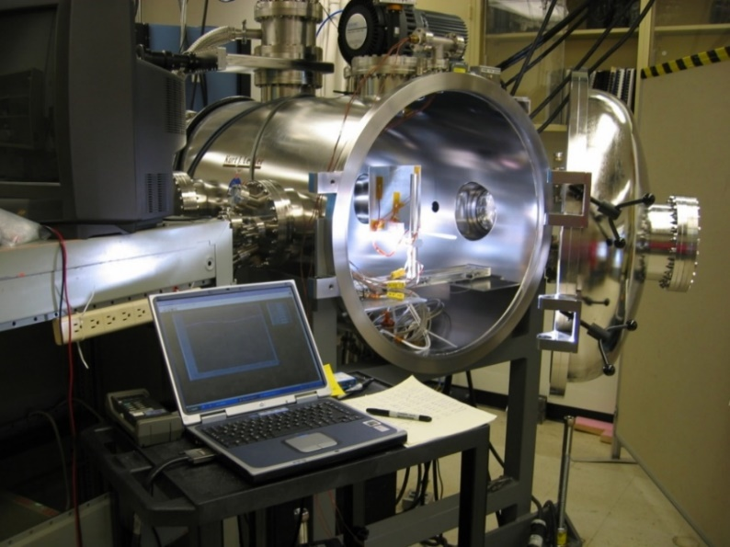
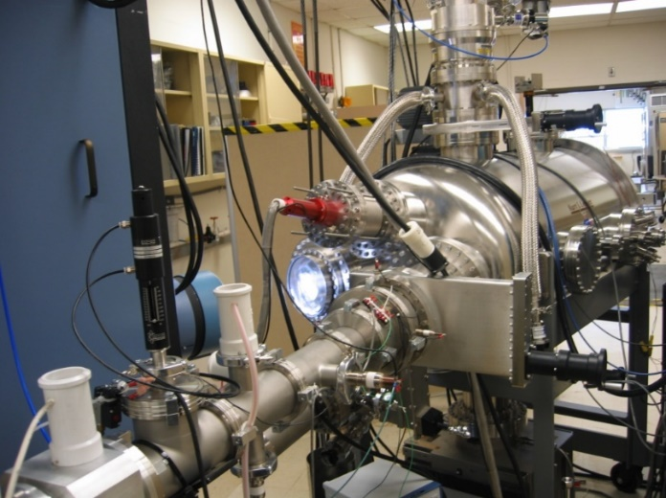
Ionizing Radiation: X-Ray and Solar Wind
X-Ray Source
The MSFC x-ray system for radiation effects provides materials with mission predicted total ionizing dose (TID)
Spot size varies as inverse of dose rate (<= Mrad/hr)
More penetrating than particles; no charging
  Solar Wind Chambers
  Low Energy Electrons (1 keV – 100 keV)
  Low Energy Protons (1 keV – 30 keV)
  Ultraviolet Radiation (VUV & NUV)
  12-inch Diameter Exposure Area
320 kV X-Ray Source
Notes:
Besides the big guns, we also have a number of lower energy electron and proton guns on most of our chambers, for simulating solar wind and charging.
Additionally, we have a 320 kV x-ray machine that can deliver total ionizing doses quickly to smaller components and samples.

Slide 9
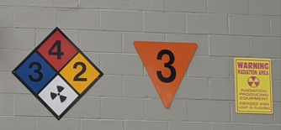
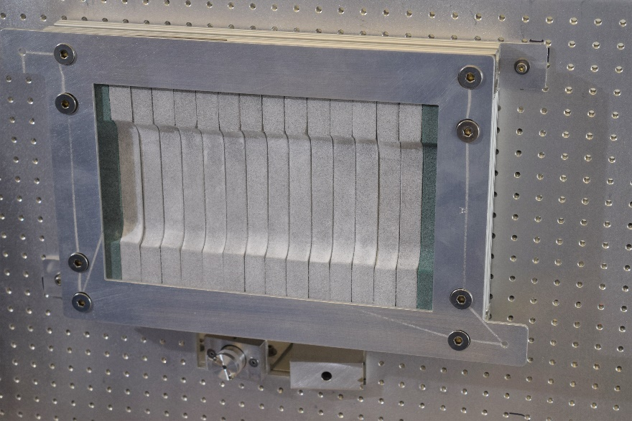
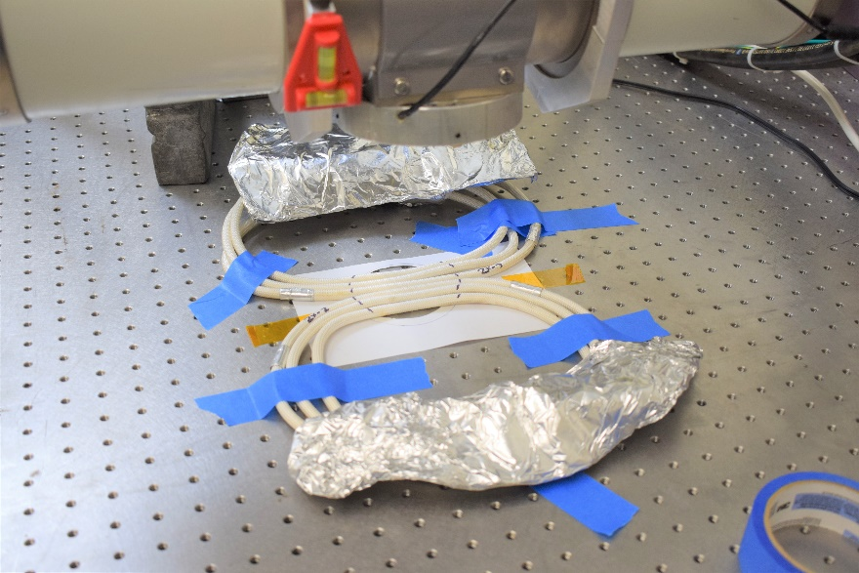
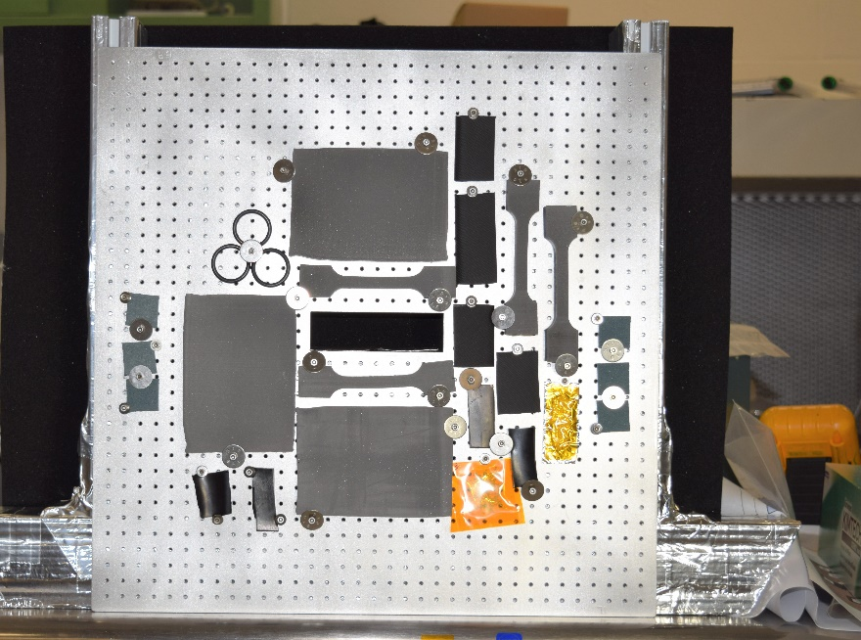
Irradiation of Explosive materials
MSFC has the capability to irradiate all the materials and components used to produce a Solid Rocket Motor (SRM) including live propellant, insulation, and initiator train materials and components.
Solid Rocket Motor (SRM) Live Propellant
Confined Detonating Fuse Assemblies (CDFA) for SRM Initiation
Insulation and O-rings
Notes:
We are also certified as an Explosives Handling facility! That’s an extremely unique capability of ours, and allows us to do things like irradiate solid rocket motor propellant and detonating assemblies in house. We’ve actually been doing a lot of this recently for Europa Lander.

Slide 10
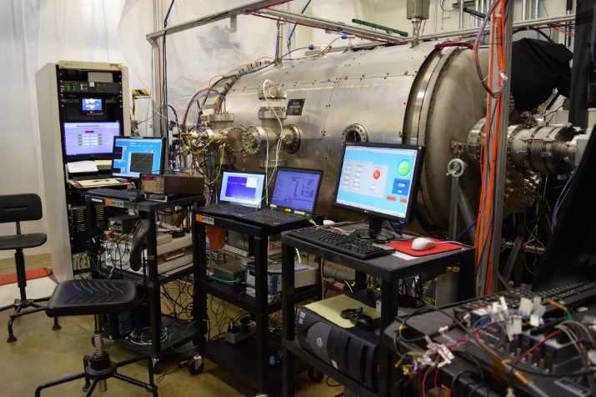
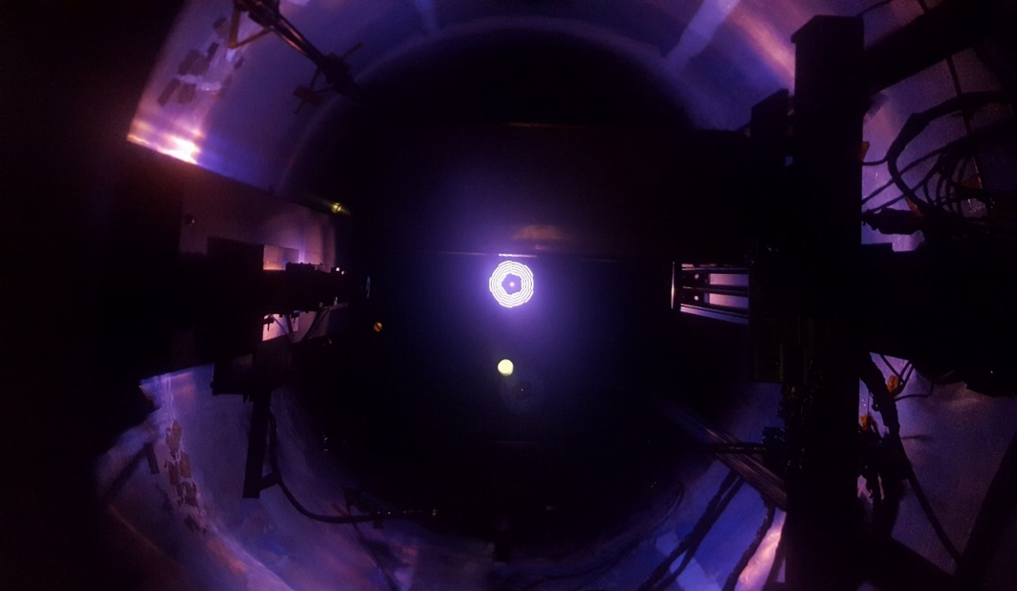
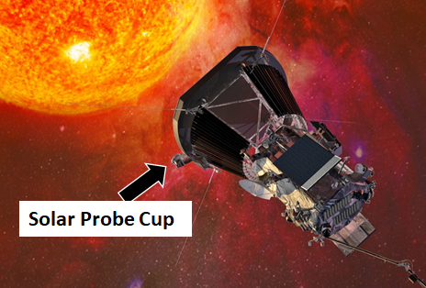
Plasma Environments & SPACECRAFT CHARGING
Plasma is a rarefied gas composed of charged particles
  Ions or protons (+)
  Electrons (-)
  May be out of balance, resulting in different interactions with spacecraft
The Sun is composed of plasma and is a source of plasma in our solar system
  Solar Wind Plasma
    Sun streams charged particles (radially) in all directions
    Protons (+) and electrons (-)
    Streaming Speed of 300 km/s (670,000 mph)
  Lunar surface has complicated plasma environment, depending on relative positions of Sun, Earth, & Moon
Can result in surface charging or deep charge deposition (depending on energy), or even charge removal
Notes:
The solar wind is a plasma source, and on the lunar surface, we have a really complicated, dynamic plasma environment, because of passing in and out of the solar wind and magnetotail. This results in potential space craft charging problems, especially when you have different materials and illumination conditions in a single system. So it’s definitely preferable to recreate and solve those potential issues on earth instead of on the moon!

Slide 11
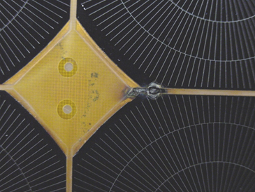
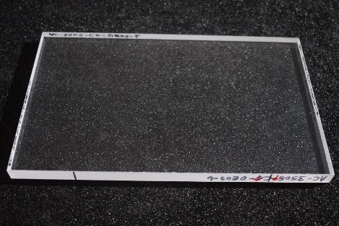
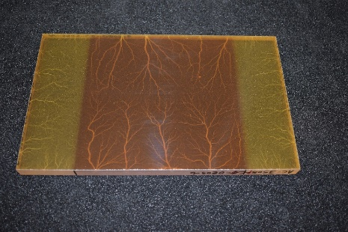
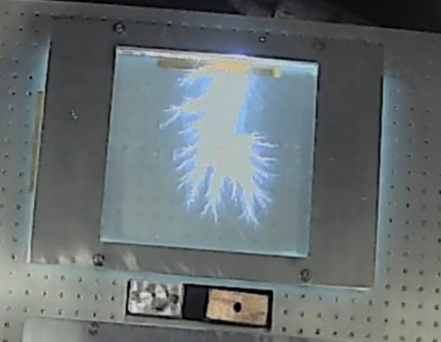
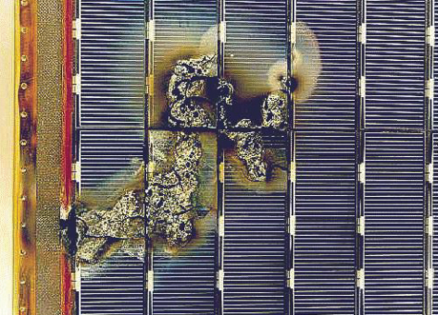
Damage Due to Electro-static Discharge (ESD)
ElectroStatic Discharges (ESD) can occur when charge build-up and potential differences occur within or across a system
  Different & non-conductive materials
  Varying illumination conditions
  Tribocharging – lunar rovers
A poor design can lead to an ESD event that can permanently damage the system, via property changes or complete loss of function
ESD damage (close-up) on ISS solar array sample
Credit: T. Schneider
ESD damage on a European Space Agency satellite solar array
Clear Window Sample (on a black mat) Before Radiation Exposure
Clear Window Sample (on a black mat) After Radiation Exposure
Internal ESD!
MSFC frequently tests systems, materials, & coatings for arcing & ESD generation
Credit: ESA
Notes:
Charging can lead to big issues – here are a few images of solar arrays that have failed due to electrostatic discharge following exposure to the solar wind. A lot of our testing involves characterizing these potential discharges, so that developers can mitigate risks.
Illumination differences
Ambient plasma conditions, high charging
Solar arrays
Tribocharging
Internal charging

Slide 12
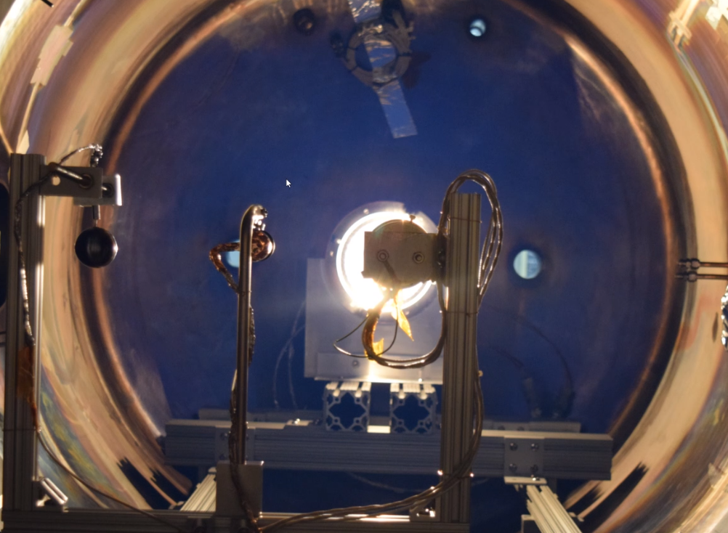
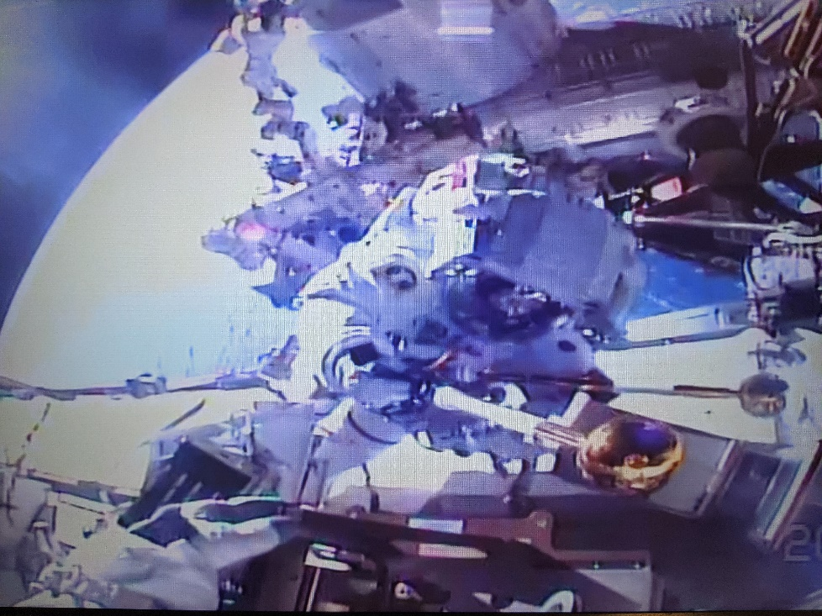
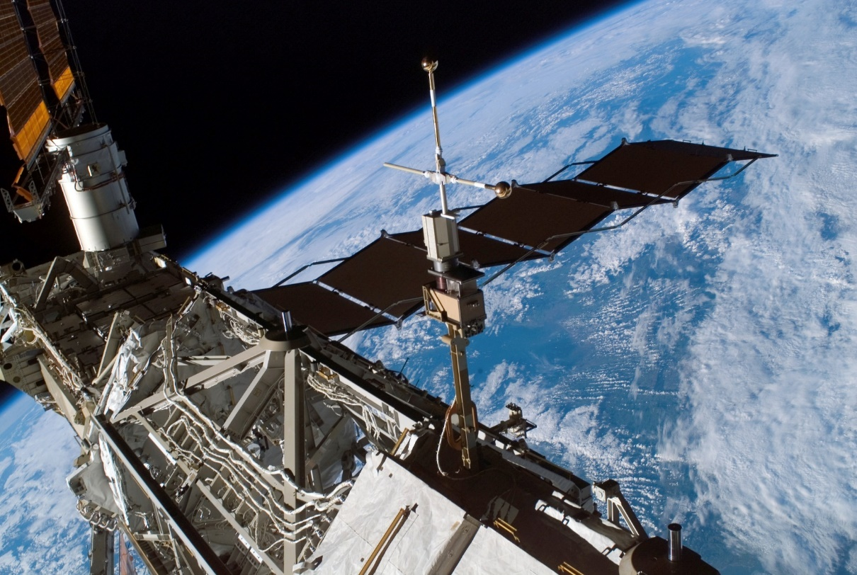
Plasma Instruments: On-orbit and In the Lab
Floating Potential Measurement Unit (FPMU) on ISS
  Measures the Low Earth Orbit Plasma Environment
  Directly Measure Spacecraft Charging Voltage
  Qualified by the MSFC SEE Team
  Deployment, Check-out, and Initial Operation by the MSFC SEE Team
Aki Hoshide & Thomas Pesquet replacing the FPMU with an on-orbit spare (2021)
The SEE Team also utilizes specialized plasma diagnostic instruments in their labs
Image Credit: NASA
Notes:
We have several plasma experts on our team. They’ve developed diagnostic and measurements instruments such as Langmuir Probes for use in our lab, and also on the ISS! This is a Floating Potential Measurement Unit, which was actually just replaced during an EVA, and has provided a lot of great data on the plasma environment and potential of the ISS for years now.
Langmuir probe, faraday cup…. Beam uniformity measurements…

Slide 13
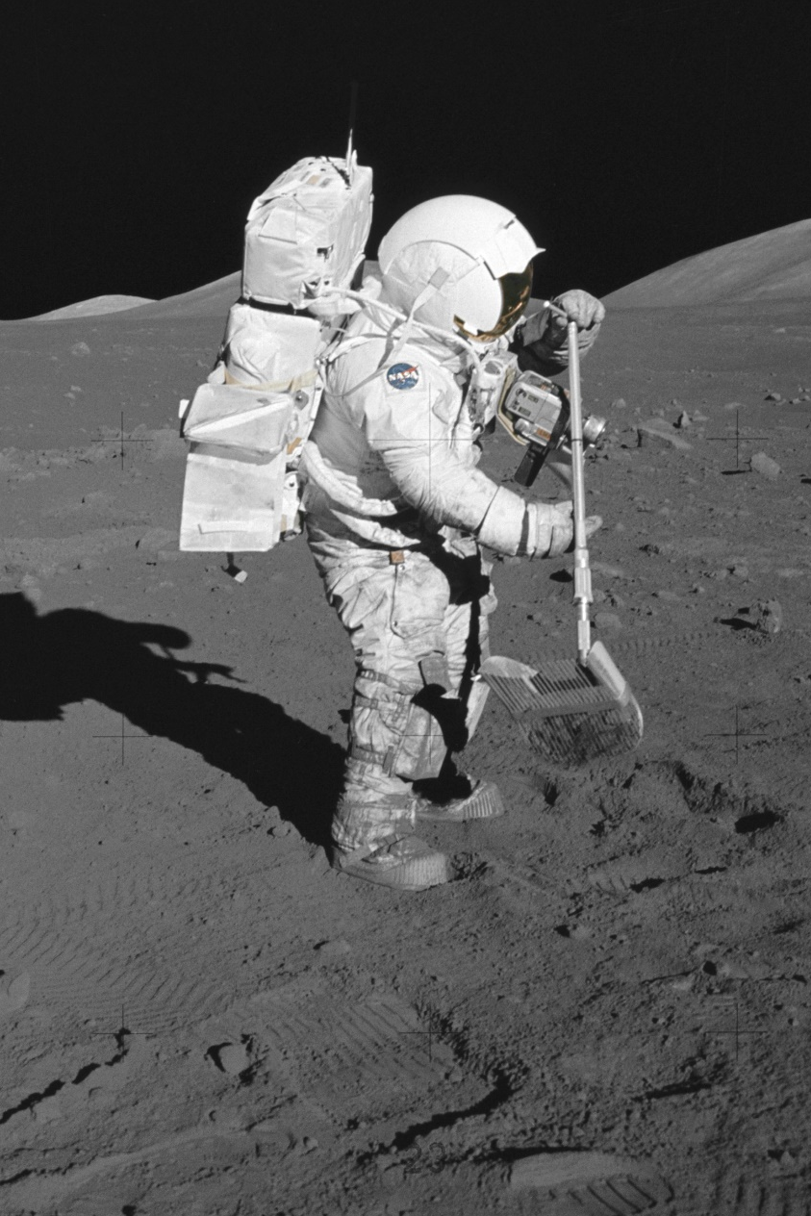
Planetary and Extraterrestrial Environments
Lunar Environment Test System (LETS)
Fully functional test system for studying the effects of the lunar surface environment on materials and systems as well as enabling the study of the effect of lunar dust charging on materials and mechanisms.
Large quantity of regolith simulant
Vacuum UV radiation
Electrons
Protons
Samples can be heated and/or cooled
Particle Image Velocimeter (PIV) to measure dust particle movement
Notes:
Now the chamber you’ve all been waiting for, LETS, the Lunar Environment Test System! LETS is a lunar surface environment testbed, with a regolith box, UV and particle radiation, and heating and cooling capability. We’re anticipating that this chamber will be in high demand with the lunar focus right now, because there are so many open questions on how regolith will interact with and cause problems for our systems and materials. We currently have JSC-1A simulant, but there’s potential for testing with other types if desired.

Slide 14
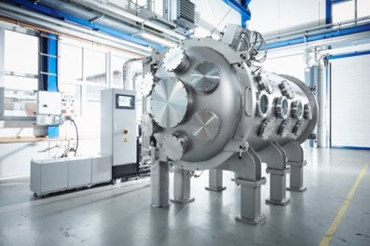
Future Regolith Test Chambers…
PLANET:
Planetary, Lunar, & Asteroid Natural Environments Test Bed
Will be Agency’s only complete space environment testbed with m^3 exposure envelope
  2m diameter x 3m length
Vacuum, UV, charged particle, regolith bed, planetary atmosphere, shroud (LN2, He)
Currently looking for funding!
Ongoing at MSFC: V20 Conversion from a clean chamber to a dirty thermal vac chamber.
Will NOT have other space environmental effects, but has a large volume (20’ diameter).
Within the ET20 group.
Notes:
LETS is a fantastic chamber, but it is limited in size. It’s a 1 m diameter chamber, so we can generally only test things like components and coatings, not full systems. We are hoping to add a midsize chamber to our portfolio in the next couple of years, which would be called PLANET ……… This chamber would replicate the full space environment, including vacuum, UV, charged particles, but also include a regolith bed with different simulant capabilities for the Moon and Mars, and have the ability to do planetary atmospheres like CO2. We’d eventually like to get the capability to do liquid He, since you can go even colder than Ln2, which would be great for looking at PSRs. This would be the agency’s only complete space environment testbed on this scale. We are currently shopping this idea around, and have had a lot of interest, but no clear path to funding yet as it’s expensive to get running. It’s currently under consideration for a Tech Excellence award, and we are soliciting letters of interest and small promises of in-kind contributions. If you think it’s something your project could benefit from, please get in contact with me!
I also want to mention another chamber that y’all might be interested in. The ET20 test group here at Marshall is converting one of their large clean chambers into a dirty regolith chamber. It’s only thermal vac, not the other space environmental effects, but very useful for the right test.

Slide 15
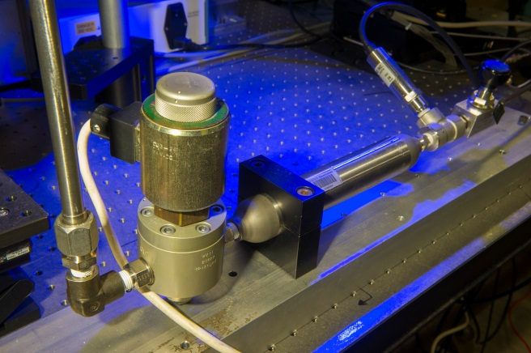
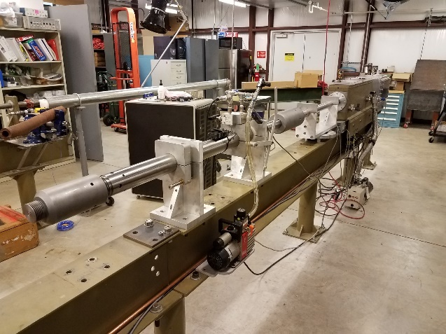
EM41 Impact Test Capabilities
Microballistic Gas Gun/
Sand Gun
Hypervelocity Impact Range
Micro-Light Gas Gun (MLGG)
Velocity: Up to 3,000 ft/s (Mach 2.76)
Projectile Diameter: 2-4 mm
Target Size: 51 x 51 mm (2x2 in.) up to full-scale hardware
Research focused
High Speed Digital Video
Working on conversion to shoot regolith simulant
Velocity Range: 0.3 – 7.5 km/s
Bore size .22 caliber (0.223 in.) diameter
Target chamber approx. 1 ft. wide x 2ft. long
Projectile Types include but are not limited to: Al, glass, polymers, ceramics
Hypervelocity impact testing is often performed in combination with other SEE exposures to evaluate combined effects.
Upcoming new capability: low speed regolith blaster for erosion and wear studies
Notes:
Our impact test facility has several different guns that can simulate impacts from micrometeoroids, launch debris, and orbital debris. On the left you can see the two-stage microlight gas gun, which can reach speeds of up to 7.5 km/s, in the low-mid range of what you would expect on the moon. We often use this gun in combination with other testing – for example, exposing a material to UV first, then shooting it, to determine what effects the exposure has had on mechanical properties.
We also have a microballistic sand gun that shoots just a few grains of sand at a time into a material, and captures the interaction with high speed cameras. This is a great research tool for looking at the specific damage modes from sand grains of different sizes and shapes, and works especially well on optically clear materials. We’re going to test using this with regolith as well, which is typically much more abrasive and irregular than sand.
Finally, we’re working on a new capability which is essentially a regolith sand blaster. We intend to study erosion and wear characteristics of different materials that are exposed to regolith dust.

Slide 16
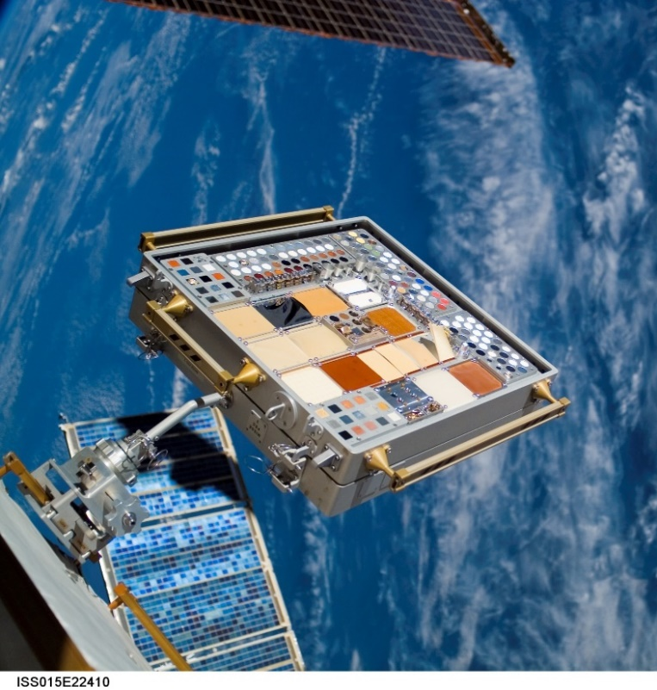
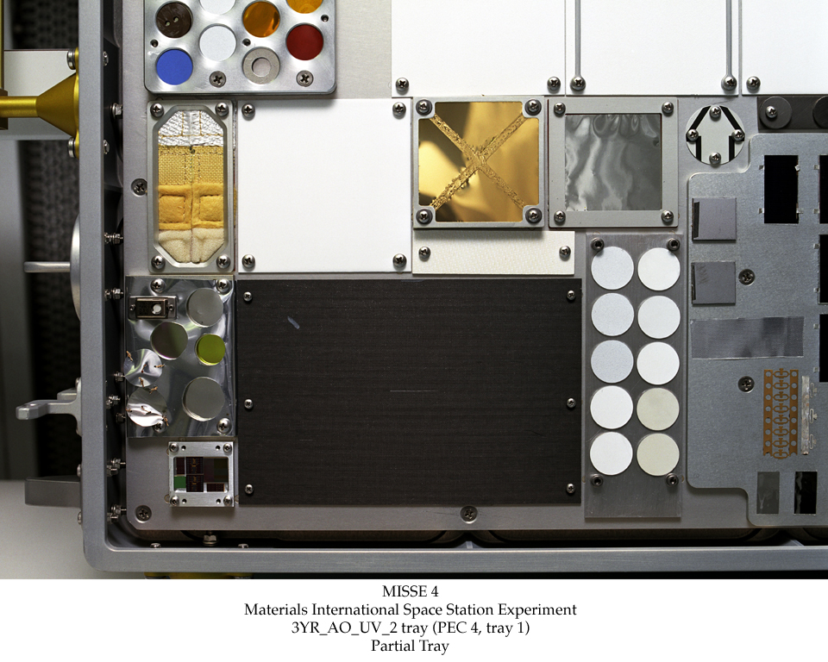
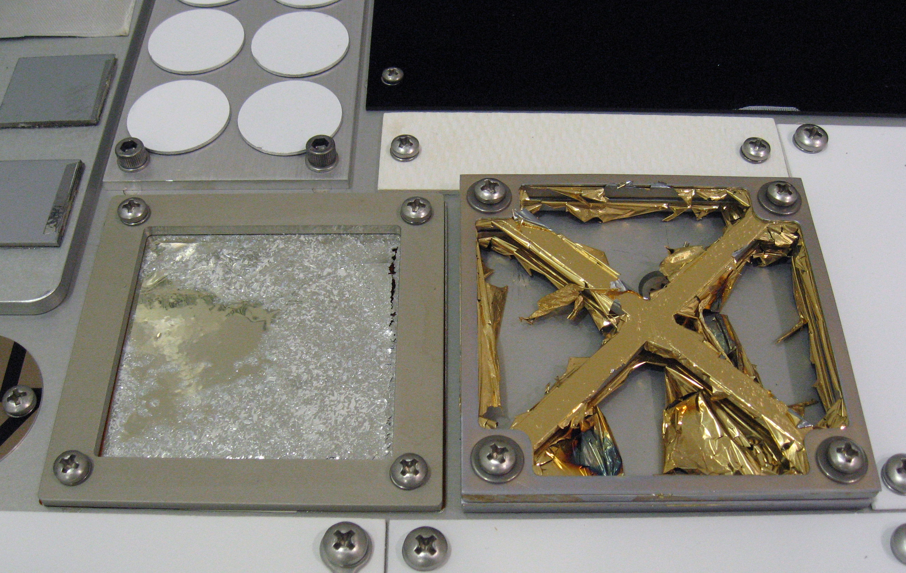
Material Flight Experiments
Lessons learned from past experiments
  Shuttle experiments, Long Duration Exposure Facility, Mir space station solar array
Experiments on International Space Station and X-37
  Materials on International Space Station Experiment (MISSE)
  Materials Exposure and Technology Innovation in Space (METIS)
Future experiments on Gateway, Lunar surface, Mars?
MISSE-3 on orbit
Polymer films before space exposure
Polymer films after space exposure

Slide 17
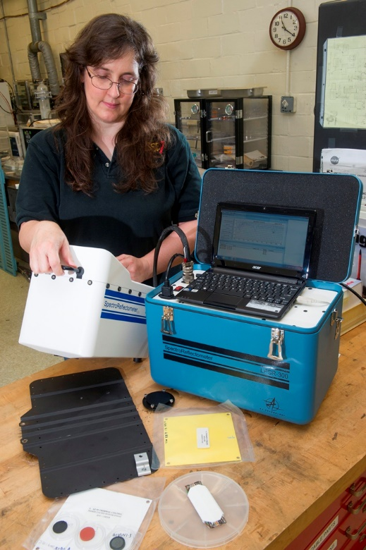
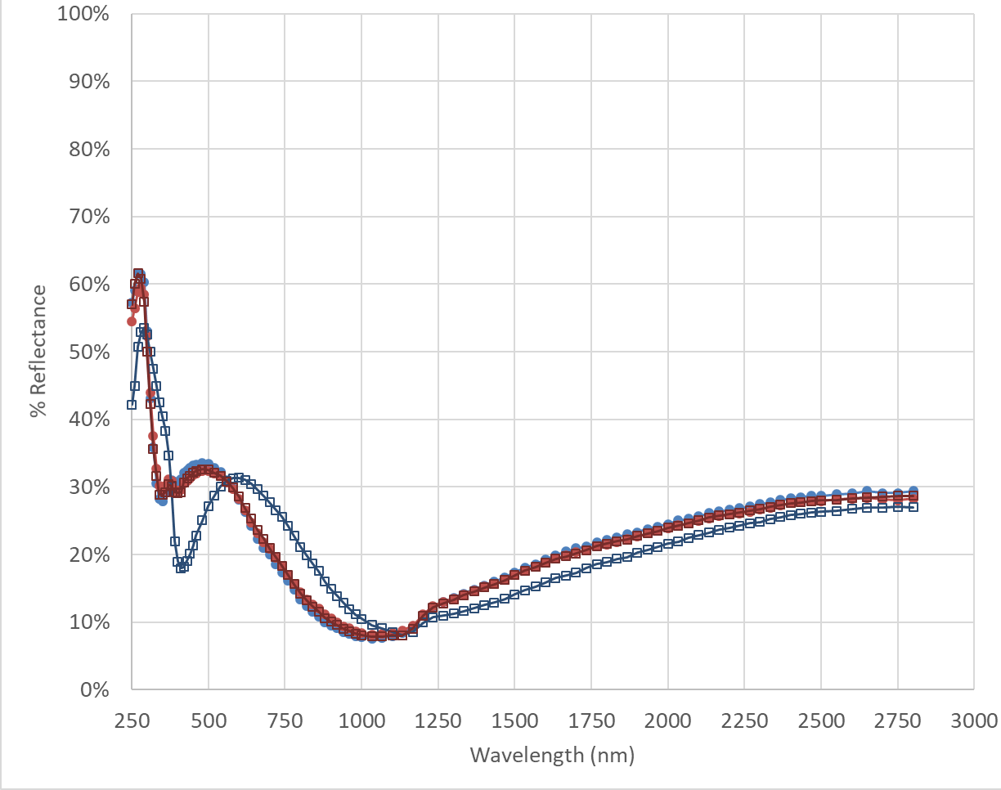
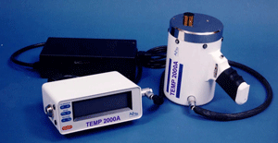
Analytical Capabilities
  Solar Absorptance Measurements (LPSR)
  Transmission Measurements (Lambda 1050)
  Vacuum Ultraviolet Radiation (VUV) Reflectance and Transmission
  Infrared Reflectance Measurements (LPIR)
  Infrared Emittance Measurements (TEMP 2000)
  Surface Resistivity for Conductive Coatings
  Surface Roughness
  Thin Films Tensile Testing

Slide 18



Some of the projects we have worked on…
Europa Clipper
Europa Lander
ISS – Payloads & Safety Assessments
ROSA (Roll Out Solar Array)
Parker Solar Probe
IXPE
Gateway PPE
Lunar GATR
KNaCK
MISSE
E-Sail
SEE testing can raise hardware and components to TRL-6: “Qualification in a Relevant Environment”
SEE for Exploration
MSFC Space Environmental Effects Team has unique capabilities to simulate a dramatic range of environments, from Heliophysics Missions to Deep Space Missions, and everything in between!
high vacuum
UV/VUV radiation
temperature extremes
solar wind plasma
particle & x-ray radiation
atomic oxygen
planetary surface and regolith effects
impact testing

Slide 19

BACKUP
MSFC Space Environmental Effects Team has unique capabilities to simulate a dramatic range of environments, from Heliophysics Missions to Deep Space Missions, and everything in between!

Slide 20

Comparison Of Capability
Complimentary facilities…
 | X-ray Irradiation | Pelletron Electron | Pelletron Proton
Max dose rate | ~10⁶ rad/hr | ~10⁷-10⁸ rad/hr | ~10⁸ rad/hr
Spot width (and Area) | 4” Circle (12 in²)* | 16-24” Circle (200 in²) | 16” Square (256 in²)
Penetration | $$cm scale$$ | $$mm scale$$ | $$μm scale$$
Charging | None | Deep, Negative chg | Shallow, Positive chg
*Larger spot areas are easily achievable on X-ray, but dose rate reduces proportionally
Proton
Dose Rate
Electron
X-ray
Depth

Slide 21


Planetary Protection
Current NASA projects include landers to touchdown on the surface of potentially life-supporting planets and moons.
Planetary protection is the required prevention of accidental transportation of Earth's microbes to these environments.
In addition to traditional interplanetary spacecraft decontamination operations, EM41 is investigating new techniques for biological burden reduction.
Studies are focusing on solid rocket propulsion systems and the innate antimicrobial capacity of both the chemical agents within the motor and of the assembly and operational environments.
Tardigrade
Video of Tardigrade through a microscope lens
Bacilli on Propellant Sample
Notes:
One of our labs newest specialties is in Planetary Protection.

Slide 22




Atomic Oxygen (AO)
We breathe O₂ molecular oxygen. In the ionosphere, UV breaks O₂ into oxygen atoms (O). This reacts with many materials and can be extremely destructive.
AO is found in low Earth orbit (LEO) and low Martian orbit.
MSFC’s Atomic Oxygen Beam Facility (AOBF) provides an accurate simulation of AO in LEO
5 eV atomic oxygen source
Used to determine the erosion rate of materials and the effect on thermal properties
Heatshield Material
AOBF
Before Space Exposure
After Space Exposure
Notes:
Atomic Oxygen is not a problem on the moon, but can definitely be in Low Earth Orbit. It’s very reactive and can be extremely destructive. We do have a facility that can generate AO, so hardware developers can determine erosion rate and effects on thermal properties.
This is a heavy ion experiment on the Long Duration Exposure Facility. The multi-layer insulation blankets had been taped down, and the tape failed due to AO erosion and thermal cycling. You can also see the darkening due to UV. In some places, the Kapton of the MLI eroded completely away, leaving only flakes of aluminization.

