Slide 1
Space Communications & Navigation
Lunar Communications & Navigation
Interoperability Standards
Engineering Interchange Meeting
September 15, 2021
WE WILL BEGIN SHORTLY

Slide 2

Agenda
Introduction: Andrew Petro
LunaNet & Interoperability Document Overview: Dave Israel
Discussion, Questions, & Feedback
If you have questions or comments during the session:
  Submit in the chat
  Submit anonymously at https://www.menti.com/f9m6fdcqdd

Slide 3
References
NASA Lunar Interoperability Specification: https://go.nasa.gov/3BQrCOk
2020 Request for Information Lunar Communications Relay and Navigation Services: https://bit.ly/3EkILle
SpaceOps 2021 LunaNet Architecture and Concept of Operations: https://go.nasa.gov/3nuBklx
The Future Lunar Communications Architecture (IOAG Report): https://bit.ly/3CeHBWy
International Communication System Interoperability Standards (ICSIS) Rev A: https://bit.ly/3hzsG1k
Recommendations on the Selection of End-to-end Space Internetworking Protocol: https://bit.ly/3k7zcOI

Slide 4
Introduction
Andrew Petro
Space Communications and Navigation
Human Exploration and Operations
NASA Headquarters, Washington D.C.
September 15, 2021

Slide 5
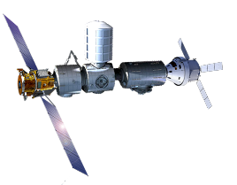
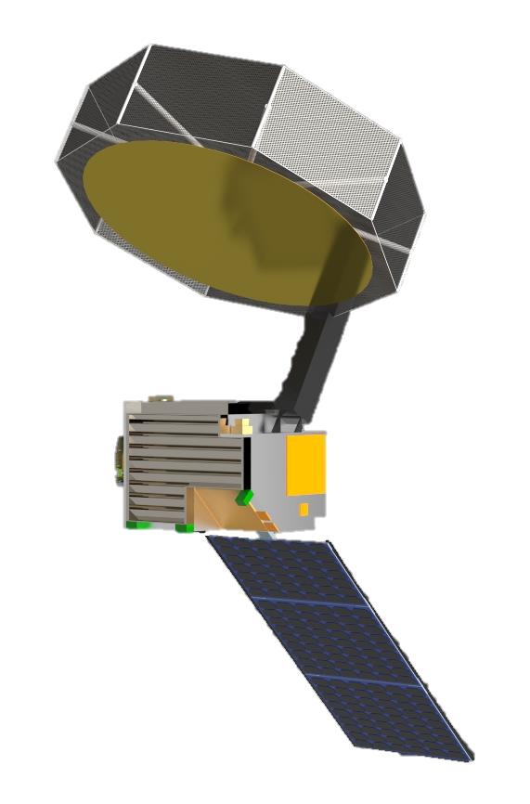
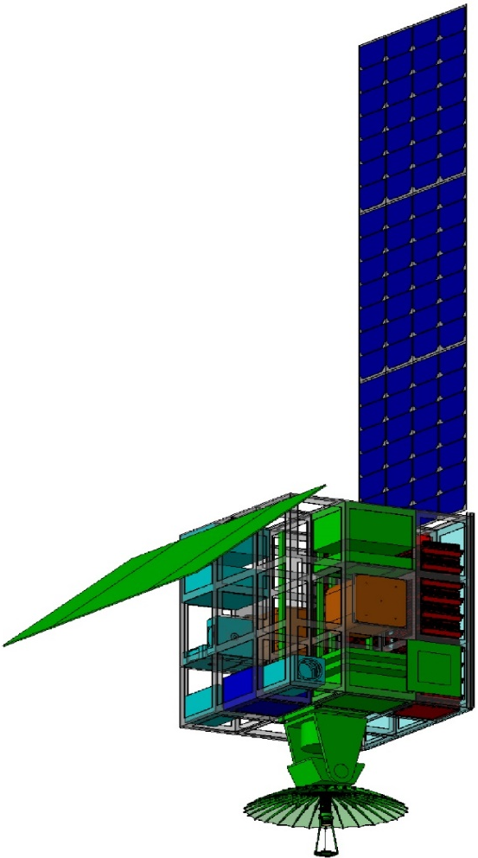
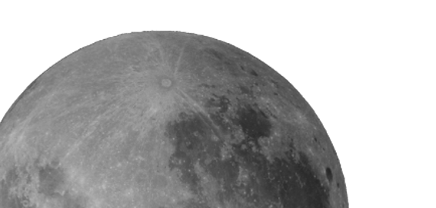


Overview of Early Lunar Communications Architecture
Orbital Relays
LINKING LUNAR USERS TO EARTH
& TO EACH OTHER
Gateway
LunaNet
Diverse, evolving constellation with multiple users and providers
Earth Stations
Framework of standards for
open, interoperable networks,
data, PNT & other services
Additional relay capability
Upgraded DSN and
other assets, including commercial stations
Orbiting Spacecraft
Users
SOUTH
POLE
Artemis Surface Missions
Far Side
Missions
Surface Communications and Navigation Assets
Other Robotic Missions
Communication and navigation infrastructure lowers the barriers to entry for new missions and capabilities and supports expanding robotic and human activities on the Moon.

Slide 6
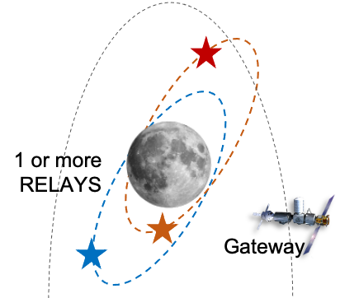
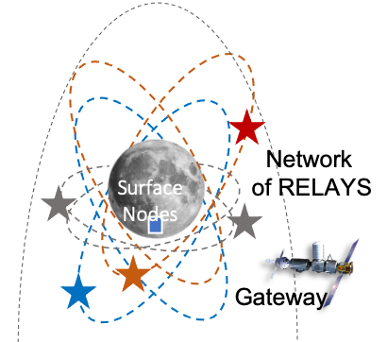
Lunar Communications & Navigation Evolution
Now to 2024
NEEDS
• Far side science mission
• South Pole human exploration
• PNT services
IMPLEMENTATION
• Existing ground networks
• Initial relay capabilities
• LunaNet compatibility
2024 to 2028
NEEDS
• Global coverage
• Longer, more complex
missions, greater mobility
IMPLEMENTATION
• Comprehensive relay network
• Surface comm & nav assets
• Full LunaNet services
2028 and Beyond
NEEDS
• Sustained surface and orbital presence
IMPLEMENTATION
• Evolution of infrastructure
• Infusion of new technology

Slide 7
A Few Key Points
Our purpose today is to introduce a draft of the Interoperability Standards and Conceptual Framework and begin the dialogue with potential commercial service providers.
  Questions
  Feedback on the content
  Request for working group participants
These standards are not intended to be owned and controlled by NASA alone.
We are planning interaction with international partner agencies and expect more input from NASA and other U.S. government agencies.
We intend to be consistent with applicable existing standards, as much as possible.
We want to be inclusive of all potential providers and users but complete a useful product in a reasonable time.

Slide 8
Integration of Feedback &
Completion of Baseline Document
Introductory Meetings with industry, space agencies, other U.S. government agencies: September 2021
Working Groups, facilitated by NASA, to include members from private companies, national space agencies, and other U.S. government agencies
    Communications Services Working Group: focus on Initial Operations Capabilities (IOC)
    PNT Services Working Group: focus on IOC
    Enhanced Operations Capabilities (EOC) Working Group
Complete Baseline Document (IOC Sections): by end of January 2022
Complete Baseline Document (EOC Sections): by end of June 2022

Slide 9
LunaNet Overview and
Interoperability Document Walkthrough
Dave Israel
Architect
Exploration and Space Communications Projects Division
Goddard Space Flight Center
dave.israel@nasa.gov
September 15, 2021

Slide 10
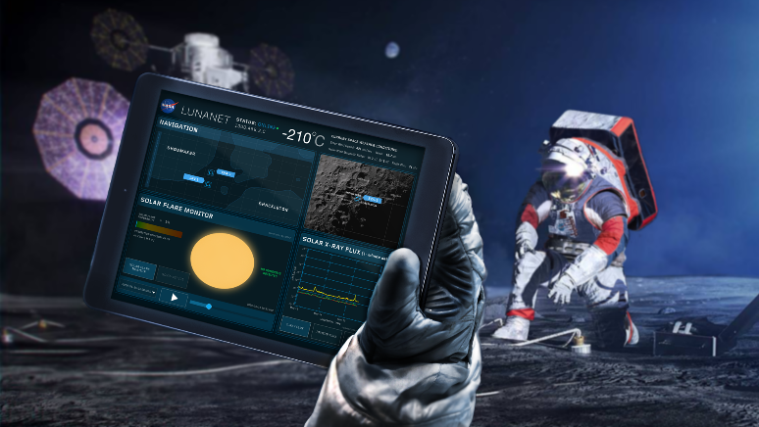
LunaNet Services
Networked Communication Services
Critical data transmitted in real time
Data aggregated and transmitted in store-and-forward mode from orbiting and surface relays
Data exchanged among lunar users with no need for transfer to and from Earth
Data sent on demand by user or scheduled to better manage Earth stations loading & spectrum use
Position, Navigation, & Timing Services
Precise position, velocity, and time for autonomous navigation and collision avoidance
Fusion of multiple data types including radiometrics, optimetrics, celestial navigation, optical nav, terrain relative nav, and Global Navigation Satellite System (GNSS)
Broadcast service supplies time transfer and metric tracking to synchronize users
Detection and Information Services
Alerts for events such as space weather, collision avoidance, and surface impact predictions sent to all LunaNet subscribers
Mission sensors, for space weather and other measurements, distribute information services to other users via LunaNet information services
LunaSAR: Distress detection and notification services
Science Services
Use radio frequency (RF) & optical assets (part of) as scientific instruments
Supports Radio & Radar Sciences, Radio Astronomy / Very Long Baseline Interferometry (VLBI), and other space sciences

Slide 11
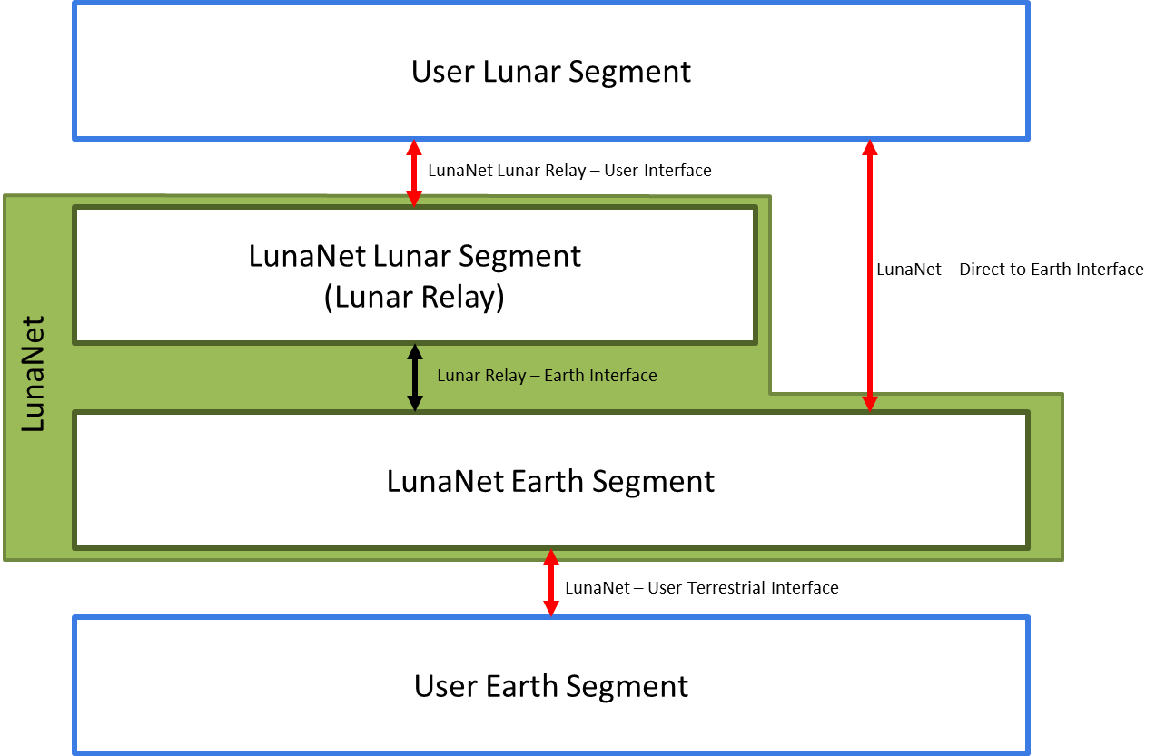
LunaNet Segments

Slide 12
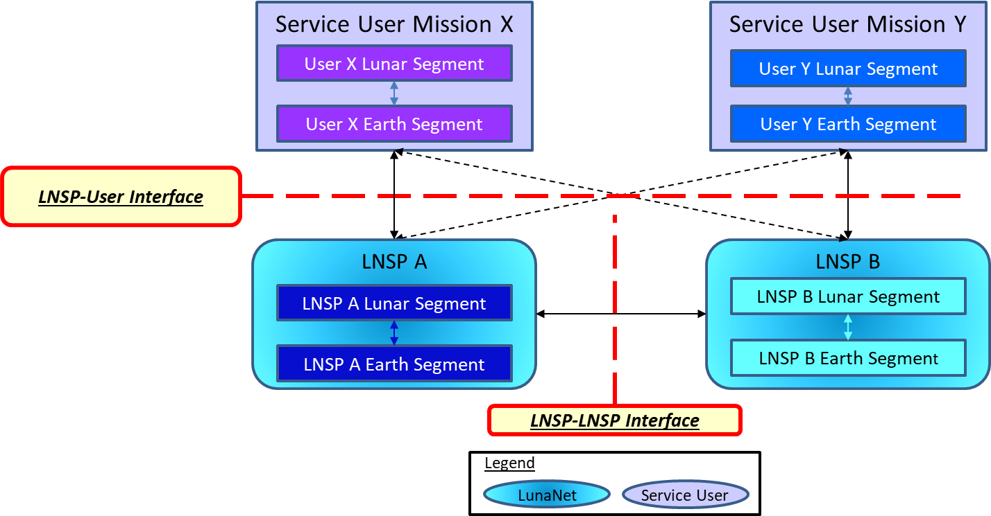
LunaNet Standard Services and Interfaces

Slide 13
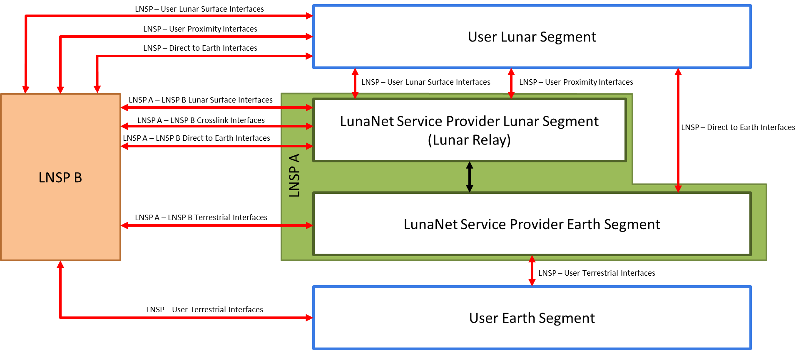
LunaNet Service Provider Interfaces

Slide 14
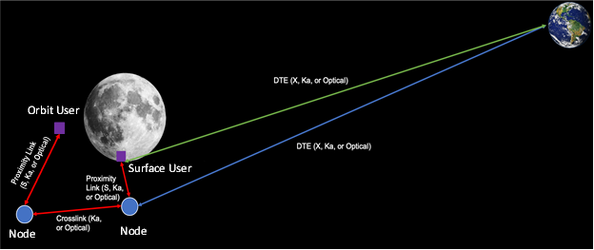
Spacelink Interfaces and Frequency Bands

Slide 15
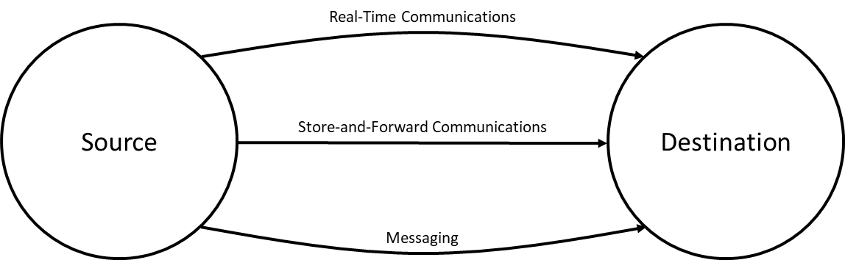
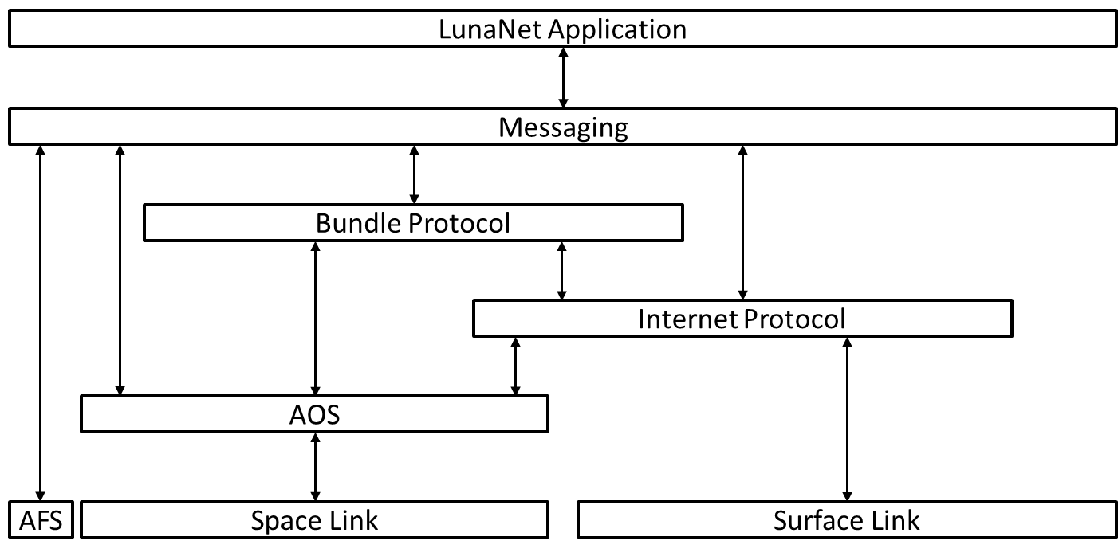
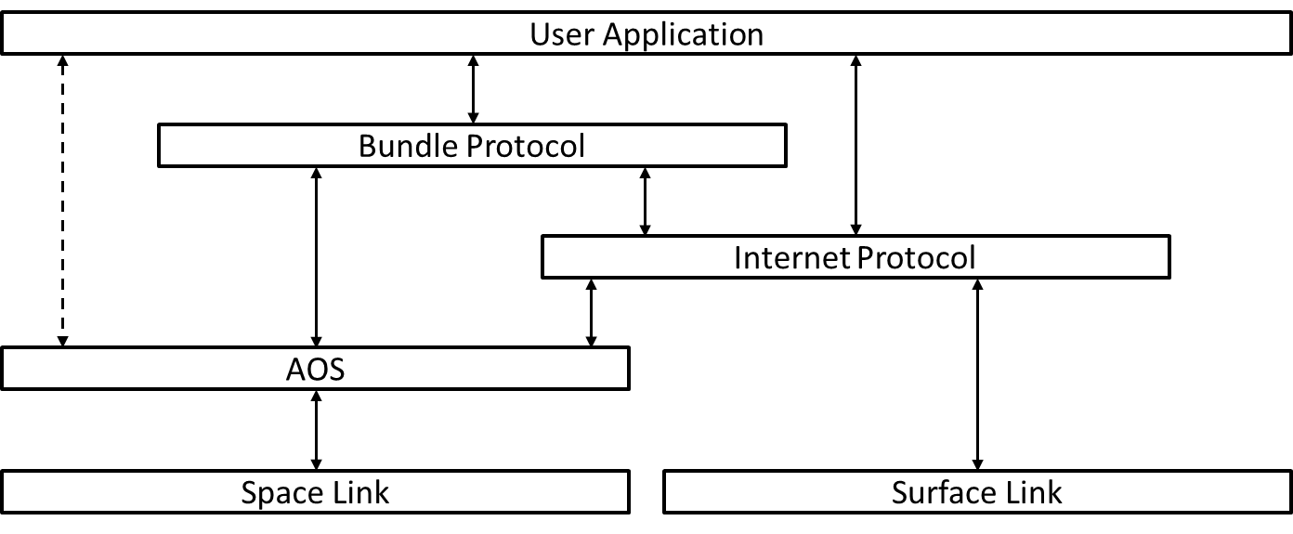
LunaNet Communications Services
User Applications Simplified Protocol Stack
LunaNet Applications Simplified Protocol Stack

Slide 16
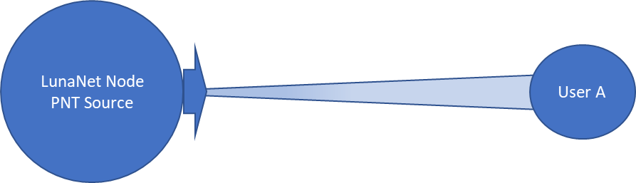
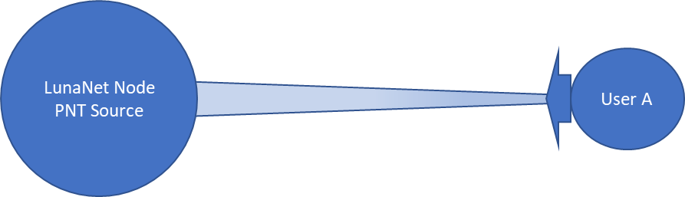
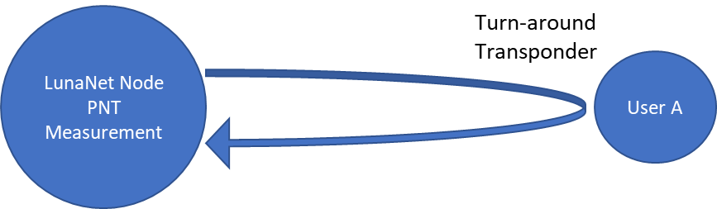
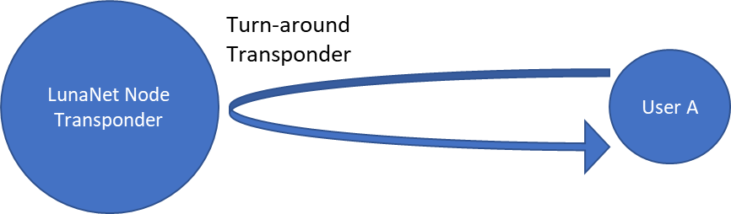
LunaNet PNT Services

Slide 17
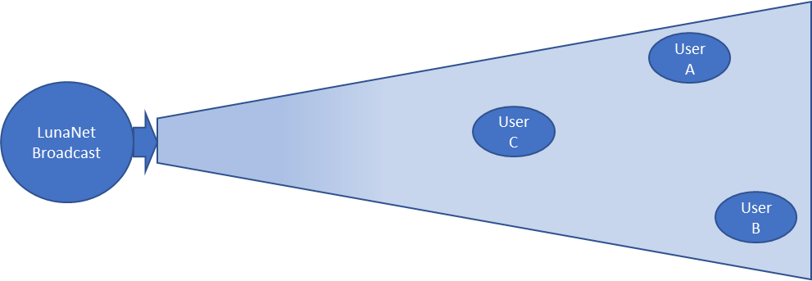
Augmented Forward Signal

Slide 18
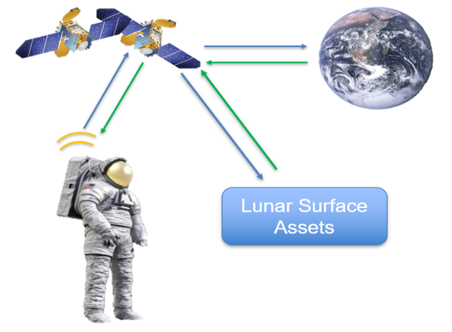
LunaSAR Data Path ConOps

Slide 19
Document Walkthrough

Slide 20
Questions or Comments?

Slide 21
References
NASA Lunar Interoperability Specification: https://go.nasa.gov/3BQrCOk
2020 Request for Information Lunar Communications Relay and Navigation Services: https://bit.ly/3EkILle
SpaceOps 2021 LunaNet Architecture and Concept of Operations: https://go.nasa.gov/3nuBklx
The Future Lunar Communications Architecture (IOAG Report): https://bit.ly/3CeHBWy
International Communication System Interoperability Standards (ICSIS) Rev A: https://bit.ly/3hzsG1k
Recommendations on the Selection of End-to-end Space Internetworking Protocol: https://bit.ly/3k7zcOI

Slide 22
Thank You!
For any follow-up questions or comments, please email:
nasa-commercialsynergies@mail.nasa.gov

