Slide 1
HSRL-2 Data Products

Slide 2
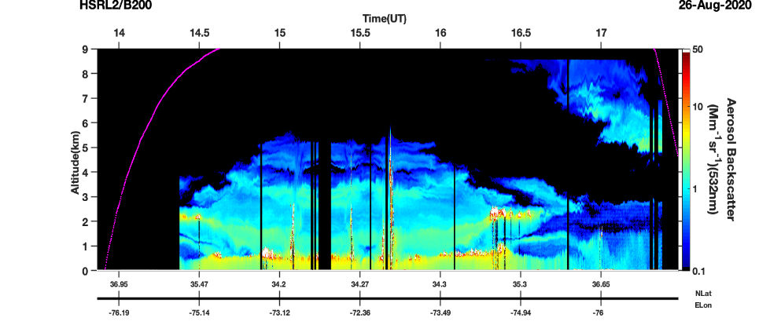
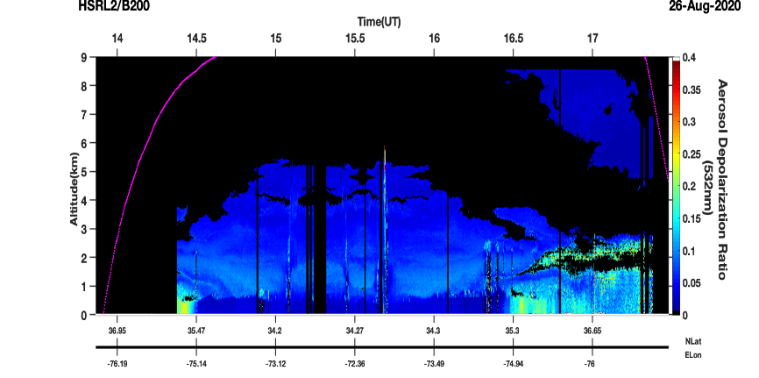
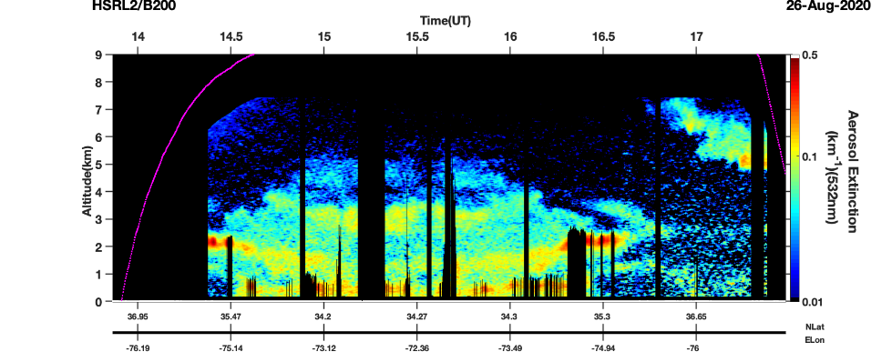
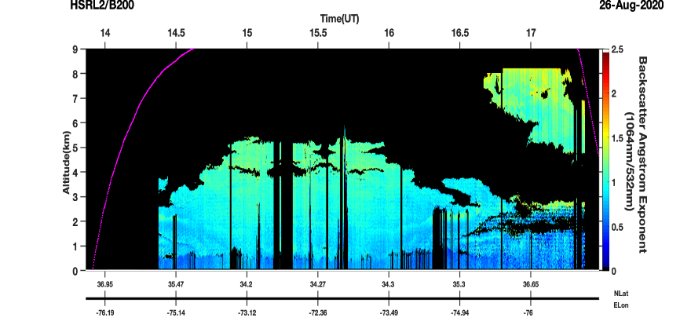
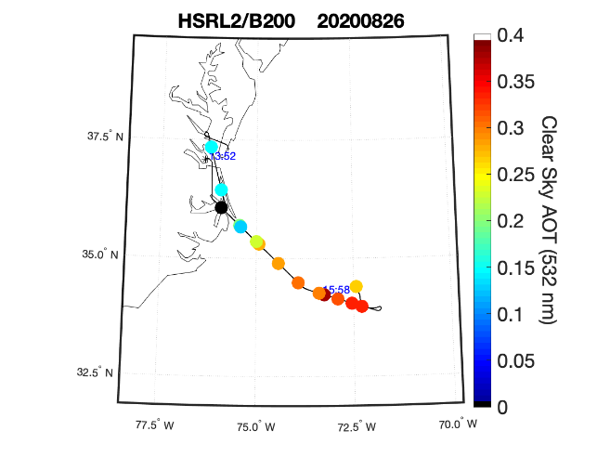
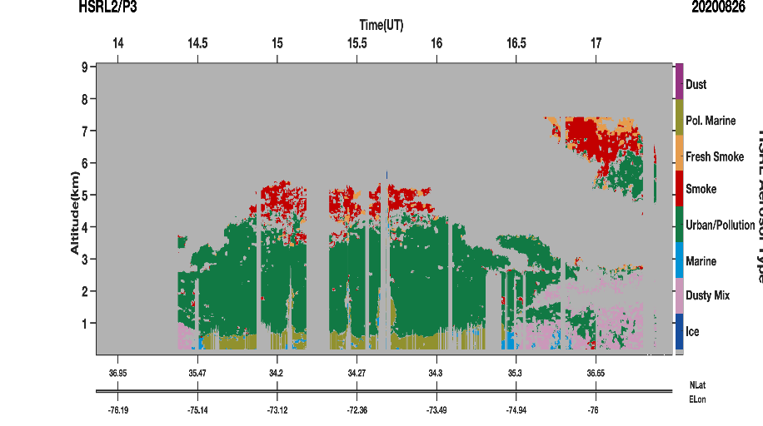
LaRC Airborne High Spectral Resolution Lidar – Generation 2 (“HSRL-2”)
Data Products
hdf5 data and png plot images
Aerosol Extensive Measurements
  Particulate backscatter profiles (355, 532, 1064 nm)
    Δx ~ 1 km, Δz ~ 15 m
  Aerosol extinction profiles and AOT (355 and 532 nm)
    Δx ~ 6 km, Δz ~ 270 m
Aerosol Intensive measurements
  Particle depolarization profiles (355, 532, 1064 nm)
    Δx ~ 1 km, Δz ~ 15 m
  Extinction-to-backscatter ratio profiles (355 and 532 nm)
    Δx ~ 6 km, Δz ~ 270 m
  Angstrom exponent profiles
    Extinction: 355-532 (Δx ~ 6 km, Δz ~ 315 m)
    Backscatter 355-532, 532-1064 (Δx ~ 1 km, Δz ~ 15 m)
Aerosol Type
Aerosol Optical Thickness
Cloud top heights
Cloud top extinction and lidar ratios (future)
ICARTT format
Mixed Layer Heights
Aerosol Optical Thickness
Data archived at https://www-air.larc.nasa.gov/cgi-bin/ArcView/activate.2019#HOSTETLER.CHRIS/
Look for
ACTIVATE-HSRL2_UC12_2020_R0_Read_Me_First.pdf
ACTIVATE-HSRL2_UC12_2020_R0_DataFileDescription.pdf
Aerosol Backscatter
Aerosol Depolarization (532 nm)
Boundary
Layer
Low-level clouds
Aerosol Extinction
Smoke
Layer
Aerosol Backscatter Wavelength Dependence (1064/532 nm)
Aerosol Type
Aerosol Optical Thickness (532 nm)

Slide 3
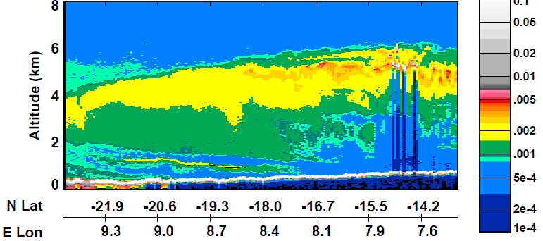
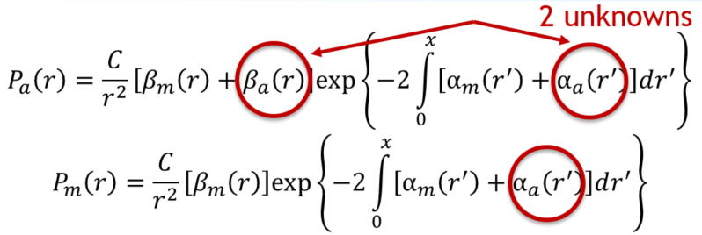
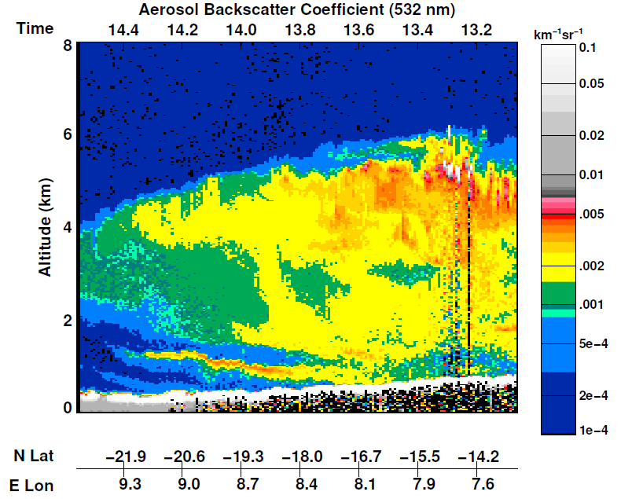
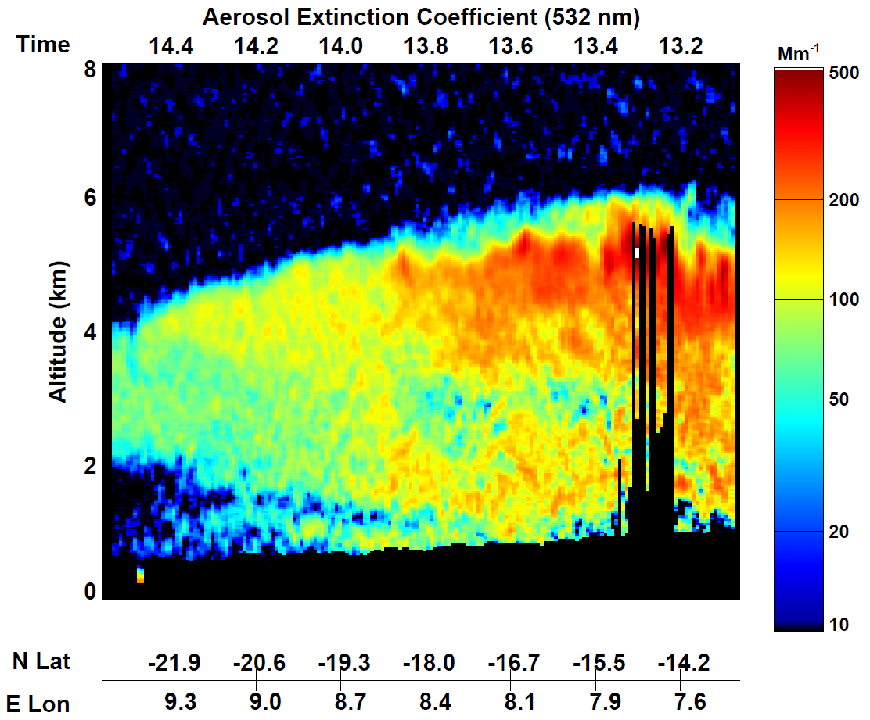
HSRL technique provides greater accuracy than the standard elastic backscatter lidar
Two spectrally resolved channels → two equations to solve for 2 unknowns
Raw measurement for standard lidar: attenuated backscatter
Advantages
Backscatter coefficient
    Direct measure of backscatter, rather than attenuated
    Accurate at all altitudes; errors do not accumulate with range
Independent measure of extinction
    No need for assumed lidar ratio or external constraint
    Molecular channel also provides direct measure of AOT
  Highly accurate particulate depolarization
  Separating particulate and molecular parts requires accurate backscatter
Vertically resolved aerosol type information
    Lidar ratio gives the most information about aerosol composition for non-dust aerosol
Ocean retrieval
    HSRL technique allows vertically resolved ocean retrieval
Retrieval: true aerosol backscatter coefficient
Retrieval: aerosol extinction coefficient

Slide 4
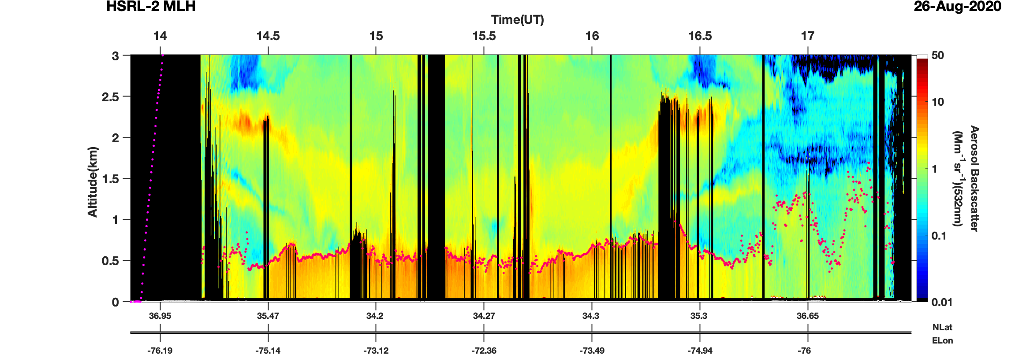
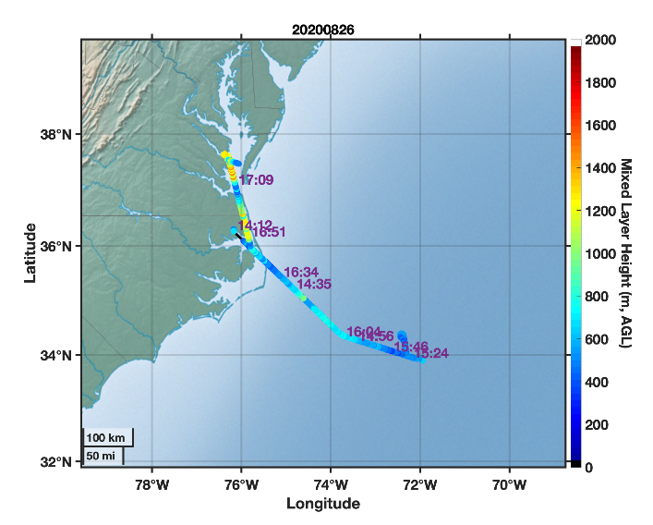
HSRL-2 Derived Data Products
Mixed Layer Heights
Mixed Layer (ML) heights derived from cloud-screened aerosol backscatter profiles
Technique uses a Haar wavelet covariance transform with multiple wavelet dilations to identify sharp gradients in aerosol backscatter (adapted from Brooks, JAOT, 2003)
Automated HSRL algorithm chooses ML from among aerosol gradients with input from manual inspection where necessary (Scarino et al., 2014, ACP)
Aerosol Type
Multiwavelength HSRL measurements provide aerosol intensive parameters for classifying aerosols and apportioning AOT to type
Suite of aerosol intensive parameters (lidar ratio, color ratios, depolarization) provide more robust aerosol classification
Reveals significant vertical variability of aerosol types not apparent in passive retrievals
Aerosol Backscatter
Mixed Layer Height
Mixed Layer Height (m)
Scarino et al., 2014, ACP
Aerosol Type
Burton et al.,
2012, AMT

