Slide 1
ISS Plug-in Plan (IPiP) 101
Abigail De Los Reyes – Increment 67 Lead
281.483.2996, abigail.delosreyes@nasa.gov
Kevin D. Moore, PE/OP – Increment 67 Alternate
281.244.8313, kevin.moore-1@nasa.gov
https://home.iss.nasa.gov/om/ipip
October 19 – 21, 2021

Slide 2
Overview
Agenda
Introduction
“Where Do You Plug-in?”
ISS Plug-in Plan UOP/SUP Power Request
IPiP Schedule
Questions for the PIM/ Requester
IPiP Process FAQs
Conclusion
Backup
  US Lab UOPs: Most Requested Aisle-Deployed Locations
  Midware 3D CAD Model Views
    AC Inverter
    PS-120 Junction Box
    “Cobalt” Brick

Slide 3
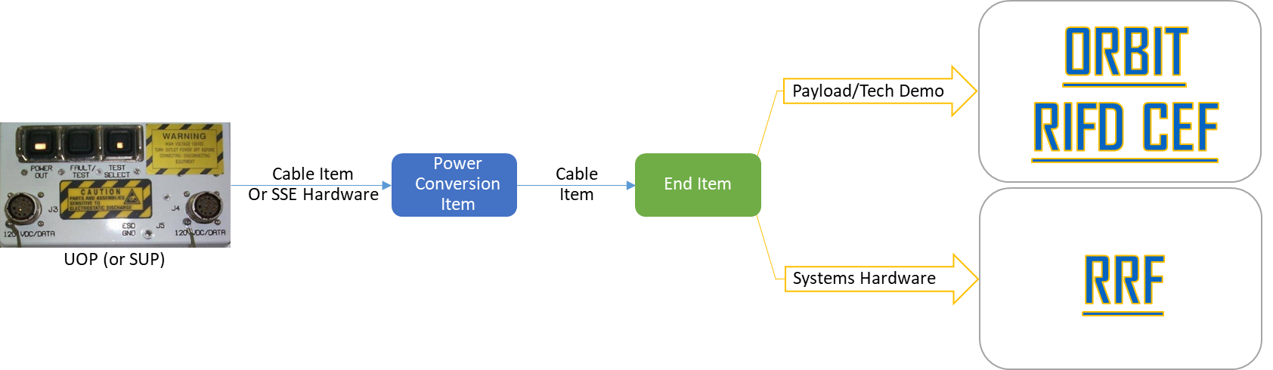
Introduction
The ISS Plug-In Plan (IPiP) Team coordinates and develops an integrated plug-in plan per Increment for Payload, Tech Demo, and Systems hardware power requirements that require secondary power - 120 VAC or 120 VDC or less - via a Utility Outlet Panel (UOP) or Standard Utility Panel (SUP) in Columbus. IPiP delivers that Plan to Flight Operations Directorate (FOD) Plug-in Port Utilization Task Officer (PLUTO) for real-time execution.
IPiP collects requirements via IPiP Forms to support the assessment, integration, and baseline of the ISS Plug-In Plan.

Slide 4
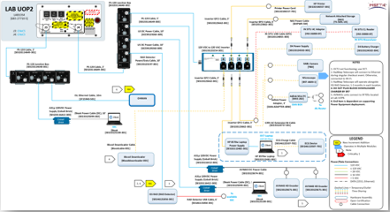
“Where Do You Plug-In?”
What is a Plug-in?
  Posted on IPiP Increment Products Webpage as Working Data until Baselined
A “portable load” (or an “end item”) is IVA hardware that receives power from the ISS EPS Secondary Hardware Subsystem through a Utility Outlet Panel (UOP) or Standard Utility Panel (SUP), that uses 120 VAC or 120 VDC or less
  UOPs are located in US Lab, US Airlock, Nodes, and JEM
  SUPs are located only in Columbus Module
IPiP-analyzed hardware does not receive power solely from an internal camera port (ICP), or ExPRESS Rack, or is designed for operation only in the Russian Segment
  e.g. LAB UOP2 Schematic

Slide 5
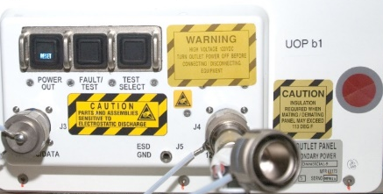
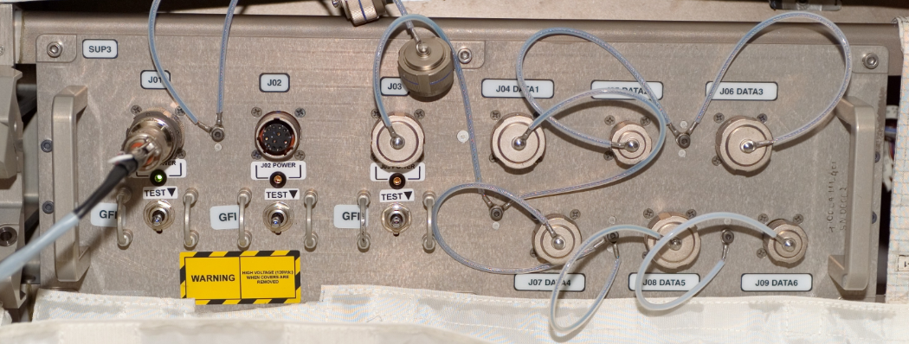
ISS Plug-in Plan UOP/SUP Power Request
Does the hardware require secondary power source from a USOS Utility Outlet Panel (UOP) or Columbus Standard Utility Panel (SUP)?
The End Item Hardware must:
Use 120 VAC, or 120 VDC or less
Utilize 12A or less
Not receive power solely from an Internal
Camera Port (ICP), ExPRESS Rack, or be
designed for operation only in the Russian Segment
Nominally before Increment – 8 mos:
Payloads/ Tech Demos
  Initiate ORBIT > RiFD > “Plug-In Plan” CEF
Systems/most Tech Demo Hardware
  Initiate SharePoint RRF
Additional Resources: https://home.iss.nasa.gov/om/vcr/iss-plug-in-plan/
Utility Outlet Panel (UOP)
or COL Standard Utility Panel (SUP)
Cable Item
Or SSE Hardware
Power Conversion Item
Cable
Item
End Item
Hardware

Slide 6
IPiP Schedule
  Submit IPiP Forms for Baseline by Wednesday, January 12, 2022
  Submit IPiP Forms for IOR by Nov. 10, 2021
Increment 67
  September 2021
  November 2021
  November 2021
  February 2022
  February 2022
I-8m
IMT
~I-8m Kickoff
First Call for IPiP Forms
I-6m
IMT
~I-6m
Last Call for IPiP Forms
I-4m
IOR
Present IPiP, PLUTO & IP Approved Hardware
~I-1m
I-1.5m
IP + PLUTO Baseline
Meeting
Post IP + PLUTO Baseline Data to IPiP Website
CoFR
Systems hardware/tech demos - submit an IPiP Requirement Request Form (RRF): https://mapi.sp.iss.nasa.gov/sites/mapi/Lists/IPiP/AllItems.aspx. Payloads - submit an IPiP Change Evaluation Form (CEF) within OZ Requirements Baselining and Integration Tool (ORBIT) Research Investigation/Facility Database (RIFD): https://orbit.iss.nasa.gov/ORBIT/RIFD/

Slide 7
Questions for the PIM/Requester
System, Tech Demo, Payload
Q: Does your hardware require 120 VDC or less or 120 VAC? and/or
Q: Do you expect to receive power and data from Utility Outlet Panels (UOPs) in the US Airlock, Cupola, JEM, US Lab, Node 1, Node 2, Node 3, or from Standard Utility Panels (SUPs) in Columbus?
A: For systems hardware or tech demos, submit an IPiP Requirement Request Form (RRF): https://mapi.sp.iss.nasa.gov/sites/mapi/Lists/IPiP/AllItems.aspx
For payloads, submit an IPiP Change Evaluation Form (CEF) within OZ Requirements Baselining and Integration Tool (ORBIT) Research Investigation/Facility Database (RIFD): https://orbit.iss.nasa.gov/ORBIT/RIFD/
Q: Who should complete/submit the requirement request form?
A: Technical personnel such as PIMs or project engineers complete the IPiP Form. The PD or other technical POC may submit as needed and as coordinated with the PIM. The submitter must have access to the NDC domain as the forms are within the NASA firewall.
Q: How do I complete/submit the requirement request form?
A: IPiP RRF (Systems): From the RRF SharePoint list, select “new item” at the upper left side and complete the fields. This site retains responses upon clicking “Submit.” If you need to stop for any reason, click “Save” and continue it at a later time.
IPiP CEF (Payloads): From the RFID site, select Launch Application > “ORBIT Functions” > Research Planning (RIFD) > “New Change Package”, Change package label = Plug-in Plan for “Hardware Title” > “Create CP”
Additional instruction details are located at the IPiP team’s RRF website.
Upon completion of either form, you will receive an acknowledgement of your submission for your records.

Slide 8
IPiP Process FAQs
Q: Did you submit an IPiP Form for your hardware in prior Increments and do you plan to use that hardware during this Increment?
IPiP CEF A: To extend or resume operations or relocate hardware, clone the existing ORBIT CEF and edit the Increment timeframe, location or needs for the hardware
IPiP RRF A: For hardware with the same P/N or refurbished: To extend or resume deployed hardware operations or relocate hardware, copy an existing ORBIT RRF entry and edit the Increment timeframe, deployment location or needs of the hardware, accordingly. For hardware with an updated P/N, a new IPiP RRF needs to be created & submitted.
Q: Do you need qualification / certification, or end-to-end testing, or JCCT interface certificates of your configuration?
A: Use of cobalt, emerald or black bricks or an AC outlet needs approval of the Computer Resource Control Panel (CRCP). Contact the JCCT (POC: OP/Rick Fisher or OP/Brian Campana), if you will operate in an IP module.
Other Notes:
It is not necessary to submit an IPiP Form for hardware powered only from non-rechargeable batteries, solely from ICPs or ExPRESS Racks, or for ISS external payloads.
All power outlets are in short supply. Hardware can expect to timeshare which means that you will likely share your power connection with other users, based on ISSP requirements and priorities. Deployment of your hardware depends upon availability of crew time to deploy IPiP support hardware such as PS-120 Junction Boxes, AC Inverters, etc.
Responses are due COB Wednesday, January 12, 2022

Slide 9
Conclusion
IPiP completed request forms are due Wednesday, January 12, 2022
  Request forms and supporting data not fully processed on time will not be included in the Inc 67 IPiP Baseline Configuration and will require a Chit to be added to the real-time plug-in power plan
  In-work and baselined data will be posted on the IPiP Increment Products Webpage
Contact Information
  Abigail De Los Reyes (abigail.delosreyes@nasa.gov) or Kevin Moore (kevin.moore-1@nasa.gov)
  IPiP Webpage: https://home.iss.nasa.gov/om/vcr/iss-plug-in-plan/

Slide 10
BACKUP

Slide 11
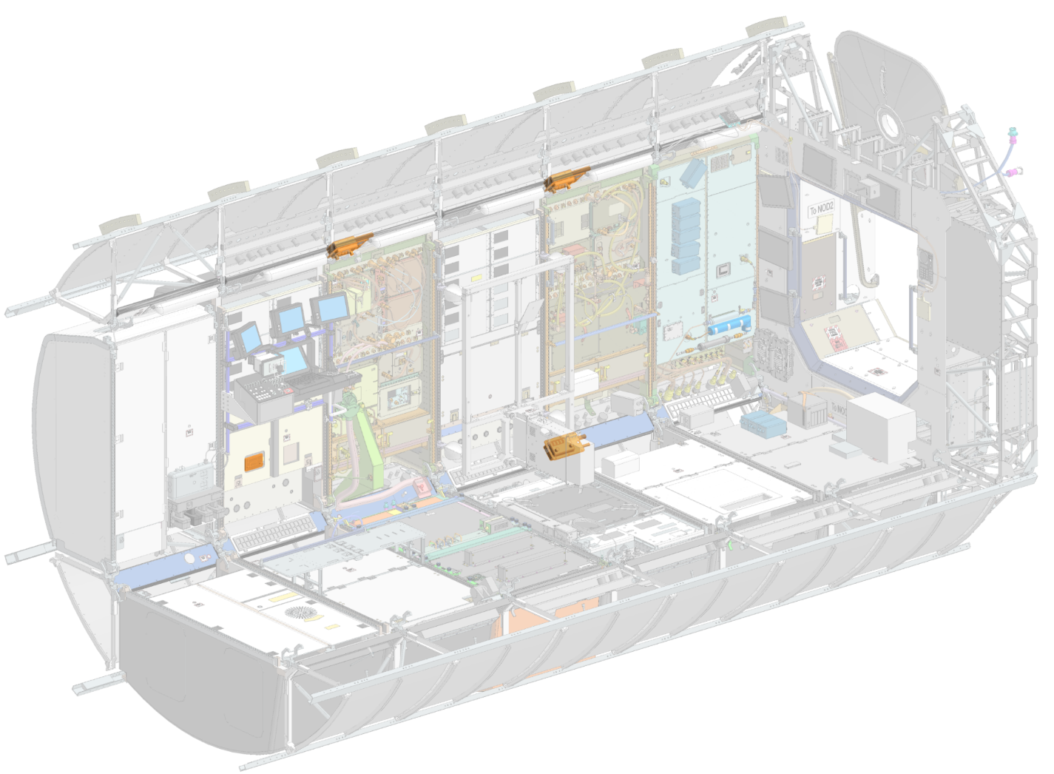
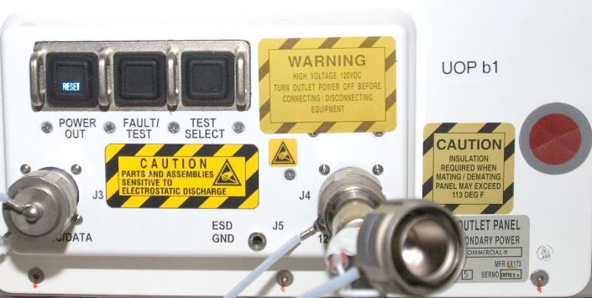
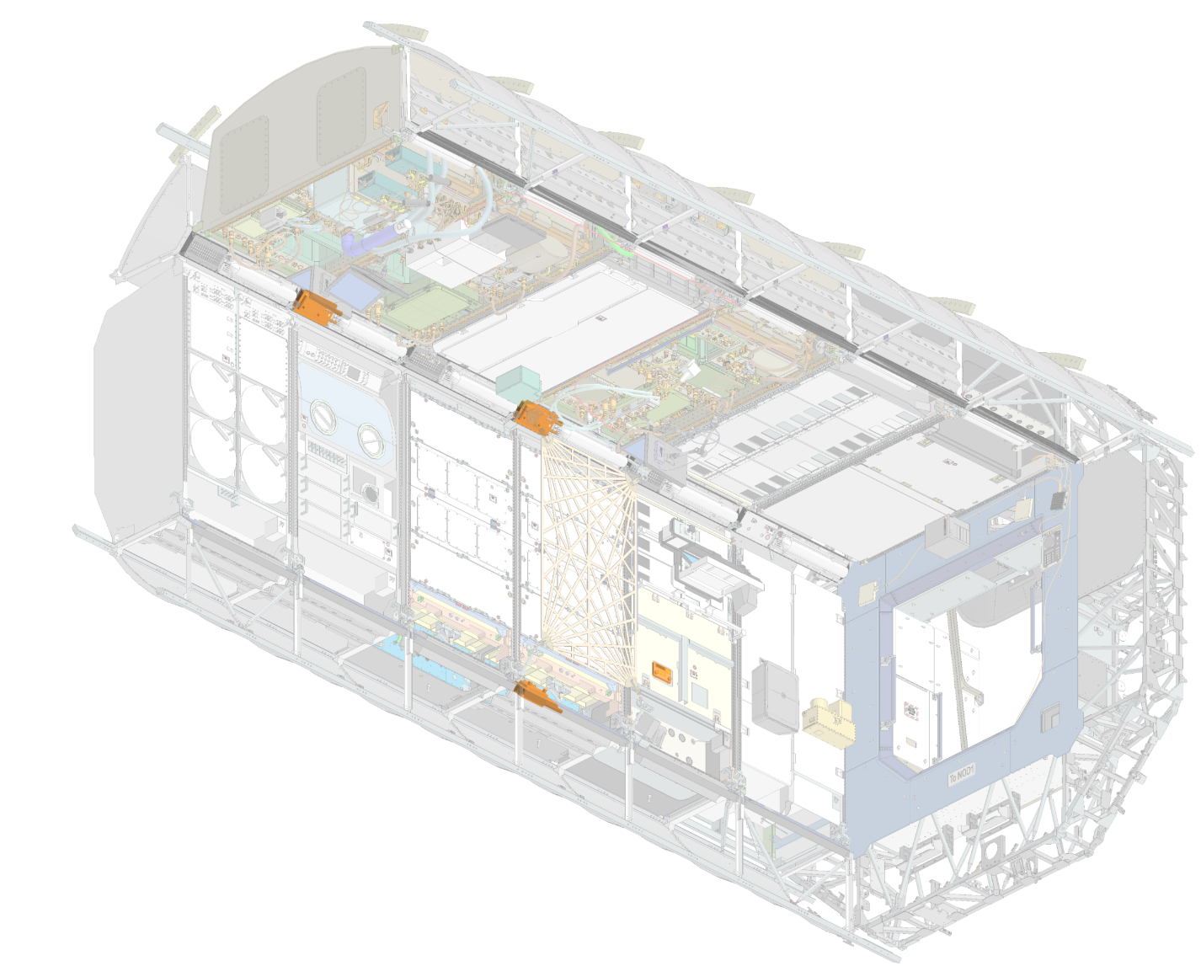
US Lab UOPs: Most Requested Aisle-Deployed Locations
Utility Outlet Panel (UOP)
LAB UOP3
LAB1OP2
LAB UOP4
LAB1OP4
LAB UOP7
LAB1P5
LAB UOP5
LAB1PD2
LAB UOP1
LAB1OS2
USL Forward-Port-Deck
LAB UOP2
LAB1OS4
LAB UOP8
LAB1S5
LAB UOP6
LAB1SD4
USL Aft-Starboard-Overhead

Slide 12
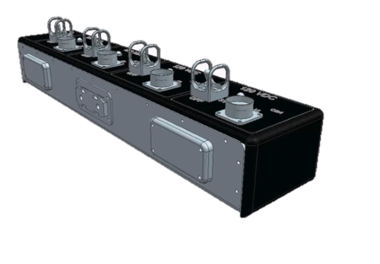
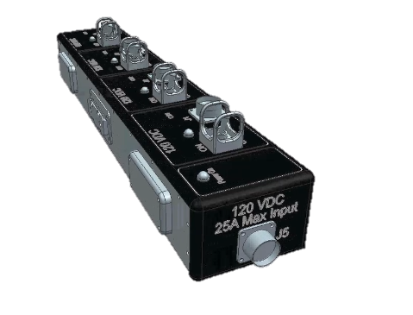
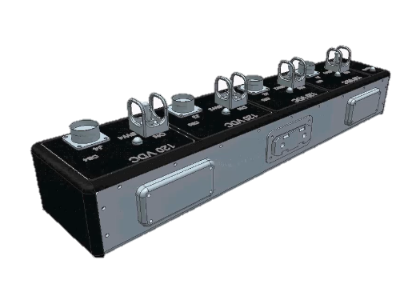
PS-120 Junction Box (P/N: SEG33114648-301)
3D CAD Model Views
Midware 3D CAD Model Videos

Slide 13
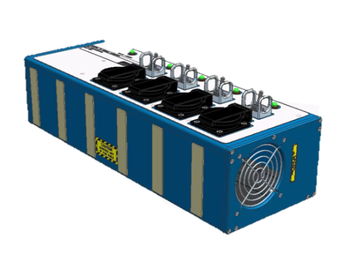
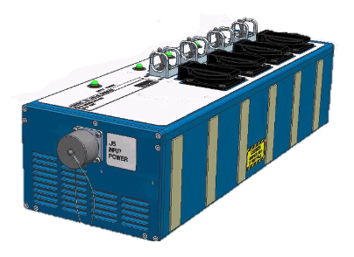
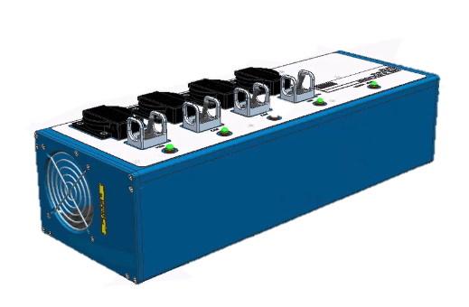
120 VDC to 120 VAC Inverter (P/N: SEG33123254-303)
3D CAD Model Views
Midware 3D CAD Model Videos

Slide 14
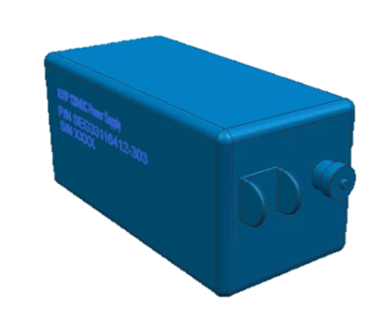
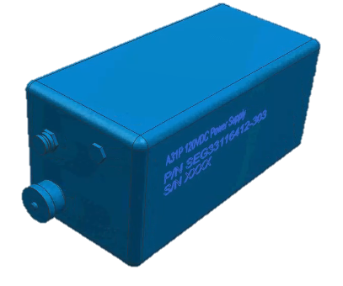
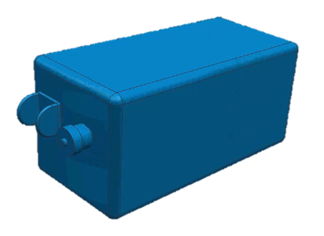
A31p 120VDC Power Supply (Cobalt Brick) (P/N:SEG33116412-303)
3D CAD Model Views
Midware 3D CAD Model Videos

