Slide 1
Assurance of Conventional and Machine Learning Systems
Alwyn Goodloe
NASA Langley Research Center

Slide 2
So You Want to Build an Airplane
Form a startup and start hacking - just like Silicon Valley, right?
  Not so fast!
Process starts off with a notification of intent to the FAA
  A minuet begins between the company and the regulators
  For a Part 25 aircraft they will tell you over 1500 safety criteria you must meet
    Autos and medical devices are easy in comparison
    DoD aircraft not subject to these regulations
The FAA must certify the aircraft
  Designated Engineering Representative (DER)
The cyber-physical component is one of the largest risk factors
You can choose to do things your own way and make an argument to the FAA that the aircraft is safe OR you can follow approved guidelines
  Very process oriented
  Overarching properties will be another path to assurance in the future

Slide 3

Ultra-Reliability is Hard
We are very good at building complex software systems that work 95% of the time---but not as good at building complex software systems that are ultra-reliably safe.
What has saved us in the past?
    Minimal amount of software that is safety-critical
    Simple designs with predictable behavior
    Enormously expensive verification and certification processes
    Backups that are not software, e.g.
      Hardware interlocks
      Human intervention
All sectors of aerospace are increasingly relying on software to perform safety-critical functions
Size and
Complexity
777
747-400
747-200
757/767
0

Slide 4
Eliminating Common Mode Errors
Independence – A concept to minimize the likelihood of common mode and cascade errors
Diversity
  Hardware and software
Redundancy
  Triple redundancy
  Com/Mon
Can mix techniques
  Dissimilar com/mon
When all these things fail, well-trained pilots do an amazing job to save the day
Notes:
Error → Fault → Failure
Error
Fault – manifestation of an error in s/w A fault may cause an error

Slide 5
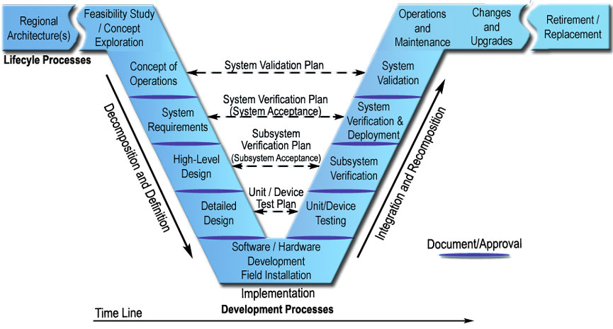
Traditional Systems Engineering Process

Slide 6
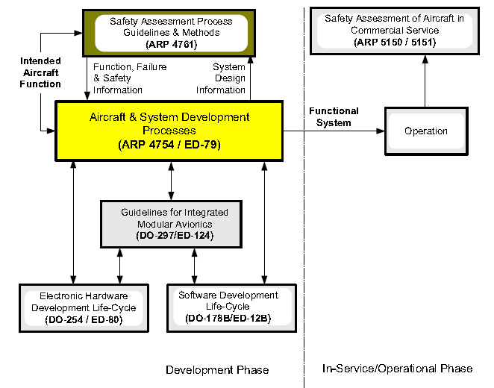
Guideline Documents
Notes:
From SAE ARP 4754A, Figure 1. Guideline Documents Covering Development and In-Service/Operational Phases

Slide 7
Central Role of Requirements
Emphasis on getting the requirements correct
  Requirements get refined into specifications
Many analysis techniques are applied to validate the requirements
Verification focuses on assuring that the system behaves as the specification indicates and does not exhibit unintended behavior
Implementations need to show traceability to the requirements

Slide 8
ARP 4761
Aerospace Recommended Practice for performing safety assessments on civil aircraft
Guidelines and methods of performing the safety assessment
Functional Hazard Analysis (FHA)
Preliminary System Safety Assessment (PSSA)
System Safety Assessment (SSA)

Slide 9
ARP 4761 Contd.
Safety assessment process
Safety assessment overview
Detailed method guidelines
  Functional Hazard Assessment (FHA)
  Fault-Tree Analysis (FTA)
  Failure Modes and Effects Analysis (FMEA)
  Common Mode Analysis (CMA)
  Zonal Safety Analysis (ZSA)

Slide 10
Functional Hazard Analysis
Identifies and classifies the failure conditions associated with the aircraft functions and combinations of aircraft functions
  Classification Levels: Minor (D), Major (C), Hazardous (B), Catastrophic (A)
  Classifications establish safety objectives
  Output starting point for generation and allocation of safety requirements

Slide 11
Preliminary System Safety Assessment
Systematic examination of proposed system architecture
  Used to complete the failure conditions list and the safety requirements
Identify how failures lead to the hazards identified in FHA
  Suggested analysis techniques such as FTA
How FHA requirements can be met
  Identify protective strategies
    Partitioning, dissimilarity, etc.

Slide 12
System Safety Assessment
Systematic examination of system, architecture, and installation to show compliance with safety requirements
A SSA done for each PSSA
Verification that the design requirements established at system level
Verification that safety requirements derived from requirements are met
Verification design requirements in CCA met
Linkage system level SSA to aircraft level FHA

Slide 13
4754A
Input is the function, failure, and safety info from 4761
Iterative process as design is refined and the analysis process prescribed by 4761 is repeated
Functional Design Assurance Levels (FDAL) assigned
FDAL assigned to systems from aircraft architecture based on Preliminary Aircraft Safety Assessment (PASA)
Item Design Assurance Level (IDAL) done in refinement

Slide 14
4754A Contd.
FDAL considers functional independence of aircraft/system functions
IDAL considers design independence of items
Assertion of independence must be substantiated
  Verify no common mode introduced
IDALs are assigned to items then fed back to analysis
During allocation of top-level function into two or more independent sub-functions
  One sub-function cannot itself cause top-level hazard

Slide 15
Independence Can Be Your Friend
Architectural strategies incorporating independence, redundancy, and dissimilarity can be a powerful means of reducing the potential for errors in requirements or in design implementation
The people writing the standards have built these architectures
  They do it for Boeing, Airbus, etc.
The justifications and arguments for safety are found in certification documents
Engineers and certification bodies lack guidelines and examples

Slide 16
Yet ...
The effectiveness of particular architectural strategies, introduced to allow the allocation of lower item risk level, generally cannot be quantified
  John Downer’s work redundancy in engineering
As a consequence, the justification to support such allocation necessarily involves some degree of engineering judgment by the applicant and the certification authorities
Do existing architectural patterns and arguments work on newer more complex systems

Slide 17
ML Assurance Problem
We do not know how to assure machine learning (ML) enabled systems within the framework of existing methodologies used for safety-critical systems
  Reliability, predictability, robustness to faults and failures
The AI community have not been interested in this problem as performance is the main concern
  ML systems “fail regularly” while the ultra safety-critical systems (aircraft, nuclear power, etc.) ideally never fail in their operating life

Slide 18
Machine Learning Use Cases
Two classes of use cases for machine learning (ML)
Conventional approaches work, but ML is cheaper, more optimal, etc.
  Can derive specifications for what it is supposed to do or not supposed to do
We have no idea how to build the system using conventional approaches
  On only specification is a large high-dimensional data set
  Runtime assurance not effective as no actionable spec is available

Slide 19
Current Approaches
Many research efforts underway to verify machine learning enabled systems
Many efforts focus on showing robustness against adversarial attacks
Some known known approaches such as:
  Reluplex -- SMT based approach
  ERAN, GPUPoly, DeepPoly – Abstract Interpretation
None of these efforts really help resolve the major challenge of assuring ML enabled systems where the spec is really a large high-dimensional data set

Slide 20
Questions?
Contact Information:
Alwyn E. Goodloe
+1-757-864-5064
a.goodloe@nasa.gov

