Slide 1
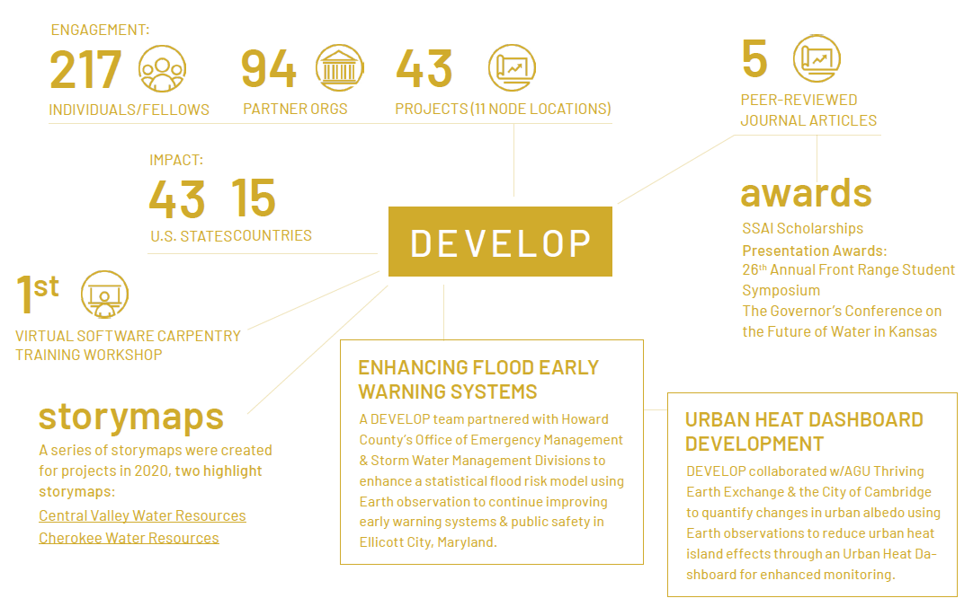







2021 FALL PREVIEW
WATER RESOURCES
HEALTH &
AIR QUALITY
ECOLOGICAL FORECASTING
URBAN DEVELOPMENT
DISASTERS
AGRICULTURE
ENERGY

Slide 2
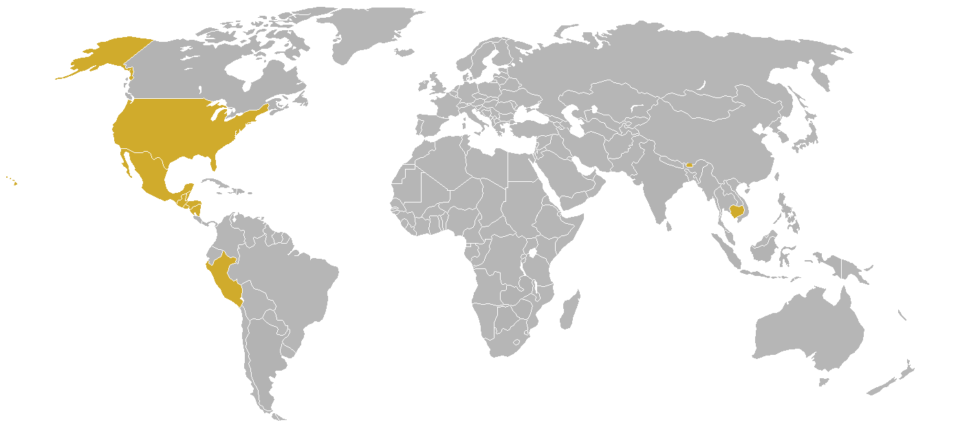
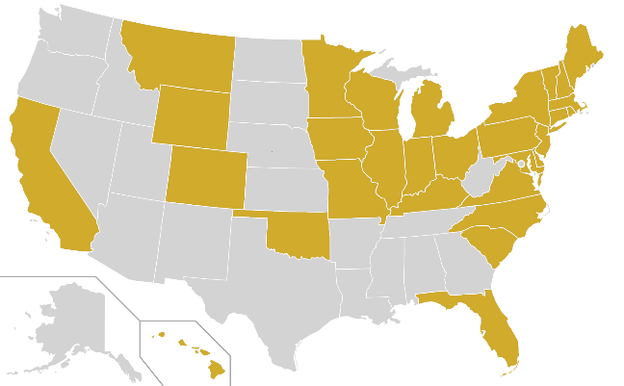
*Impacts and partners are tentative
2021 FALL PORTFOLIO
ENGAGEMENT:
94
57
20
PARTICIPANTS
PARTNER ORGS
PROJECTS
TERM I: 15
IMPACT:
TERM II: 4
30
10
TERM III: 1
U.S. STATES
COUNTRIES
ACADEMIC
DISASTERS
CONSORTIUM
AGRICULTURE
LOCAL GOVERNMENT
WATER RESOURCES
STATE GOVERNMENT
INSTITUTIONAL SECTOR
THEMATIC AREA
URBAN DEVELOPMENT
FEDERAL GOVERNMENT
ECOLOGICAL FORECASTING
FOR-PROFIT
NON-PROFIT
HEALTH & AIR QUALITY
INTERNATIONAL
ENERGY

Slide 3
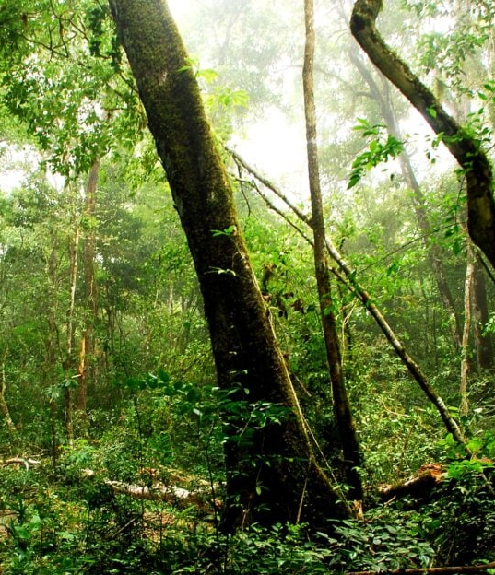
Maya Forest Water Resources II
Community Concern: Extreme weather events in relation to climate change are impacting wetland ecosystems, altering the frequency and levels of inundation which threaten water resource availability and land stability in these systems. These changes have negative impacts for surrounding community infrastructure and agriculture that rely on forested wetlands in the Maya Tri-National Forest.
Partners:
Forest Department (Belize)
Land Information Center (Belize)
Center for Monitoring and Evaluation (Guatemala)
El Colegio de la Frontera Sur (Mexico)
UCSB MesoAmerican Research Center
Boles Environmental Consulting
SICA
California – JPL
Earth Observations:
ICESat GLAS
ICESat-2 ATLAS
ISS GEDI
ALOS PALSAR
ALOS PALSAR-2
Impact: End users can use these products to identify areas prone to highly variable inundation, monitor forested wetland extent, and evaluate sustainable forest management activities and/or agricultural practices.
Image Credit: Charlie Watson
Notes:
------------------------------Image Information Below ------------------------------
Image Credit: Charlie Watson
Image Source: https://pixnio.com/nature-landscapes/forest/guatemala-maya-biosphere-reserve (CC0)

Slide 4
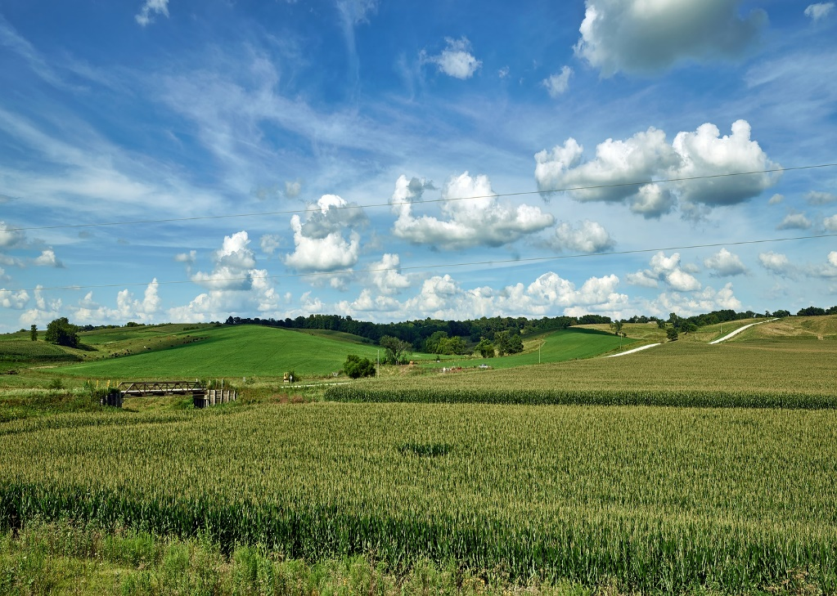
Midwest Water Resources
Community Concern: Understanding seasonal water variability is of vital importance to agriculturally intensive regions, affecting irrigation schedules and growing seasons. Evapotranspiration is a critical component of the seasonal hydrologic cycle, however sparse in situ measurements and short periods of record limit the historical perspective of this variable.
Partners:
USDA Midwest Climate Hub
NOAA NIDIS, Midwest Drought Early Warning System
Minnesota Department of Agriculture, Pesticide and Fertilizer Management Division
Michigan State University, Department of Geography, Environmental, and Spatial Sciences
North Carolina – NCEI
Earth Observations:
Terra MODIS
GPM IMERG
Image Credit: User 1778011 from Pixabay
Impact: Climatology maps and time series analyses of potential evapotranspiration, actual evapotranspiration, and precipitation will identify spatiotemporal shifts, trends, and anomalies in the seasonal water cycle and inform partner decisions regarding land management practices, water resource allocation, and drought mitigation strategies.
Notes:
------------------------------Image Information Below ------------------------------
Image Credit: User 1778011 from Pixabay (Pixabay License)
Image Source: https://pixabay.com/photos/iowa-corn-cornfield-sky-clouds-4100107/

Slide 5
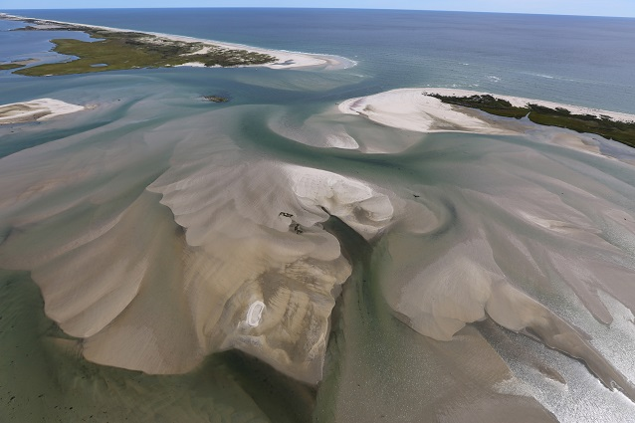
Fire Island Water Resources
Community Concern: In recent years, Fire Island National Seashore in New York has experienced damaging amounts of coastal erosion, leading to the destruction of homes, rising groundwater, and risk to a globally rare, polymaritime forest. Beach nourishment efforts are crucial to protect high-risk areas, however in-person shoreline monitoring is expensive and time-consuming.
Partners:
National Park Service, Fire Island National Seashore
National Park Service, Ocean and Coastal Resources Branch, Water Resources Division, Northeast Region
National Park Service, National Resource Stewardship and Science Directorate
Massachusetts – Boston
Earth Observations:
Landsat 8 OLI
Sentinel-2 MSI
Aqua MODIS
Image Credit: USFWS Photo/ G. Thompson
Impact: Maps of sediment dynamics, transport direction, and turbidity, as well as timeseries of sediment and turbidity patterns, will help partners understand nearshore movements and inform their future beach nourishment projects to better protect high-erosion areas.
Notes:
------------------------------Image Information Below ------------------------------
Image Credit: USFWS Photo/ G. Thompson (Public Domain)
Image Source: https://www.nps.gov/articles/the-fire-island-wilderness-breach-ecological-resilience-in-the-great-south-bay.htm?utm_source=article&utm_medium=website&utm_campaign=experience_more&utm_content=small

Slide 6
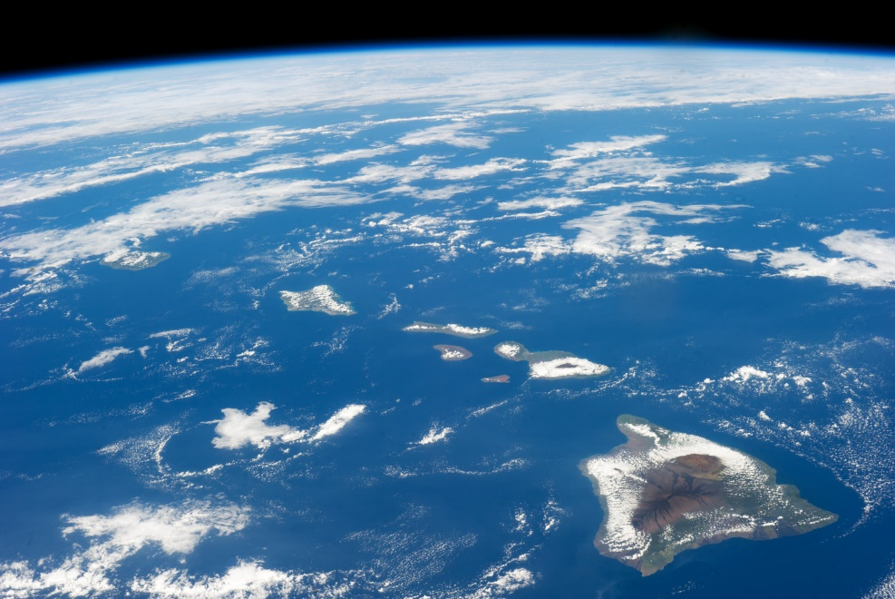
Hawai'i Island Disasters
Community Concern: Coastal communities on Hawai'i island are currently at risk due to sea-level rise as current projections indicate increases exceeding 1-2 m of rise by 2050. The County of Hawai'i is currently working on their Climate Adaptation Plan and have little island-specific data understanding coastal vulnerability and need direction on where to best allocate limited resources.
Arizona – Tempe
Image Credit: NASA
Partners:
County of Hawai'i
Arizona State University, Center for Global Discovery and Conservation Science
University of Hawai'i - Hilo
Earth Observations:
Sentinel-6 Michael Freilich Altimeter
Landsat 8 OLI
Sentinel-2 MSI
Suomi NPP VIIRS
Impact: This project will provide partners island-specific datasets for sea-level rise and coastal vulnerability as the County of Hawai'i works on several initiatives including their Climate Adaptation Plan and development General Plan. End products from this project will help analyze current sea-level rise and understand future flooding and vulnerability to coastal development. Information from this project will allow the County to solicit additional funding towards adaptation and prioritize infrastructure and climate resiliency for coastal communities on the island.
Notes:
------------------------------Image Information Below ------------------------------
Image Credit: NASA Earth Observatory
Image Source: https://earthobservatory.nasa.gov/images/82975/hawaii

Slide 7
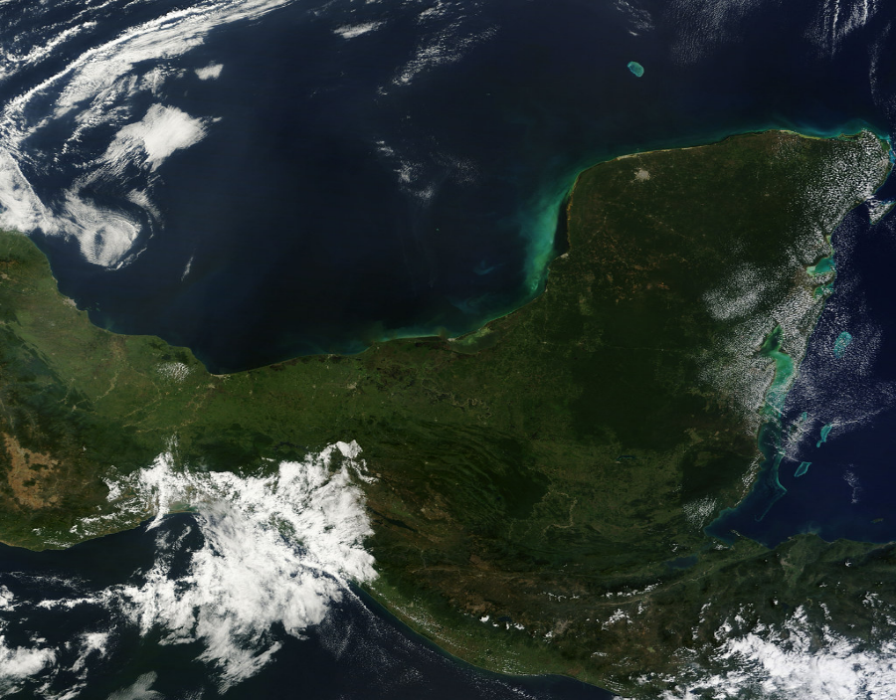
Central America Disasters
Community Concern: Central America is often subject to extreme climatic events such as hurricanes and heavy rainfall leading to flooding-related disasters, including Hurricanes Eta and Iota in November 2020. This project will utilize NASA SERVIR’s HYDRAFloods tool to aid local end users in monitoring surface water, preparing for flood event response, and inform potential risks.
Partners:
Centro de Coordinación para la Prevención de los Desastres en América Central y República Dominicana
Comité Regional de Recursos Hidráulicos
Sistema de la Integración Centroamericana
Alabama – Marshall
Earth Observations:
Landsat 7 ETM+
Landsat 8 OLI
Sentinel-1 C-SAR
Sentinel-2 MSI
Suomi NPP VIIRS
MODIS
SRTM
Image Credit: NASA GSFC
Impact: This project will aid partners in their efforts of monitoring, response to, and risk to inform on potential impacts of flooding taking place in the study region. The project will provide partners a way to visualize flooding in near real-time utilizing NASA Earth observations and the end products will provide partners with maps of surface inundation, an analysis of Hurricanes Eta and Iota, and a code tutorial to help with flood mitigation and decision-making processes.
Notes:
------------------------------Image Information Below ------------------------------
Image Credit: NASA Goddard Space Flight Center
Image Source: https://search.creativecommons.org/photos/8b741847-3937-4708-bb25-463b93a71bfc
Image License: https://creativecommons.org/licenses/by/2.0/

Slide 8
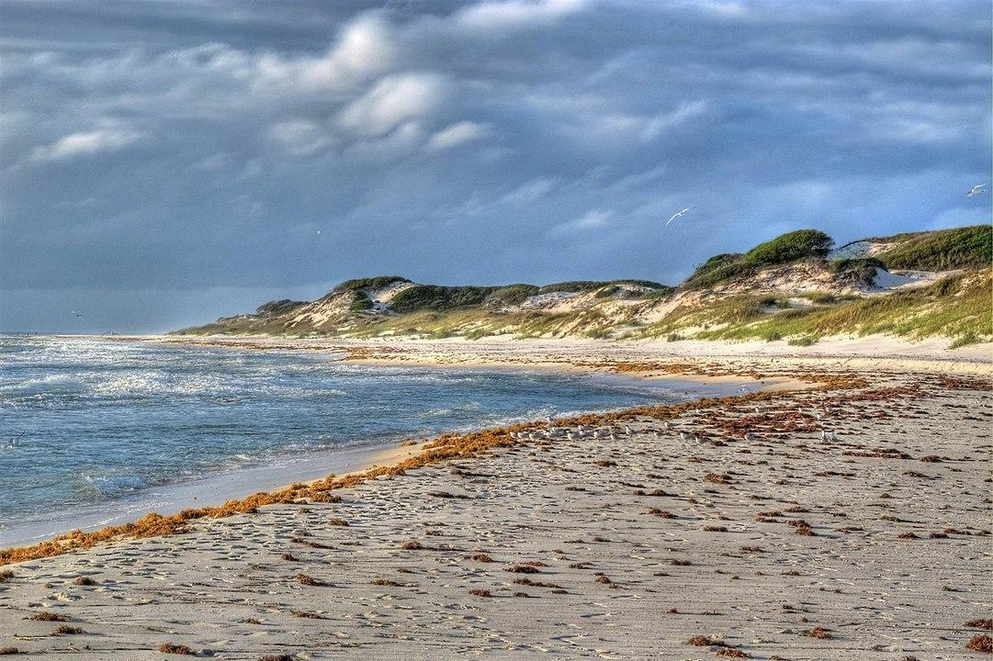
St. Joseph Peninsula Disasters
Community Concern: St. Joseph Peninsula is vulnerable to future severe storm events, and the state park is still recovering from October 2018’s Hurricane Michael, which caused major damage to roads, utilities, facilities, and changes to land extent. The Florida Department of Environmental Protection wants to better understand changes to land cover and shoreline as they plan for future projects and possible infrastructure.
Alabama – Marshall
Earth Observations:
Landsat 7 ETM +
Landsat 8 OLI
Sentinel-2 MSI
Aqua MODIS
Suomi NPP VIIRS
Partners:
Florida Department of Environmental Protection
Image Credit: Mike Tilley
Impact: This project will aid the Florida Department of Environmental Protection on the St. Joseph Peninsula to better understand how land cover and shoreline have changed in recent years, analyze sediment transport around the entire cape, and provide a climatology timeseries. The project’s end products will provide the partner with important analyses to help with future decision-making in the state park and for the cape.
Notes:
------------------------------Image Information Below ------------------------------
Image Credit: Mike Tilley
Image Source: https://commons.wikimedia.org/wiki/Category:St._Joseph_Peninsula_State_Park#/media/File:Dunes_-_St_Joseph_Pennsula_-_panoramio.jpg
Image License: https://creativecommons.org/licenses/by/3.0/deed.en

Slide 9

Southern California Health & Air Quality
Community Concern: This past spring, data collected by Scripps Institution of Oceanography scientists reported the highest cell numbers of red tide algae (Lingulodinium polyedra) ever recorded in southern California, causing massive mortality of fish and invertebrates as well as widely reported respiratory distress in humans.
California – Ames
Image Credit: Kevin Baird
Partners:
California Office of Environmental Health Hazard Assessment
California Department of Public Health
NOAA Southwest Fisheries Science Center
University of California San Diego, Scripps Institution of Oceanography
Earth Observations:
Landsat 8 OLI
Aqua MODIS
Sentinel-3 OLCI
Suomi NPP VIIRS
GCOM-C
Impact: This project aims to better understand the frequency, drivers, and remote detection of red tide blooms in California. Maps highlighting bloom areas and a seasonal water quality time series analysis via Google Earth Engine will further inform partners’ decision-making practices related to L. polyedra management efforts.
Notes:
------------------------------Image Information Below ------------------------------
Image Credit: "Red Tide Bioluminescence in San Diego" by Kevin Baird is licensed with CC BY-NC-ND 2.0.
Image Source: https://creativecommons.org/licenses/by-nc-nd/2.0/

Slide 10
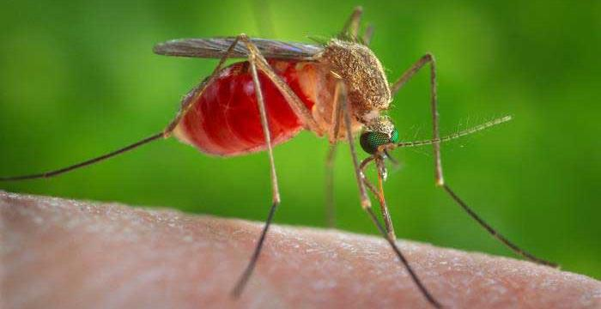
Peru Health & Air Quality II
Community Concern: Communities bordering forests in rural Peru face hazards including elevated cases of malaria and dengue fever. Research institutions and conservation groups have assessed forest loss with an emphasis on threats to wildlife, but an integrated human-wildlife approach has yet to be taken.
Partners:
Ministry of Health & Ministry of the Environment (Peru)
Universidad Peruana Cayetano Heredia, Lab for EcoHealth and Urban Ecology
Asociación para la Conservación de la Cuenca Amazónica
Instituto del Bel Común
The National Commission for Aerospace Research and Development (Peru)
Georgia – Athens
Image Credit: CDC
Earth Observations:
Landsat 5 TM
Landsat 8 OLI
SRTM
PlanetScope
PeruSAT
Impact: Partners will use maps of zoonotic disease outbreak and land use cover to understand the human health risks of deforestation by identifying areas with high potential for zoonotic disease.
Notes:
------------------------------Image Information Below ------------------------------
Image Credit: Centers for Disease Control and Prevention,
Image Source: https://www.cdc.gov/mosquitoes/about/index.html

Slide 11
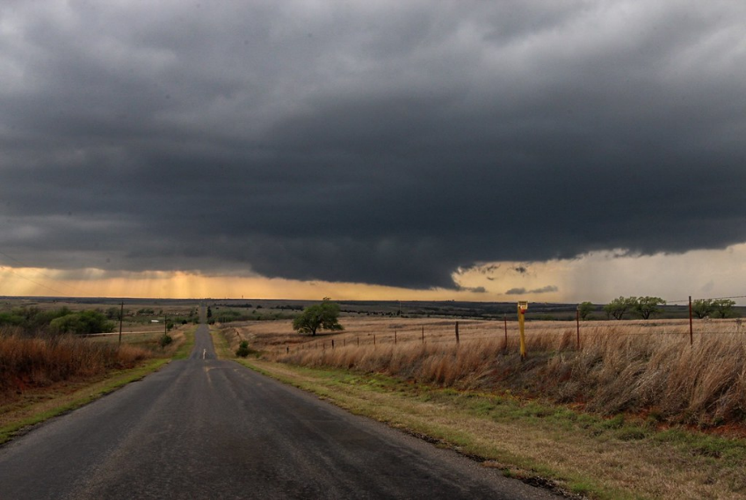
Oklahoma Health & Air Quality
Community Concern: Oklahoma has recently experienced a decline in air quality with the main contributors being ozone and fine particulate matter. There have been unexpected patterns with spikes in ozone in rural locations, where monitors are designed to capture background air quality, have even exceeded concentrations in Oklahoma's metropolitan areas.
California – JPL
Partners:
Oklahoma Department of Environmental Quality, Air Quality Division
Image Credit: BrianKhoury
Earth Observations:
Sentinel-5p TROPOMI
Aura OMI
Terra/Aqua MODIS
Impact: End users can use the results to better understand this unexpected pattern in air quality, enabling them to identify and address contributors to emissions. Additionally, they can identify gaps in the ground monitoring network and implement regulations to improve air quality in Oklahoma.
Notes:
------------------------------Image Information Below ------------------------------
Image Credit: BrianKhoury
Image Source: https://search.creativecommons.org/photos/ca0ef39b-680a-4aef-b5c6-4e06f6b4bb59 (CC BY-ND 2.0)

Slide 12
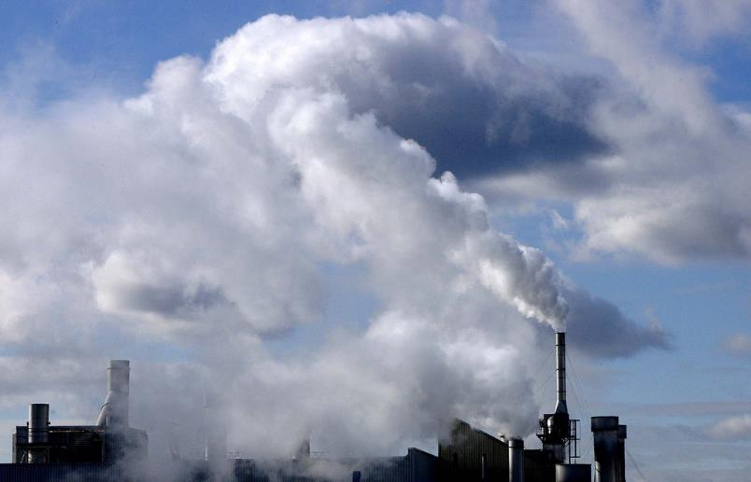
Southeast Michigan Health & Air Quality
Community Concern: Asthma is the number one reason students miss class in southwest Detroit, and it is suspected that exposure to PM2.5 has contributed 5.5% of annual deaths in the Detroit area. Southeast Michigan has historically been a heavily industrialized region and is currently an ozone non-attainment zone.
Virginia – Langley
Partners:
Michigan Department of Environment, Great Lakes, and Energy, Air Quality Division
Lake Michigan Air Directors Consortium
Earth Observations:
Sentinel-5P TROPOMI
Aura OMI
Image Credit: United Nations Photo
Impact: This work will assist partners in identifying large emission sources as well as understand the spatial distribution of atmospheric gases to inform potential control strategies for reaching ozone attainment.
Notes:
------------------------------Image Information Below ------------------------------
Image Credit: United Nations Photo
Image Source: https://search.creativecommons.org/photos/1827730a-4546-41b1-92b3-e44307fcad4d (CC BY-NC-ND 2.0)

Slide 13
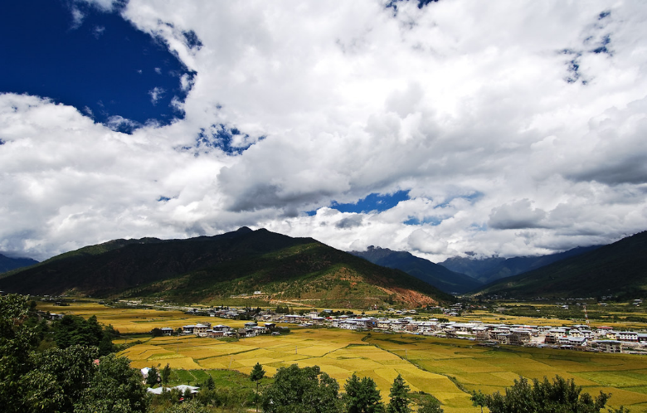
Bhutan Agriculture
Community Concern: Bhutan’s national economy is primarily agrarian with approximately 80% of the population involved in agriculture, and rural areas especially relying on agriculture as an important source of income. Utilizing Earth observations to more effectively monitor agriculture and conduct land-use planning will allow for the Department of Agriculture to supplement field surveys and improve monitoring efficiency.
Alabama – Marshall
Partners:
Bhutan Department of Agriculture
Bhutan Foundation
Ugyen Wangchuck Institute for Conservation and Environmental Research
Earth Observations:
Landsat 5 TM
Landsat 7 ETM+
Landsat 8 OLI
Sentinel-1 C-SAR
Sentinel-2 MSI
Planet
Image Credit: Gelay Jamtsho
Impact: This project will aid the Bhutan Department of Agriculture in its efforts to better understand crop distribution. The project will also enable future analysis of rice crops that would not have been possible without the utilization of NASA Earth observations, including the development of a crop mask and sampling protocol.
Notes:
------------------------------Image Information Below ------------------------------
Image Credit: Gelay Jamtsho (“Bhutan360”)
Image Source: https://search.creativecommons.org/photos/87e904f2-605b-4d5d-baaf-5490626eaa10
Image License: https://creativecommons.org/licenses/by-nc-sa/2.0/

Slide 14
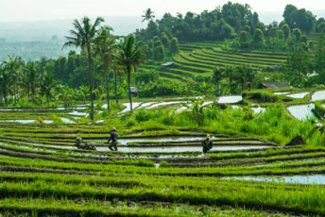
Tonlé Sap Agriculture III
Community Concern: Tonlé Sap, located in Cambodia’s Lower Mekong Basin, is the largest freshwater lake in Southeast Asia and provides fisheries and freshwater to nearby agricultural communities. Increased pumping and shifts in global climate threaten the ecosystem’s water quality and fish habitat.
Partners:
Conservation International
Ministry of Water Resources and Meteorology, Tonlé Sap Authority
Virginia – Langley
Earth Observations:
Landsat 5 TM
Landsat 7 ETM+
Landsat 8 OLI
Terra MODIS
Aqua MODIS
GRACE
GPM IMERG
Impact: The final term of this project will provide partners with a comprehensive methodology to calculate the Freshwater Health Index using remote sensing data and enable partners to determine resource allocation in the basin.
Image Credit: Sebastian Pena Lambarri, Unsplash
Notes:
------------------------------Image Information Below ------------------------------​
Image Credit: Sebastian Pena Lambarri
Image Source: https://unsplash.com/photos/Ke8EuI2xOUc (Free to use under Unsplash license: https://unsplash.com/license)

Slide 15
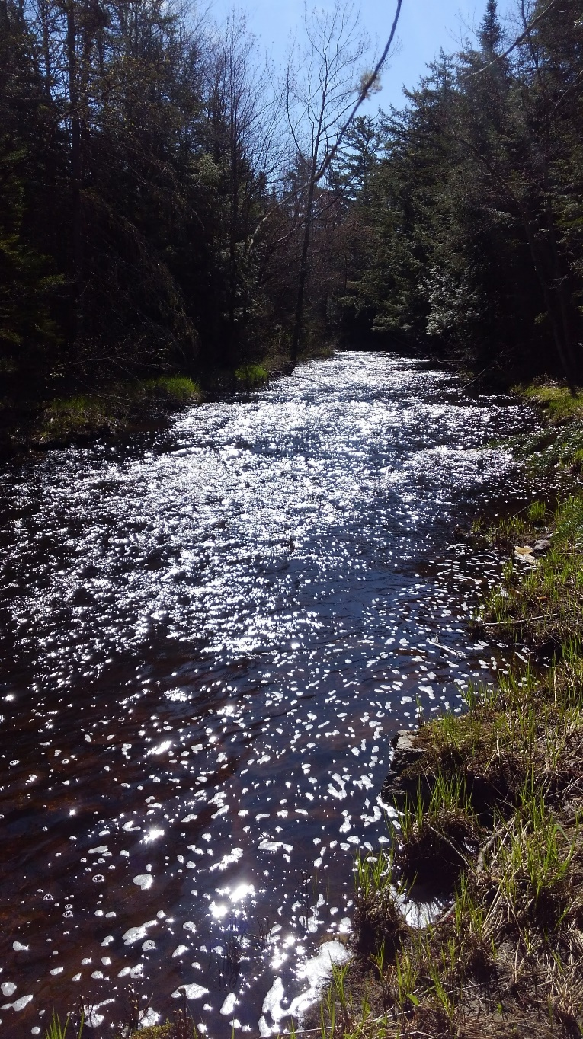
Maine Ecological Forecasting
Community Concern: Shifting patterns in temperature and precipitation paired with changes in land use and land cover threaten the survival of Federally Endangered juvenile Atlantic salmon (Salmo salar) in Maine streams.
Maryland – Goddard
Partners:
Department of Marine Resources
Downeast Salmon Federation
Earth Observations:
Aqua MODIS
Terra MODIS
Landsat 5 TM
Landsat 8 OLI
GPM IMERG
Impact: Spatial and temporal assessment of temperature, precipitation, and land cover will provide a comprehensive understanding of how these factors have changed throughout critical salmon habitat over the past 30 years. Ultimately, this work will inform ongoing salmon recovery initiatives that aim to improve riverine habitat quality.
Image Credit: Nicole Ramberg-Pihl
Notes:
------------------------------Image Information Below ------------------------------
Image Credit: Nicole Ramberg-Pihl
Image Source: Nicole Ramberg-Pihl, permission to use

Slide 16

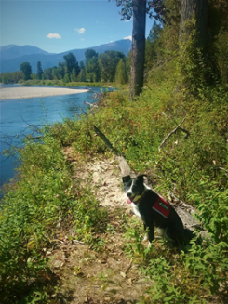
Western Montana Ecological Forecasting II
Community Concern: Contaminants including flame retardants, pharmaceuticals, and heavy metals, are becoming increasingly prevalent in Western Montana’s rivers. These contaminants easily travel up the food chain and threaten Montana’s riverine ecosystems.
Partners:
Working Dogs for Conservation
Virginia Institute of Marine Science
Maryland – Goddard
Earth Observations:
Landsat 8 OLI
Terra MODIS
GPM IMERG
SRTM
SMAP
Image Credits: Working Dogs for Conservation
Impact: Refined mink and otter habitat suitability models generated for an expanded study region along with site accessibility maps, will guide Working Dogs for Conservation in their efforts to collect contaminant samples from mustelid scat in Montana.
Notes:
------------------------------Image Information Below ------------------------------
Image Credit: Working Dogs for Conservation
Image Source: Provided by partner with permission to use

Slide 17

Carolina Coastal Plain Ecological Forecasting
Community Concern: The Venus flytrap (Dionaea muscipula) is endemic to a 90-mile range in North and South Carolina where its habitat is threatened by overharvesting, development, and fire suppression. More information is needed on how climate and land cover change could affect viable habitat for this vulnerable species.
Partners:
North Carolina Botanical Garden
University of North Carolina Herbarium
North Carolina Natural Heritage Program
Georgia - Athens
Earth Observations:
Landsat 8 OLI
Terra MODIS
GPM IMERG
SMAP L-Band Radiometer
SRTM
Image Credit: USFWS Dale Suiter
Impact: The partners will be able to use Venus flytrap habitat suitability maps for more efficient data collection and more strategic conservation work. Furthermore, the partners will be able to assess future extent, informing discussions of reintroduction of the species and prioritization of persisting habitat.
Notes:
------------------------------Image Information Below ------------------------------
Image Credit: USFWS Photo/ Dale Suiter (Public Domain)
Image Source: https://www.fws.gov/southeast/articles/coastal-program-funds-survey-for-venus-flytrap/

Slide 18

Grand Teton Ecological Forecasting
Community Concern: The survival of the ~125 high elevation wintering bighorn sheep in the Grand Teton Range is threatened by a combination of anthropogenic and climatic factors including increased winter disturbance and changing habitat and forage availability.
Partners:
NPS, Grand Teton National Park
Teton Range Bighorn Sheep Working Group
Idaho – Pocatello
Earth Observations:
Landsat 5 TM
Landsat 8 OLI
Terra/Aqua MODIS
SRTM
Sentinel-2 MSI
Image Credit: C. Adams, NPS
Impact: Historic and forecasted time series maps and analysis will help partners to understand climatic, vegetative, and habitat suitability trends impacting bighorn sheep summer and winter range. These results will also help inform future management strategies to ensure that bighorn continue to have suitable habitat in the range into the future.
Notes:
------------------------------Image Information Below ------------------------------
Image Credit: NPS Photo, C. Adams
Image Source: https://www.nps.gov/grte/learn/news/park-plan-aids-in-conservation-of-native-bighorn-sheep.htm

Slide 19
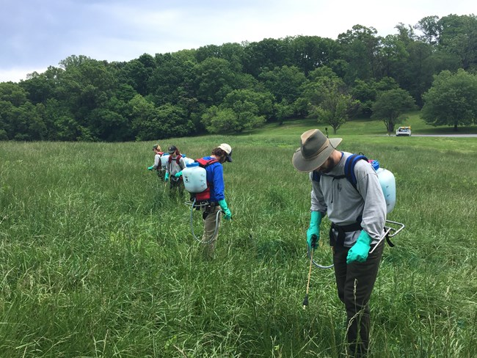
Northeast Ecological Forecasting
Community Concern: Invasive species continue to be an economic and ecological burden in the Northeast and often outcompete native species and are cause for concern for their impact on forest biodiversity. Limiting the impact of these invaders could be greatly improved with accurate and reliable predictions of future spread.
Colorado – Fort Collins
Partners:
National Park Service, Invasive Plant Management Team
USGS, Fort Collins Science Center
Earth Observations:
Landsat 8 OLI
Sentinel-2 MSI
SRTM
Image Credit: National Park Service
Impact: The team will evaluate effective US and global predictor variables to model invasive species risk. Results will inform partners on how to develop more efficient and accurate models of new invaders to the US.
Notes:
------------------------------Image Information Below ------------------------------
Image Credit: National Park Service
Image Source: https://www.nps.gov/orgs/1027/exotic.htm

Slide 20
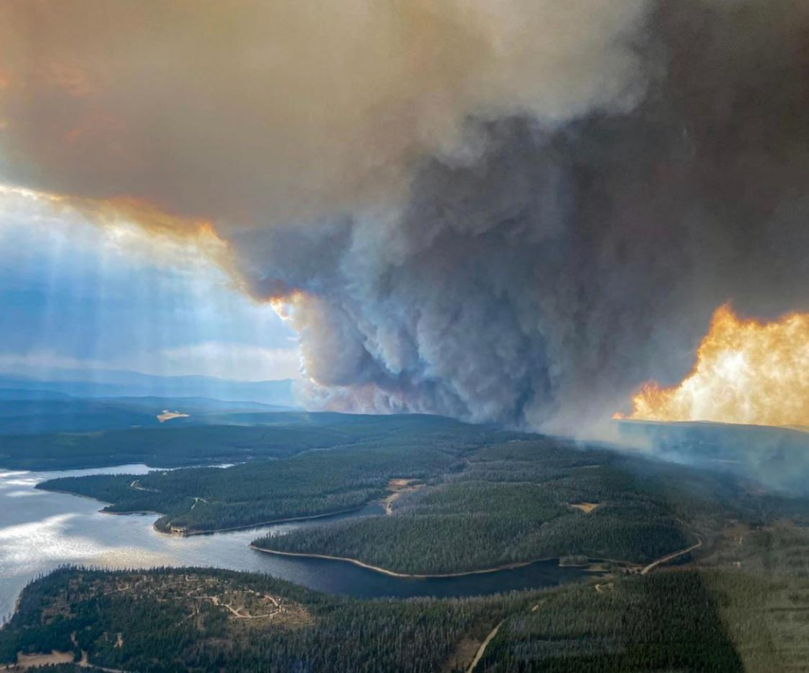
Southern Wyoming Ecological Forecasting
Community Concern: The Mullen Fire burned nearly 180,000 acres and is raising concerns for issues such as impacts on water quality, vegetation recovery, and spread of invasive plants. Land managers need to know where recovery is happening, the magnitude of invasives species growth, and factors that impact recovery.
Partners:
Medicine Bow-Routt National Forest
Wyoming Game & Fish Department
USGS, Fort Collins Science Center
Colorado – Fort Collins
Earth Observations:
Landsat 8 OLI
Sentinel-2 MSI
SRTM
Impact: Maps of burn severity, species richness, native and invasive plant recovery, and an analysis of vegetation recovery patters, will inform partners to recognize and understand recovery patterns, and help them to rapidly detect and control invasive species.
Image Credit: Justin Hawkins, USFS
Notes:
------------------------------Image Information Below ------------------------------
Image Credit: Justin Hawkins, USFS
Image Source: https://inciweb.nwcg.gov/incident/photograph/7208/28/108709

Slide 21

Washington DC & Maryland Energy
Community Concern: Washington DC has committed to reducing its greenhouse gas emissions by 50% by 2031 and 100% by 2050. Of the energy emissions in the District, 75% of those emissions come from the energy used to heat, cool, and power buildings.
Virginia – Langley
Partners:
Washington DC Department of Energy & Environment
Earth Observations:
NASA POWER
Impact: This project will allow the end user to understand energy potential in areas where distributor feeder lines can reach new development of solar energy. This information can then inform the District’s goal of reducing its greenhouse gas emissions.
Image Credit: Andra C Taylor Jr, Unsplash
Notes:
------------------------------Image Information Below ------------------------------
Image Credit: Andra C Taylor Jr
Image Source: city skyline under blue sky during daytime photo – Free Washington Image on Unsplash (Free to use under Unsplash license: https://unsplash.com/license)

Slide 22
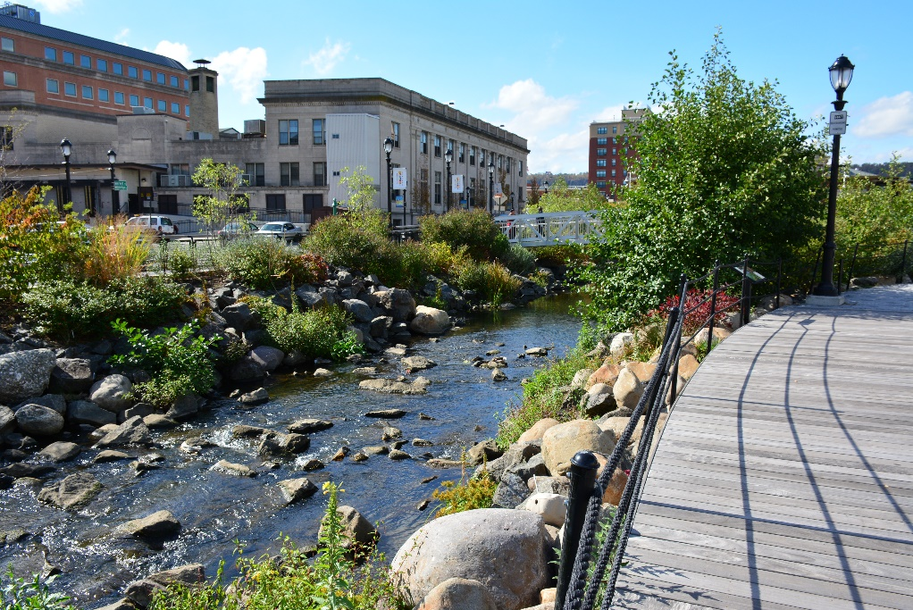
Yonkers Urban Development II
Community Concern: The urban heat island effect (UHI) in Yonkers, NY has contributed to excess heat in certain areas of the city and is expected to intensify
with projected climate changes. The UHI contributes to heat-related illness and morbidity in response to hot-weather episodes and has been especially prominent in neighborhoods subjected to historical race-based housing segregation where little green infrastructure exists.
Arizona – Tempe
Partners:
Groundwork Hudson Valley
Groundwork USA
Earth Observations:
Landsat 8 OLI
Landsat 8 TIRS
ISS ECOSTRESS
Credit: Groundwork HV
Impact: Utilizing NASA Earth observations and building on work from prior terms, end products from this project will be used to better understand the cooling capacity and thermal comfort that specific green infrastructure implementations can provide in identified vulnerable neighborhoods experiencing environmental inequities. This will allow end users to determine which infrastructure will be the most effective for mitigating UHI.
Notes:
------------------------------Image Information Below ------------------------------
Image Credit: Groundwork HV
Image Source: Used with permission and media release from Groundwork HV

