Slide 1
Phase Field Informed Monte Carlo Texture Evolution Models for Additive Manufacturing: Microstructure Simulation and the Need for Experimental Grain Competition Data
Brodan Richter¹ brodan.m.richter@nasa.gov
Joseph Pauza²
Anthony D. Rollett²
Edward H. Glaessgen³
¹Advanced Materials and Processing Branch, NASA Langley Research Center, Hampton, VA, USA
²Department of Materials Science and Engineering, Carnegie Mellon University, Pittsburgh, PA, USA
³Durability, Damage Tolerance, and Reliability Branch, NASA Langley Research Center, Hampton, VA, USA
MS&T21: Materials Science & Technology
Additive Manufacturing of Metals: ICME Gaps: Material Property and Validation Data to Support Certification
Notes:
Introduction
Good morning, my name is Brodan Richter and I am a Research Materials Engineer at NASA Langley Research Center. Today I will be talking about “Phase Field Informed Monte Carlo Texture Evolution Models for Additive Manufacturing.” I will also be discussing the current need for experimental grain competition data.

Slide 2
Outline
Background & Introduction
Techniques and Materials
Results
Need for Additional Validation Data & Conclusions
Notes:
- In a brief outline of my talk, I will start by reviewing background and introductory material on this topic. I will then discuss the techniques and materials used and go over the results from the work. I will finish with a discussion about data needs and conclusions of the work as a whole.

Slide 3
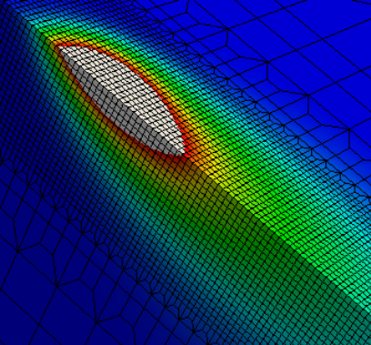
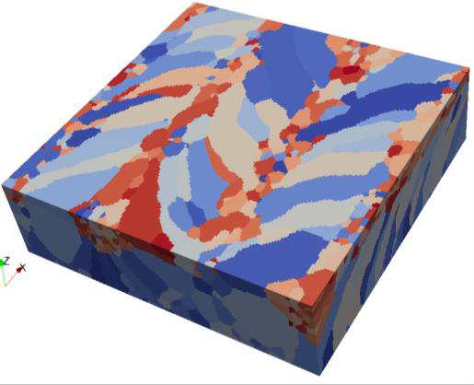
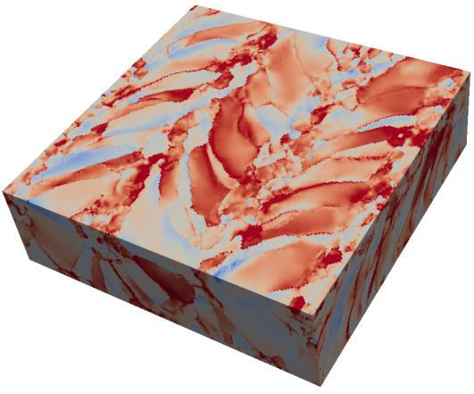

Powder-Bed Fusion (PBF)
Process-microStructure-Property (PSP) Frameworks
Process Modeling
Microstructure Modeling
Property Modeling
[1]
Von Mises stress (MPa)
[1]
[1]
Finite Element Analysis (FEA) Thermal Simulation
SPPARKS [2] Microstructure Simulation
SciFEN [3] Crystal-Plasticity FEA Simulation
Process Control & Optimization
[1] Yeratapally, S.R., NIA Sandwich Series (2020)
Open access as a work of the U.S. Government
NTRS #20205001613
[2] Stochastic Parallel PARticle Kinetic Simulator (SPPARKS), https://spparks.github.io/
[3] SCalable Implementation of Finite Elements by NASA (SciFEN), https://software.nasa.gov/software/LAR-18720-1
Notes:
Additive manufacturing and the powder-bed fusion process has seen rapid growth in recent years. Due to the complex nature of the process, modelling efforts of AM processes have seen similar growth. My team at NASA Langley is working on developing a process-structure-property framework for modeling the powder-bed fusion process. A brief high-level example of a PSP framework is shown in this slide. AM process models, such as finite element thermal simulations, are used to inform inputs to structure models. In the center an AM microstructure that has been generated using Sandia National Laboratory’s SPPARKS package is shown. These structure models are then used as inputs to property models that can be used to estimate the Von Mises stresses experienced within the microstructure.
CLICK
One of the ultimate goals of such a framework is to enable process control and optimization. If a set of processing parameters are predicted to produce unsatisfactory properties, they can be modified until a suitable set of processing parameters are found.
CLICK
I am focused on developing AM microstructure modeling capabilities for this framework.
Highlight for additive manufacturing / powder-bed fusion processes

Slide 4
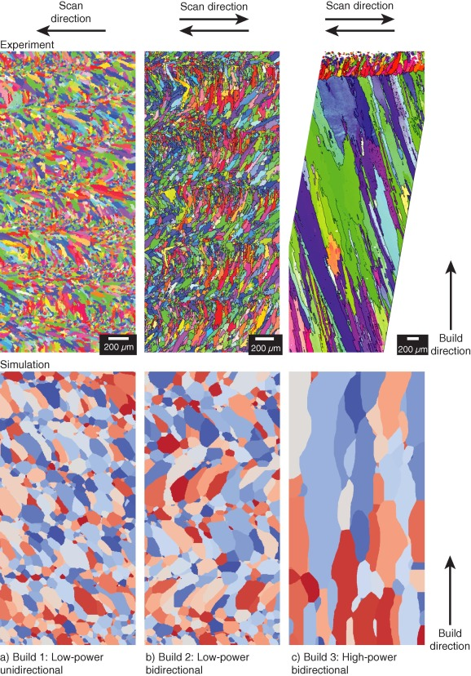
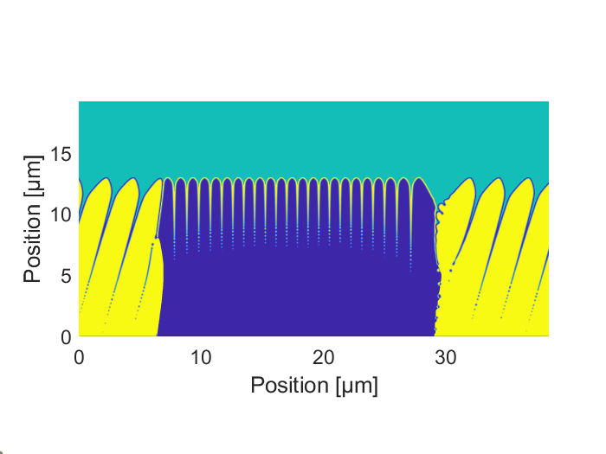
Computational Microstructure Modeling for Additive Manufacturing (AM)
Other Methods
Cellular Automata
  Zinovieva et al., 2018
Analytical Bulk-Scale Models
  Irwin et al., 2016
Ray-Tracing Methods
  Liu & To, 2017
Phase-Field (PF)
Monte Carlo (MC)
Simulates by solving governing partial differential equations
Experimental
Simulates through a series of probabilistic flips
Nanometer resolution
High accuracy
Expensive
Fine details (texture)
Micrometer resolution
Highly Flexible
Cheap
MC Sim.
PF Simulation
Liquid
[4]
Solid
[4] Simulation of metal additive manufacturing microstructures using kinetic Monte Carlo, Figure 6
Rodgers, T. M., Madison, J. D., & Tikare, V., Comp. Mater. Sci. (2017)
This work is licensed under the Creative Commons Attribution 4.0 License https://creativecommons.org/licenses/by/4.0/
https://doi.org/10.1016/j.commatsci.2017.03.053
Figure cropped and labeled vs. original
Notes:
Various computational microstructure modeling techniques have been used for AM, and this work will focus on two of them. The first technique is the phase-field method.

Slide 5
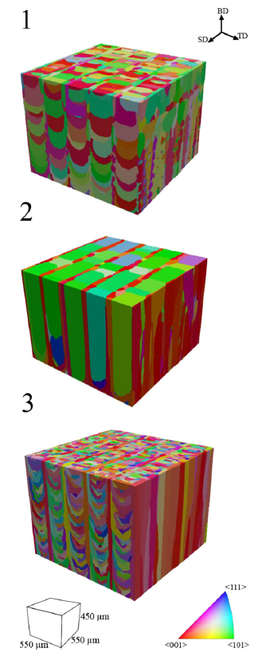
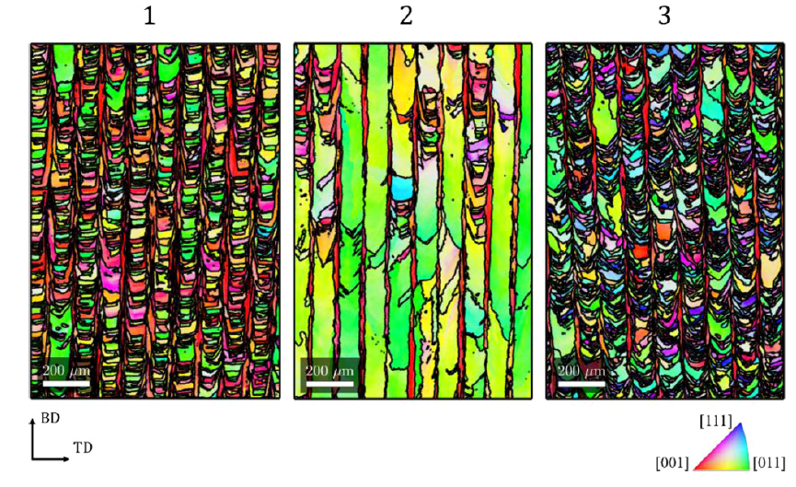
Texture Modeling in AM Monte Carlo Models
Monte Carlo simulations [5]
2)
3)
Recent work [5] incorporated texture into MC simulations empirically
Good experimental quantitative and qualitative agreement
Relation to texture developmental theories unknown
1)
Experimental results [5]
[5] Computer simulation of microstructure development in powder-bed additive manufacturing with crystallographic texture, Figures 6 & 8
Pauza, J.G., Tayon, W.A., & Rollett, A., Model. Simul. Mater. Sc. (2021)
This work is licensed under a Creative Commons Attribution 4.0 License https://creativecommons.org/licenses/by/4.0/
https://doi.org/10.1088/1361-651X/ac03a6
Figures cropped, re-arranged, and labeled vs. original

Slide 6
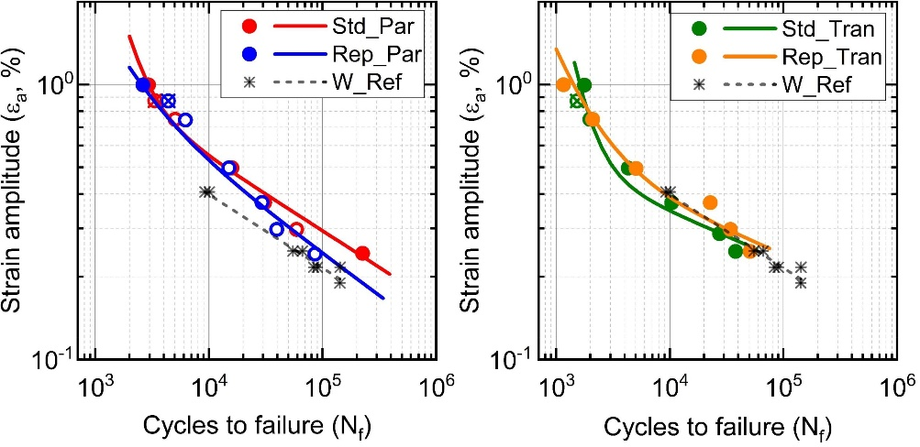
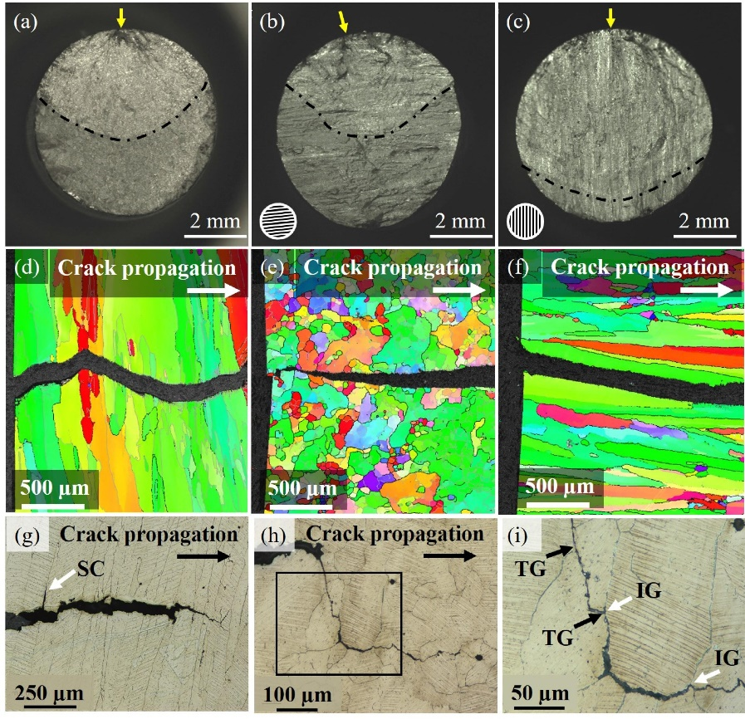
AM Crystallographic Texture – Why care?
Cubic crystals preferably solidify along the <001> direction
Rapid solidification promotes columnar grains
Many passes → large <001> orientated columnar grains
Causes performance anisotropy
  Even after hot isostatic pressing, solution treatment, and aging [6]
Variability in build direction makes qualification difficult
[6]
Build Direction
Build Direction
[6]
[6] Anisotropic fatigue properties of Alloy 718 manufactured by Electron Beam Powder Bed Fusion, Figures 10 & 13
Balachandramurthi, A.R., Moverare, J., Hansson, T., & Pederson, R., Int. J. Fatigue (2020)
This work is licensed under the Creative Commons Attribution 4.0 License https://creativecommons.org/licenses/by/4.0/
https://doi.org/10.1016/j.ijfatigue.2020.105898
Figures cropped, re-arranged, and lines added vs. original

Slide 7
Overview & Objectives
Phase Field Model
Texture plays a role in AM part performance
Micro-scale (PF) models simulate texture development with physics-based backing
Meso-scale (MC) models simulate texture development empirically
How do they relate and compare to texture development theories?
How do the models compare to experimental data?
What experimental data are still needed?
Monte Carlo Model [5]
2)
1)
3)
[5] Computer simulation of microstructure development in powder-bed additive manufacturing with crystallographic texture, Figure 8
Pauza, J.G., Tayon, W.A., & Rollett, A., Model. Simul. Mater. Sc. (2021)
This work is licensed under a Creative Commons Attribution 4.0 License https://creativecommons.org/licenses/by/4.0/
https://doi.org/10.1088/1361-651X/ac03a6
Figure cropped, re-arranged, and labeled vs. original

Slide 8
Outline
Background & Introduction
Techniques and Materials
Results
Need for Additional Validation Data & Conclusions

Slide 9
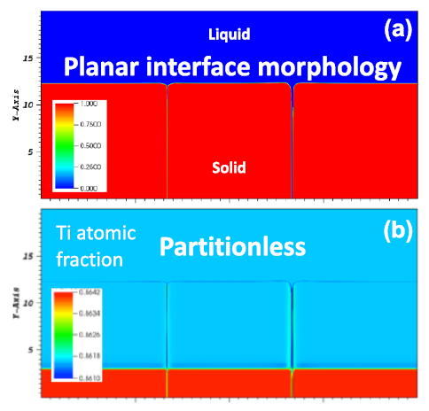
Materials & Methods
[11] A mesoscopic digital twin that bridges length and time scales for control of additively manufactured metal microstructures, Figure 7
Heo, T.W., Khairallah, S.A., Shi, R., Berry, J., Perron, A., Calta, N.P., Martin, A.A., Barton, N.R., Roehling, J., Roehling, T., Fattebert, J.L., Anderson, A., Nichols, A.L., Wopschall, S., King, W.E., McKeown, J.T., & Matthews, M.J., JPhys. Materials (2021)
This work is licensed under a Creative Commons Attribution 4.0 License https://creativecommons.org/licenses/by/4.0/
https://doi.org/10.1088/2515-7639/abeef8
Figure cropped and labeled vs. original
Phase field modeling
  Karma Model for quantitative alloy solidification [7]
  2D explicit finite difference approach solved on GPUs (NVIDIA V100)
  Inconel 718 materials properties from Ghosh et al. [8]
  Grain texture field implemented through Tourret et al. approach [9]
Compared to Inconel 792 directional solidification experiments [10]
Phase field material property needs for Ti-6Al-4V:
  Recent work predicted planar growth in Ti64 PBF AM [11]
  Alpha-beta transformation hides previous dendrites
  Ti-6Al-4V needs more high temperature property data to rectify simulation with theory
    Liquidus & solidus temperatures, partition coefficients, Gibbs-Thomson coefficient, mass diffusivities
PBF Ti-6Al-4V Planar Growth [11]
Individual Grains
[7] Karma, A., Phys. Rev. Lett. (2001)
[9] Tourret, D., et al., Acta Mater. (2017)
[8] Ghosh, S., et al., Model. Simul. Mater. Sc. (2017)
[10] Zhou, Y. Z., et al., Acta Mater. (2008)

Slide 10
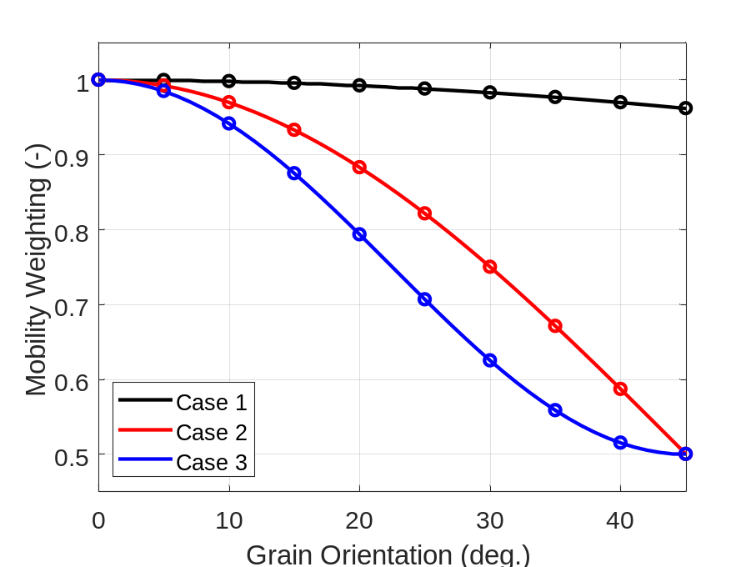






Monte Carlo Microstructure Modeling
Implemented using SPPARKS Kinetic Monte Carlo solver [2]
Reduced to 2D for parity with phase-field models
Removed grain coarsening behavior to focus on solidification behavior
Texture incorporated through method of Pauza et al. [5]
  3 mobility weighting functions tested
Example Flip Attempts
$$P_{accept} ∝ M_{orientation}$$
Amplitude Effect
$$θ_{1}$$
$$liq$$
$$M_{orientation}→$$
Phase Effect
$$P_{accept, θ_{1}}>P_{accept, θ_{2}}$$
$$θ_{2}$$
[2] Stochastic Parallel PARticle Kinetic Simulator, https://spparks.github.io/
[5] Pauza, J. G., et al., Model. Simul. Mater. Sc. (2021)

Slide 11




Texture Evolution and Grain Competition Models
Diverging GB
Overgrowth potentially occurs
AM texture evolves from dendrite competition during solidification
  Favorably orientated grains overgrow unfavorably orientated grains*
Grain Boundaries (GB)
  Diverging – Potential overgrowth*
  Converging – No overgrowth*
Studied experimentally & with phase-field models
Converging GB
No overgrowth*
$$θ_{gradient}=0°$$
$$θ_{1}=0°$$
$$θ_{2}=15°$$
Grain $θ_{2}$ on the right should be overgrown eventually
  *Abnormal grain growth can occur

Slide 12
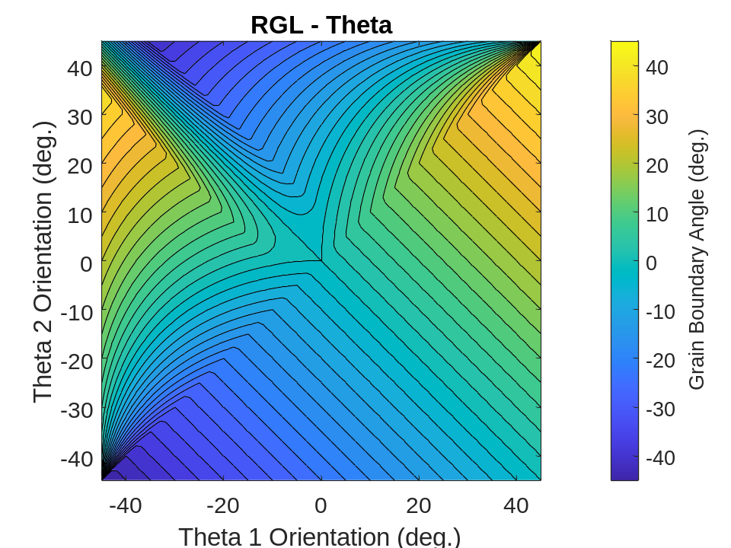
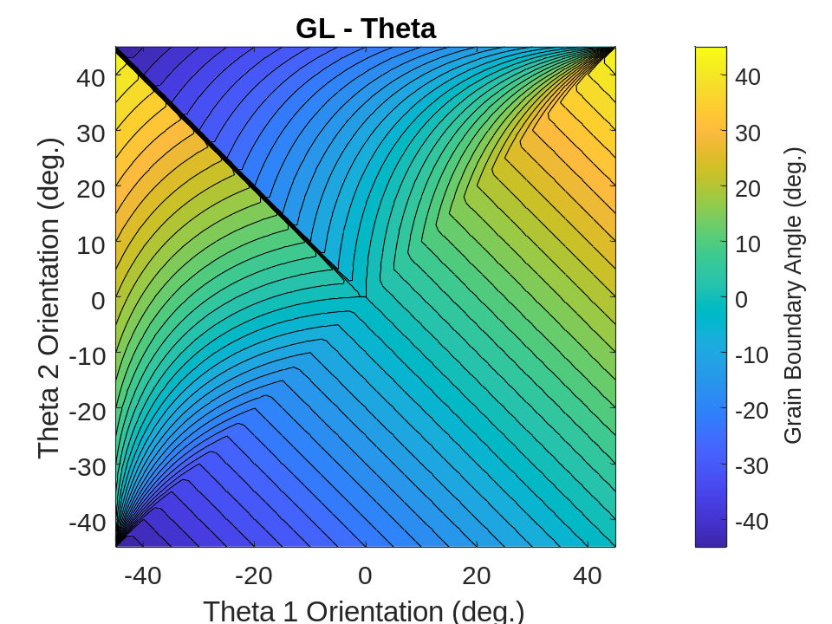
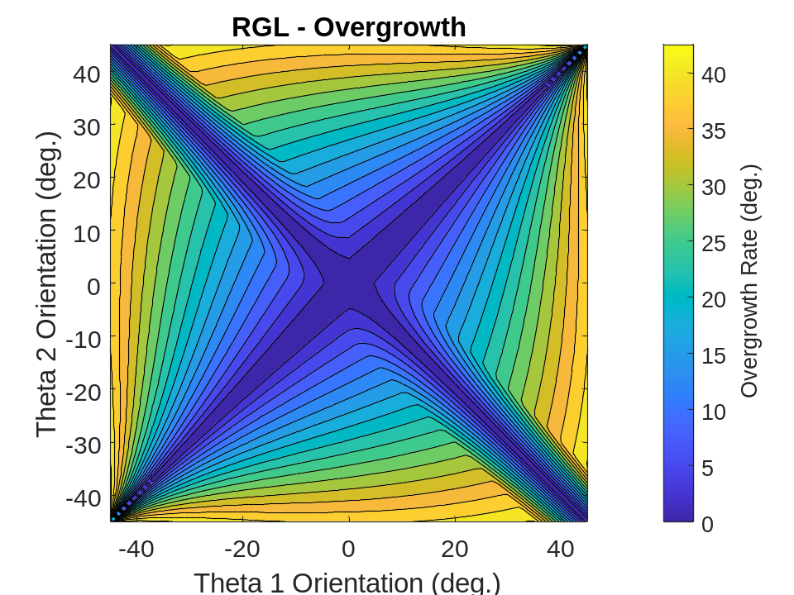
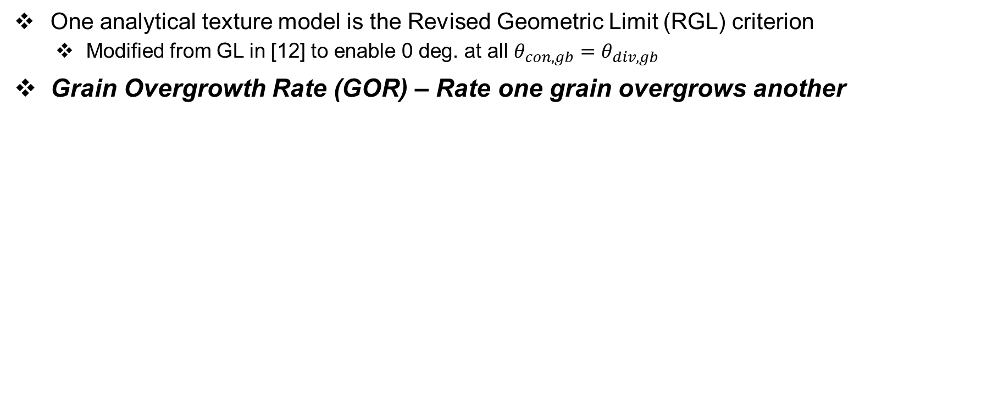

Revised Geometric Limit Texture Model
One analytical texture model is the Revised Geometric Limit (RGL) criterion
  Modified from GL in [12] to enable 0 deg. at all $θ_{con,gb}=θ_{div,gb}$
Grain Overgrowth Rate (GOR) – Rate one grain overgrows another
RGL Analytical Model
RGL GOR Surface
Converging Grains
GOR Transform
$$\left|\operatorname{atan}\left[\tan\left(θ_{1}\right)−\tan\left(θ_{2}\right)\right]\right|$$
Diverging Grains
[12] Pineau, A., et al., Acta Mater. (2018)

Slide 13










Simulation Experimental Design
Directional solidification experiments, periodic boundaries
MC: 100 conditions, 3 repetitions each, 3 sets of weightings, 25 grain-pairs
PF: 22 conditions, 5 repetitions each, 2 grain-pairs
MC Design
PF Design
$N_{n}(θ_{1})$
$N_{4}(θ_{2})$
$N_{n−1}(θ_{1})$
Grain-Pair
Grain-Pair
…
$N_{3}(θ_{1})$
$N_{4}(θ_{2})$
$N_{2}(θ_{2})$
$N_{3}(θ_{1})$
Solidification Direction
Solidification Direction
$N_{2}(θ_{2})$
$N_{1}(θ_{1})$
$N_{1}(θ_{1})$

Slide 14
Outline
Background & Introduction
Techniques and Materials
Results
Need for Additional Validation Data & Conclusions

Slide 15
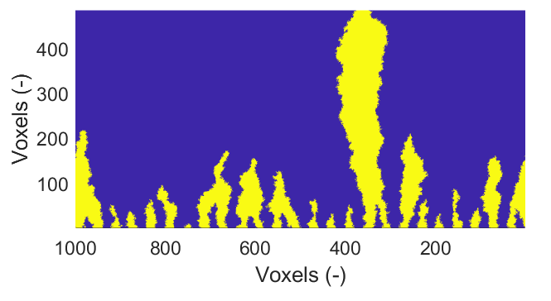
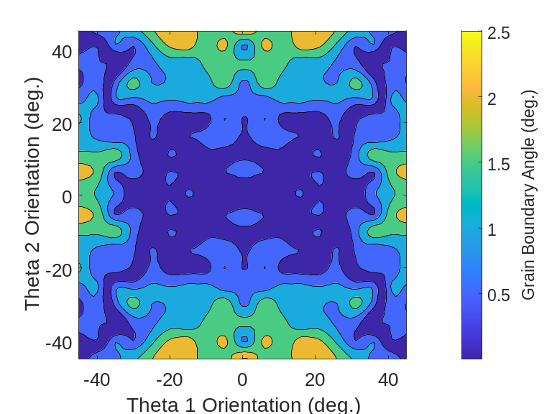
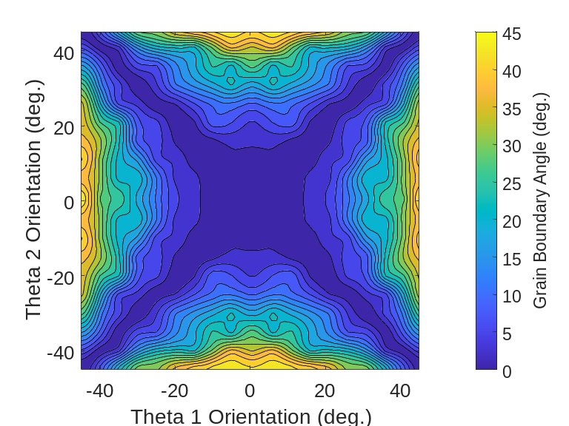
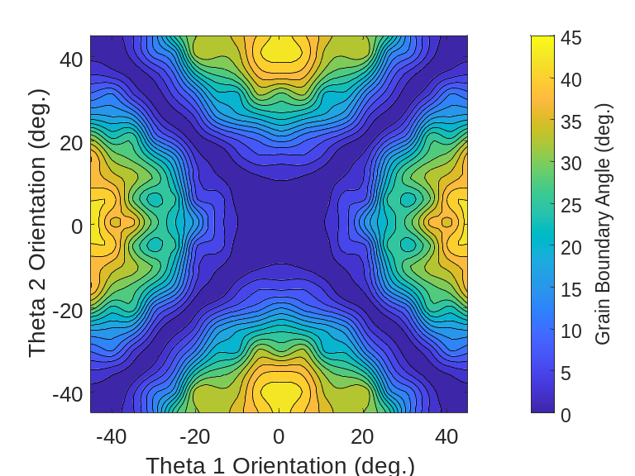





Monte Carlo Simulation of Overgrowth
Example MC Simulation
$$θ_{1}=45°$$
Case 1
$$θ_{2}=0°$$
Grain GOR is strongly dependent on format of weighting function
$$M\left(θ\right)=0.5+0.5\cos\left(0.5∗θ\right)$$
$$M\left(θ\right)=0.5+0.5\cos\left(2.0∗θ\right)$$
$$M\left(θ\right)=0.75+0.25\cos\left(4.0∗θ\right)$$
Amplitude Effect
Phase Effect
Case 1
Case 2
Case 3

Slide 16
Monte Carlo Simulation of Overgrowth
RGL GOR Surface
Grain GOR is strongly dependent on format of weighting function
Shares characteristics to RGL model
$$M\left(θ\right)=0.5+0.5\cos\left(0.5∗θ\right)$$
$$M\left(θ\right)=0.5+0.5\cos\left(2.0∗θ\right)$$
$$M\left(θ\right)=0.75+0.25\cos\left(4.0∗θ\right)$$
Amplitude Effect
Phase Effect
Case 1
Case 2
Case 3

Slide 17
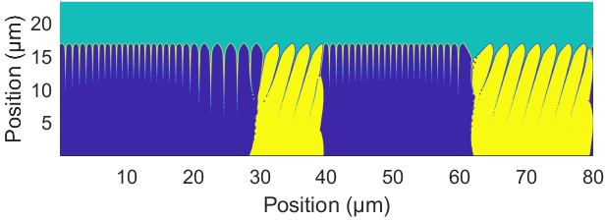
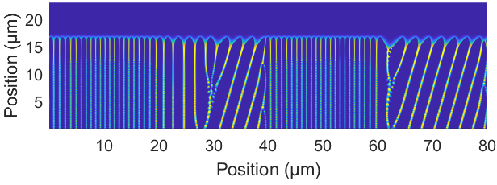

Phase Field Simulation of Overgrowth
Grains & Phase Field
Example of overgrowth shown on right
  0 deg. and 15 deg.
Yellow and blue grains started with equal sizes
Unfavorably orientated grains outcompeted
  Observe overgrowth event
Overgrowth occurred at diverging boundary
Chemical Concentration

Slide 18
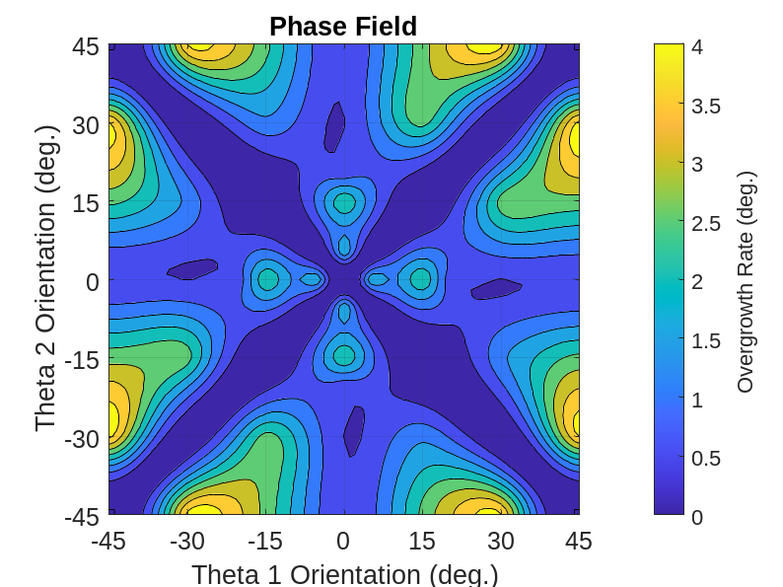
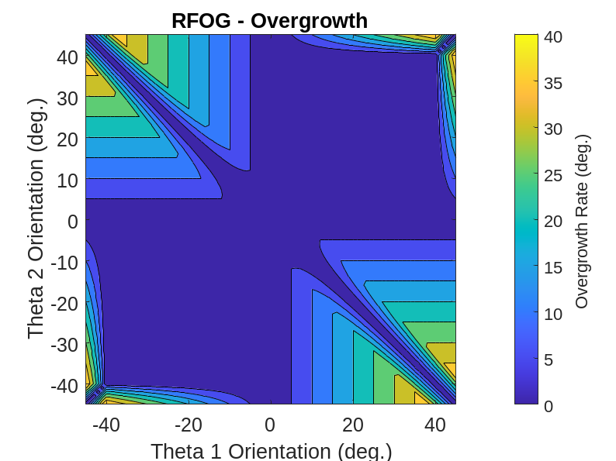
Phase Field Simulation of Overgrowth
GOR magnitudes from phase field simulations smaller with different maximum locations
Similar to alternative Revised-Favorably Orientated Grain (RFOG) criterion model [12]
  Derived through phase field simulations at slow solidification velocities
Need for more experimental data: When does one model best apply vs. another?
Phase Field GOR Surface
RGL GOR Surface
RFOG GOR Surface
[12] Pineau, A., et al., Acta Mater. (2018)

Slide 19
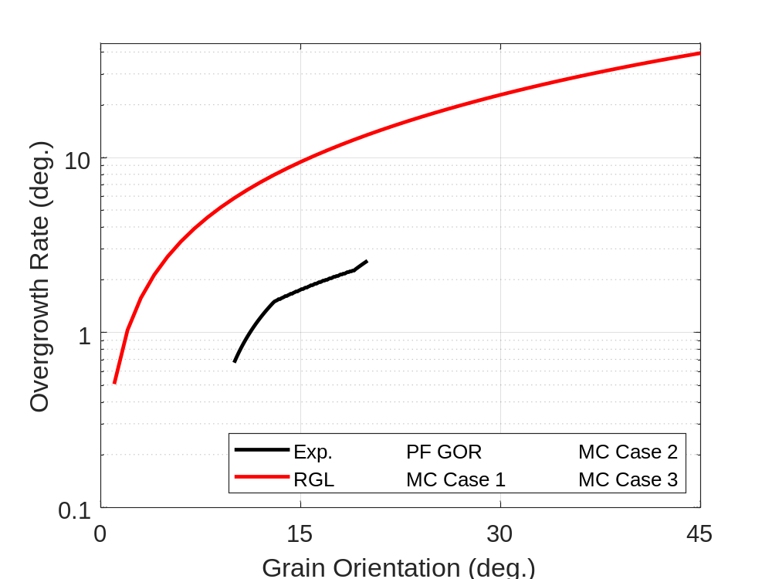
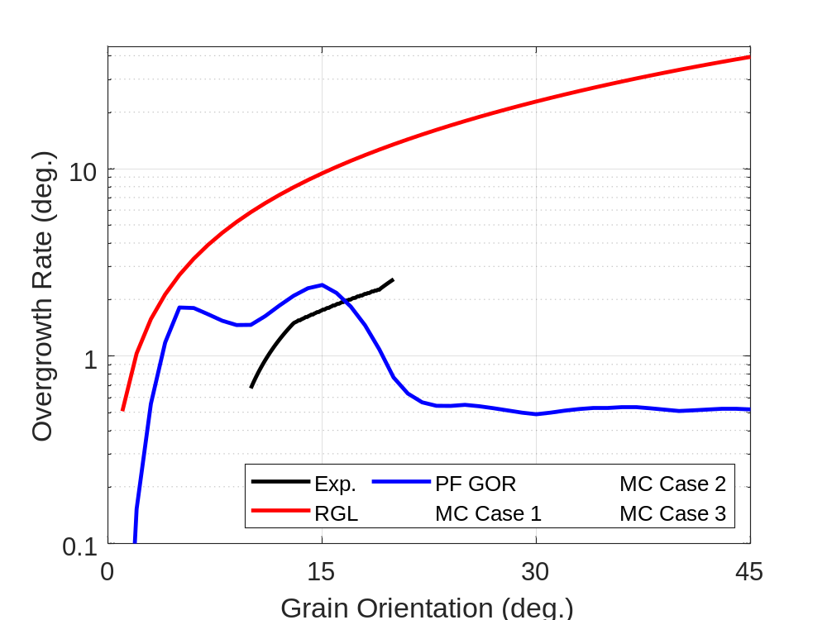
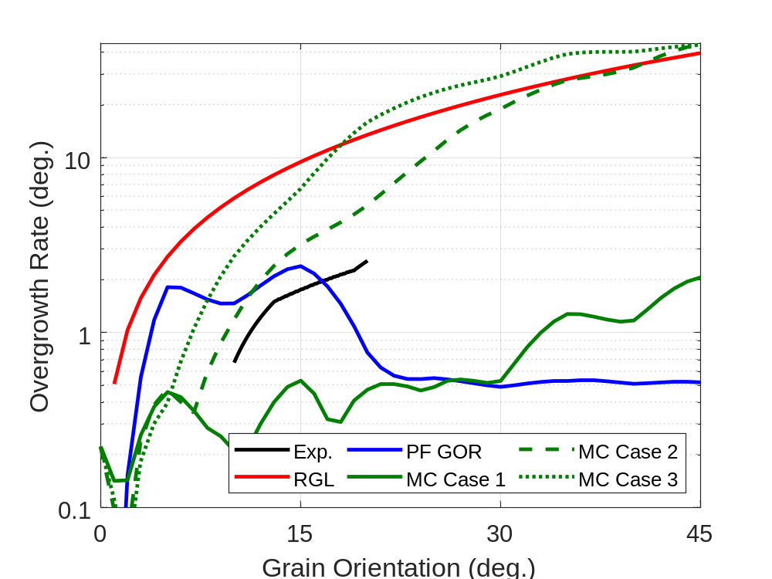
Comparisons of Experimental and Simulated Values
Experimental [10] vs. Theory
  Inconel 792 directional solidification exp.
  Experimental values lower than theory
Phase Field Case
  Close to experimental data, but drops off
  Right order-of-magnitude
Monte Carlo Cases
  Case 1: Best 3D, directional solidification results in [5]
    Lower than experimental data
    Lower than PF at low orientations
  Case 2 & 3: Closest to RGL
    Portions over- and under-estimate RGL
    Higher than experimental data
Phase Effect
Amplitude Effect
[10] Zhou, Y. Z., et al., Acta Mater. (2008)
[5] Pauza, J. G., et al., Model Simul. Mater. Sc., (2021)
Notes:
Trim further

Slide 20
Outline
Background & Introduction
Techniques and Materials
Results
Need for Additional Validation Data & Conclusions

Slide 21
Need for More Experimental Characterization of Grain Growth Behavior
More experimental data of competitive grain growth is needed
  Traditional directional solidification methods at ~10 mm/min → AM at ~1000 mm/s
  Lack of AM alloys
Many modern studies are 2D phase field at low velocities
  Models only recently incorporating quasi-rapid AM solidification effects [13, 14]
  3D is computationally expensive
Experimental validation data is needed
  Need quasi-rapid solidification speeds
  Difficult & expensive data to produce
    – How to best generate and support?
    – Potential of modern techniques?
[5] Experimental results
[5] Computer simulation of microstructure development in powder-bed additive manufacturing with crystallographic texture, Figure 6
Pauza, J.G., Tayon, W.A., & Rollett, A., Model. Simul. Mater. Sc. (2021)
This work is licensed under a Creative Commons Attribution 4.0 License https://creativecommons.org/licenses/by/4.0/
https://doi.org/10.1088/1361-651X/ac03a6
Figure labeled vs. original
[13] Kavousi, S. & and Mohsen A. Z., Acta Mater. (2021)
[14] Pinomaa, T. & Provatas N., Acta Mater. (2019)
Notes:
Modern techniques such as experiments at the APS or dynamic-TEM

Slide 22
Need for Capability to Simulate Microstructure & Texture
PBF AM metal parts → large, columnar grains
Texture plays a big role
  Anisotropy and fatigue performance
Texture and microstructure depend on build parameters
  Varies within individual part
PSP-Framework: Strong role of texture suggests property models need to include it
How to best simulate microstructure and texture at the close-to-part scale?
Build Direction
Crack Direction
[6]
Build Direction
Crack Direction
[6]
[6] Anisotropic fatigue properties of Alloy 718 manufactured by Electron Beam Powder Bed Fusion, Figure 10
Balachandramurthi, A.R., Moverare, J., Hansson, T., & Pederson, R.
This work is licensed under the Creative Commons Attribution 4.0 License https://creativecommons.org/licenses/by/4.0/
https://doi.org/10.1016/j.ijfatigue.2020.105898
Figure cropped, re-arranged, and lines added from original
Notes:
Trim further

Slide 23

Conclusions
RGL GOR Surface
Monte Carlo texture model:
  Approximates the revised-Geometric Limit criterion
  Can be modulated by changing weighting form factor
Phase field model:
  Matches experimental data reasonably well
  Better matches revised-Favorably Orientated Grain criterion
Experimental data:
  Various grain overgrowth theories exist. More data needed to develop understanding
  More data needed to understand role of temperature gradient and solidification velocity
$$M\left(θ\right)=0.5+0.5\cos\left(2.0∗θ\right)$$

Slide 24
Acknowledgements
This work was supported by NASA through:
  Aeronautics Research Mission Directorate’s Transformational Tools and Technologies (TTT) Project
  Aeronautics Research Mission Directorate’s University Leadership Initiative (ULI) (Grant # 80NSSC19M0123)

