Slide 1
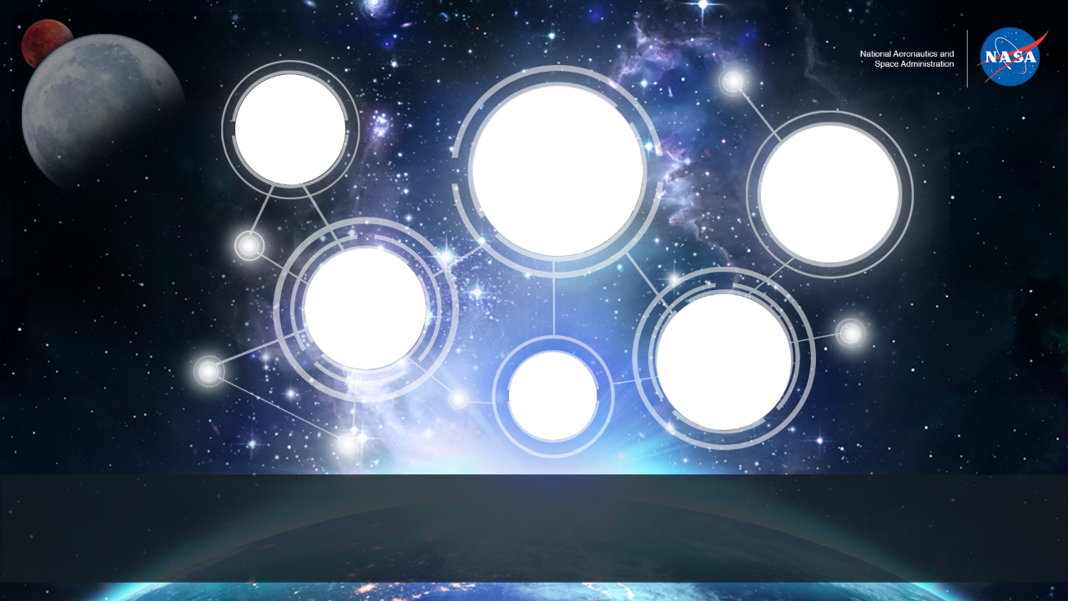
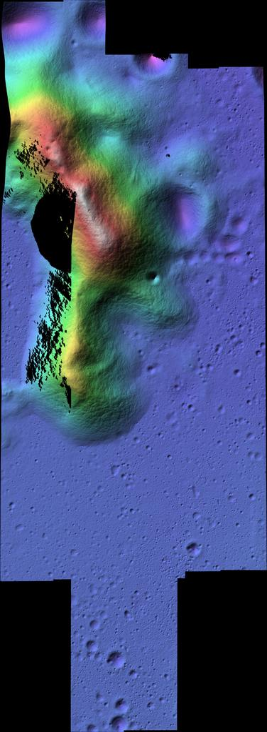
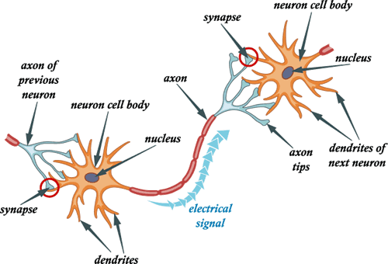
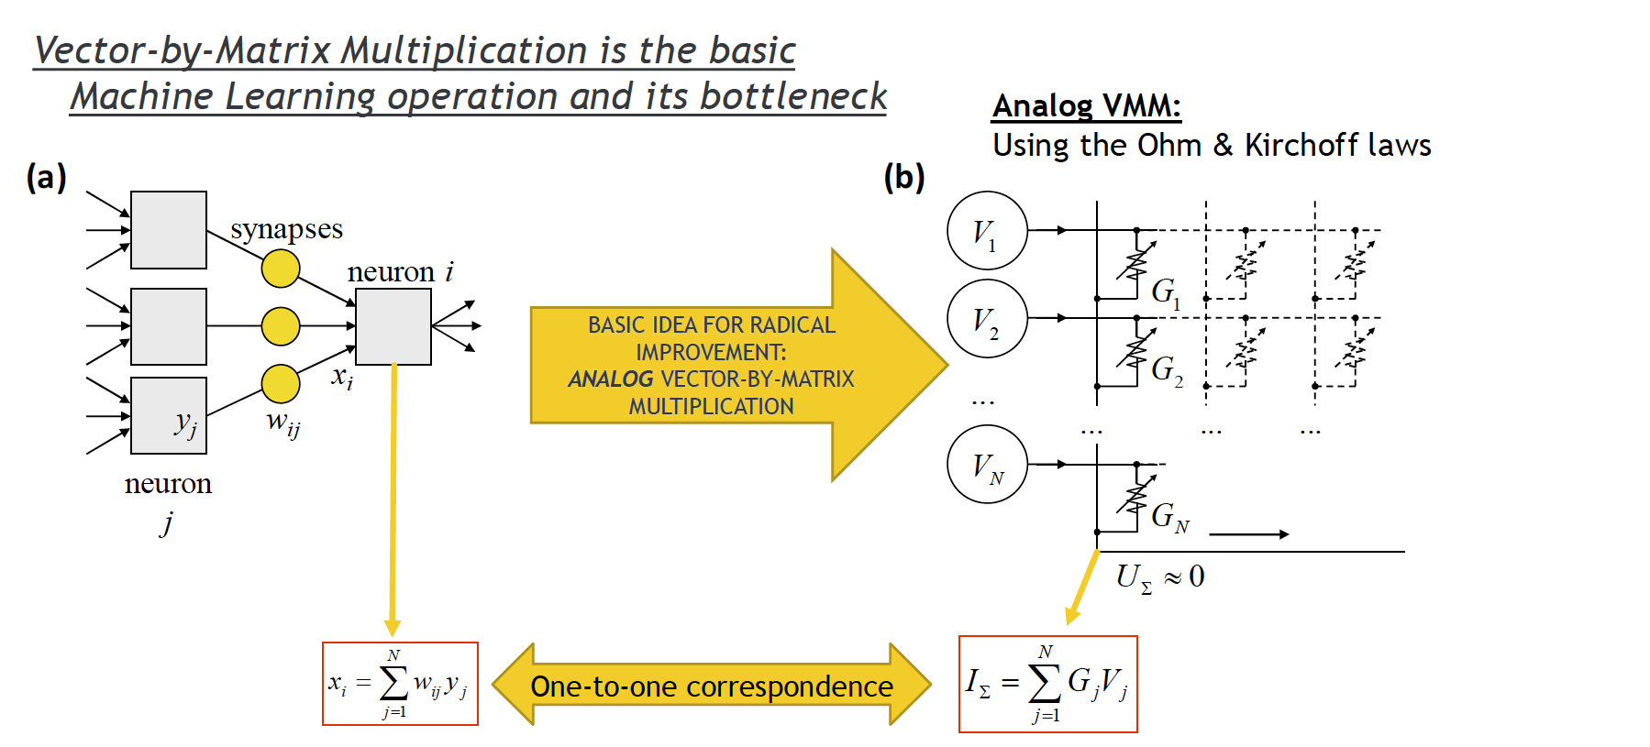
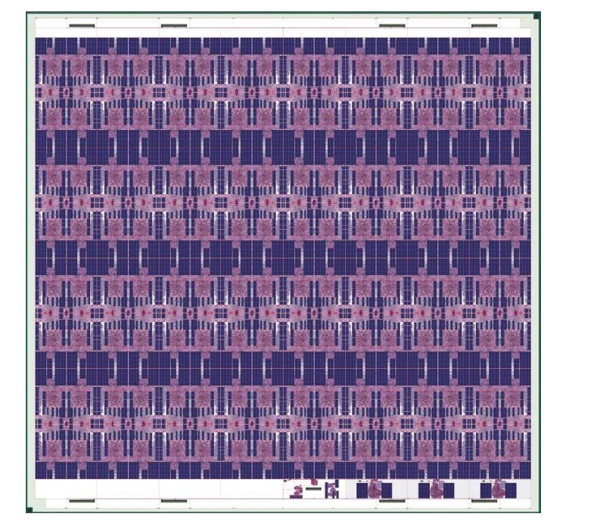
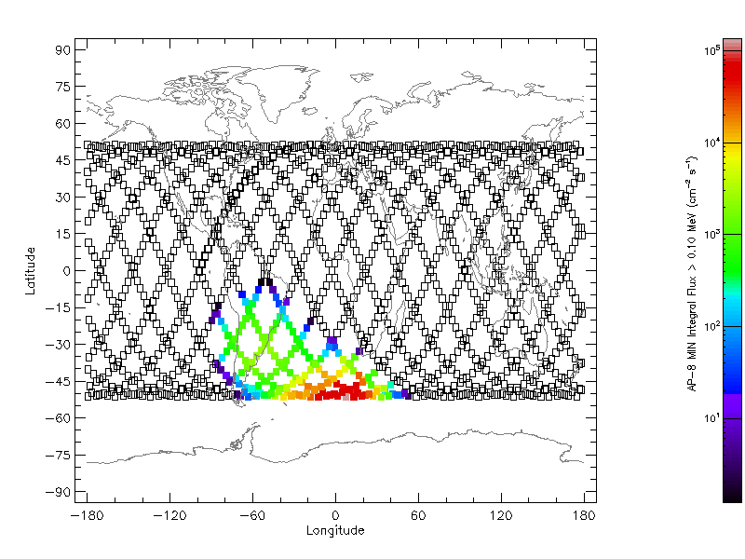
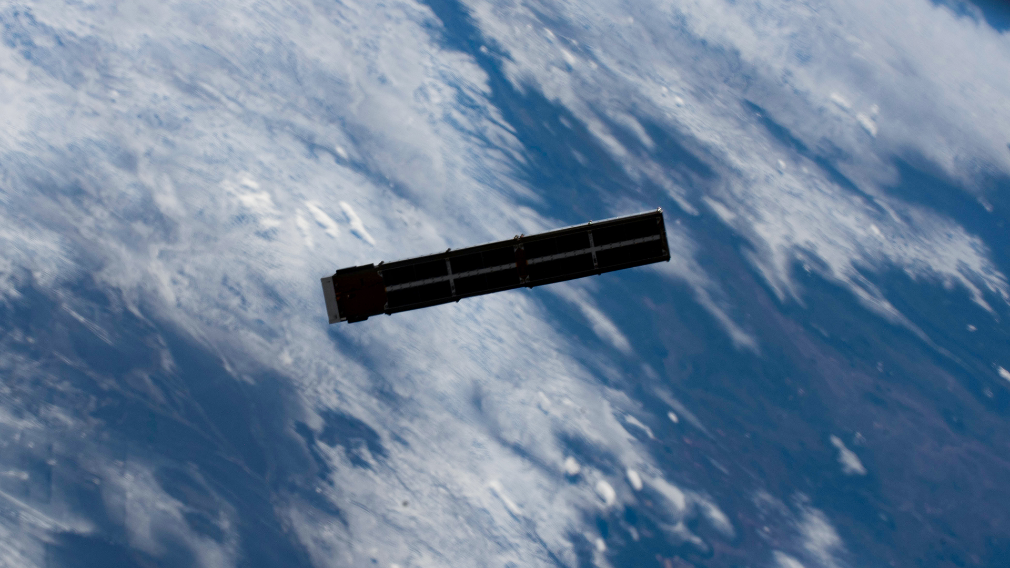
Neuroscience
Super-Res
Analog
Informed
Co-Processor
1000x
Spiking NN
Rad-Tolerant
Trade
Space
Space Technology Mission Directorate
Game Changing Development Program
Dr. Michael Lowry| Dr. Eric Barszcz, Richard Alena | FY21 RadNeuro Annual Review Presentation
Notes:
1. Upper left: Neuromorphic computing maps lessons from neuroscience to silicon processors.. Picture is of a stylized pair of neurons – pre-synaptic and post-synaptic, that are linked computationally through synapses.
2 Upper center: picture of Aiken crater, color coded with a super-resolution digital elevation map. Coarse lidar is fused with high-resolution camera images to derive detailed depth maps through neural net processing suitable for precision landing and fast rover traverse or extreme access.
3. Upper right: mixed analog/digital neuromorphic processing has potential for a thousand times more throughput per watt than general purpose CPUs. Neuromorphic processors can be used standalone or in synergy with general purpose processors.
4. Lower left: Intel Loihi is a second-generation neuromorphic processor that incorporates the spike model of neural processing. It is especially promising for power-efficient in-situ learning.
5. Lower center: technology maturation through relevant experiments such as cubesat missions.
6 .Lower right: rad-tolerant neuromorphic processors need to span a wide range of radiation environments. Picture: radiation flux for earth orbit spans five orders of magnitude from equatorial to south Atlantic anomaly.

Slide 2
RadNeuro Overview
Technology Product Capability: Radiation-Tolerant Neuromorphic Processor Project offers Power Efficiency and Radiation Tolerance for Artificial Intelligence and Machine Learning space capabilities – both as a co-processor and standalone. Neuromorphic maps neuroscience onto silicon to achieve Teraops (trillions per second) throughput with 100x to 1000x more power efficiency than general purpose CPUs.
Technical Capabilities
  Radiation Tolerance: Leveraging processor advances in terrestrial neuromorphic computing to space radiation tolerance through new device technology,
  redundancy management, new system architectures, and system software.
  Technology maturation for space missions through experiments and demonstrations in increasingly relevant environments.
Exploration & Science Applicability
  The technology targets high-throughput and critical in-situ computing.
  Fast traverse autonomous roving, lunar and planetary.
  Perceptual processing for extreme access
  Anomaly detection, FDIR, spacecraft health
  Cognitive Radio
  In-situ adaptation and science.
  Sentient small spacecraft
Top picture is an innovative analog neuromorphic chip
from partner Mentium with extreme power efficiency.
GCD is funding radiation hardening. The middle picture
is a Tech Ed Sat nanosat mission. Tes13 passed environmental testing August 2021. Intel Loihi, bottom, is targeted to be first neuromorphic processor in space, launch early FY22.
Notes:
Provide an overview of the Project/Task
The slide content is intended to remain static unless significant changes are made to the Project
Pictures are encouraged, please provide new pictures as frequently as possible

Slide 3

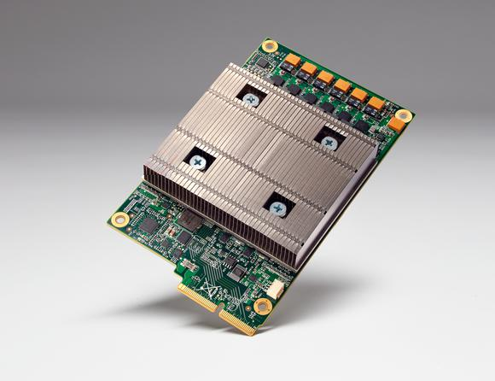
Why Rad-Tolerant Neuromorphic?
Neuromorphic processors have outstanding Power Efficiency (100x to 1,000x throughput per watt compared to a CPU) for Artificial Intelligence and Machine Learning applications. Radiation tolerance brings these capabilities to space missions. Rad-tolerant neuromorphic processors, both as a co-processor to a CPU and standalone processor for smart instruments and nanosats, will bring
high-throughput and critical in-situ computing for capabilities ranging from fast traverse autonomous rovers to precision extreme access to in-situ adaptation and science.
  Neuromorphic: Map NeuroScience onto Silicon
  Human Brain: Exascale+ processing @ 20 watts
  (86 Billion Neurons, 150 Trillion Synapses)
Google
Tensorflow
Processing Unit
83x CPU ops/watt
Digital Systolic Array
Intel Loihi:
Onboard Learning
Mesh Network
Analog
Mentium San Migual :Mixed Analog/Digital 10x Digital Efficiency
Analog Systolic Array

Slide 4
Neuromorphic Vector Operations
Deep Inference = [RELU(DotProduct(,))] *
Hebbian Learning = TensorProduct(Pre,Post)
Deep Learning = [VectorError(Output,SupervisedOutput);ChainRule]*
Layer 1
Gradient Descent
Layer N
Pre-Synaptic
Neurons
Synaptic Weights
Delta Synaptic Weights
Output Error
Delta Synaptic Weights
Back-
propagation
Back-propagation
Non-linear Threshold
_/ _/ _/ _/ _/ _/
Post-Synaptic Neurons

Slide 5
Collaborative Partnerships for Advancement of Aerospace Materials
Mission Infusion & Partnerships
NASA Centers
Ames
JPL
Goddard (NEPP)
Glen
(Cognitive
Radio)
Public/Private Partnerships
Intel Corporation
Loihi Space Act Agreement
OGA Leveraging
AFRL
SBIR/STTR
Mentium
Exploration Institute
Nanomatronix
Numem
NASA Programs
SSTP Small Spacecraft Technology Program
Mission Infusion
• SSTP PACE4 mission with prototype
rad-tolerant Neuromorphic processor(s)
• First-gen processors available for pacing missions
with radiation tolerance.
• Radiation tolerant technology for Neuro conveyed
to avionics community.
• Phase 2 proposal to GCD for full-scale Neuro
Solicit partners, downselect
Design, develop, verify, deploy
Collaborative multidisciplinary partnerships to leverage fiscal resources, ideas, knowledge & expertise.
Notes:
Detailed Example Only for context

Slide 6
RadNeuro Phase 1
Technology Goals & Project Objectives
Technology Goals
Goal #1 | Enable space missions to use neuromorphic processors for in-situ autonomy.
Goal #2 | Augment CPU space processors with rad-tolerant neuromorphic co-processor providing 100x ops/watt for high compute AI and Machine Learning tasks.
Goal #3 | Ultra low-power standalone neuromorphic processor for small space assets and standalone instruments
Goal #4 | Bridge gap between commercial industry and space rad-tolerant neuromorphic processors.
Project Objectives
Objective #1 | Trade-space analysis.
Objective #2 | Mature TRL for neuromorphic processing in space from 2 to 4
Objective #3 | Radiation test neuromorphic devices, circuits, and chips
Objective #4 | Design and fabricate prototype rad-tolerant neuromorphic circuits and processors for space
Objective #5 | Engage partner for Phase 2 design and fabrication of full rad-tolerant neuromorphic processor.

Slide 7
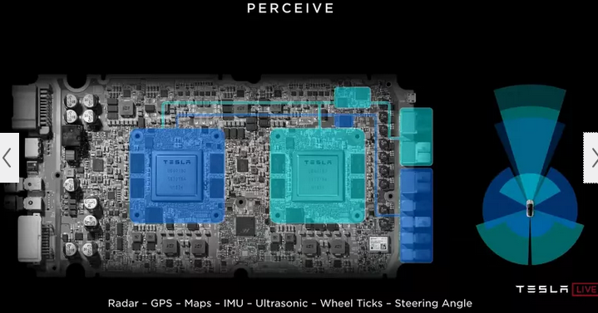
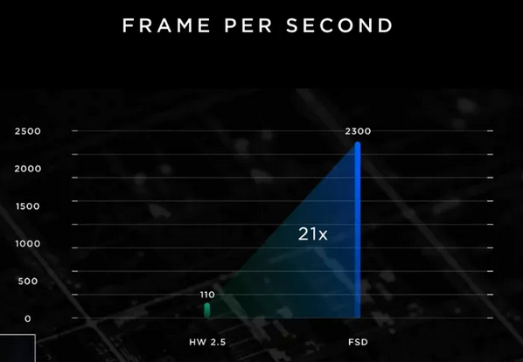
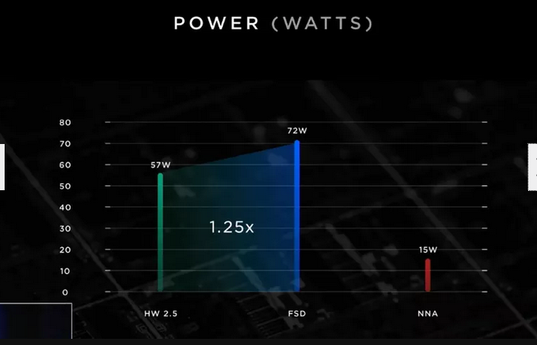
Force Multiplier Co-Processor for Space Autonomy
Example from Terrestrial Autonomous Cars Tesla Full Self-Driving Chip (6B transistors 14nm FinFET )
Heavy lifting for vector processing off-loaded to Neural Net Accelerators
System Level: 21x perceptual processing for 1.25x power 17x ratio
Force Multiplier towards Autonomous Cars
Autonomy: Achieves SAE Level 2 (Hands-on human vigilance)
Specialized NNA: 72 Terops @ 15 Watts [12x ARM + GPU @ 60 Watts]

Slide 8
Sentient Small Spacecraft
Today’s Small Spacecraft
Next-Gen Small Spacecraft
Low mass, shared launch, affordable missions.
Typically single-point sensor, bandwidth limited to Earth with minimal on-board processing, on-board processing limited by size and power.
Typically either single-spacecraft missions or non-coordinated constellations.
Typically LEO minimal radiation missions.
Small mass, shared or dedicated launch, affordable missions.
High-throughput, low-power on-board processing enables sentient actions and data processing, compressed communication to Earth with high information content, opportunistic science.
Swarms of distributed communicating small spacecraft provide synthetic large sensors (DSA).
Widespread solar system exploration.

Slide 9
Accomplishments - Technical
Hokulele: First neuromorphic AI/ML system ready for space launch
  Hokulele (meteor) system consists of Intel Loihi spiking neural net Gen 1 processor and supporting avionics
  Tes13 3U nanosat now packaged for launch on Virgin Orbit fall 2021, environmental and functional tests complete, launch Nov15 +, parallel orbit to ISS, likely months of operations.
  Tes13 is a collaboration of RadNeuro, Cognitive Radio, Small Spacecraft Technology Program, SBIR companies and AFRL contribution
  Hokulele requirements are defined as a progression of increasing success criteria
  Hokulele software consists of C&DH, scheduling and execution framework, 7 AI/ML applications, and robust reset strategy for hardware faults
  Software was designed, developed, peer-reviewed, and verified by RadNeuro in collaboration with SBIR Exploration Institute and Blaze computing.
  Loihi hardware was debugged in collaboration with Intel Neuromorphic Research Laboratory, hangs isolated to auxiliary USB circuitry with mitigation by Hokulele software
  Hokulele Incorporates in-situ learning capability: 6 baseline classes for anomaly detection already learned during test and checkout
  Hokulele deployment experiment operational policies and procedures have been defined, including nominal and extended modes, and ‘war plans’ for potential fault conditions
  Once success criteria have been achieved - expected within first 30 days using Iridium
  100-byte communications- longer mission will validate in-situ learning with S-band ‘lunar radio’ 10s of MBytes data downloads, and characterize Loihi hardware space performance.

Slide 10
Accomplishments - Technical
Analysis Estimates
TOP = 10^12 operations/sec
Tradespace:
Throughput and Quantization tradespace defined for
NASA Applications
Bandwidth Limited
750 TOPS
Human Vision
Throughput
And Sizing
TOPS/Watt – efficiency
Onchip synaptic storage
Precision Perception for Extreme Access
(Super-Resolution)
600 to 800 TOPS
Perception for
Extreme Access
Fast Rover Traverse
Type of Neuromorphic
200to 400 TOPS
Fast Rover
Traverse
Quantization
74 TOPS
Tesla FSD SAE L2
Hands On Constant
Monitoring
Float
Integer
Analog
4.5 x 10^8 ATP
per spike
appx. 0.045pJ per
synapse
Energy for
Multiply (synapse)
4pJ @ 14nm
Finfet
0.5pJ
Estimated
0.2 pJ@ 14nm
Finfet
Appx. 0.05pJ
64bit FP
High Precision
Simulation
32bit FP
Digital Signal
Processing
2-4 bit
Biological
Synapse
Rolls et al
BFloat16
Deep Learning
Int8
Edge Inference
4-6 bit
Analog

Slide 11
Accomplishments - Technical
Radiation Test Procedures
  Extended TID testing defined for synaptic weight shifts
  Engagement with Intel for radiation-testing Loihi
  Testing procedures defined and written for Neuromorphic Devices:
    Analog NOR Flash, Memristors, STT-MRAM

Slide 12



Prototype Radiation Tolerant Processors
Three broad processor classes as defined by layout and architecture.
RadNeuro will leverage these classes with Radiation & Fault Tolerance.
Systolic Array for Artificial Neural Net
San Miguel (California mission) – FY22Q2
Radneuro-Mentium collaboration for rad-tolerance
Mesh Network for Spiking Neural Net
Hoku-pa’a (Hawiaan Northstar) – FY22Q2
Radneuro-intel collaboration rad-tolerance with
Loihi baseline architecture
FPGA Neuromorphic
Freya (Norse clairvoyant shapeshifter goddess) – FY23Q1
Radneuro-Brainchip collaboration

Slide 13

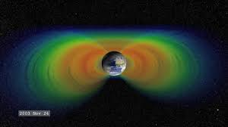
Prototype RadNeuro Processor Validation
Radiation TID/Beam test prototype neuromorphic processors (FY22, FY23 Q1)
Downselect Prototype Neuromorphic Processors (FY23 Q1)
Agneya Baptism by Fire (Sanskrit, Hindu Goddess) Summer 2023
RadTolerant AI/ML system on PACE4 Mission
GeoTransfer Orbit with repeated exposure to
Earth’s Natural Synchrotron – the Van Allen Belts
2mm AL SHIELDING
Mission | Trapped Solar Particles |  |  |  | Solar Flares |  |  | GCR | Total Dose
 | Proton Dose | Electron Dose | Brem Dose | Total Trapped | Dose/SPE | Annual SPE | Total SPE | Proton, He | Rads (Si)
LEO Zero | 12 | 0 | 0 | 12 | 30 | 4 | 120 | 5 | 137
LEO 51˚ | 200 | 1000 | 10 | 1210 | 30 | 4 | 120 | 5 | 1335
LEO Polar | 150 | 1000 | 10 | 1160 | 30 | 4 | 120 | 5 | 1285
GEO | 10000 | 100000 | 1000 | 111000 | 30 | 4 | 120 | 10 | 111130
GTO (max rad) | 10000 | 10000000 | 10000 | 10020000 | 30 | 4 | 120 | 10 | 10020130

Slide 14
Objectives Status Summary
Project Objectives
Objective #1 | Trade-space analysis. 70% complete
Objective #2 | Mature TRL for neuromorphic processing in space from 2 to 4. Hokulele system checkout testing has achieved TRL 3 Hokulele space launch on Tes13 nanosat will achieve TRL 4 Agneya RadTolerant AI/ML on PACE 4 nanosat will achieve TRL 5
Objective #3 | Radiation test neuromorphic devices, circuits, and chips Test procedures defined for extended TID / Synaptic Weight radiation stability
Objective #4 | Design and fabricate prototype rad-tolerant neuromorphic circuits and processors for space San Miguel tapeout November 2021, following Santa Barbara and Santa Cruz processors
Objective #5 | Engage partner for Phase 2 design and fabrication of full rad-tolerant neuromorphic processor. OGA, 8 SBIR companies, 2 large tech companies interested

Slide 15
RadNeuro Maturation Timeline
August 2021: Neuromorphic processor successfully integrated into 3U nanosat, 9K SLOC, functional and environmental checkout – ready for launch on Virgin Orbit. 6 classes learned in-situ. TRL 3
December 2021: Intel Loihi operational in LEO. Ground command through Iridium for successive executions of 7 Loihi applications, including in-situ learning for anomaly detection. Evaluation against success criteria. Data acquisition through S-band of Loihi operational profile in orbit. TRL 4
FY22 Q1, Q2: Radiation testing of neuromorphic synaptic devices – high TID – MRAM, Memristors,
Analog NOR. TRL 2
March 2022: Tape-out of San Miguel rad-tolerant Analog Systolic array. Radiation and functional testing through June 2022. TRL 3
August 2022: Rad-tolerant firmware for SNN developed with Intel for Loihi. Radiation and functional testing through November 2022. TRL 3
November 2022: Rad-tolerant FPGA neural cores developed with selected partners (e.g., Brainchip). Integration with radiation-tolerant configuration and synaptic memory. Radiation and functional testing through January 2023.
February 2023: downselect rad-tolerant prototype Neuromorphic processors for PACE Baptism by fire.

Slide 16
RadNeuro Maturation Timeline
March 2023: integration onto PACE4. TRL 4 rad-tolerant prototype processors
July 2023: PACE4 nanosat mission through Van Allen belts. TRL 5.
September 2023: Publication of data and rad-tolerant technology capabilities from radiation labs and Agneya mission.
If approved, Phase 2 RadNeuro for development of full rad-tolerant neuromorphic processor.
Solicit and Downselect partners (+ 4 months)
Initial tapeout of processor (+ 18 months)
Radiation, throughput, and power efficiency verification and debugging (+24 months)
Fabrication of full-scale Rad-Tolerant Neuro Processor (+36 months)

Slide 17
Technical Assessment
Technical Elements | TRL
 | Entry | Current¹ | Exit | Verification
Trade-Space Analysis | 2 | 3 | 4 | Milestone ID K1
Radiation Tolerance | 2 | 3 | 5 | Milestone ID K2
Technology Maturation | 2 | 3 | 5 | Milestone ID: C2
Prototype Rad-Tolerant Neuromorphc Processors | 2 | 2 | 4 | Milestone ID: C3
Date of last Technical Assessment was August 2021
for PCD Approval by GCD Chief Engineer

Slide 18
RadNeuro Key Performance Parameter (KPP) Status
Key Performance Parameters
Parameter | Units | State of the Art (SOA) | Threshold Value | Project Goal | Current Value To Date | TBoE for the provided Current Value | Expected Exit Value | TBoE for the provided Expected Exit Value
Compute Power Efficiency | Tera ops /sec/watt | 2⁽¹⁾ | 10 | 20 | 4 | Estimate for Analog | 10 to 15 | Benchmarks
Total Ionizing Dose | Kilorad | 20 | 100 | 200 | 20 | Previous TID tests⁽²⁾ | 120 | Preliminary data on Neuromorphic Devices
Fault Recovery | Seconds | Latchup | 10 | 1 | Undef | N/A | 2 | Verified
Machine Learning Capability | InSitu Timeliness | Pretrained | Batch Learning | Adaptive Learning | Ground Adaptive Learning | Tes13 Checkout | Adaptive Learning | Verified
Notes: Technical Basis of Estimate (TBoE) SOA comparison to Google Tensorflow Edge Processor Previous tests on Magnetic STT-RAM conducted by Ames at JSC

Slide 19
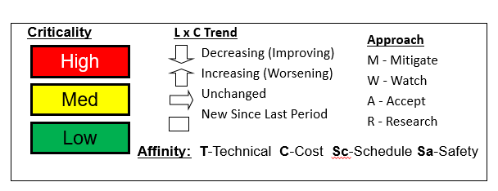
Risk Summary
L
I
K
E
L
I
H
O
O
D
 |  | 2 | 3
 |  | 1 | 4
5
Risk ID | Affinity/ Approach | Description/Status | Trend
1 | T /A | Launch failure of Nanosat Mission | Unch
2 | T/ R | Unforeseen Radiation vulnerability of Prototype Processor | New
3 | S / W | Schedule slip of Nanosat Mission | Dec
4 | S /W | Schedule slip of Prototype Processor Development | Unch
4
3
2
1
1
2
3
4
5
CONSEQUENCES

Slide 20
Project Assessment Summary
Project Name | Performance |  |  |  | Comments
 | C | S | T | P
Mid Year |  |  |  |  | Technical – Tes13 nanosat mission in development, Intel and Mentium prototypes Cost – COVID19 expense rebaseline request pending Schedule – COVID19 rebaseline request pending Programmatic – RTOW package submitted
Annual |  |  |  |  | Technical – Tes13 nanosat passed checkout and environmental testing Cost – rebaseline request accepted Schedule – rebaseline request accepted Programmatic – RadNeuro lab re-opened under COVID19 protocols

Slide 21
EPO Update
Upcoming significant events
  Tes13 nanosat launch (November or December)
  Hokulele Machine Learning system success fullfillment
  (December or January)
  San Miguel analog neuromorphic fabrication (March or April)
Conferences
  International Conference on Neuromorphic Systems July 2021
  Space Computing August 2021

Slide 22
Plans Forward and Infusion Plan
Tes13 Launch
Hokulele Machine Learning system success criteria fullfillment on Nanosat Tes13
Prototype Rad-Tolerant Neuromorphic Processors, Radiation Lab Testing
San Miguel Analog Systolic Array
Hoku-pa’a - rad-tolerant mesh network for Spiking Neural Network
Freya – FPGA neuromorphic
Baptism by Fire – PACE4 GTO nanosat with Agneya RadTolerant AI/ML system
Infusion into STMD Small Spacecraft Technology Program
Infusion of Radiation-Tolerant Technology into Neuromorphic Processor Community
Data, Analysis, and Guidebook
Direct Partnerships with both small companies and large companies
Phase 2 RadNeuro proposal for development of full-scale Rad-Tolerant Neuro Processor
Solicit and Downselect partners (+ 4 months)
Initial tapeout of processor (+ 18 months)
Radiation, throughput, and power efficiency verification and debugging (+24 months)
Fabrication of full-scale Rad-Tolerant Neuro Processor (+36 months)

Slide 23
Summary – Accomplishments 2021
Trade-space analysis: 70% complete
Mature TRL for neuromorphic processing in space from 2 to 4:
Hokulele system checkout testing has achieved TRL 3
Hokulele space launch on Tes13 nanosat will achieve TRL 4
Radiation Testing:
Test procedures defined for extended TID / Synaptic Weight radiation stability
Design and fabricate prototype rad-tolerant neuromorphic circuits and processors for space:
San Miguel tapeout November 2021, following Santa Barbara and Santa Cruz processors
Engage partner for Phase 2 design and fabrication of full rad-tolerant neuromorphic processor: 8 SBIR companies engaged, 2 large tech companies interested, OGA discussions

Slide 24
Technical Capability End State Phase 1
Maturation of TRL for neuromorphic processing in space from 2 to > 4
Individual KPPs achieved at component level on one or more prototypes (not integrated)
  Teraops per watt
  Synaptic circuit radiation tolerance
  Rapid recovery after upset
  Adaptive learning demonstrated
Prototype Rad-Tolerant Processors verified in radiation labs and validated in
GTO ‘Baptism by Fire’. Prototypes potentially useful in selected missions as
force-multiplier co-processors and sentient small spacecraft.
Technical capability for leveraging terrestrial neuromorphic industry to space missions through radiation tolerant devices, circuits, and architectures.
Summarize the TechMat Capability End State for the Scope of the Project
  Phase 1

Slide 25
BACKUP

Slide 26
Success Criteria for Hokulele AI/ML System on Tes13
Pre-flight Minimum Success: successful end-to-end EDU tests with ground Irridium transfers and packets received, hangs are minimal and recovered automatically.
+ Exploration Institute NSFM monitored checkout and environmental testing, identified 6 classes of nominal operation.
Already achieved.
Flight Minimum Success: Verify the UP Loihi was turned on, one Loihi application succeeds and packet is received on ground via Irridium.
Nominal Success: Verify the UP/Loihi successfully executes at least 5 Loihi applications in Nominal mode and downlinks them to ground via Irridium.
Comprehensive success: Nominal executions routinely succeed, and SIMULATED learning in-situ is demonstrated with pre-recorded data.
Interstellar success: in-situ learning demonstrated with data from flight.
Additional success: functionality of S-band/Lunar Radio

Slide 27
Neuromorphic Trade Space
Precision Entry-Descent-Landing
(Super-Resolution)
Type of Neuromorphic
Throughput
And Sizing
TOPS/Watt – efficiency
Onchip synaptic storage
Fast Rover Traverse
In-Situ Learning
Spiking NN Inference
Rate-Based (ANN) Inference
Float
Integer
Analog
Quantization

Slide 28
Quantization of Arithmetic
4.5 x 10^8 ATP
per spike
appx. 0.045pJ per
synapse
Energy for
Multiply (synapse)
4pJ @ 14nm
Finfet
0.5pJ
Estimated
0.2 pJ@ 14nm
Finfet
Appx. 0.05pJ
2-4 bit
Biological
Synapse
Rolls et al
1 bit
NN
64bit FP
High Precision
Simulation
32bit FP
Digital Signal
Processing
BFloat16
Deep Learning
Int8
Edge Inference
4-6 bit
Analog
Resolve Poles
Near Unit Circle
AI chip doubles as
DSP chip
Inference +
Deep Learning
Google cloud
Servers TPU v2, v3
Google Edge TPU
Tesla FSD
Simulate Chaotic Systems
AI Chip doubles as
Supercomputer for CFD
and other PDE
Sufficient for
Typical Feed
Forward ANN
Biological
Neural Circuitry
is Robust despite
Noisy Neurons and
Synapses
Radiation
Tolerance
CMOS RHBD and TMR
Floating Gate TMR
ReRAM
SRAM -> STT-RAM

Slide 29
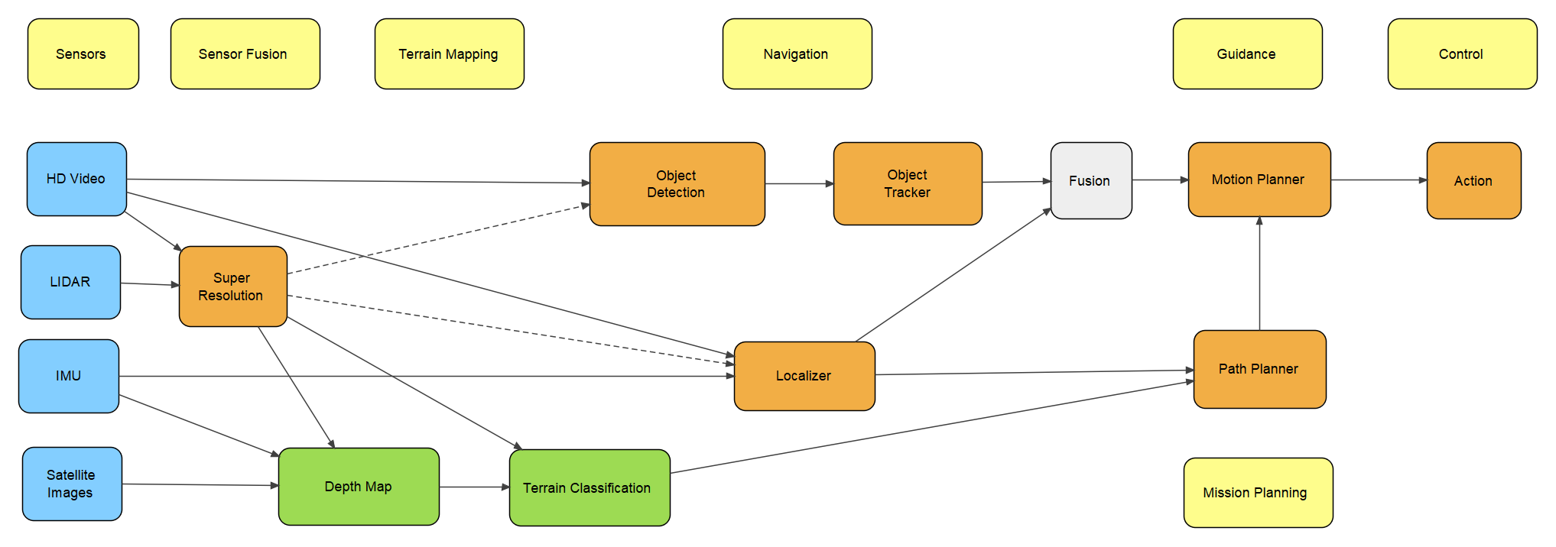
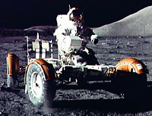
Fast-Traverse Autonomous Rover SOS
NN Architecture Extrapolated from Autonomous Car
Apollo 17
Yellow: Category
Blue: Input Data Source
Green: Low frequency process
Orange: High frequency process
20 kph

