Slide 1
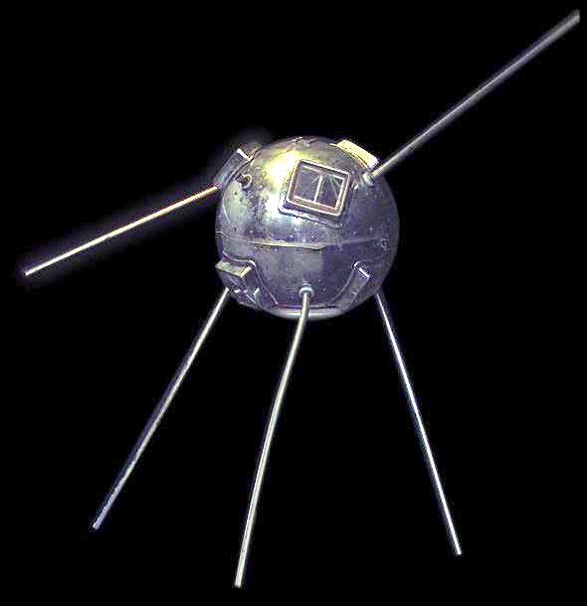
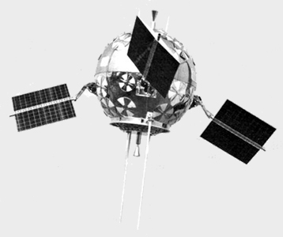
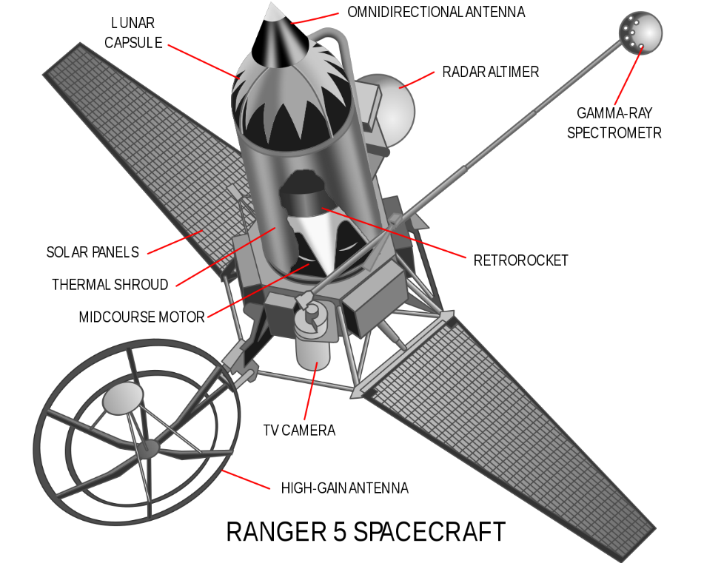
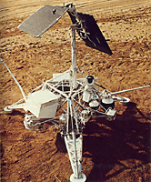
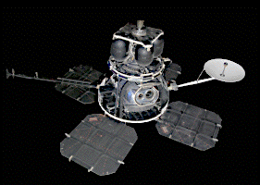
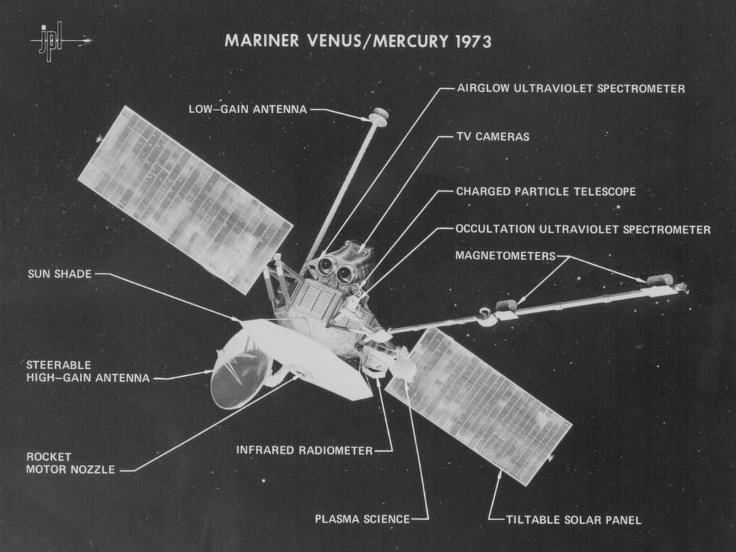
FIGURE 1. Solar Array Progression (representative)
(a) Vanguard I - 1958
(Body Mount)
(b) Pioneer P-3 - 1959
(Paddles)
(c) Ranger I - 1961
Dual Wing
(f) Surveyor 3 – 1966
Single panel (High Gain Antenna also mounted on mast)
(g) SERT II - 1970
(e) Mariner 10
1973 (Venus/Mercury Flyby)
Credit: NASA
(d) Lunar Orbiter 1
1966 (Lunar orbit)

Slide 2
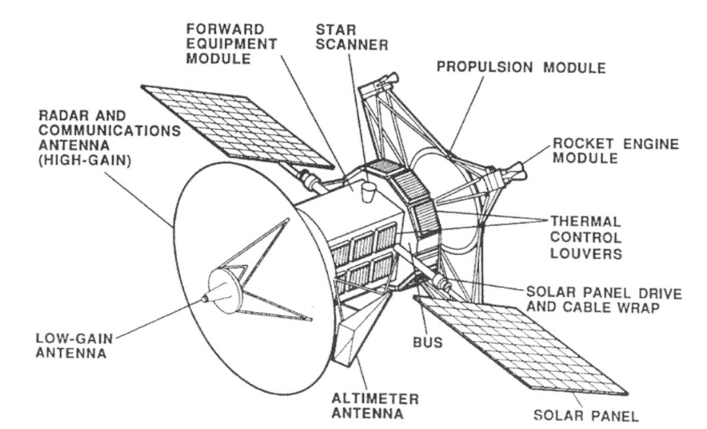
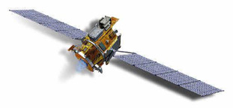
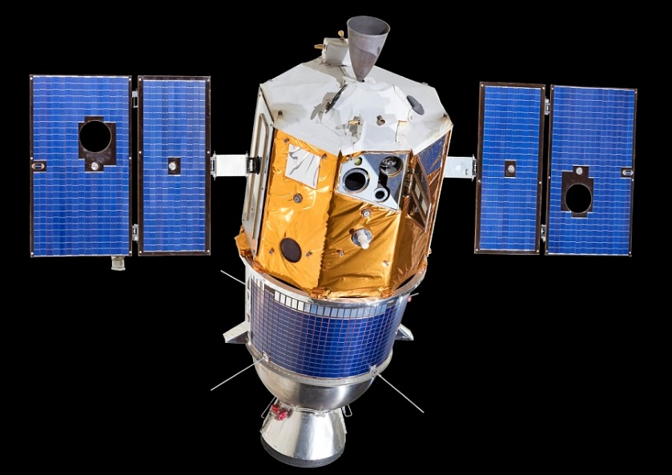
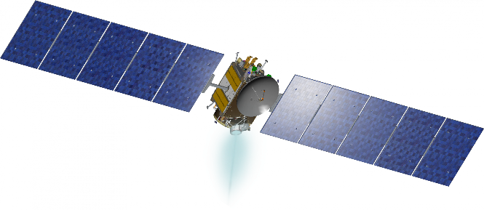
Figure 2– Classic Gimbaled Wings
Deep Space 1
1998 (Technology Demo)
Credit: NASA
Magellan
1989 (Venus orbit)
Clementine with Interstage
1994 (Lunar orbit)
Dawn
2007 (Main asteroid belt)
Credit: NASA

Slide 3
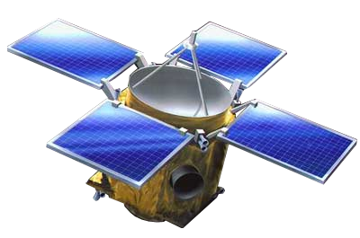
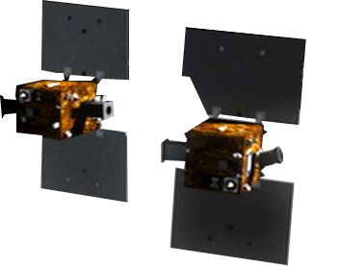
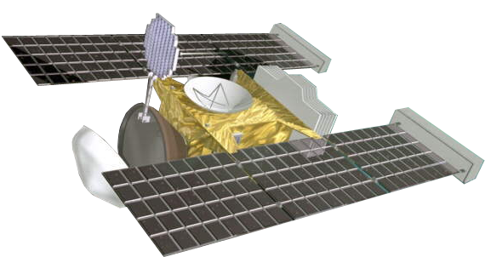
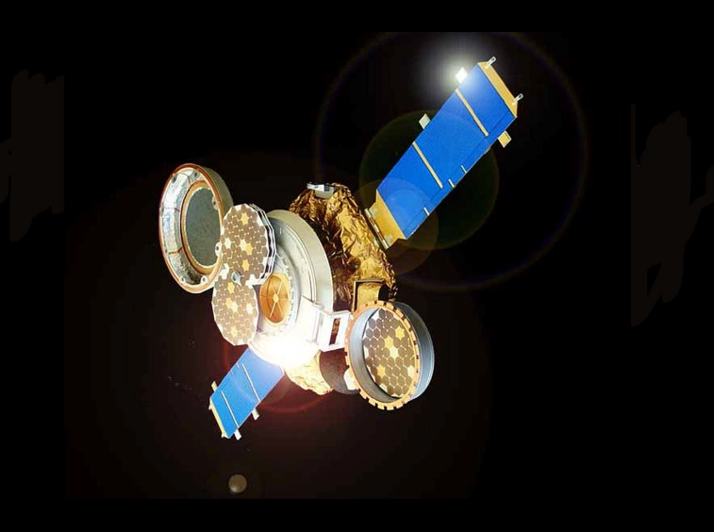
Figure 3. Fixed Wings or Paddles
(a) NEAR Shoemaker
1996 (433 Eros lander)
(b) Grail
2001 (Lunar orbit)
Credit:NASA
(c) Stardust NeXT
1999 (Wild 2 flyby)
(d) Genesis
2001 (Sun-Earth Lagrange Point #1)

Slide 4
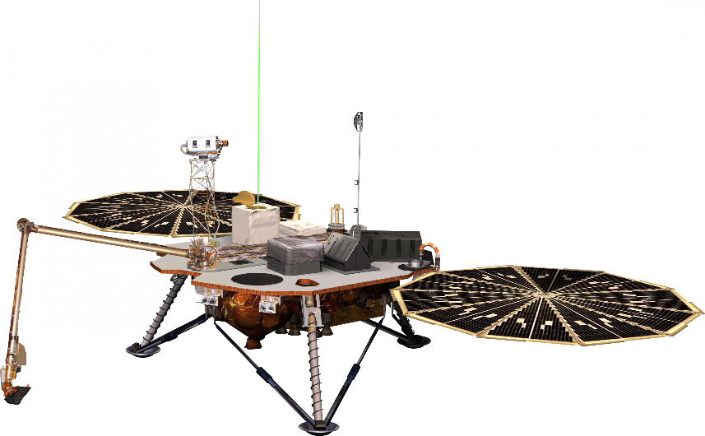
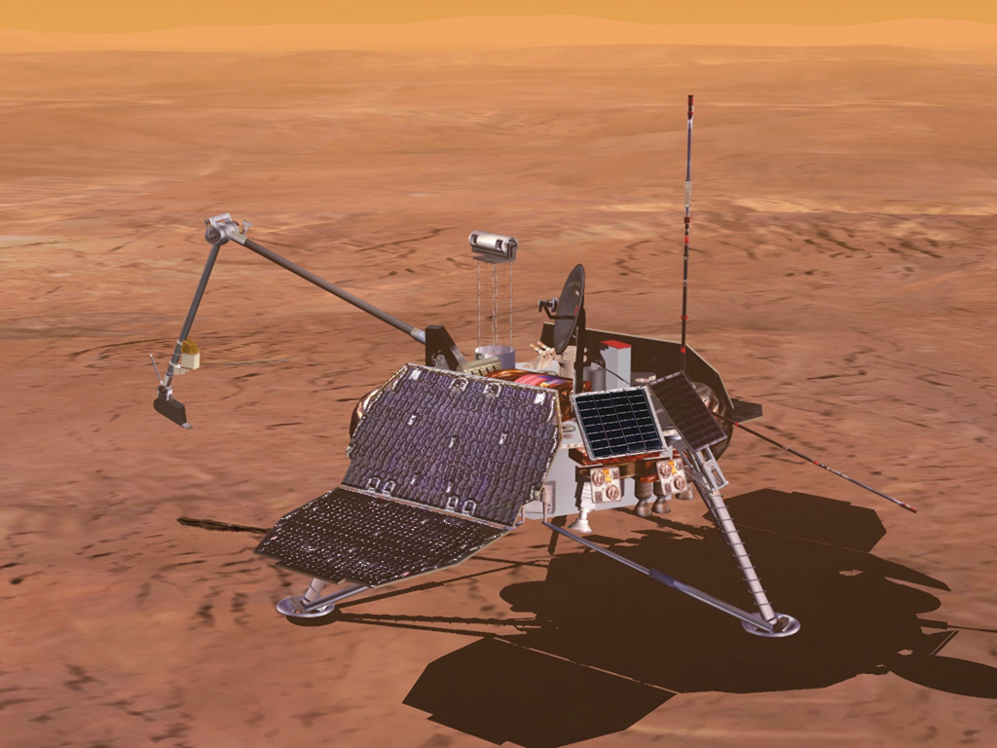
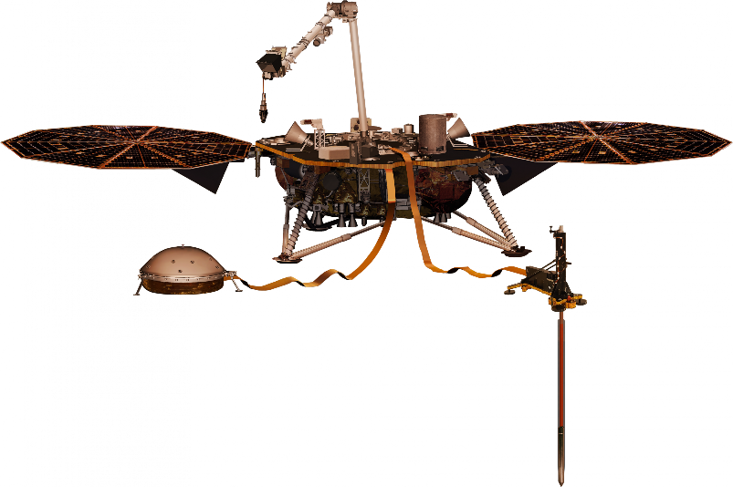
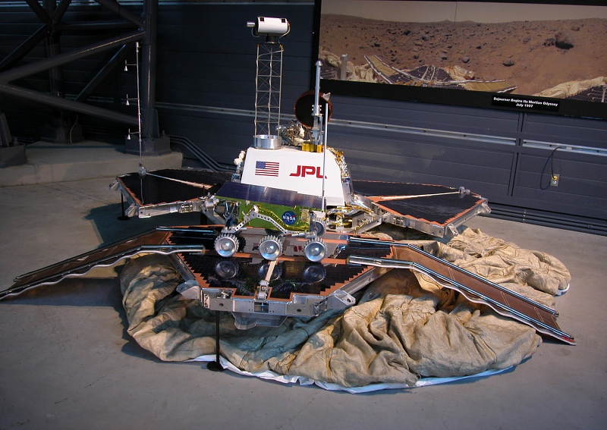
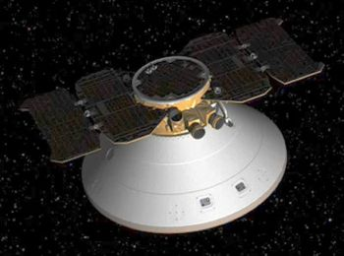
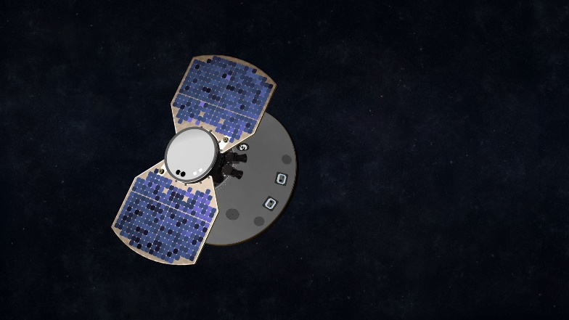
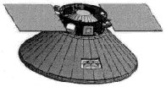
Figure 4. Fixed Wings or Paddles: Cruisers and Landers
(a) Mars Pathfinder Lander
1996
(b) Mars Polar Lander
1999 (unsuccessful)
(c) Phoenix
2007
(d) Insight
2018
(e) Mars Polar Lander
1999 (unsuccessful)
Origin unknown
(f) Phoenix
2007 (Mars)
(g) Insight
2018 (Mars)

Slide 5
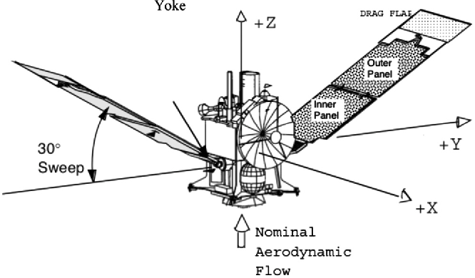
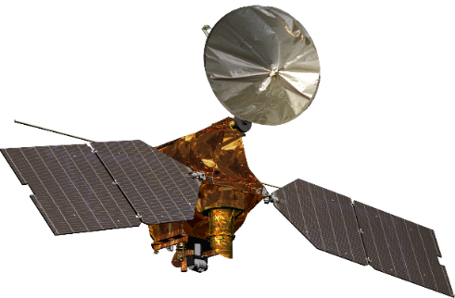
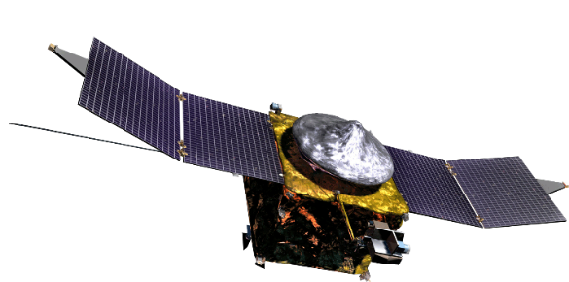
Figure 5a – Aerobraking
(a) Mars Global Surveyor
1996 (Mars orbit)
(b) Mars Reconnaissance Orbiter
2007 (Mars orbit)
Credit: NASA
(c) Maven
2013 (Mars orbit)
Credit: NASA

Slide 6
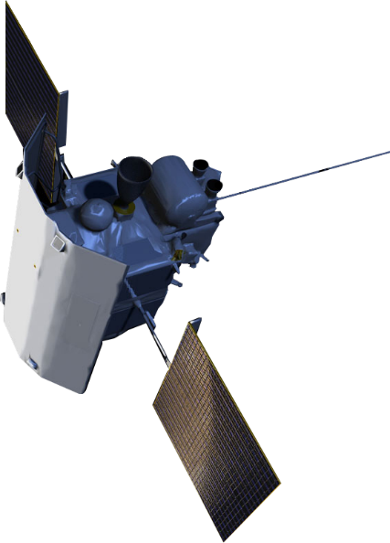
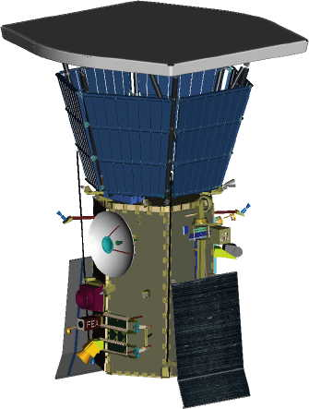
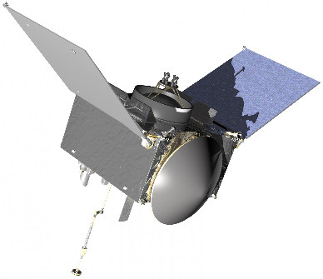
Figure 5b – Tilt-Back
OSIRIS-REx
2016 (Bennu rendezvous)
Credit:NASA
Messenger
2004 (Mercury orbit)
Parker Solar Probe
2021

Slide 7
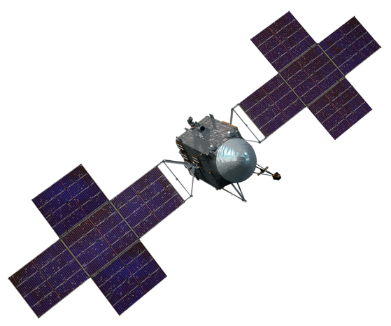
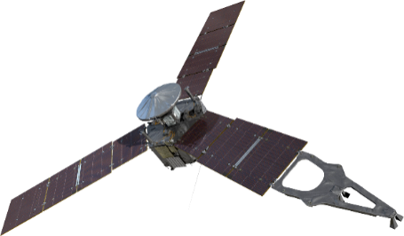
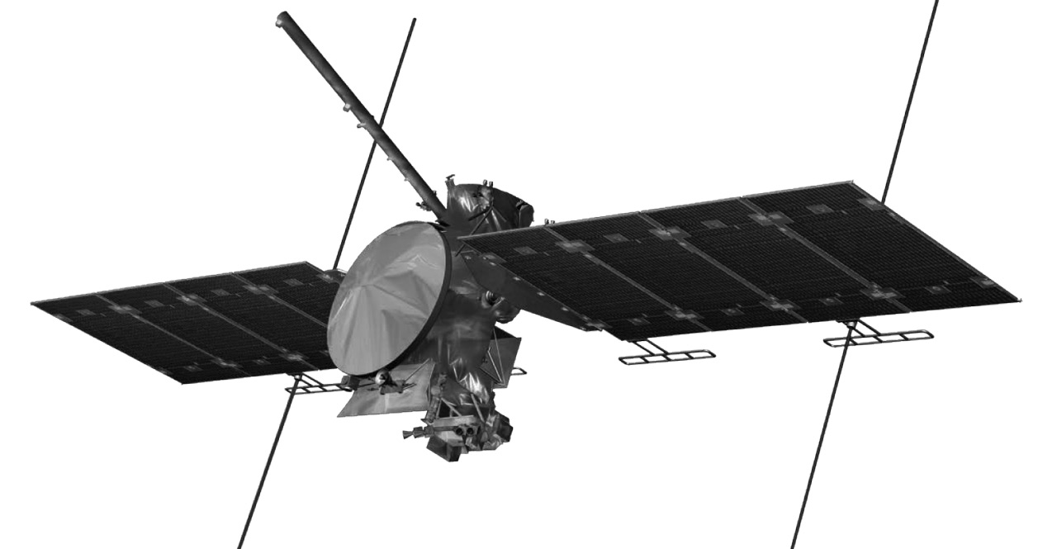
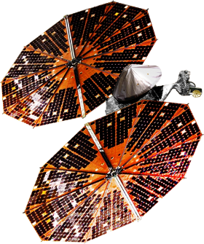
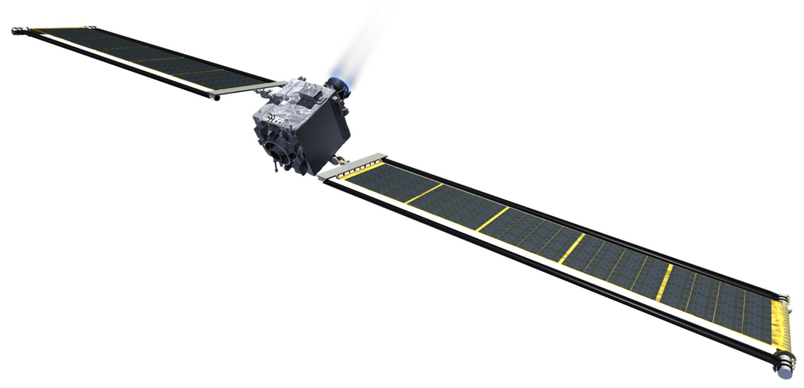
Figure 5c – Other Unique
Psyche
2022 (Psyche flyby)
Credit: NASA/JPL-Caltech/Arizona State University/Space Systems Loral/Peter Rubin
Public Domain, https://commons.wikimedia.org/w/index.php?curid=59554600
Juno
2001 (Jupiter orbit)
Credit: NASA
Europa Clipper
2025 (Europa orbiter)
Credit:NASA
Lucy
2021 (Trojan tour)
Credit: NASA
DART
2022 (Didymos impactor)
Credit:
https://www.nasa.gov/planetarydefense/dart

Slide 8
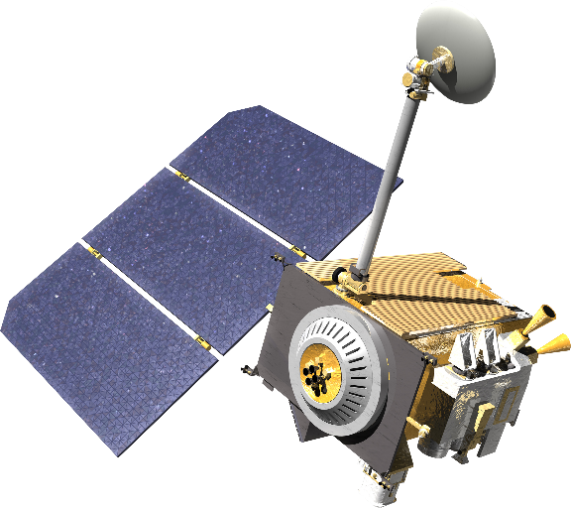
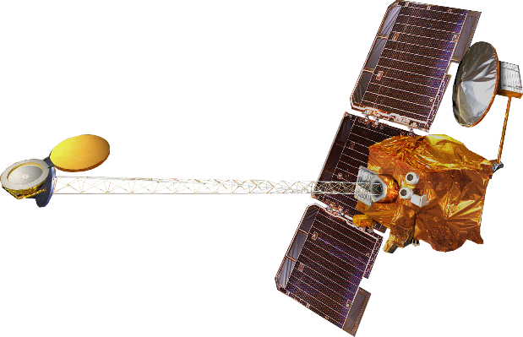
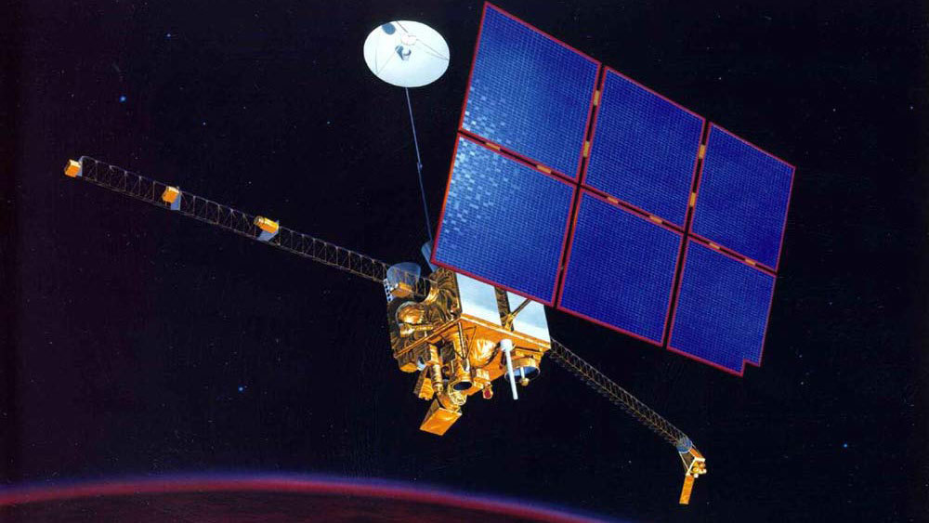
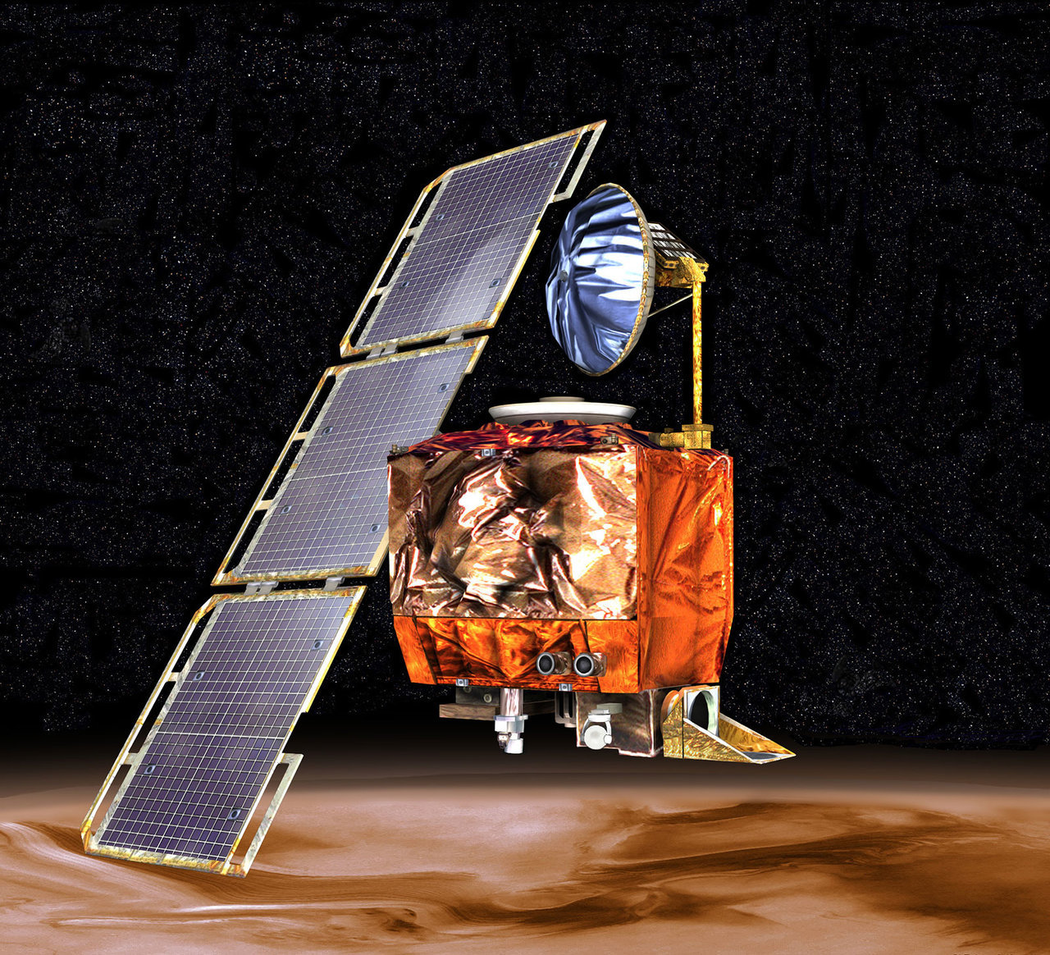
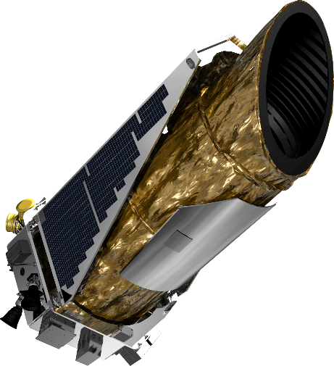
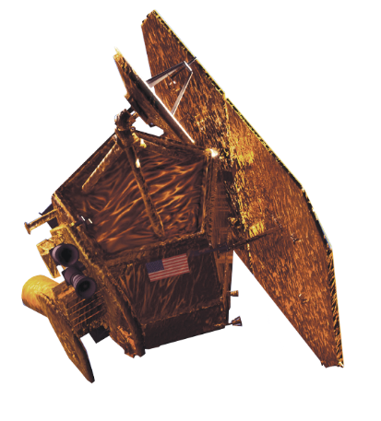
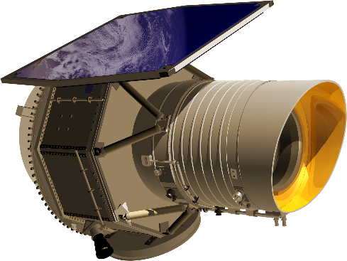
Figure 6– Single Panels
(d) Mars Odyssey
2001 (Mars orbit)
Credit: NASA
(b) Lunar Reconnaissance Orbiter
2009 (Lunar orbit)
(c) Mars Climate Orbiter
1998 (Mars orbit, unsuccessful)
(a) Mars Observer
1992 (Mars orbit, unsuccessful)
(f) Kepler
2009
Credit: NASA
(e) EPOXI Deep Impact
2005
Credit:NASA
(g) NEOWISE
2009

Slide 9
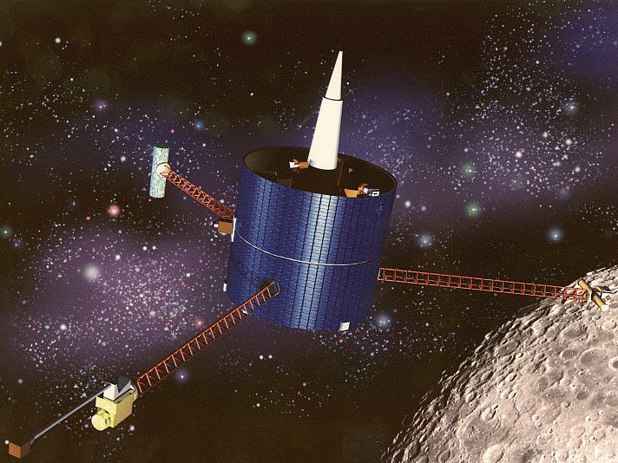
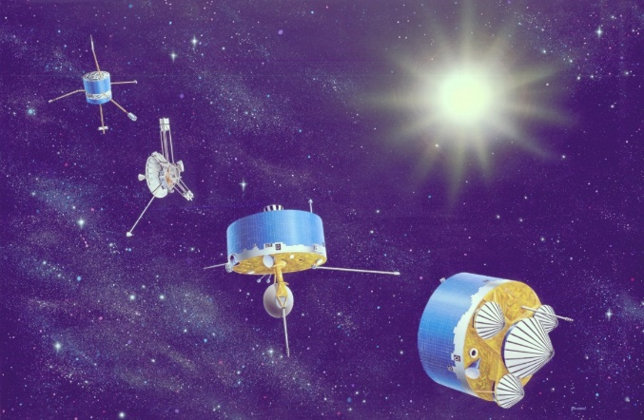
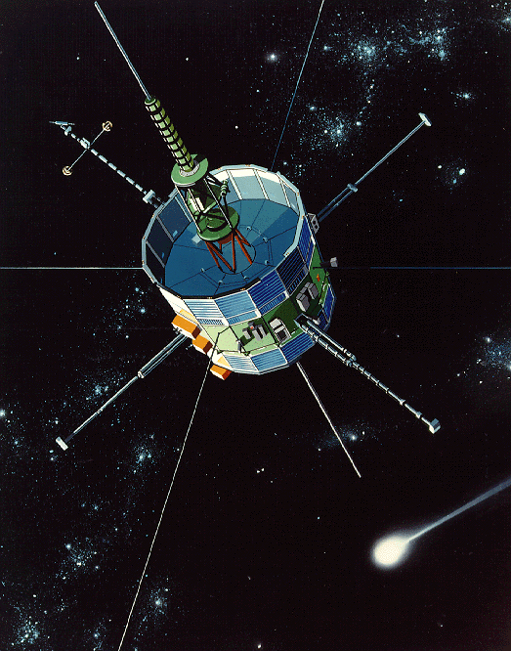
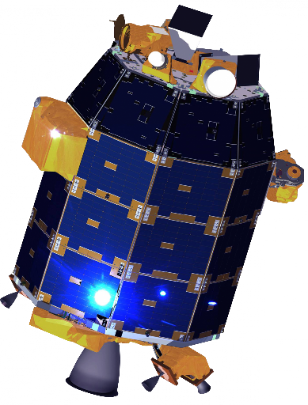
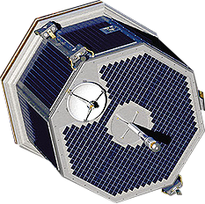
Figure 7. Body Mounted Missions
(a) Pioneer 12 and 13, rightmost images.
1978 (Venus orbit and probes)
Pioneer 6-9 and the nuclear powered Pioneer 10-11 are shown on the right.
Credit: NASA
(b) ICEE-3/ICE
1978
(c) Lunar Prospector
1998 (Lunar orbit)
(d) Contour
2002 (NEO)
Credit:NASA
(e) LADEE
2009 (Lunar impact)

Slide 10
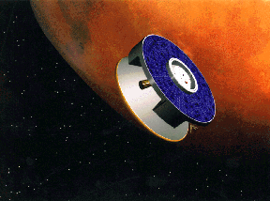
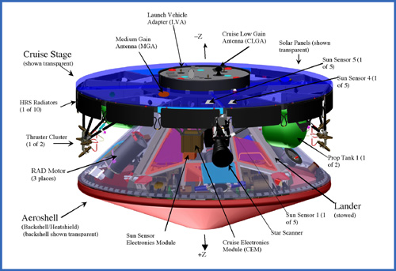
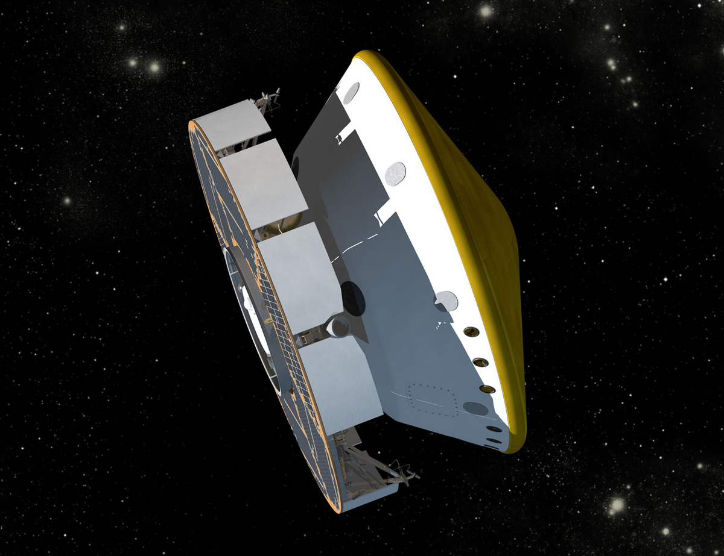
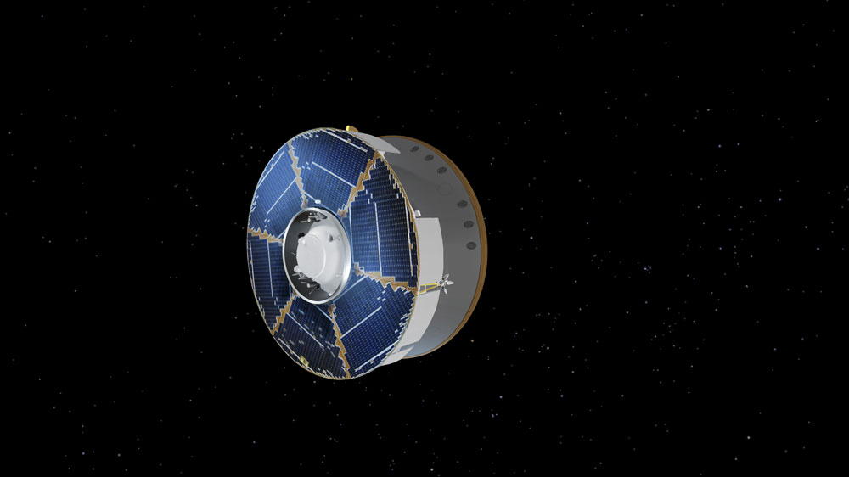
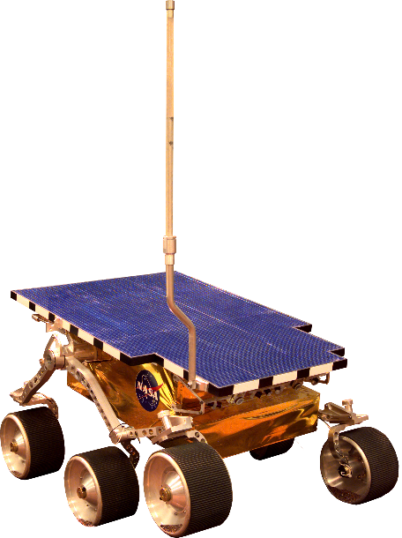
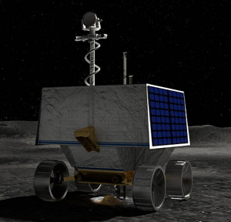


Figure 8 Body Mounted Missions – Cruisers and Rovers
(a) Mars Pathfinder
1996
(b) Mars Exploration Rover
2003
(c) Mars Science Laboratory
2011
(d) Mars 2020
2020
(e) Mars Pathfinder “Sojourner”
1996
(f) Mars Exploration Rovers “Spirit” and “Opportunity”
2003
(g) Ingenuity
2020
(h) VIPER
2023

Slide 11








Figure 9 – Rideshares
(a) GENE-SAT
2006 (LEO)
(b) Pharma-SAT
2009 (LEO)
(c) O/OREOS
2010 (LEO)
(d) Q-PACE
2021 (LEO)
(f) LCROSS
2009 (Lunar impactor)
(h) LunaH-Map
2021 (Lunar orbit)
(e) Apollo 15
(g) MarCO
2018 (Mars flyby)

