Slide 1
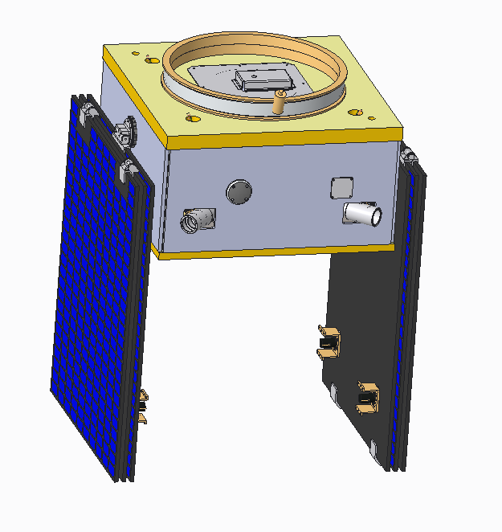
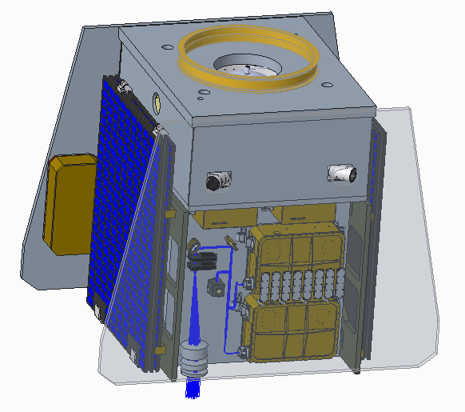
Millennium Provided CAD vs. Current ABLE CAD
TOMCAT_SC_BUS_STOWED_7-13-2020.STP
Provided by Millennium
20008-7003-001_ASM_20201127.ASM
Current as of 9/21/21
Millennium and ABLE Competition Sensitive

Slide 2
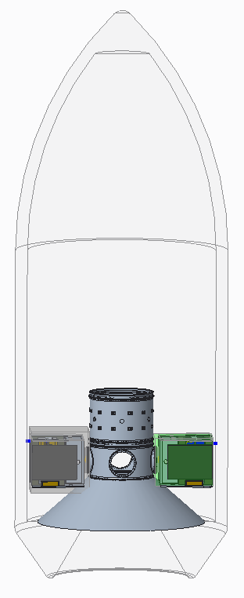
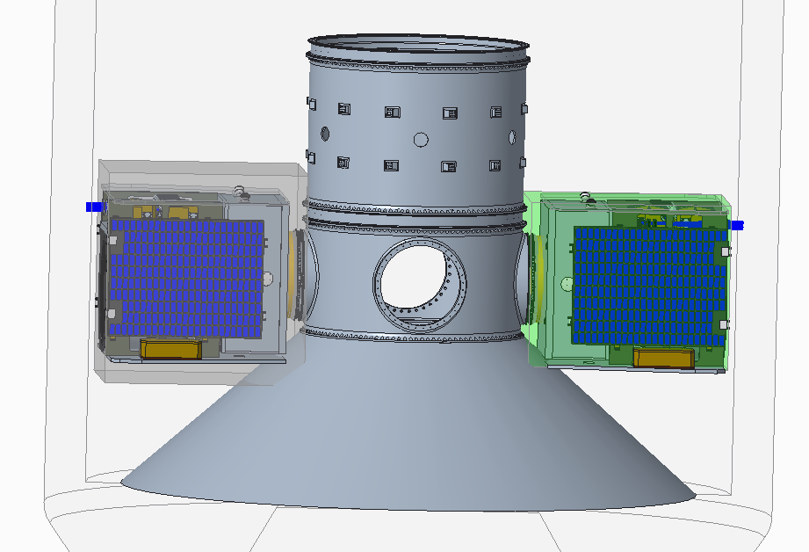
Current Payload Volume Checks
Expanded height Volume
(standard spacer ring)
Standard ESPA Grande Volume
Falcon 9
Fairing
Millennium and ABLE Competition Sensitive

Slide 3
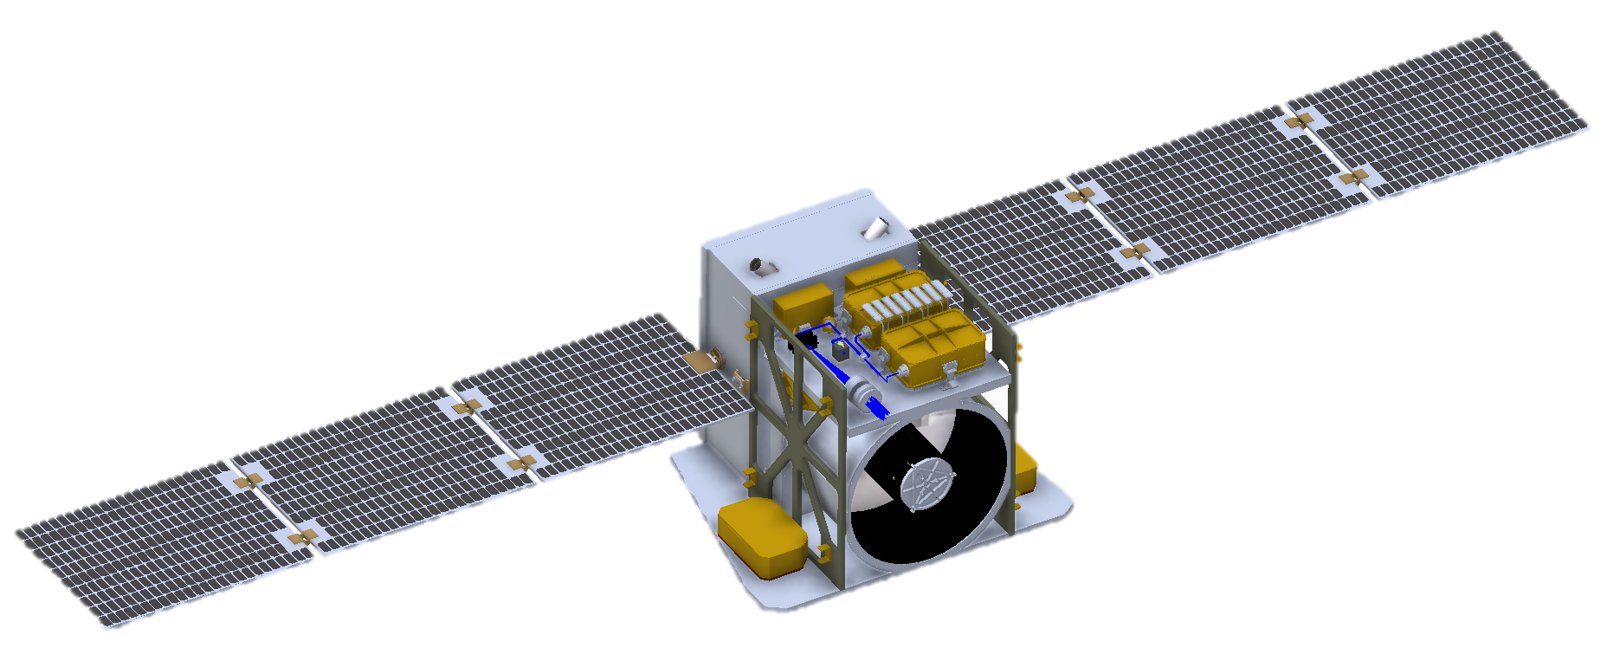
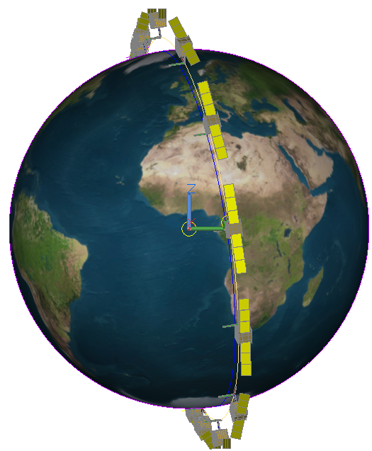
ABLE Components
Beta = 12°
Viewed from Sun
Pulsed Lasers
Seed Lasers
Bus
0.8 m telescope
Warm side radiator
Cold side (laser) radiator
(not shown)
Detector pressure vessels
Millennium and ABLE Competition Sensitive

Slide 4
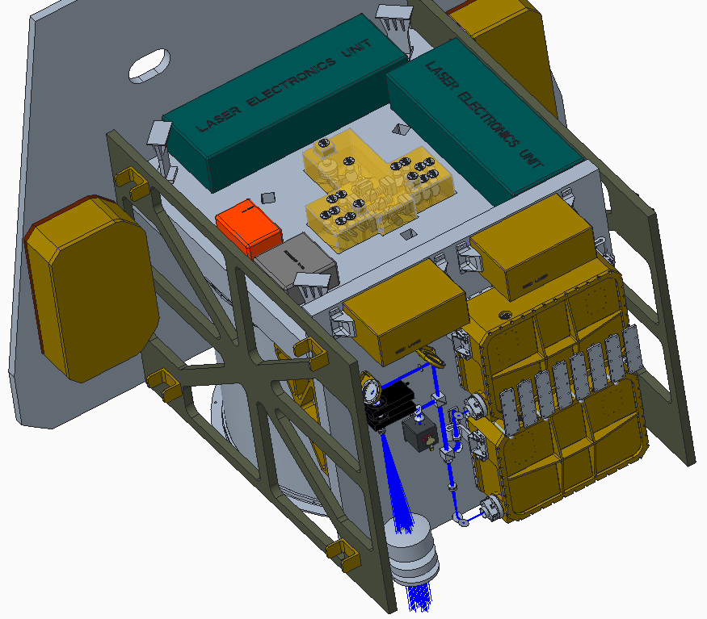
ABLE Components
Spacecraft Bus Mount Locations
Laser Electronics Unit
Optic Bench Added
Receiver
Optic Bench Added
1645 nm Detector
Data Acquisition
Structure Added
Millennium and ABLE Competition Sensitive

Slide 5
Questions for Millennium
Is the current instrument configuration and physical envelop compatible with a Millennium bus?
How much radiator area does the spacecraft require? One full side of the spacecraft?
For an inclined orbit the cold side radiator needs to be on the same side as the solar array. Would it be feasible to make the support structure also serve as radiators?
The instrument prime power consumption will likely hover around 400-450W. Would the spacecraft have sufficient room for additional batteries and additional solar arrays?
Practical limitations for mass? ABLE will likely push the 200 kg ‘limit’ we previously discussed. Looking at the EELV Secondary Payload Adapter it seems like the mass for each port could be as high as 600-700 kg (including the bus). Is this feasible?
Does Millennium have insight into how using the extended height ESPA volume effects flight opportunities?
Millennium and ABLE Competition Sensitive

Slide 6
Backup

Slide 7
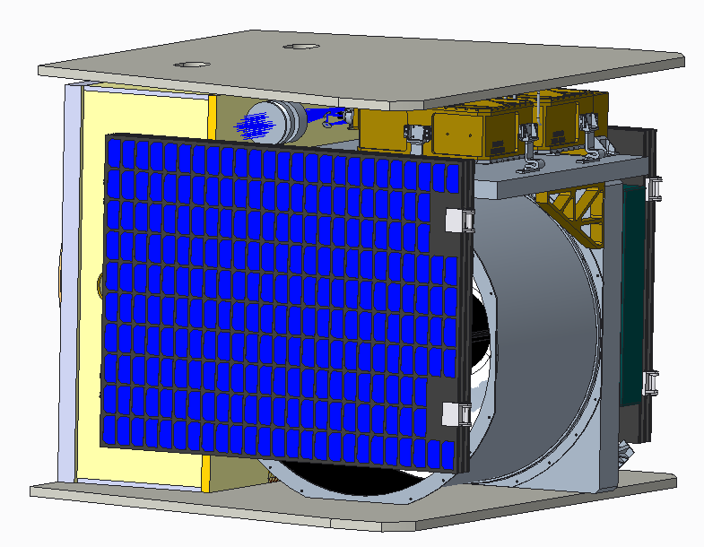
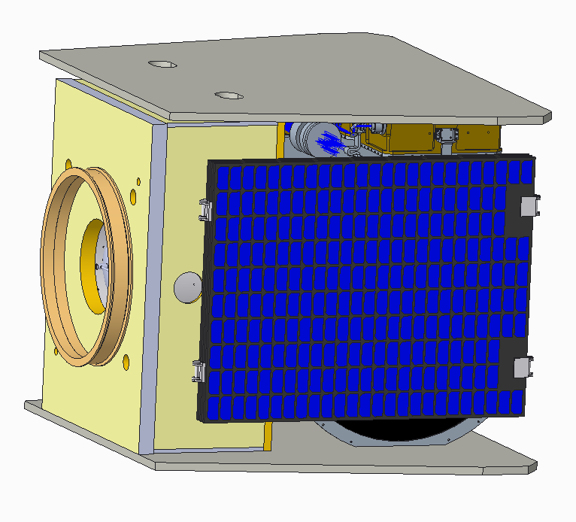
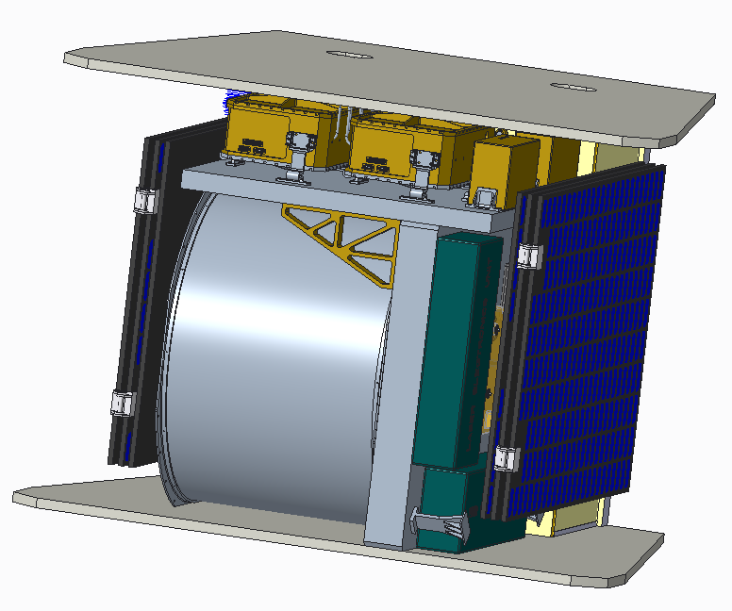
Alternate Configuration
Millennium and ABLE Competition Sensitive

Slide 8
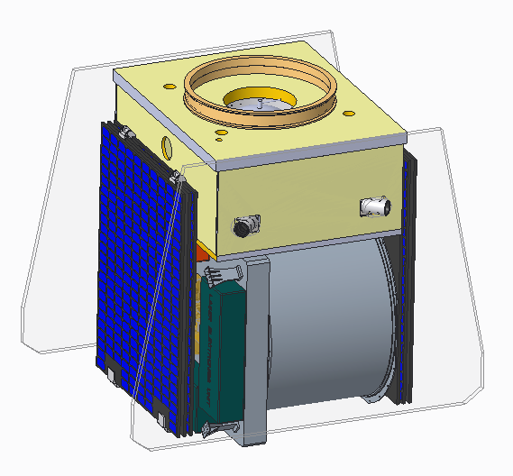
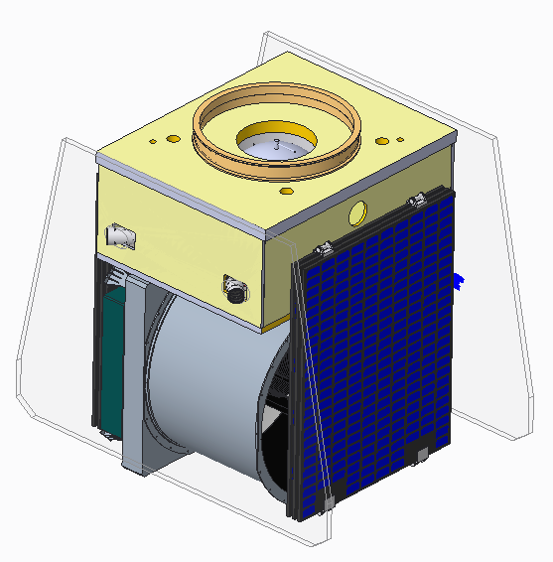
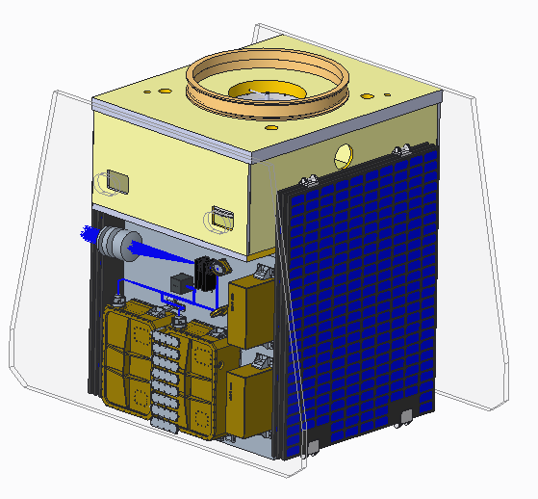
Alternate Configuration
Millennium and ABLE Competition Sensitive

Slide 9
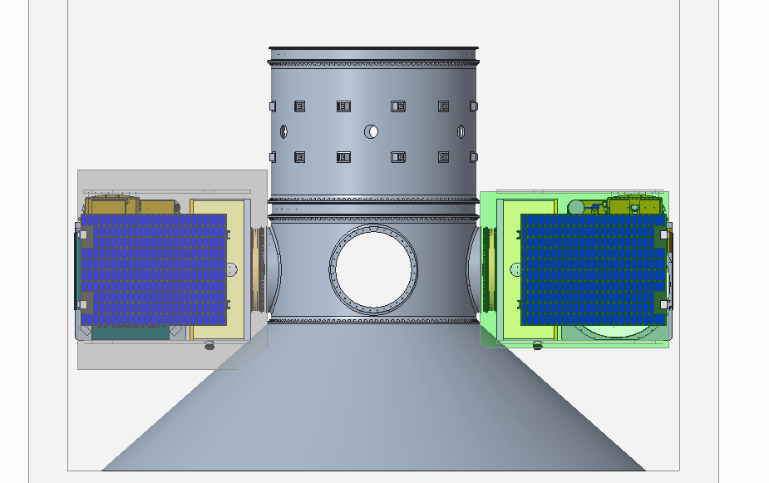
Alternate Configuration
Slightly out of radial volume, with this telescope diameter probably will not work
Millennium and ABLE Competition Sensitive

Slide 10
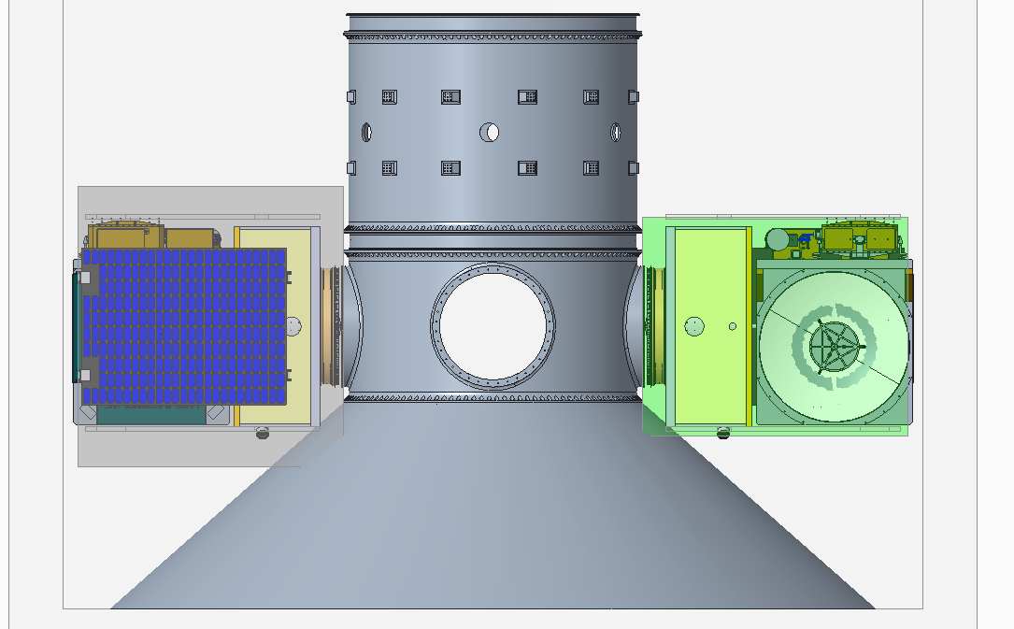
Alternate Configuration
Solar panel hidden
Millennium and ABLE Competition Sensitive

