Slide 1


Glenn Extreme Environment Rig
(GEER)
National Aeronautics and Space Administration
Leah Nakley
NASA Glenn Research Center
SiC Materials & Devices Workshop
September 30, 2021

Slide 2
Agenda
Overview
Technical Specifications
Venus Atmosphere
History & Accomplishments
Prospective Users

Slide 3
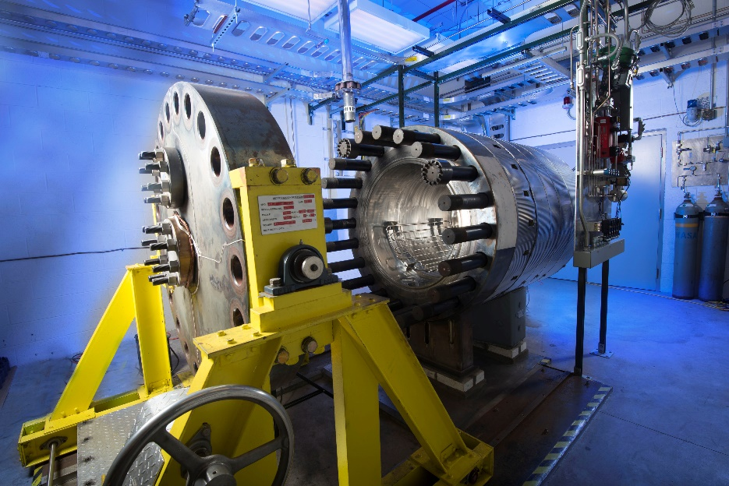
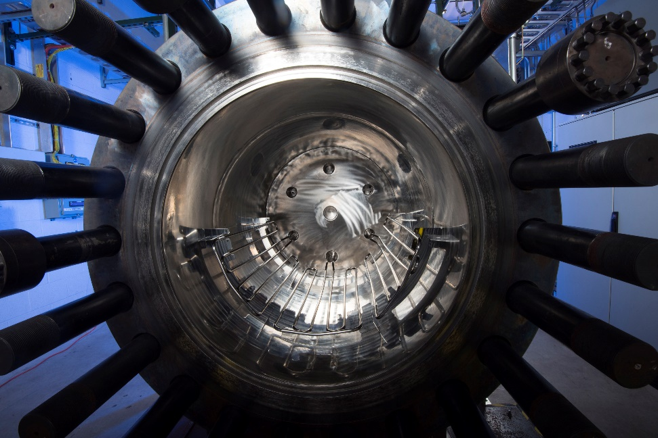
GEER Overview
Test facility for simulating some of the most extreme environments in our solar system
  Temperature, pressure, and chemistry
GEER is known for its size, long duration testing, and Venus surface simulations
Supports science and technology users
  Passive samples and components
  Active sensors, integrated systems
  Atmospheric chemistry and physics
Built for Venus, designed for more

Slide 4
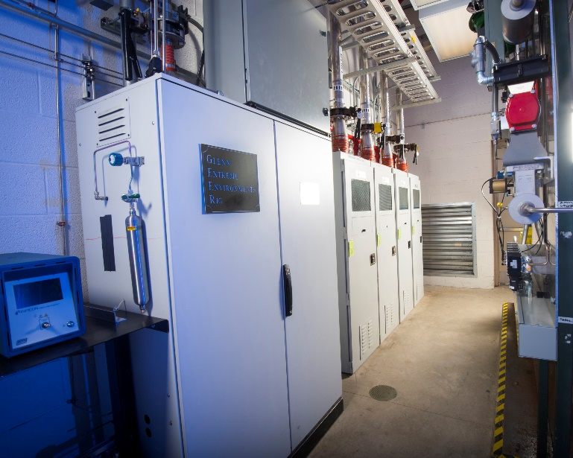
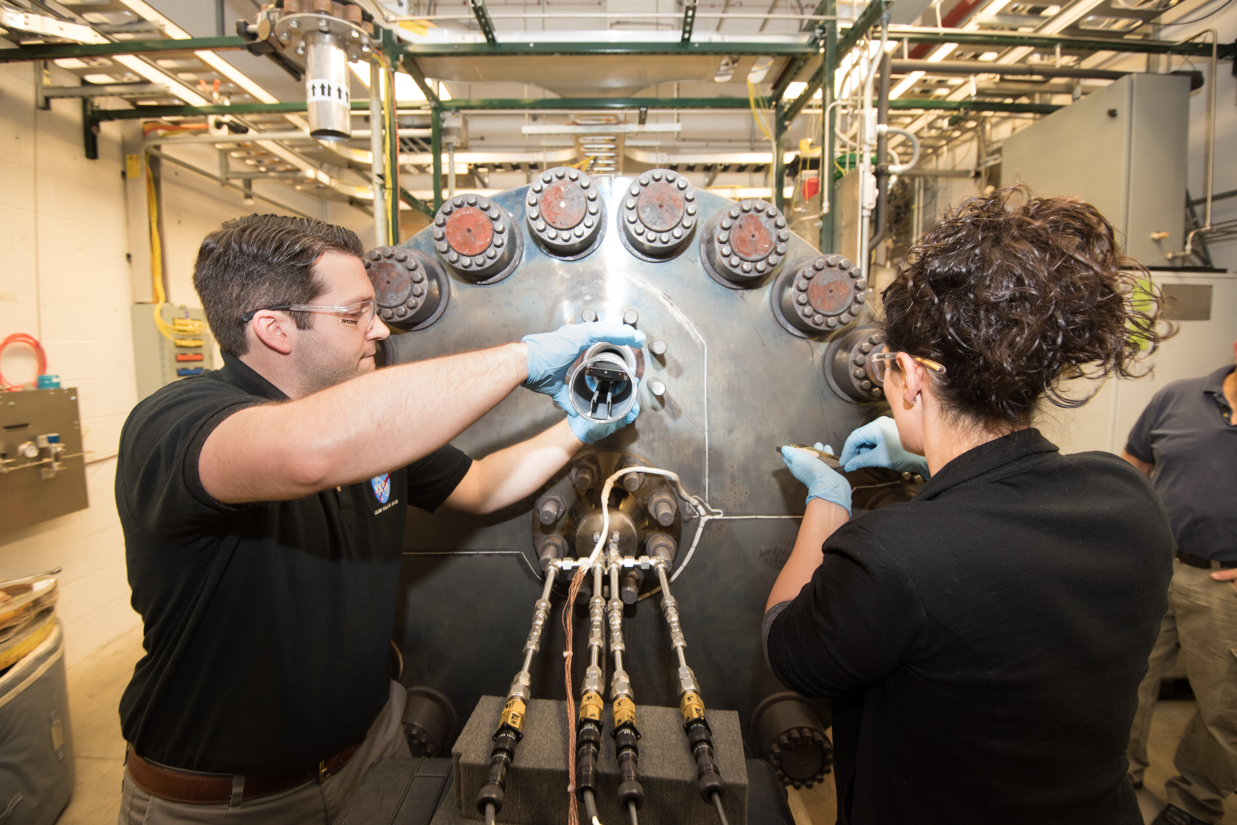
Technical Specifications
Chamber
304SS pressure vessel
36” W x 48” Long
3” and 4” access ports on both ends
Adjustable support holds up to 200 lbs
Operating temperature: Ambient – 500 C
Operating pressure: Rough vacuum – 96 bar
Gas Mixing System
Bulk CO2 and N2
Up to 8 trace gases
Custom gas blends down to ppb level
High pressure gas and liquid injection
Analytics
Gas Chromatograph - real time analysis
Mass Spectrometer onsite

Slide 5
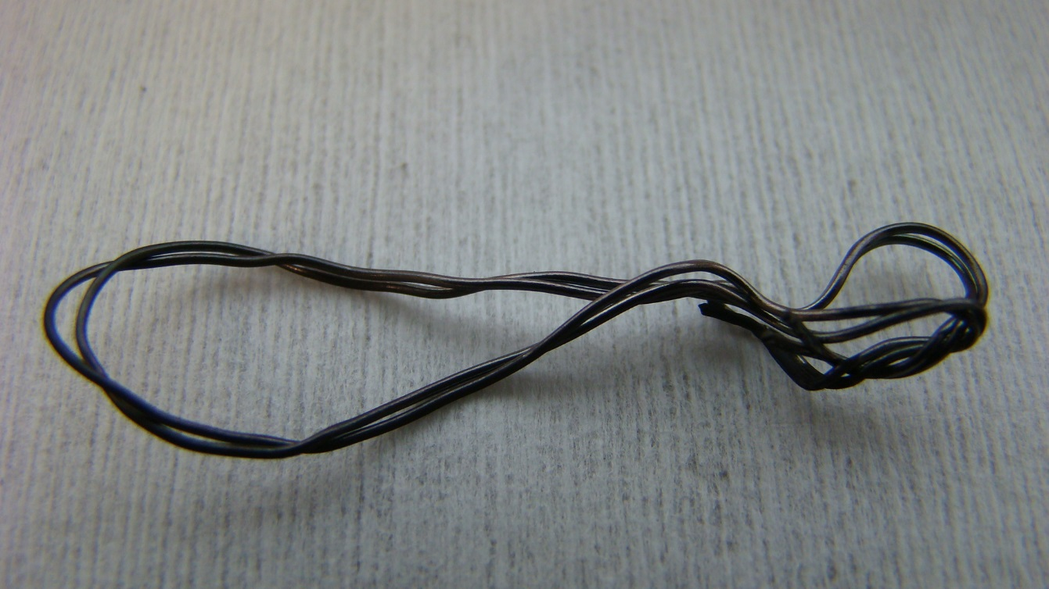
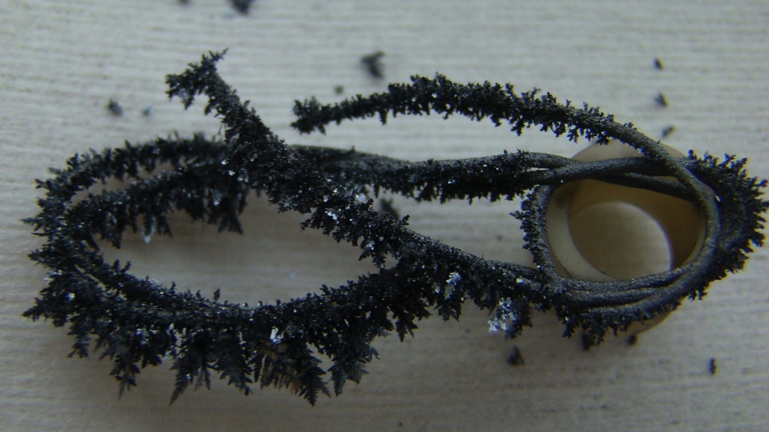
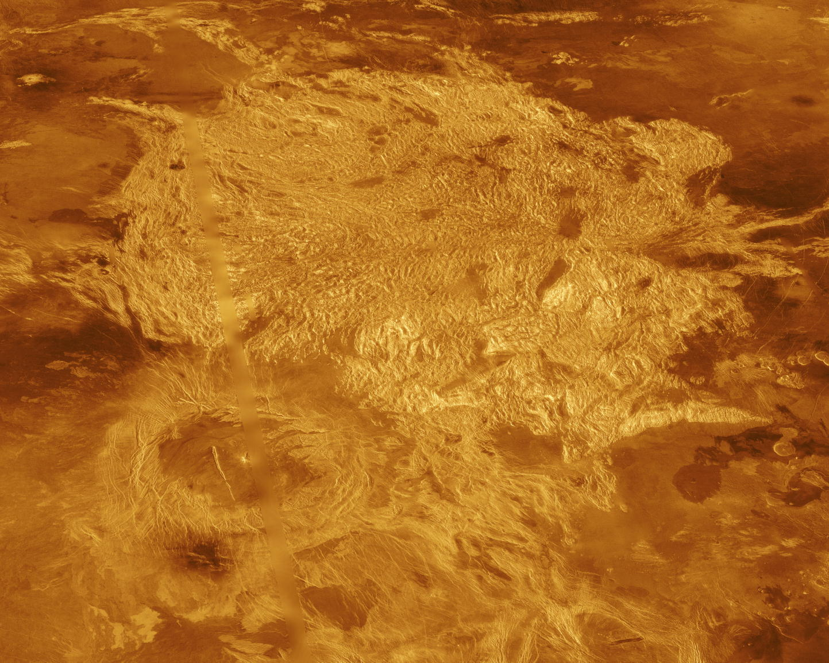
Venus Atmosphere
Typical Venus Surface Simulation in GEER
21 Day Exposure in GEER Before & After
Temperature | 465 C
Pressure | 93 bar
CO₂ | 96.5%
N₂ | 3.4%
SO₂ | 180 ppm
OCS | 51 ppm
H₂O | 30 ppm
CO | 12 ppm
H₂S | 2 ppm
HCl | 0.5 ppm
HF | 2.5 ppb

Slide 6
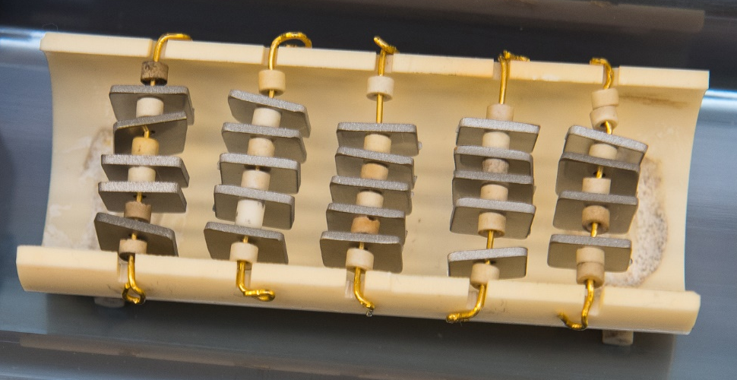
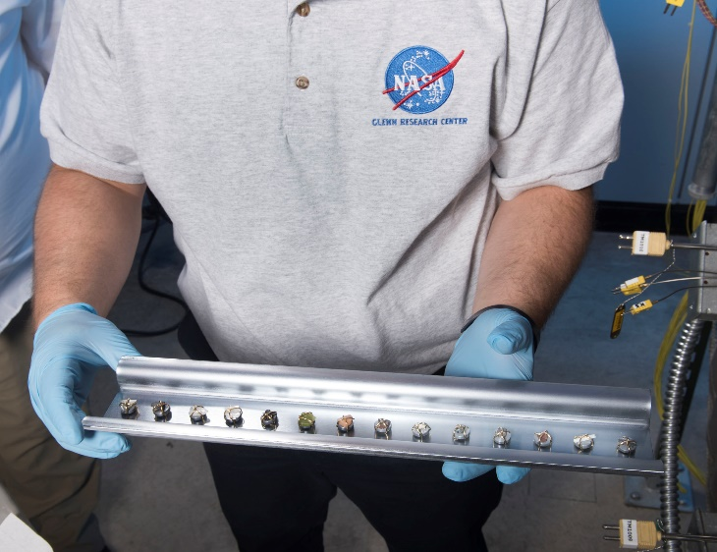
History & Accomplishments
Operating since 2013
Available to greater science community since 2016
Venus weathering
  Various minerals
Materials study
  Corrosion resistance of various materials exposed to Venus surface conditions
Deep Venus Atmosphere Experiment
  Physics of the atmosphere near the surface

Slide 7
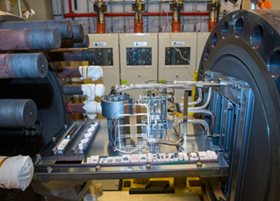
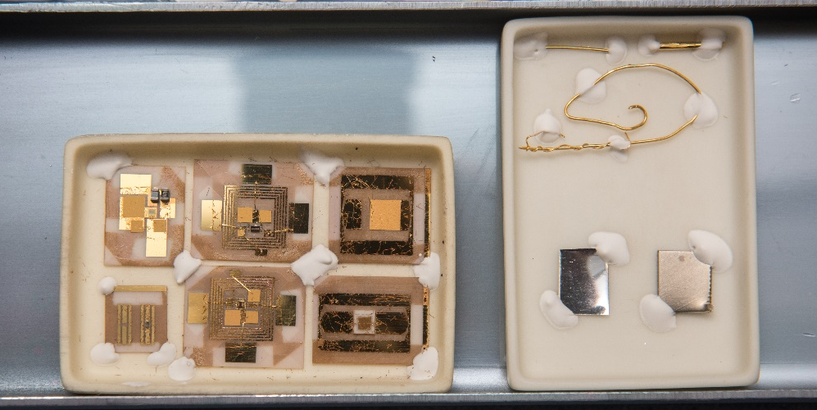
History & Accomplishments
Silicon carbide electronics
  Demonstrated 60 days at Venus surface in 2016
Long-Lived In-Situ Solar System Explorer (LLISSE)
  Component and integrated testing
In-situ chemical sensors
  SBIR develop chemical sensors for Venus
Pressure, wind, temperature sensors

Slide 8
Prospective Users
Available to government, industry, academia
Proposed use through NASA solicitations such as ROSES NSPIRES
Collaboration is encouraged
Custom is standard
Contacts
Website https://www1.grc.nasa.gov/space/geer/
Leah Nakley leah.m.nakley@nasa.gov

Slide 9
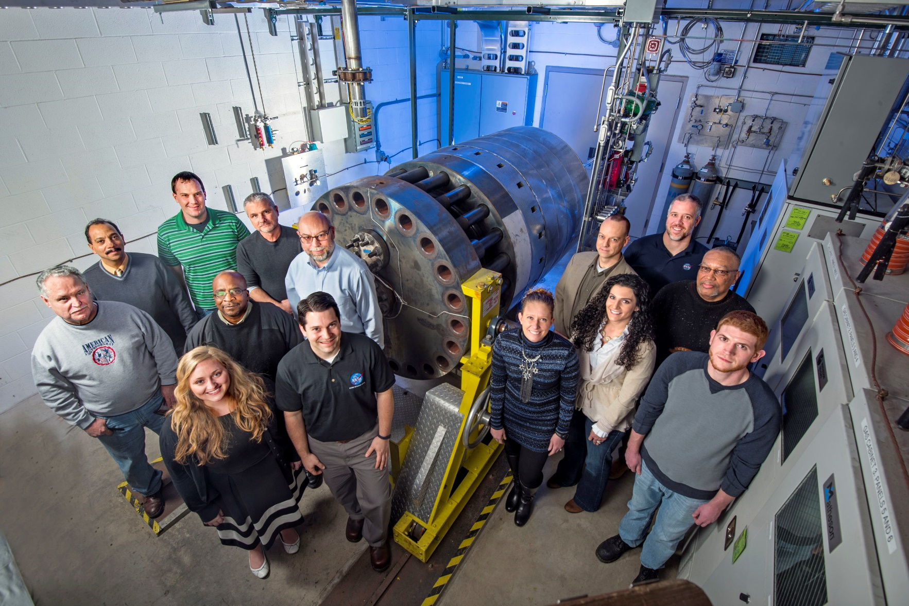
Thank You!

Slide 10
Questions

