Slide 1
HSRL-2 Status Update
September 28, 2021
NASA LaRC HSRL-2 Team - Rich Ferrare, Chris Hostetler, John Hair, Sharon Burton, Marta Fenn, Dave Harper, Tony Cook, Amy Jo Scarino, Marian Clayton, Eduard Chemyakin, Joe Lee
Contributions from:
Sue van den Heever, Joe Schlosser, Snorre Stamnes, Bastiaan van Diedenhoven

Slide 2
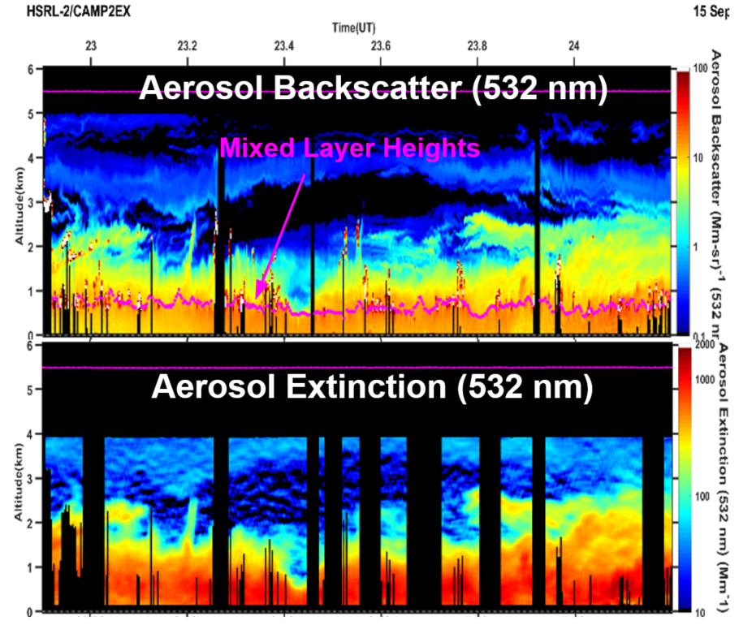
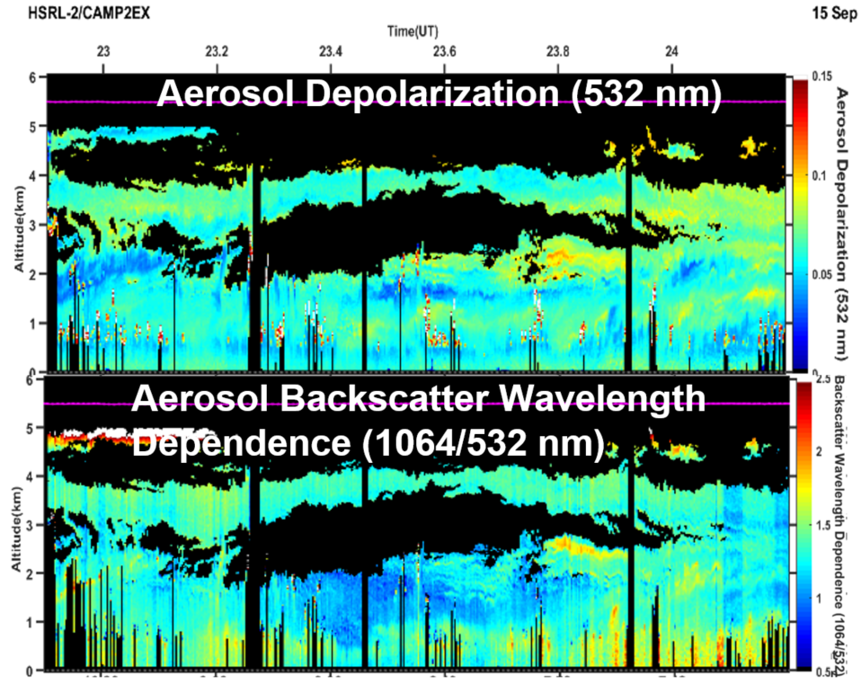
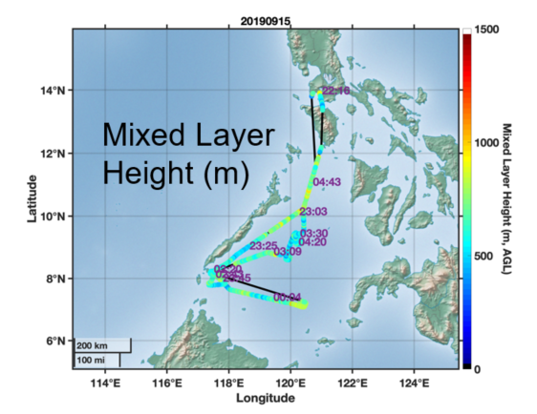
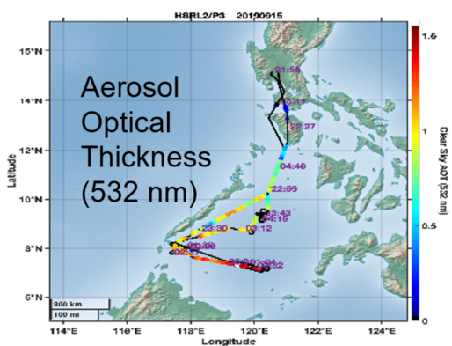
Summary of HSRL2 CAMP2Ex Products
Available Data Products
Aerosol Extensive Measurements (data(hdf5) and imagery(png) archived)
  Particulate backscatter profiles (355, 532, 1064 nm)
  Aerosol extinction profiles and AOT (355 and 532 nm)
Aerosol Intensive measurements (data(hdf5) and imagery(png) archived)
  Particle depolarization profiles (355, 532, 1064 nm)
  Extinction-to-backscatter ratio profiles (355 and 532 nm)
  Angstrom exponent profiles
    Extinction: 355-532
    Backscatter 355-532, 532-1064
Aerosol Type (data(hdf5) and imagery(png) archived)
Aerosol Optical Thickness (data(ICARTT) archived)
Mixed Layer Heights (data(ICARTT) archived)
Mean aerosol extinction and backscatter values within and above the Mixed Layer (data(ICARTT) archived)

Slide 3
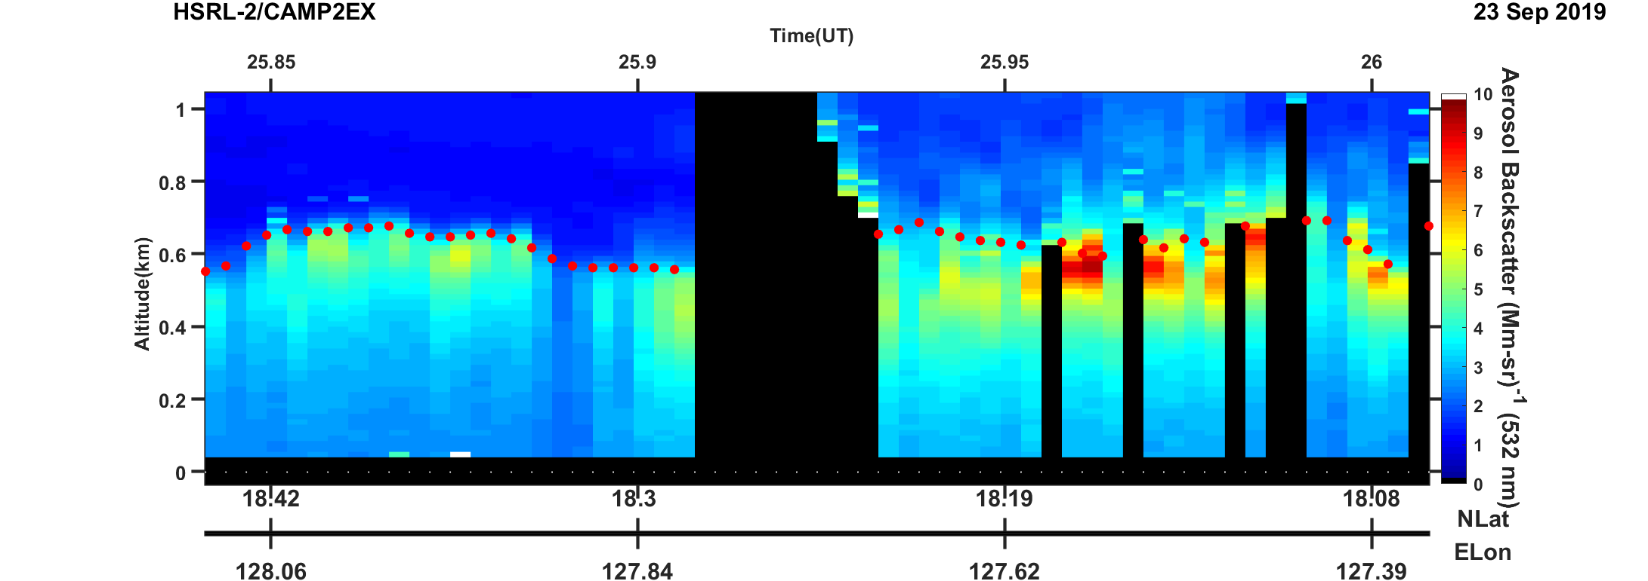
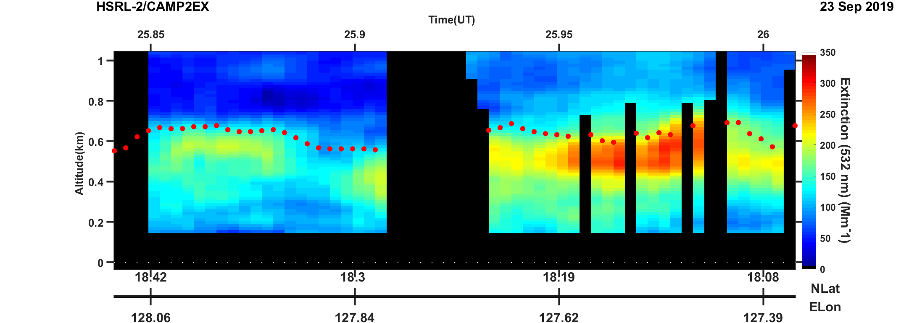
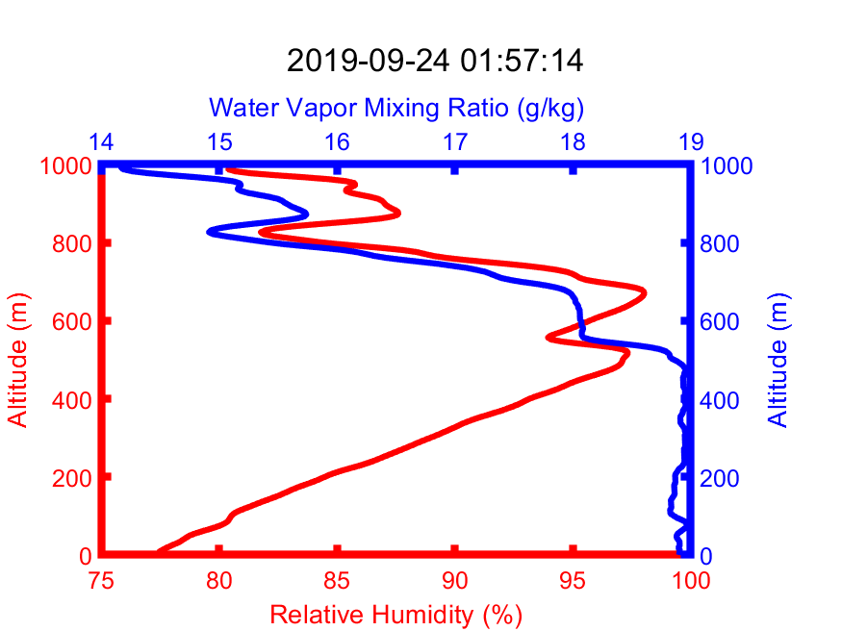
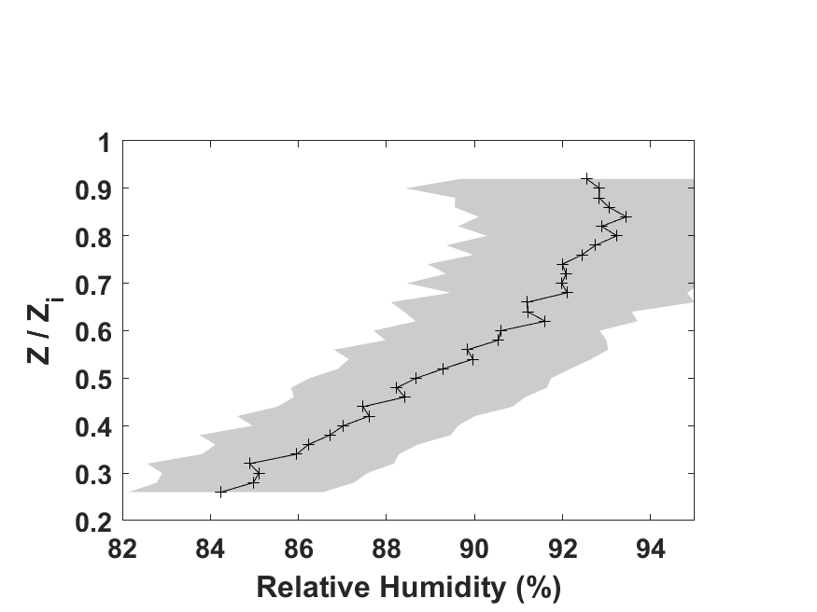
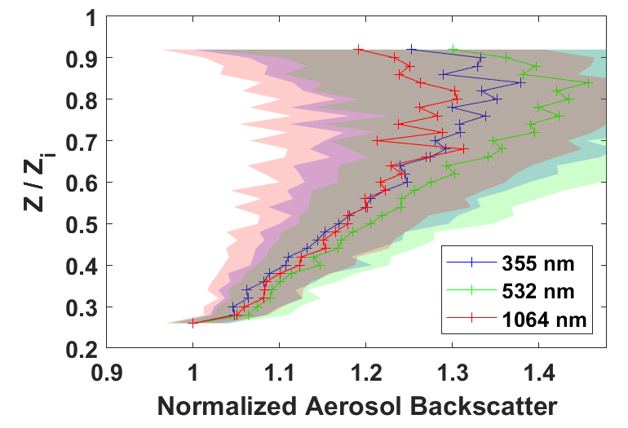
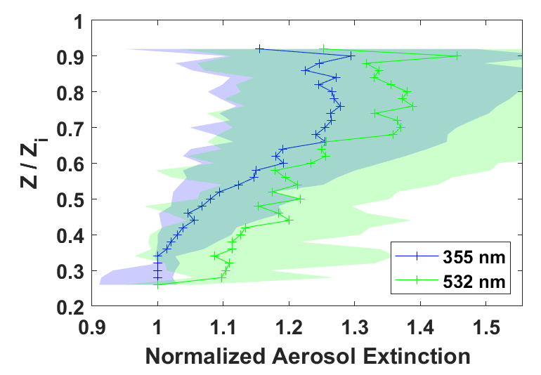
Aerosol Backscatter and Extinction Increase with Height in Mixed Layer associated with Increase in Relative Humidity (RH)
dropsonde
dropsonde
Aerosol
Backscatter (532 nm)
Aerosol
Extinction (532 nm)
Water Vapor
Mixing Ratio
Relative
Humidity
Mixed Layer Heights
Dropsonde
Profiles
Sept. 23, 2019
Sept. 23, 2019
Dropsondes provide relative humidity profiles
Mixed Layer Height (Z_{i}) derived from HSRL2 aerosol backscatter profiles
As RH increases with height within Mixed Layer, fine mode hygroscopic particles take on water, so aerosol backscatter and extinction increase.
These plots show behavior averaged over all of CAMP2Ex
Relative Humidity
Normalized
Aerosol
Backscatter
Normalized
Aerosol
Extinction

Slide 4
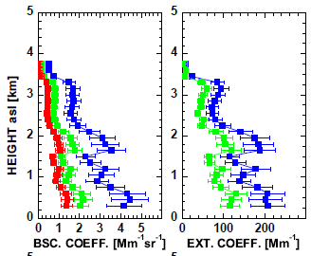
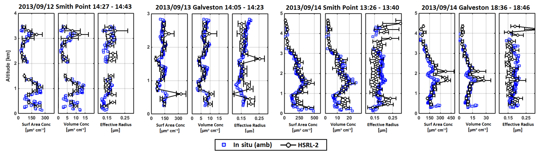
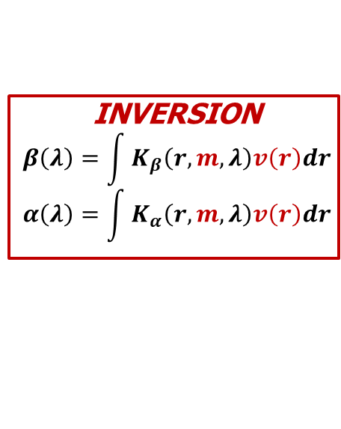
Multiwavelength Lidar Aerosol Microphysical Retrievals
lidar measurements
particle size distribution
3β
2α
INVERSION
$$β\left(λ\right)=\int{K_{β}\left(r,m,λ\right)v\left(r\right)dr}$$
$$α\left(λ\right)=\int{K_{α}\left(r,m,λ\right)v\left(r\right)dr}$$
size, refractive index, wavelength
3β+2α (i.e. 3 backscatter + 2 extinction) considered the minimum information content necessary for microphysical retrievals (Bockmann et al, 2005)
Information content and sensitivity studies suggest concentrations and effective radius can be retrieved well (Burton et al., 2016)
Aerosol
Backscatter:
355 nm
532 nm
1064 nm
Aerosol
Extinction:
355 nm
532 nm
Lidar microphysical retrievals of effective radius and concentrations compare well to airborne in situ measurements
TCAP (Müller et al., 2014, AMT)
DISCOVER-AQ (Sawamura et al., 2017, ACP)
+
References
Müller et al, 1999, Applied Optics
Veselovskii et al. 2002, Applied Optics
Müller et al, 2014, AMT
Sawamura et al., 2017, ACP
Notes:
PLACEHOLDER
Fix spacing
Consider using charts from Patricia’s instead
Add reference for Patricia’s paper also.

Slide 5
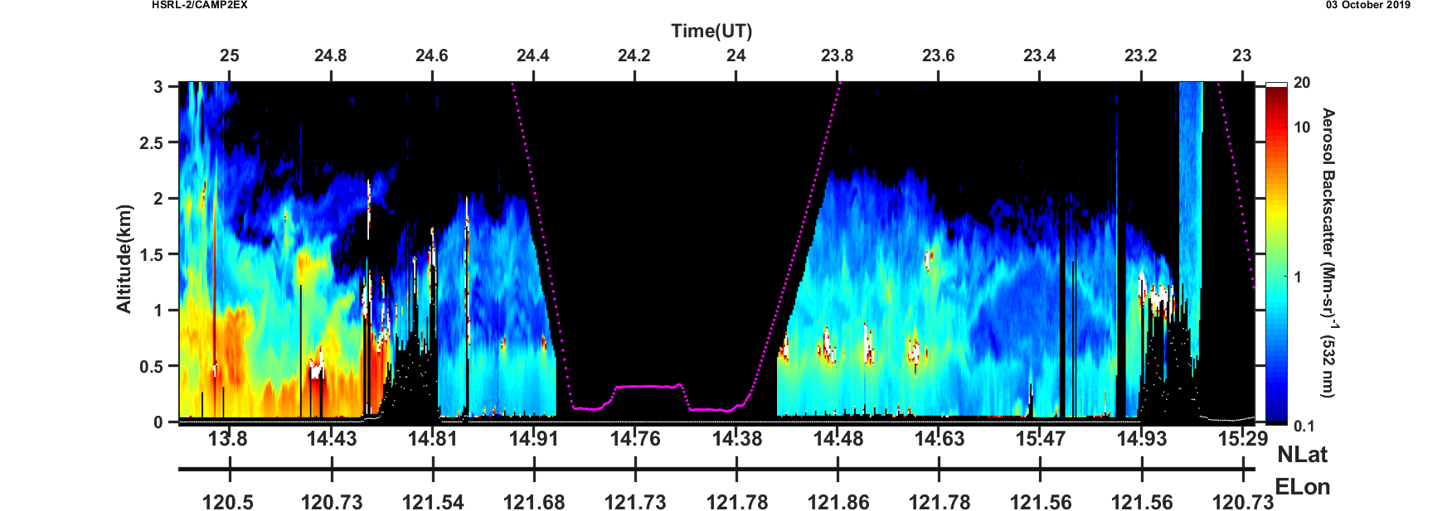
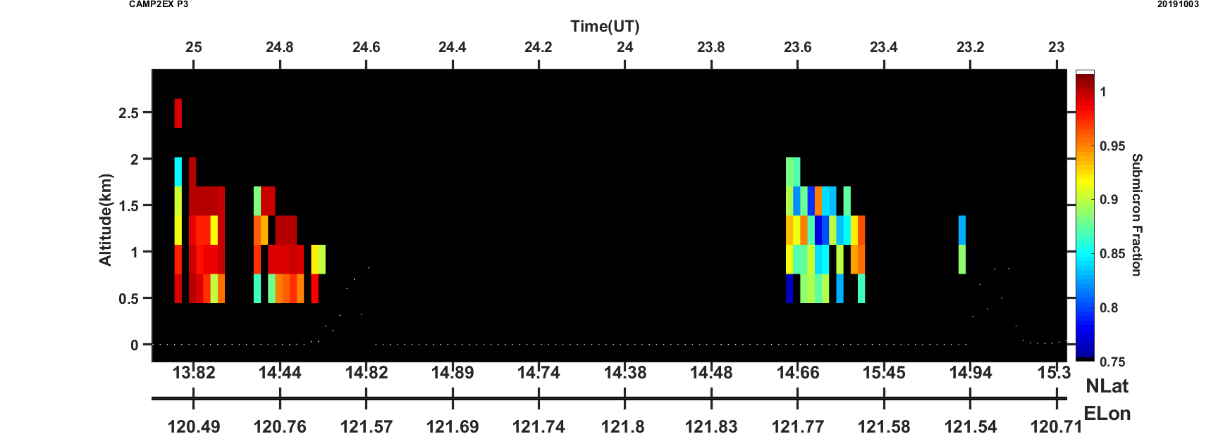
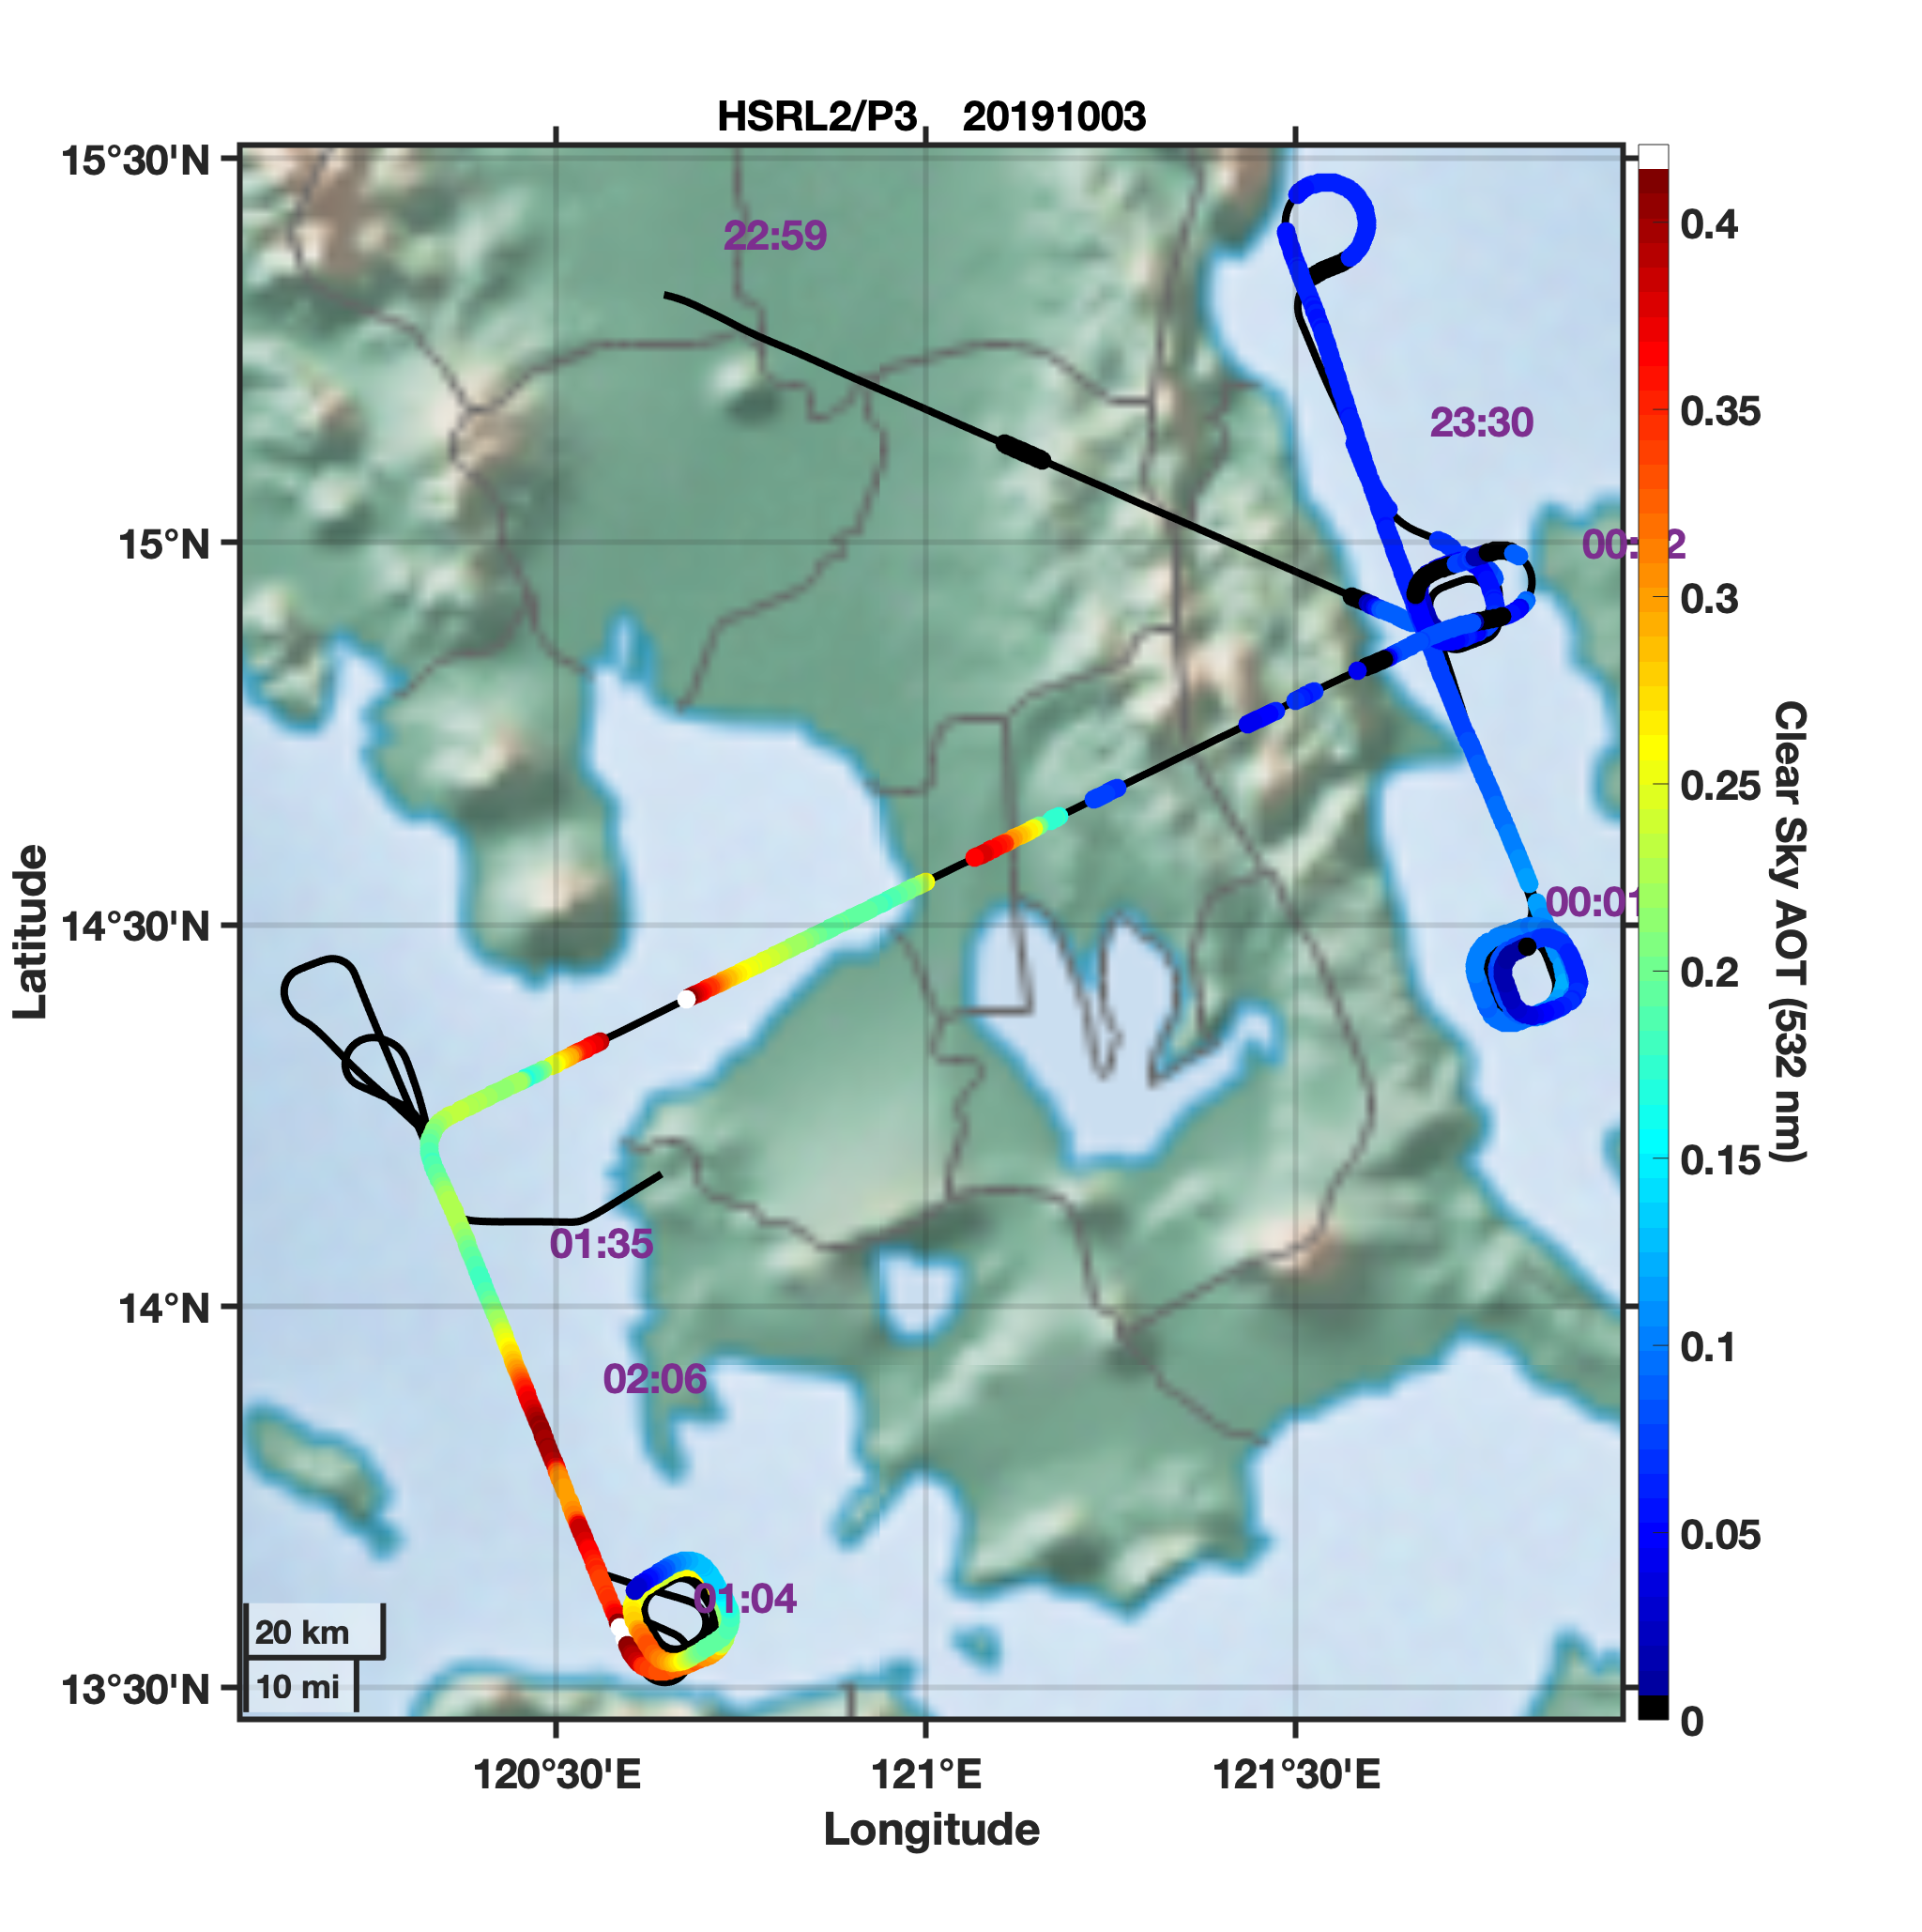
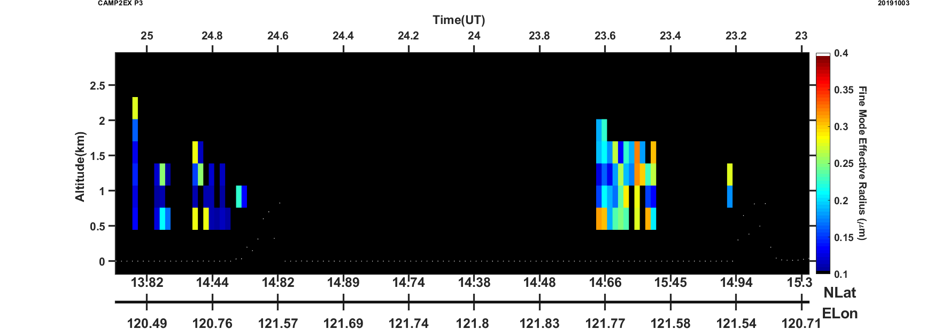
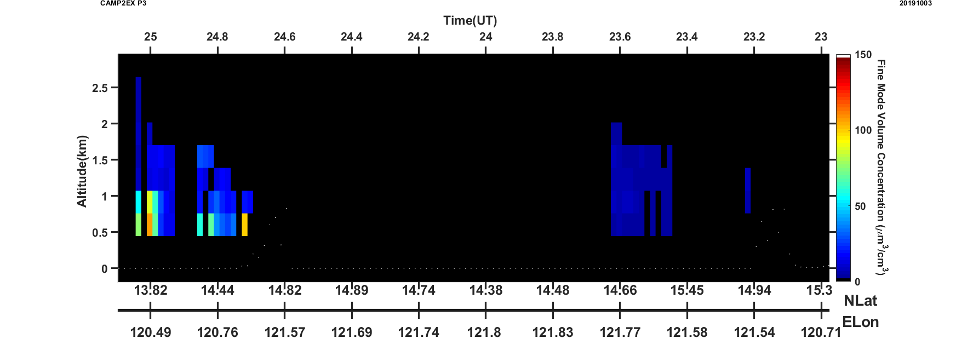
HSRL2 Microphysical Retrievals – October 3, 2019
East of Manila
Larger particles
Lower SMF, Vol. Conc.
West of Manila
Smaller particles
Higher SMF, Vol. Conc.
Aerosol Backscatter (532 nm)
west
east
Preliminary
Submicron Fraction
east
Manila
west
east
west
east
west
Fine Mode Effective Radius
Fine Mode Volume Conc.

Slide 6
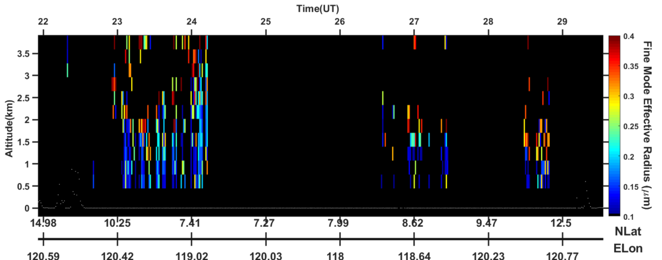
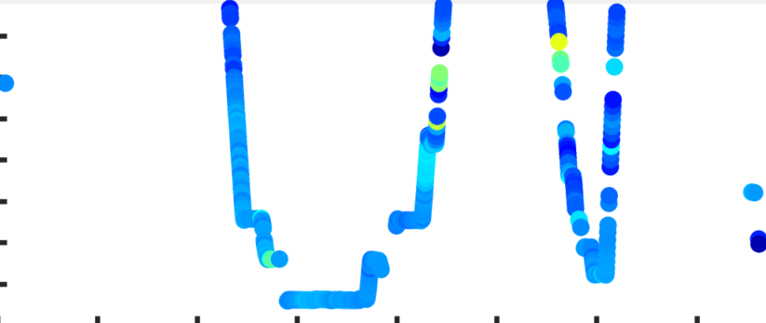
Aerosol Fine Mode Effective Radii from HSRL2 and LARGE (ambient RH)
Joe Schlosser (U of A) computed fine mode effective radius (and other aerosol properties) at ambient RH using LARGE LAS aerosol measurements
Preliminary

Slide 7
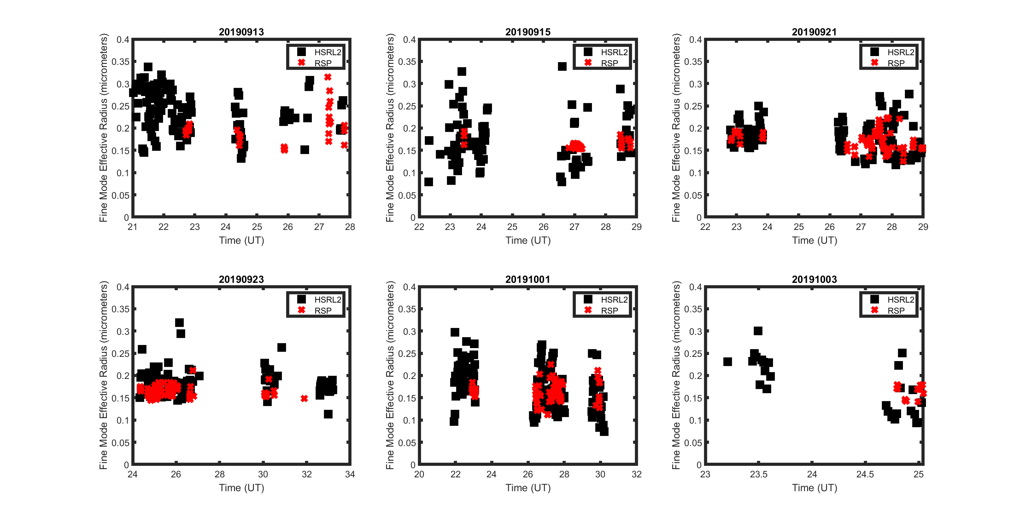
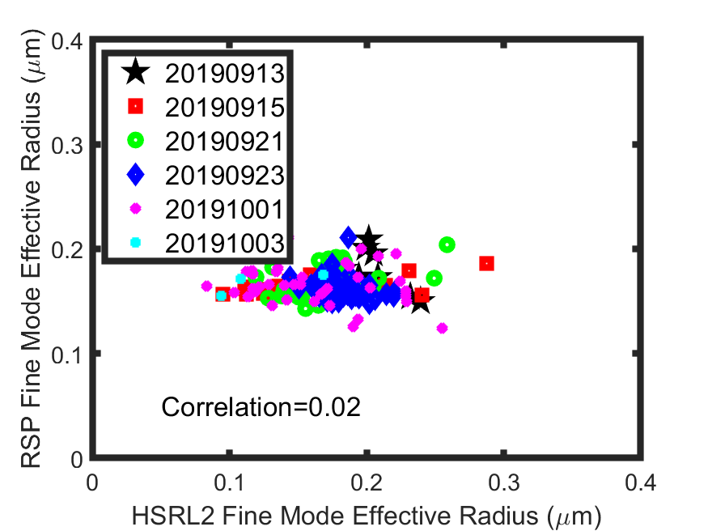
HSRL2 and RSP retrievals of column fine mode effective radius
Preliminary

Slide 8
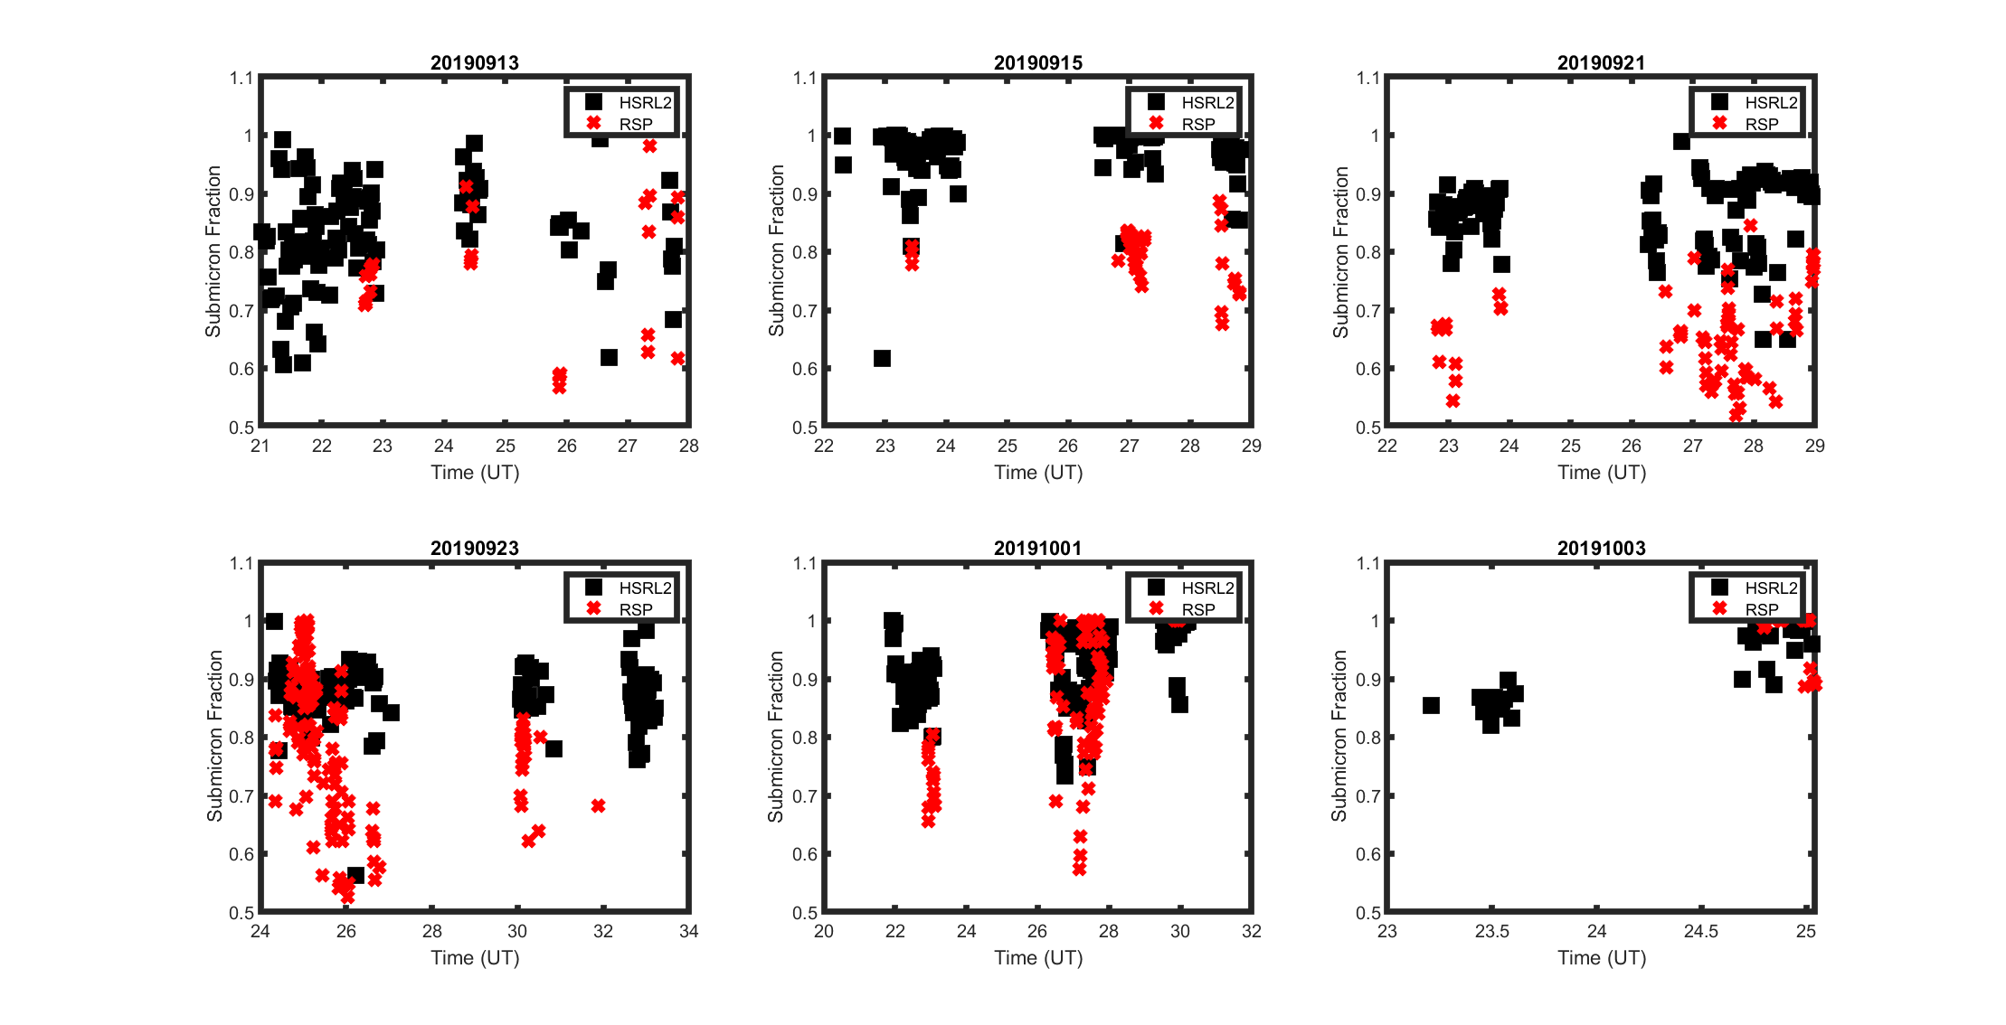
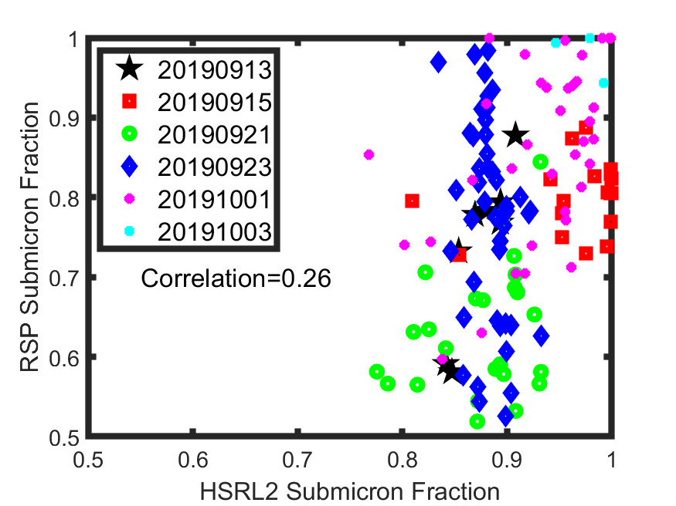
HSRL2 and RSP retrievals of column Submicron Fraction Extinction (AOD)
Preliminary

Slide 9
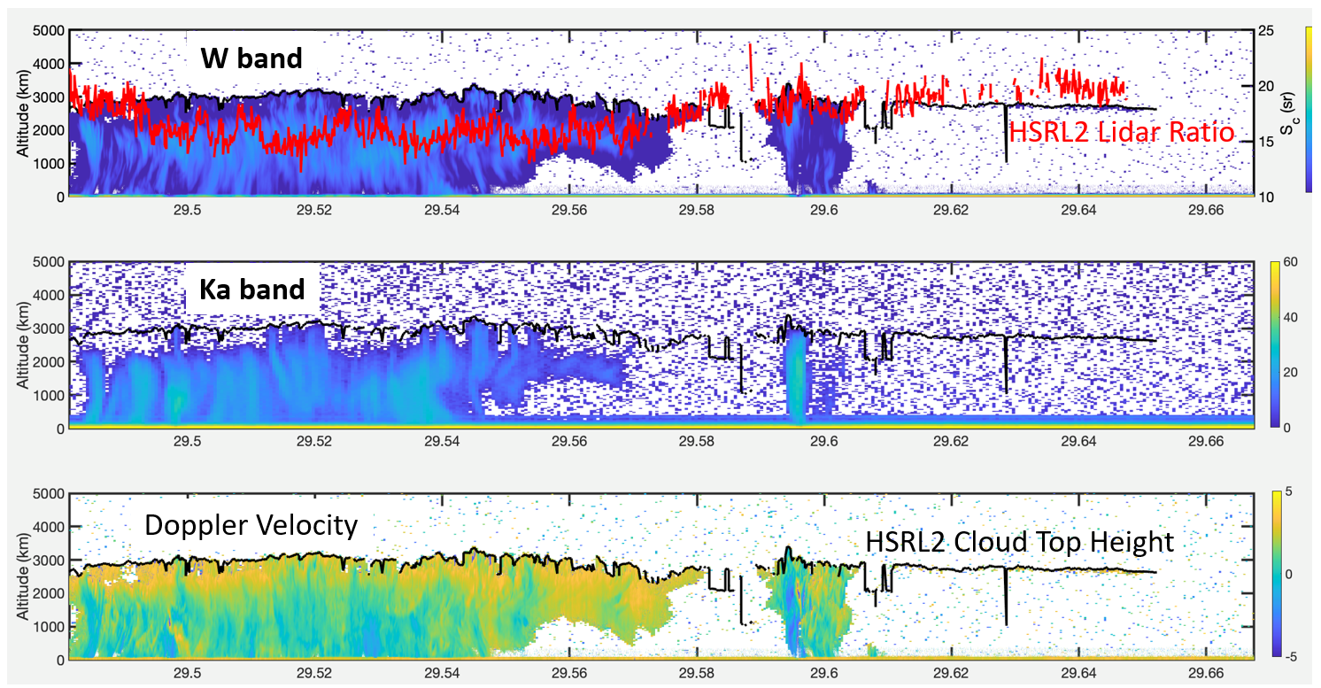
HSRL2 Liquid Cloud Measurements (Ongoing Research)
CAMP2Ex offers opportunity to explore combined measurements from HSRL2, radar, and polarimeter
Cloud Top Height:
  (1.25 m vertical resolution) based on backscatter gradient and absolute backscatter value – can provide cloud tops for tenuous clouds missed by radar
Cloud Lidar Ratio:
  HSRL technique provides unique method to normalize the measurements above the cloud (i.e. account for the attenuation above the cloud top)
  Observe variations in lidar ratio that are larger than those determined from the size parameters from polarimeter. There is interest into better understanding these differences and their variability. For example, do drizzling clouds reduce the lidar ratio?

Slide 10
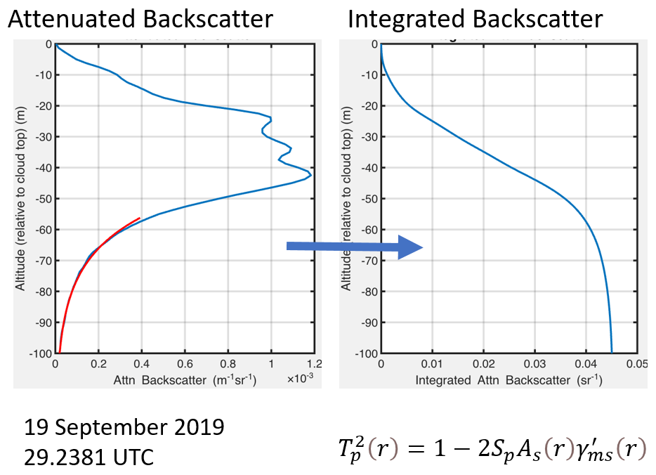
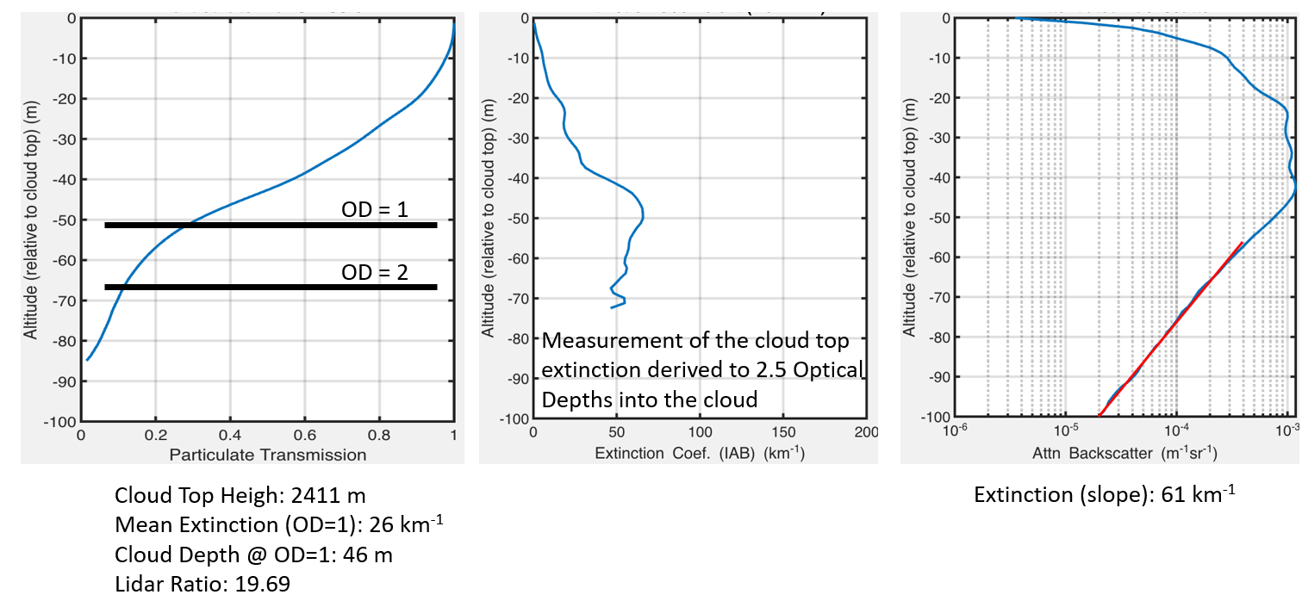
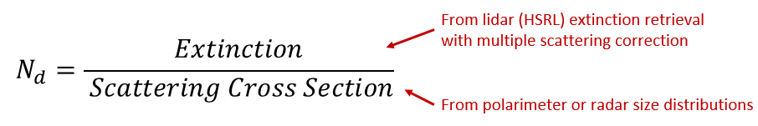
Cloud Top Extinction Derived from HSRL2 measurements
Cloud Top Extinction - (mean and profile) – uses decay of signal within cloud to derive extinction. Integrated backscatter profile provides particulate transmission and extinction. Integrated depolarization profile provides multiple scattering fraction (Hu et al., 2006).
Particulate Transmission
Extinction (Profile)
Extinction (Mean)
Cloud Droplet Number Concentrations (CNDC): Cloud Top Extinction combined with scattering cross sections derived from polarimeter (or radar) size distributions

Slide 11
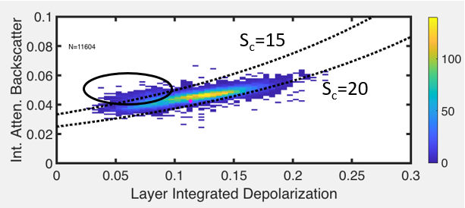
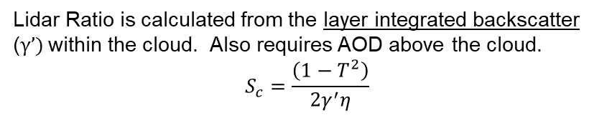
Cloud Lidar Ratio Derived from HSRL2 measurements
CAMP2Ex provides opportunity to evaluate the lidar ratio at cloud top using detailed airborne remote sensing and in situ measurements.
What is the Lidar Ratio?
Lidar Ratio: S_{c}= extinction/backscatter
Note that backscatter here is the 180 degree backscatter
Why would we care about it?
Does not depend on number concentration, therefore it is an intensive parameter which provides information on the microphysics of the cloud
The lidar ratio is a function of the particle size distribution and the index of refraction of the cloud droplets
It can be directly compared to retrievals of the size distributions calculated from remote sensing and in situ measurements
Does drizzle impact lidar ratio? Radar profiles might help provide insight on this question.
Higher lidar ratios are present and are typically associated with mixed phase clouds. Are there other factors controlling higher lidar ratios?
Can the high vertical resolution profiles provide additional insight on these retrievals?
Lidar Ratio is calculated from the layer integrated backscatter (γ’) within the cloud. Also requires AOD above the cloud.
$$S_{c}=\frac{\left(1−T^{2}\right)}{2γ^{′}η}$$

