Slide 1
Advanced Electric Prolusion System (AEPS)
Enabling a Sustainable Return to the Lunar Surface through NASA Gateway
Peter Peterson
NASA AEPS Product Lead Engineer
October 4, 2021
74th Annual Gaseous Electronics Conference

Slide 2
Space Policy Directive 1: To the Moon, then Mars
“Lead an innovative and sustainable program of exploration with commercial and international partners to enable human expansion across the solar system and to bring back to Earth new knowledge and opportunities. Beginning with missions beyond low-Earth orbit, the United States will lead the return of humans to the Moon for long-term exploration and utilization, followed by human missions to Mars and other destinations…”
The Artemis Program
Artemis is the twin sister of Apollo and goddess of the Moon in Greek mythology. Now, she personifies our path to the Moon as the name of NASA’s program to return astronauts to the lunar surface by 2024.
When they land, Artemis astronauts will step foot where no human has ever been before: the Moon’s South Pole.
With the horizon goal of sending humans to Mars, Artemis begins the next era of exploration.

Slide 3
NASA Artemis Plan
Credit: NASA

Slide 4
Gateway Configuration: PPE & HALO Co-Manifest Vehicle (CMV)
Landing System
Power and Propulsion Element (PPE)
High- Efficiency Solar Electric Propulsion
Future Expansion
Habitation and Logistics Outpost (HALO)

Slide 5
NASA Gateway:
Credit: NASA

Slide 6
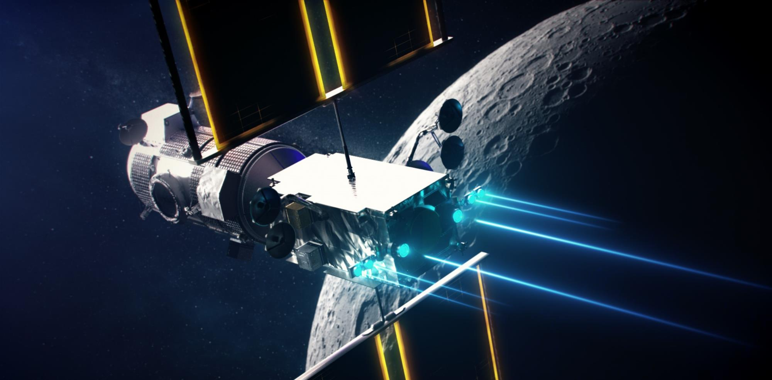
Propelling NASA Gateway: High-Power Electric Propulsion
PPE EP System (>45 kW):
12 kW Hall Thrusters
6 kW Hall Thrusters

Slide 7
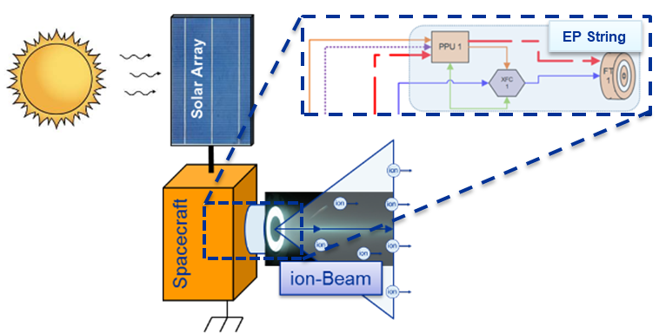
Solar Electric Propulsion String
Photons to Ions
Spacecraft SEP System
Solar Array
Power Distribution System
Propellant Management System
EP String
EP String
Thruster
Power Processing Unit
Propellant Flow Controller

Slide 8
NASA Solar Electric Propulsion Technology Demonstration Mission (SEP) Project under NASA STMD
NASA SEP Project is under NASA Space Technology Mission Directorate
SEP Project Objectives:
Develop and qualify high power electric propulsion technologies for NASA exploration that benefit US government and private-sector missions
Empower the US space industry to accelerate the adoption of high-power electric propulsion technologies by reducing the risk and uncertainty of integrating SEP technologies into space flight systems
Develop and qualify an advanced 12 kW EP thruster applicable to human/robotic exploration and commercial spaceflight missions including the Power and Propulsion Element (PPE)
Access to Space/Demo Details:
Provide Advanced Electric Propulsion System (AEPS) string qualification data and information to Power and Propulsion Element (PPE)
Deliver Plasma Diagnostic Package (PDP) to PPE prime contractor for flight integration to enable characterization of EP technology

Slide 9
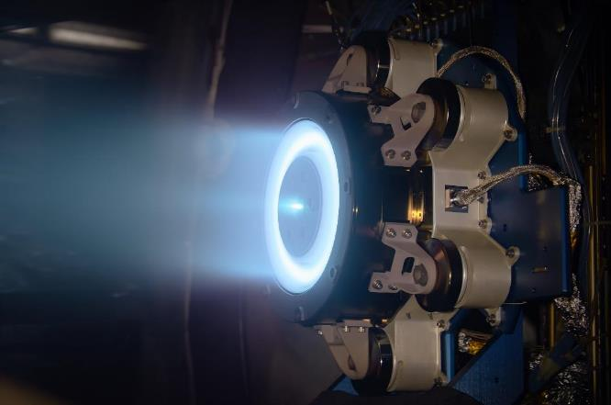
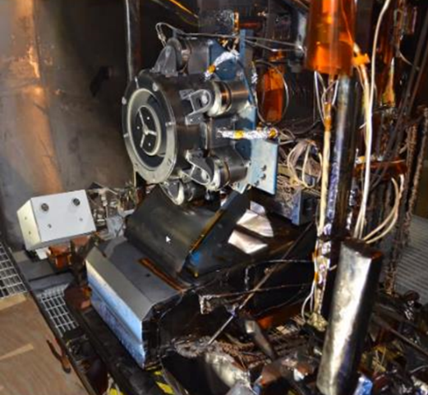
NASA Solar Electric Propulsion Technology Demonstration Mission (SEP) Project
The SEP Project consist of two elements
Advanced Electric Prolusion System (AEPS)
The AEPS is a next-generation electric propulsion capability that will enable human missions to the Moon and Mars.
12-kW class Hall thruster developed for 50-kW class ion propulsion system (IPS)
Power: 12 kW (3X SOTA)
Propellant Throughput: >1,700 kg (7X SOTA)
Maximum Isp: >2,600 s (1.5X SOTA)
Plasma Diagnostic Package (PDP)
The PDP will enable collection of plasma plume data in orbit from the AEPS propulsion system
The PDP consists of a Main Electronics Package (MEP), discharge current sensors and probes housed in a Thruster Probe Assembly (TPA)

Slide 10
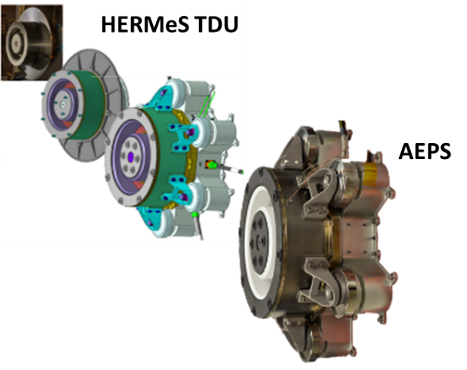
NASA AEPS Development
NASA began the development of the higher power Hall thruster EP system in 2011
First 12 kW-class Hall-Effect Rocket with Magnetic Shielding (HERMeS) Technology Development Unit (TDU) in 2014
Flight hardware devolvement was transitioned to Aerojet Rocketdyne (AR) via a competitive procurement selection for the AEPS contract in May 2016
AR and NASA completed all engineering qualification level development testing of the AEPS thruster
CDR is schedule for Feb 2022
Flight hardware delivery in 2023

Slide 11
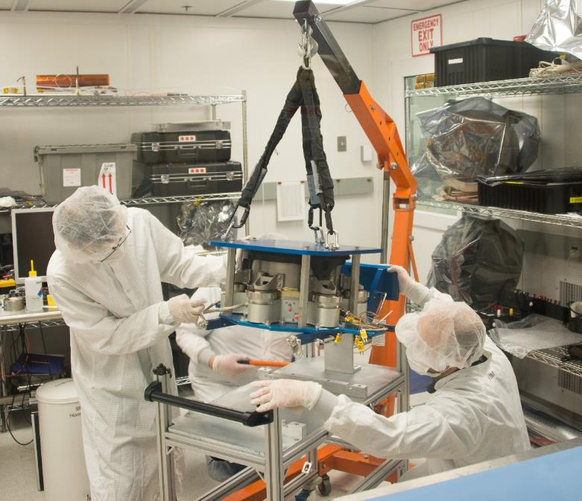
AEPS Engineer Thruster Shipped to NASA
AEPS ETU-1 at NASA JPL

Slide 12
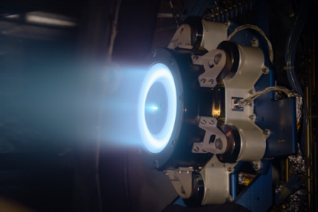
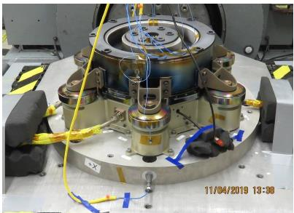
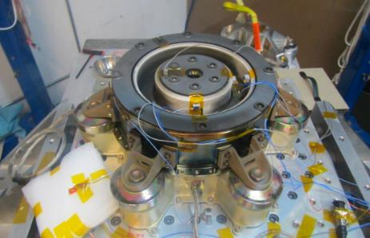
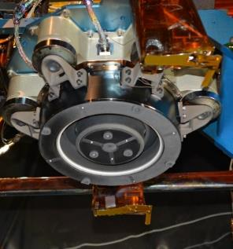
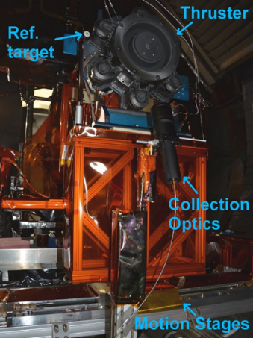
AEPS Engineer Thruster Flight Development Testing
AEPS Performance Testing
Vibration Testing
Shock Testing
AEPS TVAC
AEPS Wear Testing
AEPS Plume Testing
AEPS LIF Testing

Slide 13
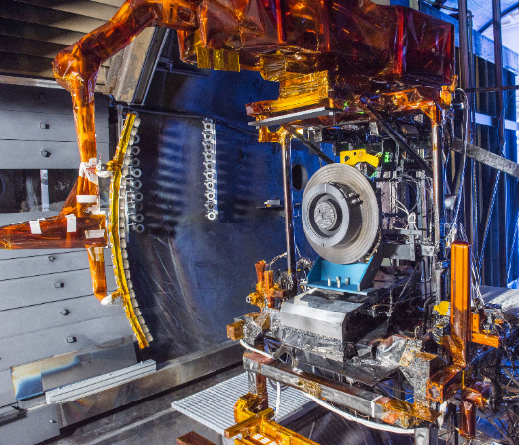
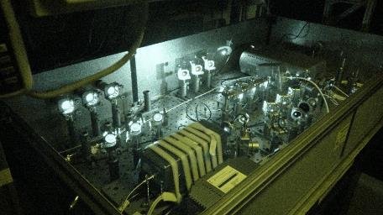
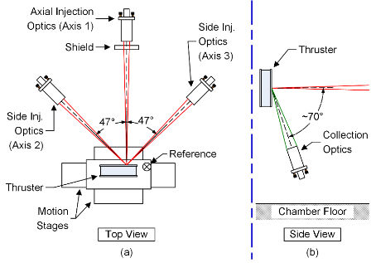
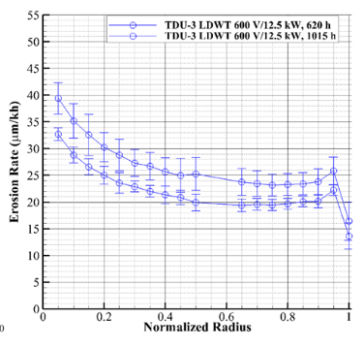
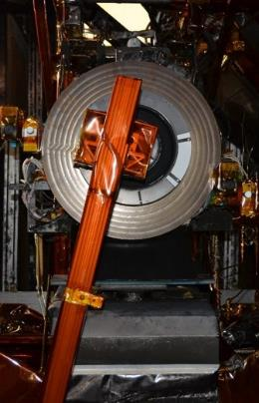
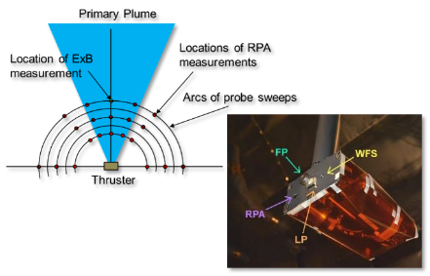
NASA SEP Status: Key Instrumentation for AEPS
Thrust Stand
Based on decades of successful performance measurements of various EP systems
Accurately measures the performance of an EP thruster
Demonstrated thrust stand uncertainty of 0.8% (±5.0 mN)
Thrust Vector Probe (TVP) and Plasma Diagnostics
Measure the plasma plume properties of the EP thruster
Beam current centroid measurement to approximate direction of thrust vector
In-Situ and Tabletop Erosion Diagnostics
The erosion diagnostic measures and monitors thruster surface erosion and deposition periodically during testing
In-Situ probe allows for measurements during long-duration testing without venting between test segments
Laser Induced Fluorescence (LIF)
LIF diagnostic is used to measure ion velocity inside and near the thruster
The data is used to refine thruster plasma model for life assessment of the thruster
Thrust Vector Probe (TVP)
& Thrust Stand
Laser Induced Fluorescence (LIF)
Sample Erosion Measurements
In-Situ Erosion Diagnostic
Plasma Probe

Slide 14
How Does a Hall Thruster Work
Credit: NASA Psyche Mission Capstone Project

Slide 15
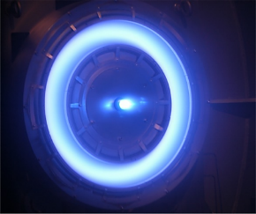
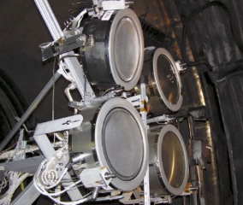
GRC Electric Propulsion History
circa 1961
NASA GRC (formally LeRC) performing low-thrust trajectory analysis as early as 1956
These analysis resulted in the initiation of EP facility studies in 1957
First EP facilities operational in Electric Propulsion Research Building in 1959 and large chambers in the Electric Propulsion Laboratory in late 1961.
First flight of an ion thruster on SERT-1 in 1964
Active area of R&D, space flight h/w development, facility maintenance and upgrade at GRC.
circa 1968
circa 1994
2004
2008
2013
2017

Slide 16
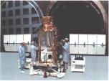
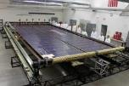
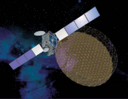
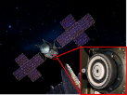
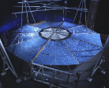
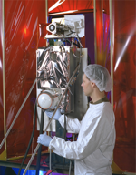
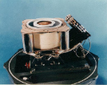
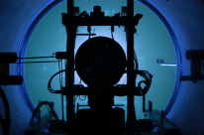
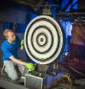
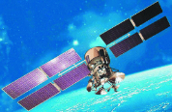
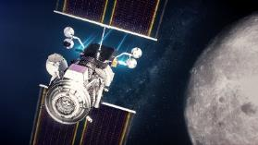
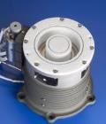
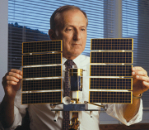
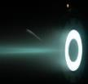
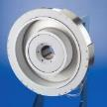
GRC Hall Propulsion Accomplishments
Demonstration test of a 100 kW Hall Effect Thruster (2003)
600 W Hall prop system developed and flown on NRL spacecraft (1998)
GRC/JPL develop and demonstrate 12.5 kW Hall technology for SEP TDM/ARRM
(2013-Present)
SSL/JPL/GRC Demonstration test of SPT-140 Hall thruster for NASA Discovery mission Psyche
(2016-Present)
GRC Sub-kW Hall thruster ion propulsion system
(2017-Present)
Quantified S/C integration impacts of 1.5kW prop systems onboard Loral geo-comsats
DSS and ATK awarded solar array contracts for 30-50 kW systems with extensibility to 250 kW (2012)
Russian-developed Hall Effect Thruster technology evaluated at GRC (1991)
1,000 hour feasibility demonstration of 10kW class Hall thruster
Flight Experiment to evaluate plume interactions onboard Russia Spacecraft (2001)
Invention of 2500 second Hall thruster technology for deep space missions awarded multiple patents
GRC performs in-house and contracted studies of SEP TDM mission concepts (2012)
GRC Lead of the Power & Propulsion Element of NASA Gateway
GRC serves as DoD agent for development of Hall propulsion systems for use by BMDO
First demonstration of a efficient krypton Hall thruster operation at 5000 seconds (2004)
GRC/JPL/Univ. of Michigan/Aerojet Rocketdyne
NASA NEXTStep demonstration of a 100 kW EP system with the X3 Nested Hall Thruster
(2015-Present)

Slide 17
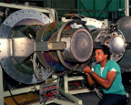
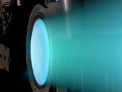
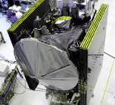
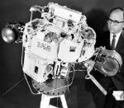
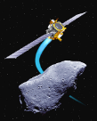
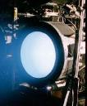
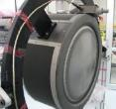
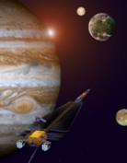
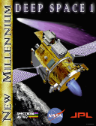
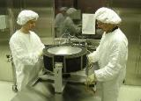
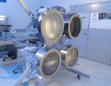
GRC Ion Propulsion Accomplishments
NEXT ion thruster demonstrates >51,000 hours of operation
Contract award for NEXT-C flight hardware fabrication (2015)
SERT I & II Flight Experiments
GRC supplied hollow cathodes used for ISS charge control
16,265 hours of in-space operation of the DS1 ion engine (2002)
30 cm J-Series
Boeing XIPS-13 and XIPS-25 use GRC developed technology (1997)
GRC makes critical contributions to the development of the DAWN IPS
(2007)
Electron Bombardment Ion Engine Invented (1958)
NASA Invention of the Year for ISS hollow cathode (2002)
Maturity of NEXT ion propulsion system allows for inclusion in ‘09 & ’10 SMD New Frontiers & Discovery Mission solicitation
NEXT collaboratively evaluated with the AF for use on future DoD assets
GRC chosen by SMD to lead development of 7 kW class next generation ion propulsion system
(2001)
R&D 100 Award for the Ring Cusp Ion Thruster (2001)
IAPS developed to flight status (1980)
GRC Lead for the JIMO electric propulsion element; develops 25 kW class HiPEP ion engine, completed breadboard testing (2003)
Double Asteroid Redirection Test (DART) Mission with GRC/Aerojet Rocketdyne NEXT-C ion propulsion system
GRC responsible for development of DS1 ion engines and power processors (1997)

Slide 18
GRC Electric Propulsion Facilities

Slide 19
GRC Electric Propulsion Facilities
Credit: NASA GRC

Slide 20
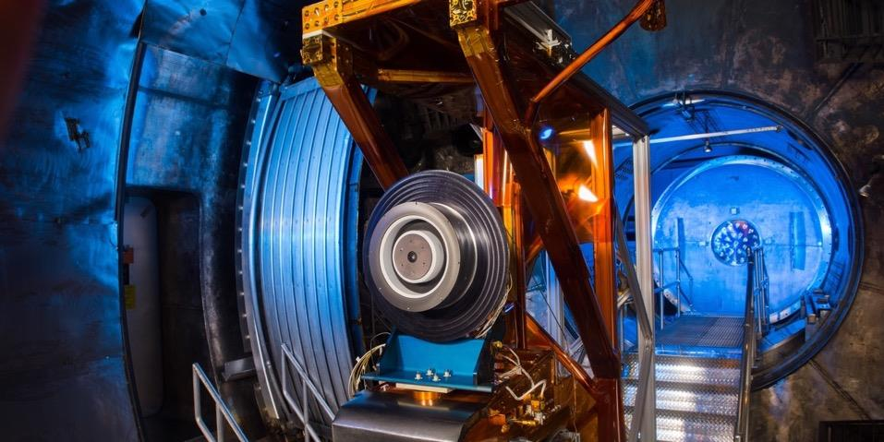
Acknowledgements
The authors would like to thank the Space Technology Mission Directorate through the Solar Electric Propulsion Technology Demonstration Mission Project for funding the joint NASA GRC and JPL development the HERMeS and PPU TDUs and contracting Aerojet Rocketdyne flight development of Advanced Electric Propulsion System. The authors would also like to thank the many NASA/JPL team members and subject matter experts for providing their expertise and technical guidance in the development of AEPS.

