Slide 1
Integrated Crewed Mars Mission Analysis, Part II:
The Trajectory Strikes Back
Andrew Owens, Christopher Jones, William Cirillo, Jordan Klovstad, Emily Judd, Patrick Chai, Raymond Merrill, and Akshay Prasad
Space Mission Analysis Branch
NASA Langley Research Center
Jason Cho and Chel Stromgren
Binera, Inc.
ASCEND
15-17 November 2021
www.ascend.events

Slide 2
Introduction
Crewed Mars missions are an unprecedented challenge in human spaceflight
Previous work examined mass and cost impacts of changes in Environmental Control and Life Support System (ECLSS) architecture and other factors for fixed mission
This paper expands that analysis to incorporate different transportation system options across a range of mission durations and evaluates integrated mass and cost impacts
More detail and background provided in paper
Transportation Options:
  Hybrid Nuclear Electric Propulsion (NEP) and chemical (1.8 MW reactor)
  Hybrid Solar Electric Propulsion (SEP) and chemical (400 kW thruster, 675 kW array)
Durations from 750 to 1,000 d
 |  | ECLSS Architecture
 |  | Open Loop | Up to UPA | Up to BPA | Up to Sabatier | Up to PPA
Technology | Baseline ECLSS | ✓ | ✓ | ✓ | ✓ | ✓
 | OGA |  | ✓ | ✓ | ✓ | ✓
 | WPA |  | ✓ | ✓ | ✓ | ✓
 | UPA |  | ✓ | ✓ | ✓ | ✓
 | BPA |  |  | ✓ | ✓ | ✓
 | Sabatier |  |  |  | ✓ | ✓
 | PPA |  |  |  |  | ✓
Food Hydration |  | 50% | 50% | 50% | 35% | 25%
OGA = Oxygen Generation Assembly WPA = Water Processor Assembly | UPA = Urine Processor Assembly BPA = Brine Processor Assembly | PPA = Plasma Pyrolysis Assembly

Slide 3
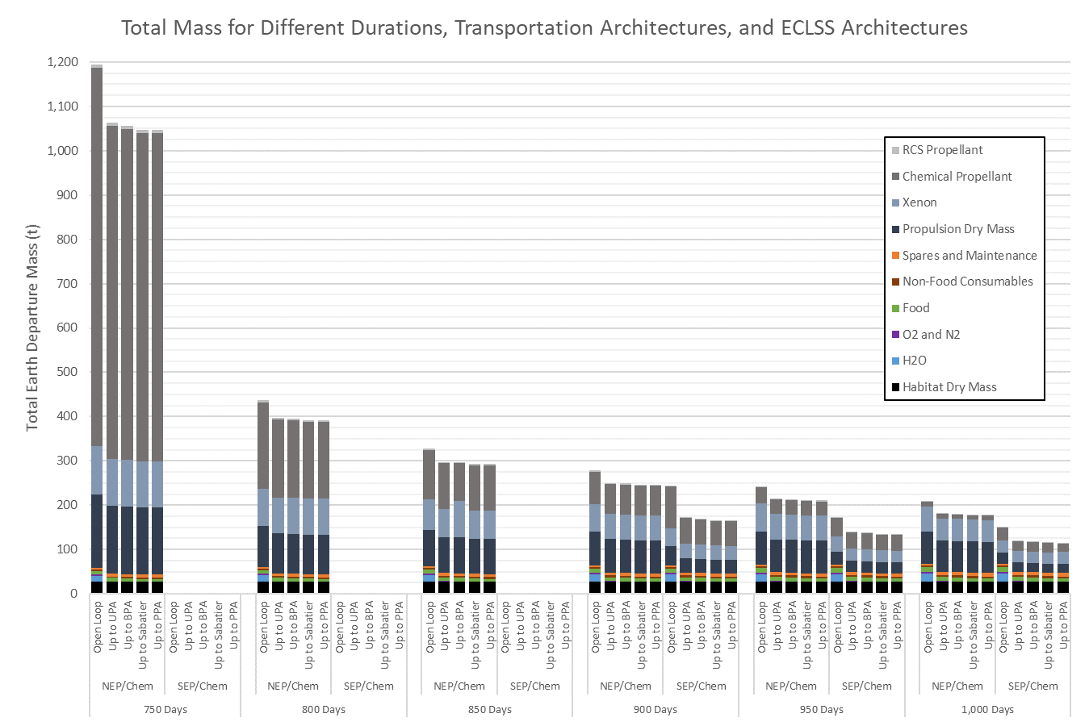
Total Earth Departure Mass
Transportation System
Combined effects of ECLSS architecture, transportation system, and mission duration results in >1,000 t change in mass (over a million kg)
Propellant mass requirements grow exponentially as mission duration decreases, due to increased energy requirements
No feasible SEP/Chem trajectories found for mission durations <900 d under assumptions used here
Habitat

Slide 4
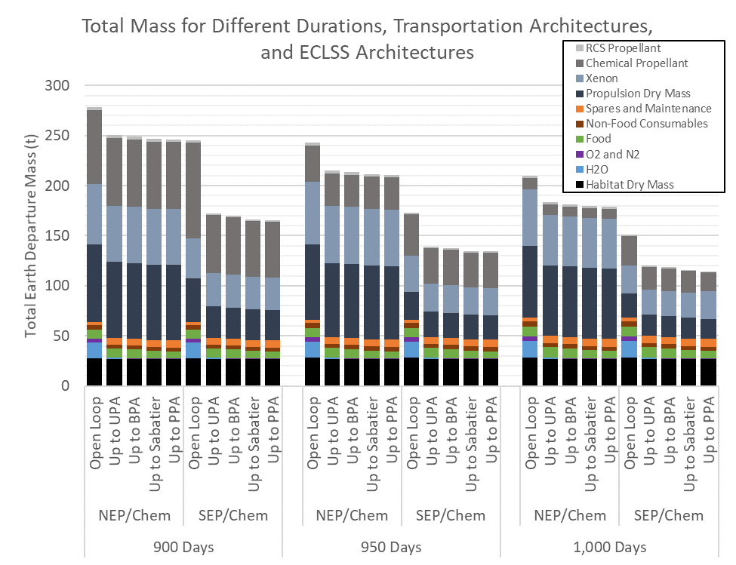
Total Earth Departure Mass (Zoomed In)
Transportation system and propellant mass typically much larger than habitat mass
Logistics represents approximately half of total habitat mass
  Mostly food and spares
  Moving from Open Loop to initial water/oxygen recycling reduces mass significantly
NEP/Chem evaluated here is designed to achieve shorter duration missions than SEP/Chem
  Tends to be more massive and expensive
  Enables mission durations < 900 d
  Future work will examine different power levels

Slide 5
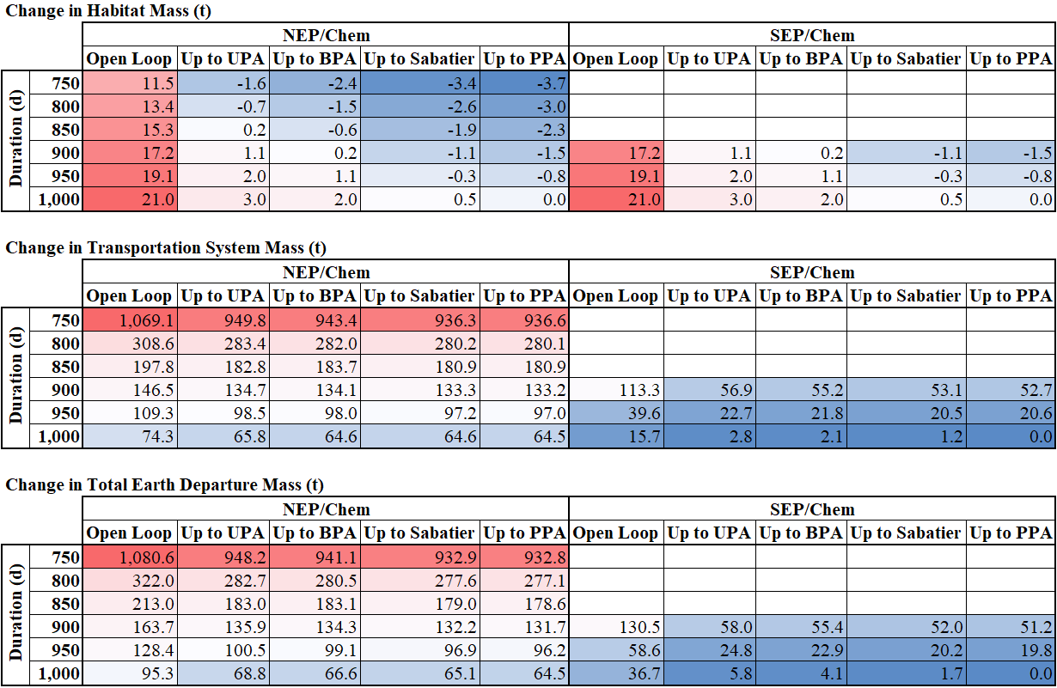
Change in Earth Departure Mass
All changes measured relative to SEP/Chem, Up to PPA, 1,000 d mission
Different mass trends for habitat and transportation system
Magnitude of changes in transportation system mass tend to dominate
ECLSS loop closure beyond UPA provides diminishing returns, but still reduces mass
Red indicates higher values, Blue indicates lower values

Slide 6
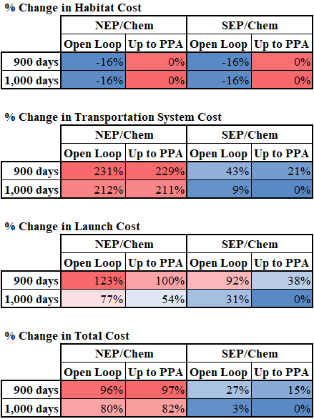
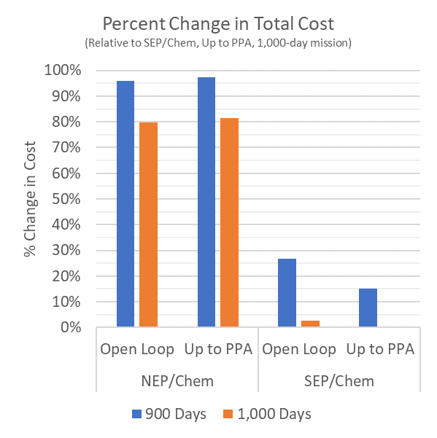
Change in Cost
Full cost analysis only performed for subset of cases due to schedule limitations
  Open Loop and Up to PPA
  900 and 1,000 d
Percent change evaluated relative to SEP/Chem, Up to PPA, 1,000 d case
Full ECLSS loop closure reduces cost for SEP/Chem, but not NEP/Chem (Hab cost increase outweighs other savings)
Local cost minima likely exist at partial loop closure; more comprehensive cost analysis planned for future work
Red indicates higher values, Blue indicates lower values

Slide 7
Discussion
Minimum-mass solution is not always the minimum-cost solution; choice of objective impacts architecture preferences
Mission and programmatic risk implications of different architectures and technologies need to be considered alongside mass and cost impacts
New technologies and systems can provide value to a specific mission as well as benefits for future missions
  Payback period of a new technology may be more than one mission
  System and technology investments should consider impacts beyond initial operations
Historical experience shows that missions tend to look for mass reductions wherever they can be found in order to remain feasible as launch deadlines approach
  Realities of implementation often do not fully achieve goals of conceptual planning
  System/subsystem mass may grow, or launch/propulsion capabilities may shrink
  Flexibility is extremely valuable, particularly when expanding frontiers of technology and exploration
All models are imperfect and incomplete, but they are valuable if used correctly
  Even when intuition does correctly identify trends, models provide valuable insight into magnitude
  Models should adapt and adjust as new information becomes available

Slide 8
Conclusions and Future Work
ECLSS, transportation, and mission duration options examined here result in very large changes in key mission metrics (10x change in mass, 2x change in cost)
Space mission design is a complex, multidisciplinary activity with coupled factors that can interact in nonintuitive ways
Integrated design/optimization produces better results than siloed, isolated work
Integrated modeling enables examination and understanding of a larger number of options than could be explored manually, leading to more informed decisions and more effective missions
Future work:
  More comprehensive cost modeling
  Evaluation of different NEP and SEP power levels
  More evaluation of risk (mission and programmatic)
  Multi-mission campaign evaluation

Slide 9
References
[1] Owens, A., Jones, C. A., Cirillo, W., Klovstad, J., Judd, E., Chai, P., Merrill, R. G., Piontek, N., Stromgren, C., and Cho, J. Integrated Trajectory, Habitat, and Logistics Analysis and Trade Study for Human Mars Missions. Presented at the ASCEND 2020, Virtual Event, 2020. AIAA 2020-4034.
[2] Arney, D. C., Earle, K. D., Cirillo, W., Jones, C. A., Klovstad, J., Grande, M., and Stromgren, C. The Impact of Mission Duration on a Mars Orbital Mission. Presented at the AIAA SPACE and Astronautics Forum and Exposition, Orlando, FL, 2017. AIAA 2017-5284.
[3] Douglas, G. L., Johnson, M., and Broyan, J. Space Food System Water Content: Considerations for ECLSS Water System Closure. Presented at the 50th International Conference on Environmental Systems, 2021. ICES-2021-130.
[4] Ewert, M. K., and Stromgren, C. Astronaut Mass Balance for Long Duration Missions. Presented at the 49th International Conference on Environmental Systems, Boston, MA, 2019. ICES-2019-126.
[5] Owens, A. Multiobjective Optimization of Crewed Spacecraft Supportability Strategies. Doctoral Thesis. Massachusetts Institute of Technology, Cambridge, MA, 2019.
[6] Owens, A., Cirillo, W. M., Piontek, N., Stromgren, C., and Cho, J. Analysis and Optimization of Test Plans for Advanced Exploration Systems Reliability and Supportability. Presented at the 50th International Conference on Environmental Systems, 2021. ICES-2021-199.
[7] Chai, P., Qu, M., Merrill, R. G., and Pfrang, K. G. Hybrid Transportation System Integrated Trajectory Design and Optimization for Mars Landing Site Accessibility. Presented at the AIAA Propulsion and Energy 2019 Forum, Indianapolis, IN, 2019. AIAA 2019-3961.
[8] Chai, P., Qu, M., and Saputra, B. Human Mars Mission In-Space Transportation Sensitivity for Nuclear Electric / Chemical Hybrid Propulsion. Presented at the AIAA Propulsion and Energy 2021 Forum, VIRTUAL EVENT, 2021. AIAA 2021-3237.
[9] Chai, P., McBrayer, K. T., McCrea, A. C., Merrill, R. G., Prasad, A., and Qu, M. Crewed Mars Mission Mode Options for Nuclear Electric/Chemical Hybrid Transportation Systems. Presented at the ASCEND 2021, 2021. Submitted for publication.
[10] Meisl, C. J. Cost Estimating Relationships for Nuclear Power and Propulsion. Publication NAS3-25808. Rockwell International Corporation, Rocketdyne Division, Cleveland, OH, 1992.
[11] Jones, C. A., Clark, M., Pensado, A., Ivanco, M. L., Reeves, D., Judd, E., and Klovstad, J. Cost Breakeven Analysis of Lunar ISRU for Human Lunar Surface Architectures. Presented at the 70th International Astronautical Congress, Washington, DC, 2019. IAC-19-D4.5.15.
[12] Grande, M. L., Carrier, M., Cirillo, W., Earle, K. D., Jones, C. A., Judd, E., Klovstad, J. J., Owens, A. C., Reeves, D., and Stafford, M. Mega-Drivers to Inform NASA Space Technology Strategic Planning. Presented at the 2018 AIAA SPACE and Astronautics Forum and Exposition, Orlando, FL, 2018. AIAA 2018-5137.

